Slide 1
Abstract Data Types
Chapter 1

Slide 2
Introduction
This course emphasizes three important concepts in computer science:
  algorithms
  data structures
  abstractions

Slide 3
Algorithm
A sequence of clear and precise step-by-step instructions for solving a problem in a finite amount of time.
The foundation of computer science is based on the study of algorithms.

Slide 4
Programming
Algorithms are implemented by translating the steps into a computer program.
  computer programming
    the translation process.
  programming language
    used to construct a computer program.
    should be appropriate for the given problem.

Slide 5
Data Types
Data is stored in a computer as a sequence of binary digits.
  type
    a collection of values.
    ex: numeric
  data type
    a given type along with a collection of operations.
    ex: integers

Slide 6
Data Types
Data types can be divided into two groups:
  simple
    consists of single values
    ex: integers, floating-points
  complex (or composite)
    multiple components
    ex: lists, tuples, strings

Slide 7
Data Types
Data types can also be characterized by their definition:
  primitive types
    provided by the language itself.
    ex: int, float, list, string
  user-defined types
    defined by the programmer as needed.
    class definitions create new data types.
    ex: social security number, student record

Slide 8
Abstractions
Used by computer scientists to help manage complex problems.
  abstraction
    a mechanism for separating the properties of an object, and
    restricting the focus to those relevant in the current context.
  Focus on the “what” not the “how”.

Slide 9
Abstractions
Common types in computer science:
  procedural abstraction
    use of a function/method knowing what it does but not how it's done.
    ex: y = sqrt( x )
  data abstraction
    separate the values/operations from the implementation of a data type.
    ex: big integers in Python

Slide 10
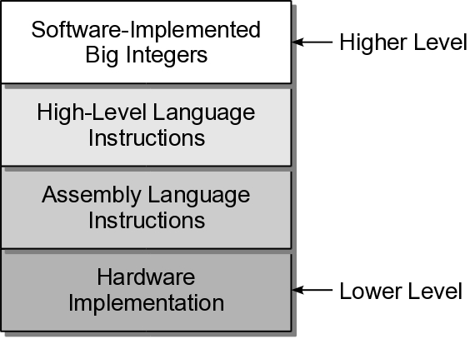
Abstractions
For complex problems, there may be multiple layers of abstraction.

Slide 11
Abstract Data Type
A programmer-defined data type specified by:
  a domain or set of data values
  a collection of well-defined operations
Defined independent of its implementation.

Slide 12
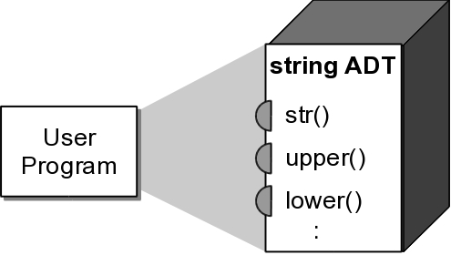
Information Hiding
ADTs can be viewed as black boxes:
  functionality is provided through an interface.
  implementation details are hidden inside the box.

Slide 13
Types of Operations
ADT operations can be grouped into four categories:
  constructors
  accessors
  mutators
  iterators

Slide 14
ADT Implementation
Abstractions make problem solving easier.
Programs require concrete implementations in order to execute.
  language library ADTs
    implemented by the library maintainers.
  your own ADTs
    implemented by you.

Slide 15
ADT Implementation
ADTs can be categorized based on their implementation:
  simple ADT
    composed of simple individual parts.
    ex: Cartesian coordinates, dates, rational numbers.
  complex ADT
    composed of a collection or group of values.
    ex: list, dictionary, set

Slide 16
Data Structure
Complex abstract data types are implemented using a data structure.
  Physical representation of how data is stored, organized, and manipulated.
  Store a collection of values.

Slide 17
Data Structure
Many common data structures
  arrays, linked lists, stacks, queues, trees
Differ in:
  data organization
  available operations
Choice of data structure depends on:
  the specific ADT
  the problem being solved.

Slide 18
Advantages
Several advantages of working with ADTs:
  Focus on solving the problem at hand.
  Help to reduce logical errors from misuse of the data type.
  Can easily change the implementation w/o affecting the use of the ADT.
  Easier to manage and divide larger problems into smaller parts.

Slide 19
General Definitions
Some terms used in computer science can have different meanings in different textbooks.
  collection
    a group of values with no implied organization or relationship.
  container
    a data structure or ADT that stores a collection.
    organization and operations can vary.
  element
    an individual item or value stored in a container.

Slide 20
General Definitions
Additional terms used throughout the text:
  sequence
    a container with elements arranged in linear order.
    elements can be accessed by index position.
    ex: list, tuple
  sorted sequence
    a sequence in which the elements are arranged based on a relationship between the elements.
    ex: list sorted by name.

Slide 21
List Definition
The term list commonly refers to any collection with linear ordering such that:
  every element, but the first, has a unique successor.
  every element, but the last, has a unique predecessor.
A sequence is a list,
but a list is not necessarily
a sequence.

Slide 22
List Definition
Python uses the term list for its primitive mutable sequence type.
To avoid confusion, we will use the terms:
  list
    to refer to Python's list structure
  general list or list structure
    to refer to the more general list structure as defined on the previous slide.

Slide 23
The Date ADT
Example of a simple ADT.
Represents a single day in the proleptic Gregorian calendar:
  First date of the Gregorian calendar
    Friday, October 15, 1582
  What about earlier dates?
    use proleptic Gregorian calendar
    extension for accommodating earlier dates
    first date: November 24, 4713 BC

Slide 24
Date ADT
A date represents a single day in the proleptic Gregorian calendar where the first day starts on November 24, 4713 BC.
Date( month, day, year ) day() month() year() monthName() dayOfWeek() | numDays( otherDate ) isLeapYear() advanceBy( numDays ) comparable( otherDate ) toString()

Slide 25
Python Classes
Define and implement ADTs using Python classes.
Advantages:
  Use Python's simple syntax.
  Easily translated to other languages.
  Provide an interface to hide the implementation.
  Allow for encapsulation
    specification of the data and operations combined in a single definition and implementation.

Slide 26
Using the ADT
Given the definition, we can use the ADT without knowing how it's implemented.
Reinforces the use of abstraction:
  by focusing on what functionality is provided
  instead of how that functionality is implemented.

Slide 27
Defining Operations
The ADT definition should specify:
  required inputs and resulting outputs.
  state of the ADT instance before and after the operation is performed.

Slide 28
Precondition
Condition or state of the ADT instance and data inputs before the operation is performed.
  Assumed to be true.
  Error occurs if the condition is not satisfied.
    ex: index out of range
  Implied conditions
    the ADT instance has been created and initialized.
    valid input types.

Slide 29
Postcondition
Result or state of the ADT instance after the operation is performed.
  Will be true if the preconditions are met.
    given: x.pop(i)
    the i^{th} item will be removed if i is a valid index.

Slide 30
Postcondition
The specific postcondition depends on the type of operation:
  Access methods and iterators
    no postcondition.
  Constructors
    create and initialize ADT instances.
  Mutators
    the ADT instance is modified in a specific way.

Slide 31
Exceptions
OOP languages raise exceptions when errors occur.
  An event that can be triggered by the program.
  Optionally handled during execution.
Example:
myList = [ 12, 50, 5, 17 ]
print( myList[4] )
Traceback (most recent call last):
File "<stdin>", line 1, in <module>
IndexError: list index out of range

Slide 32
Assertions
Used to state what we assume to be true.
If condition is false, a special exception is automatically raised.
  Combines condition testing and raising an exception.
  Exception can be caught or let the program abort.
assert value != 0, “Value cannot be zero.”

Slide 33
Date ADT Implementation
How should a date be represented?
What data should be stored?
What types of data should be used?

Slide 34
Gregorian Representation
Common date consisting of month, day, year.
    Store individual date components as int values.
    12, 15, 2010
  Easy access to individual components.
  No conversions required.
  Difficult to perform some operations
    date comparisons
    advance by some number of days
    compute number of days between two dates

Slide 35
Julian Day Representation
Number of days elapsed since an initial date.
    Store the Julian day as a single int value >= 0.
    12/10/2010: 2455541
    12/31/2010: 2455562
  Easy to perform all defined operations.
  Easy conversions to/from Julian and Gregorian.

Slide 36
Constructing the Date
Convert a Gregorian date to a Julian day number
  day 0 = November 24, 4713 BC
  integer arithmetic
T = (M - 14) / 12
jday = D - 32075 + (1461 * (Y + 4800 + T) / 4) +
(367 * (M - 2 - T * 12) / 12) -
(3 * ((Y + 4900 + T) / 100) / 4)

Slide 37
Date: Constructor
date.py
class Date :
def __init__( self, month, day, year ):
# Create the attributes.
self._julianDay = 0
# Verify the precondition.
assert self._isValidGregorian( month, day, year ), \
"Invalid Gregorian date."
# The first line of the equation, T = (M – 14)/12, has
# to be changed due to Python's integer division.
tmp = 0
if month < 3 :
tmp = -1
# The rest of the equation.
self._julianDay = day - 32075 + \
(1461 * (year + 4800 + tmp) // 4) + \
(367 * (month - 2 - tmp * 12) // 12) - \
(3 * ((year + 4900 + tmp) // 100) // 4)

Slide 38
Protected Members
Python does not provide for a technique to protect attributes and methods from direct access.
  We use identifiers beginning with an underscore.
  Rely on the user to not attempt direct access.
self._julianDay = 0

Slide 39
Helper Methods
Methods used internally to implement the class.
  Allow for the subdivision of larger methods.
  Help to reduce code repetition.
Not meant to be accessed from the outside.
self._isValidGregorian( month, day, year )

Slide 40
Julian to Gregorian
To access the Gregorian components, convert Julian day back to Gregorian.
date.py
class Date :
# ...
def _toGregorian( self ):
A = self._julianDay + 68569
B = 4 * A // 146097
A = A - (146097 * B + 3) // 4
year = 4000 * (A + 1) // 1461001
A = A - (1461 * year // 4) + 31
month = 80 * A // 2447
day = A - (2447 * month // 80)
A = month // 11
month = month + 2 - (12 * A)
year = 100 * (B - 49) + year + A
return month, day, year

Slide 41
Date: Date Components
date.py
class Date :
# ...
def month( self ):
return (self._toGregorian())[0]
def day( self ):
return (self._toGregorian())[1]
def year( self ):
return (self._toGregorian())[2]
def __str__( self ):
month, day, year = self._toGregorian()
return "%02d/%02d/%04d" % (month, day, year)

Slide 42
Date: Day of Week
Can be determined from the Julian day.
date.py
class Date :
# ...
def dayOfWeek( self ):
month, day, year = self._toGregorian()
if month < 3 :
month = month + 12
year = year – 1
# Returns 0...6 for Monday...Sunday.
return ((13 * month + 3) // 5 + day + \
year + year // 4 - year // 100 + year // 400) % 7

Slide 43
Overloading Operators
We can implement methods to define many of Python's standard operators.
  Allows for more natural use of objects.
  Limit use of operator methods for meaningful purposes.

Slide 44
Date: Comparable
Need only implement 3 of the 6 comparable operators.
date.py
class Date :
# ...
def __eq__( self, otherDate ):
return self._julianDay == otherDate._julianDay
def __lt__( self, otherDate ):
return self._julianDay < otherDate._julianDay
def __le__( self, otherDate ):
return self._julianDay <= otherDate._julianDay

Slide 45
Bags
A bag is a basic container like a shopping bag that can be used to store collections.
There are several variations:
  simple bag
  grab bag
  counting bag

Slide 46
Bag ADT
A simple bag is a container that stores a collection with duplicate values allowed. The elements
  are stored individually
  have no particular order
  must be comparable
Bag() length() contains( item ) add( item ) remove( item ) iterator()

Slide 47
Bag: Example 1
# Creates a bag and fills it with values. The user is then
# prompted to guess a value contained in the bag.
myBag = Bag()
myBag.add( 19 )
myBag.add( 74 )
myBag.add( 23 )
myBag.add( 19 )
myBag.add( 12 )
value = int( input("Guess a value contained in the bag.") )
if value in myBag:
print( "The bag contains the value", value )
else :
print( "The bag does not contain the value", value )

Slide 48
Bag: Example 2
checkdates2.py
# Modified version of the checkdates.py program which first
# stores the birth dates and then processes them.
from linearbag import Bag
from date import Date
def main():
bornBefore = Date( 6, 1, 1988 )
bag = Bag()
# Extract dates from the user and place them in the bag.
date = promptAndExtractDate()
while date is not None :
bag.add( date )
date = promptAndExtractDate()
# Iterate over the bag and check the age.
for date in bag :
if date <= bornBefore :
print( "Is at least 21 years of age: ", date )

Slide 49
Why a Bag ADT?
Python's list can accomplish the same thing as a Bag ADT.
So, why do we need a new ADT?
  For a small program, the use of a list may be appropriate.
  For large programs the use of new ADTs provide several advantages.

Slide 50
Why a Bag ADT?
By working with the abstraction of a bag, we can:
  Focus on solving the problem at hand instead of how the list will be used.
  Reduce the chance of errors or misuse of the list.
  Provide better coordination between different modules and programmers.
  Easily swap out one Bag implementation for a possibly more efficient version.

Slide 51
Implementing the Bag
Implementation of a complex ADT typically requires the use of a data structure.
There are many data structures (and other ADTs) from which to choose.
Which should we use?

Slide 52
Evaluating a Data Structure
Evaluate the data structure based on certain criteria.
Does the data structure:
  provide for the storage requirements of the ADT?
  provide the necessary functionality to fully implement the ADT?
  lend itself to an efficient implementation of the operations?

Slide 53
Selecting a Data Structure
Multiple data structures may be suitable for a given ADT.
  Select the best possible based on the context in which the ADT will be used.
  Common for language libraries to provide multiple implementations of a single ADT.

Slide 54
Bag ADT Data Structure
Evaluate each DS/ADT option to determine if it can be used for the Bag.
  dictionary
  list

Slide 55
Evaluating Candidate DS
Provide for the storage requirements of the ADT?
  dictionary
    stores key/value pairs; key must be unique.
    can store duplicates (using a counter as the value)
    can not store each item individually.
  list
    can store any type of comparable object.
    can store duplicates.
    can store each item individually.

Slide 56
Evaluating Candidate DS
Does the list provide the necessary functionality to fully implement the ADT?
  Empty bag – empty list
  Bag size – list size
  Contains item – use in operator on list.
  Add item – append() to the list.
  Remove item – remove() from the list.
  Traverse items – can access each list elements.

Slide 57
Selecting the List
The Python list can be used to implement the bag:
  provides for the storage requirements.
  provides the necessary functionality.

Slide 58
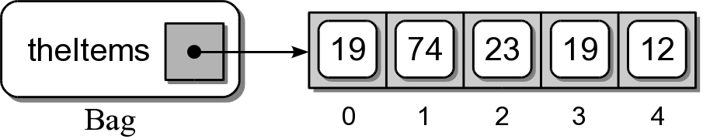
Sample Bag Instance

Slide 59
Bag: List Implementation
linearbag.py
class Bag :
def __init__( self ):
self._theItems = list()
def __len__( self ):
return len( self._theItems )
def __contains__( self, item ):
return item in self._theItems
def add( self, item ):
self._theItems.append( item )
def remove( self, item ):
assert item in self._theItems, "The item must be in the bag."
ndx = self._theItems.index( item )
return self._theItems.pop( ndx )

Slide 60
Traversals and Iterators
Traversals are very common operations performed on containers.
  Iterates over the entire collection.
  Provides access to each individual element.
  Examples:
    find an item.
    print entire collection.

Slide 61
Traversals
We could define specific traversal operations as part of the ADT.
class Bag :
# ...
def saveToFile( self, filename ):
......
def findSmallest( self ):
......

Slide 62
Generic Traversals
What about other traversals?
  Find the largest instead of the smallest?
  Save to a file in a different format?
We can not possibly add all traversals to a general container.
  Need to provide generic traversal.
  Without requiring access to the implementation.

Slide 63
Python Iterators
Python provides a built-in iterator mechanism.
  Create an iterator object.
  Used with the for loop construct .
  Works for both built-in and user-defined containers.
# Iterate over the bag and check the ages.
for date in bag :
if date <= bornBefore :
print( "Is at least 21 years of age: ", date )

Slide 64
Designing an Iterator
Step 1: define and implement an iterator class.
  Class with two special methods.
  Defined in the same module as the container class.
class _BagIterator :
def __init__( self, theList ):
self._bagItems = theList
self._curItem = 0
def __iter__( self ):
return self
def __next__( self ):
if self._curItem < len( self._bagItems ) :
item = self._bagItems[ self._curItem ]
self._curItem += 1
return item
else :
raise StopIteration

Slide 65
Designing an Iterator
Step 2: define the iterator operator as part of the container class.
  Creates an instance of the iterator object.
  Called at the beginning of the for loop.
class Bag :
# ...
def __iter__( self ):
return _BagIterator( self._theItems )

Slide 66
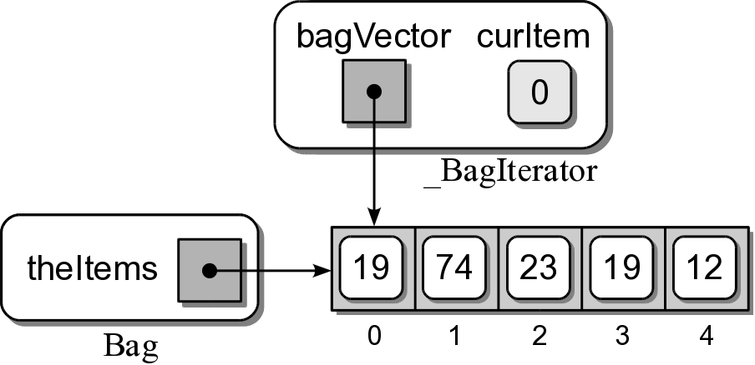
Bag Iterator
An instance of the iterator is automatically created.
for item in bag :
print( item )

Slide 67
Student Records
Suppose we have a collection of student records on external storage.
    id #
    first name
    last name
    class code
    GPA
We need to extract the data and produce a report in a prescribed format.

Slide 68
Sample Report
LIST OF STUDENTS
ID NAME CLASS GPA
----- ------------------------- ---------- ----
10015 Smith, John Sophomore 3.01
10167 Jones, Wendy Junior 2.85
10175 Smith, Jane Senior 3.92
10188 Wales, Sam Senior 3.25
10200 Roberts, Sally Freshman 4.00
10208 Green, Patrick Freshman 3.95
10226 Nelson, Amy Sophomore 2.95
10334 Roberts, Jane Senior 3.81
10387 Taylor, Susan Sophomore 2.15
10400 Logan, Mark Junior 3.33
10485 Brown, Jessica Sophomore 2.91
--------------------------------------------------
Number of students: 11

Slide 69
File Format
We have not been told the type or format of the external storage.
  What type?
    plain text file
    binary file
    relational database
  How is the data formatted?

Slide 70
Using Abstraction
By applying abstraction to this problem, we can begin designing a solution.
No matter the source, the record extraction will be similar:
  open the a connection
  extract the records
  close the connection

Slide 71
Student File Reader ADT
A student file reader extracts student records from external storage.
  Data components will be stored in an appropriate storage object.
StudentFileReader( filename ) open() close() fetchRecord() fetchAll()

Slide 72
Creating the Report
studentreport..py
from studentfile import StudentFileReader
# Name of the file to open.
FILE_NAME = "students.txt"
def main():
# Extract the student records from the given text file.
reader = StudentFileReader( FILE_NAME )
reader.open()
studentList = reader.fetchAll()
reader.close()
# Sort the list by id number and print the report.
sortTheList( studentList )
printReport( studentList )
def sortTheList( theList ):
......
def printReport( theList ):
......
main()

Slide 73
Student Records
Tuples should not be used for structured data.
    access by subscript.
Use storage objects created from a storage class.
    access by named data fields.
class StudentRecord :
def __init__( self ):
self.idNum = 0
self.firstName = None
self.lastName = None
self.classCode = 0
self.gpa = 0.0

Slide 74
Storage Class
Regular class with only a constructor.
    creates and initializes data fields
    data fields are public
Internal storage classes should be private.
    name starts with an underscore.
StudentRecord objects needed outside the ADT.
Defined within the module where they are used.

Slide 75
Sort The List
studentreport..py
def sortTheList( theList ):
theList.sort( key = lambda rec: rec.idNum )
# Each object is passed to the lambda expression
# which returns the idNum field of the object.

Slide 76
Print the Report
studentreport..py
def printReport( theList ):
# The class names associated with the class codes.
classNames = ( None, "Freshman", "Sophomore",
"Junior", "Senior" )
# Print the header.
print( "LIST OF STUDENTS".center(50) )
print( "" )
print( "%-5s %-25s %-10s %-4s" % \
('ID', 'NAME', 'CLASS', 'GPA'))
print( "%5s %25s %10s %4s" % \
('-' * 5, '-' * 25, '-' * 10, '-' * 4))
# Print the body.
for record in theList :
print( "%5d %-25s %-10s %4.2f" % \
(record.idNum, \
record.lastName + ', ' + record.firstName,
classNames[record.classCode], record.gpa) )
# Add a footer.
print( "-" * 50 )
print( "Number of students:", len(theList) )

Slide 77
ADT Implementation
Does not require a data structure.
Implemented based on the storage type/ format.
Assume a text file with the format:
10015
John
Smith
2
3.01
10334
Jane
Roberts
4
3.81
:
:

