Slide 1
Arrays
Chapter 2

Slide 2
The Array Structure
An array is the most basic type of container.
  Implemented at the hardware level.
  Most languages provide arrays as a primitive type.
  Can be used with a wide range of problems.

Slide 3
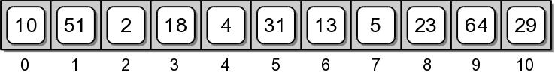
1-D Array
A sequence structure:
  Composed of multiple elements.
  Elements are stored in contiguous bytes of memory.
  Entire contents is known by a single name.
  Individual elements can be accessed by subscript.

Slide 4
Array -vs- Python List
Both are sequences, but there are two major differences:
  Arrays only have 3 operations.
    array creation
    reading a specific element
    writing a specific element
  The size of an array is fixed.

Slide 5
Why Study Arrays?
Python provides the list structure as its mutable sequence type.
Do we really need arrays?
  Many languages only provide the array structure.
  Both structures have their uses.

Slide 6
When to use Arrays?
Arrays are best suited to problems where:
  maximum number of elements is known upfront.
    array size is fixed
    the list has extra space that can be wasteful.
  only a limited number of operations are needed.
    arrays have 3 operations.
    the list can manage the items in the container.

Slide 7
1-D Array ADT
A 1-D array is a collection of contiguous elements with each element identified by integer subscript.
  Subscripts start at 0.
  Once created, array size can not be changed.
Array( size ) length() getitem( index) setitem( index, value ) clear( value ) iterator()

Slide 8
Array Example #1
fillarray.py
# Fill a 1-D array with random values, then print the values.
from array import Array
import random
# The constructor is called to create the array.
valueList = Array( 100 )
# Fill the array with random floating-point values.
for i in range( len(valueList) ):
valueList[i] = random.random()
# Print the values, one per line.
for value in valueList :
print( value )

Slide 9
Array Example #2
countarray.py
# Count the number of occurrences of each letter in a text file.
from array import Array
# Create an array for the counters.
theCounters = Array( 127 )
theCounters.clear( 0 )
# Open the text file for reading and extract each letter.
theFile = open( 'atextfile.txt', 'r' )
for line in theFile :
for letter in line :
code = ord( letter )
theCounters[code] += 1
# Close the file
theFile.close()
# Print the results.
for i in range( 26 ) :
print( "%c - %4d %c - %4d" % \
(chr(65+i), theCounters[65+i], chr(97+i), theCounters[97+i]) )

Slide 10
Array Implementation
Python is built using the C language.
  High-level compiled language.
  Provides syntax for working with the hardware.
Python provides the ctypes module
  Access to C data types and functionality.
  Provides for hardware-supported arrays.
  Requires knowledge of C language.
  Not meant for direct use in programs.

Slide 11

Hardware Array: Creation
Create a hardware array
  fixed size
  each element stores a reference to an object.
import ctypes
ArrayType = ctypes.py_object * 5
slots = ArrayType()

Slide 12
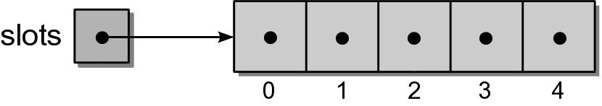
Hardware Array: Initialize
A hardware array has to be initialized before it can be used.
  elements are like any other variable.
  we must keep track of the size of the array.
for i in range( 5 ):
slots[i] = None

Slide 13
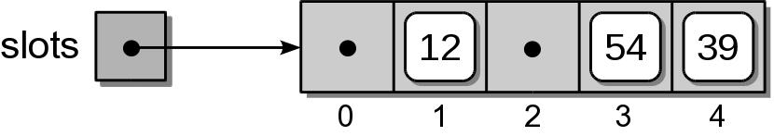
Hardware Array: Add
References can be stored in any array element.
slots[1] = 12
slots[3] = 54
slots[4] = 37

Slide 14
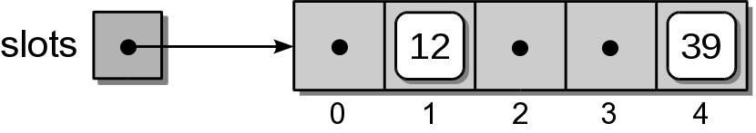
Hardware Array: Remove
Items can be removed from the array.
slots[3] = None

Slide 15
Array ADT Implementation
array.py
import ctypes
class Array :
def __init__( self, size ):
assert size > 0, "Array size must be > 0"
self._size = size
PyArrayType = ctypes.py_object * size
self._elements = PyArrayType()
self.clear( None )
def __len__( self ):
return self._size
def clear( self, value ):
for i in range( len(self) ) :
self._elements[i] = value
def __iter__( self ):
return ArrayIterator( _self.elements )

Slide 16
Array ADT Implementation
array.py
class Array :
# ...
def __getitem__( self, index ):
assert index >= 0 and index < len(self), \
"Array subscript out of range"
return self._elements[index]
def __setitem__( self, index, value ):
assert index >= 0 and index < len(self), \
"Array subscript out of range"
self._elements[index] = value

Slide 17
The Python List
A mutable sequence type container.
  Provides operations for managing the collection.
  Can grow and/or shrink as needed.
  Implemented using an array.

Slide 18
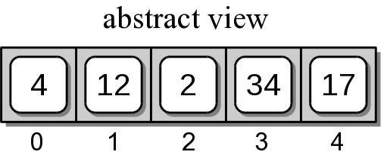
List: Construction
The Python list interface provides an abstraction to the actual underlying implementation.
pyList = [ 4, 12, 2, 34, 17 ]

Slide 19
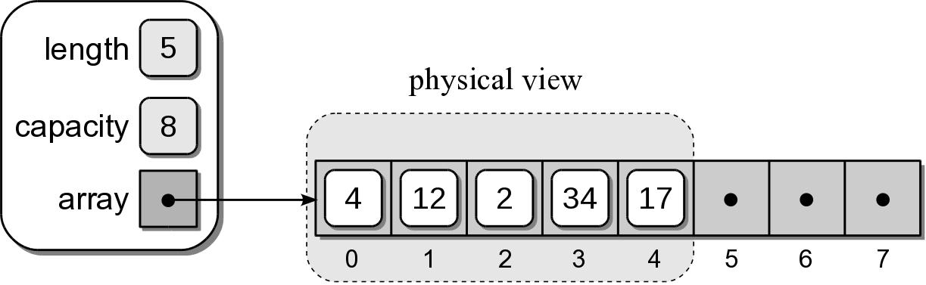
List: Implementation
An array is used to store the items of the list.
  Created bigger than needed.
  Has capacity for future items.
  subarray – the items are stored in a contiguous subset of the array.

Slide 20
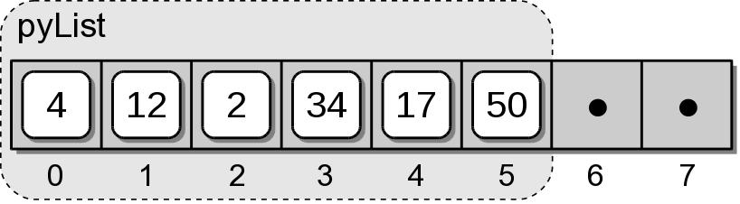
List: Appending an Item
New items can be added at the end of the list.
When space is available, the item is stored in the next slot.
pyList.append(50)

Slide 21
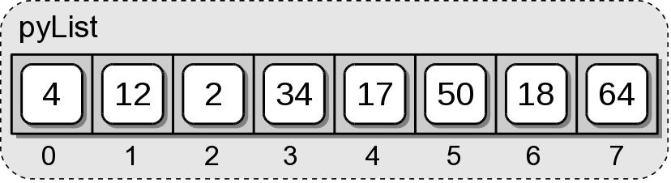
List: Appending an Item
What happens when the array becomes full?
There is no space for value 6.
pyList.append(18)
pyList.append(64)
pyList.append(6)

Slide 22
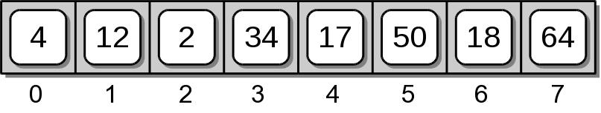
List: Appending an Item
The array has to be expanded.
  Can not change the size of an array.
  Will require multiple steps.
The original array.

Slide 23
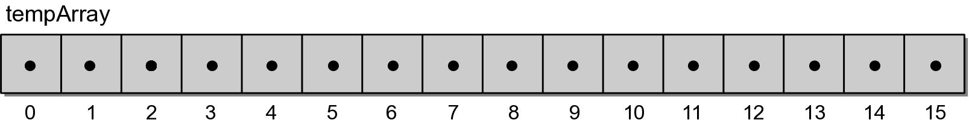
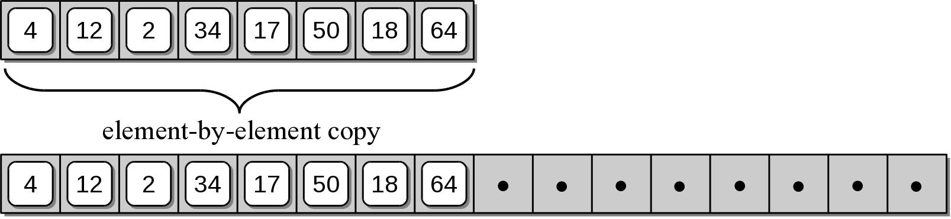
Expanding The Array
Step 1: create a new array, double the size.
Step 2: copy the items from original array to the new array.

Slide 24
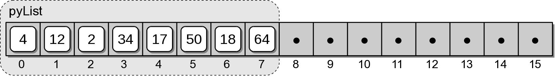
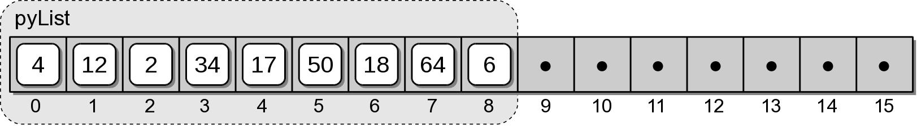
Expanding The Array
Step 3: replace the original array with the new array.
Step 4: store value 6 in the next slot of the new array.

Slide 25
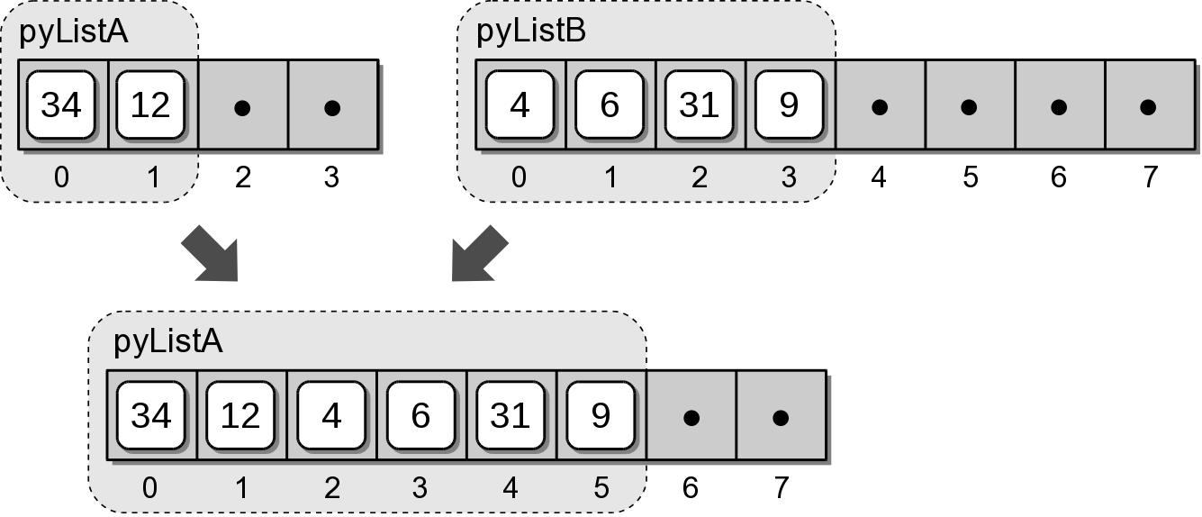
List: Extending
The entire contents of a list can be appended to a second list.
pyListA = [34, 12]
pyListB = [4, 6, 31, 9]
pyListA.extend( pyListB )

Slide 26
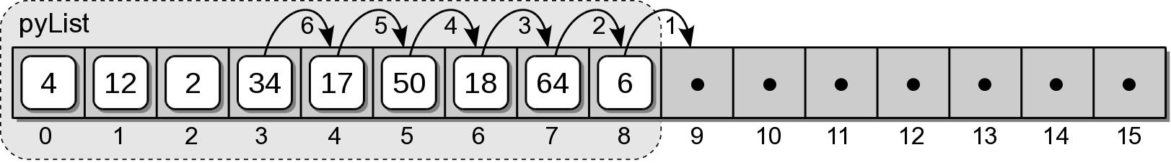
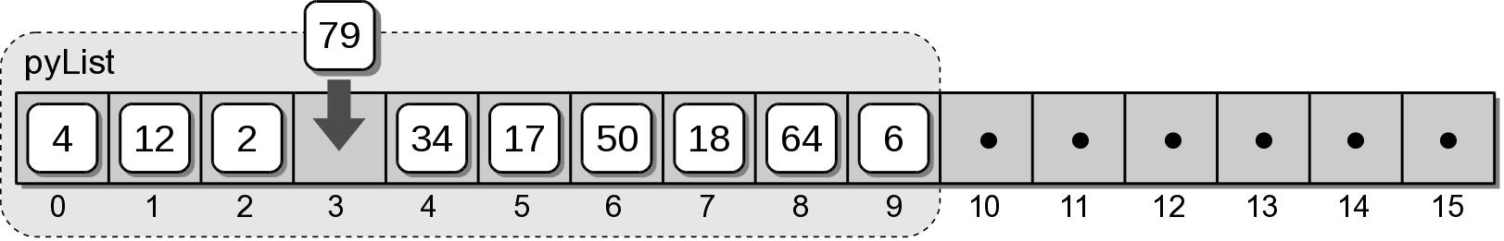
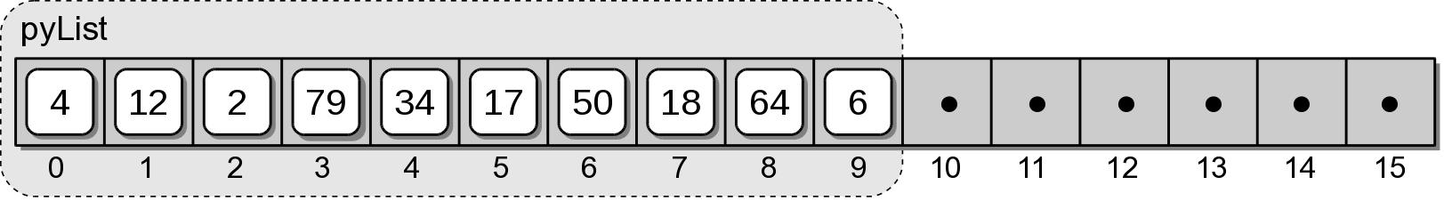
List: Inserting Items
An item can be inserted anywhere within the list.
pyList.insert( 3, 79 )

Slide 27
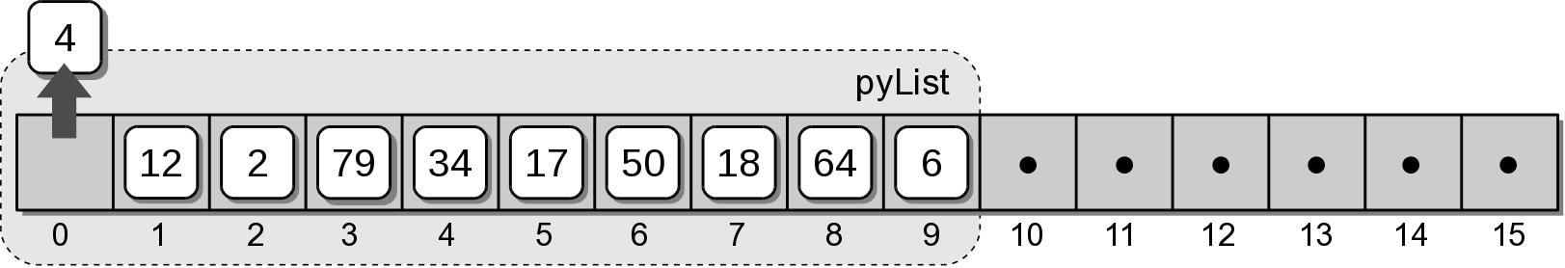
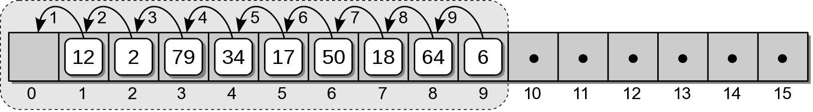
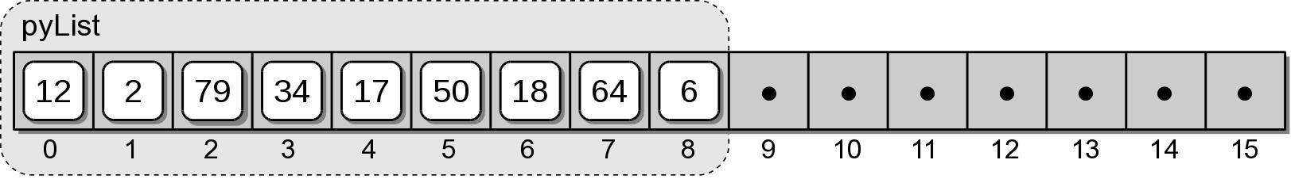
List: Removing Items
An item can be removed from position of the list.
pyList.pop(0)

Slide 28

List: Removing Items
Removing the last item in the list.
pyList.pop()

Slide 29
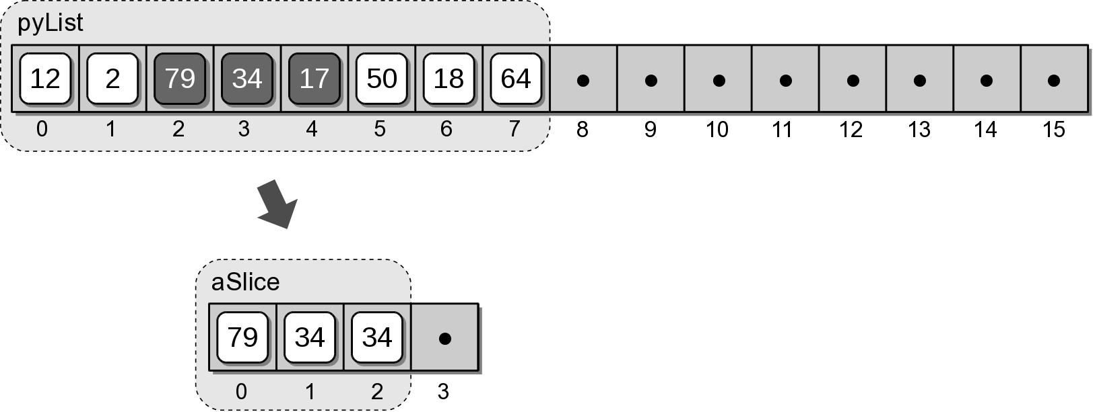
List: Slices
Slicing a list creates a new list from a contiguous subset of elements.
aSlice = pyList[2:5]

Slide 30
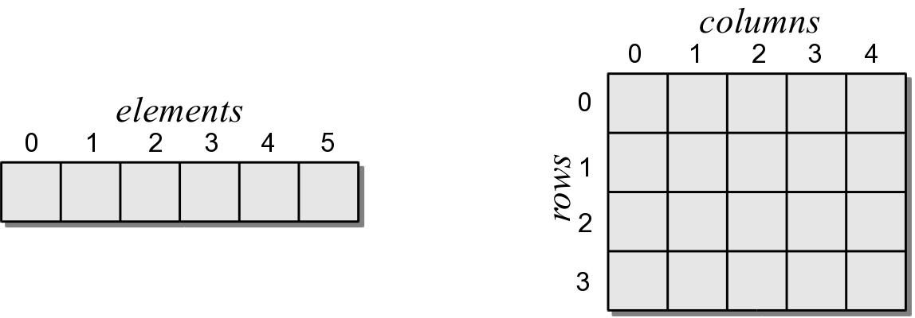
2-D Arrays
Arrays can be defined with multiple dimensions.
Two-dimensional arrays:
  organize the data in rows and columns
  element access: [i,j]

Slide 31
2-D Arrays
Arrays of 2 or more dimensions are not supported at the hardware level.
  Most languages provide some mechanism for creating and managing multi-dimensional arrays.
  2-D arrays are very common in computer science.

Slide 32
2-D Array ADT
A 2-D array consists of a collection of elements organized into rows and columns.
  Elements are referenced by row and column subscript (start at 0).
  Once created, array size can not be changed.
Array2D( nrows, ncols ) numRows() numCols() clear( value ) getitem( i₁, i₂ ) setitem( i₁, i₂, value )

Slide 33
2-D Array Example
Suppose we have a text file containing exam grades for multiple students.
  Extract the grades from the file.
  Store them in a 2-D array.
  Compute the average exam grades.
7
3
90 96 92
85 91 89
82 73 84
69 82 86
95 88 91
78 64 84
92 85 89

Slide 34
2-D Array Example
avggrades.py
from array import Array2D
# Open the text file for reading.
gradeFile = open( filename, "r" )
# Extract the first two values; indicate the size of the array.
numExams = int( gradeFile.readline() )
numStudents = int( gradeFile.readline() )
# Create the 2-D array to store the grades.
examGrades = Array2D( numStudents, numExams )
# Extract the grades from the remaining lines.
i = 0
for student in gradeFile :
grades = student.split()
for j in range( numExams ):
examGrades[i,j] = int( grades[j] )
i += 1
# Close the text file.
gradeFile.close()

Slide 35
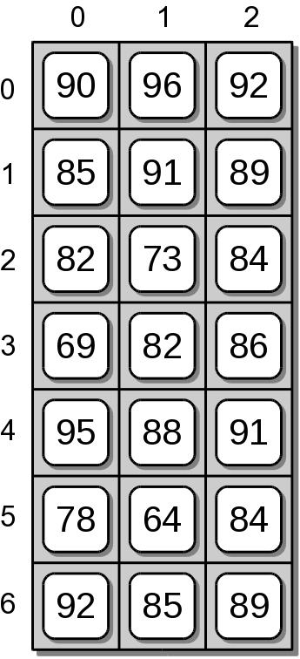
2-D Array Example
The contents of the 2-D array produced by the previous code segment.
7
3
90 96 92
85 91 89
82 73 84
69 82 86
95 88 91
78 64 84
92 85 89

Slide 36
2-D Array Example
avggrades.py
# Compute each student's average exam grade.
for i in range( numStudents ) :
total = 0
for j in range( numExams ) :
total += examGrades[i,j]
examAvg = total / numExams
print( "%2d: %6.2f" % (i+1, examAvg) )

Slide 37
Implementing the 2-D Array
There are various approaches that can be used to implement a 2-D array.
  Use a single 1-D array with the elements arranged by row or column.
  Use a 1-D array of 1-D arrays.

Slide 38
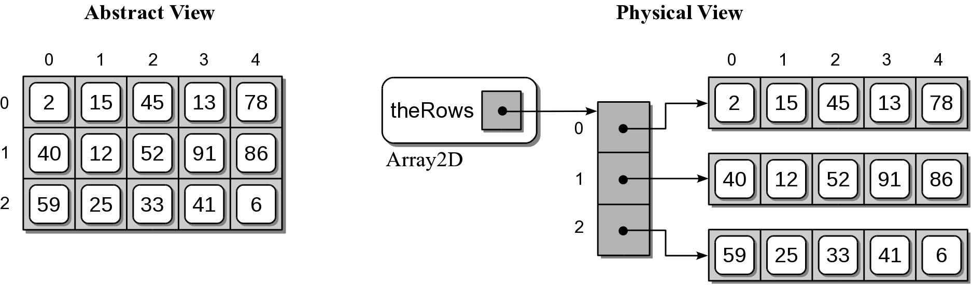
Array of Arrays Implementation
Each row is stored within its own 1-D array.
A 1-D array is used to store references to each row array.

Slide 39
2-D Array Implementation
array.py
class Array2D :
def __init__( self, numRows, numCols ):
self._theRows = Array( numRows )
for i in range( numRows ) :
self._theRows[i] = Array( numCols )
def numRows( self ):
return len( self._theRows )
def numCols( self ):
return len( self._theRows[0] )
def clear( self, value ):
for row in range( self.numRows() ):
row.clear( value )

Slide 40
2-D Array Implementation
Subscript notation:
  y = x[r, c] x[r, c] = z
  Subscripts are passed to the methods as a tuple.
  Must verify the size of the tuple.

Slide 41
2-D Array Implementation
array.py
class Array2D :
# ...
def __getitem__( self, ndxTuple ):
assert len(ndxTuple) == 2, "Invalid number of array subscripts."
row = ndxTuple[0]
col = ndxTuple[1]
assert row >= 0 and row < self.numRows() \
and col >= 0 and col < self.numCols(), \
"Array subscript out of range."
the1dArray = self._theRows[row]
return the1dArray[col]

Slide 42
2-D Array Implementation
array.py
class Array2D :
# ...
def __setitem__( self, ndxTuple, value ):
assert len(ndxTuple) == 2, "Invalid number of array subscripts."
row = ndxTuple[0]
col = ndxTuple[1]
assert row >= 0 and row < self.numRows() \
and col >= 0 and col < self.numCols(), \
"Array subscript out of range."
the1dArray = self._theRows[row]
the1dArray[col] = value

Slide 43
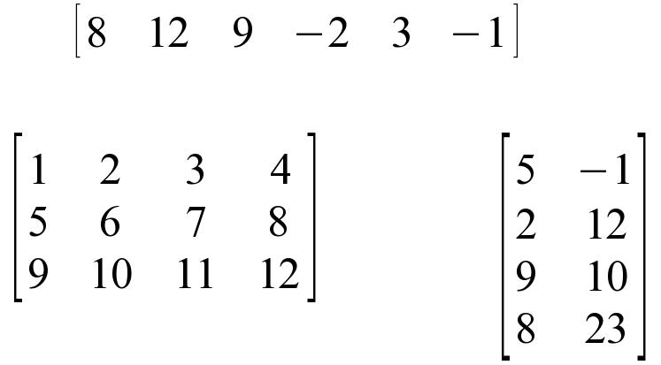
The Matrix
Matrices are very common in mathematics.
  Used for solving systems of linear equations.
  Linear algebra and computer graphics.

Slide 44
The Matrix ADT
A matrix is a collection of scalar values arranged in rows and columns as a fixed sized rectangular grid.
  Elements are accessed by (row, col) subscript.
  Indices start at 0.
Matrix( nrows, ncols ) numRows() numCols() getitem( i₁, i₂ ) setitem( i₁, i₂, value ) | scaleBy( value ) transpose() add( rhsMatrix ) subtract( rhsMatrix ) multiply( rhsMatrix )

Slide 45
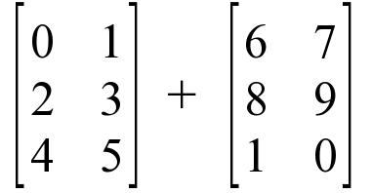
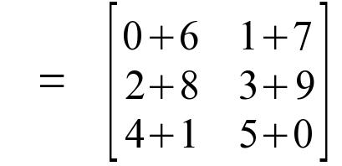
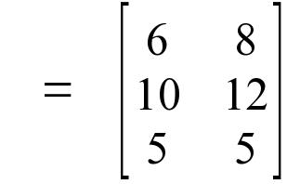
Matrix: Addition & Subtraction
Two m x n matrices can be added or subtracted to create a new m x n matrix.
+
=

Slide 46
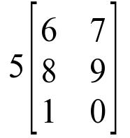
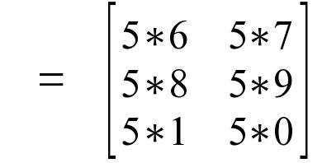
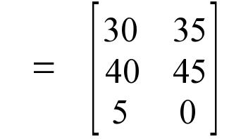
Matrix: Scaling
Modify each element by a common scale factor.
  factor < 1 reduces each element value.
  factor > 1 increases each element value.

Slide 47
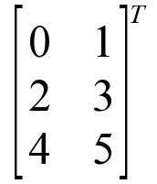
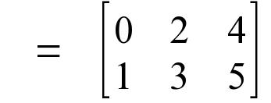
Matrix: Transpose
Swaps the rows and columns of an m x n matrix to create a new n x m matrix.

Slide 48
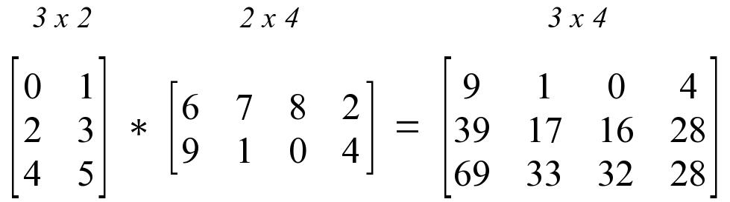
Matrix: Multiplication
A matrix of size m x n can be multiplied by a matrix of size n x p. Result is a new m x p matrix.

Slide 49
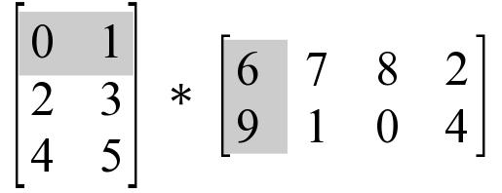
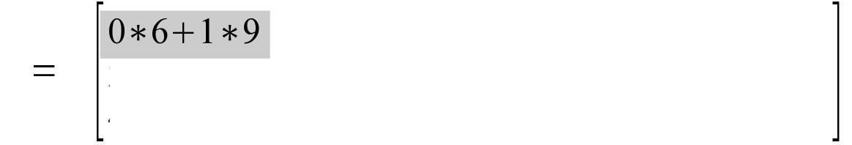
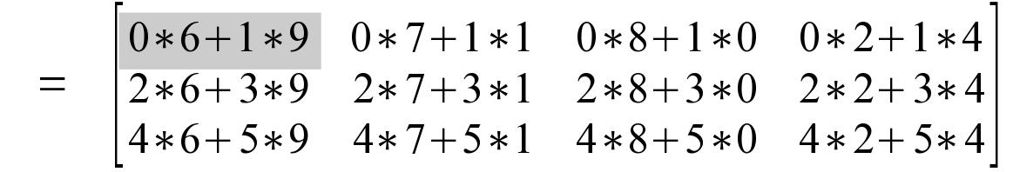
Matrix: Multiplication
Each element of the new matrix is the result of:
  summing the product of a row in the lhs matrix
  by a column in the rhs matrix.

Slide 50
Matrix Implementation
How should we implement the Matrix ADT?
  There are different ways to organize the data contained in a matrix.
  Most obvious approach is to use a 2-D array.

Slide 51
Matrix Implementation
matrix.py
from array import Array2D
class Matrix :
def __init__( self, numRows, numCols ):
self._theGrid = Array2D( numRows, numCols )
self._theGrid.clear( 0 )
def numRows( self ):
return self._theGrid.numRows()
def numCols( self ):
return self._theGrid.numCols()
def __getitem__( self, ndxTuple ):
return self._theGrid[ ndxTuple[0], ndxTuple[1] )
def __setitem__( self, ndxTuple, scalar ):
self._theGrid[ ndxTuple[0], ndxTuple[1] ] = scalar

Slide 52
Matrix: Scaling
matrix.py
class Matrix :
# ...
def scaleBy( self, scalar ):
for r in range( self.numRows() ) :
for c in range( self.numCols() ) :
self[r, c] *= scalar
def __add__( self, rhsMatrix ):
assert rhsMatrix.numRows() == self.numRows() and \
rhsMatrix.numCols() == self.numCols(), \
"Matrix sizes not compatible for the add operation."
newMatrix = Matrix( self.numRows(), self.numCols() )
for r in range( self.numRows() ) :
for c in range( self.numCols() ) :
newMatrix[r, c] = self[r, c] + rhsMatrix[r, c]
return newMatrix

Slide 53
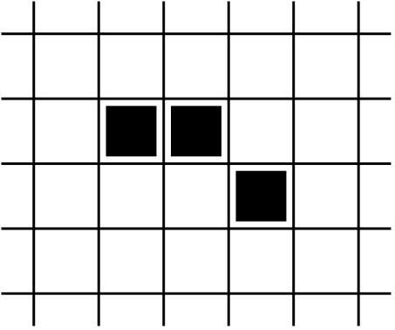
The Game of Life
Devised by British mathematician John H. Conway; first introduced by Martin Gardner.
  Example of a problem from cellular automata.
  A zero-player solitaire type game.
  Uses an infinite-sized grid of cells:
    contains an organism (alive)
    empty (dead)

Slide 54
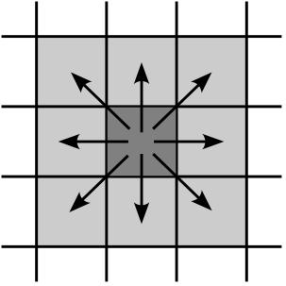
Life: Cell Neighbors
Played over a specific period of time:
  each turn creates a new “generation”.
  based on the current “configuration”.
  next generation determined by applying 4 rules.
Neighbors of a cell:

Slide 55
Rules of the Game
Rule 1: if a cell is alive and has either two or three neighbors, the cell remains alive.
Rule 2: A living cell with 0 or 1 live neighbors dies from isolation.
Rule 3: A living cell with 4 or more live neighbors dies from overpopulation.
Rule 4: A dead cell with 3 live neighbors becomes alive resulting from a birth.

Slide 56
Life Grid ADT
A life grid is used to represent and store the grid in the game of Life.
  Contains a rectangular grouping of cells of a finite size.
  The cells are referenced by row and column indices, starting at 0.
LifeGrid( nrows, ncols ) numRows() numCols() configure( coordList ) | clearCell( row, col ) setCell( row, col ) isLiveCell( row, col ) numLiveNeighbors( row, col )

Slide 57
Playing the Game of Live
Given the definition, we can use the ADT without knowing how it's implemented.
  main() creates the grid and evolves new generations.
  draw() prints the current configuration.
  evolve() generates a new configuration based on the rules of the game.

Slide 58
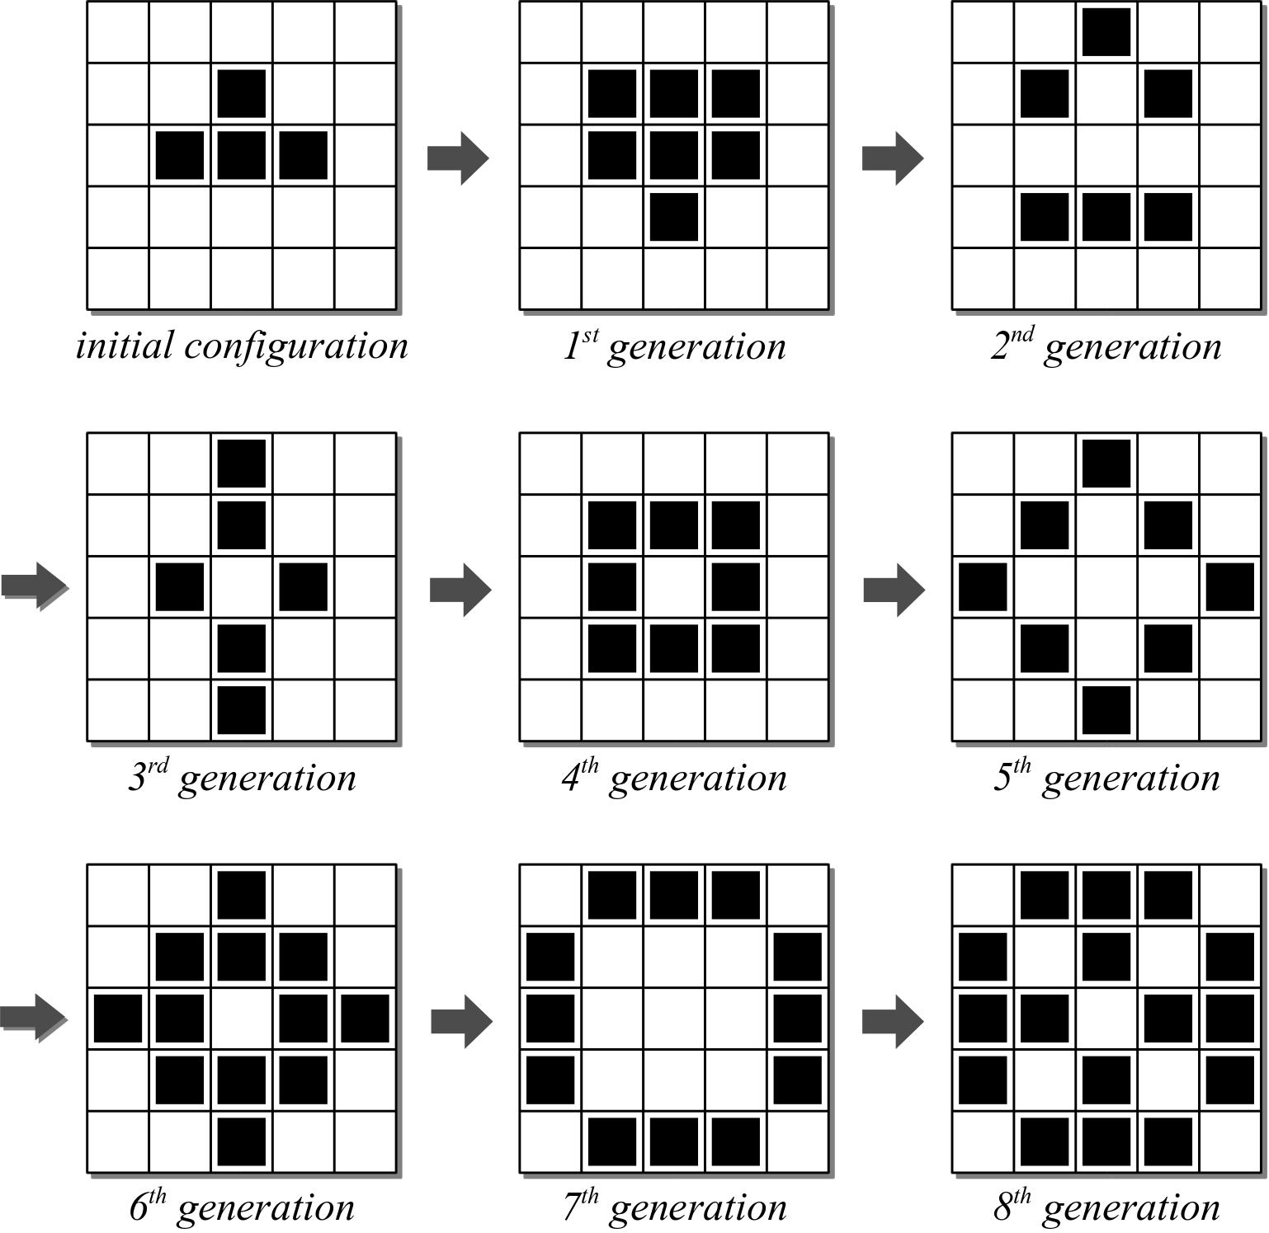
Example Game

Slide 59
Game Grid Implementation
Actual game specifies a grid of infinite size.
  This solution will use a grid of fixed size.
  If the system grows too large, it can be “played” again with a larger grid.

Slide 60
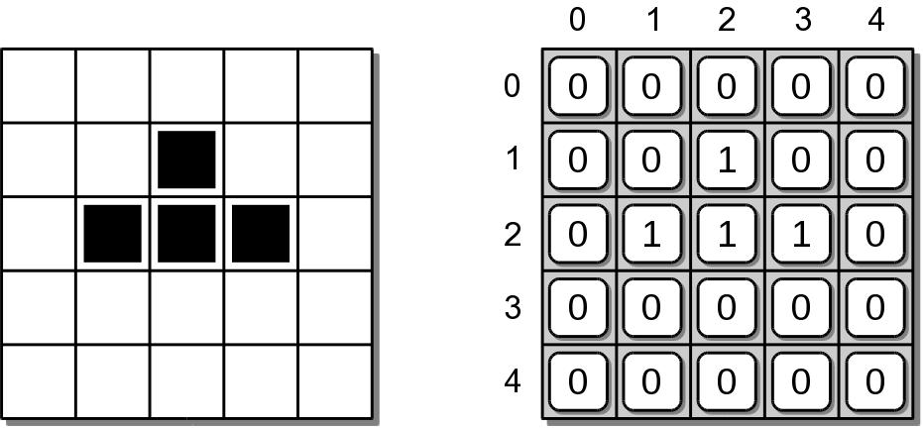
Game Grid Implementation
We can use a 2-D array for the grid:

