Slide 1
Algorithm Analysis
Chapter 4

Slide 2
Algorithms
Algorithms are designed to solve problems.
A problem can have multiple solutions.
How do we determine which
solution is the most efficient?

Slide 3
Execution Time
Measure execution time:
  construct a program for a given solution.
  execute the program.
  time it using a “wall clock”.
Dependent on:
  amount of data
  type of hardware and time of day
  programming language and compiler

Slide 4
Complexity Analysis
What if we examine the solution itself and measure critical operations:
  logical comparisons
  assignments
  arithmetic operations

Slide 5
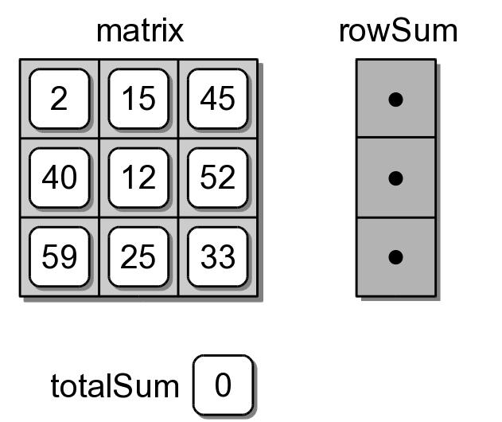
Example Algorithm
Given a matrix of size n x n, compute the:
  sum of each row of a matrix.
  overall sum of the entire matrix.

Slide 6
Example Algorithm (v.1)
How many additions are performed?
= 2
n
(n)
= 2n²
rowSum = Array(n)
totalSum = 0
for i in range( n ) :
rowSum[i] = 0
for j in range( n ) :
rowSum[i] = rowSum[i] + matrix[i,j]
totalSum = totalSum + matrix[i,j]
n
n
2

Slide 7
Example Algorithm (v.2)
How many additions are performed?
= n
= n² + n
( ) n
+ 1
rowSum = Array(n)
totalSum = 0
for i in range( n ) :
rowSum[i] = 0
for j in range( n ) :
rowSum[i] = rowSum[i] + matrix[i,j]
totalSum = totalSum + matrix[i,j]
n
n
1
1

Slide 8
Compare the Results
Number of additions: v₁: 2n² v₂: n² + n
Second version has fewer additions (n > 1)
  Will execute faster than the first.
  Difference will not be significant.
Both algorithms execute on the same order of magnitude, n²

Slide 9
Growth Rates
As n increases, both algorithms increase at approx the same rate:
n | 2n² | n² + n
10 | 200 | 110
100 | 20,000 | 10,100
1000 | 2,000,000 | 1,001,000
10,000 | 200,000,000 | 100,010,000
100,000 | 20,000,000,000 | 10,000,100,000

Slide 10
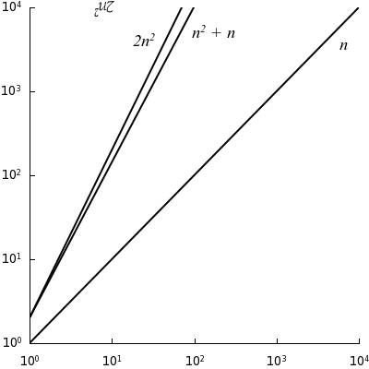
Growth Rates

Slide 11
Big-O Notation
No need to count precise number of steps.
Classify algorithms by order of magnitude.
  execution time
  space requirements
Approximates actual number of
steps or actual storage in terms
of variable-sized data sets.

Slide 12
Big-O Definition
Given a function T(n)
  # of steps required for an input of size n.
  Ex: T₂(n) = n² + n
Suppose there exist a function f(n) for all integers n > 0 such that
for some constant c and for all large values of n > m (a constant).
T(n) < c f(n)

Slide 13
Big-O Definition
Then, the algorithm has a time-complexity of or executes “on the order of” f(n)
  We use the notation: O( f(n) )
  Big-O is intended for large values of n.
f(n) indicates the rate of growth
at which the run time increases
as the input size increases.

Slide 14
Big-O Example (v.1)
Consider the previous sample algorithms.
Version 1: T₁(n) = 2n²
T₁(n) < c f(n)
2n² < 2n²
Let c = 2
O( n² )

Slide 15
Big-O Example (v.2)
Consider the previous sample algorithms.
Version 2: T₂(n) = n² + n
T₂(n) < c f(n)
n² + n < n² + n²
n² + n < 2n²
Let c = 2
O( n² )

Slide 16
Upper Bound
There is more than one f(n) for an algorithm.
  n² is not the only choice
  f(n) could be n², n³, n⁴
n² + n < c f(n)
Objective: find an f(n) that
provides the tightest (lowest)
upper bound.

Slide 17
Constant of Proportionality
Is it important?
Consider two algorithms:
  O(n²), with c = 1
  O(2n), with c = 2
n | n² | 2n
10 | 100 | 20
100 | 10,000 | 200
1000 | 1,000,000 | 2,000
10,000 | 100,000,000 | 20,000
100,000 | 10,000,000,000 | 200,000

Slide 18
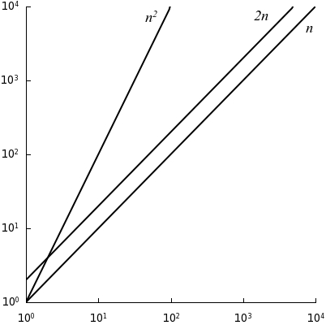
Constant of Proportionality

Slide 19
Constructing T(n)
We don't count total number of specific instructions (math operations, comparisons, etc)
  Assume each basic statement takes the same time, constant time.
  Total number of steps required:
T(n) = f₁(n) + f₂(n) + ... + f_{k}(n)

Slide 20
Constructing T(n) Example
1
rowSum = Array(n)
totalSum = 0
for i in range( n ) :
rowSum[i] = 0
for j in range( n ) :
rowSum[i] = rowSum[i] + matrix[i,j]
totalSum = totalSum + matrix[i,j]
1
1
1
n
1
n
1
1

Slide 21
Constructing T(n) Example
Constant time steps are generally omitted.
. . .
rowSum = Array(n)
totalSum = 0
for i in range( n ) :
rowSum[i] = 0
for j in range( n ) :
rowSum[i] = rowSum[i] + matrix[i,j]
totalSum = totalSum + matrix[i,j]
. . .
n
n
. . .

Slide 22
Choosing the Function
Given T(n), choose the dominant term.
T(n) = n² + log₂n + 3n
n² dominates the other terms (for n > 3)
n² + log₂n + 3n < n² + n² + n²
n² + log₂n + 3n < 3n²

Slide 23
Choosing the Function
What is the dominant term for the following expression?
T(n) = 2n² + 15n + 500
When n < 16, 500 dominates.
When n > 16, n² is the dominate term.

Slide 24
Classes of Algorithms
Many algorithms have a time-complexity selected from a common set of functions.
f() | Common Name
1 | constant
log n | logarithmic
n | linear
n log n | log linear
n² | quadratic
n³ | cubic
a^{n} | exponential

Slide 25
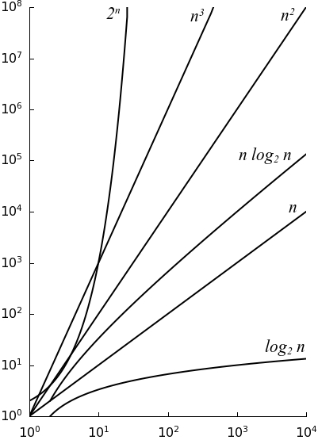
Classes of Algorithms

Slide 26
Evaluating Python Code
Basic operations only require constant time:
  x = 5
  z = x + y * 6
  if x > 0 and x < 100
What about function calls?
y = ex1(n)

Slide 27
Code Evaluation #1
def ex1( n ):
count = 0
for i in range( n ):
count += i
return count

Slide 28
Code Evaluation #2
def ex2( n ):
count = 0
for i in range( n ):
count += 1
for j in range( n ):
count += 1
return count

Slide 29
Code Evaluation #3
def ex3( n ):
count = 0
for i in range( n ):
for j in range( n ):
count += 1
return count

Slide 30
Code Evaluation #3b
def ex3b( n ):
count = 0
for i in range( n ):
count += ex2( n )
return count

Slide 31
Code Evaluation #4
def ex4( n ):
count = 0
for i in range( n ):
for j in range( 25 ):
count += 1
return count

Slide 32
Code Evaluation #5
def ex5( n ):
count = 0
for i in range( n ):
for j in range( i+1 ):
count += 1
return count

Slide 33
Code Evaluation #6
def ex6( n ):
count = 0
i = n
while i >= 1 :
count += 1
i = i // 2
return count

Slide 34
Code Evaluation #7
def ex7( n ):
count = 0
for i in range( n ) :
count += ex6( n )
return count

Slide 35
Different Cases
Some algorithms have different run times for different sets of inputs of the same size.
  best case
  worst case
  average case

Slide 36
Different Cases
def findNeg( intSeq ):
n = len( intSeq )
for i in range( n ) :
if intSeq[i] < 0 :
return i
return None
L = [ 72, 4, 90, 56, 12, 67, 43, 17, 2, 86, 33 ]
p = findNeg( L )
L = [ -12, 50, 4, 67, 39, 22, 43, 2, 17, 28 ]
p = findNeg( L )

Slide 37
The Python List
We used the list to implement many of our ADTs.
Their efficiency depends on the efficiency of Python's list.

Slide 38
Python List: Traversal
Iterates over the contiguous elements of the underlying array.
# Sum the elements of a list.
sum = 0
for value in valueList :
sum = sum + value
# Alternate version.
sum = 0
n = len(valueList)
for i in range( n ) :
sum = sum + valueList[i]

Slide 39
Python List: Allocation
Creating a non-empty list is not constant.
temp = list()
listX = [ 0 ] * n
valueList = [ 4, 8, 20, 2, 15, 89, 60, 75 ]

Slide 40
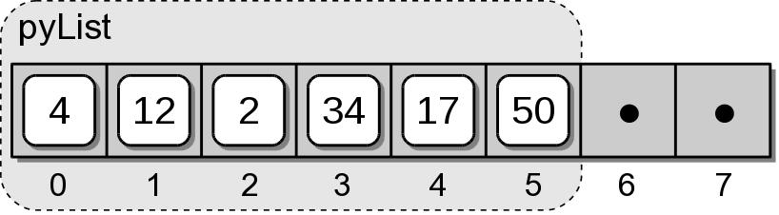
Python List: Appending
When space is available, the item is stored in the next slot.
What if the underlying
array is full?

Slide 41
Python List: Expansion
Expanding the underlying array:
  Step 1: create a new array, double the size.
  Step 2: copy the items from original array to the new array.
  Step 3: replace the original array with the new array.
  Step 4: store the new value the next slot of the new array.

Slide 42
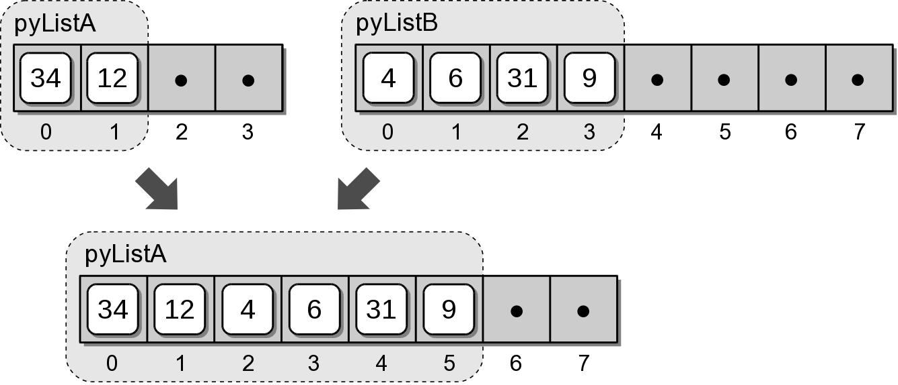
Python List: Extending
Adds the contents of a source list to the end of the destination list.

Slide 43
Python List: Time-Complexities
List Operation | Worst Case
v = list() | O(1)
len(v) | O(1)
v = [ 0 ] * n | O(n)
v[i] = x | O(1)
v.append(x) | O(n)
v.extend(w) | O(n)
v.insert(x) | O(n)
v.pop() | O(n)
traversal | O(n)

Slide 44
Amortized Cost
Consider a sequence of n append operations:
What is the worst-case running time?
L = list()
for i in range( 1, n+1 ):
L.append( i )

Slide 45
Special Case
The append() method introduces a special case.
  available capacity: O(1)
  expansion required: O(n)
How many times does
append require O(n) time?

Slide 46
Amortized Analysis
Given a sequence of operations, compute the time-complexity by computing the average cost over the entire sequence.
  Cost per operation must be known.
  Cost must vary, with
    many ops contributing little cost.
    only a few ops contributing high cost.

Slide 47
Aggregate Method
Determine upper bound total cost: T(n)
Calculate average cost: T(n) / n
Example: sequence of n append operations
  Storage of a single item: O(1)
  Expansion only occurs when (i – 1) is a power of 2.
  Cost of the expansion based on current array size.

Slide 48
Amortized Cost
The append() operation:
  worst-case time: O(n)
  amortized cost: O(1)
Can only be used for a long sequence of append operations.

Slide 49
Evaluating the Set ADT
Given the running-time of the list operations, we can evaluate our Set ADT.
class Set:
def __init__( self ):
self._theElements = list()
def __len__( self ):
return len( self._theElements )
def __contains( self, element ):
return element in self._theElements

Slide 50
Evaluating the Set ADT
class Set:
# ...
def add( self, element ):
if element not in self :
self._theElements.append( element )
def remove( self, element ):
assert element in self, \
"The element must be in the set."
self._theElements.remove( item )

Slide 51
Evaluating the Set ADT
class Set:
# ...
def __eq__( self, setB ):
if len( self ) != len( setB ) :
return False
else :
return self.isSubsetOf( setB )
def isSubsetOf( self, setB ):
for element in self :
if element not in setB :
return False
return True

Slide 52
Evaluating the Set ADT
class Set:
# ...
def union( self, setB ):
newSet = Set()
newSet._theElements.extend( self._theElements )
for element in setB :
if element not in self :
newSet._theElements.append( element )
return newSet

Slide 53
Set ADT: Time-Complexities
List Operation | Worst Case
s = Set() | O(1)
len(s) | O(1)
x in s | O(n)
s.add(x) | O(n)
s.isSubsetOf(t) | O(n²)
s == t | O(n²)
s.union(t) | O(n²)
traversal | O(n)

Slide 54
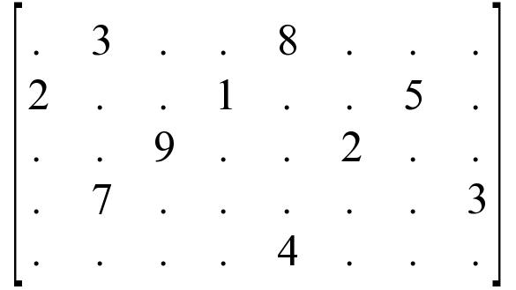
The Sparse Matrix
A matrix containing a large number of 0 elements.
  Common in scientific applications.
Formal definition:
  An m x n matrix that contains k non-zero elements.
  Such that k << m x n.

Slide 55
Data Organization
The use of a 2-D array for the Matrix ADT:
  Works well for general matrices.
  Wastes space for large sparse matrices.

Slide 56
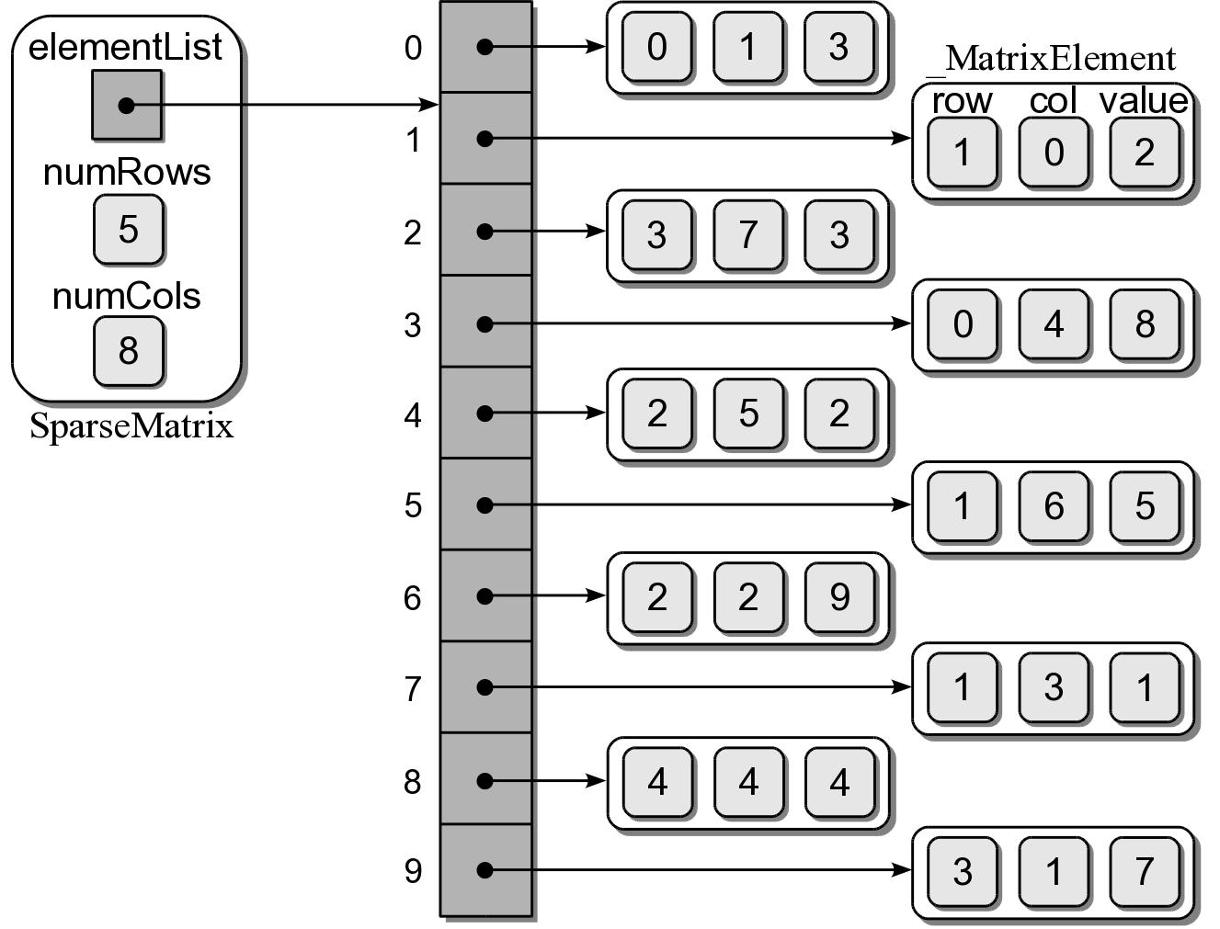
Data Organization
Use a single list and store the non-zero elements.

Slide 57
SparseMatrix Class
sparsematrix.py
class SparseMatrix :
def __init__( self, numRows, numCols ):
self._numRows = numRows
self._numCols = numCols
self._elementList = list()
def numRows( self ):
return self._numRows
def numCols( self ):
return self._numCols
# ...
class _MatrixElement:
def __init__( self, row, col, value ):
self.row = row
self.col = col
self.value = value

Slide 58
SparseMatrix: ScaleBy
sparsematrix.py
class SparseMatrix :
# ...
def scaleBy( self, scalar ):
for element in self._elementList :
element.value *= scalar

Slide 59
Setting an Element
Set an element by row and column indices.
In the 2-D array implementation of the Matrix class, this was easy.
For the SparseMatrix class, an element can not be directly set.
M = SparseMatrix(5, 8)
M[0,1] = 3
M[3,7] = 3
M[1,6] = 5

Slide 60
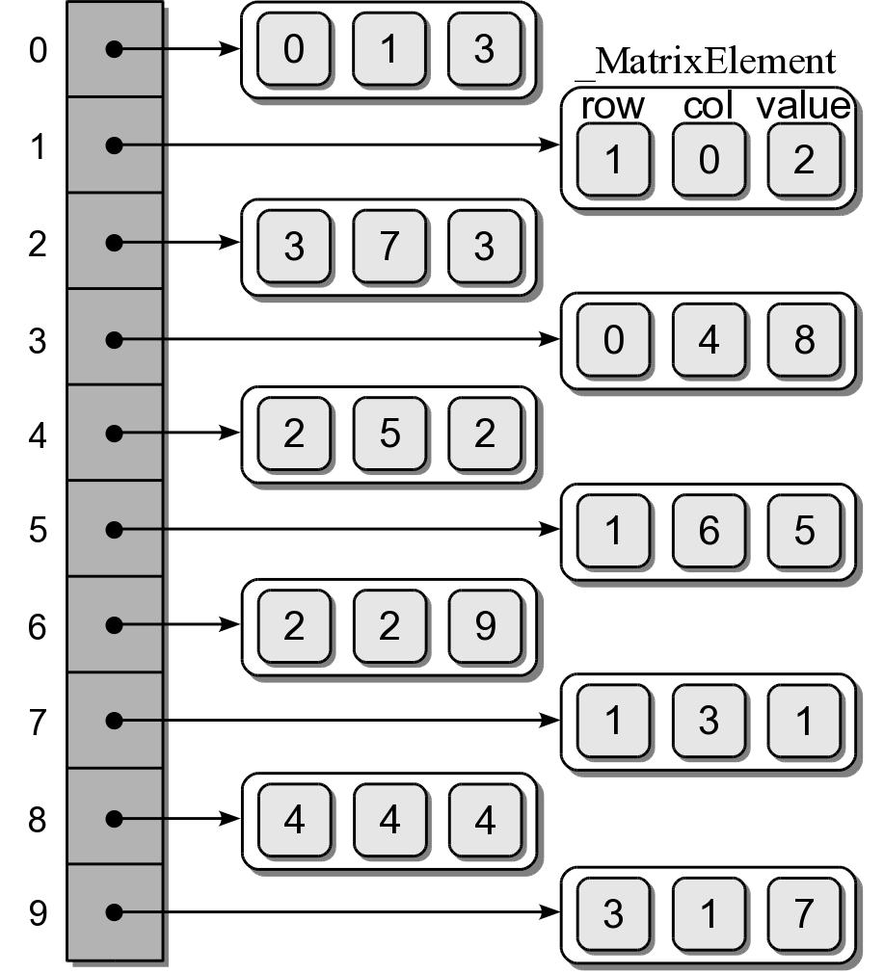
Setting an Element
There are four possible conditions:
  The element is not in the list.
    New value is not 0
    New value is 0
  The element is in the list.
    New value is not 0.
    New value is 0.

Slide 61
SparseMatrix: SetItem
sparsematrix.py
class SparseMatrix :
# ...
def __setitem__( self, ndxTuple, scalar ):
ndx = self._findPosition( ndxTuple[0], ndxTuple[1] )
if ndx is not None :
if scalar != 0.0 :
self._elementList[ndx].value = scalar
else :
self._elementList.pop( ndx )
else :
if scalar != 0.0 :
element = _MatrixElement( ndxTuple[0],
ndxTuple[1], scalar )
self._elementList.append( element )

Slide 62
SparseMatrix: Find Position
sparsematrix.py
class SparseMatrix :
# ...
def _findPosition( self, row, col ):
n = len( self._elementList )
for i in range( n ) :
if row == self._elementList[i].row and \
col == self._elementList[i].col:
return i
return None

Slide 63
SparseMatrix: Addition
The same add() operation can be used.
class SparseMatrix :
# ...
def __add__( self, rhsMatrix ):
for r in range( self.numRows() ) :
for c in range( self.numCols() ) :
newMatrix[r,c] = self[r,c] + rhsMatrix[r,c]
return newMatrix

Slide 64
SparseMatrix Analysis
Assume a square n x n matrix with k << n x n.
  constructor: O(1)
  size: O(1)
  scaleBy: O(k)
  get/set item: O(k)
  addition O(n²)

Slide 65
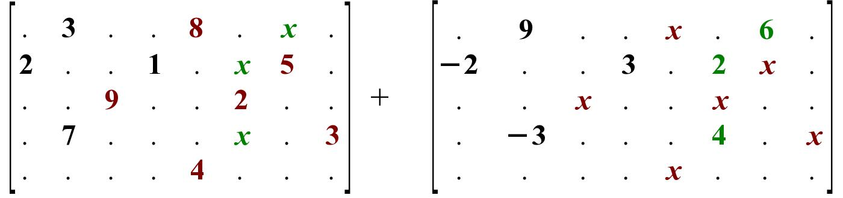
Faster Addition
We can improve the addition operation by only considering the non-zero elements.

Slide 66
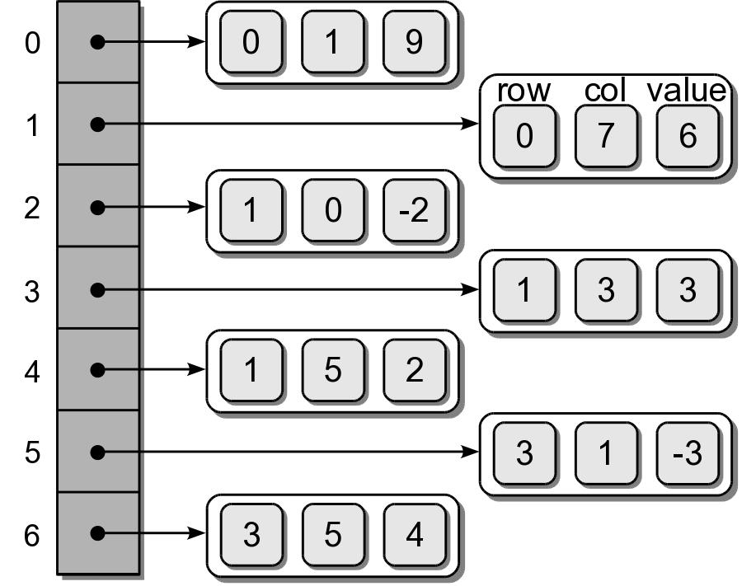
Faster Addition

Slide 67
Faster Addition
Requires 4 steps.
  Verify the precondition.
  Create a new SparseMatrix object.
  Duplicate the elements of the self matrix.
  Iterate over the rhs matrix elements and add them to the new matrix.

Slide 68
SparseMatrix: Faster Addition
sparsematrix.py
class SparseMatrix :
# ...
def __add__( self, rhsMatrix ):
assert rhsMatrix.numRows() == self.numRows() and \
rhsMatrix.numCols() == self.numCols(), \
"Matrix sizes not compatible for the add operation."
newMatrix = SparseMatrix(self.numRows(), self.numCols())
for element in self._elementList :
dupElement = _MatrixElement(element.row, element.col,
element.value)
newMatrix._elementList.append( dupElement )
for element in rhsMatrix._elementList :
value = newMatrix[ element.row, element.col ]
value += element.value
newMatrix[ element.row, element.col ] = value
return newMatrix

Slide 69
Faster Addition Analysis
Assume a square n x n matrix with k << n x n.
  check precondition: O(1)
  create new matrix: O(1)
  Duplicate lhs: O(k)
  Loop through rhs list: O(2k²)
    get item: O(k)
    set item: O(k)

Slide 70
Time-Complexity Comparisons
Operation | Matrix | SparseMatrix
constructor | O(n²) | O(1)
m.numRows() | O(1) | O(1)
m.numCols() | O(1) | O(1)
m.scaleBy(x) | O(n²) | O(k)
x = m[i, j] | O(1) | O(k)
m[i, j] = x | O(1) | O(k)
r = m + t | O(n²) | O(k²)

