Slide 1
Queues
Chapter 8

Slide 2
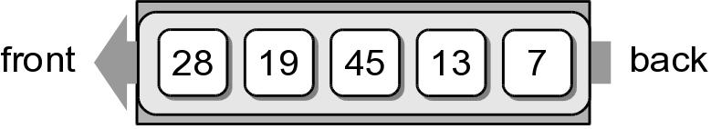
Queue
A restricted access container that stores a linear collection.
  Very common for solving problems in computer science that require data to be processed in the order in which it was received.
  Provides a first-in first-out (FIFO) protocol.
New items are added at the back while existing items are removed from the front of the queue.

Slide 3
The Queue ADT
A queue stores a linear collection of items with access limited to a first-in first-out order.
  New items are added to the back.
  Existing items are removed from the front.
Queue() isEmpty() length() enqueue( item ) dequeue()

Slide 4
Queue Example
The following code creates the queue from earlier.
Q = Queue()
Q.enqueue( 28 )
Q.enqueue( 19 )
Q.enqueue( 45 )
Q.enqueue( 13 )
Q.enqueue( 7 )

Slide 5
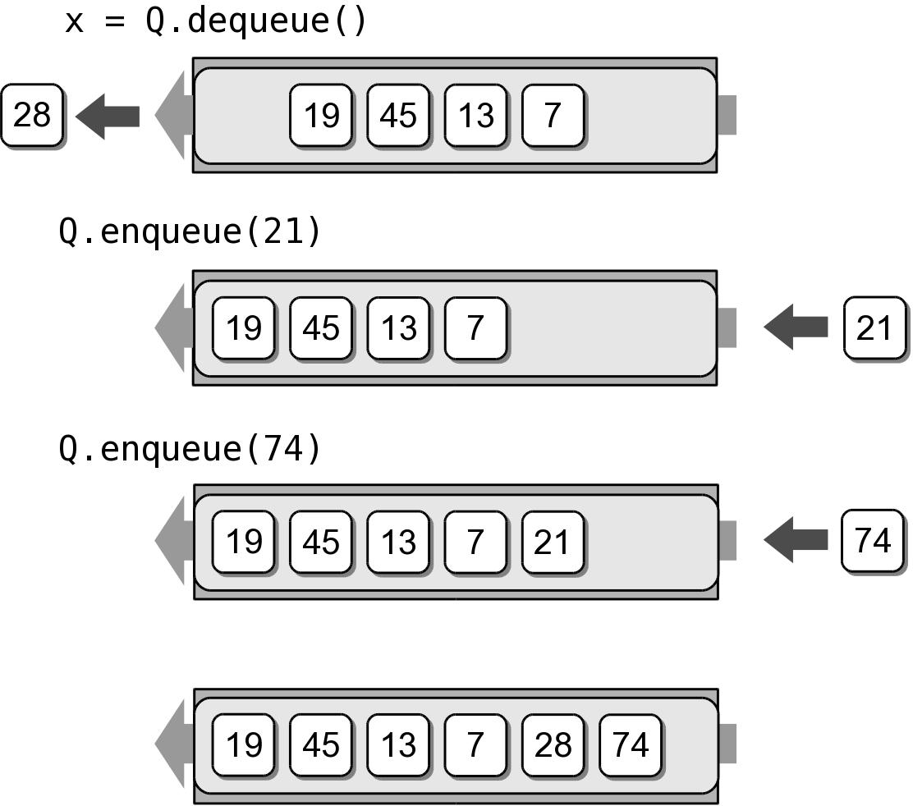
Queue Example
We can remove items from the queue and add more items.
x = Q.dequeue()
Q.enqueue( 21 )
Q.enqueue( 74 )

Slide 6
Queue Implementation
Several common ways to implement a stack:
  Python list
    easiest to implement
  Linked list
    reduces memory wastes by eliminating the extra capacity created with a vector.
  Circular array
    fast operations with a fixed size queue.

Slide 7
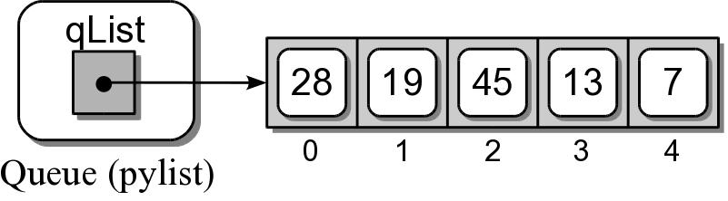
Queue: Python List
How is the data organized within the Python list?
  Add new items to the end of the list.
  Remove items from the front of the list.

Slide 8
Queue: Python List
pylistqueue.py
# Implementation of the Queue ADT using a Python list.
class Queue :
def __init__( self ):
self._qList = list()
def isEmpty( self ):
return len( self ) == 0
def __len__( self ):
return len( self._qList )
def enqueue( self, item ):
self._qList.append( item )
def dequeue( self ):
assert not self.isEmpty(), "Cannot dequeue from an empty queue."
return self._qList.pop( 0 )

Slide 9
Queue Analysis: Python List
Queue Operation | Worst Case
q = Queue() | O(1)
len(q) | O(1)
q.isEmpty() | O(1)
q.enqueue(x) | O(n)
x = q.dequeue() | O(n)

Slide 10
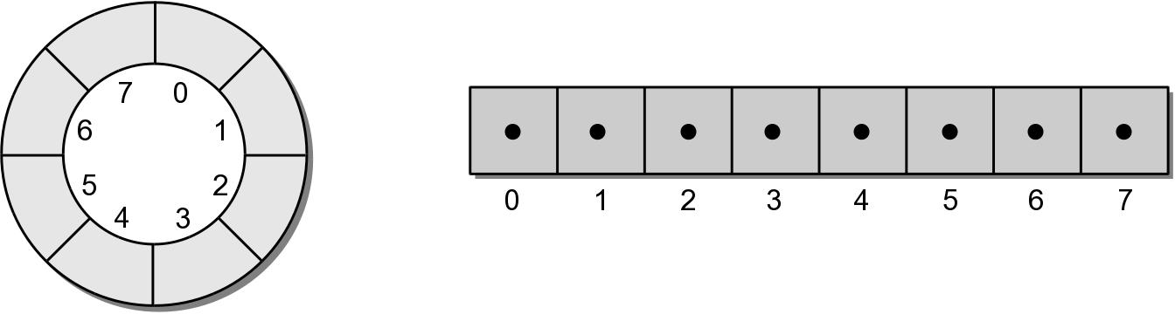
Queue: Circular Array
circular array – an array viewed as a circle instead of a line.
  Items can be added/removed without having to shift the remaining items in the process.
  Introduces the concept of a maximum-capacity queue that can become full.

Slide 11
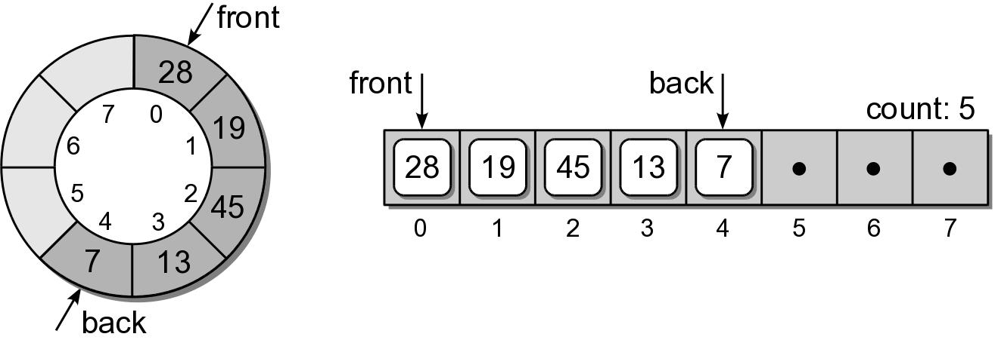
Queue: Circular Array
How should the data be organized within the array?
  count field – number of items in the queue.
  front and back markers – indicate the array elements containing the queue items.

Slide 12
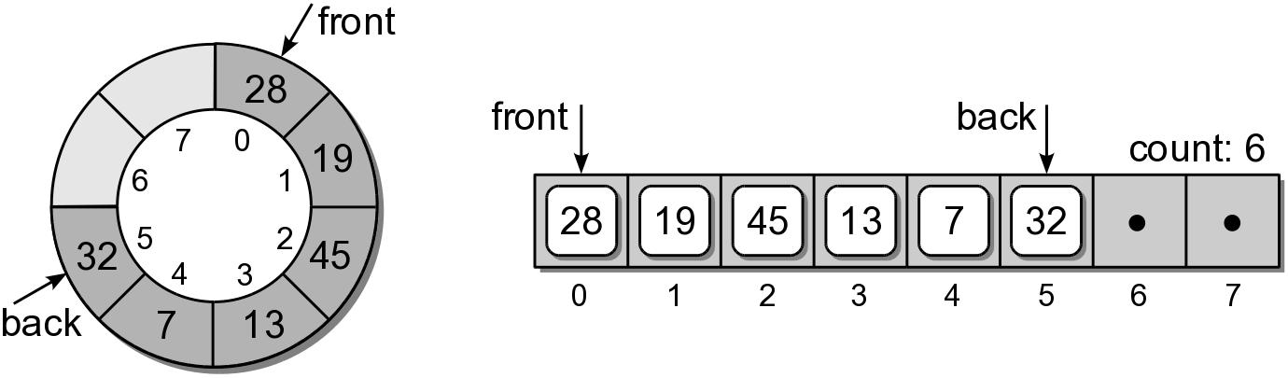
Queue: Circular Array
To enqueue an item:
  new item is inserted at the position following back
  back is advanced by one position
  count is incremented by one.
Suppose we enqueue 32:

Slide 13
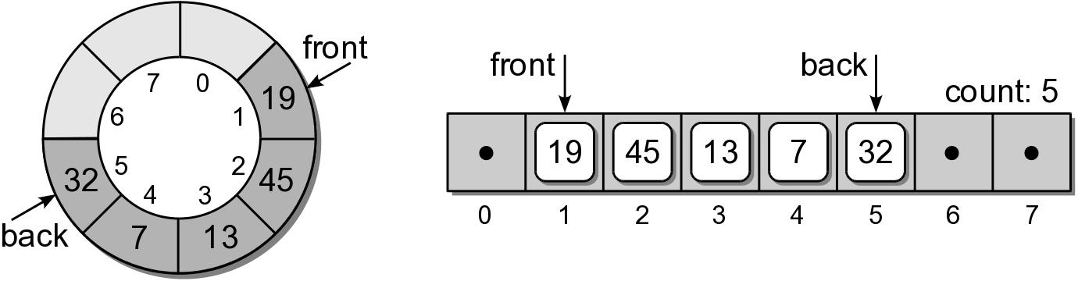
Queue: Circular Array
To dequeue an item:
  the value in the front position is saved
  front is advanced by one position.
  count is decremented by one.
Suppose we dequeue an item:

Slide 14
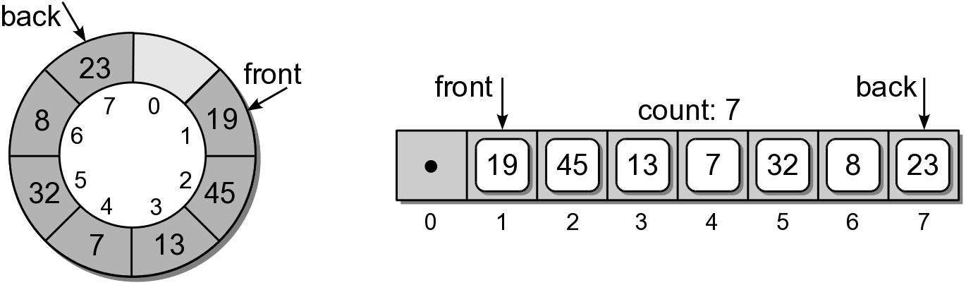
Queue: Circular Array
Suppose we enqueue items 8 and 23:

Slide 15
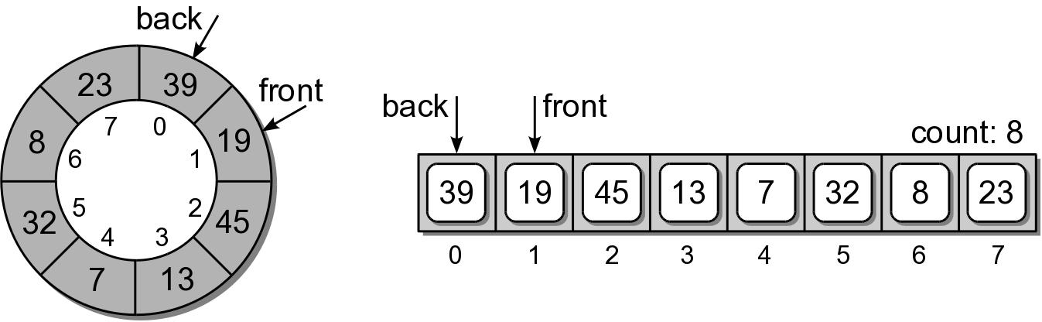
Queue: Circular Array
What happens if we enqueue 39?
  Since we are using a circular array, the same steps are followed.
  But since back is at the end of the array, it wraps around to the front.

Slide 16
Queue: Circular Array
arrayqueue.py
class Queue :
def __init__( self, maxSize ) :
self._count = 0
self._front = 0
self._back = maxSize - 1
self._qArray = Array( maxSize )
def isEmpty( self ) :
return self._count == 0
# A new operation specifically for the circular array.
def isFull( self ) :
return self._count == len(self._qArray)
def __len__( self ) :
return self._count
# ...

Slide 17
Queue: Circular Array
arrayqueue.py
class Queue :
# ...
def enqueue( self, item ):
assert not self.isFull(), "Cannot enqueue to a full queue."
maxSize = len(self._qArray)
self._back = (self._back + 1) % maxSize
self._qArray[self._back] = item
self._count += 1
def dequeue( self ):
assert not self.isEmpty(), "Cannot dequeue from an empty queue."
item = self._qArray[ self._front ]
maxSize = len(self._qArray)
self._front = (self._front + 1) % maxSize
self._count -= 1
return item

Slide 18
Queue Analysis: Circular Array
Queue Operation | Worst Case
q = Queue() | O(1)
len(q) | O(1)
q.isEmpty() | O(1)
q.enqueue(x) | O(1)
x = q.dequeue() | O(1)

Slide 19
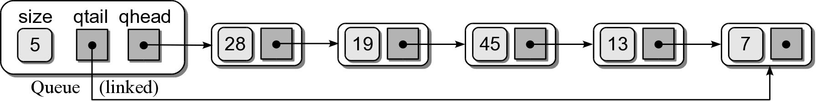
Queue: Linked List
How should the data be organized?
  Use both head and tail references.
  Let the head of the list represent the front of the queue and the tail the back.

Slide 20
Queue: Linked List
llistqueue.py
# Implementation of the Queue ADT using a linked list.
class Queue :
def __init__( self ):
self._qhead = None
self._qtail = None
self._count = 0
def isEmpty( self ):
return self._qhead is None
def __len__( self ):
return self._count
# ...
# Private storage class for creating the linked list nodes.
class _QueueNode:
def __init__( self, item ):
self.item = item
self.next = None

Slide 21
Queue: Linked List
llistqueue.py
class Queue :
# ...
def enqueue( self, item ):
node = _QueueNode( item )
if self.isEmpty() :
self._qhead = node
else :
self._qtail.next = node
self._qtail = node
self._count += 1
def dequeue( self ):
assert not self.isEmpty(), "Cannot dequeue from an empty queue."
node = self._qhead
if self._qhead is self._qtail :
self._qtail = None
self._qhead = self._qhead.next
self._count -= 1
return node.item

Slide 22
Queue Analysis: Linked List
Queue Operation | Worst Case
q = Queue() | O(1)
len(q) | O(1)
q.isEmpty() | O(1)
q.enqueue(x) | O(1)
x = q.dequeue() | O(1)

Slide 23
Priority Queues
Some applications require the use of a queue in which items are assigned a priority.
  higher priority items are dequeued first.
  items with equal priority still follow FIFO.
Two types:
  bounded – limited range of priorities.
  unbounded – unlimited range.

Slide 24
The Priority Queue ADT
A priority queue is a queue in which each item is assigned a priority and items with a higher priority are removed before those with lower priority.
  Integer values are used for the priorities.
  Smaller integers have a higher priority.
PriorityQueue() BpriorityQueue( numLevels ) isEmpty() length() enqueue( item, priority ) dequeue()

Slide 25
Priority Queue Example
Consider the following code segment:
Q = BpriorityQueue( 6 )
Q.enqueue( “purple”, 5 )
Q.enqueue( “black”, 1 )
Q.enqueue( “orange”, 3 )
Q.enqueue( “white”, 0 )
Q.enqueue( “green”, 1 )
Q.enqueue( “yellow”, 5 )

Slide 26
Priority Queue Implementation
How should the ADT be implemented. We must consider:
  A priority must be associated with each item in the queue.
  The next item dequeued is the item with the highest priority.
  If multiple items have the same priority, those must be dequeued in a FIFO order.

Slide 27
Unbounded Priority Queue
We explore two approaches:
  Python list
  Linked list

Slide 28
Unbounded Priority Q: Python List
We can use a Python list to implement the unbounded Priority Queue ADT.
  How do we associate a priority with each item?
  How should the entries be organized?
    append new items to the end, or
    keep the items in sorted order based on priority.
class PriorityQEntry :
def __init__( self, item, priority ):
self.item = item
self.priority = priority

Slide 29
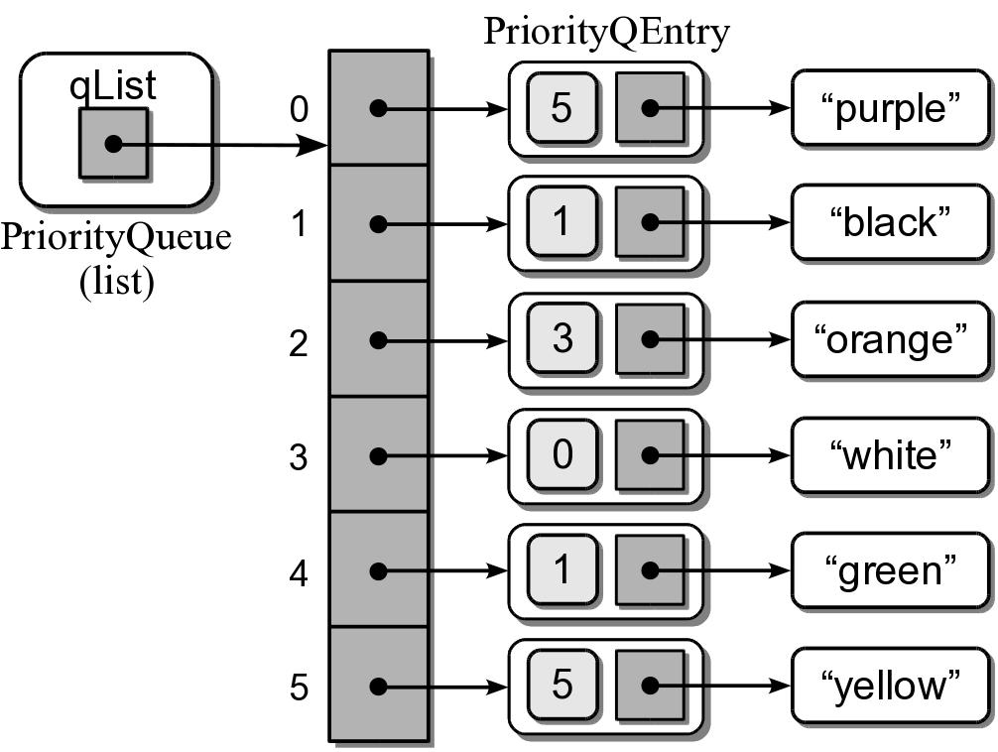
Unbounded Priority Q: Python List
Sample instance for the earlier priority queue.

Slide 30
Unbounded Priority Q: Python List
priorityq.py
# Implementation of the unbounded Priority Queue ADT using a Python
# list with new items appended to the end.
class PriorityQueue :
def __init__( self ):
self._qList = list()
def isEmpty( self ):
return len( self ) == 0
def __len__( self ):
return len( self._qList )
# ...

Slide 31
Unbounded Priority Q: Python List
priorityq.py
class PriorityQueue :
# ...
def enqueue( self, item, priority ):
entry = _PriorityQEntry( item, priority )
self._qList.append( entry )
def dequeue( self ) :
assert not self.isEmpty(), "Cannot dequeue from an empty queue."
# Find the entry with the highest priority.
highest = self._qList[i].priority
for i in range( self.len() ) :
if self._qList[i].priority < highest :
highest = self._qList[i].priority
# Remove the entry with the highest priority and return the item.
entry = self._qList.pop( highest )
return entry.item

Slide 32
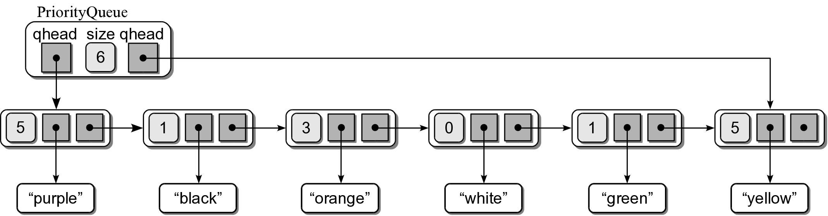
Unbounded Priority Q: Linked List
We can use a singly linked list:
  Head and tail references.
  Append new entries to the end.

Slide 33
Priority Queue Analysis
The worst case analysis for the two implementations.
Queue Operation | Python List | Linked List
q = PriorityQueue() | O(1) | O(1)
len(q) | O(1) | O(1)
q.isEmpty() | O(1) | O(1)
q.enqueue(x) | O(n) | O(1)
x = q.dequeue() | O(n) | O(n)

Slide 34
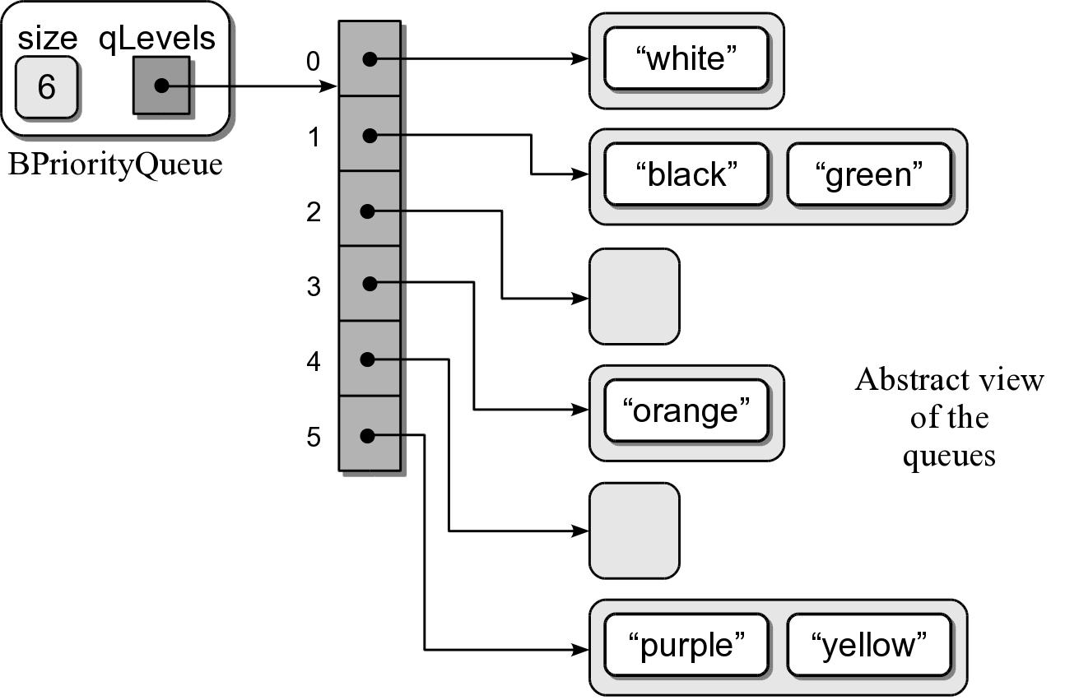
Bounded Priority Queue
We can use the Python list or linked list to implement the bounded Priority Queue.
  Both require linear time to dequeue an item.
  We can improve this time using an array of queues.

Slide 35
Bounded Priority Q Implementation
bpriorityq.py
from array import Array
from llistqueue import Queue
class BPriorityQueue :
def __init__( self, numLevels ):
self._qSize = 0
self._qLevels = Array( numLevels )
for i in range( numLevels ) :
self._qLevels[i] = Queue()
def isEmpty( self ):
return len( self ) == 0
def __len__( self ):
return len( self._qSize )
# ...

Slide 36
Bounded Priority Q Implementation
bpriorityq.py
class BPriorityQueue :
# ...
def enqueue( self, item, priority ):
assert priority >= 0 and priority < len(self._qLevels), \
"Invalid priority level."
self._qLevels[priority].enqueue( item )
def dequeue( self ) :
# Make sure the queue is not empty.
assert not self.isEmpty(), "Cannot dequeue from an empty queue."
# Find the first non-empty queue.
i = 0
p = len(self._qLevels)
while i < p and not self._qLevels[i].isEmpty() :
i += 1
# We know the queue is not empty, so dequeue from the ith queue.
return self._qLevels[i].dequeue()

Slide 37
Computer Simulations
Computers can be used to model and simulate real-world systems and phenomena.
  Computer applications.
  Designed to represent and react to significant events in the system.
Examples:
  Weather forecasting
  Flight simulators
  Business activities

Slide 38
Airline Ticket Counter
How many ticket agents are needed at certain times of the day in order to provide timely service?
  Too many agents will cost the airline money.
  Too few will result in angry customers.
A computer simulation can be developed to model this real system.

Slide 39
Queuing System
A system where customers must stand in line awaiting service.
  A queue structure is used to model the system.
  Simple systems only require a single queue.
  The goal is to study certain behaviors or outcomes.
    average wait time
    average queue length
    average service time

Slide 40
Discrete Event Simulation
Consists of a sequence of significant events that cause a change in the system.
  Time driven and performed over a preset time period.
  Passing of time is represented by a loop, one iteration per clock tick.
  Events can only occur at discrete time intervals.
  Time units must be small enough to accommodate the events.

Slide 41
Sample Events
Some sample events include:
  Customer arrival
  Start or end of a transaction (service)
  Customer departure

Slide 42
System Parameters
A simulation is commonly designed to allow user supplied parameters to define conditions:
  Length of the simulation (begins at time 0).
  Number of servers.
  Expected time to complete a transaction.
  Distribution of arrival times.
By adjusting these, the conditions can be changed under which the simulation is performed.

Slide 43
Event Rules
A set of rules are defined for handling the events during each tick of the clock.
The specific rules depend on what is being studied.

Slide 44
Sample Event Rules
To determine the average wait time:
  If a customer arrives, he is added to the queue.
    at most one customer can arrive per time step.
  If there are free servers and customers waiting, the next customer in line begins her transaction.
    we begin a transaction for each free server.
  If a transaction ends, the customer departs and the server becomes free.
    multiple transactions can complete in one time step.

Slide 45
Random Events
To correctly model a queuing system, some events must occur at random. (i.e. customer arrival)
We need to model this action as close as possible.
  Specify the odds of a customer arriving at each time step as the average time between arrivals.
  Use a random number generator to produce a value.
  Compare the value to the average arrival time.

Slide 46
Sample Simulation
Analyze the average time passengers have to wait for service at an airport ticket counter.
  Multiple ticket agents.
  Multiple customers that must wait in a single line.

Slide 47
System Inputs
The program will prompt the user for the queuing system parameters.
For simplicity, we use minutes as the discrete time units.
Number of minutes to simulate: 25
Number of ticket agents: 2
Average service time per passenger: 3
Average time between passenger arrival: 2

Slide 48
System Outputs
After performing the simulation, the program will produce the following output:
Number of passengers served = 12
Number of passengers remaining in line = 1
The average wait time was 1.17 minutes.

Slide 49
Debug Info
We also display event information that can help verify the validity of the program.
Time 2: Passenger 1 arrived.
Time 2: Agent 1 started serving passenger 1.
Time 3: Passenger 2 arrived.
Time 3: Agent 2 started serving passenger 2.
Time 5: Passenger 3 arrived.
Time 5: Agent 1 stopped serving passenger 1.
Time 6: Agent 1 started serving passenger 3.
Time 6: Agent 2 stopped serving passenger 2.
Time 8: Passenger 4 arrived.
Time 8: Agent 2 started serving passenger 4.
Time 9: Agent 1 stopped serving passenger 3.
Time 10: Passenger 5 arrived.
Time 10: Agent 1 started serving passenger 5.
Time 11: Passenger 6 arrived.
Time 11: Agent 2 stopped serving passenger 4.
Time 12: Agent 2 started serving passenger 6.
Time 13: Passenger 7 arrived.

Slide 50
Class Organization
Our design will be an object-oriented solution with multiple classes.
  Passenger – store info related to a passenger.
  TicketAgent – store info related to an agent.
  TicketCounterSimulation – manages the actual simulation.

Slide 51
Passenger Class
simpeople.py
class Passenger :
# Creates a passenger object.
def __init__( self, idNum, arrivalTime ):
self._idNum = idNum
self._arrivalTime = arrivalTime
# Gets the passenger's id number.
def idNum( self ) :
return self._idNum
# Gets the passenger's arrival time.
def timeArrived( self ) :
return self._arrivalTime

Slide 52
TicketAgent Class
simpeople.py
class TicketAgent :
def __init__( self, idNum ):
self._idNum = idNum
self._passenger = None
self._stopTime = -1
def idNum( self ):
return self._idNum
def isFree( self ):
return self._passenger is None
def isFinished( self, curTime ):
return self._passenger is not None and self._stopTime == curTime
def startService( self, passenger, stopTime ):
self._passenger = passenger
self._stopTime = stopTime
def stopService( self ):
thePassenger = self._passenger
self._passenger = None
return thePassenger

Slide 53
The Simulation Class
simulation.py
from array import Array
from llistqueue import Queue
from people import TicketAgent, Passenger
class TicketCounterSimulation :
def __init__( self, numAgents, numMinutes,
betweenTime, serviceTime ):
# Parameters supplied by the user.
self._arriveProb = 1.0 / betweenTime
self._serviceTime = serviceTime
self._numMinutes = numMinutes
# Simulation components.
self._passengerQ = Queue()
self._theAgents = Array( numAgents )
for i in range( numAgents ) :
self._theAgents[i] = TicketAgent(i+1)
# Computed during the simulation.
self._totalWaitTime = 0
self._numPassengers = 0
# ...

Slide 54
The Simulation Class
simulation.py
class TicketCounterSimulation :
# ...
# Run the simulation using the parameters supplied earlier.
def run( self ):
for curTime in range(self._numMinutes + 1) :
self._handleArrival( curTime )
self._handleBeginService( curTime )
self._handleEndService( curTime )
# Print the simulation results.
def printResults( self ):
numServed = self._numPassengers - len(self._passengerQ)
avgWait = float( self._totalWaitTime ) / numServed
print( "" )
print( "Number of passengers served = ", numServed )
print( "Number of passengers remaining in line = %d" %
len(self._passengerQ) )
print( "The average wait time was %4.2f minutes." % avgWait )
# The remaining methods that have yet to be implemented.
# def _handleArrive( curTime ): # Handles simulation rule #1.
# def _handleBeginService( curTime ): # Handles simulation rule #2.
# def _handleEndService( curTime ): # Handles simulation rule #3.

Slide 55
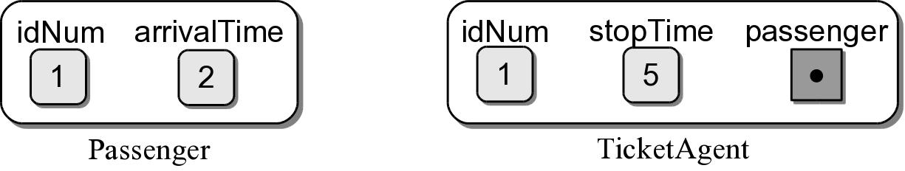
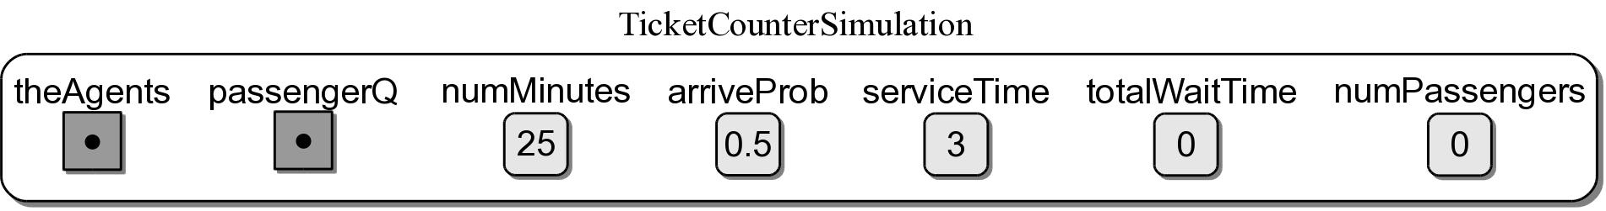
Simulation Objects
Sample instances of each class.

Slide 56
Sample Results
Num Minutes | Num Agents | Avg Service | Time Between | Avg Wait | Passengers Served | Passengers Remaining
100 | 2 | 3 | 2 | 2.49 | 49 | 2
500 | 2 | 3 | 2 | 3.91 | 240 | 0
1000 | 2 | 3 | 2 | 10.93 | 490 | 14
5000 | 2 | 3 | 2 | 15.75 | 2459 | 6
10000 | 2 | 3 | 2 | 21.17 | 4930 | 18
100 | 2 | 4 | 2 | 10.60 | 40 | 11
500 | 2 | 4 | 2 | 49.99 | 200 | 40
1000 | 2 | 4 | 2 | 95.72 | 400 | 104
5000 | 2 | 4 | 2 | 475.91 | 2000 | 465
10000 | 2 | 4 | 2 | 949.61 | 4000 | 948
100 | 3 | 4 | 2 | 0.51 | 51 | 0
500 | 3 | 4 | 2 | 0.50 | 240 | 0
1000 | 3 | 4 | 2 | 1.06 | 501 | 3
5000 | 3 | 4 | 2 | 1.14 | 2465 | 0
10000 | 3 | 4 | 2 | 1.21 | 4948 | 0

