Slide 1
Advanced Linked Lists
Chapter 9

Slide 2
Review
The singly linked list:
  consists of nodes linked in a single direction.
  access and traversals begin with the first node.
What if we want to traverse the nodes in reverse order?

Slide 3
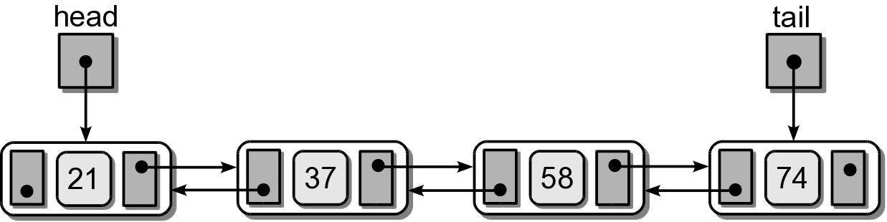
Doubly Linked List
A linked list in which each node contains a data component(s) and two links:
  one pointing the next node and
  one pointing to the preceding node.

Slide 4
Doubly Linked: Order
Can be unsorted or sorted based on a key value.
  Operations on the unsorted version are very similar to those of a singly linked list.
  We limit our discussion to the sorted doubly linked list.

Slide 5
Doubly Linked Nodes
The node storage class is similar to that of a singly linked list.
class DListNode :
def __init__( self, data ):
self.data = data
self.next = None
self.prev = None

Slide 6
Doubly Linked: Traversing
Traversals can be in either order.
  Forward is the same as with a singly linked list.
  Reverse order is similar but the prev link is followed.
def revTraversal( tail ):
curNode = tail
while curNode is not None :
print( curNode.data )
curNode = curNode.prev

Slide 7
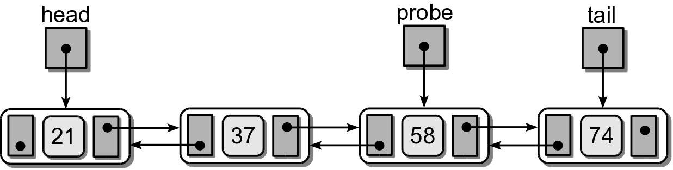
Doubly Linked: Search
Normal searching based on key value is the same as searching a singly linked list.
Doubly linked lists provide an additional advantage.
  We can search both forwards and backwards.
  Use and maintain a probe reference.

Slide 8
Doubly Linked: Probing
Use the probe reference for searching.
  After a search, keep the reference where it left off.
  On the next search, we can search either forwards or backwards based on the target value.

Slide 9
Doubly Linked: Probing
# Make sure the list is not empty.
if head is None :
return False
# If probe is null, initialize it to the first node.
elif probe is None :
probe = head
# If the target comes before the probe node, we traverse backward
if target < probe.data :
while probe is not None and target <= probe.data :
if target == probe.data :
return True
else :
probe = probe.prev
else : # otherwise traverse forward.
while probe is not None and target >= probe.data :
if target == probe.data :
return True
else :
probe = probe.next
# If the target is not found in the list, return False.
return False

Slide 10
Doubly Linked: Insert
Locate the position for the new node, then connect the links.
  There are three possible cases.
  No need for a second temporary reference.
  Connections must be made in a specific order.

Slide 11
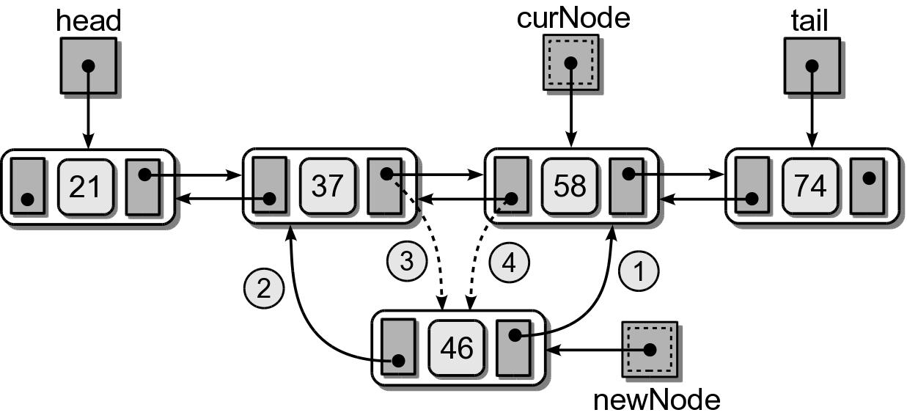
Doubly Linked: Insert
(1) Insert in the middle.

Slide 12
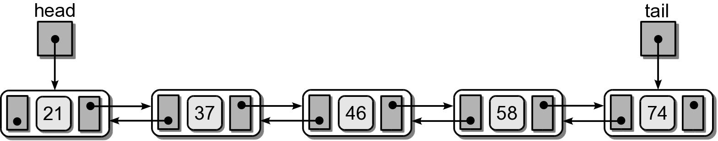
Doubly Linked: Insert
Result after the insertion.

Slide 13
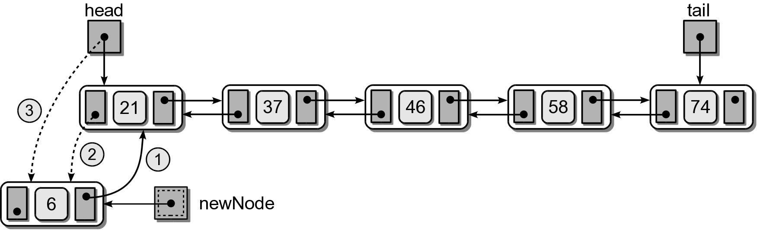
Doubly Linked: Insert
(2) Insert at the front.

Slide 14
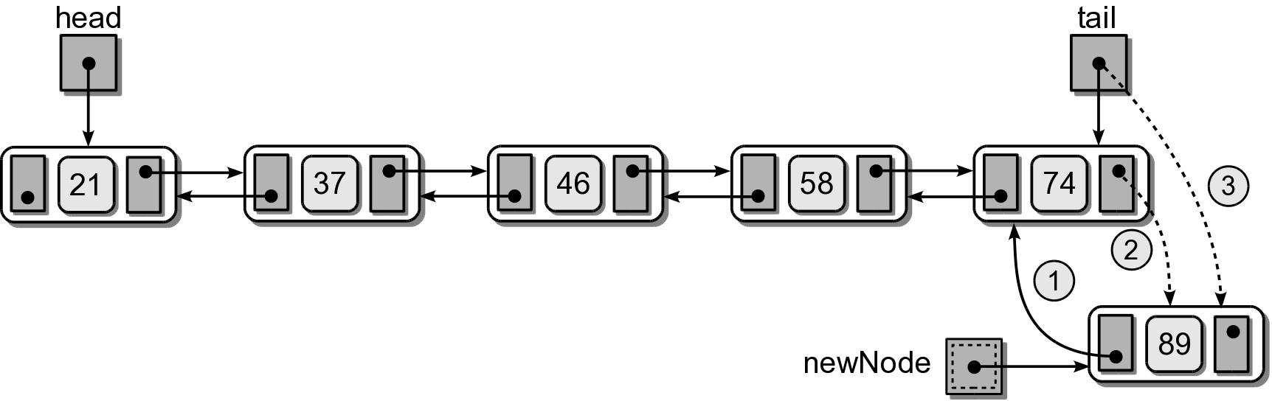
Doubly Linked: Insert
(2) Insert at the end.

Slide 15
Doubly Linked: Insert
# Add a new value given a head and tail reference
newnode = DListNode( value )
if head is None : # empty list
head = newnode
tail = head
elif value < head.data : # insert before head
newnode.next = head
head.prev = newnode
head = newnode
elif value > tail.data : # insert after tail
newnode.prev = tail
tail.next = newnode
tail = newnode
else : # insert in the middle
node = head
while node is not None and node.data < value :
node = node.next
newnode.next = node
newnode.prev = node.prev
node.prev.next = newnode
node.prev = newnode

Slide 16
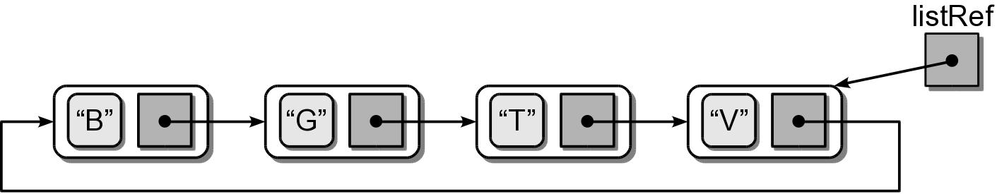
Circular Linked List
Another variation of the linked list in which the nodes form a continuous circle.
  Allows for a complete traversal from any initial node.
  Used with round-robin type applications.
  The external reference can point to any node in the list. Common to reference “end” of the list.

Slide 17
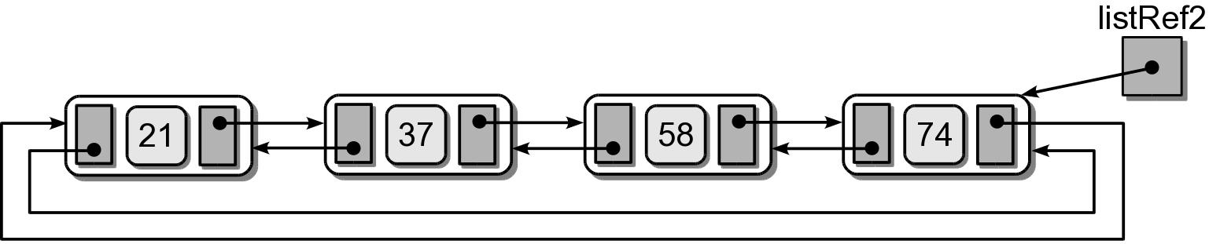
Circular Linked List
A circular linked list can also be doubly linked.

Slide 18
Circular Linked: Traverse
A traversal can start from any node, but it must visit every node.
def traverse( listRef ):
curNode = listRef
done = listRef is None
while not done :
curNode = curNode.next
print( curNode.data
done = curNode is listRef

Slide 19
Circular Linked: Searching
Searching a circular linked list is similar to the traversal operation.
def searchCircularList( listRef, target ):
curNode = listRef
done = listRef is None
while not done :
curNode = curNode.next
if curNode.data == target :
return True
else :
done = curNode is listRef or\
curNode.data > target
return False :

Slide 20
Circular Linked: Inserting
Adding nodes is very similar to that of the sorted singly linked list.
  Unsorted list – common to add the node following the listRef.
  Sorted list – new node is placed in proper position.
    Can be divided into four cases.

Slide 21
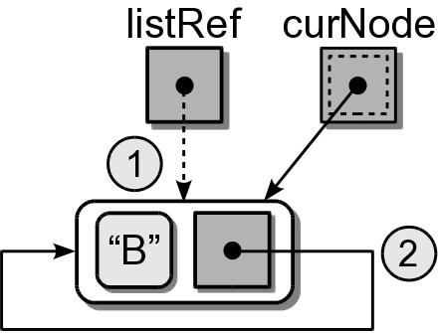
Circular Linked: Inserting
(1) Insert into an empty list.
...
if listRef is None :
listRef = newNode
newNode.next = newNode

Slide 22
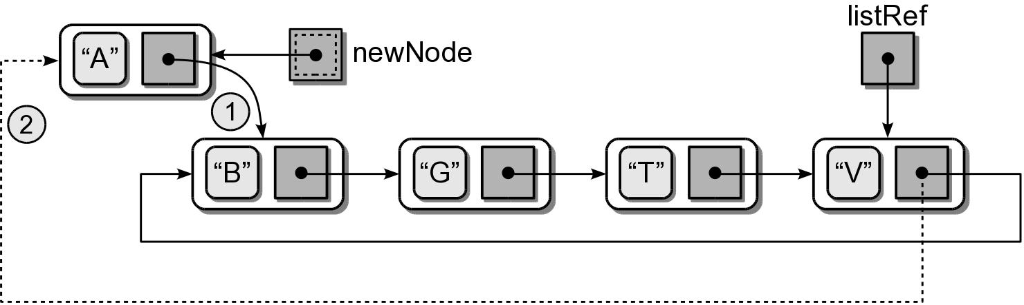
Circular Linked: Inserting
(2) Insert at the “front” (one node past listRef)
...
if value < listRef.next.data :
newNode.next = listRef.next
listRef.next = newNode

Slide 23
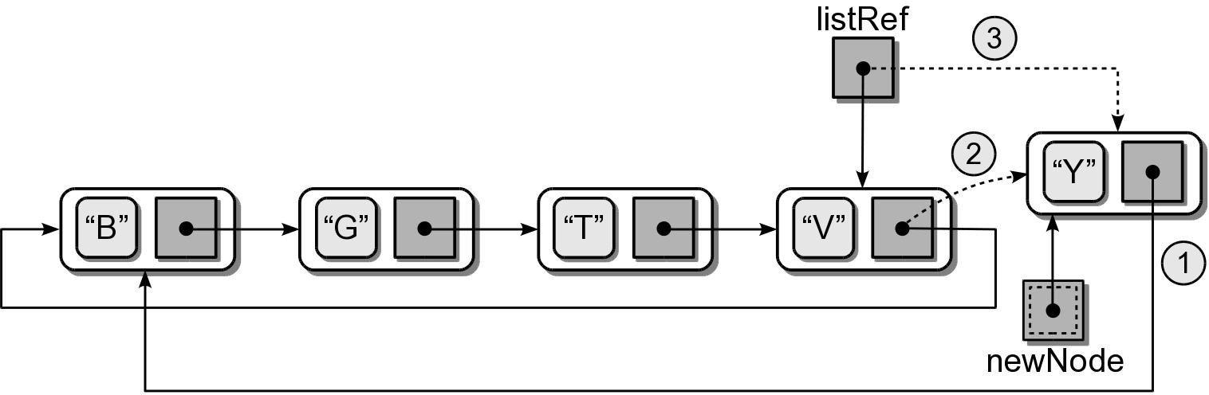
Circular Linked: Inserting
(3) Insert at the “end” (adjust listRef)
...
if value > listRef.next.data :
newNode.next = listRef.next
listRef.next = newNode
listRef = newNode

Slide 24
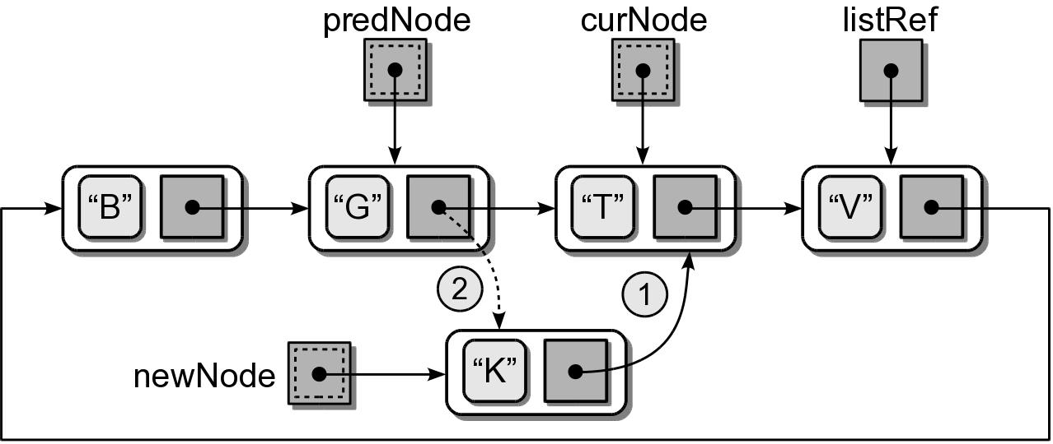
Circular Linked: Inserting
(4) Insert in the middle.

Slide 25
Circular Linked: Inserting
newnode = ListNode( value )
if listRef is None : # empty list
listRef = newNode
newNode.next = newNode
elif value < listRef.next.data : # insert in front
newNode.next = listRef.next
listRef.next = newNode
elif value > listRef.data : # insert in back
newNode.next = listRef.next
listRef.next = newNode
listRef = newNode
else : # insert in the middle
# Position the two pointers.
predNode= None
curNode = listRef
done = listRef is None
while not done :
predNode = curNode
predNode = curNode.next
done = curNode is listRef or curNode.data > target
# Adjust links to insert the node.
newNode.next = curNode
predNode.next = newNode

Slide 26
Multi-Linked Lists
A linked list in which each node contains multiple link fields.
  Used to create multiple chains within the same collection of nodes.
  Each chain has its own head reference.
The doubly linked list is a special case of the multi-linked list.

Slide 27
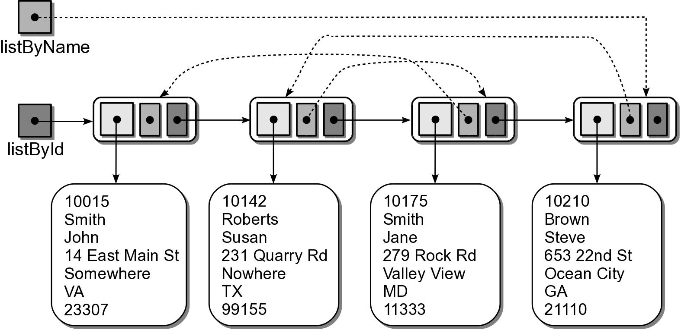
Multiple Chains
Multiple keys and multiple lines are used to create chains through one set of nodes.

Slide 28
Multi-linked Nodes
The storage class contains the data and one link field for each chain.
class StudentMListNode :
def __init__( self, data ):
self.data = data
self.nextById = None
self.nextByName = None

Slide 29
Multi-Linked Operations
Traversal and search
  Can be performed on any chain.
  Depends on the application.
Adding nodes:
  Create an initialize a single node.
  Add the node to each chain.

Slide 30
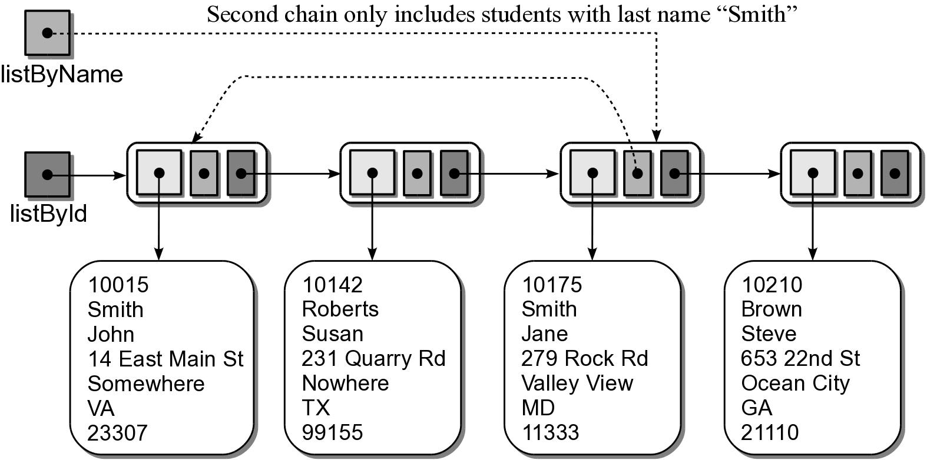
Multi-Linked Example
The chains do not all have to form complete lists.
  Common for at least one chain to contain all nodes in the list.

Slide 31
Sparse Matrix Revisited
Alternative implementation uses multi-linked lists.
  Provides convenient traversals of both rows and columns.
  The nodes are linked by two chains.
  Requires two arrays of linked lists.
  Individual elements can be accessed by traversing either the row or column chain.

Slide 32
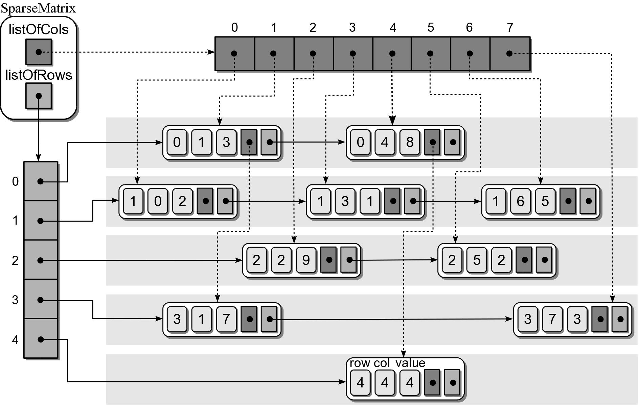
Sparse Matrix Object
A sample instance of the new sparse matrix implementation.

Slide 33
Sparse Matrix Nodes
The multi-linked nodes for the new sparse matrix implementation.
class MatrixMListNode :
def __init__( self, row, col, value ) :
self.row = row
self.col = col
self.value = value
self.nextCol = None
self.nextRow = None

Slide 34
Application: Text Editor
Text editors are very common.
  Can be a complete editor or for a simple input box.
  Must maintain and manage text as user enters, deletes, and manipulates characters.
We define an a simple Edit Buffer ADT.
  Defined independent of the editor.
  Contains operations for storing and manipulating plain text.

Slide 35
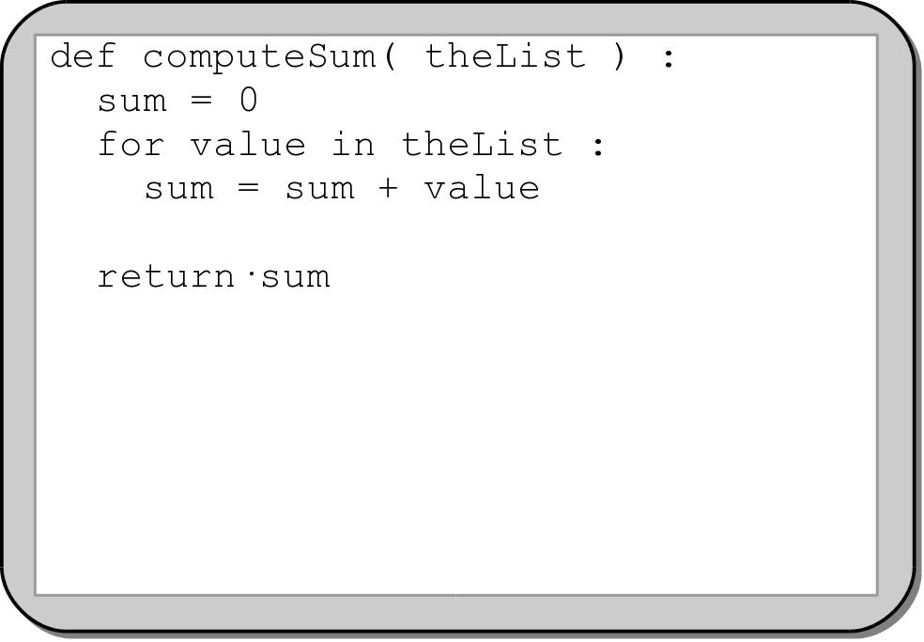
Text Editor: Layout
Text editors typically work with an abstract view of the text document.

Slide 36
Text Editor: Layout
Physical storage of the text document depends on the underlying data structure.
When stored on disk, it is a sequential stream of characters.
  Each line of text ends with a \n
  Rows can be of varying sizes.

Slide 37
Text Editor: Cursor
A cursor is used to mark the current position within the document.
  Identified by row and a char offset within the row.
  Insertions and deletions are performed relative to the cursor.
  The cursor can be moved anywhere within the document, but only to a spot containing a character.
We only consider a
keyboard text cursor.

Slide 38
Cursor Movement
Minimum cursor movements:
  Vertical: up or down one or more lines.
    maintains the same horizontal cursor position.
    if the new line is shorter, the cursor is positioned at the end of the line.
  Horizontal: forwards or backwards one or more chars.
    wraps to the end of the previous line or the beginning of the next line.
  Extremes:
    moved to the front or back of the current line or to the beginning or end of the document.
    end of document: moved to front of the last row.

Slide 39
Text Editor: Insert
Use an entry mode of either insert or overwrite.
  insert mode
    new characters are inserted into the text.
    chars on the same line are shifted down following the cursor.
  overwrite mode
    new characters replace existing chars at the cursor position.

Slide 40
Text Editor: Insert
Chars are inserted at the cursor position.
The cursor is moved forward one position after the insertion.
The newline chars used to indicate the end of a line are treated like any other character.
  If new chars are inserted:
    before a \n, the current row is extended.
    after a \n, they are inserted at the front of the next row.
  If a \n is inserted, the current row is split into two.

Slide 41
Text Editor: Delete
Provide both a delete and rub-out operation.
  delete
    the char at cursor position is removed.
    cursor remains at the same position.
  rub-out (backspace)
    removes the char preceding the cursor.
    cursor moves one position to the left.
Both delete a char and shift all following chars on the same line forward one position.

Slide 42
Text Editor: Delete
Deleting newline chars
  When a \n is deleted the current line and the one immediately following are merged.
  The \n at the end of the last row can not be deleted.
Truncating a line
  Remove all chars from he cursor position to the end of the line.
  Does not remove the \n.
Delete a line
  Remove all chars on the current line including \n.

Slide 43
The Edit Buffer ADT
An edit buffer is a text buffer that be used with a text editor for storing and manipulating the text.
  Stores plain text with no special formatting codes.
  Uses \t and \n characters.
  Individual lines are terminated with a \n.
  All operations are performed relative to the current cursor position.
  The cursor can only be positioned where a char currently exists.
  The cursor can never be moved outside the bounds of the document.

Slide 44
The Edit Buffer ADT
EditBuffer() numLines() numChars() lineIndex() columnIndex() setEntryMode( insert ) toggleEntryMode() inInsertMode() getChar() getLine() moveUp( num ) moveDown( num ) moveDocHome() | moveDocEnd() moveLeft() moveRight() moveLineHome() moveLineEnd() breakLine() deleteLine() truncateLine() addChar( char ) deleteChar() ruboutChar() deleteAll()

Slide 45
Edit Buffer Implementation
There are many ways to implement an edit buffer.
We choose a doubly linked list of Python lists.
  Each row will be stored in a node.
  Chars of a line will be in a Python list.
Advantages
  Allows the buffer to dynamically grow or shrink.
  Provides quick line insertions and deletions.

Slide 46
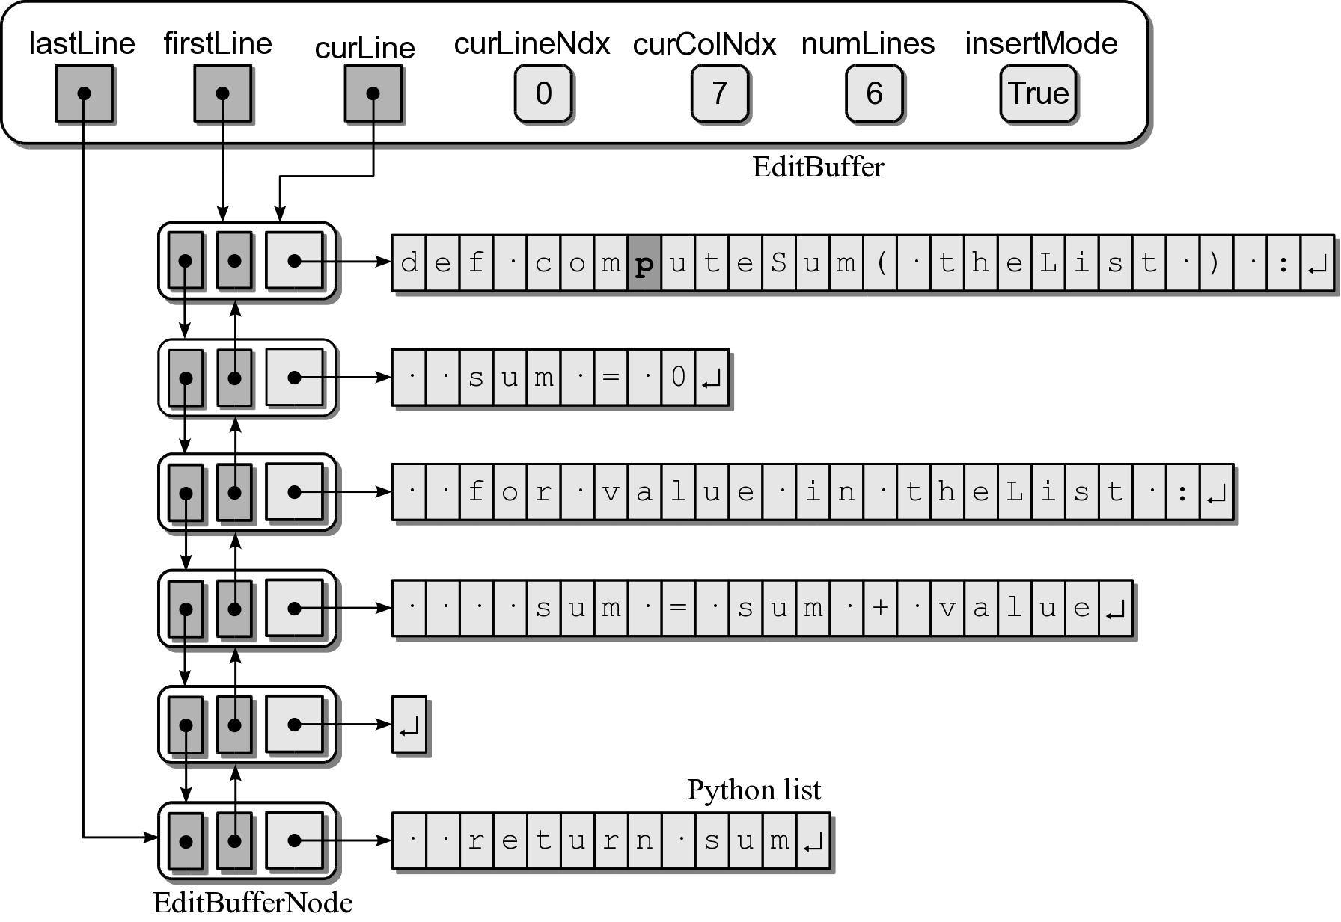
Edit Buffer Object

