Slide 1
Recursion
Chapter 10

Slide 2
Recursion
Recursion is a process for solving problems.
  Subdivides a larger problem into smaller cases of itself.
  Solves the smaller, more trival parts.
Recursion is a powerful tool.
  Can be used with a wide range of problems.
  Not always the most efficient.

Slide 3
Recursive Function
A function (or method) that calls itself and results in a virtual or repetition loop.
def printRev( n ):
if n > 0 :
print( n )
printRev( n-1 )

Slide 4
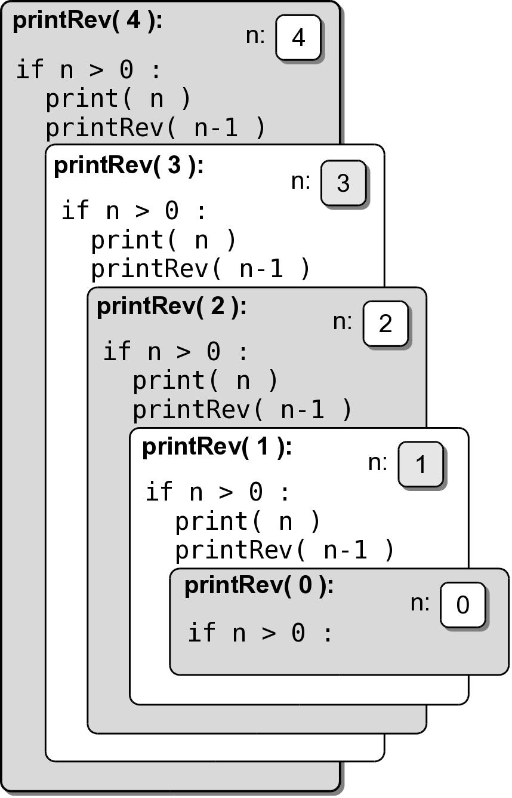
Recursive Flow
If we make the call
recursive calls are made until n == 0.
printRev( 4 )

Slide 5
Local Variables
Each call to a recursive function creates new instances of all local variables.
Changing the contents of a local variable does not affect the contents of the other instances.

Slide 6
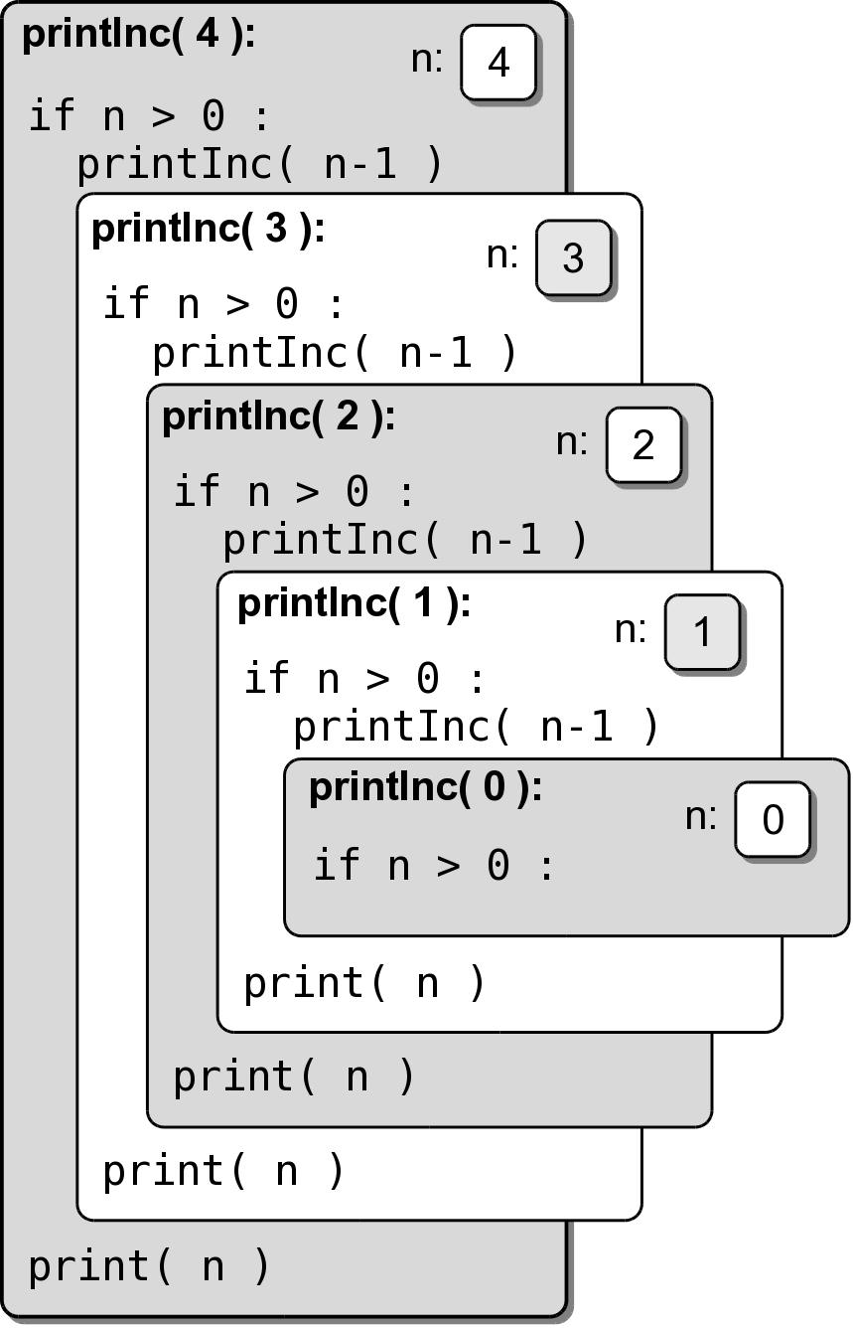
Print In Order
What changes are needed to print the int values in order?
def printInc( n ):
if n > 0 :
printInc( n-1 )
print( n )

Slide 7
Properties of Recursion
All recursive solutions must satisfy three rules or properties:
  must contain a base case.
  must contain a recursive case.
  must make progress toward the base case.

Slide 8
Recursive Solutions
A recursive solution subdivides a problem into smaller versions of itself.
  Must consist of a data set or a term that can be divided into smaller sets or a smaller term.
  The base case is the terminating case and represents the smallest subdivision.
  If a the solution does not make progress toward the base case, the recursion will never end.

Slide 9
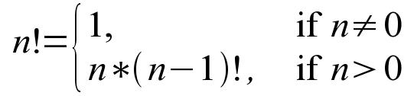
Factorial Example
The factorial function
can be solved recursively
n! = n * (n-1) * (n-2) * ... * 1
def fact( n ):
assert n >= 0, \
"Factorial not defined for negative values."
if n < 2 :
return 1
else :
return n * fact(n - 1)

Slide 10
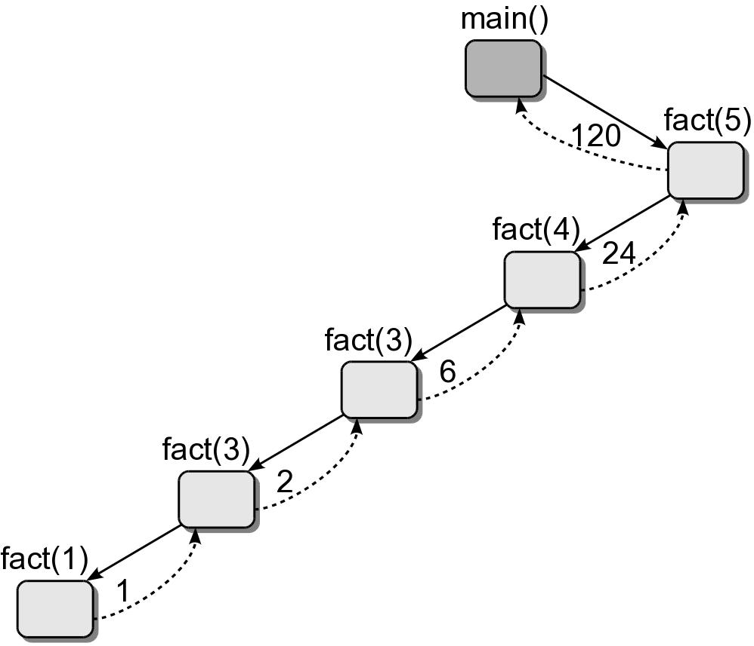
Recursive Call Trees
When developing or evaluating a recursive function, we use a recursive call tree.

Slide 11
Recursive Call Trees
Each box represents a function call.
  Function name.
  Actual arguments used to invoke it.
The directed edges indicate the flow of execution.
  Solid edges indicate function calls.
  Dashed edges indicate function returns.
  Return values of a function shown on dashed lines.

Slide 12
Call Trees: Multiple Calls
If a function makes multiple function calls, each call is indicated in the tree.
def main():
y = foo( 3 )
bar( 2 )
def foo( x ):
if x % 2 != 0 :
return 0
else :
return x + foo( x-1 )
def bar( n ):
if n > 0 :
print( n )
bar( n-1 )
main()

Slide 13
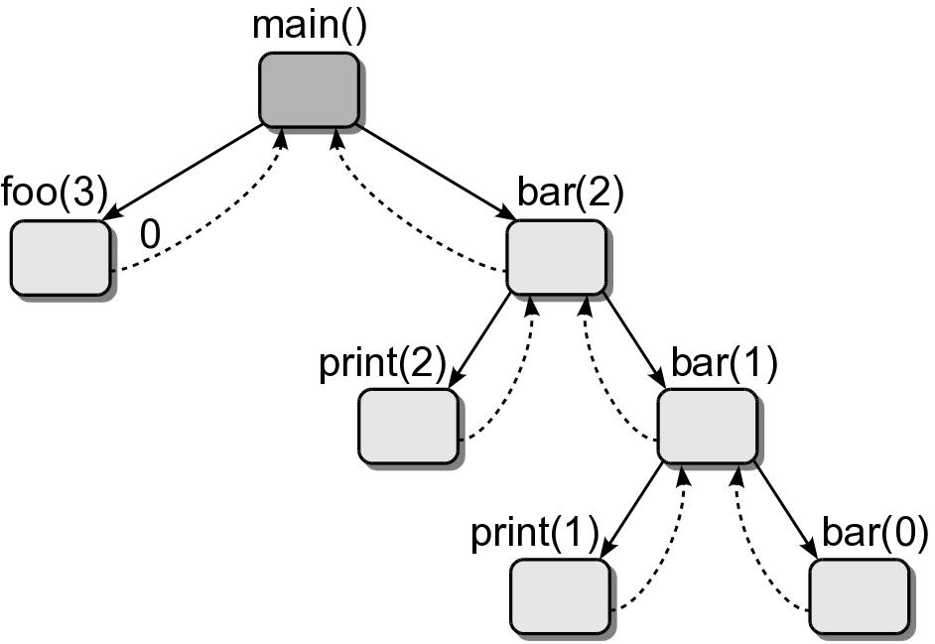
Call Trees: Multiple Calls
The edges are listed left to right in the order the calls are made.

Slide 14
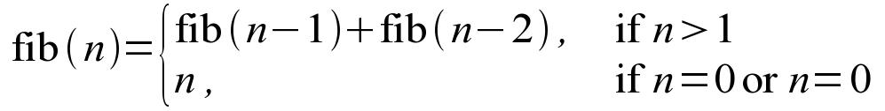
Fibonacci Sequence
The Fibonacci sequence
can be solved recursively
1, 1, 2, 3, 5, 8, 13, 21, 34, 55, 89, ...
def fib( n ):
assert n >= 1, "Fibonacci not defined for n < 1."
if n == 1 :
return 1
else :
return fib(n - 1) + fib(n - 2)

Slide 15
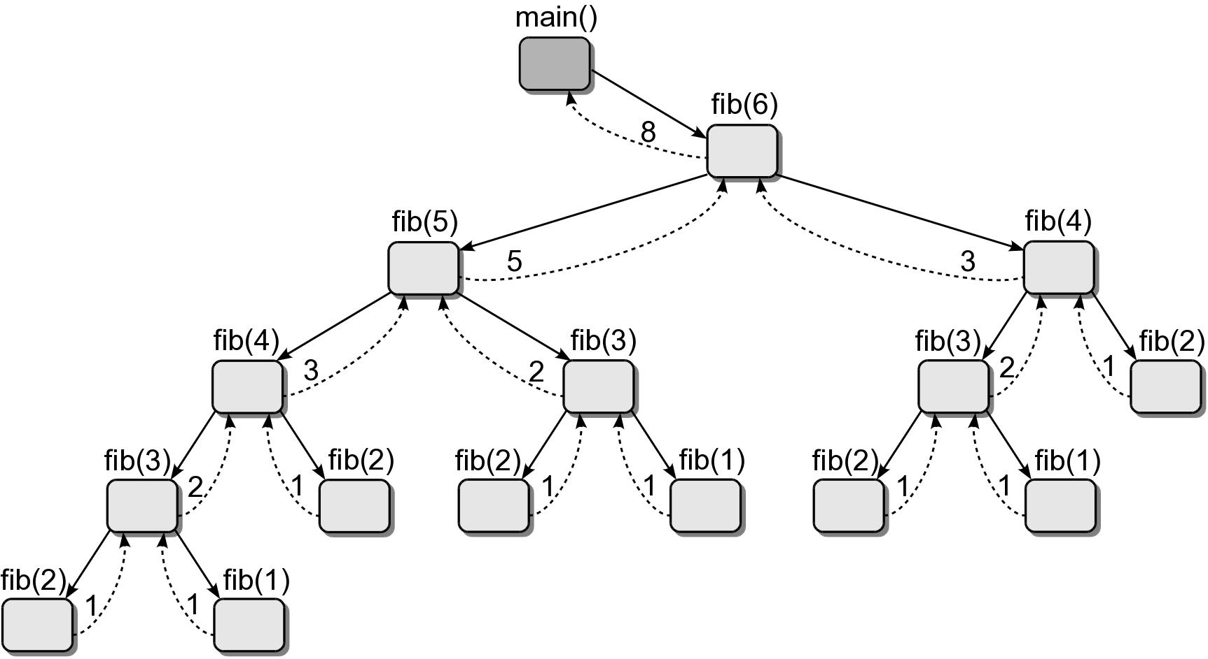
Fibonacci Sequence

Slide 16
How Recursion Works
When a function is called,
  sequential flow of execution is interrupted and jumps to the function.
When a function terminates,
  execution returns to the point where it was interrupted.
How does it know
where to return?

Slide 17
Activation Record
Maintains information related to a function instance.
  storage space for local variables
  return address
Activation records
  created per function call.
  destroyed when the function terminates.

Slide 18
Run Time Stack
The system must manage the activation records.
  Must remember the order they were created.
  Stored on a stack managed by the system.
Activation records
  pushed onto the stack when a function is called.
  popped off the stack when a function terminates.

Slide 19
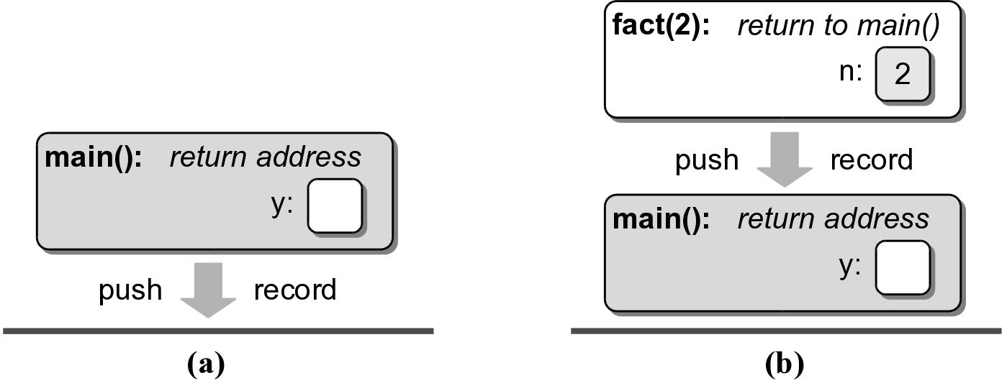
Run Time Stack Example
Consider the execution of the code segment
def main():
y = fact( 5 )
main()

Slide 20
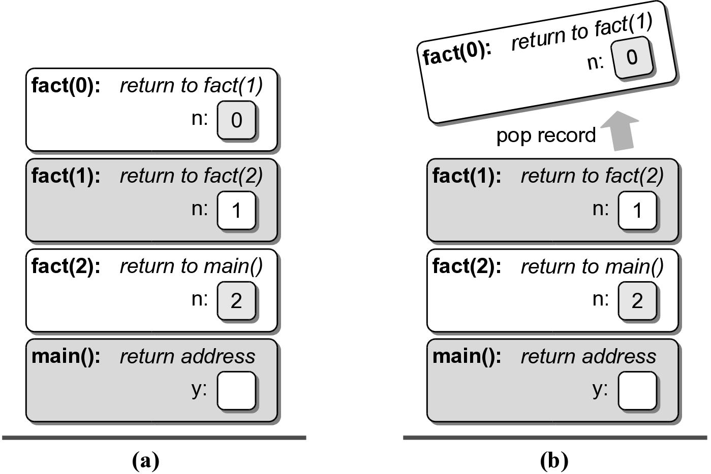
Run Time Stack Example

Slide 21
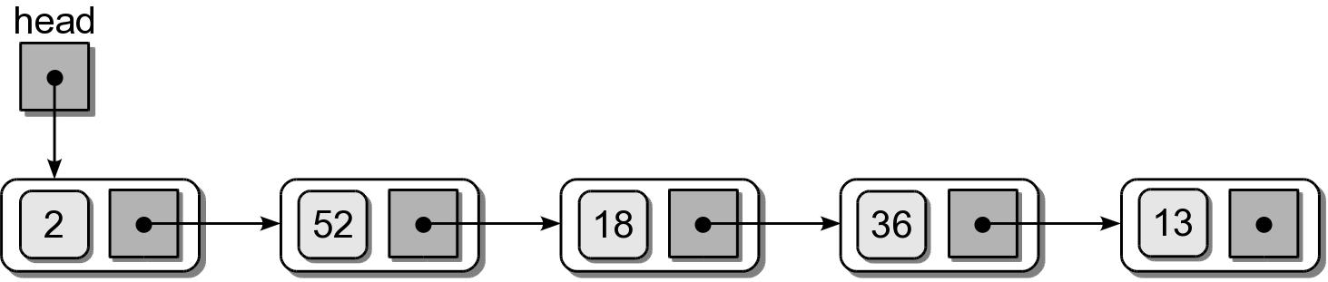
Recursion -vs- Software Stack
Any solution that can be implemented using a stack structure can be implemented with recursion.
  Suppose you are given a linked list of integers.
  We want to print the values in reverse order.

Slide 22
Software Stack Example
# Brute force approach.
def printListBF( head ):
numNodes = 0
curNode = head
while curNode is not None :
curNode = curNode.next
numNodes += 1
for i in range( numNodes ):
curNode = head
for j in range( numNodes - 1 ):
curNode = curNode.next
print( curNode.data )

Slide 23
Software Stack Example
# Using a software stack.
from lliststack import Stack
def printListStack( head ):
s = Stack()
curNode = head
while curNode is not None :
s.push( curNode.data )
curNode = curNode.next
while not s.isEmpty() :
item = s.pop()
print item

Slide 24
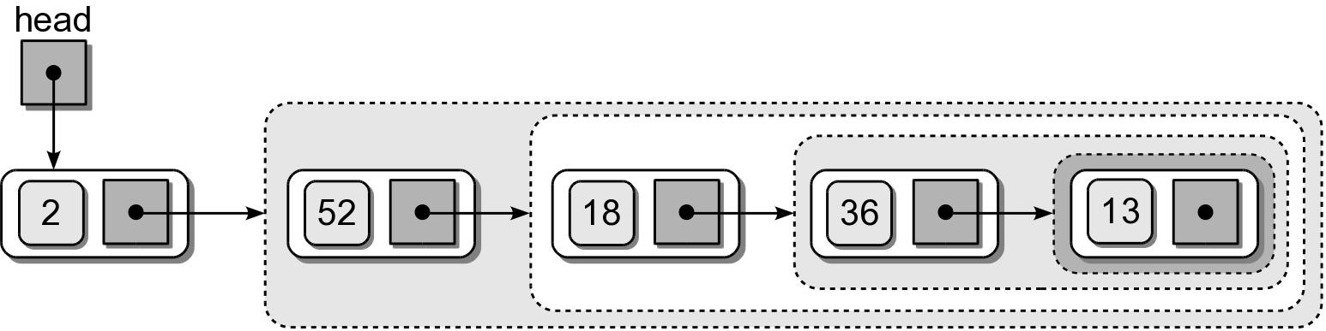
Recursive Example
A recursive solution for this problem is also possible.
  Use the divide and conquer strategy.
  A linked list can be viewed as a recursive structure.

Slide 25
Recursive Example
The solution subdivides the problem into smaller parts of itself.
def printList( node ):
if node is not None :
printList( node.next )
print( node.data )

Slide 26
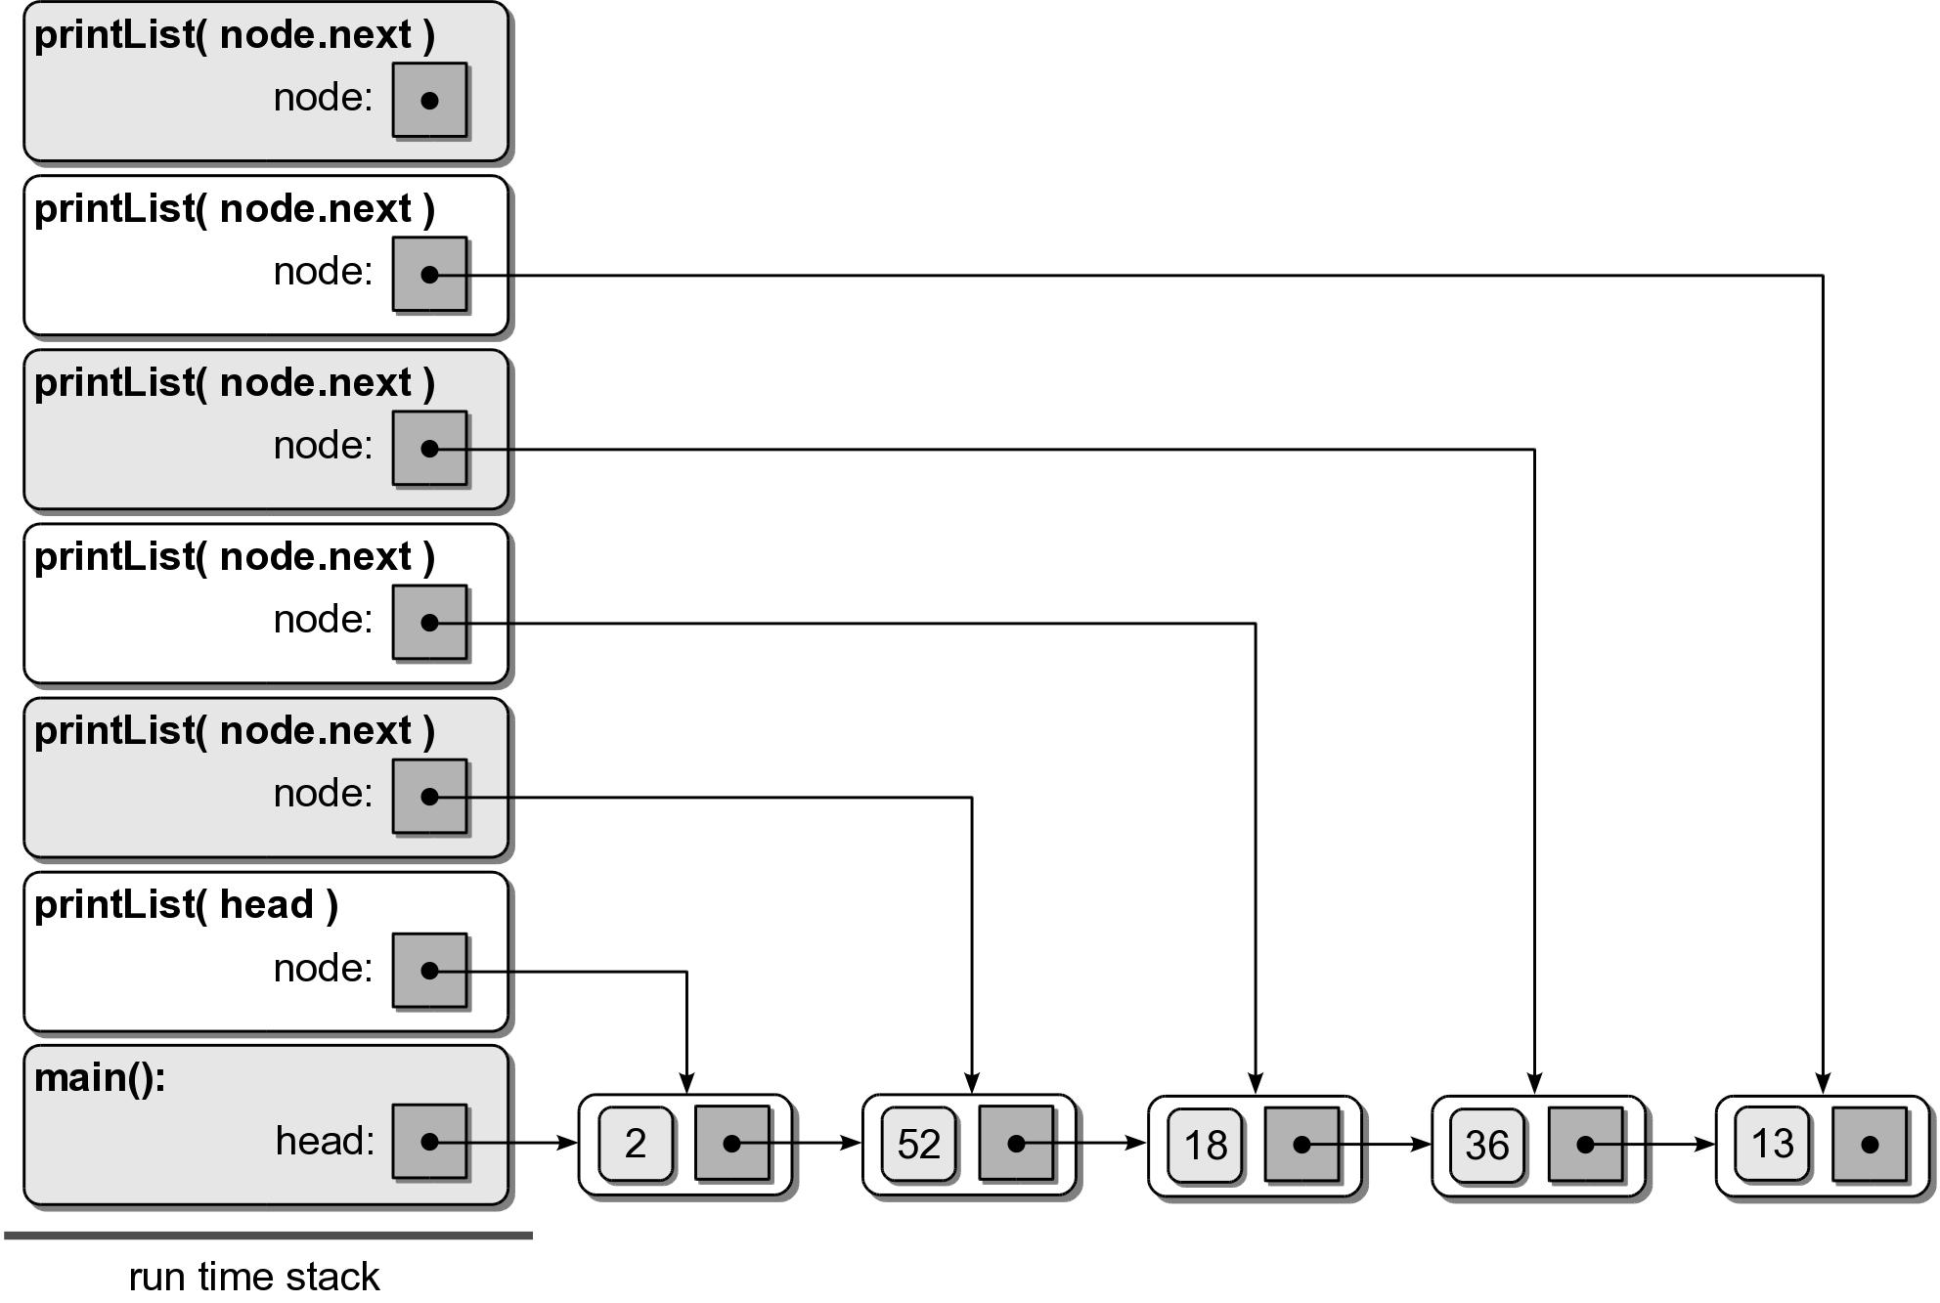
Recursive Example

Slide 27
Recursive Applications
Many applications can be solved using recursion.
  Binary Search
  Towers of Hanoi
  Exponential Operation
  Tic-Tac-Toe

Slide 28
Recursive Binary Search
The binary search algorithm can be implemented recursively.
The problem is expressed in smaller versions of itself.
  At each split, the list is cut in half.
  Continues until the target is located or the sub list contains no items.

Slide 29
Recursive Binary Search
def recBinarySearch( target, theSeq, first, last ):
# If the sequence cannot be subdivided further, we are done.
if first > last : # base case #1
return False
else :
# Find the midpoint of the sequence.
mid = (last + first) // 2
# Does the element at the midpoint contain the target?
if theSeq[mid] == target :
return True # base case #2
# or does the target precede the element at the midpoint?
elif target < theSeq[mid] :
return recBinarySearch( target, theSeq, first, mid - 1 )
# or does it follow the element at the midpoint?
else :
return recBinarySearch( target, theSeq, mid + 1, last )

Slide 30
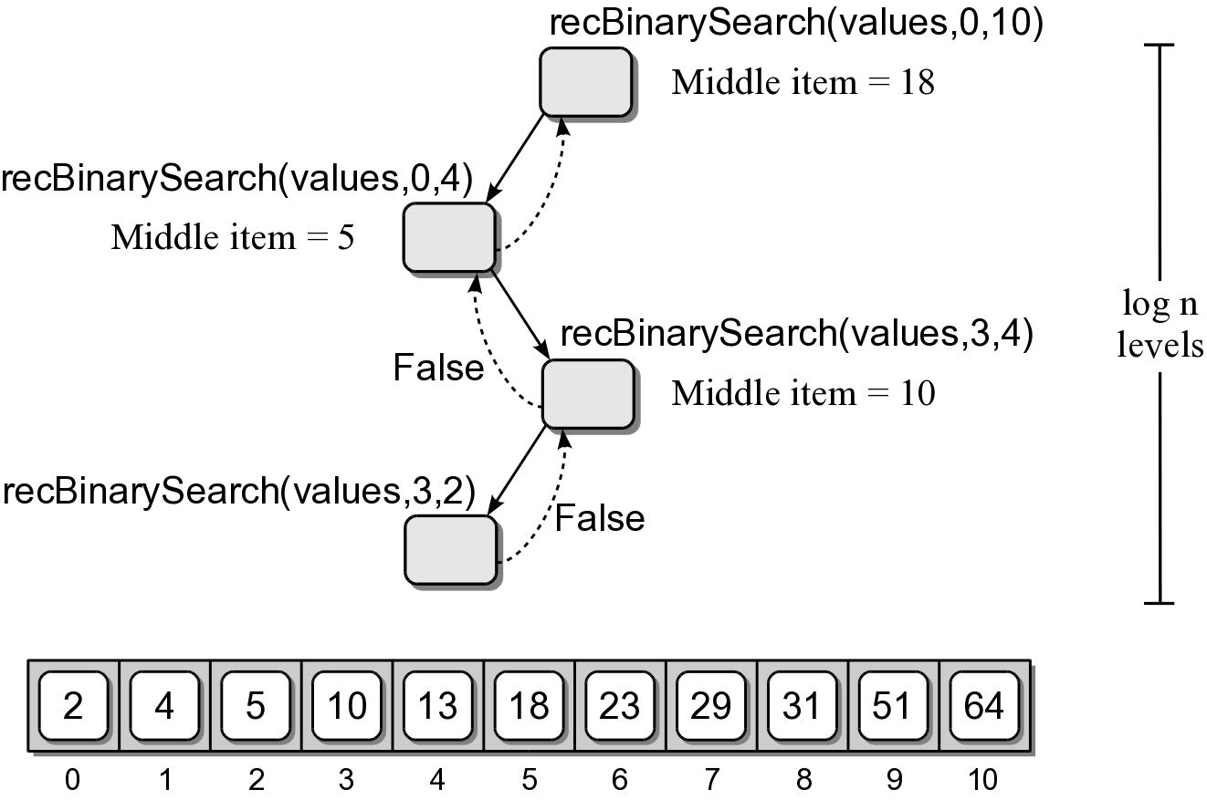
Binary Search Efficiency
To determine the efficiency of the recursive binary search algorithm, we can use a call tree.

Slide 31
Exponential Operation
Example of a recursive version that is more efficient than its iterative version.
  The operation x^{n} can be expressed as x multiplied by itself n times
  A basic iterative implementation
x * x * x * ... x
def exp1( x, n ):
y = 1
for i in range( n ):
y *= x
return y

Slide 32
Exponential Operation
We can reduce the number of multiplications.
  Instead of computing 2⁸ as
  we can compute it as
  Bet yet, computing it as 16 * 16 would be better.
2 * 2 * 2 * 2 * 2 * 2 * 2 * 2
(2 * 2)⁴

Slide 33
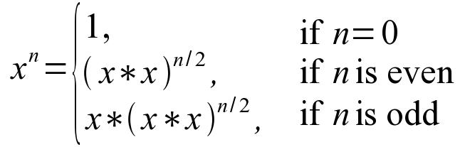
Recursive Exponential Definition
Exponential operation can be defined as
def exp( x, n ):
if n == 0 :
return 1
result = exp( x * x, n // 2 )
if n % 2 == 0 :
return result
else :
return x * result

Slide 34
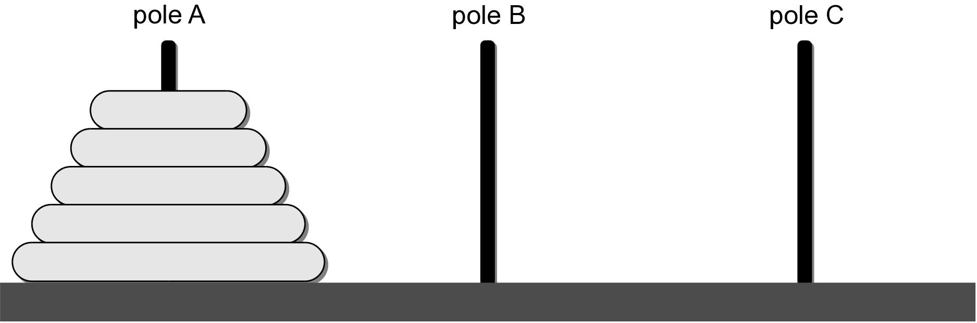
Towers of Hanoi
A puzzle invented by French mathematician Edouard Lucas in 1883.
  A board with three vertical poles.
  A stack of disks, each of increasing diameter.

Slide 35
Towers of Hanoi Objective
To move all of the disks from the starting pole to one of the other poles to create a new tower.
  Only one disk can be moved at a time.
  A larger disk can never be placed on top of a smaller disk.

Slide 36
Solving Towers of Hanoi
How would you go about solving this problem?
  Think about the base case.
  Think about the recursive case and how it reduces the size of the problem.

Slide 37
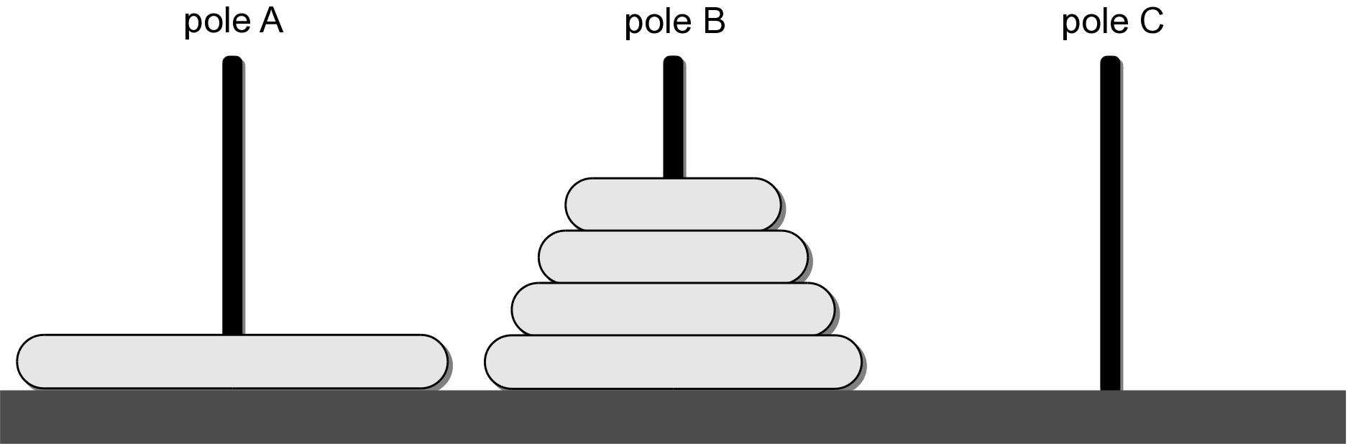
Solving Towers of Hanoi
Let's start with the hardest step of moving the bottom.

Slide 38
Solving Towers of Hanoi
We can use the same technique to move the top four disks.
Given n disk and three poles: source, destination, and intermediate:
  Move the top n - 1 disk from pole S to pole I using pole D.
  Move the remaining disk from pole S to pole D.
  Move the n – 1 disks from pole I to pole D using pole S.

Slide 39
Towers of Hanoi Solution
Python solution
Suppose we execute the function call
def move( n, src, dest, temp ):
if n >= 1 :
move( n - 1, src, temp, dest )
print( "Move %d -> %d" % (src, dest))
move( n - 1, temp, dest, src )
move( 3, 1, 3, 2 )
Move 1 -> 3
Move 1 -> 2
Move 3 -> 2
Move 1 -> 3
Move 2 -> 1
Move 2 -> 3
Move 1 -> 3

Slide 40

Towers of Hanoi Moves

Slide 41

Towers of Hanoi Moves

Slide 42

Towers of Hanoi Moves

Slide 43

Towers of Hanoi Moves

Slide 44

Towers of Hanoi Moves

Slide 45

Towers of Hanoi Moves

Slide 46

Towers of Hanoi Moves

Slide 47
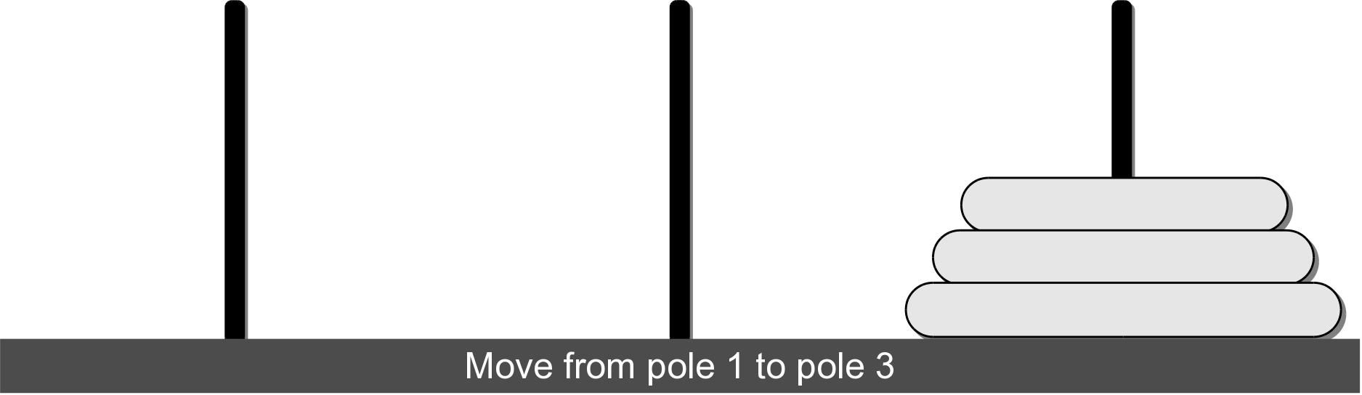
Towers of Hanoi Moves

Slide 48
Towers of Hanoi Evaluation
To evaluate the function, we need to determine for any value of n:
  cost of each a single function invocation.
  number of times the function is executed.

Slide 49
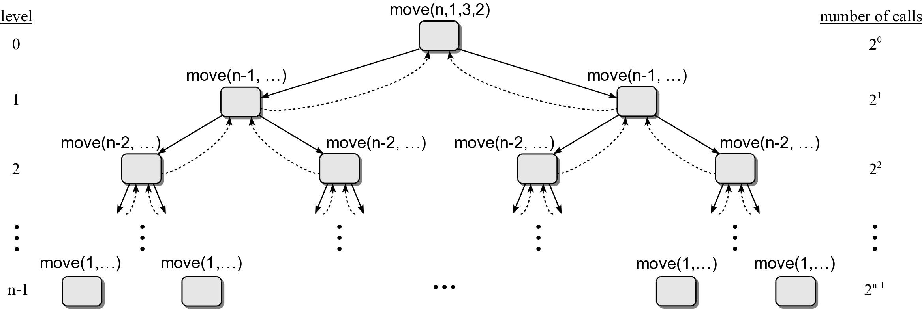
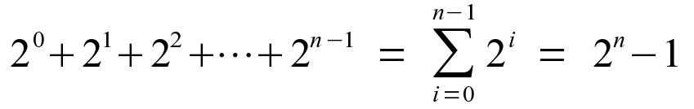
Towers of Hanoi Call Tree

Slide 50
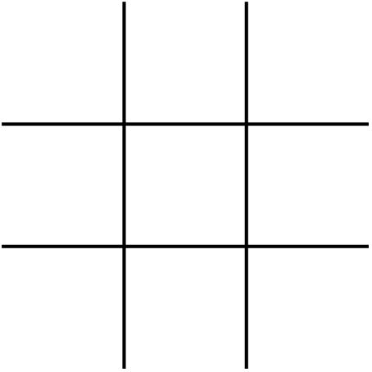
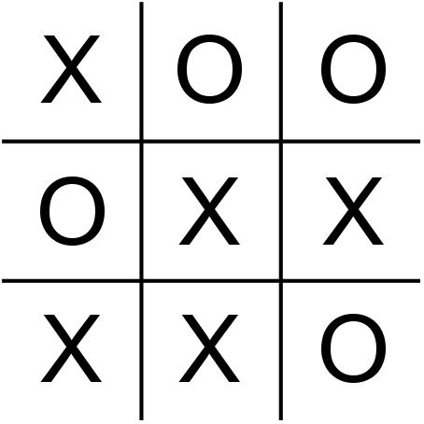
Playing Tic-Tac-Toe
Consider the game of tic-tac-toe
If you play tic-tac-toe against a computer, how does the computer make its decisions?

Slide 51
Game Tree
Provides the sequence of all possible moves that can be made in the game for both opponents.
  The computer can evaluate the game tree and determine its best move.
  For tic-tac-toe, the best move is one that
    allows it to win before its opponent
    in the fewest possible moves.
  The “computer” can evaluate every possible move much faster than a human.

Slide 52
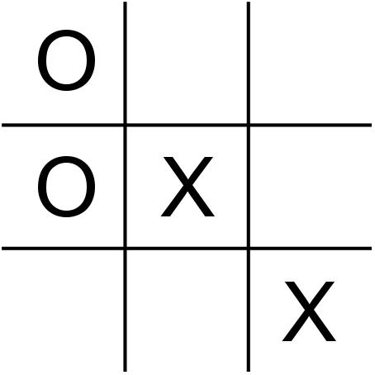
Game Tree Example
Suppose you have been playing against the computer
and now it's the computer's turn.

Slide 53
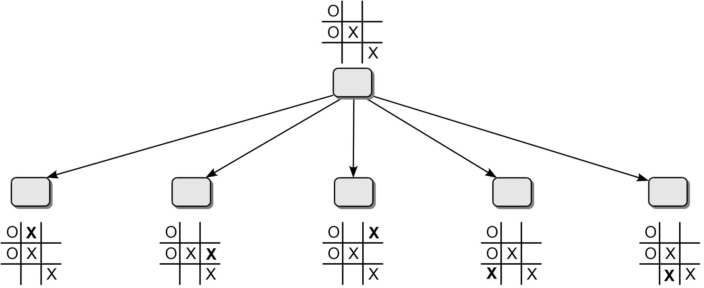
Game Tree Example
The computer would need to evaluate all of it's possible moves to determine the best.

Slide 54
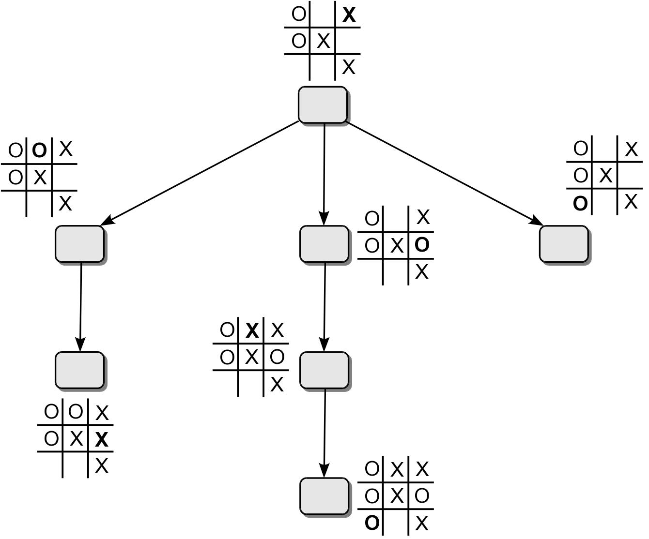
Game Tree Example
The following figure shows the rest of the tree for a movement in the upper-right square.

Slide 55
The 8-Queens Problem
The task is to place 8 queens onto a chessboard such that no queen can attach another queen.
  Uses a standard 8 x 8 chess board.
  There are 92 solutions to this problem.

Slide 56
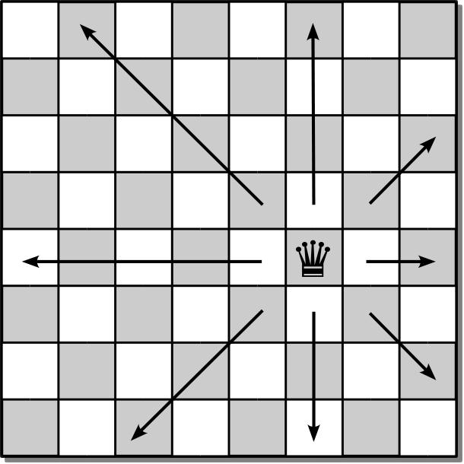
Queen Moves
The queen can move and attack any piece of the opponent by moving in any direction along a straight line.

Slide 57
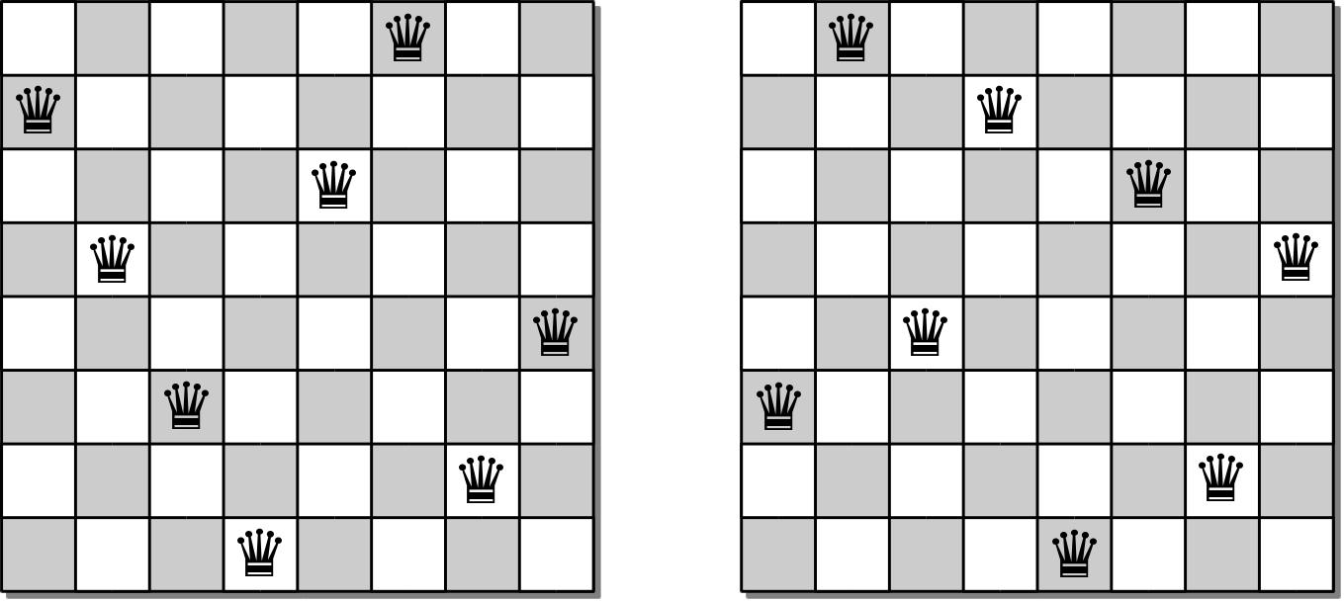
Sample Solutions

Slide 58
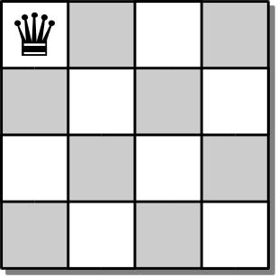
4-Queens Problem
To develop an algorithm, we consider the smaller 4-queens problem.
  Since no two queens can occupy the same column, we can proceed one column at a time.
  Place a queen in position (0, 0).

Slide 59
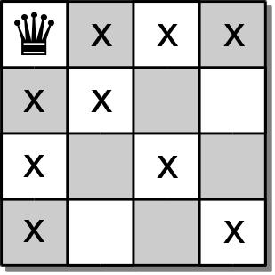
4-Queens Problem
This move eliminates a number of squares for the placement of additional queens.

Slide 60
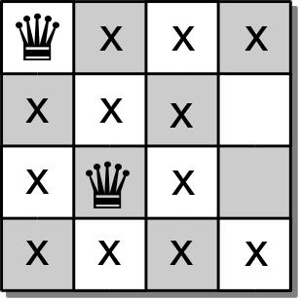
4-Queens Problem
We move to the second column and place a queen at position (2, 1)

Slide 61
4-Queens Problem
The 3rd queen should be placed in the 3rd column.
  But there are no open cells in the third column.
  So there is no solution based on the placement of the first 2 queens.

Slide 62
4-Queens Problem
We have to backtrack:
  go back to the previous column
  pickup the last queen placed
  try to find another valid cell in that column.

Slide 63
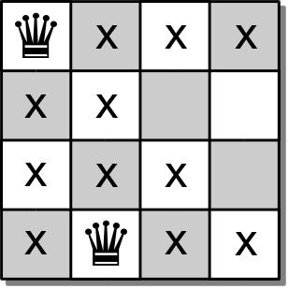
4-Queens Problem
Place a queen at position (3,1) and move forward.

Slide 64
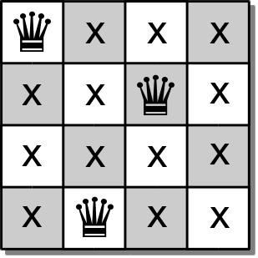
4-Queens Problem
In the 3rd column, we can now place a queen at position (1,2).
But now we have no open slots in the 4th column.

Slide 65
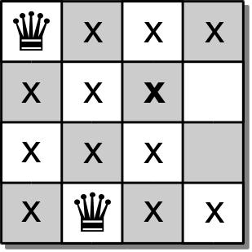
4-Queens Problem
We again must backtrack and pick up the queen from the 3rd column.
But there are no other empty cells in the 3rd column.

Slide 66
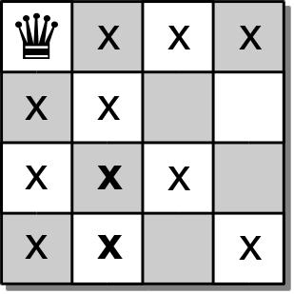
4-Queens Problem
We must backtrack yet again and pick up the queen from the 2rd column.
But there are no other empty cells in the 2nd column either.

Slide 67
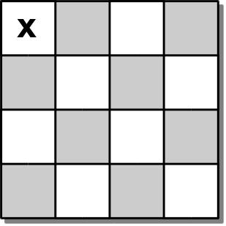
4-Queens Problem
So we backtrack one more time and pick up the queen from the 1st column.
We then try again to place a queen in the 1st column.

Slide 68
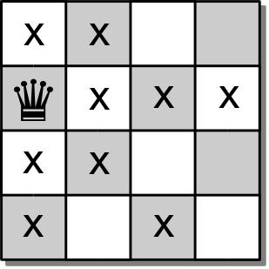
4-Queens Problem
In the 1st column, we can place a queen at position (1, 0).

Slide 69
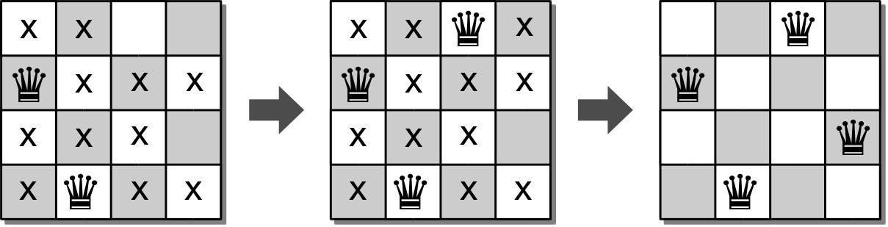
4-Queens Problem
We again continue with the process and attempt to find open positions in each of the remaining columns.
We can use a similar approach to solve the original 8-queens problem.

Slide 70
N-Queens Board ADT
The n-queens board is used for positioning queens on a square board for use in solving the n-queens problem.
  consists of n x n squares.
  each square is identified by index [0...n)
NQueensBoard( n ) size() numQueens() unguarded( row, col ) | placeQueen( row, col ) removeQueen( row, col ) reset() draw()

Slide 71
8-Queens Solution
def solveNQueens( board, col ):
if board.numQueens() == board.size() :
return True
else :
for row in range( board.size() ):
if board.unguarded( row, col ):
board.placeQueen( row, col )
if board.solveNQueens( board, col+1 ) :
return True
else :
board.removeQueen( row, col )
return False

