Slide 1
Search Trees
Chapter 14

Slide 2
Search Trees
The tree structure can be used for searching.
  Each node contains a search key as part of its data or payload.
  Nodes are organized based on the relationship between the keys.
Search trees can be used to implement various types of containers.
  Most common use is with the Map ADT.

Slide 3
Binary Search Tree (BST)
A binary tree in which each node contains a search key and the tree is structured such that for each interior node V:
  All keys less than the key in node V are stored in the left subtree of V.
  All keys greater than the key in node V are stored in the right subtree of V.

Slide 4
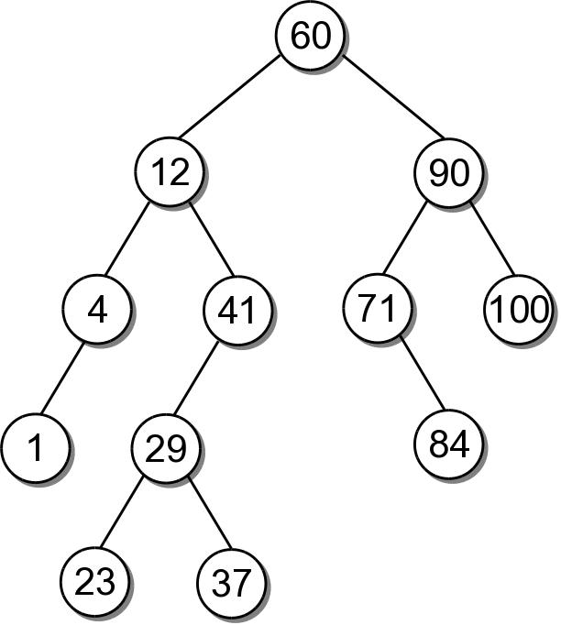
BST Example
Consider the example tree

Slide 5
BST – Map ADT
bstmap.py
# We use an unique name to distinguish this version
# from others in the chapter.
class BSTMap :
def __init__( self ):
self._root = None
self._size = 0
def __len__( self ):
return self._size
def __iter__( self ):
return _BSTreeIterator( self._root )
# ...
# Storage class for the binary search tree nodes.
class _BSTNode :
def __init__( self, key, data ):
self.key = key
self.data = data
self.left = None
self.right = None

Slide 6
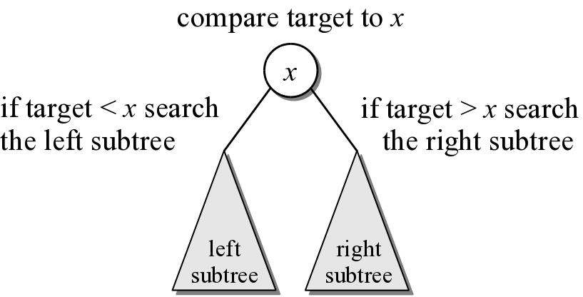
BST – Searching
A search begins at the root node.
  The target is compared to the key at each node.
  The path depends on the relationship between the target and the key in the node.

Slide 7
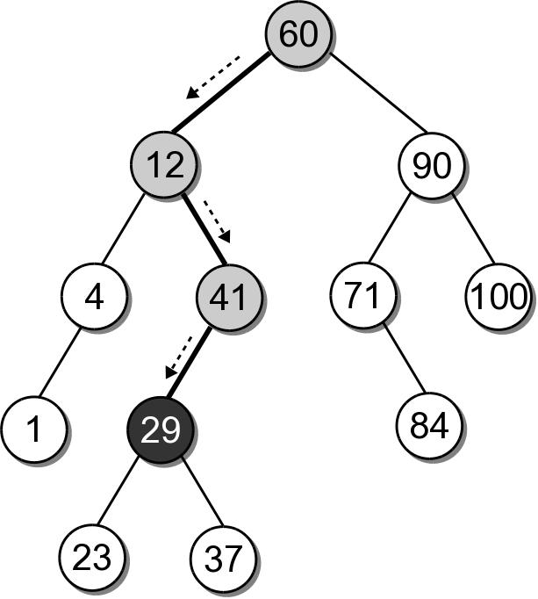
BST – Search Example
Suppose we want to search for 29 in our BST.

Slide 8
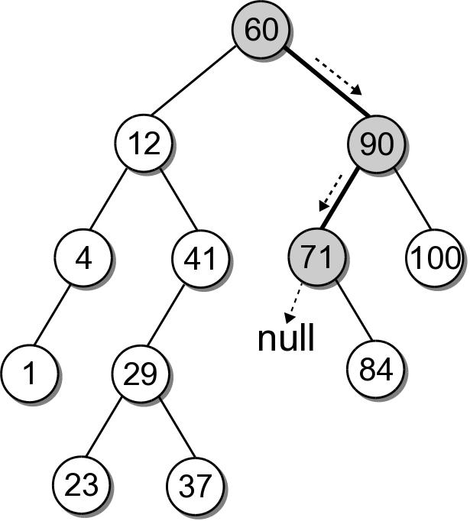
BST – Search Example
What if the key is not in the tree? Search for key 68 in our BST.

Slide 9
BST – Search Implementation
bstmap.py
class BSTMap :
# ...
def __contains__( self, key ):
return self._bstSearch( self._root, key ) is not None
def valueOf( self, key ):
node = self._bstSearch( self._root, key )
assert node is not None, "Invalid map key."
return node.value
def _bstSearch( self, subtree, target ):
if subtree is None :
return None
elif target < subtree.key :
return self._bstSearch( subtree.left )
elif target > subtree.key :
return self._bstSearch( subtree.right )
else :
return subtree

Slide 10
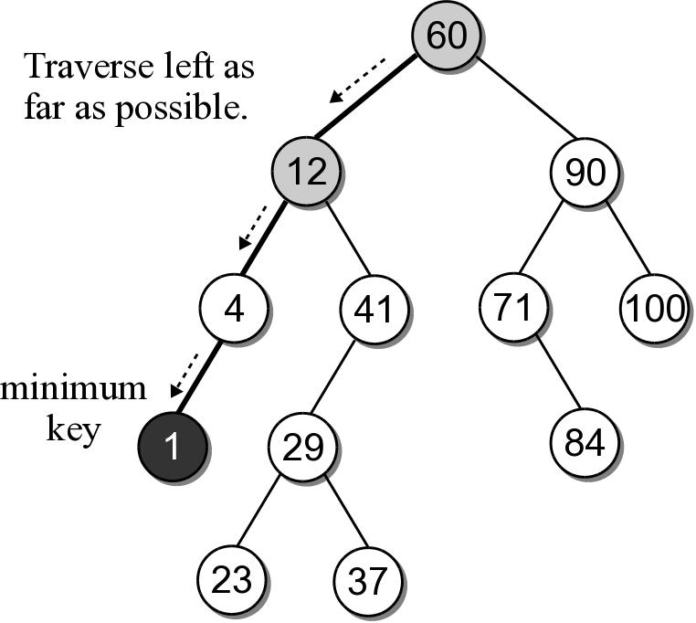
BST – Min or Max Key
Finding the minimum or maximum key within a BST is similar to the general search.
  Where might the smallest key be located?
  Where might the largest key be located?

Slide 11
BST – Min or Max Key
The helper method below finds the node containing the minimum key.
class BSTMap :
# ...
def _bstMinumum( self, subtree ):
if subtree is None :
return None
elif subtree.left is None :
return subtree
else :
return self._bstMinimum( subtree.left )

Slide 12
BST – Insertions
When a BST is constructed, the keys are added one at a time. As keys are inserted
  A new node is created for each key.
  The node is linked into its proper position within the tree.
  The search tree property must be maintained.

Slide 13
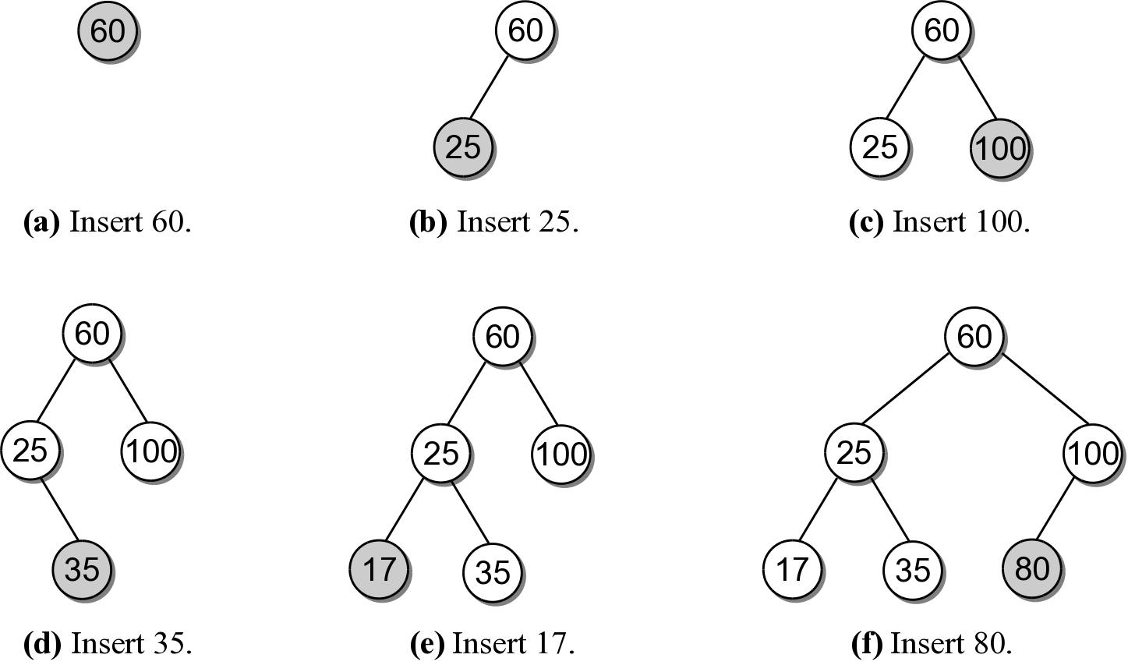
Building a BST
Suppose we want to build a BST from the key list
60 25 100 35 17 80

Slide 14
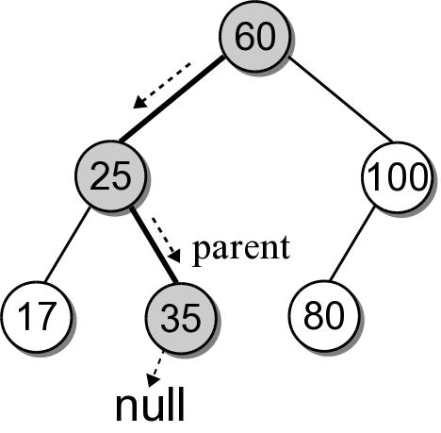
BST – Insertion
Building a BST by hand is easy. How do we insert an entry in program code?
  What happens if we use the search method from earlier to search for key 30?

Slide 15
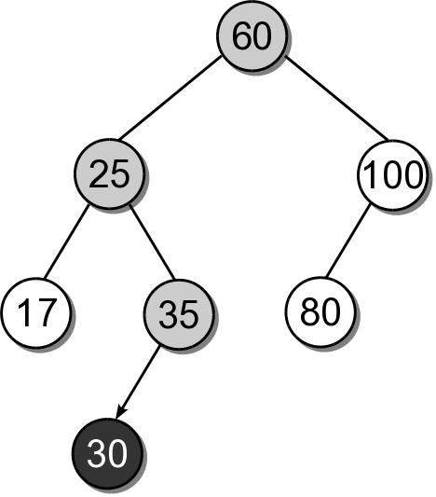
BST – Insertion
We can insert the new node where the search fell off the tree.

Slide 16
BST – Insert Implementation
bstmap.py
class BSTMap :
# ...
def add( self, key, value ):
node = self._bstSearch( key )
if node is not None :
node.value = value
return False
else :
self._root = self._bstInsert( self._root, key, value )
self._size += 1
return True
def _bstInsert( self, subtree, key, value ):
if subtree is None :
subtree = _BSTMapNode( key, value )
elif key < subtree.key :
subtree.left = self._bstInsert(subtree.left, key, value)
elif key > subtree.key :
subtree.right = self._bstInsert(subtree.right, key, value)
return subtree

Slide 17
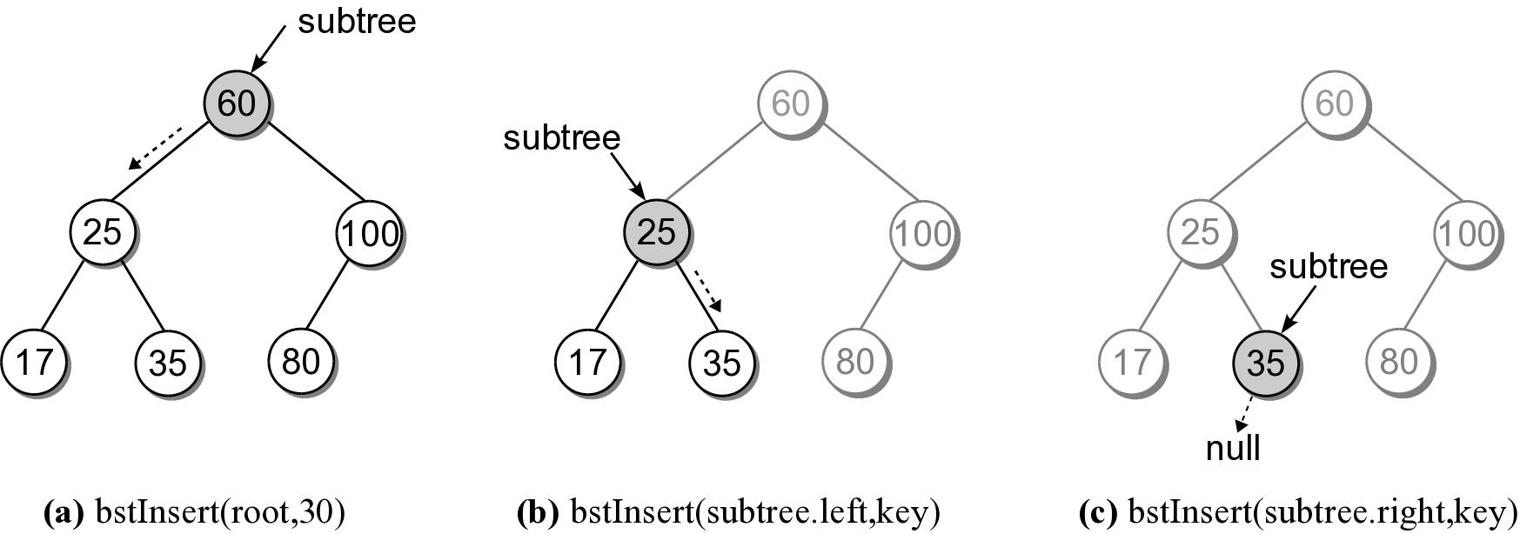
BST – Insert Steps
Add 30 to our sample BST.

Slide 18
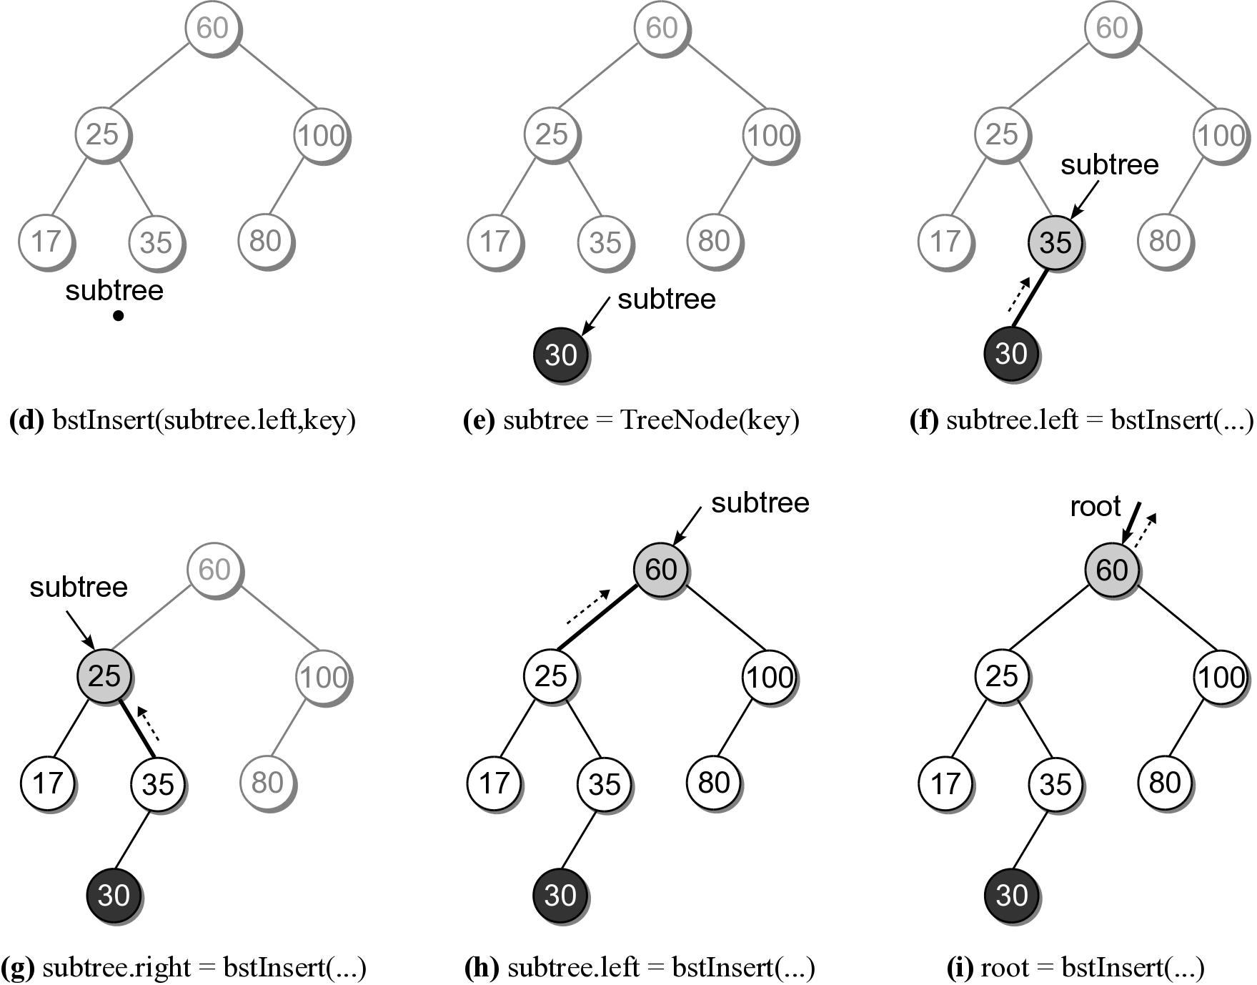
BST – Insert Steps

Slide 19
BST – Deletions
Deleting a node from a BST is a bit more complicated.
  Locate the node containing the node.
  Delete the node.
When a node is removed, the remaining nodes must preserve the search tree property.

Slide 20
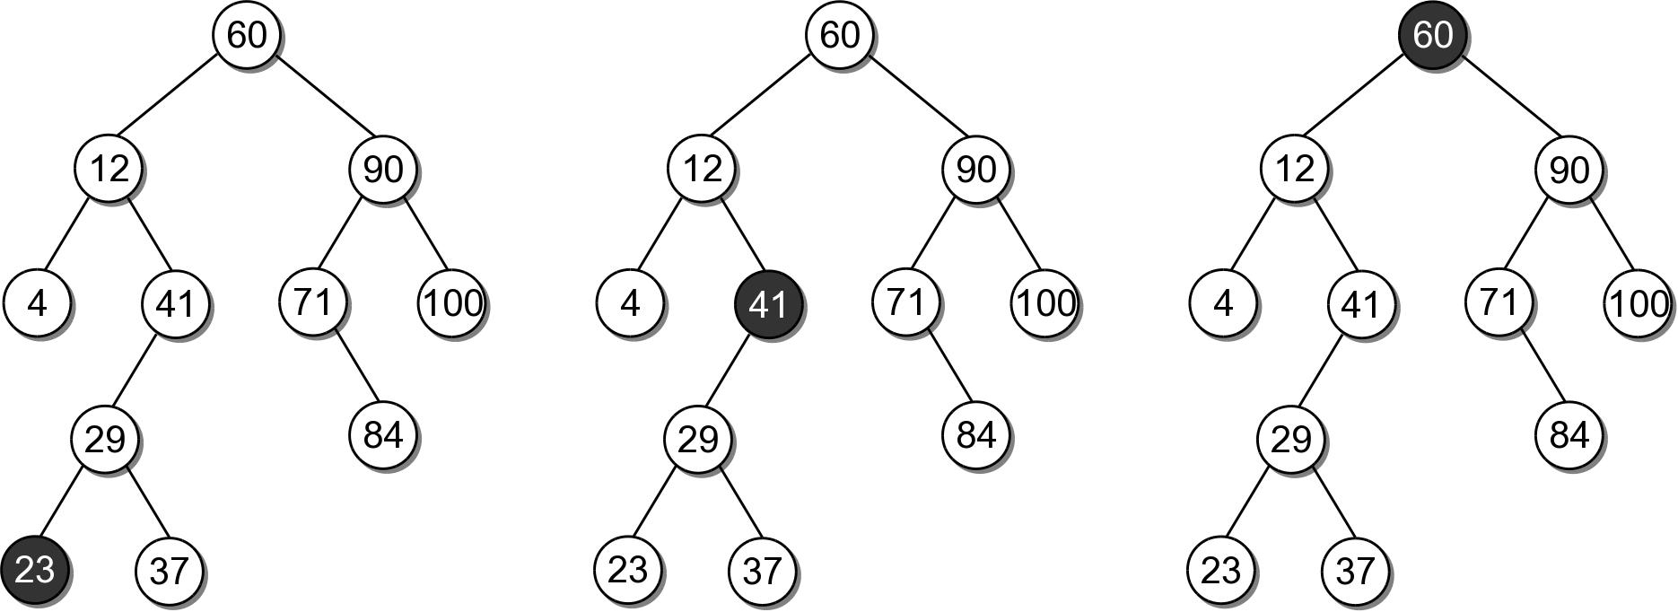
BST – Deletions
There are three cases to consider:
  the node is a leaf.
  the node has a single child
  the node has two children.

Slide 21
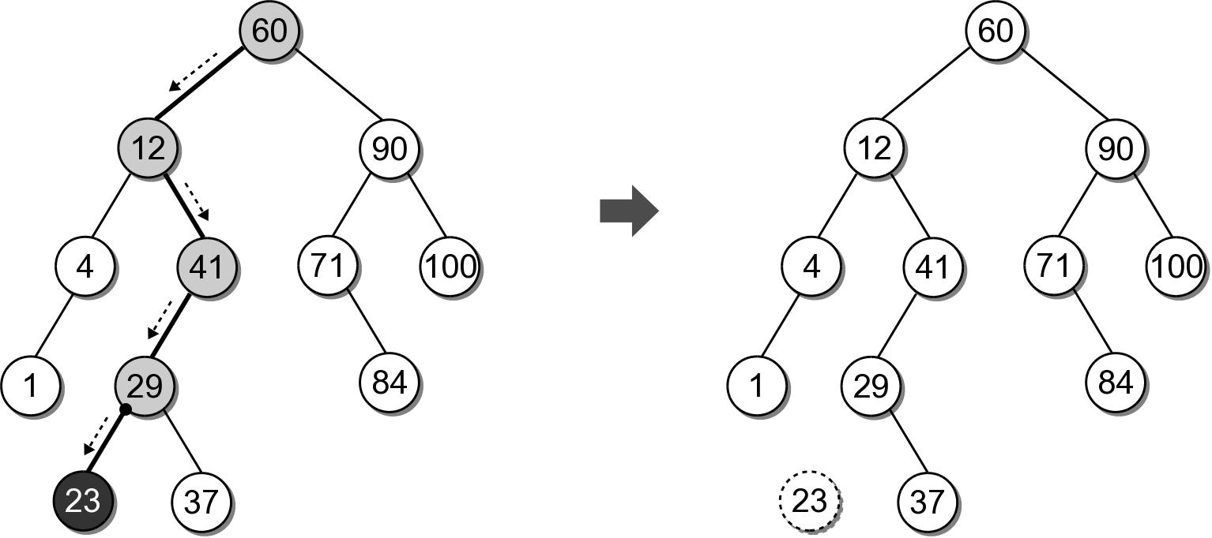
BST – Delete Leaf Node
Removing a leaf node is the easiest case.
  Suppose we want to remove 23.

Slide 22
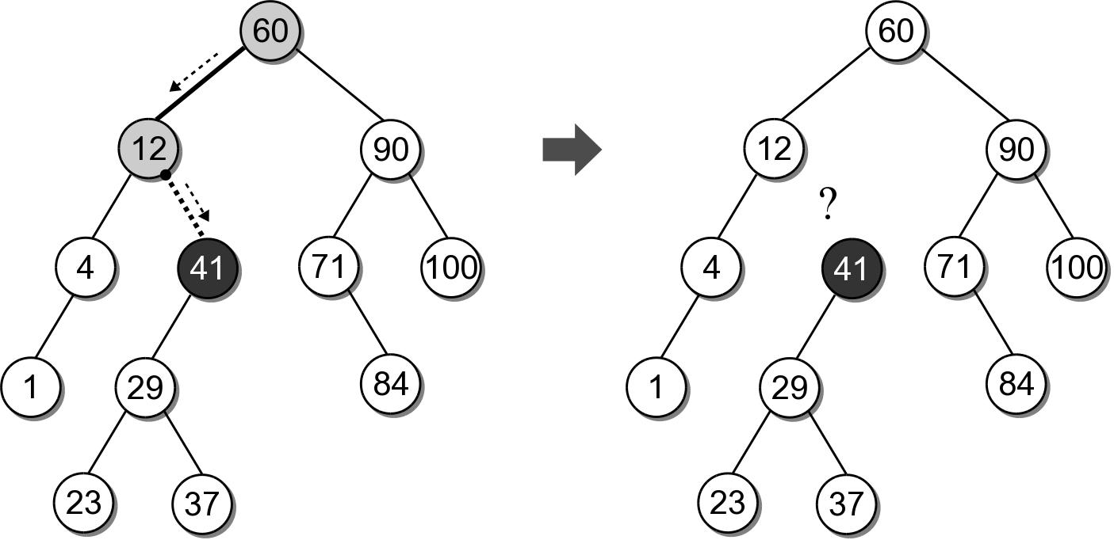
BST – Delete Interior Node
Removing an interior node with one child.
  Suppose we want to remove 41.
  We can not simply unlink the node.

Slide 23
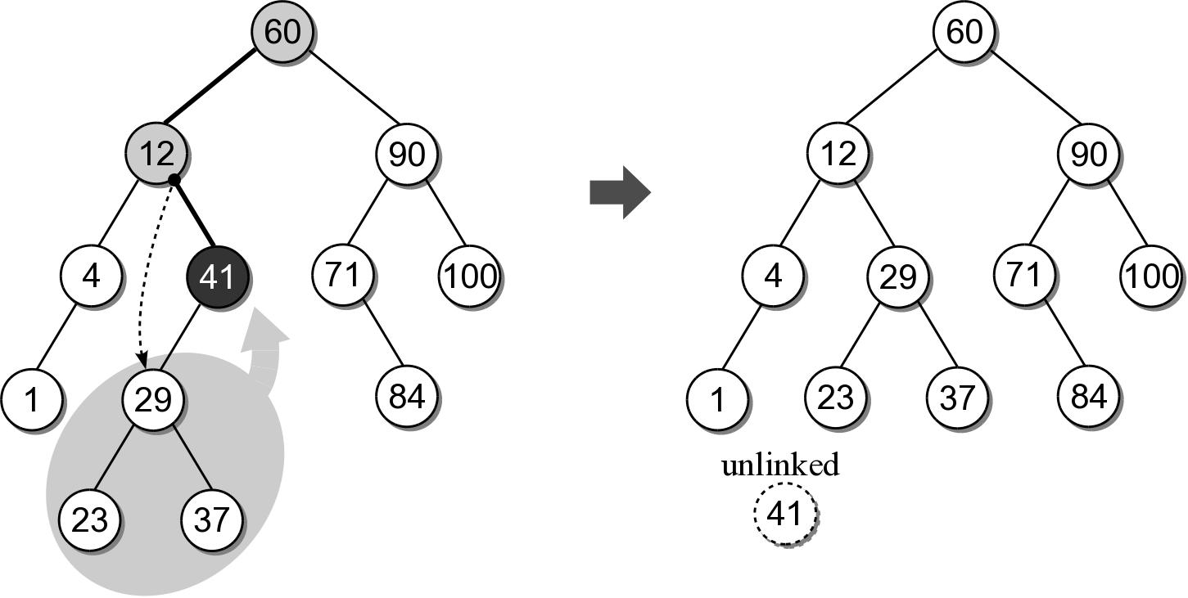
BST – Delete Interior Node
After locating the node to be removed, it's child must be linked to it's parent.

Slide 24
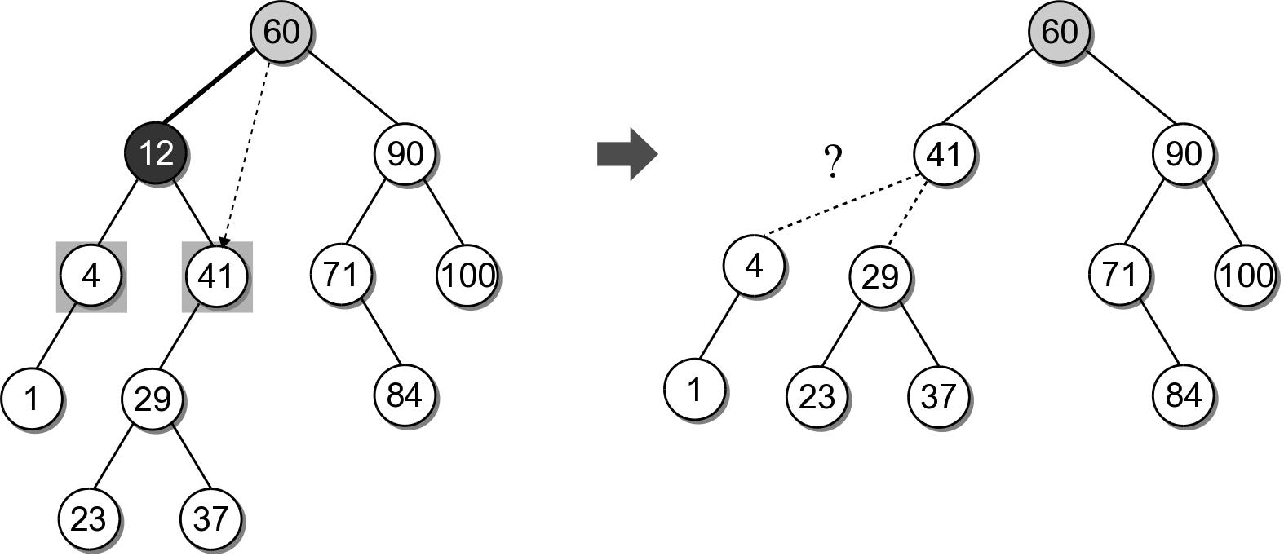
BST – Delete Interior Node
The most difficult case is deleting a node with two children.
  Suppose we want to delete node 12.
  Which child should be linked to the parent?

Slide 25
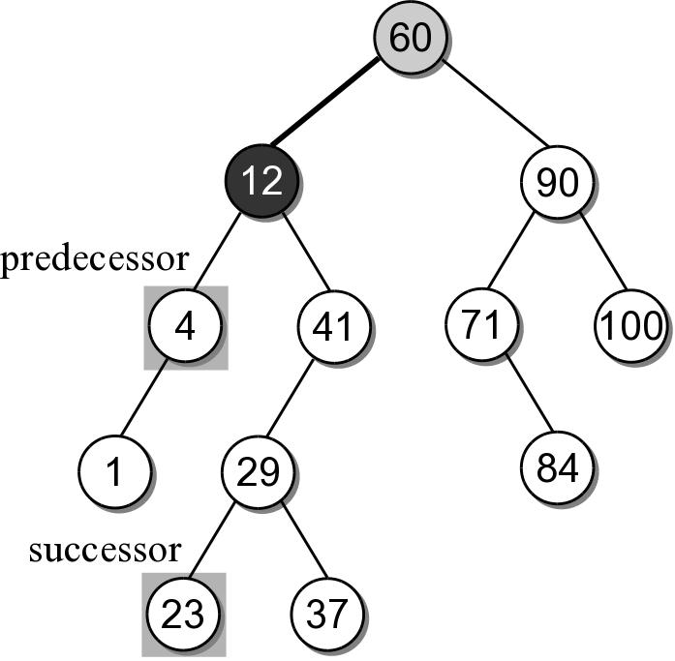
BST – Delete Interior Node
Based on the search tree property, each node has a logical predecessor and successor.
  For node 12, those are 4 and 23.

Slide 26
BST – Delete Interior Node
We can replace to be deleted with either its logical successor or predecessor.
  Both will either be a leaf or an interior node with one child.
  We already know how to remove those nodes.

Slide 27
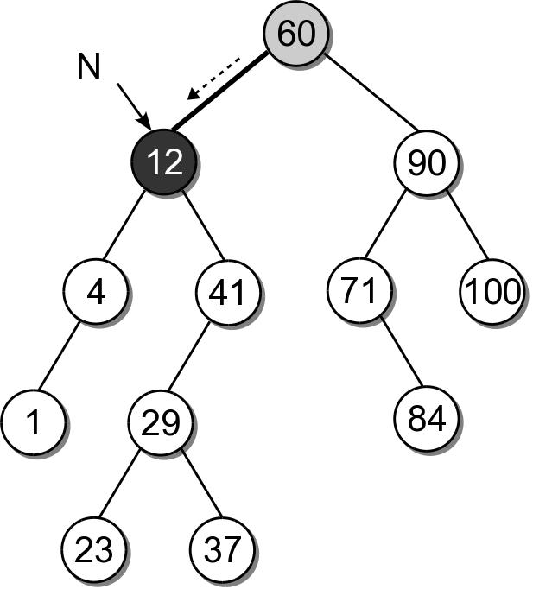
BST – Delete Interior Node
Removing an interior node with two children requires 4 steps:
  (1) Find the node to be deleted, N.

Slide 28
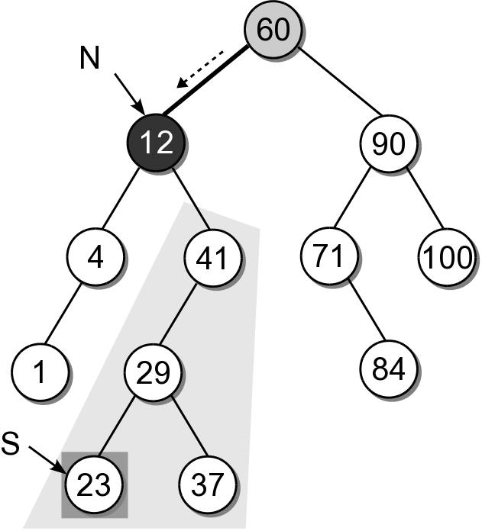
BST – Delete Interior Node
(2) Find the successor, S, of node N.

Slide 29
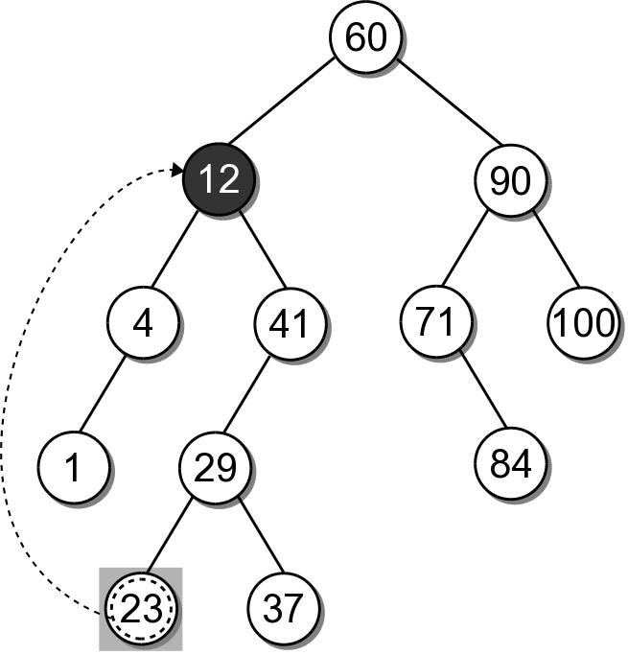
BST – Delete Interior Node
(3) Copy the payload from node S to node N.

Slide 30
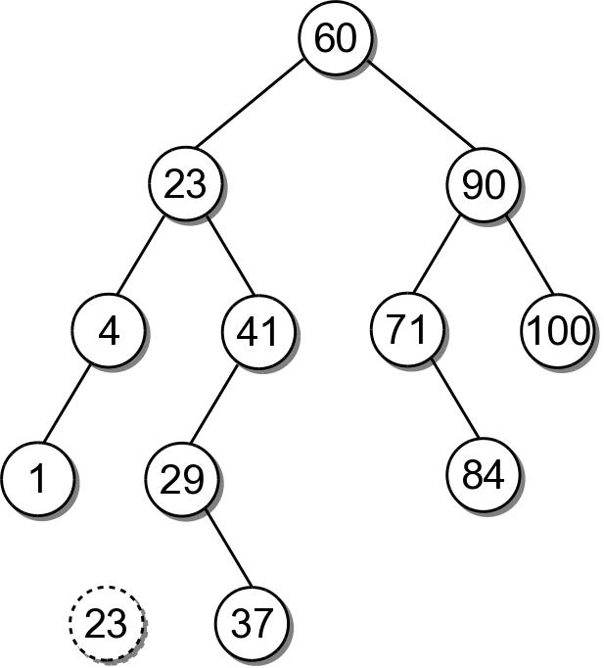
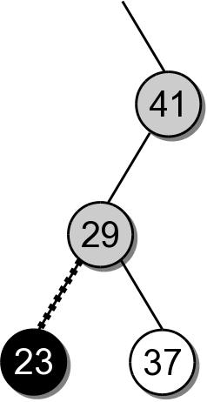
BST – Delete Interior Node
(4) Remove node S from the tree.

Slide 31
BST – Delete Interior Node
Removing an interior node with two children requires 4 steps:
  Find the node to be deleted, N.
  Find the logical successor, S, of node N.
  Copy the payload from node S to node N.
  Remove node S from the tree.

Slide 32
BST – Delete Implementation
bstmap.py
class BSTMap :
# ...
def remove( self, key ):
assert key in self, "Invalid map key."
self._root = self._bstRemove( self._root, key )
self._size -= 1

Slide 33
BST – Delete Implementation
bstmap.py
class BSTMap :
# ...
def _bstRemove( self, subtree, target ):
if subtree is None :
return subtree
elif target < subtree.key :
subtree.left = self._bstRemove( subtree.left, target )
return subtree
elif target > subtree.key :
subtree.right = self._bstRemove( subtree.right, target )
return subtree
else :
......

Slide 34
BST – Delete Implementation
bstmap.py
class BSTMap :
# ...
def _bstRemove( self, subtree, target ):
......
else :
if subtree.left is None and subtree.right is None :
return None
elif subtree.left is None or subtree.right is None :
if subtree.left is not None :
return subtree.left
else :
return subtree.right
else
successor = self._bstMinimum( subtree.right )
subtree.key = successor.key
subtree.value = successor.value
subtree.right = self._bstRemove( subtree.right,
successor.key )
return subtree

Slide 35
BST – Efficiency
Operation | Worst Case
_bstSearch( root, k ) | O(n)
_bstMinimum( root ) | O(n)
_bstInsert( root, k ) | O(n)
_bstDelete( root, k ) | O(n)
traversal | O(n)

Slide 36
Balanced Binary Search Tree (AVL)
Improves on the binary search tree by always guaranteeing the tree is height balanced.
  Allows for more efficient operations.
  Developed by Adel'son-Velskhii and Landis in 1962.
balanced – the heights of the left and right subtrees of every node differ by at most 1.

Slide 37
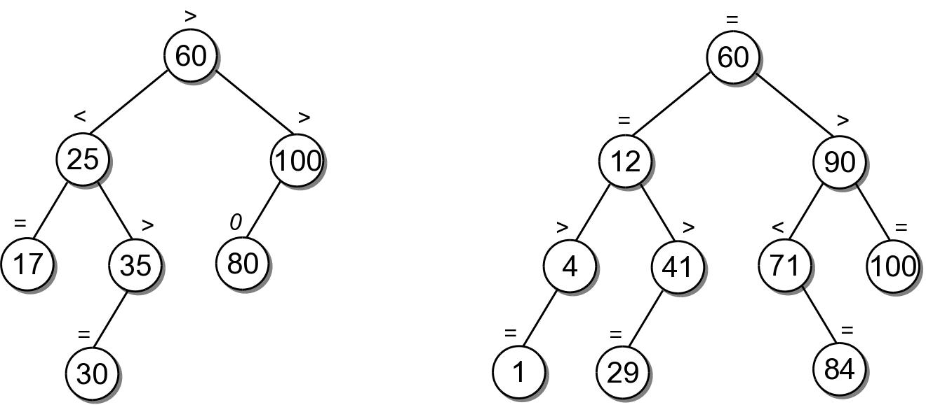
Balance Factor
Associated with each node and indicates the height difference between the left and right branch.
  left-high
  equal-high
  right-high

Slide 38
AVL Operations
Search and traversal are the same as with the binary search tree.
Insertion and deletion must be modified.
  Maintain the balance property as keys are added and/or removed.
  Ensures height never exceeds 1.44 log n.
  Provides O(log n) worst case time.

Slide 39
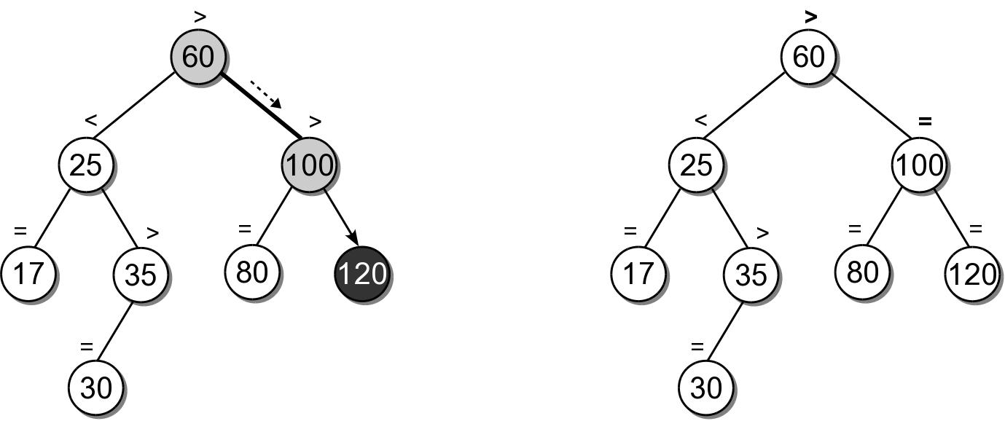
AVL Insertions
Begins with the same process used with a BST.
  Must rebalance the tree if the insertion causes it to become unbalanced.
  Example: insert key 120

Slide 40
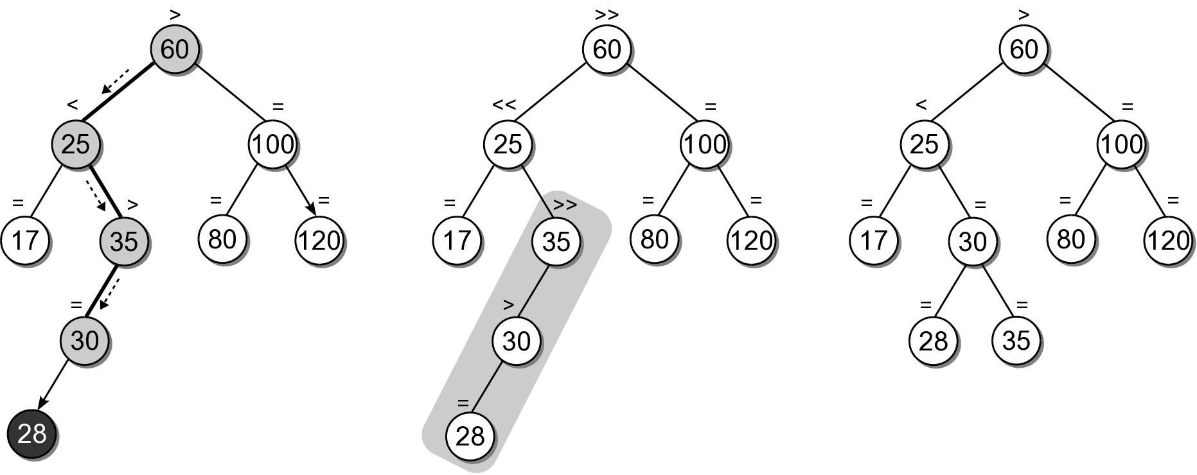
AVL Insert Example
Suppose we add key 28 to the AVL tree.

Slide 41
AVL Rotation
Multiple subtrees can become unbalanced after an inserting a new key.
  Limited to the nodes along the insertion path.
  Balance factors are adjusted during the recursion unwinding.
  pivot node – root node of the first out of balance subtree encountered.

Slide 42
AVL Rotation
An AVL subtree is rebalanced by performing a rotation around the pivot node.
  Rearrange links of the pivot node, its children and at most one of its grandchildren.
  There are four possible cases.

Slide 43
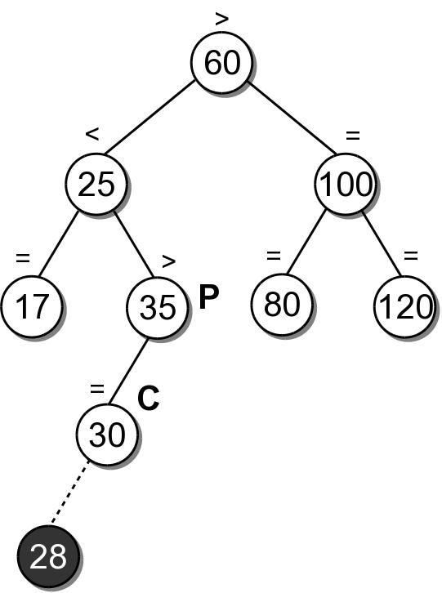
AVL Rotation (Case 1)
The balance factor of the pivot node (P) is left-high before the insertion into the left subtree (C) of P.

Slide 44
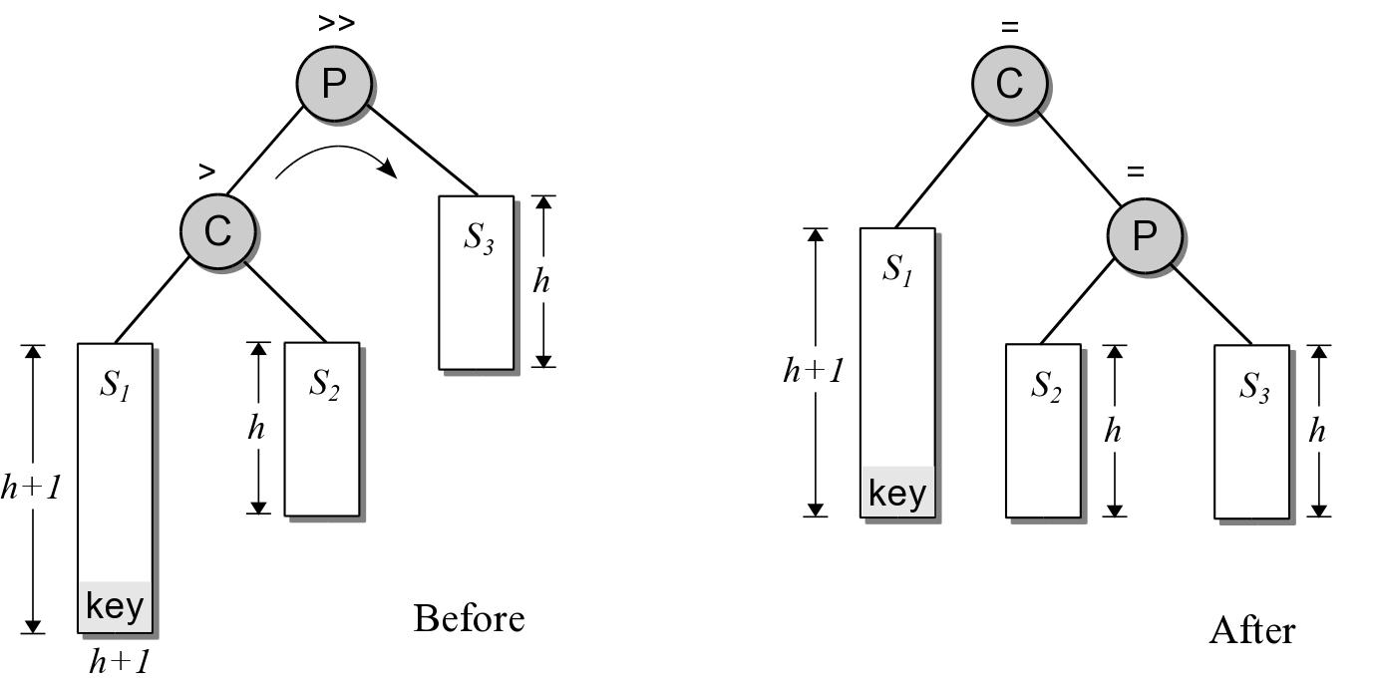
AVL Rotation (Case 1)
The pivot node has to be rotated right over its left child.
  P becomes the right child of C.
  Right child of C becomes the left child of P.

Slide 45
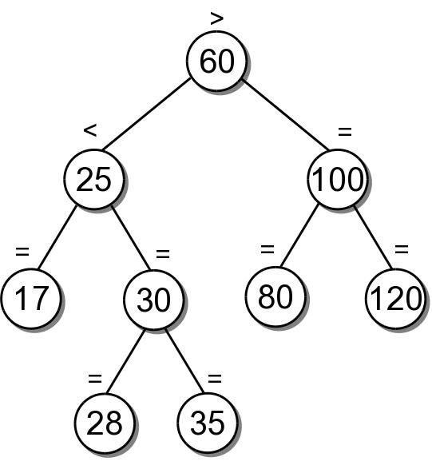
AVL Rotation (Case 1)
Result after the left rotation.

Slide 46
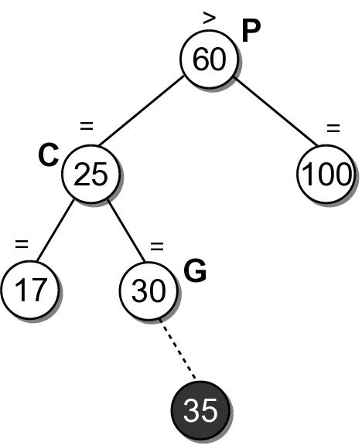
AVL Rotation (Case 2)
Involves three nodes: pivot (P), left child (C) of P and the right child (G) of C.
  Balance factor of P is left-high before the insertion.
  Inserted into either left or right subtree of G.

Slide 47
AVL Rotation (Case 2)
Requires a double rotation:
  node C has to be rotated left over node G.
  pivot node has to be rotated right over its left child.
Link modifications:
  right child of G becomes the new left child of P.
  left child of G becomes the new right child of C.
  C becomes the new left child of G.
  P becomes the new right child of G.

Slide 48
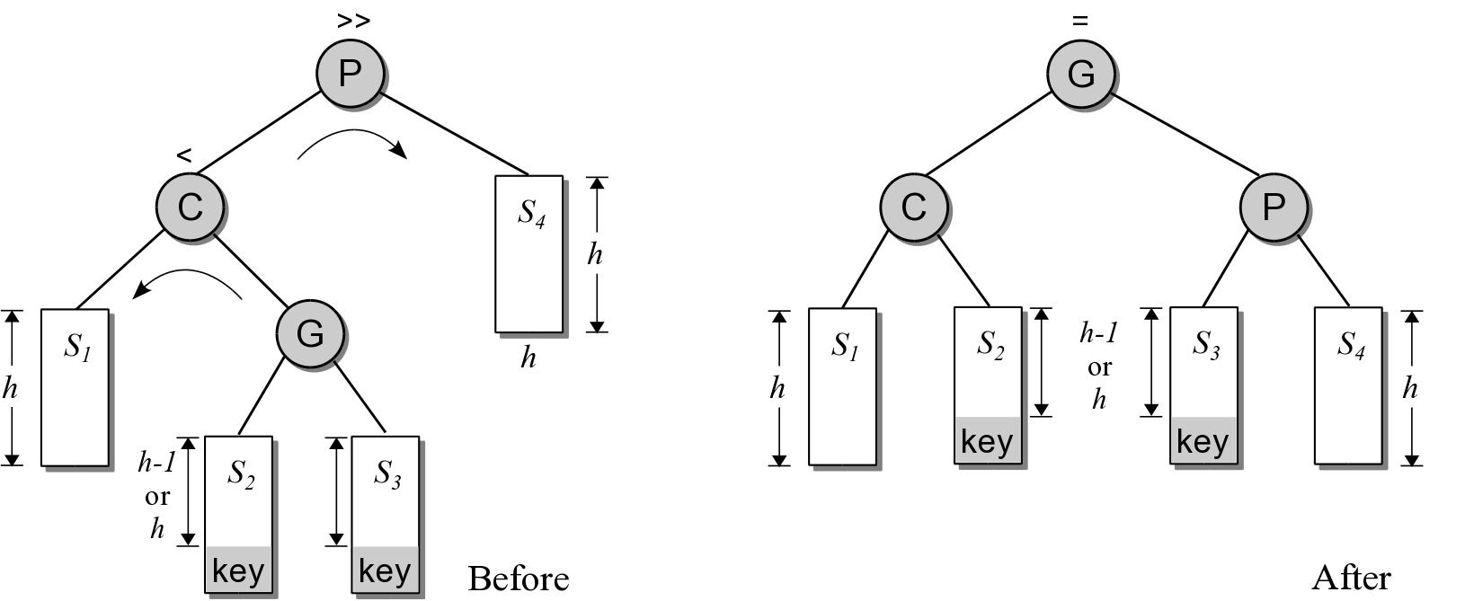
AVL Rotation (Case 2)

Slide 49
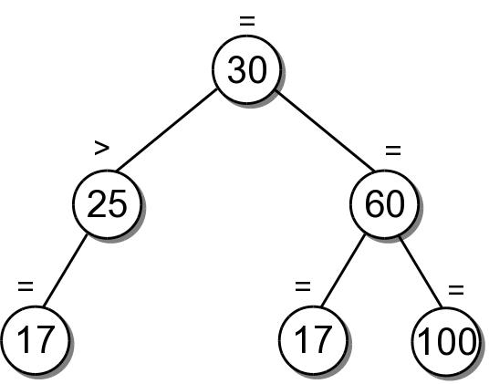
AVL Rotation (Case 2)
Result after the two rotations.

Slide 50
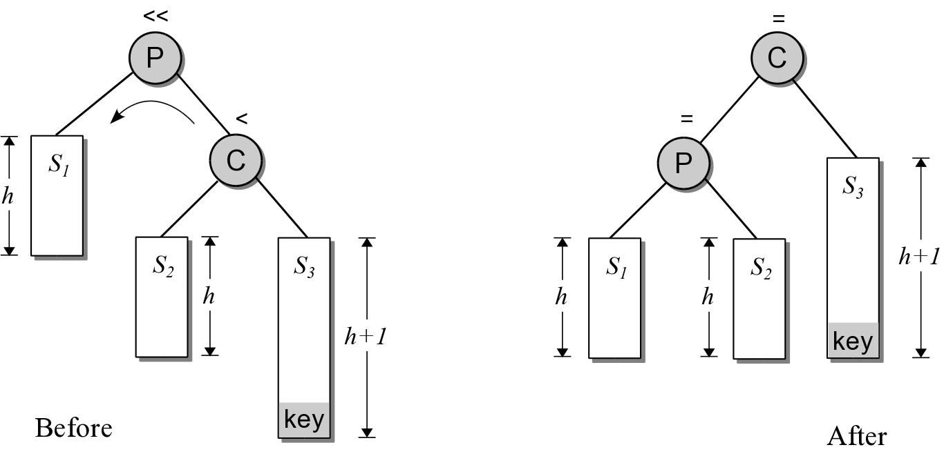
AVL Rotation (Case 3)
A mirror image of the first case.
  P is right-high.
  The new key is inserted in the right subtree of C.

Slide 51
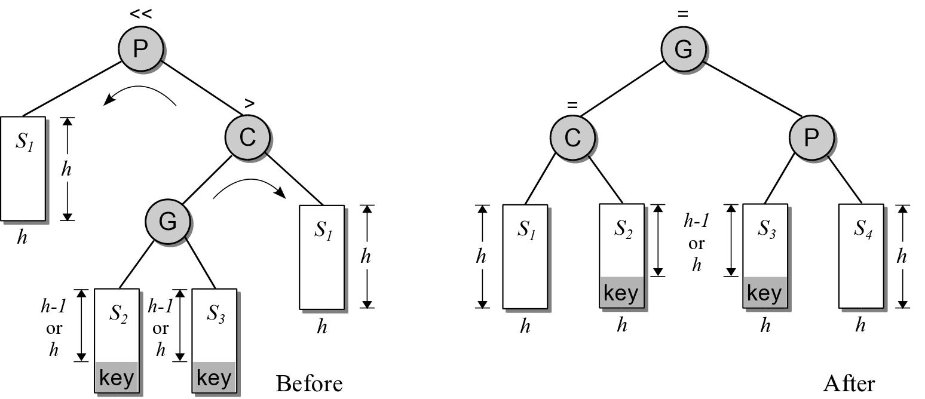
AVL Rotation (Case 4)
A mirror image of the second case.
  P is right-high.
  G is the left child of C instead of the right.

Slide 52
New Balance Factors
The balance factors of the nodes along the insertion path may have to be modified.
  Performed in reverse order as the recursion unwinds.
The new balance factor of a node depends on its current factor and the subtree into which the new node was inserted.
current factor | left subtree | right subtree
> | >> | =
= | > | <
< | = | <<

Slide 53
New Balance Factors
The balance factors of the nodes impacted by a rotation have to be modified.
  The new balance factors depends on the case that triggered the rotation.
 | G | new P | new L | new R | new G
case 1 |  | = | =
case 2 | > | < | = |  | =
 | = | = | = |  | =
 | < | = | > |  | =
case 3 |  | = |  | =
case 4 | > | = |  | = | <
 | = | = |  | = | =
 | < | = |  | = | >

Slide 54
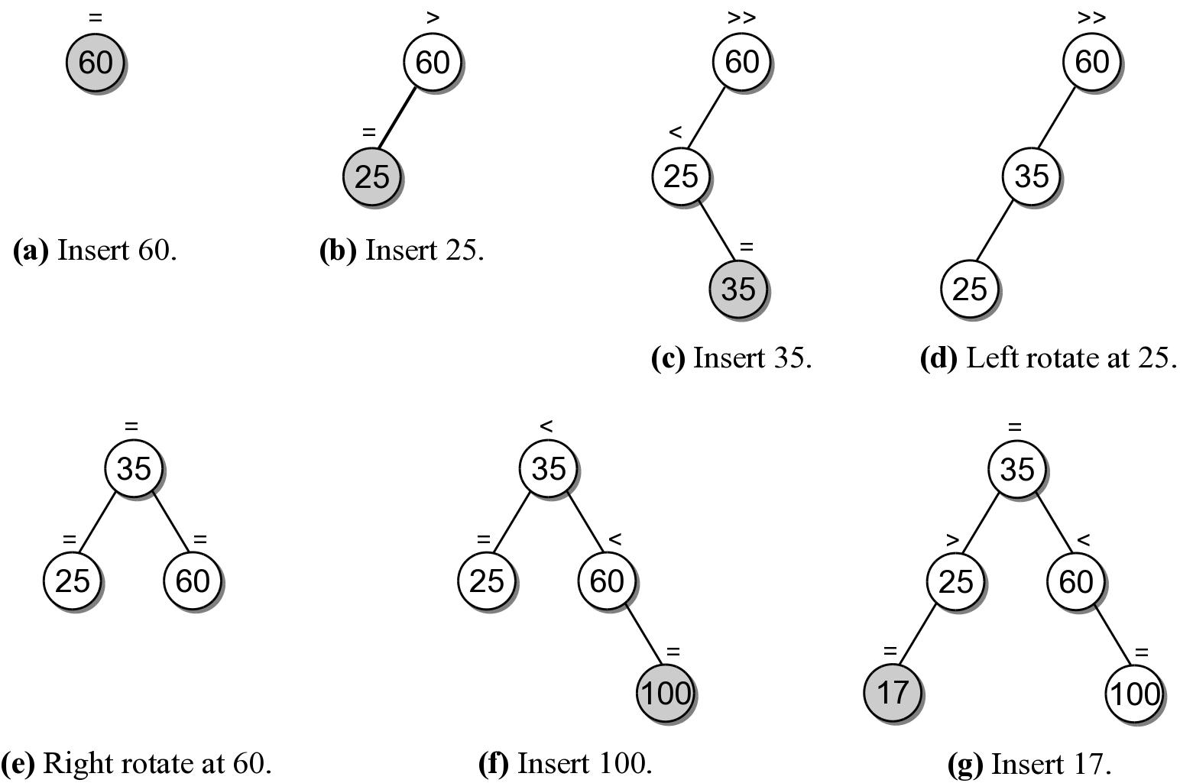
Building an AVL Tree
Suppose we want to build an AVL tree from the list.
60 25 100 35 17 80

Slide 55
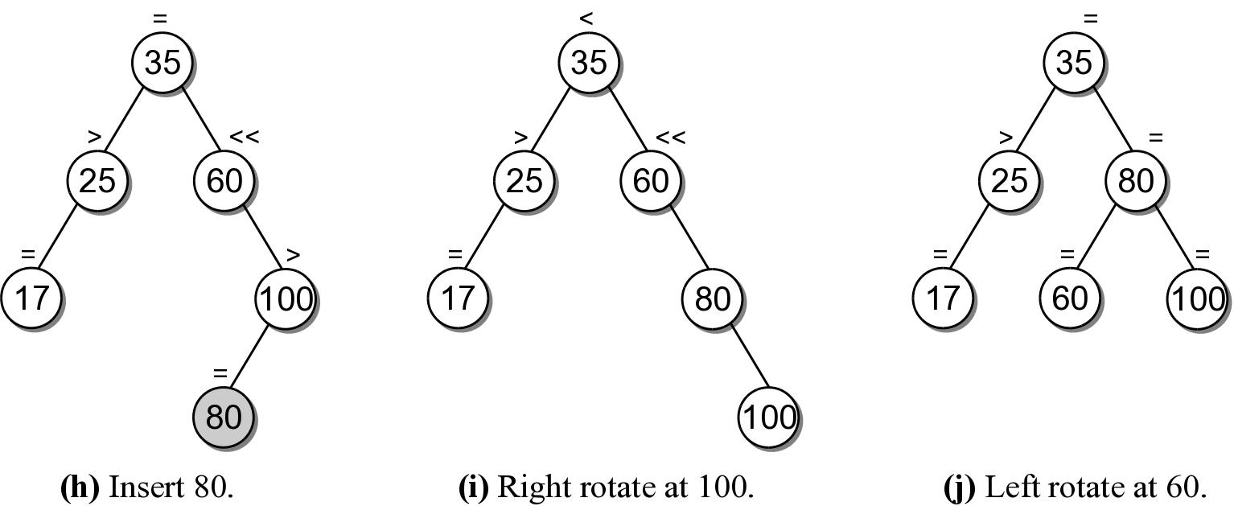
Building an AVL Tree

Slide 56
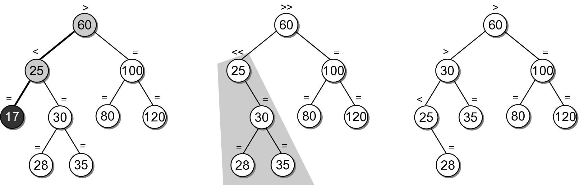
AVL Deletions
When an entry is removed, we must ensure the balance property is maintained.
  Use the same technique as with a BST.
  After the node is removed, subtrees may have to be rebalanced.

Slide 57
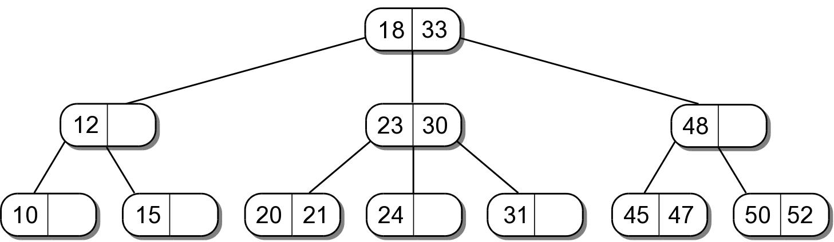
2-3 Trees
A multi-way search tree that can have up to three children.
  Provides fast operations.
  Gets its name from the max number of keys (2) and the max number of children (3) each node can have.

Slide 58
2-3 Tree Definition
A search tree that is always balanced and whose shape and structure is as follows:
  Every node has capacity for one or two keys.
  Every node has capacity for up to three children.
  All leaf nodes are at the same level.
  Every interior node must contain two or three children.
    one key = two children
    two keys = three children

Slide 59
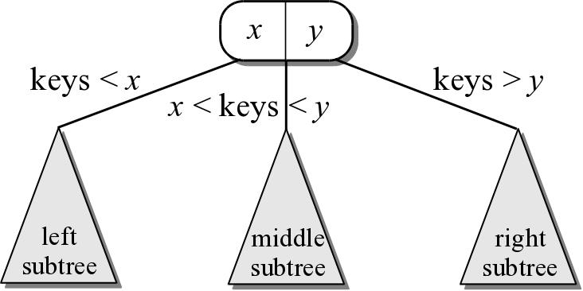
2-3 Tree Search Property
The organization of the keys in a 2-3 tree are based on the search property.

Slide 60
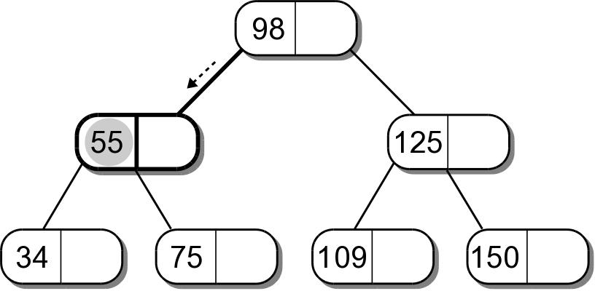
2-3 Tree Searching
Searching a 2-3 tree is similar to that of a BST.
  Start at the root node and follow the appropriate branch.
  The target has to be compared against both keys.

Slide 61
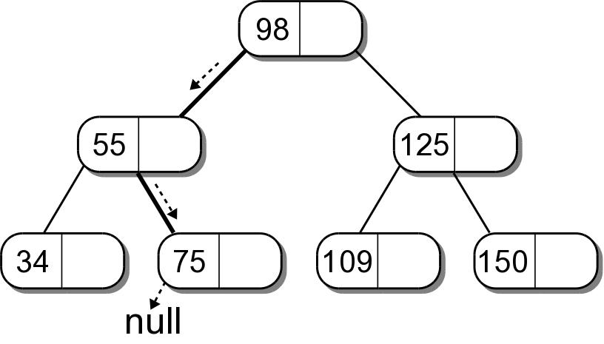
2-3 Tree Searching
Searching for a non-existent key is also the same as in a BST.

Slide 62
2-3 Tree Insertions
Inserting a key into a 2-3 tree is similar to a BST, but a bit more complicated.
  Search for the key as if it were in the tree.
  If there is space in the leaf for the new key, insert it into the leaf node.

Slide 63
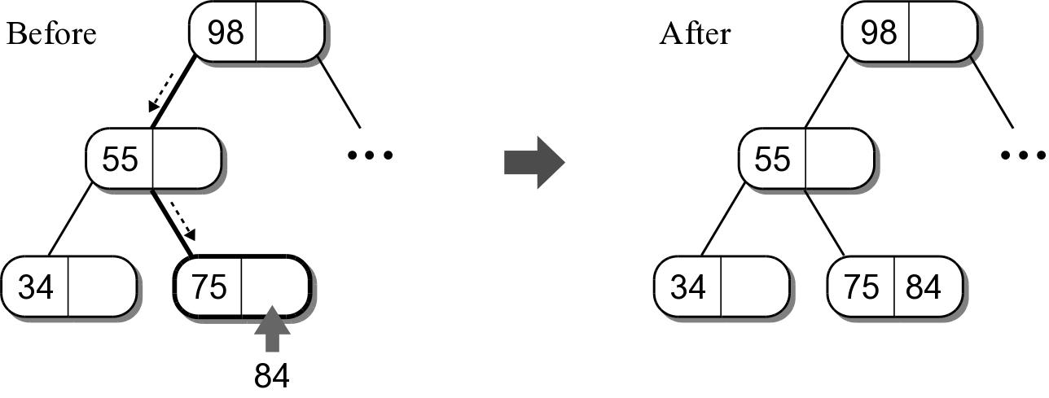
2-3 Tree Insertions
Insert key 84 into our sample tree.
  Key 84 is larger than 75 and becomes key2

Slide 64
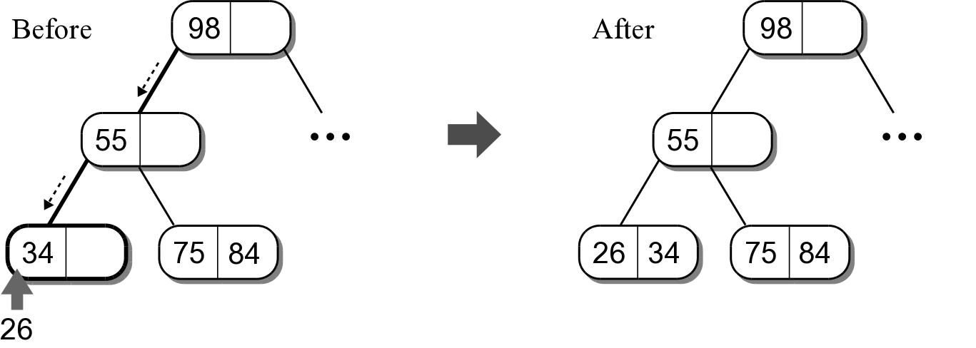
2-3 Tree Insertions
Insert key 26 into our sample tree.
  Key 26 is less than 34 and becomes key 1.

Slide 65
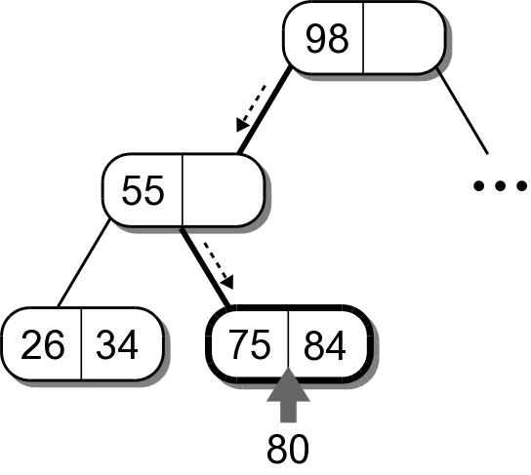
2-3 Tree Insertions
Things become more complicated if the leaf node is full.

Slide 66
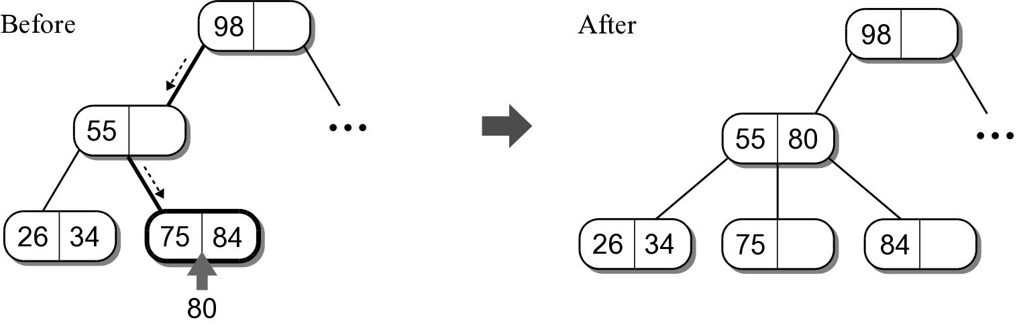
Splitting Leaf Node
All leaf nodes must be at the same level.
  Can not simply create a new node and attach it to the leaf.
  The leaf node has to be split and inserted at the same level.

Slide 67
Splitting Leaf Node
The splitting process involves two steps:
  a new node is created
  the new key is compared to the two keys in the original leaf node.
    smallest is inserted into the original node.
    largest is inserted into the new node.
    middle value is promoted to the parent along with a reference to the new node.

Slide 68
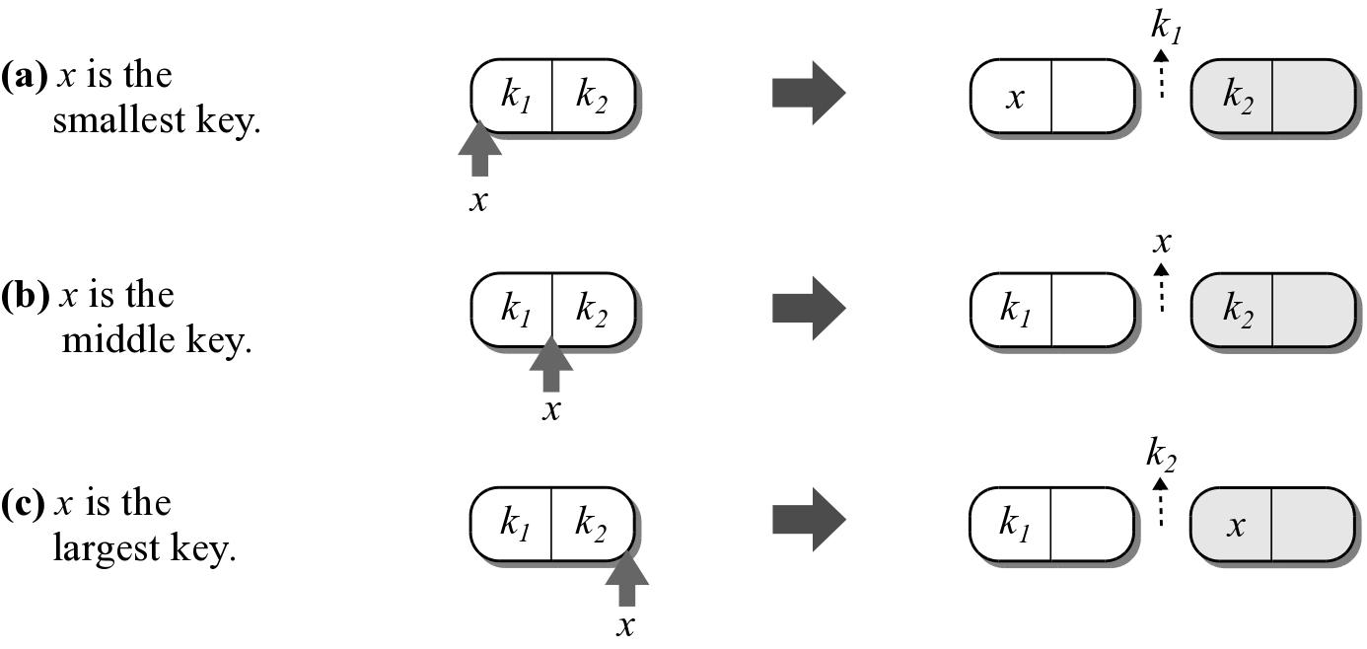
Splitting Leaf Node
Illustration of the three cases.

Slide 69
Key Promotion
When a key is promoted to the parent, it has to be inserted into the parent's node.
  A link reference to the new node is also passed up.
  The link also has to be inserted into the parent node.

Slide 70
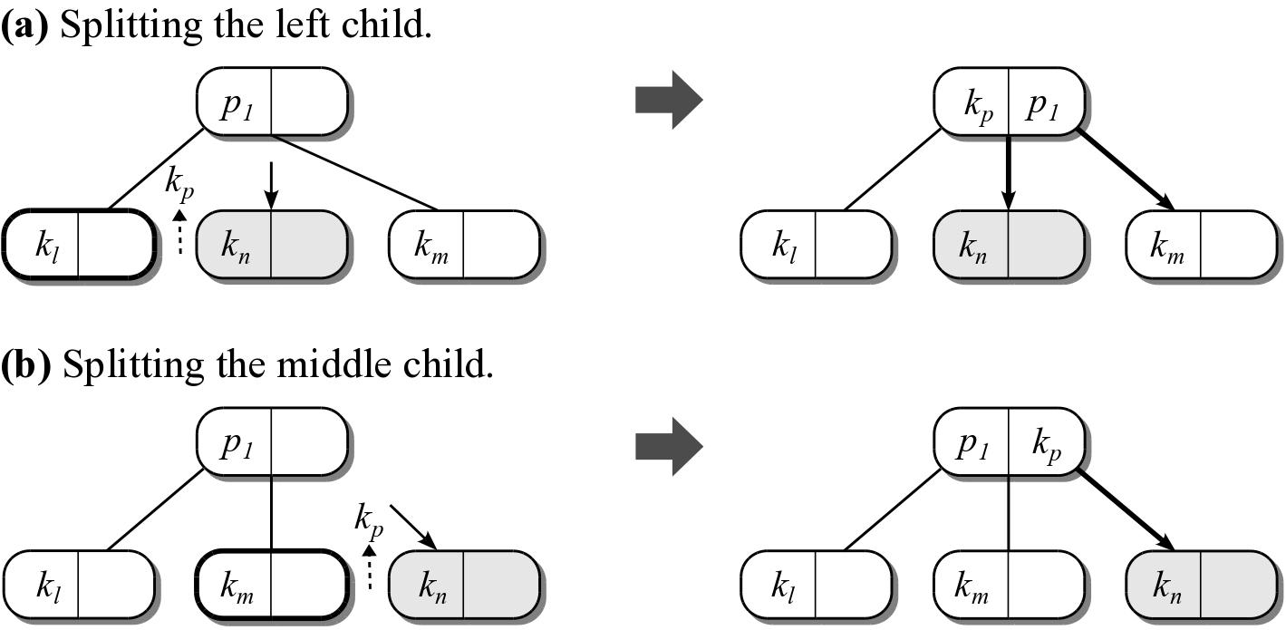
Key Promotion
Inserting the key and reference is simply if the parent contains a single key.

Slide 71
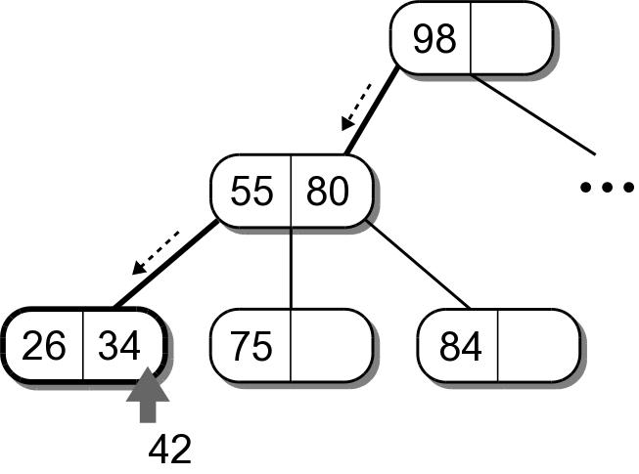
Full Parent Node
What happens if a node is split and its parent contains three children?

Slide 72
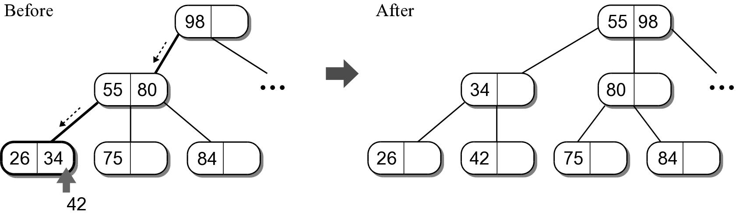
Splitting Parent Node
The parent node has to be split in a similar fashion as a leaf node.

Slide 73
Splitting Parent Node
When the parent node is split, a new parent node is created at the same level.
  The two keys in the original parent and the promoted key have to be distributed.
  Connections between the parents and children have to be modified.
  There are three cases.

Slide 74
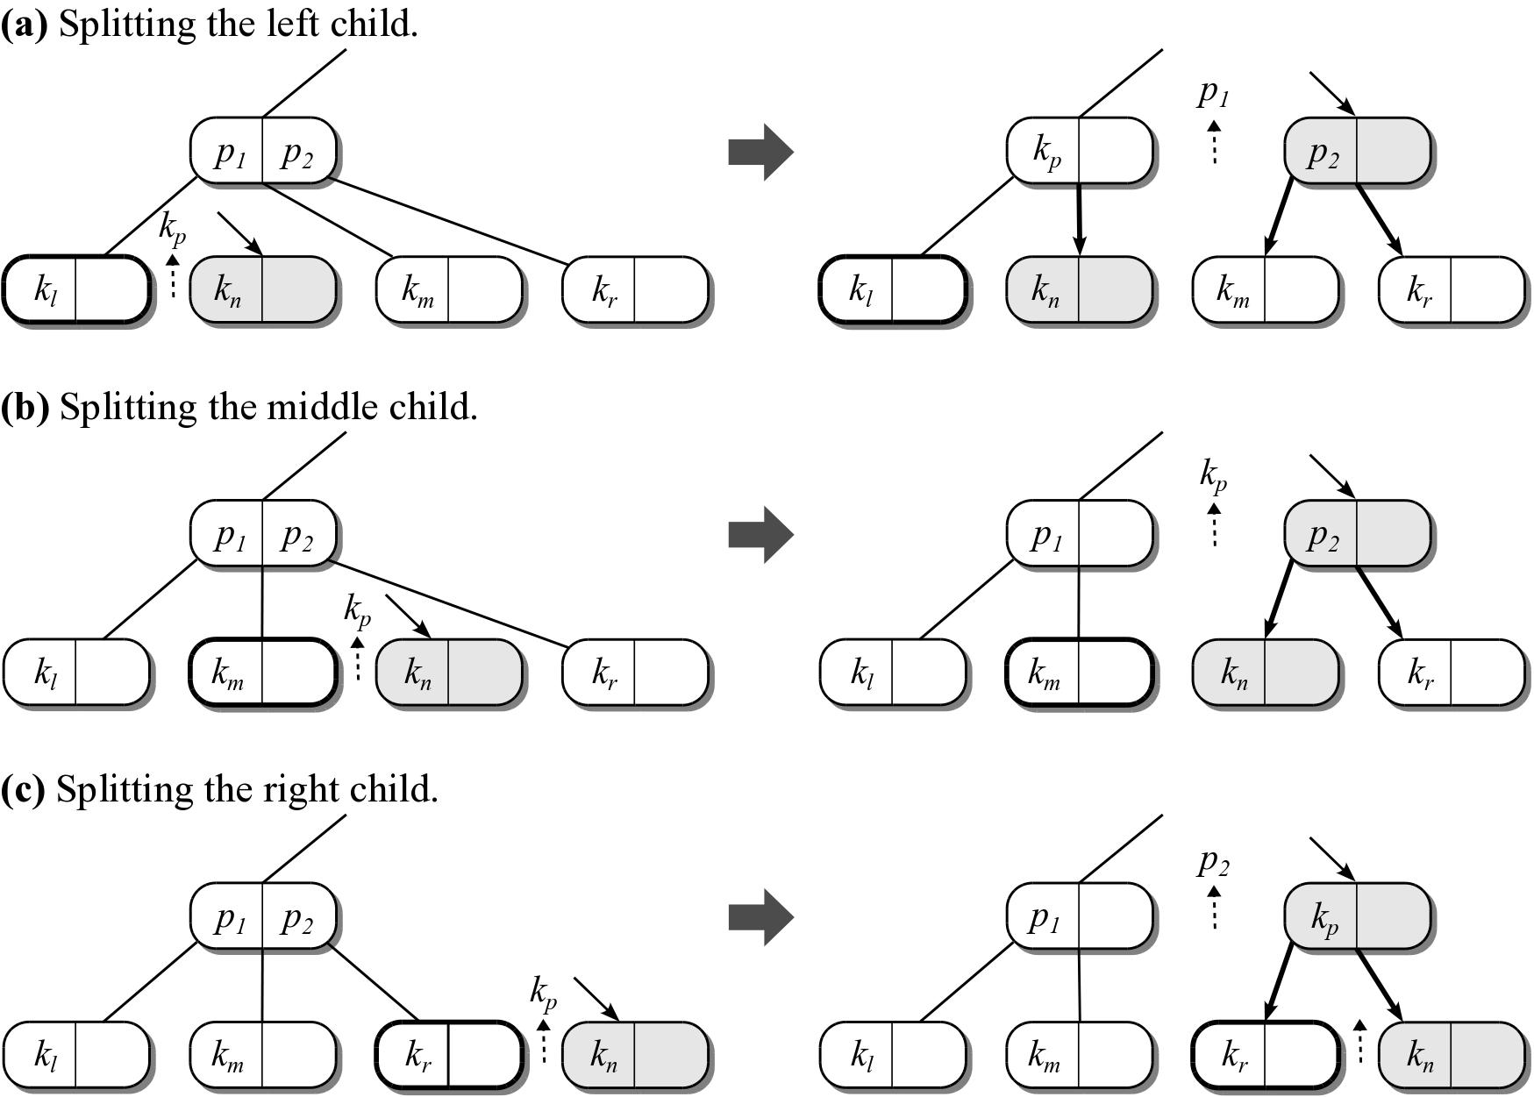
Splitting Parent Node

Slide 75
Recursive Operation
The splitting process can continue up the tree until either a non-full parent node or the root is located.
Splitting the root node is a special case.
  The root node is split like any parent or leaf node.
  A new root node is created into which the promoted key is stored.

Slide 76
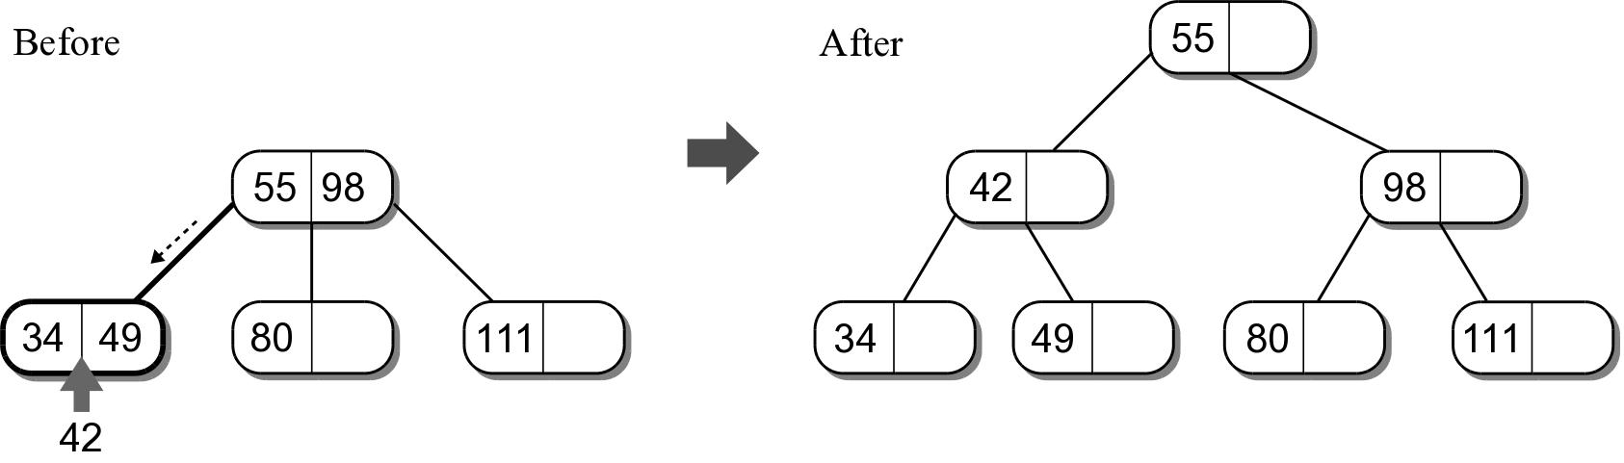
Splitting Root Node
The child links of the new root node must be set:
  The original root becomes the left child.
  The new node created from the original split of the root becomes the middle child.

Slide 77
2-3 Tree Efficiency
The efficiency depends on the height of the tree.
  minimum height = log₃n
  maximum height = log₂n
Operation | Worst Case
search | O(log n)
insert | O(log n)
delete | O(log n)
traversal | O(n)

