Slide 1
Binary Trees
Chapter 13

Slide 2
The Tree Structure
Consists of nodes and edges that organize data in a hierarchical fashion.
  nodes – store the data elements.
  edges – connect the nodes.
The organization of the nodes form relationships between the data elements.

Slide 3
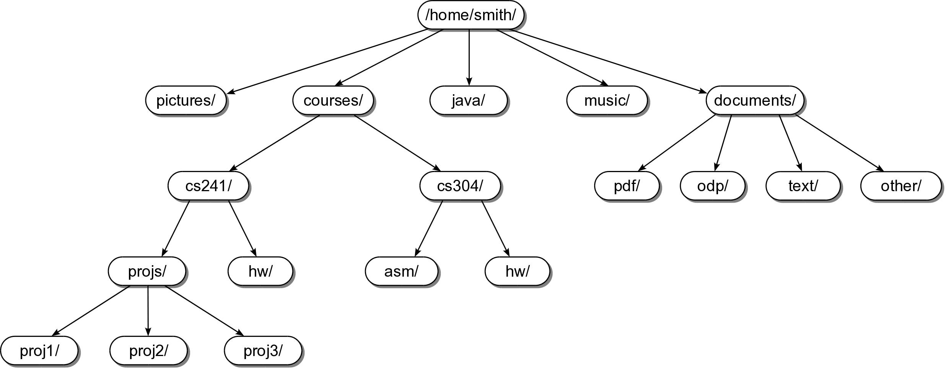
Tree Example #1

Slide 4
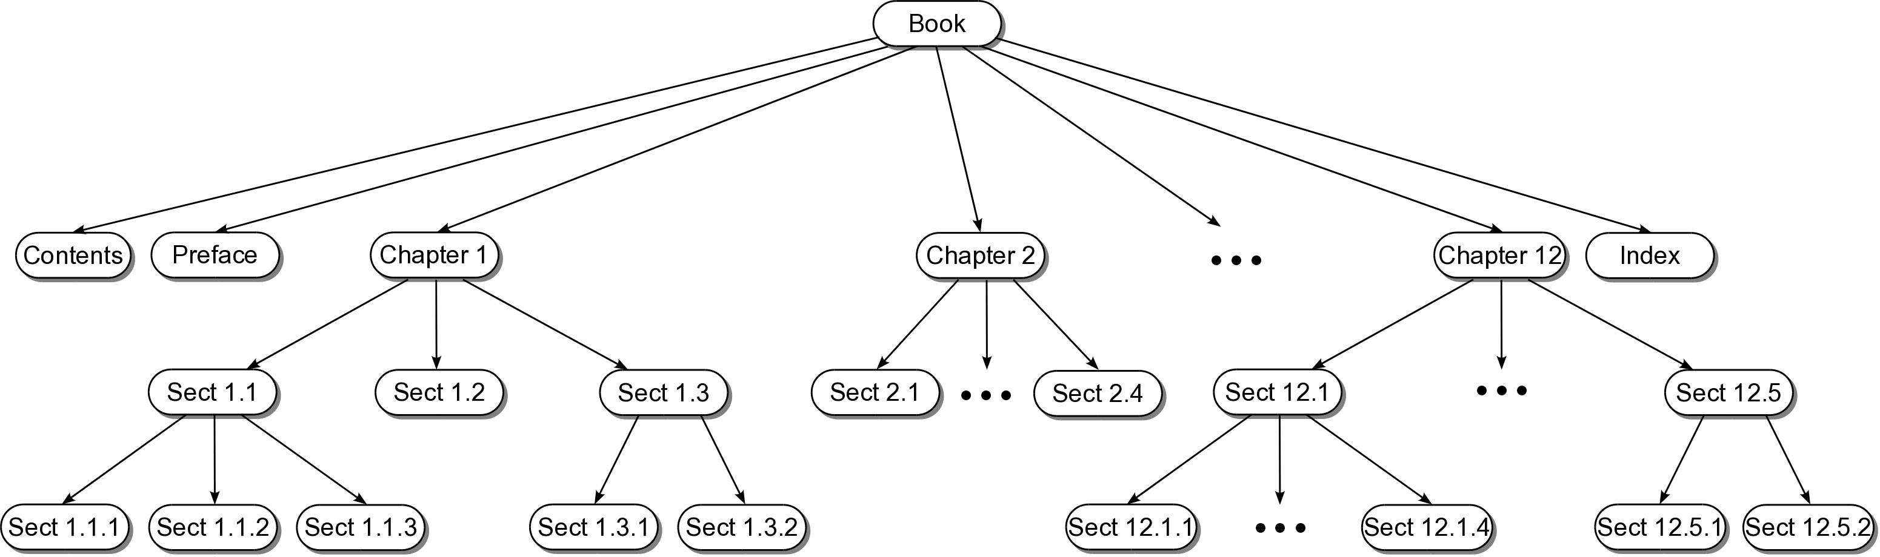
Tree Example #2

Slide 5
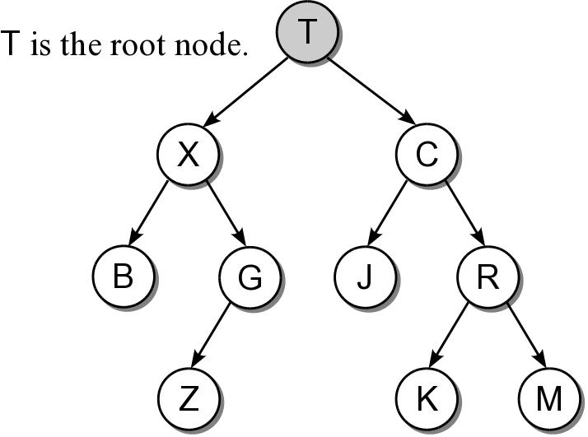
Root Node
Topmost node of the tree.
  Provides the single access point into the tree.
  Has no incoming edges.

Slide 6
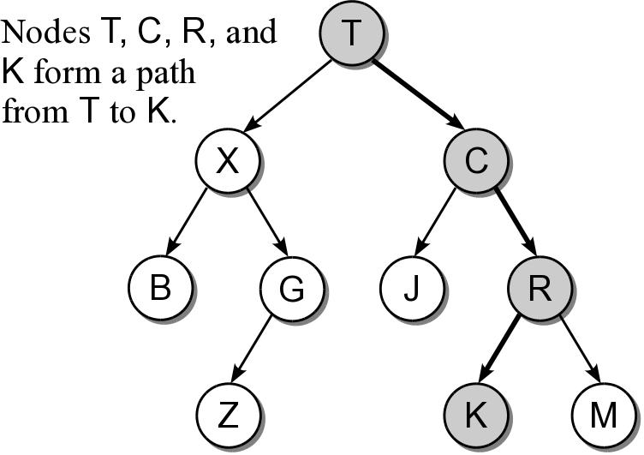
Tree Path
The nodes encountered when following the edges from the root node to the destination node.
  Access to all other nodes must start with the root.

Slide 7
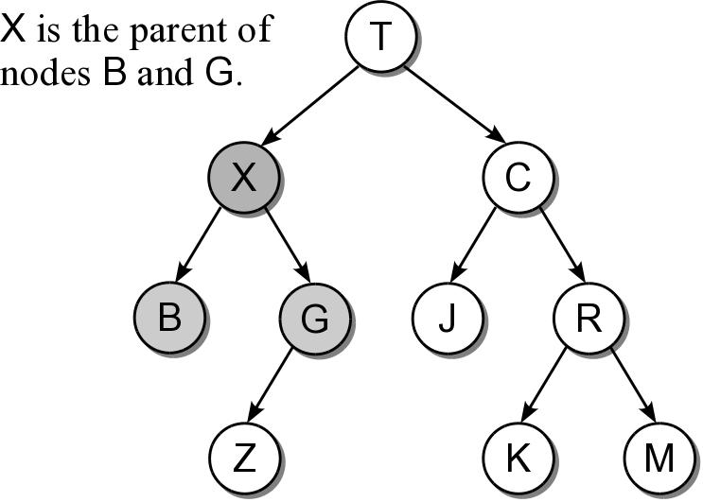
Parent Node
The node from which an incoming edge originates.
  Every node, except the root, has a parent node.
  A node can only have one parent.

Slide 8
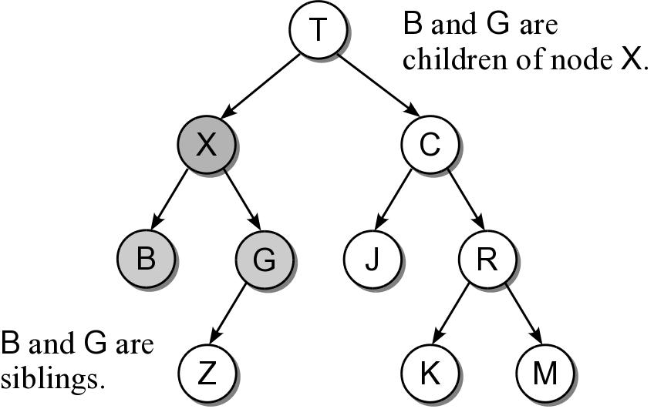
Child Node
The nodes to which outgoing edges are connected.
  Each node can have one or more child nodes.
  Results in a parent-child relationship.
  sibling nodes – all nodes that have the same parent.

Slide 9
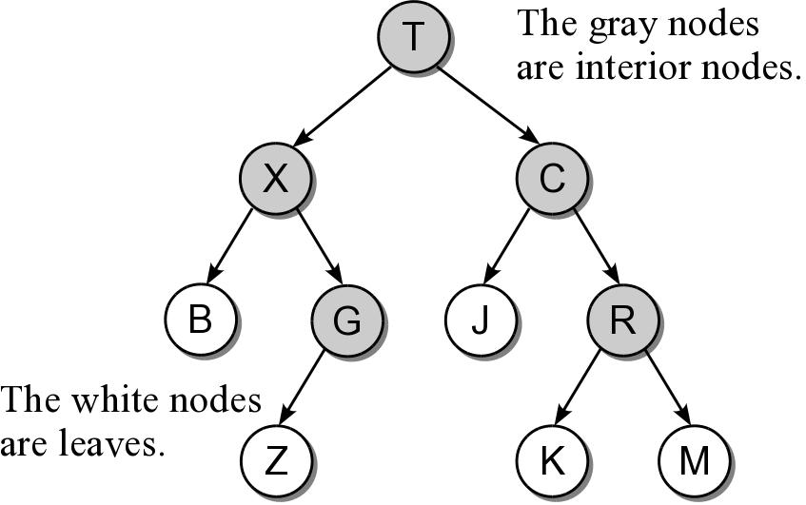
Types of Nodes
Nodes can be classified as either:
  interior node – a node that has at least one child.
  leaf node – a node that has no children.

Slide 10
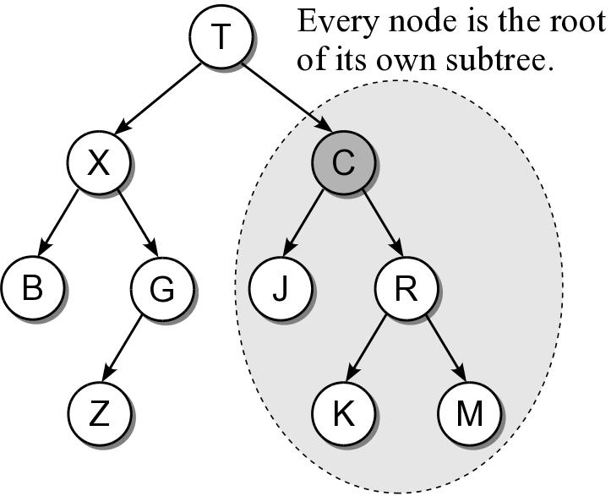
Subtree
A tree is by definition a recursive structure.
  Every node can be the root of its own subtree.
  A subtree consists of a subset of nodes and edges of the larger tree.

Slide 11
Relatives
descendants
  All nodes of a subtree are the descendants of the subtree's root.
  Every node in the tree is a descendant of the root.
ancestors
  The ancestors of a node include all of the nodes along the node's path, excluding the node itself.
  The root is the ancestor of all the other nodes.

Slide 12
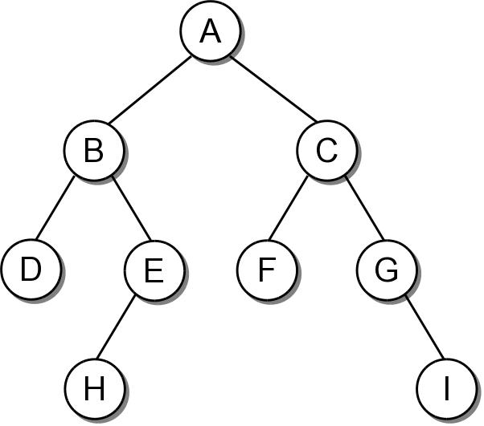
The Binary Tree
A tree in which each node can have at most two children. The nodes are commonly labeled:
  left child
  right child

Slide 13
Binary Tree Properties
There are several properties associated with binary trees that depend on the node organization.
  depth – the distance of a node from the root.
  level – all nodes at a given depth share a level.
  height – number of levels in the tree.
  width – number of nodes on the level containing the most nodes.
  size – number of nodes in the tree.

Slide 14
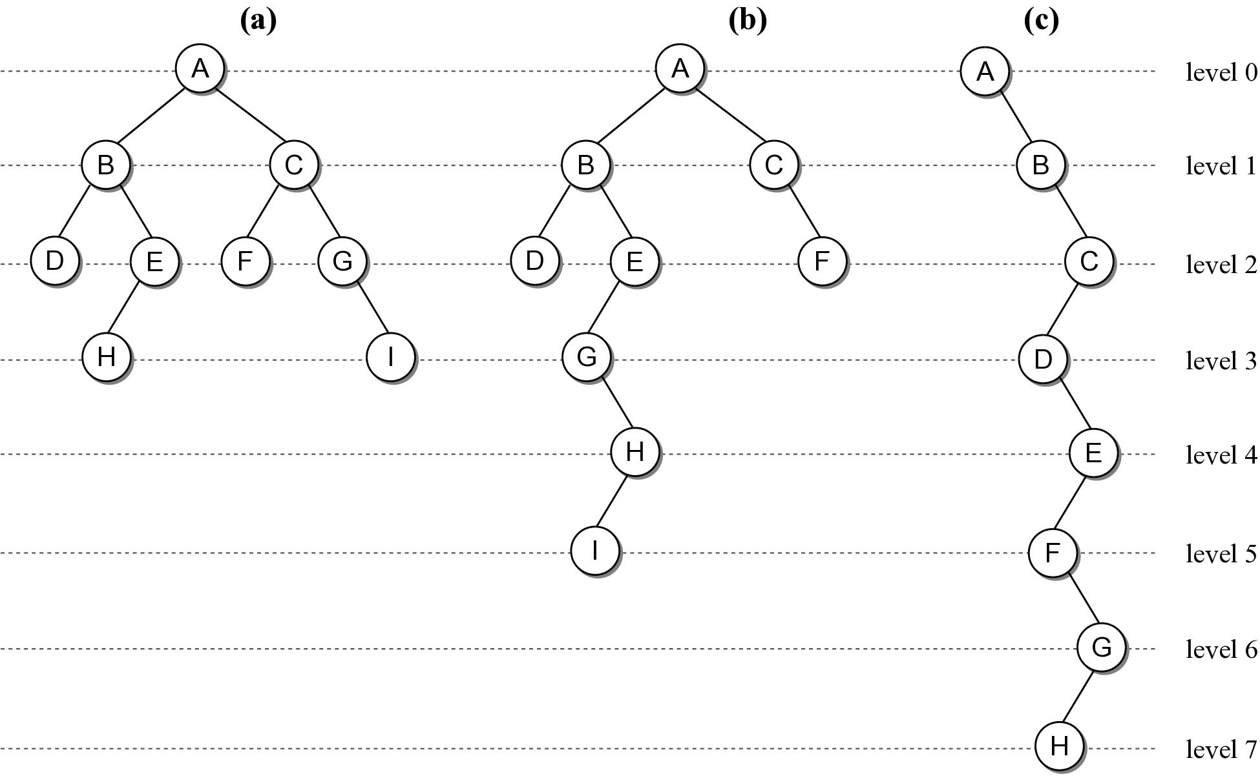
Binary Tree Properties

Slide 15

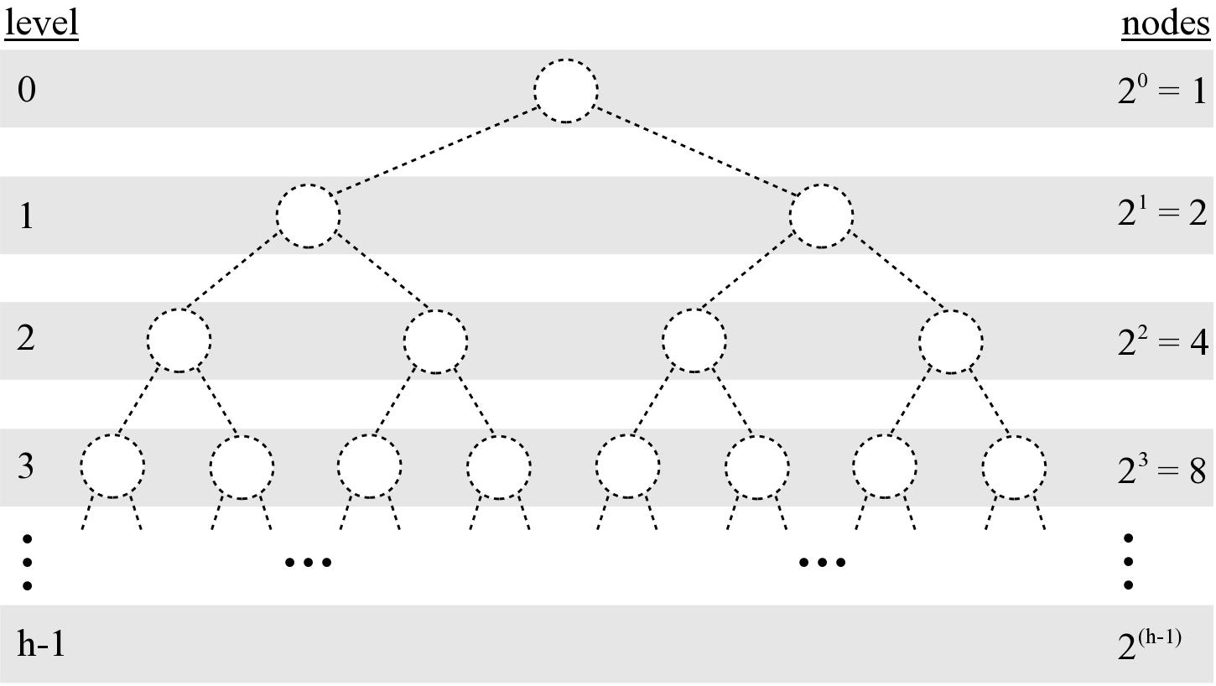
Binary Tree Properties
Given a tree of size n:
  max height = n
  min height =

Slide 16
Binary Tree Structure
Height of a tree will be important in analyzing the efficiency of binary tree algorithms.
Structural properties can play a role in the efficiency of an algorithm.

Slide 17
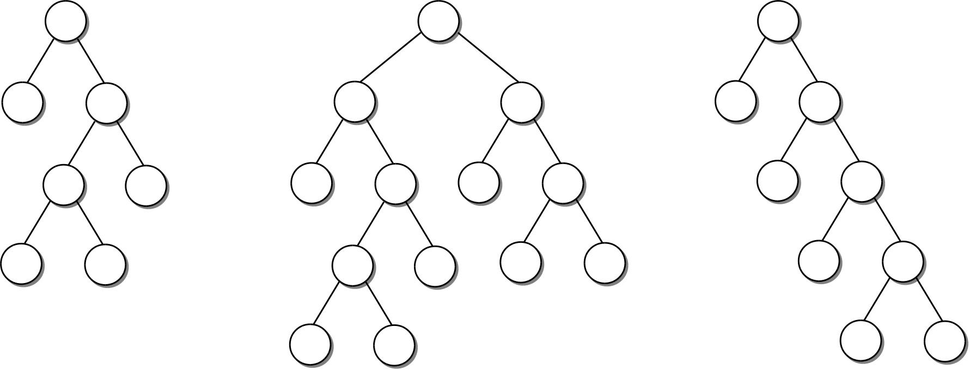
Full Binary Tree
A binary tree in which each interior node contains two children.

Slide 18
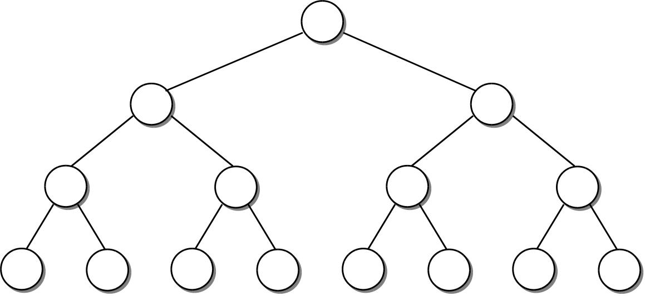
Perfect Binary Tree
A full binary tree in which all leaf nodes are at the same level.

Slide 19
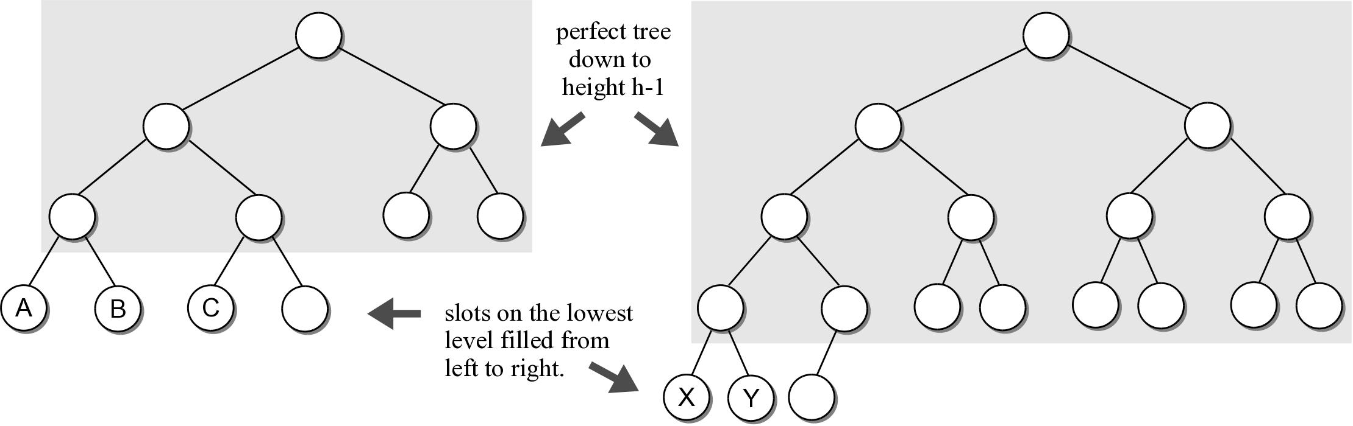
Complete Binary Tree
A binary tree of height h, is a perfect binary tree down to height h – 1 and the nodes at the lowest level are filled from left to right (no gaps).

Slide 20
Binary Tree Implementation
Commonly implemented as a dynamic structure in the same fashion as linked lists.
  Can be used to in many different applications.
  Operations depend on the application.
# The storage class for creating binary tree nodes.
class _BinTreeNode :
def __init__( self, data ):
self.data = data
self.left = None
self.right = None

Slide 21
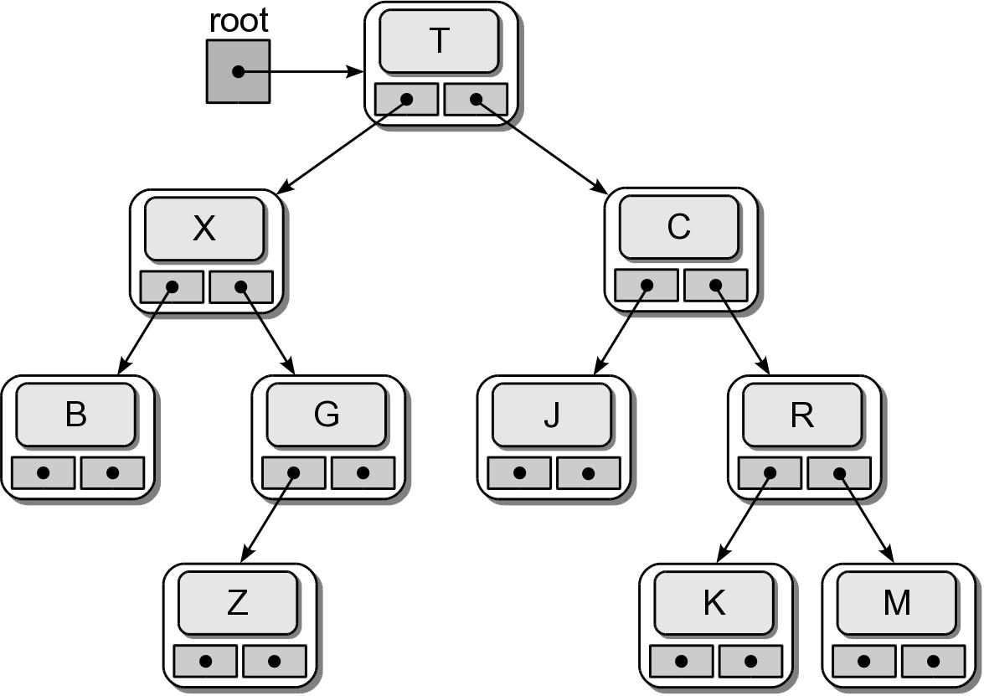
Physical Implementation

Slide 22
Tree Traversals
Iterates through the nodes of a tree, one node at a time in order to visit every node.
  With a linear structure this was simple.
  How is this done with a hierarchical structure?
    Must begin at the root node.
    Every node must be visited.
    Results in a recursive solution.

Slide 23
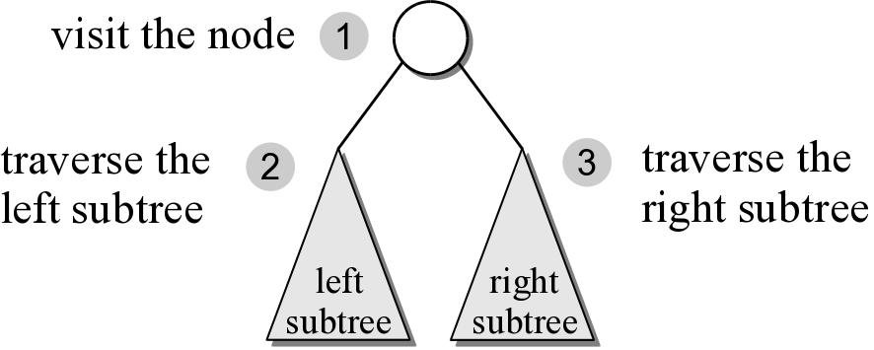
Preorder Traversal
After visiting the root,
  traverse the nodes in the left subtree
  then traverse the nodes in the right subtree.

Slide 24
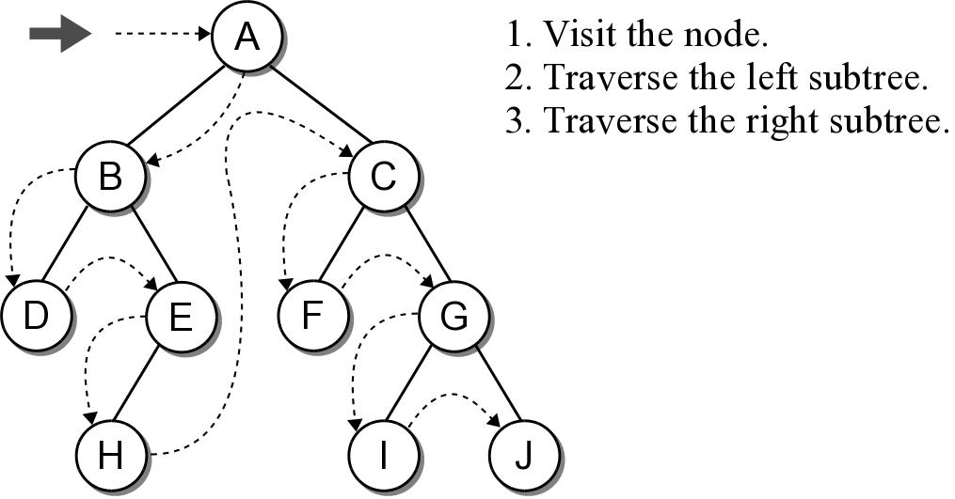
Preorder Traversal

Slide 25
Preorder Traversal
The implementation is rather simple.
Given a binary tree of size n, a complete traversal requires O(n) to visit every node.
def preorderTrav( subtree ):
if subtree is not None :
print( subtree.data )
preorderTrav( subtree.left )
preorderTrav( subtree.right )

Slide 26
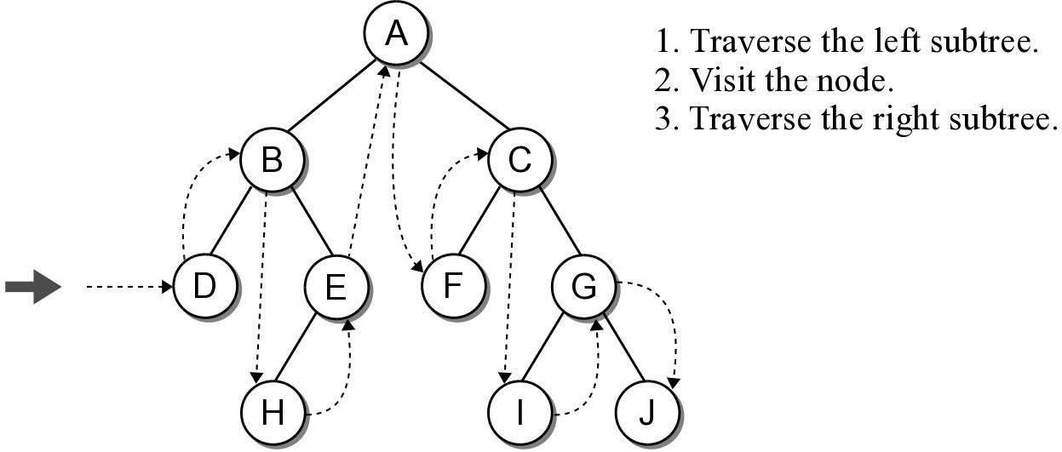
Inorder Traversal
Similar to the preorder traversal, but we traverse the left subtree before visiting the node.

Slide 27
Inorder Traversal
The implementation swaps the order of the visit operation and the recursive calls.
def inorderTrav( subtree ):
if subtree is not None :
inorderTrav( subtree.left )
print( subtree.data )
inorderTrav( subtree.right )

Slide 28
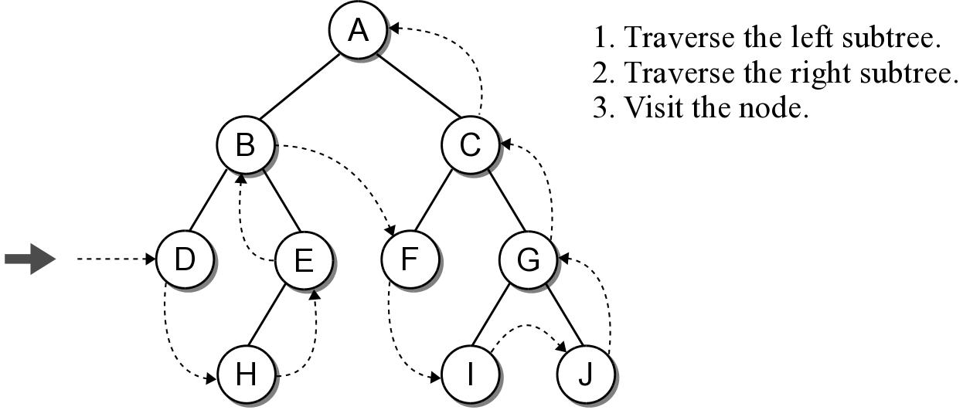
Postorder Traversal
Is the opposite of the preorder traversal.
  Traverse both the left and right subtrees before visiting the node.

Slide 29
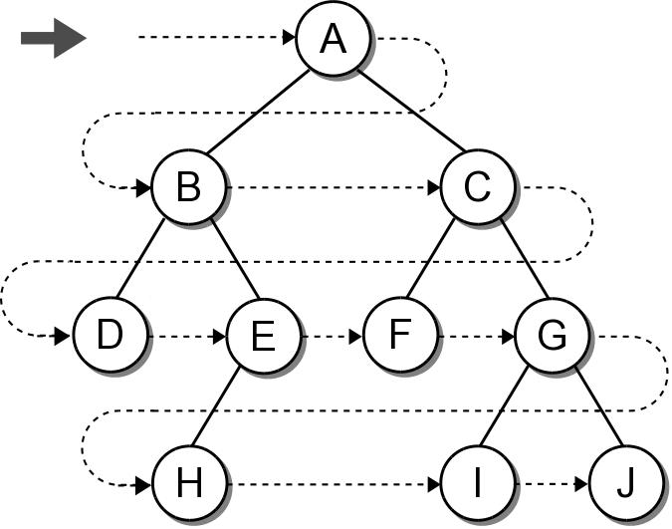
Breadth-First Traversal
The nodes are visited by level, from left to right.
  The previous traversals are all depth-first traversals.

Slide 30
Breadth-First Traversal
Recursion can not be used with this traversal.
We can use a queue and an iterative loop.
def breadthFirstTrav( bintree ):
Queue q
q.enqueue( bintree )
while not q.isEmpty() :
# Remove the next node from the queue and visit it.
node = q.dequeue()
print( node.data )
# Add the two children to the queue.
if node.left is not None :
q.enqueue( node.left )
if node.right is not None :
q.enqueue( node.right )

Slide 31
Expression Trees
A binary tree in which the operators are stored in the interior nodes and the operands are sored in the leaves.
  Used to evaluate an expression.
  Used to convert an infix expression to either prefix or postfix notation.

Slide 32
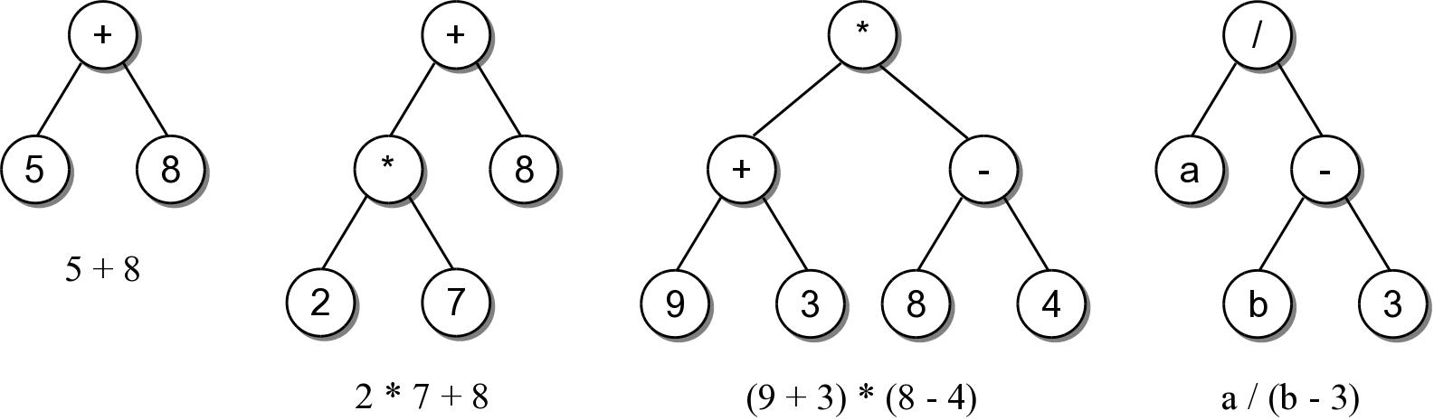
Expression Trees
The tree structure is based on the order in which the operators are evaluated.
  Operators in lower-level nodes are evaluated first.
  The last operator evaluated is in the root node.

Slide 33
Expression Tree ADT
An expression tree is a binary tree repersentation of an arithmetic expression.
  Contains various operators (+, -, *, /, %)
  Contains operands comprised of single integer digits and single-letter variables.
ExpressionTree( expStr ) evaluate( varDict ) toString()

Slide 34
Expression Tree Example
We can use the ADT to evaluate basic arithmetic expressions of any size.
# Create a dictionary containing values for the variables.
vars = { 'a' : 5, 'b' : 12 }
# Build the tree for a sample expression and evaluate it.
expTree = expressionTree( "(a/(b-3))" )
print( "The result = ", expTree.evaluate(vars) )
# We can change the value assigned to a variable
# and reevaluate.
vars['a'] = 22
print( "The result = ", expTree.evaluate(vars) )

Slide 35
Expression Tree Implementation
exptree.py
class ExpressionTree :
def __init__( self, expStr ):
self._expTree = None
self._buildTree( expStr )
def evaluate( self, varMap ):
return self._evalTree( self._expTree, varMap )
def __str__( self ):
return self._buildString( self._expTree )
# ...
# Storage class for creating the tree nodes.
class _ExpTreeNode :
def __init__( self, data ):
self.element = data
self.left = None
self.right = None

Slide 36
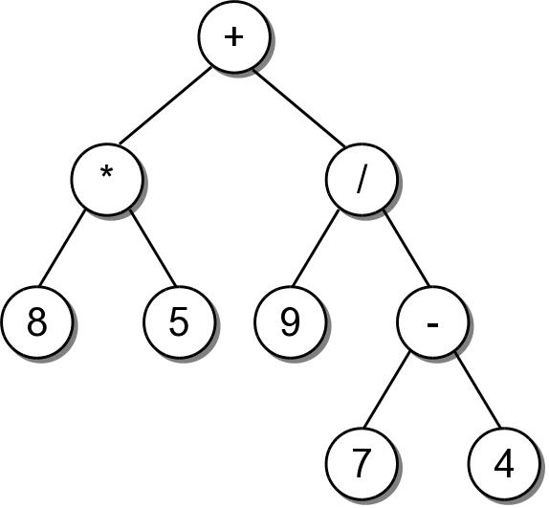
String Representation
To convert an expression tree to a string, we must perform an infix traversal.
8 * 5 + 9 / 7 - 4

Slide 37
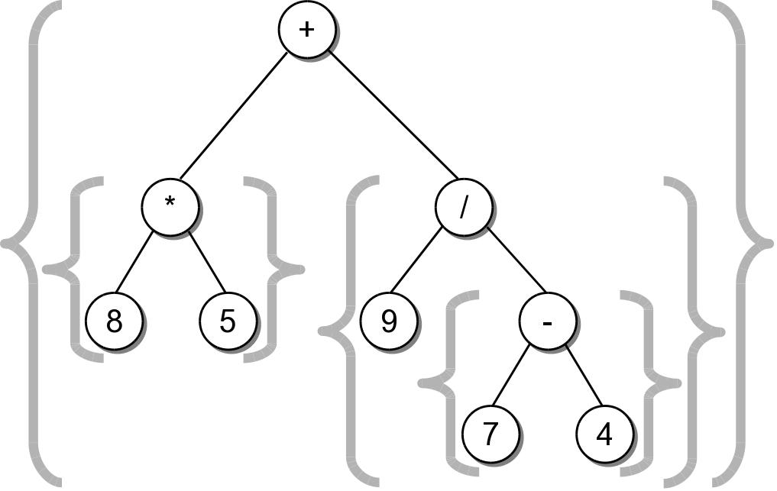
String Representation
The result was not correct because required parentheses were missing.
  Can easily create a fully parenthesized expression.
((8 * 5) + (9 / (7 - 4)))

Slide 38
Expression Tree Implementation
exptree.py
class ExpressionTree :
# ...
def _buildString( self, treeNode ):
# If the node is a leaf, it's an operand.
if treeNode.left is None and treeNode.right is None :
return str( treeNode.element )
# Otherwise, it's an operator.
else :
expStr = '('
expStr += self._buildString( treeNode.left )
expStr += str( treeNode.element )
expStr += self._buildString( treeNode.right )
expStr += ')'
return expStr

Slide 39
Expression Tree Evaluation
We can develop an algorithm to evaluate the expression.
  Each subtree represents a valid subexpression.
  Lower-level subtrees have higher precedence.
  For each node, the two subtrees must be evaluated first.

Slide 40
Expression Tree Implementation
exptree.py
class ExpressionTree :
# ...
def _evalTree( self, subtree, varDict ):
# See if the node is a leaf node
if subtree.left is None and subtree.right is None :
# Is the operand a literal digit?
if subtree.element >= '0' and subtree.element <= '9' :
return int(subtree.element)
else : # Or is it a variable?
assert subtree.element in varDict, "Invalid variable."
return varDict[subtree.element]
# Otherwise, it's an operator that needs to be computed.
else :
# Evaluate the expression in the subtrees.
lvalue = _evalTree( subtree.left, varDict )
rvalue = _evalTree( subtree.right, varDict )
# Evaluate the operator using a helper method.
return computeOp( lvalue, subtree.element, rvalue )

Slide 41
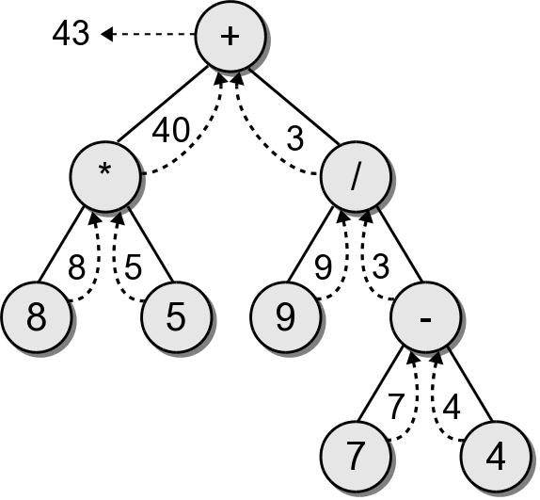
Evaluation Call Tree

Slide 42
Expression Tree Construction
An expression tree is constructed by parsing the expression and examining the tokens.
  New nodes are inserted as the tokens are examined.
  Each set of parentheses will consist of:
    an interior node for the operator
    two children either single valued or a subexperssion.

Slide 43
Expression Tree Construction
For simplicity, we assume:
  the expression is stored in a string with no white space.
  the expression is valid and fully parenthesized.
  each operand will be a single-digit or single-letter variable.
  the operators will consist of +, -, *, /, %

Slide 44
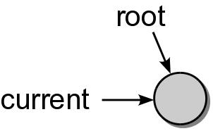
Expression Tree Construction
Consider the expression (8*5)
The process starts with an empty root node set as the current node:
The action at each step depends on the current token.

Slide 45
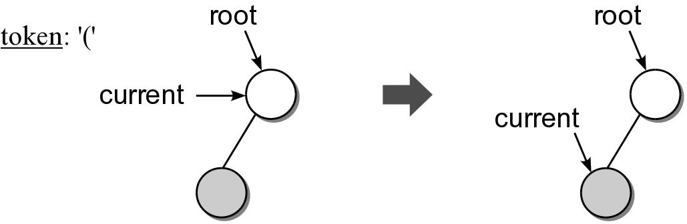
Expression Tree Construction
When a left parenthesis is encountered: (8*5)
  a new node is created and linked as the left child of the current node.
  descend down to the new node.

Slide 46
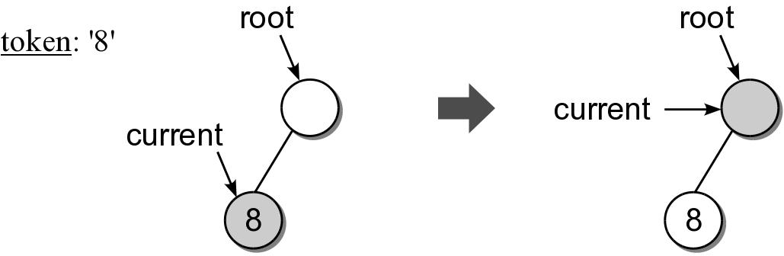
Expression Tree Construction
When an operand is encountered: (8*5)
  the data field of the current node is set to contain the operand.
  move up to the parent of current node.

Slide 47
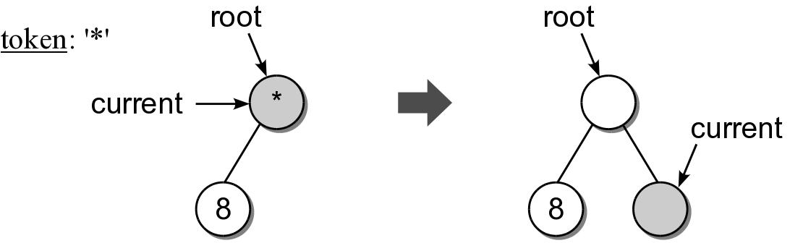
Expression Tree Construction
When an operator is encountered: (8*5)
  the data field of the current node is set to the operator.
  a new node is created and linked as the right child of the current node.
  descend down to the new node.

Slide 48
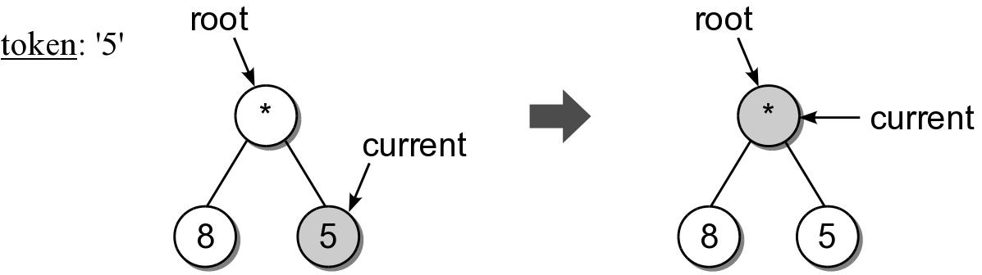
Expression Tree Construction
Another operand is encountered: (8*5)

Slide 49
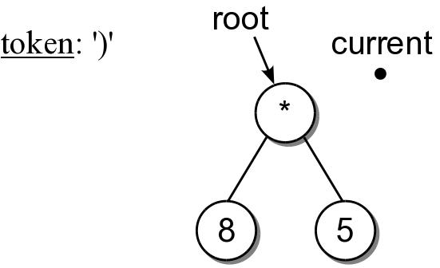
Expression Tree Construction
When a right parenthesis: (8*5)
  move up to the parent of the current node.

Slide 50
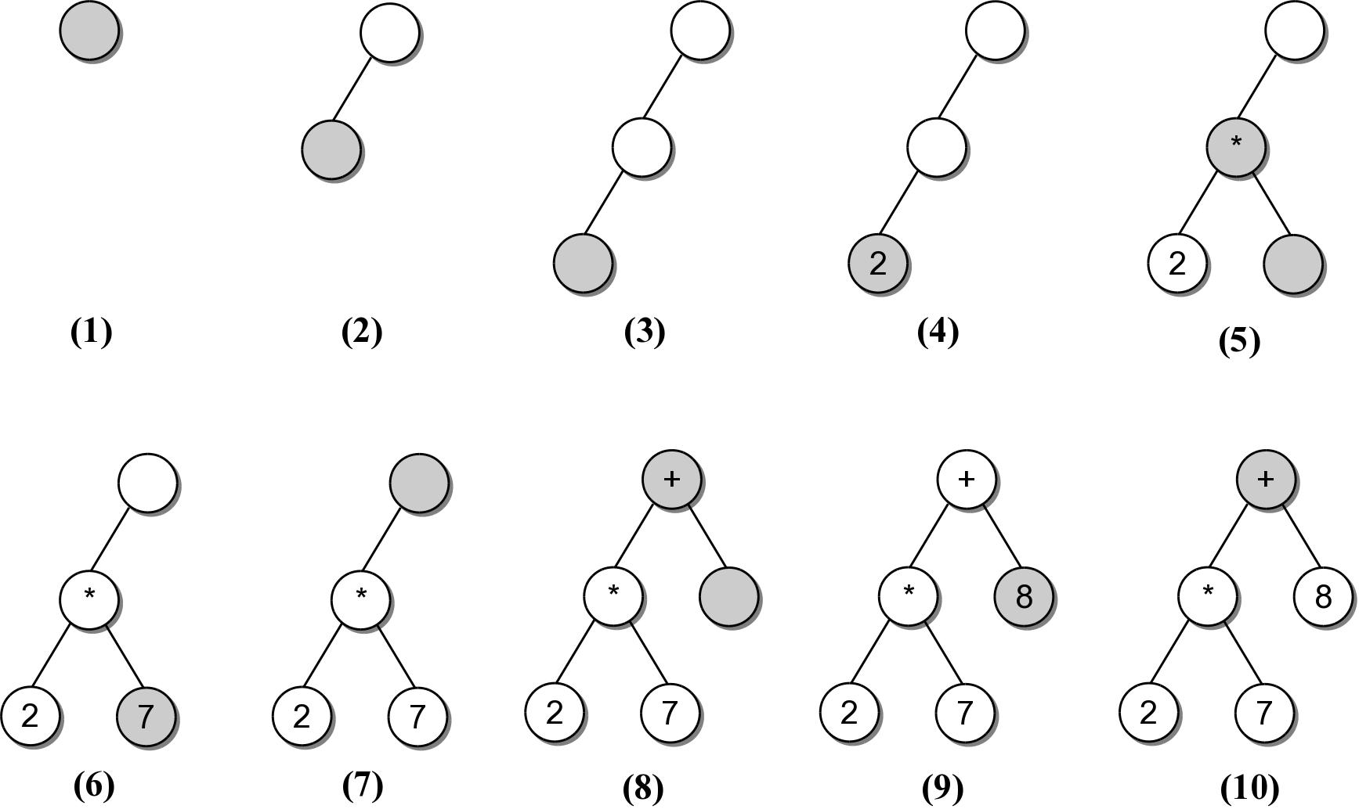
Expression Example #2
Consider another expression:
((2*7)+8)

Slide 51
Expression Tree Implementation
exptree.py
class ExpressionTree :
# ...
def _buildTree( self, expStr ):
# Build a queue containing the tokens from the expression.
expQ = Queue()
for token in expStr :
expQ.enqueue( token )
# Create an empty root node.
self._expTree = _ExpTreeNode( None )
# Call the recursive function to build the tree.
self._recBuildTree( self._expTree, expQ )

Slide 52
Expression Tree Implementation
exptree.py
class ExpressionTree :
# ...
def _recBuildTree( self, curNode, expQ ):
# Extract the next token from the queue.
token = expQ.dequeue()
# See if the token is a left paren: '('
if token == '(' :
curNode.left = _ExpTreeNode( None )
buildTreeRec( curNode.left, expQ )
# The next token will be an operator: + - / * %
curNode.data = expQ.dequeue()
curNode.right = _ExpTreeNode( None )
self._buildTreeRec( curNode.right, expQ )
# The next token will be a ), remove it.
expQ.dequeue()
# Otherwise, the token is a digit.
else :
curNode.element = token

Slide 53
Heaps
A heap is a complete binary tree in which the nodes are organized based on their data values.
heap order property – how the nodes in a heap or arranged.
heap shape property – as a complete binary tree.

Slide 54
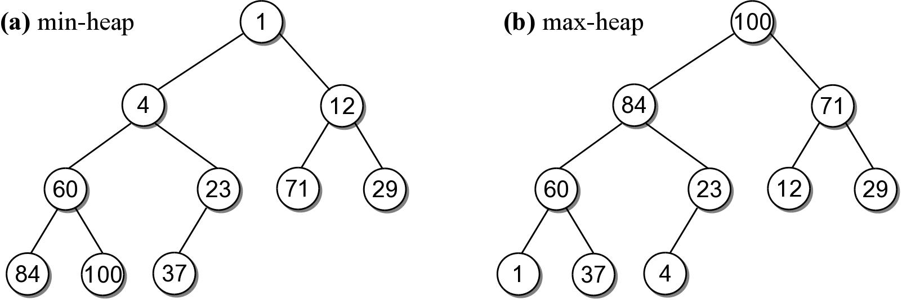
Example Heaps
For each non-leaf node V,
  max-heap: the value in V is greater than the value of its two children.
  min-heap: the value in V is smaller than the value of its two children.

Slide 55
Heap Operations
The heap is a specialized structure with limited operations.
  Insert an element into the heap.
  Remove the element from root node.

Slide 56
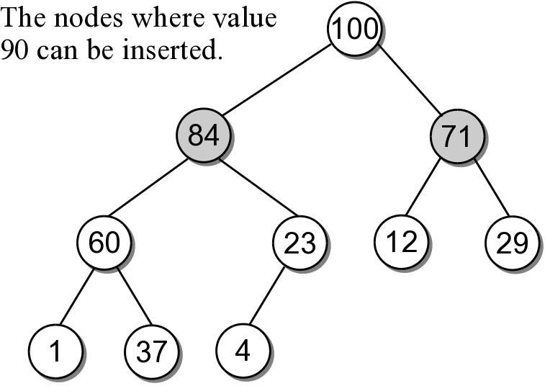
Heap Insertions
When an element is inserted into a heap, both properties must be maintained.
  Example: add 90 to the max-heap.
  There are only 2 places where 90 can be inserted.

Slide 57
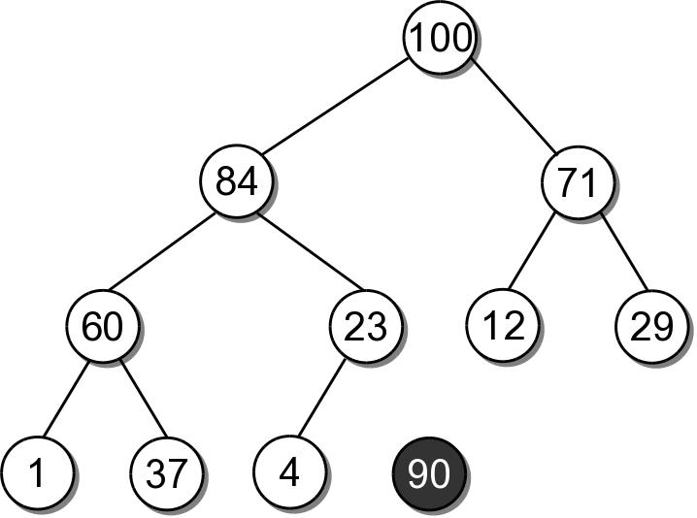
Heap Insertions
To properly insert an element into a heap involves several steps.
  Create a new node for value.

Slide 58
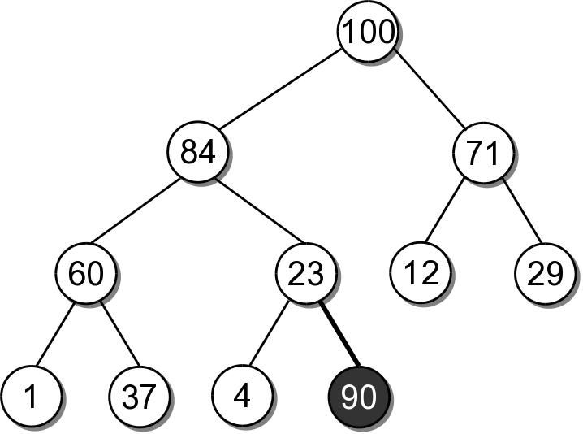
Heap Insertions
Link the node in as the last child in the complete tree.

Slide 59
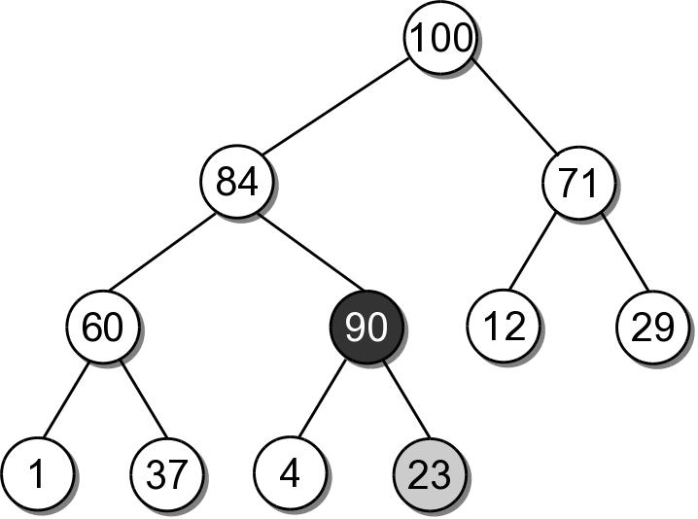
Heap Insertions
To restore the heap property, the new element has to move up along its path:
  the data is swapped with its parent's data.
  sift-up

Slide 60
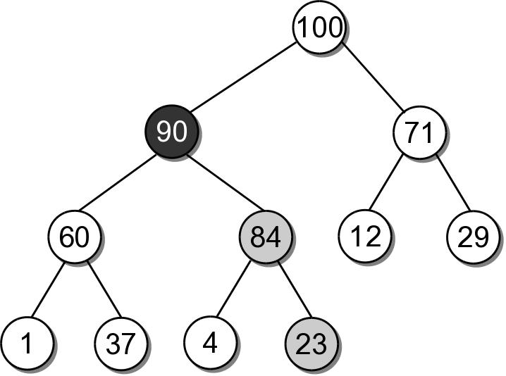
Heap Insertions
90 must move up another level since 84 is smaller.
After which, it is in it's correct position.

Slide 61
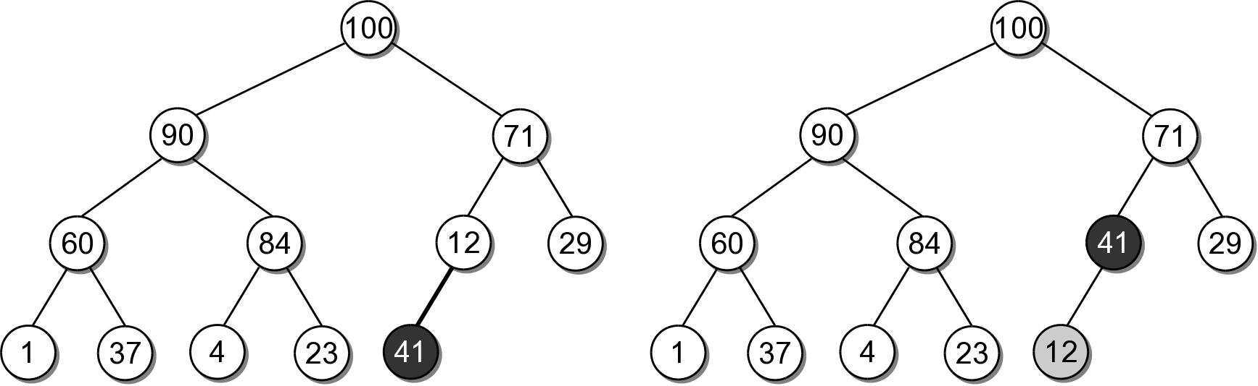
Heap Insert Example
Insert 41 into the heap from the previous slide.

Slide 62
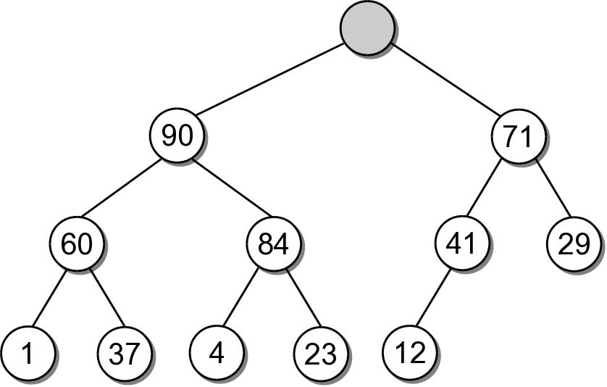
Heap Extractions
When an element is extracted from the heap, it can only come from the root node.
  Both heap properties must be maintained.

Slide 63
Heap Extractions
To restore the tree to a heap:
  another value will have to take the place of the extracted value in the root node.
  a node has to be removed from the tree.

Slide 64
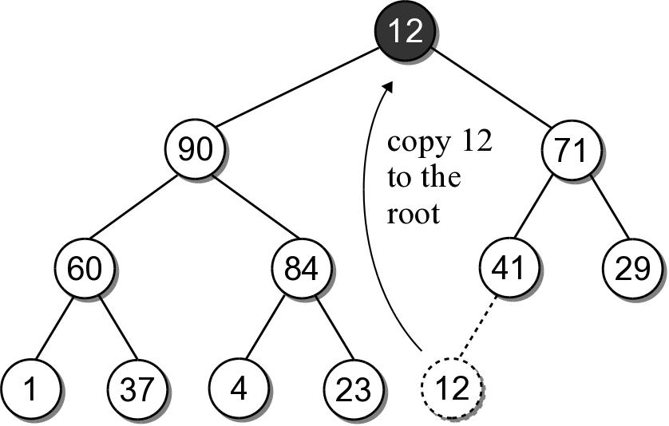
Heap Extractions
There is only one node that can be removed and still maintain the heap shape property.
  Copy the data from the last child node to the root.
  Delete the last child node.

Slide 65
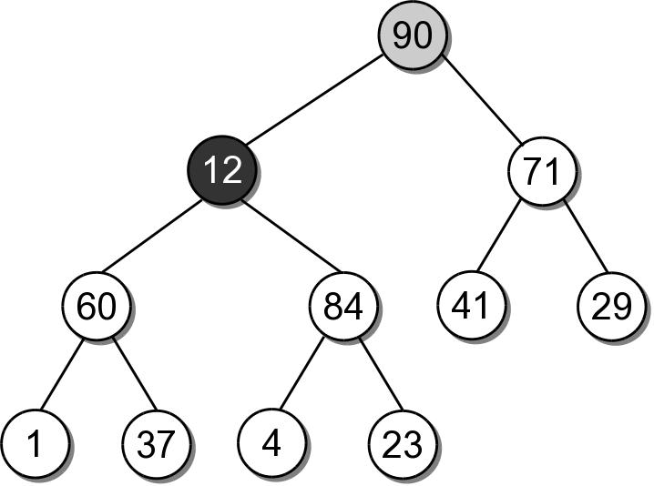
Heap Extractions
To maintain the heap order property, the new root value has to be sifted-down.

Slide 66
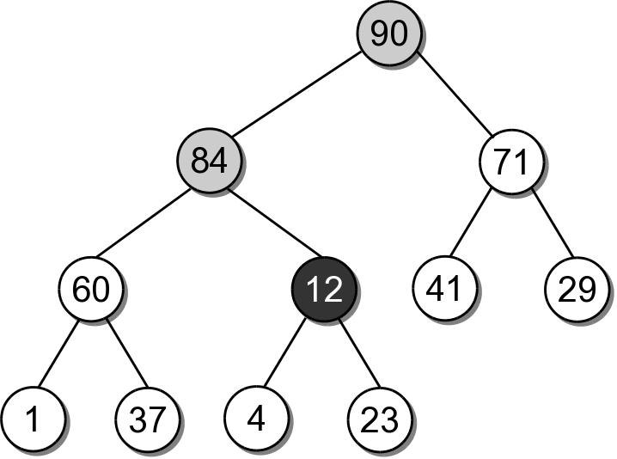
Heap Extractions
The shifting continues until the value is placed into a leaf node, or it is larger than its children.

Slide 67
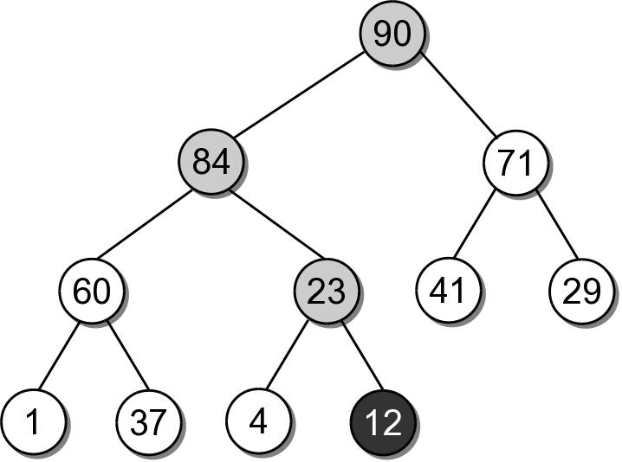
Heap Extractions
After being swapped with 23, value 12 will be in a node that maintains the heap order property.

Slide 68
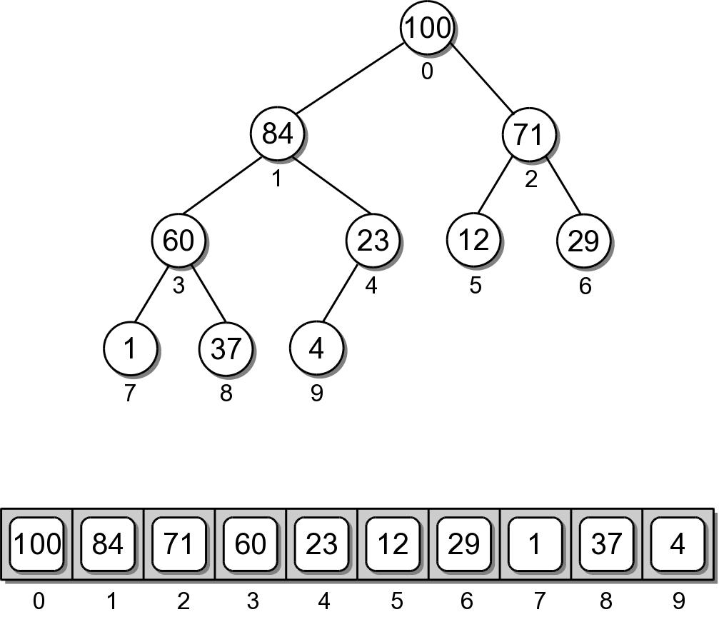
Heap Implementation
While a heap is a binary tree, it's seldom implemented as a dynamically linked structure.
  Use a sequence to physically store the nodes.

Slide 69
Heap – Node Access
The complete tree will never contain “holes”.
  The root will always be at position 0.
  Its two children will always occupy positions 1 and 2.
  The children of any node will always occupy the same position.

Slide 70
Heap – Node Access
Given the array index i
  parent = (i-1) // 2
  left = 2 * i + 1
  right = 2 * i + 2
A child link is null if the index is out of range.

Slide 71
Heap – Class Definition
arrayheap.py
class MaxHeap :
def __init__( self, maxSize ):
self._elements = Array( maxSize )
self._count = 0
def __len__( self ):
return self._count
def capacity( self ):
return len( self._elements )
# ...

Slide 72
Heap – Class Definition
arrayheap.py
class MaxHeap :
# ...
def add( self, value ):
assert self._count < self.capacity(),
"Cannot add to a full heap."
# Add the new value to the end of the list.
self._elements[ self._count ] = value
self._count += 1
# Sift the new value up the tree.
self._siftUp( self._count - 1 )
def _siftUp( self, ndx ):
if ndx > 0 :
parent = ndx // 2
if self._elements[ndx] > self._elements[parent] :
tmp = self._elements[ndx]
self._elements[ndx] = self._elements[parent]
self._elements[parent] = tmp
self._siftUp( parent )

Slide 73
Heap – Class Definition
arrayheap.py
class MaxHeap :
# ...
def extract( self ):
assert self._count > 0,
"Cannot extract from an empty heap."
value = self._elements[0]
self._count -= 1
self._elements[0] = self._elements[ self._count ]
self._siftDown( 0 )

Slide 74
Heap – Class Definition
arrayheap.py
class MaxHeap :
# ...
def _siftDown( self, ndx ):
left = 2 * ndx + 1
right = 2 * ndx + 2
largest = ndx
if left < count and \
self._elements[left] >= self._elements[largest] :
largest = left
elif right < count and \
self._elements[right] >= self._elements[largest]:
largest = right
if largest != ndx :
swap( self._elements[ndx], self._elements[largest] )
_siftDown( largest )

Slide 75
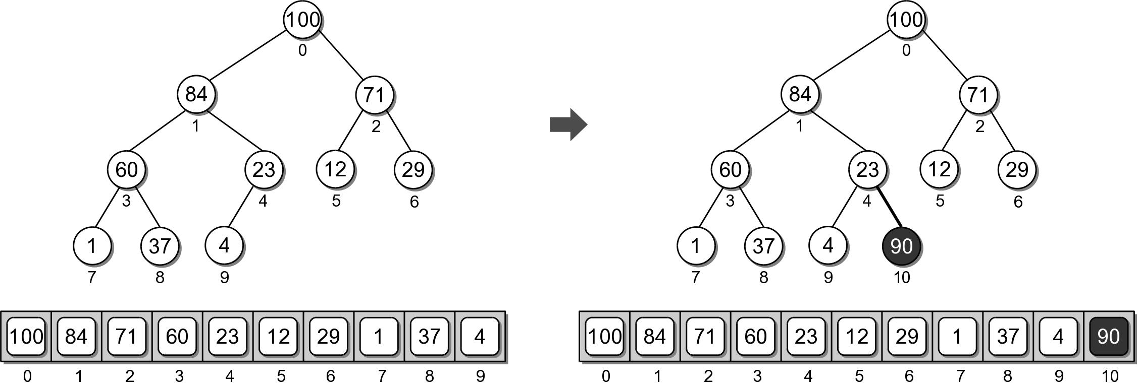
Heap Example
Physical view of adding value 90.

Slide 76
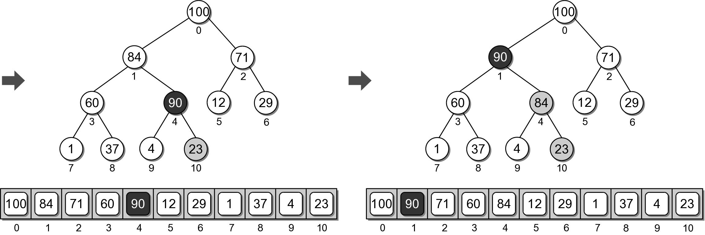
Heap Example
Physical view of adding value 90.

Slide 77
Heap Analysis
Assume a heap containing n elements:
  Insertion: O(log n)
  Extraction: O(log n)

Slide 78
Priority Queue Revisited
The unbounded priority queue does not place a restriction on the priority values.
  Earlier we explored an implementation that used a linked list.
    enqueue: O(1)
    dequeue: O(n)
  Can we improve the efficiency using a heap?

Slide 79
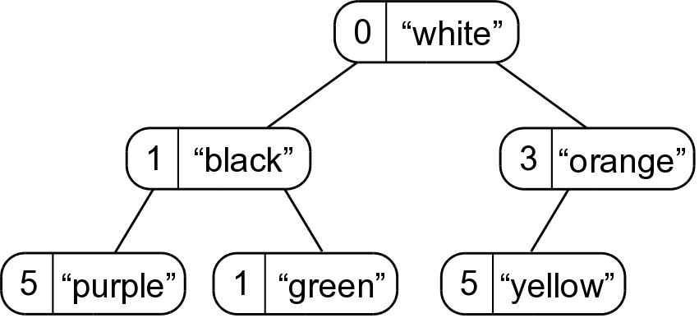
Unbounded Priority Queue
Use a min-heap:
  Store both the priority and queue elements in each element of the heap.
  The heap ordering is based on the priority.

Slide 80
Priority Queue Comparison
Implementation | Worst Case |  | Amortized
 | Enqueue | Dequeue | Enqueue | Dequeue
Python List | O(n) | O(n) | O(1) | O(n)
Linked List | O(1) | O(n) | - | -
Heap (array) | O(log n) | O(log n) | - | -
Heap (list) | O(n) | O(n) | O(log n) | O(log n)

Slide 81
The Heapsort
The simplicity and efficiency of the heap structure can be applied to the sorting problem.
  Build a heap from a sequence of unsorted keys.
  Extract the keys from the heap to create a sorted sequence.
Very efficient: O(n log n)

Slide 82
Heapsort Implementation
A simple implementation is provided below.
def simpleHeapSort( theSeq ):
# Create an array-based max-heap.
n = len(theSeq)
heap = MaxHeap( n )
# Build a max-heap from the list of values.
for item in theSeq :
heap.add( item )
# Extract each value from the heap and store
# them back into the list.
for i in range( n, 0, -1 ) :
theSeq[i] = heap.extract()

Slide 83
In-Place Heapsort
The previous version required additional storage for the heap.
The entire process can be done in-place within the original sequence.
  Suppose we are given the following array

Slide 84
In-Place Heapsort
The first step is to construct a max-heap.
  The heap nodes occupy the array from front to back.
  We can keep the heap elements in the front and those yet to be added at the back.
  Keep track of where the heap ends.

Slide 85
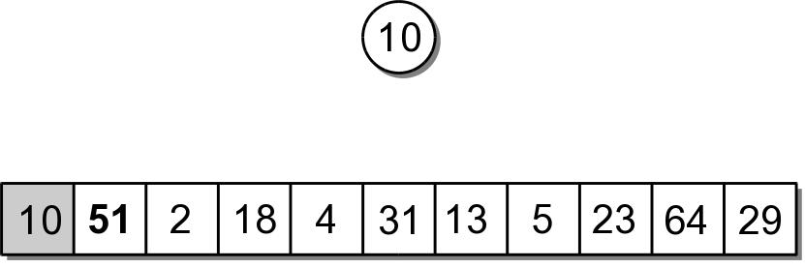
In-Place Heapsort
The first value in the array represents a max-heap of one element.

Slide 86
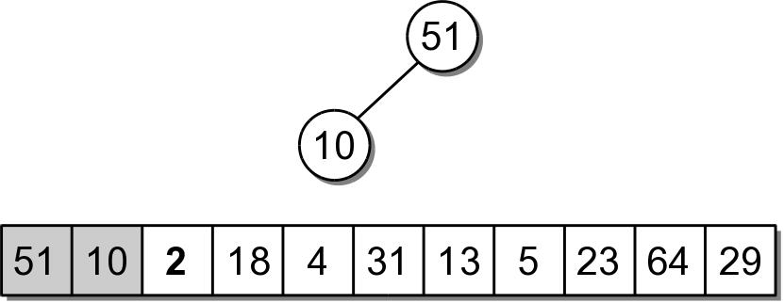
In-Place Heapsort
The next value to be added, is the next in the array.
  The value is copied to the root node (position 0).
  Then sifted down.

Slide 87
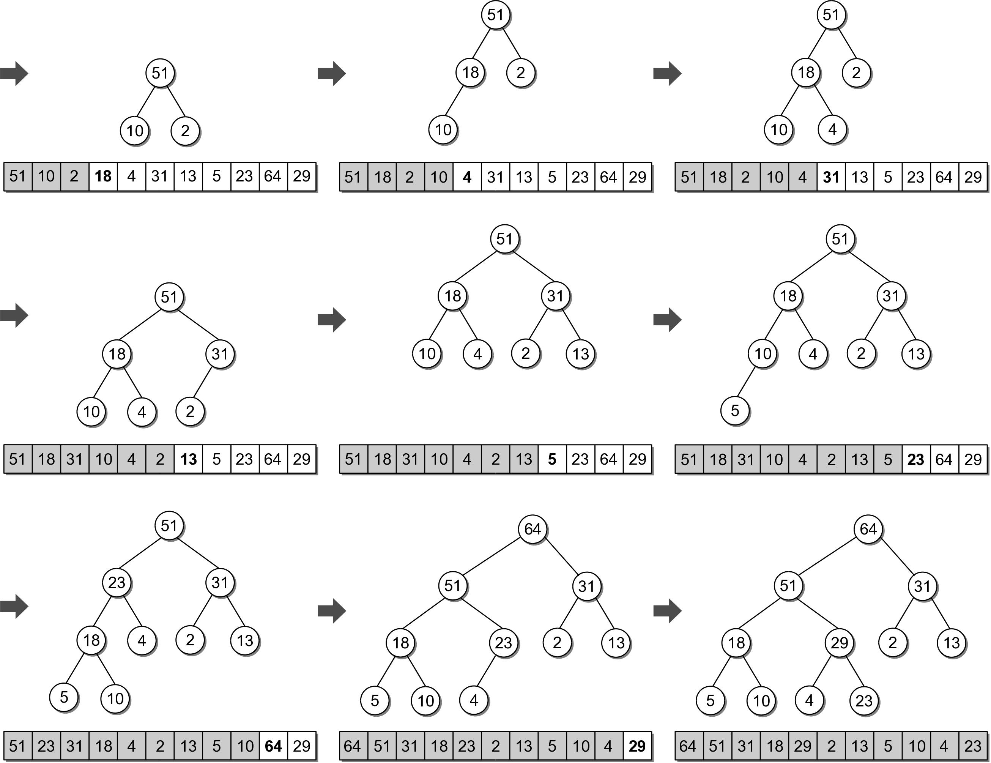
In-Place Heapsort

Slide 88
In-Place Heapsort
The next step is to extract the values from the heap and build the sorted sequence.
  When the root is extracted, the last child node is copied to the root.
  The last child node is stored in the last element of the heap.
  We can simply swap the two values.

Slide 89

In-Place Heapsort

Slide 90

In-Place Heapsort

Slide 91
In-Place Heapsort Implementation
siftUp() and siftDown() are helper functions based on those used in the heap class.
def heapsort( theSeq ):
n = len(theSeq)
# Build a max-heap within the same array.
for i in range( n ) :
siftUp( theSeq, i )
# Extract each value and rebuild the heap.
for j in range( n-1, 0, -1) :
tmp = theSeq[j]
theSeq[j] = theSeq[0]
theSeq[0] = tmp
siftDown( theSeq, j-1, 0 )

Slide 92
Application: Morse Code
A type of character encoding originally designed in the late 1830s by Samuel Morse.
  For use with his telegraph system.
  Allows messages to be transmitted long distances across wires.
  Used extensively by American railroad companies.

Slide 93
Morse Code
The modern International Morse Code uses dots (dits), dashes (dahs), short gaps and long gaps.
A | .- | F | ..-. | K | -.- | P | .--. | U | ..-
B | -... | G | --. | L | .-.. | Q | --.- | V | ...-
C | -.-. | H | .... | M | -- | R | .-. | W | .--
D | -.. | I | .. | N | -. | S | ... | X | -..-
E | . | J | .--- | O | --- | T | - | Y | -.--
 |  |  |  |  |  |  |  | Z | --..

Slide 94
Decision Tree
Models a sequence of decisions or choices in which selections are made in stages from among multiple alternatives at each stage.
  Nodes represent the stages.
  Branches indicate the decisions that can be made.
Classic example:
  Automated phone menu.

Slide 95

Morse Code Decision Tree
We can use a decision tree to represent the Morse Code translations.

Slide 96

Morse Code Example
Decoding a valid sequence.

Slide 97

Morse Code Example
Decoding an invalid sequence.

Slide 98
Morse Code Tree ADT
A Morse Code tree is a decision tree.
  Contains the letters of the alphabet and special symbols in its nodes.
  Organized based on the Morse Code sequences.
MorseCodeTree() translate( codeSeq )

