Slide 1
Sets and Maps
Chapter 3

Slide 2
Sets
A common container used in programming.
Unlike the Bag ADT:
  stores unique values.
  represents the mathematical set structure.

Slide 3
The Set ADT
A set is a container that stores a collection of unique values over a given comparable domain.
  The stored values have no particular ordering.
Set() length() contains( element ) add( element ) remove( element ) | equals( setB ) isSubsetOf( setB ) union( setB ) intersect( setB ) difference( setB )

Slide 4
Set: Venn Diagrams
A = { 2, 24, 17, 8 }
B = { 15, 24, 32 }
C = { 8, 24 }
Venn Diagrams
A
B
C

Slide 5
Set: Equals
Set A is equal to set B if both sets contain the same number of elements and both contain the exact same elements.
B
A == B?
A
A = { 2, 24, 17, 8 }
B = { 15, 24, 32 }
C = { 8, 24 }

Slide 6
Set: Subset Of
Set A is a subset of B if all elements of set A are also in set B.
Exercises:
  Is C  A?
  Is C  B?
B
A  B?
A
A = { 2, 24, 17, 8 }
B = { 15, 24, 32 }
C = { 8, 24 }

Slide 7
Set: Union
The union of sets A and B contains all of the unique elements of both A and B.
A
A
A  B?
B
A = { 2, 24, 17, 8 }
B = { 15, 24, 32 }
C = { 8, 24 }
A  B = { 2, 8, 15, 17, 24, 32 }

Slide 8
Set: Intersection
The intersection of sets A and B contains only those elements that are in both A and B.
A  B?
A
A  B
B
A = { 2, 24, 17, 8 }
B = { 15, 24, 32 }
C = { 8, 24 }
A  B = { 24 }

Slide 9
Set: Difference
The difference of sets A and B contains only those elements that are in A but not in B.
A - B?
A - B
A
B
A = { 2, 24, 17, 8 }
B = { 15, 24, 32 }
C = { 8, 24 }
A - B = { 2, 17, 8 }

Slide 10
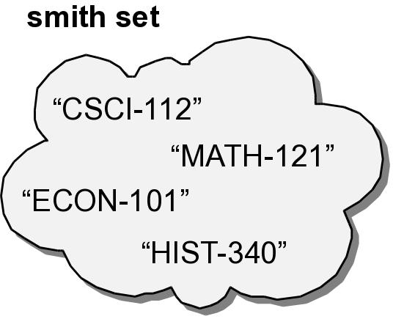
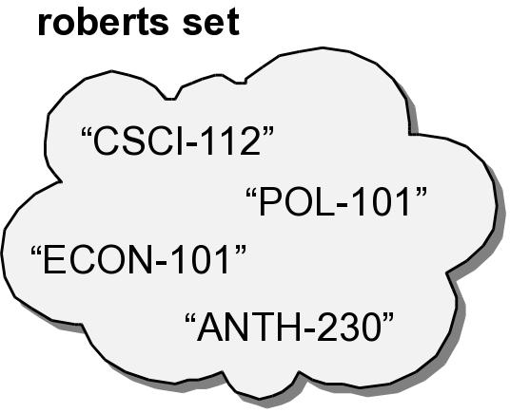
Using the Set ADT
Two sets containing the current courses for two students.
smith = Set()
smith.add( "CSCI-112" )
smith.add( "MATH-121" )
smith.add( "HIST-340" )
smith.add( "ECON-101" )
roberts = Set()
roberts.add( "POL-101" )
roberts.add( "ANTH-230" )
roberts.add( "CSCI-112" )
roberts.add( "ECON-101" )

Slide 11
Using the Set ADT
Determine if two students are taking (1) all of the same courses or (2) any of the same courses.
if smith == roberts :
print( "Smith and Roberts are taking the same courses." )
else :
sameCourses = smith.intersect( roberts )
if len(sameCourses) == 0 :
print( "Smith and Roberts are not taking any of "\
+ "the same courses." )
else :
print( "Smith and Roberts are taking some of the "\
+ "same courses:" )
for course in sameCourses :
print( course )

Slide 12
Using the Set ADT
How can we determine which courses “Smith” is taking that “Roberts” is not taking?
uniqueCourses = smith.difference( roberts )

Slide 13
Set: Which Data Structure?
Evaluate each DS/ADT option:
  dictionary
  array
  list
Criteria:
  storage requirements?
  necessary access and manipulation functionality?

Slide 14
Set: Which Data Structure?
Dictionary
  stores unique elements (key/value pairs).
  will waste space.
Array
  can store unique elements.
  lacks the functionality.
List
  can store unique elements.
  provides the functionality.

Slide 15
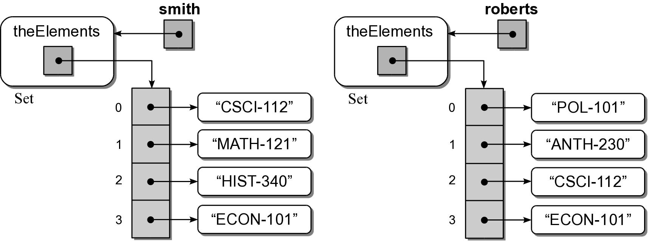
Set: List Implementation

Slide 16
The Set Class
linearset.py
class Set :
def __init__( self ):
self._theElements = list()
def __len__( self ):
return len( self._theElements )
def __contains__( self, element ):
return element in self._theElements
def add( self, element ):
if element not in self :
self._theElements.append( element )
def remove( self, element ):
assert element in self, "The element must be in the set."
self._theElements.remove( item )
def __iter__( self ):
return _SetIterator( self._theElements )

Slide 17
The Set Class
linearset.py
class Set :
# ...
def __eq__( self, setB ):
if len( self ) != len( setB ) :
return False
else :
return self.isSubsetOf( setB )
def isSubsetOf( self, setB ):
for element in self :
if element not in setB :
return False
return True

Slide 18
The Set Class
linearset.py
class Set :
# ...
def union( self, setB ):
newSet = Set()
newSet._theElements.extend( self._theElements )
for element in setB :
if element not in self :
newSet._theElements.append( element )
return newSet

Slide 19
Maps
Stores a collection of records.
  A unique key identifies each record.
  Records are selected by key value.
aka dictionary.
  Python provides a built-in dictionary.
  Great example for comparing different implementations.

Slide 20
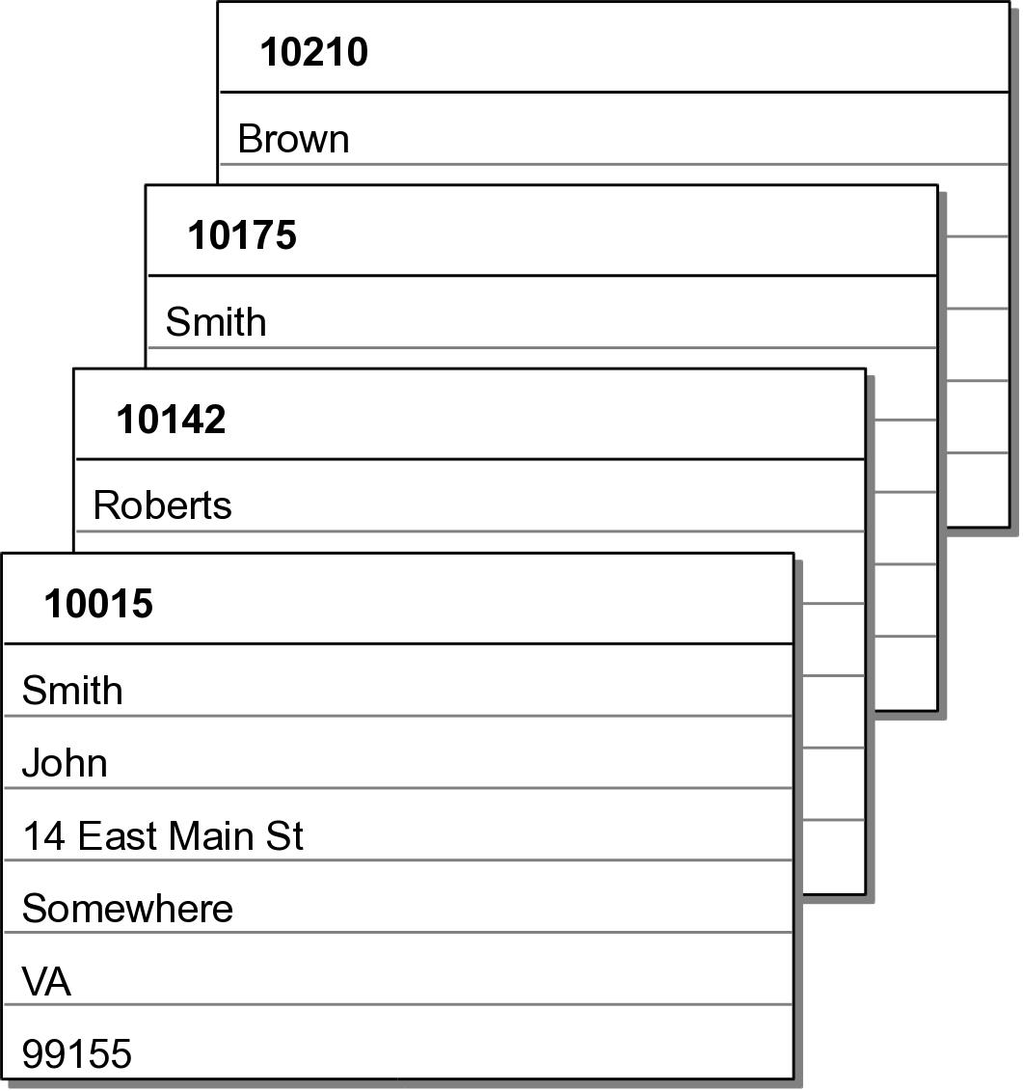
Example Use
Collection of student records managed by a university registrar:

Slide 21
The Map ADT
A map is a container for storing a collection of data records:
  Each record is associated with a unique key.
  Key components must be comparable.
Map() length() contains( key ) add( key, value ) remove( key ) valueOf( key ) iterator()

Slide 22
Map: Which Data Structure?
Evaluate each DS/ADT option:
  dictionary
  array
  list
  set

Slide 23
Map: Which Data Structure?
Array
  can store key/value pairs.
  lacks the functionality.
List
  can store key/value pairs
  provides the functionality.
Set
  same as a list.
  not a simple implementation.
  may not be efficient.

Slide 24
Map: List Implementation
At this point, the list is the best choice.
How should the data be stored and organized within the list?

Slide 25
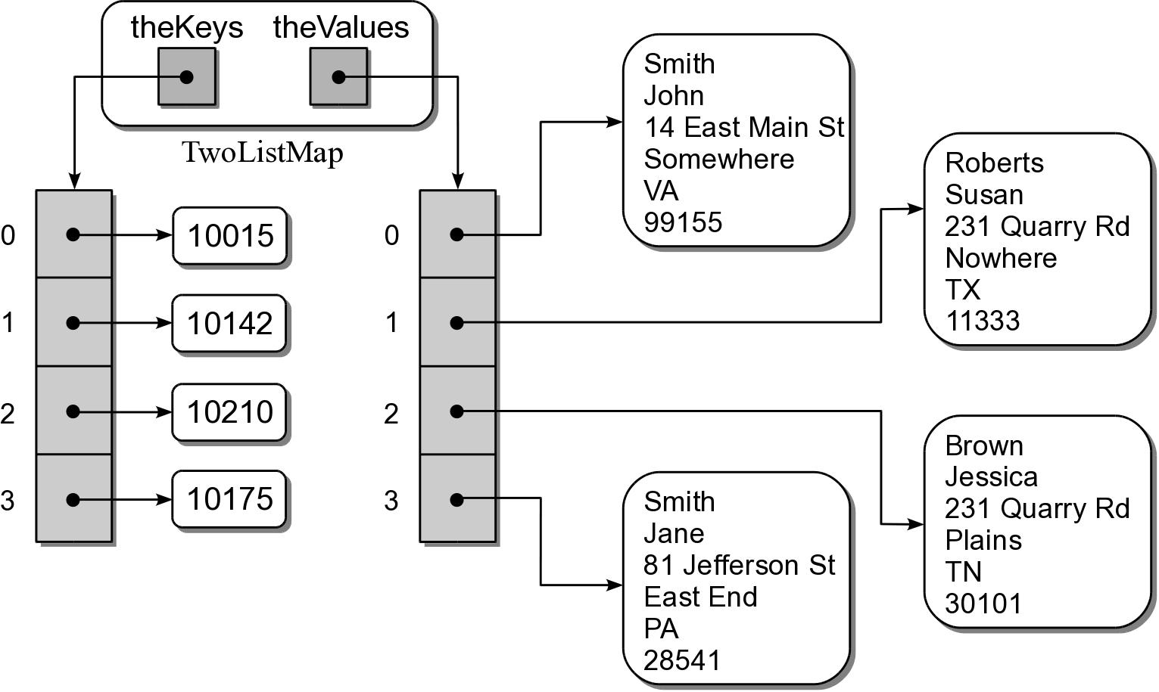
Map: Using Dual Lists
Use 2 lists in parallel:
  one for the keys
  one for the records.

Slide 26
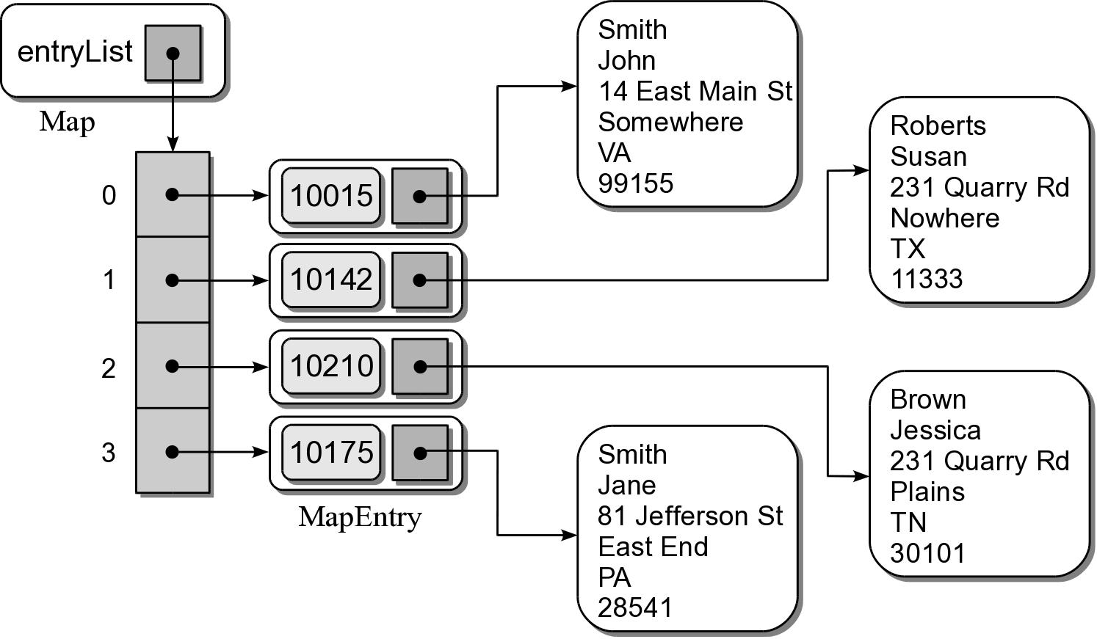
Map: Using a Single List
Use 2 lists in parallel:
  must store both key and value at the same position.
  use a storage class.

Slide 27
The MapEntry Class
linearmap.py
# Storage object private to the module.
class _MapEntry :
def __init__( self, key, value ):
self.key = key
self.value = value

Slide 28
The Map Class
linearmap.py
class Map :
# ...
# Find and return the index position of a key
# or return None.
def _findPosition( self, key ):
for i in range( len(self) ) :
if self._entryList[i].key == key :
return i
return None

Slide 29
The Map Class
linearmap.py
class Map :
def __init__( self ):
self._entryList = list()
def __len__( self ):
return len( self._entryList )
def __contains__( self, key ):
ndx = self._findPosition( key )
return ndx is not None
def __iter__( self ):
return _MapIterator( self._entryList )
# ... remaining Map methods go here ...

Slide 30
The Map Class
linearmap.py
class Map :
# ...
def add( self, key, value ):
ndx = self._findPosition( key )
if ndx is not None :
self._entryList[ndx].value = value
return False
else :
entry = _MapEntry( key, value )
self._entryList.append( entry )
return True

Slide 31
The Map Class
linearmap.py
class Map :
# ...
def valueOf( self, key ):
ndx = self._findPosition( key )
assert ndx is not None, "Invalid map key."
return self._entryList[ndx].value
def remove( self, key ):
ndx = self._findPosition( key )
assert ndx is not None, "Invalid map key."
self._entryList.pop( ndx )

Slide 32
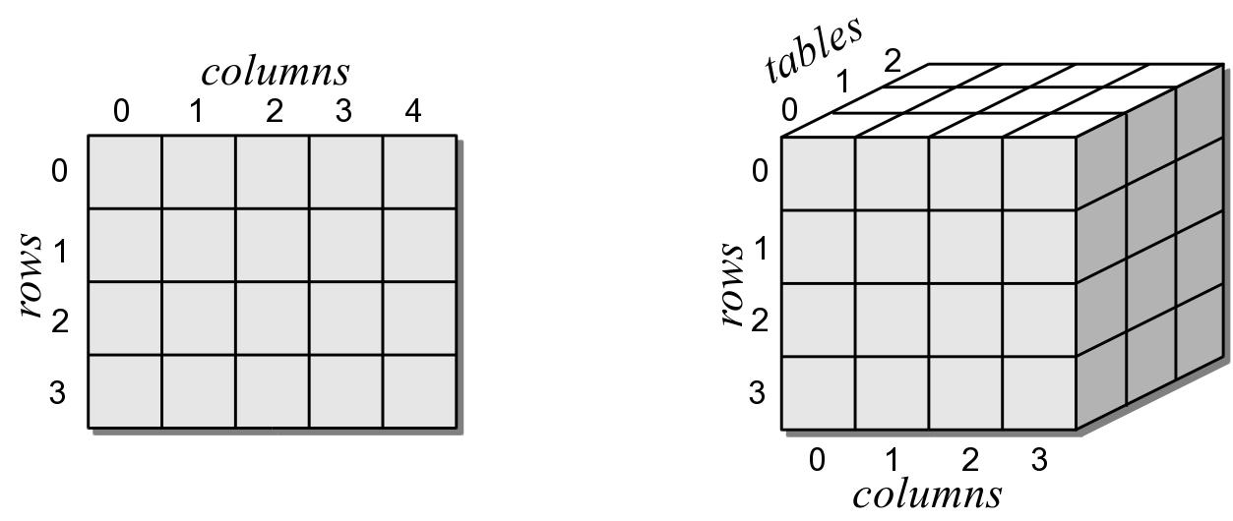
Multi-Dimensional Arrays
We can create arrays of any number of dimensions.

Slide 33
The MultiArray ADT
A multi-dimensional array consists of a collection of elements organized into multiple dimensions.
  Elements are referenced by multi-component subscripts (i₁, i₂, ..., i_{n})
  All indices start from 0.
MultiArray( d₁, d₂, ..., d_{n} ) dims() length() clear( value ) getitem( i₁, i_{2,} ... i_{n} ) setitem( i₁, i_{2,} ... i_{n}, value )

Slide 34
Data Organization
For the Array2D ADT
  Used a 1-D array of 1-D arrays.
We can also use a single 1-D array.
  Entire contents is stored in one array.
  Common approach of many languages.

Slide 35
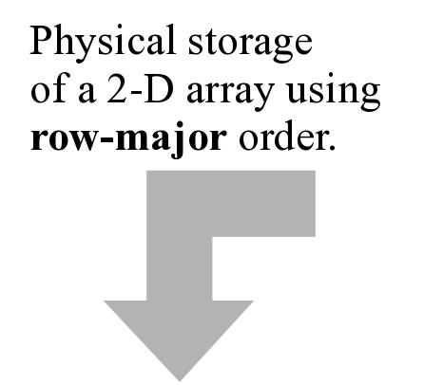
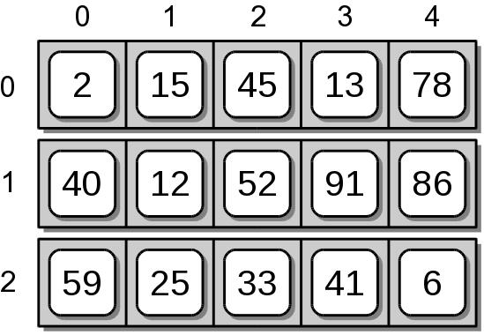
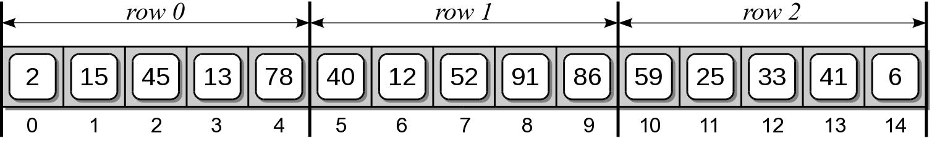
Row-Major Order
The rows are stored sequentially, one at a time.

Slide 36
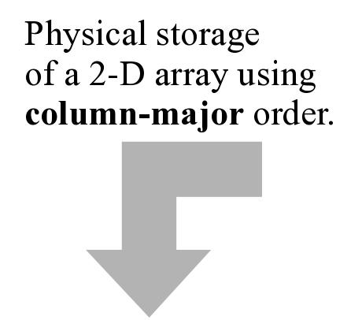
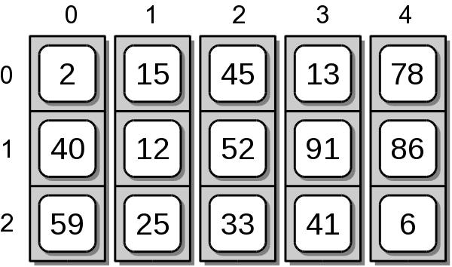
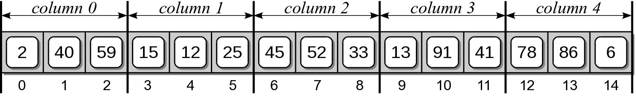
Column-Major Order
The columns are stored sequentially, one at a time.

Slide 37
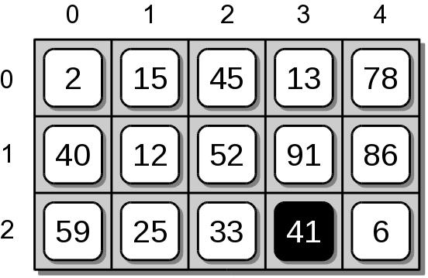
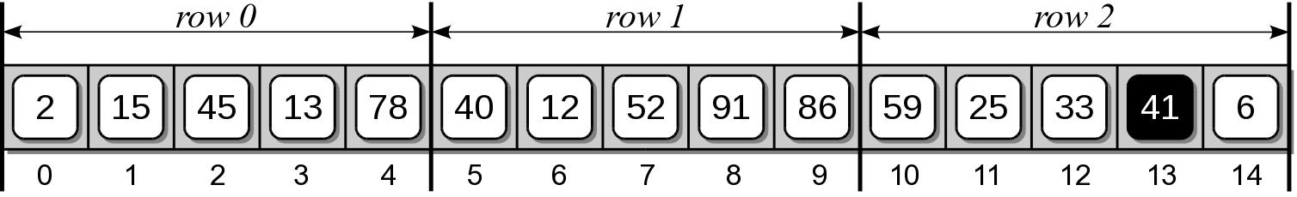
Index Computation
When accessing a 2-D array element, how do we find the actual element within the 1-D array?
  Must calculate the offset within the 1-D array.
  Ex: access element (2, 3) using row-major order.

Slide 38
Index Computation
Given an m  n array, derive an index formula:
  Element (0, 0) maps to index 0.
  Element (1, 0) maps to index 1n.
  Element (2, 0) maps to index 2n.

Slide 39
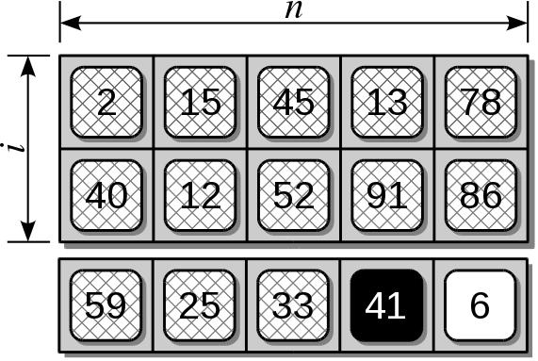
Index Computation
First element of the i^{th} row maps to index i * n.
Row subscript indicates how many rows to skip.

Slide 40
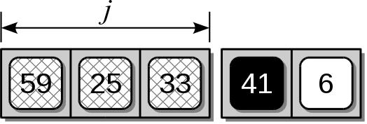

Index Computation
After skipping i complete rows, then skip j columns.
Column subscript indicates how many rows to skip on the i^{th} row.
The formula for a 2D array is:

Slide 41
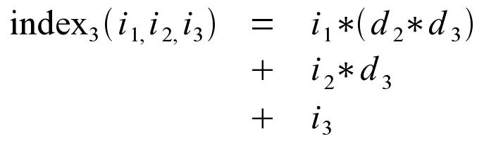
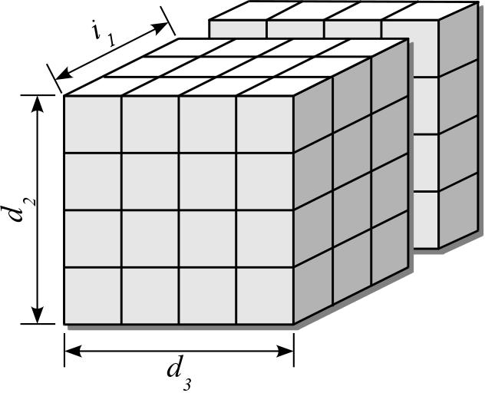
Index Computation
Similar equations can be derived for a 3-D array.
Given a 3-D array of size d₁  d₂  d₃,

Slide 42
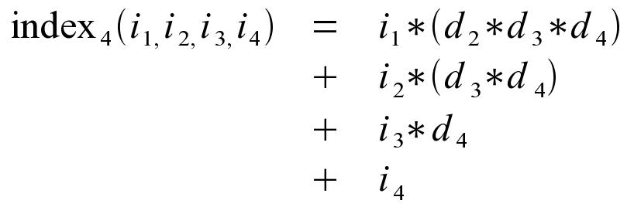
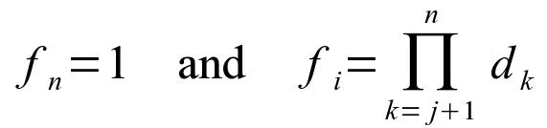
Index Computation
Given a 4-D array of size d₁  d₂  d₃  d₄
Notice a pattern developing

Slide 43
Variable-Length Arguments
Functions and methods can be defined to accept a variable number of arguments.
When used, can pass any number of argumens.
def func( *args ):
print( "Number of arguments: ", len( args ) )
sum = 0
for value in args :
sum += value
print( "Sum of the arguments: ", sum )
func( 12 )
func( 5, 8, 2 )
func( 18, -2, 50, 21, 6 )

Slide 44
Multi-Array Implementation
array.py
class MultiArray :
# Creates a multi-dimensional array.
def __init__( self, *dimensions ):
assert len(dimensions) > 1, \
"The array must have 2 or more dimensions."
# Save the variable argument tuple.
self._dims = dimensions
# Compute the total number of elements in the array.
size = 1
for d in dimensions :
assert d > 0, "Dimensions must be > 0."
size *= d
# Create the 1-D arrays.
self._elements = Array( size )
self._factors = Array( len(dimensions) )
self._computeFactors()

Slide 45
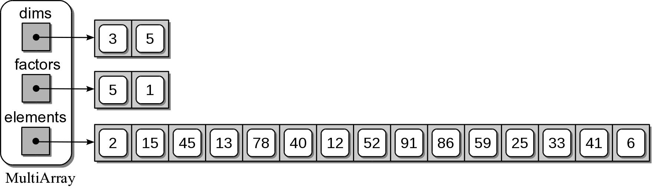
Sample MultiArray Object

Slide 46
Multi-Array Implementation
array.py
class MultiArray :
#...
def numDims( self ):
return len(self._dims)
def length( self, dim ):
assert dim >= 1 and dim < len(self._dims),\
"Dimension component out of range."
return self._dims[dim - 1]
def clear( self, value ):
self._elements.clear( value )

Slide 47
Multi-Array Implementation
array.py
class MultiArray :
#...
def __getitem__( self, ndxTuple ):
assert len(ndxTuple) == self.numDims(), \
"Invalid # of array subscripts."
index = self._computeIndex( ndxTuple )
assert index is not None, \
"Array subscript out of range."
return self._elements[index]
def __setitem__( self, ndxTuple, value ):
assert len(ndxTuple) == self.numDims(), \
"Invalid # of array subscripts."
index = self._computeIndex( ndxTuple )
assert index is not None, \
"Array subscript out of range."
self._elements[index] = value

Slide 48
Multi-Array Implementation
array.py
class MultiArray :
#...
def _computeIndex( self, idx ):
offset = 0
for j in range( len(idx) ):
if idx[j] < 0 or idx[j] >= self._dims[j] :
return None
else : # sum the product of i_j * f_j.
offset += idx[j] * self._factors[j]
return offset

Slide 49
Application: Sales Report
LazyMart is a small regional department store:
  Locations in different cities and states.
  Maintains a collection of sales records for various products sold.
  Would like to various reports from this data.

Slide 50
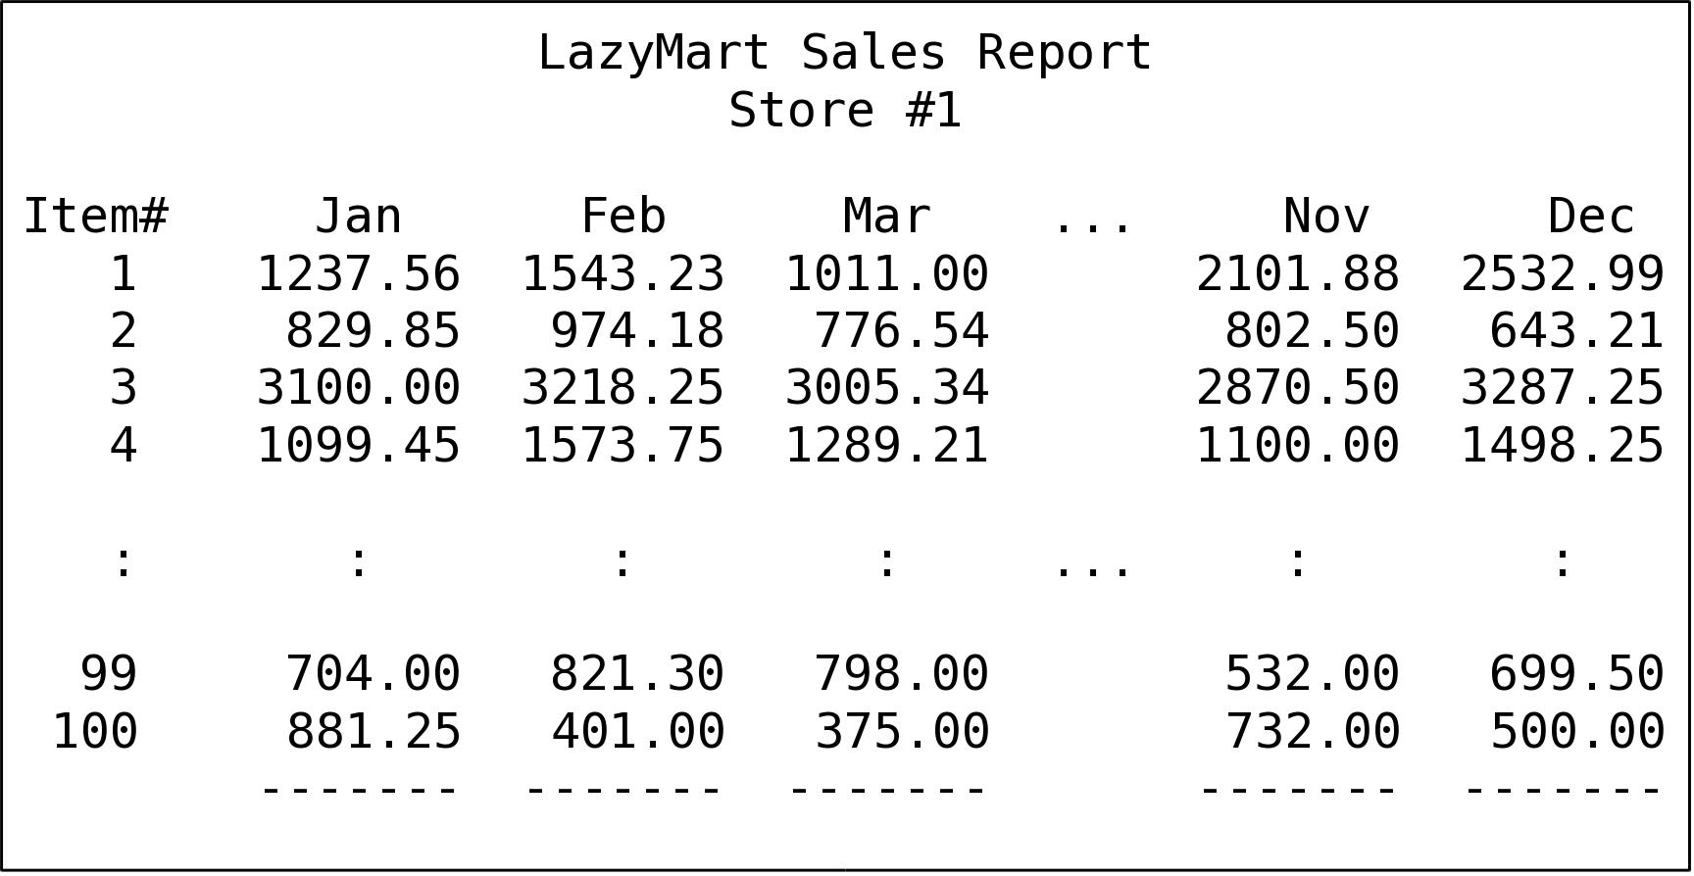
Sample Sales Report
Yearly sales by store (for one store)

Slide 51
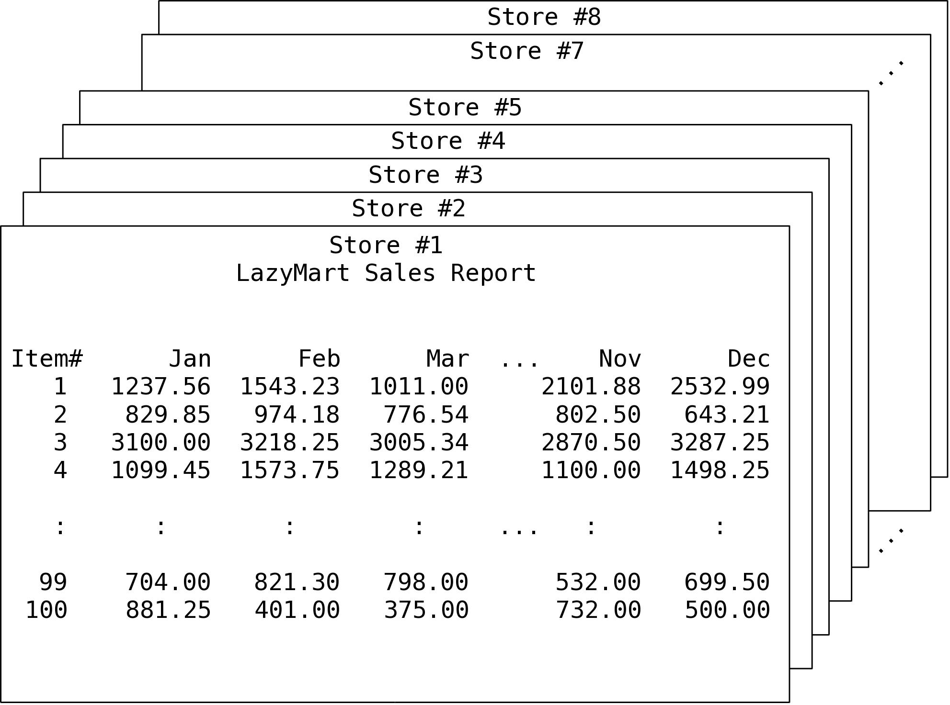
Sample Sales Report
Yearly sales by store (for all stores)

Slide 52
Sales Data
For current calendar year is maintained within a text file.
8
100
5 11 85 45.23
1 4 26 128.93
1 8 75 39.77
– number of stores
– number of products
– the sales data (per store/month/item):
- store #
- month #
- item #
- $$ of sales

Slide 53
Sales Data Organization
Some reports can be produced by directly extracting the data from the file.
But what if we need to different types of queries?
  Total sales by store
  Total sales by month
  Total sales by item
  Monthly sales by store

Slide 54
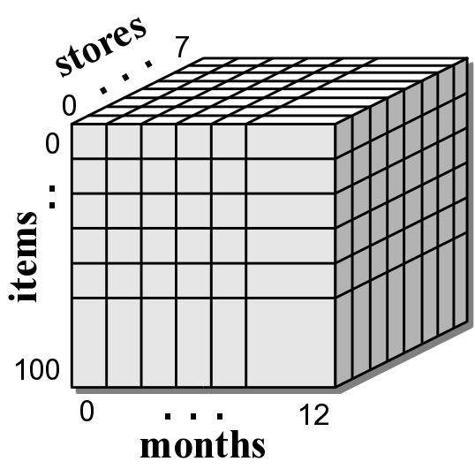
Sales Data Organization
For this problem:
  The data needs to be stored instead of loading it each time.
  We can use a 3-D array.

Slide 55
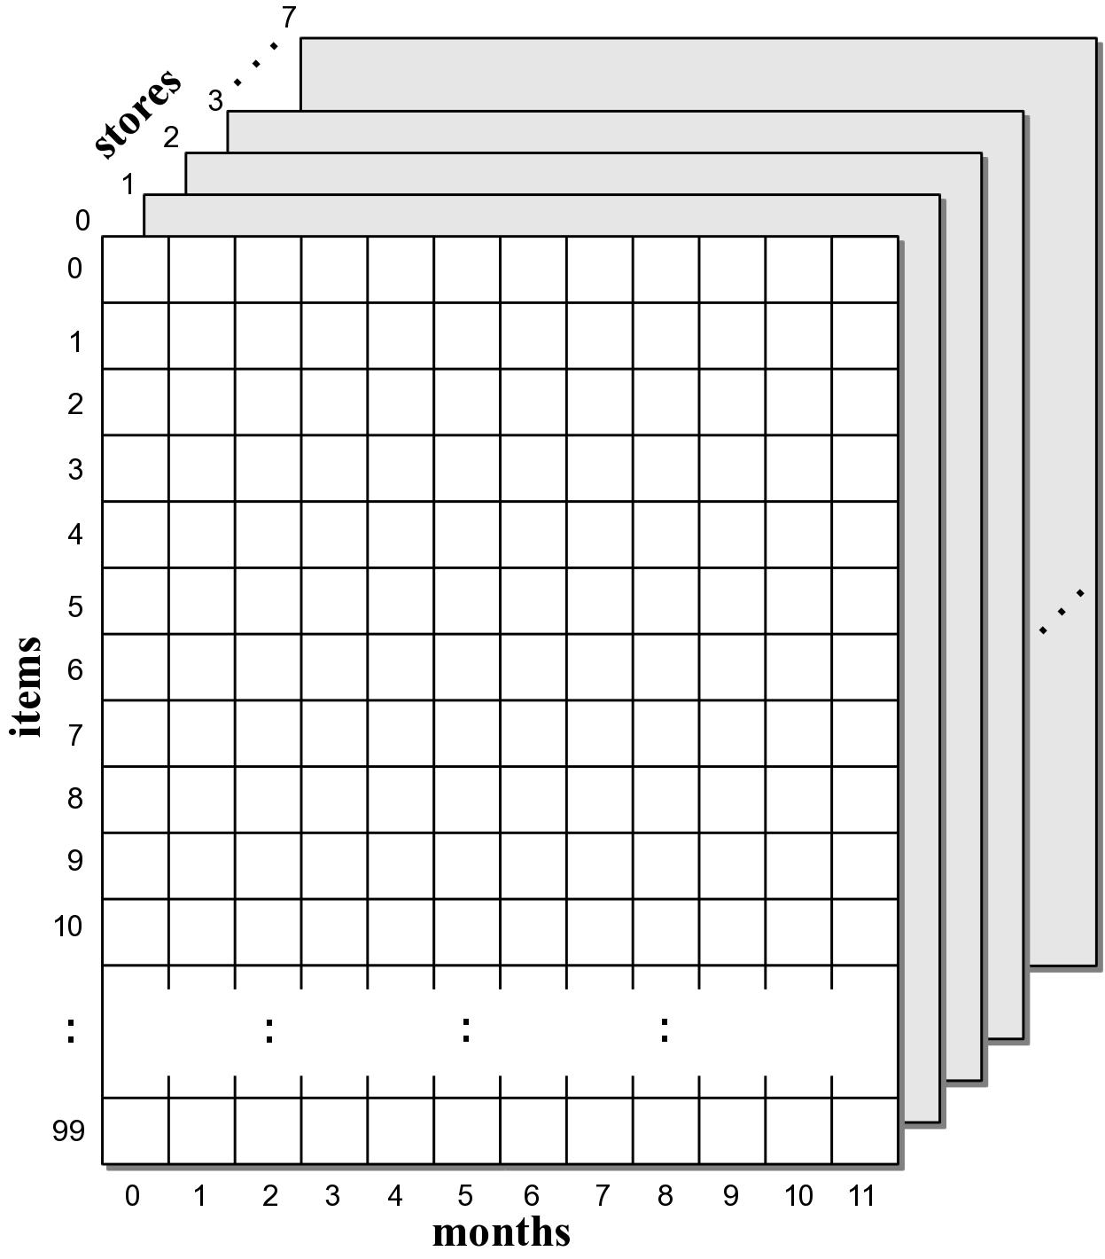
Spreadsheets
The 3-D array can be as a collection of spreadsheets.

Slide 56
Total Sales by Store
Extract the total sales of all items for all months in a given store.

Slide 57
Total Sales by Store
def totalSalesByStore( salesData, store ):
s = store-1
total = 0.0
# Iterate over item.
for i in range( salesData.length(2) ):
# Iterate over each month of the i item.
for m in range( salesData.length(3) ):
total += salesData[s, i, m]
return total

Slide 58
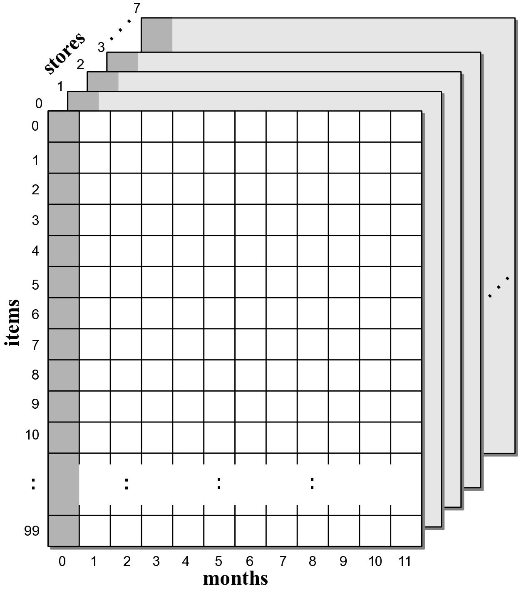
Total Sales by Month
Extract the total sales of all items in all stores for a given month.

Slide 59
Total Sales by Month
def totalSalesByMonth( salesData, month ):
m = month - 1
total = 0.0
# Iterate over each store.
for s in range( salesData.length(1) ):
# Iterate over each item of the s store.
for i in range( salesData.length(2) ):
total += salesData[s, i, m]
return total

Slide 60
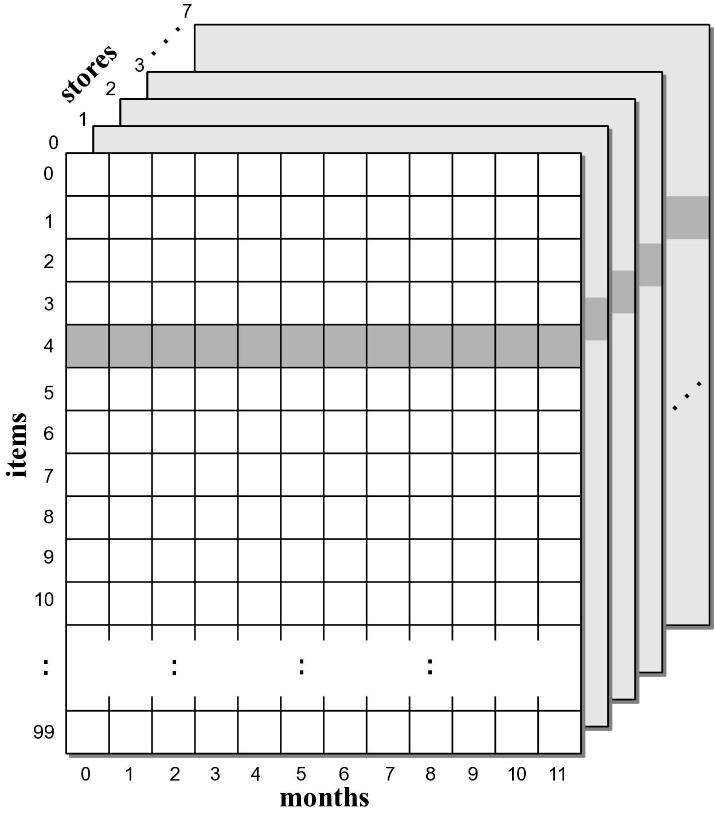
Total Sales by Item
Extract the total sales of a single item in all stores over all months.

Slide 61
Total Sales by Item
def totalSalesByItem( salesData, item ):
m = item - 1
total = 0.0
# Iterate over each store.
for s in range( salesData.length(1) ):
# Iterate over each month of the s store.
for m in range( salesData.length(3) ):
total += salesData[s, i, m]
return total

Slide 62
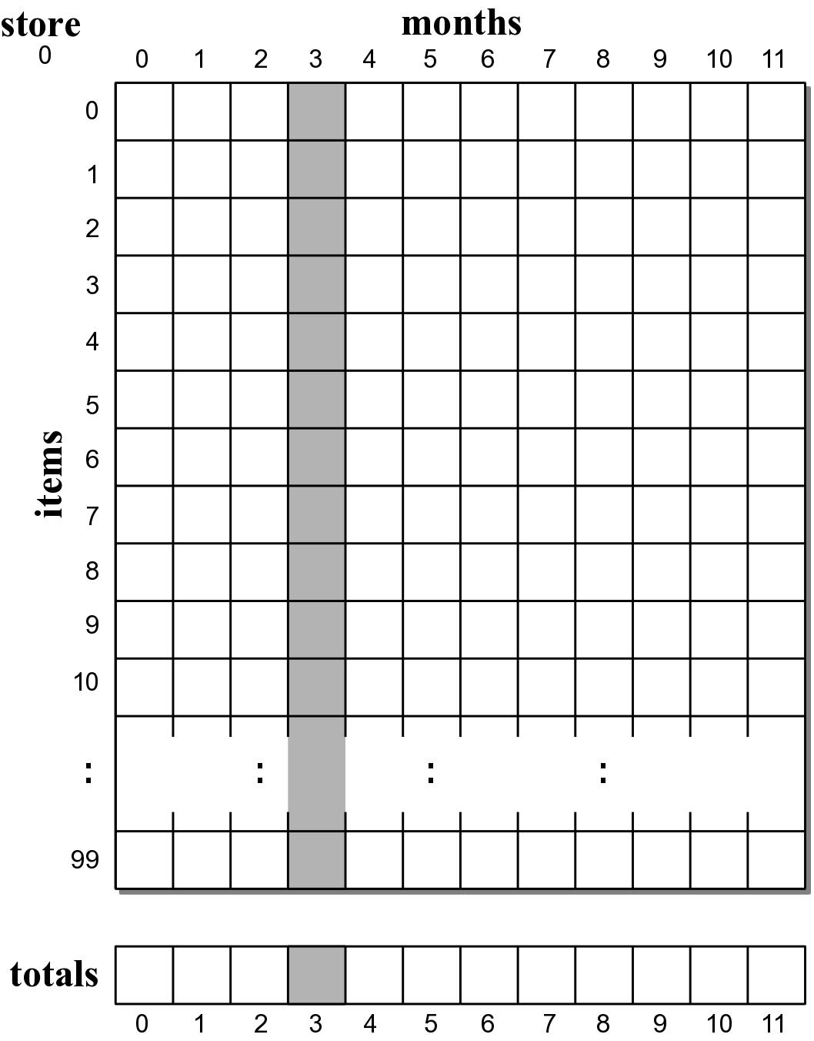
Monthly Sales by Store
Extract the total sales per month for a given store.

Slide 63
Monthly Sales by Store
def totalSalesPerMonth( salesData, store ):
s = store - 1
# The totals will be returned in a 1-D array.
totals = Array( 12 )
# Iterate over the sales of each month.
for m in range( salesData.length(3) ):
sum = 0.0
# Iterate over the sales of each item sold
# during the m month.
for i in range( salesData.length(2) ):
sum += salesData[s, i, m]
totals[m] = sum
return totals

Slide 64
Other Queries
Which store had the best sales?
What is the best selling product?
All products for which sales are under $100.

