Slide 1
Searching and Sorting
Chapter 5

Slide 2
Searching
The process of selecting particular information from a collection of data based on specific criteria.
  Can be performed on different data structures.
  sequence search – search within a sequence.
  search key (or key) – identifies a specific item.
  compound key – consists of multiple parts.

Slide 3
Linear Search
Iterates over the sequence, item by item, until the specific item is found or the list is exhausted.
  The simplest solution to sequence search problem.
  Python's in operator: find a specific item.
if key in theArray :
print( 'The key is in the array.' )
else :
print( 'The key is not in the array.' )

Slide 4
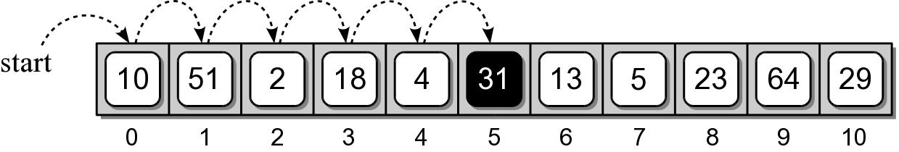
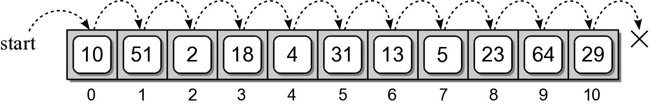
Linear Search Examples
Searching for 31
Searching for 8

Slide 5
Linear Search Code
def linearSearch( theValues, target ) :
n = len( theValues )
for i in range( n ) :
if theValues[i] == target
return True

Slide 6
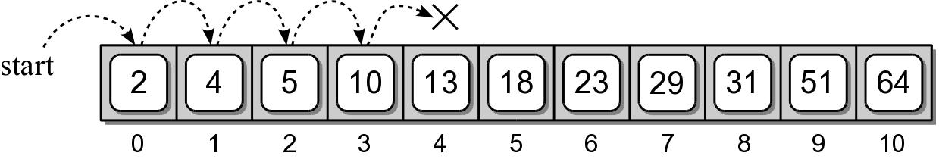
Linear Search: Sorted Sequence
A linear search can be performed on a sorted sequence.
Example: searching for 8.

Slide 7
Linear Search: Sorted Sequence
Similar to the unsorted sequence, with one major difference.
def sortedLinearSearch( theValues, target ) :
n = len( theValues )
for i in range( n ) :
if theValues[i] == target :
return True
elif theValues[i] > target :
return False
return False

Slide 8
Linear Search: Smallest Value
We can search for an item based on certain criteria.
Example: find the smallest value.
def findSmallest( theValues ):
n = len( theValues )
smallest = theValues[0]
for i in range( 1, n ) :
if theList[i] < smallest :
smallest = theValues[i]
return smallest

Slide 9
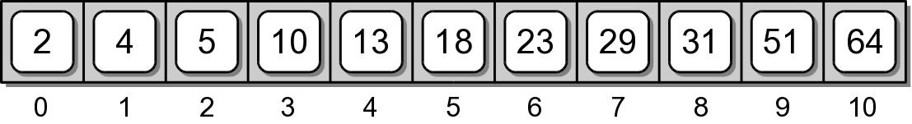
Binary Search
The linear search has a linear time-complexity.
  We can improve the search time if we modify the search technique itself.
  Use a divide and conquer strategy.
  Requires a sorted sequence.

Slide 10
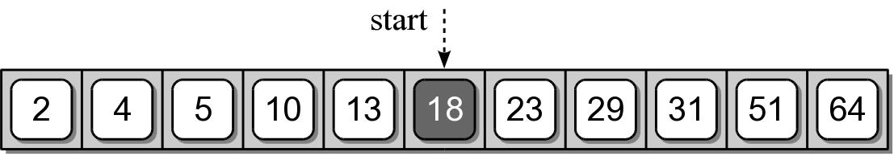
Binary Search Algorithm
Examine the middle item (searching for 10):
One of three possible conditions:
  target is found in the middle item.
  target is less than the middle item.
  target is greater than the middle item.

Slide 11
Binary Search Algorithm
Since the sequence is sorted, we can eliminate half the values from further consideration.

Slide 12
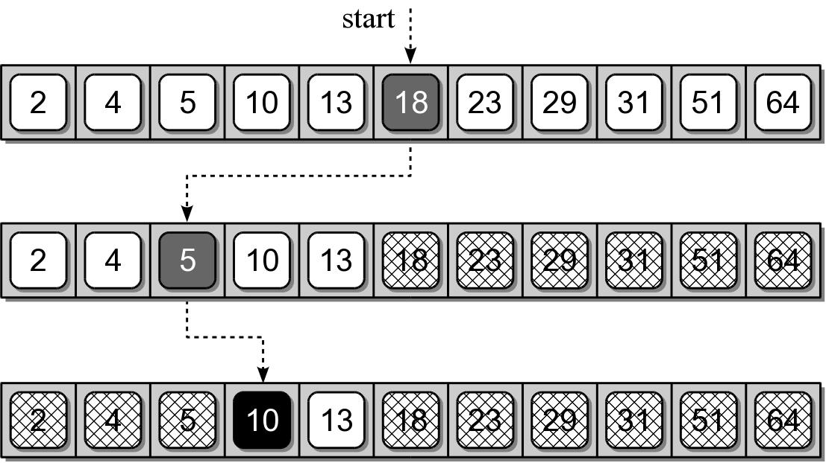
Binary Search Algorithm
Repeat the process until either the target is found or all items have been eliminated.

Slide 13
Binary Search Implementation
def binarySearch( theValues, target ) :
low = 0
high = len(theValues) - 1
while low <= high :
mid = (high + low) // 2
if theValues[mid] == target :
return True
elif target < theValues[mid] :
high = mid - 1
else :
low = mid + 1
return False n = len( theValues )

Slide 14
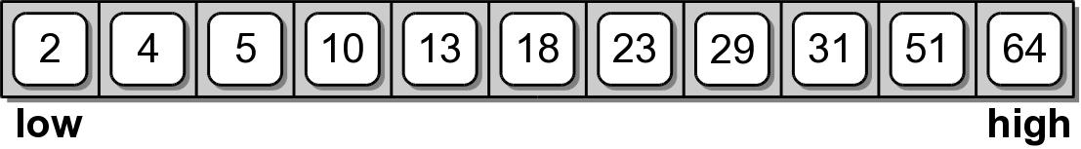
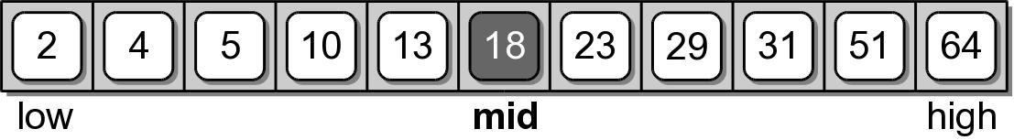
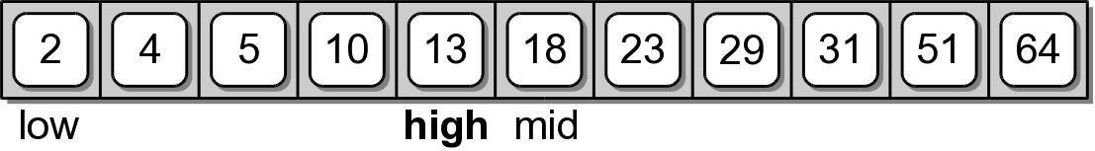
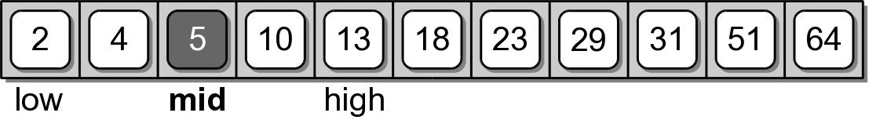
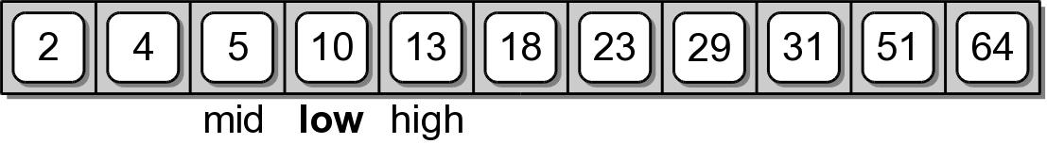
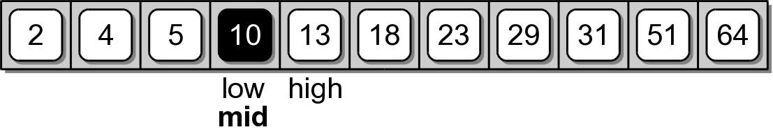
Binary Search Implementation

Slide 15
Sorting
The process of arranging a collection of items such that each item and its successor satisfy a prescribed relationship.
  sequence sort – sorting within a sequence.
  sort key – values on which items are ordered.
  items arranged in ascending or descending order.
  sorted in place – within the same structure.

Slide 16
Bubble Sort
A simple solution to the sorting problem.
Arranges the items by
  iterating over the sequence multiple times.
  larger values bubble to the top (or end).

Slide 17
Bubble Sort Code
def bubbleSort( theSeq ):
n = len( theSeq )
for i in range( n - 1 ) :
for j in range( i + n - 1 ) :
if theSeq[j] > theSeq[j + 1] :
tmp = theSeq[j]
theSeq[j] = theSeq[j + 1]
theSeq[j + 1] = tmp

Slide 18
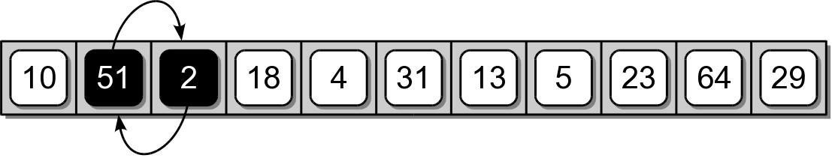
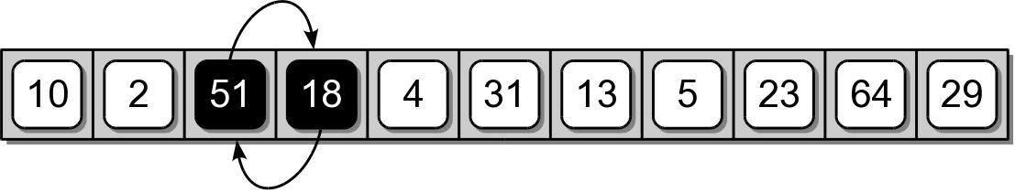
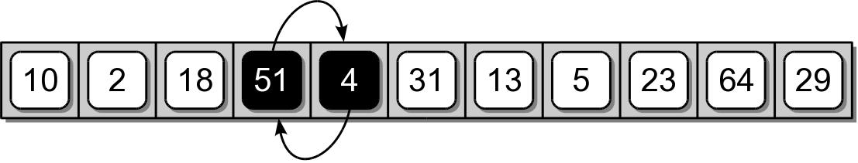
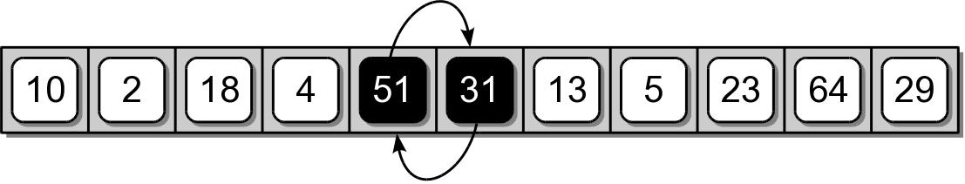
Binary Sort Example
First complete iteration of the inner loop.

Slide 19
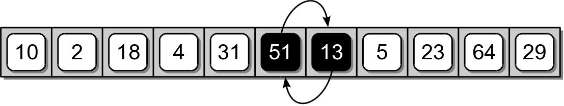
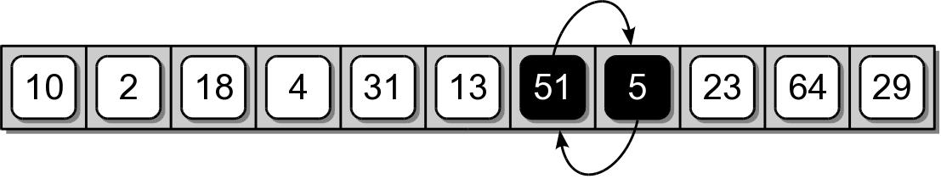
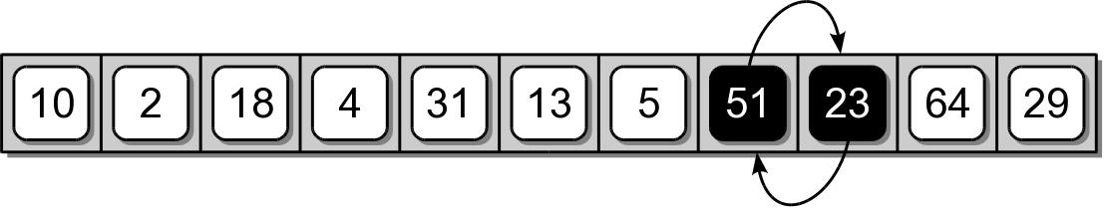
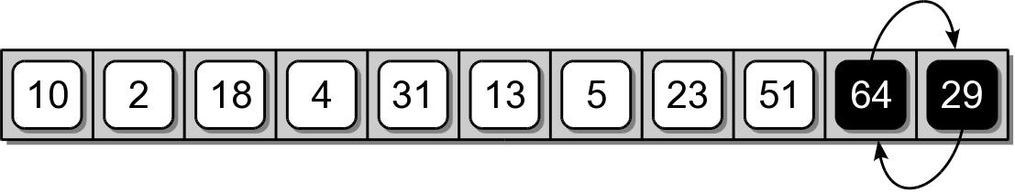
Binary Sort Example

Slide 20
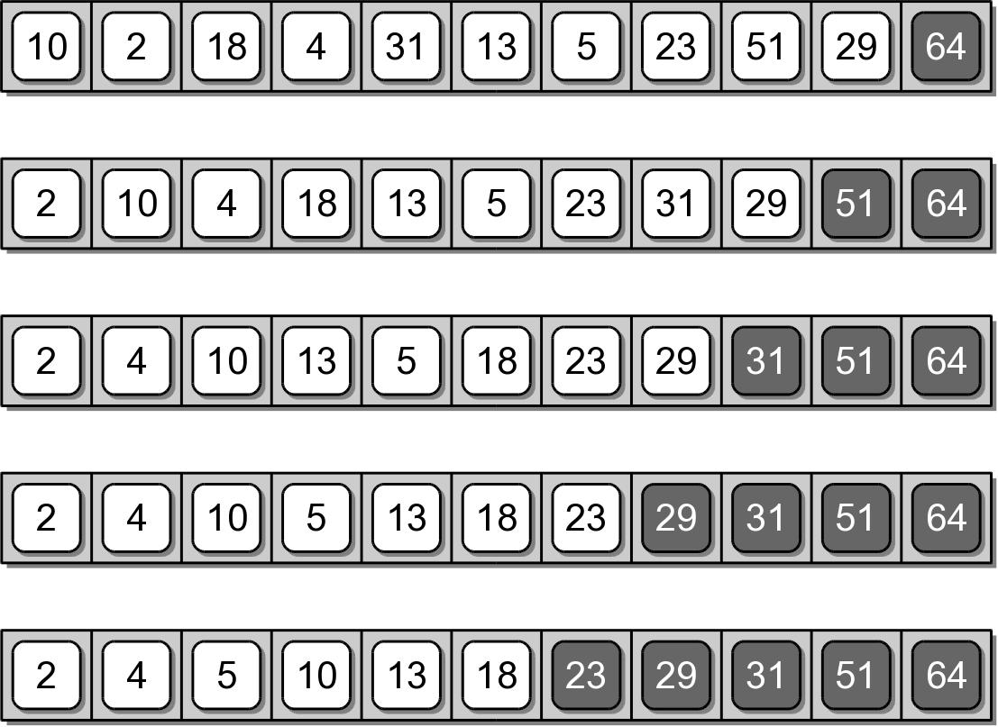
Binary Sort Example
Results after each iteration of the outer loop.

Slide 21
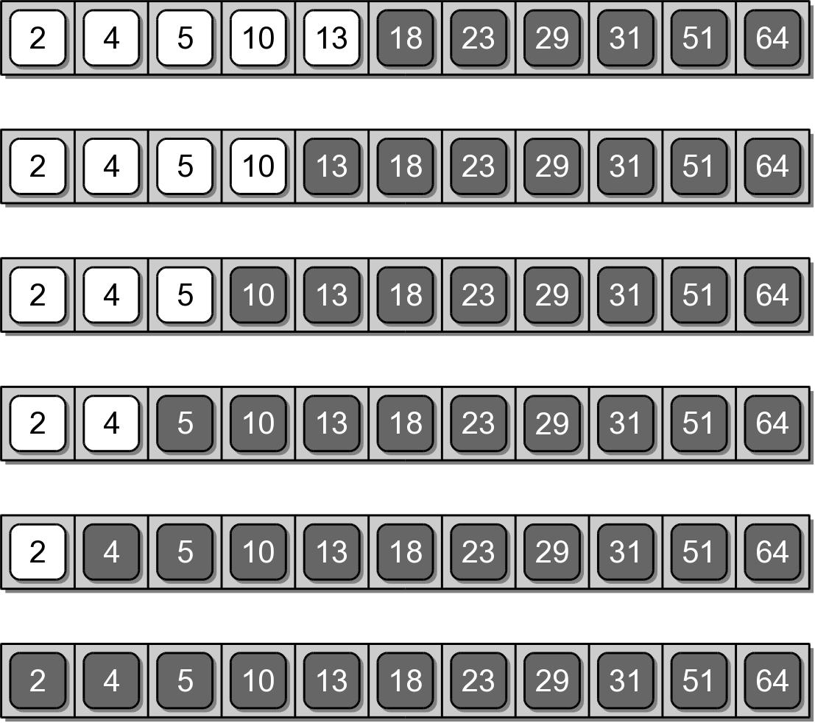
Binary Sort Example

Slide 22
Selection Sort
Improves on the bubble sort.
Works in a fashion similar to what a human may use to sort a sequence.
Instead of swapping many items,
  repeatedly selects the next largest item from among the unsorted items.
  requires a search to select the smallest item.

Slide 23
Selection Sort Code
def selectionSort( theSeq ):
n = len( theSeq )
for i in range( n - 1 ):
smallNdx = i
for j in range( i + 1, n ):
if theSeq[j] < theSeq[smallNdx] :
smallNdx = j
if smallNdx != i :
tmp = theSeq[i]
theSeq[i] = theSeq[smallNdx]
theSeq[smallNdx] = tmp

Slide 24
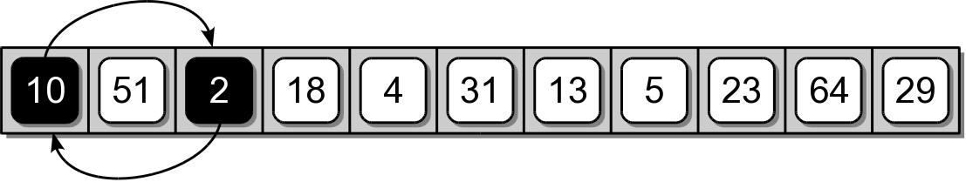
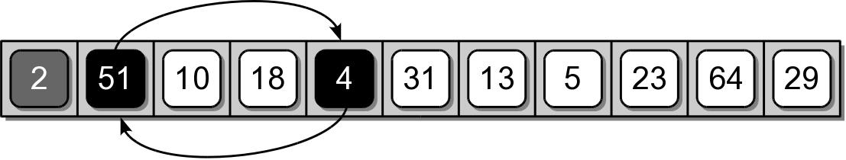
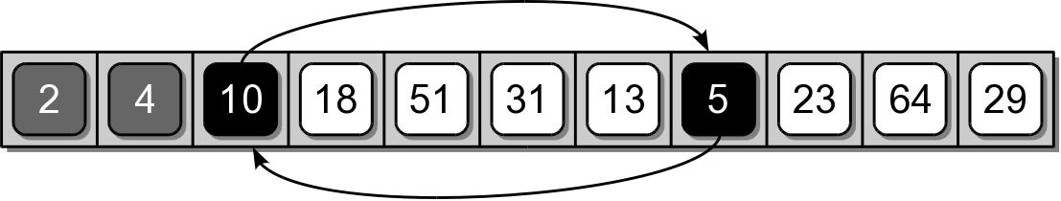
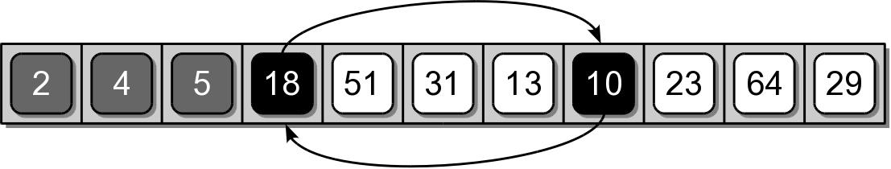
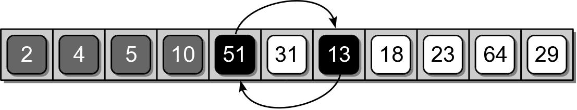
Selection Sort Example

Slide 25
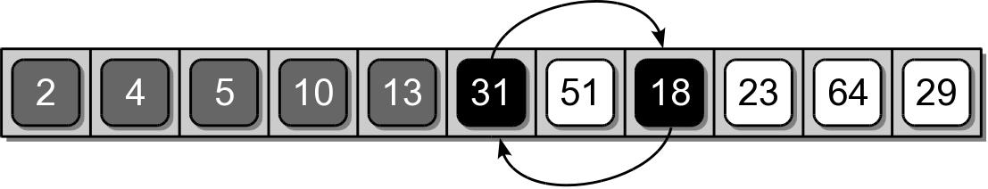
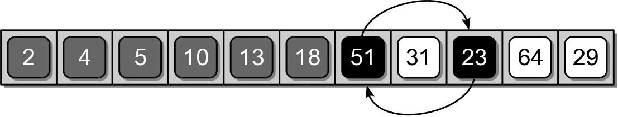
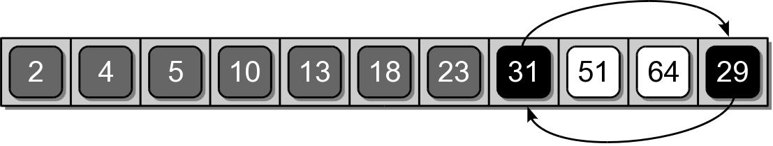
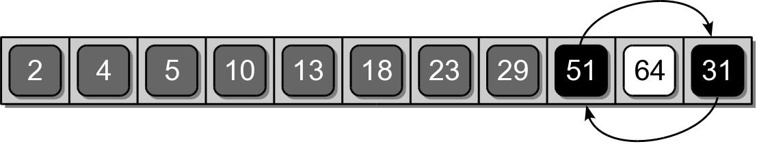
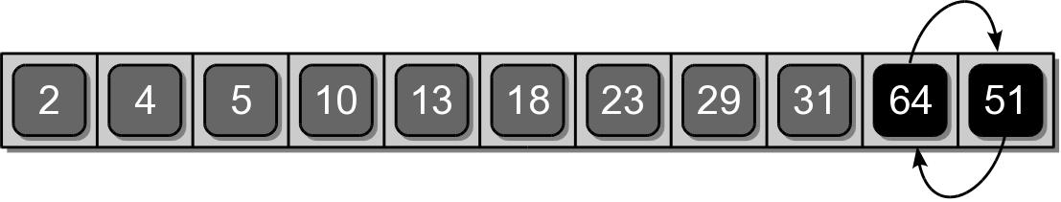
Selection Sort Example

Slide 26
Insertion Sort
Another commonly studied algorithm.
Arranges the items by
  iterating over the sequence one complete time.
  inserts each unsorted item into its proper place.

Slide 27
Insertion Sort Code
def insertionSort( theSeq ):
n = len( theSeq )
for i in range( 1, n ) :
value = theSeq[i]
pos = i
while pos > 0 and value < theSeq[pos - 1] :
theSeq[pos] = theSeq[pos - 1]
pos -= 1
theSeq[pos] = value

Slide 28
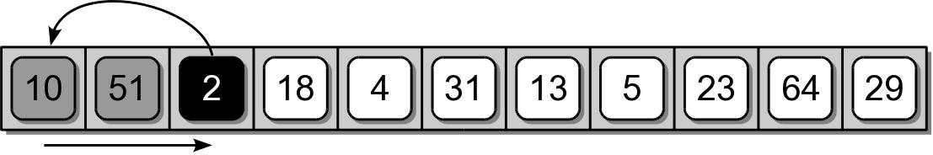
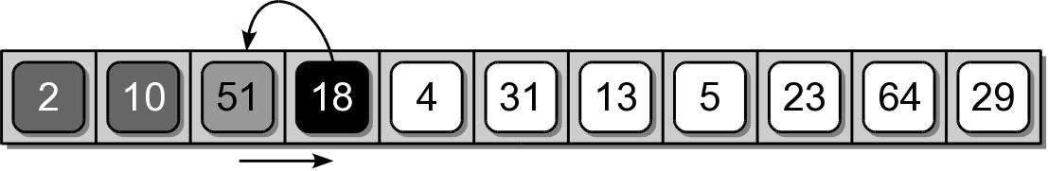
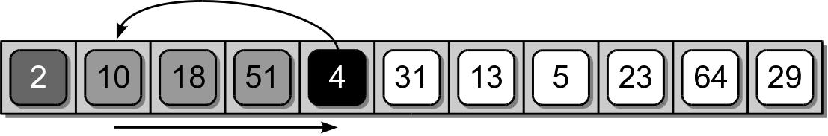
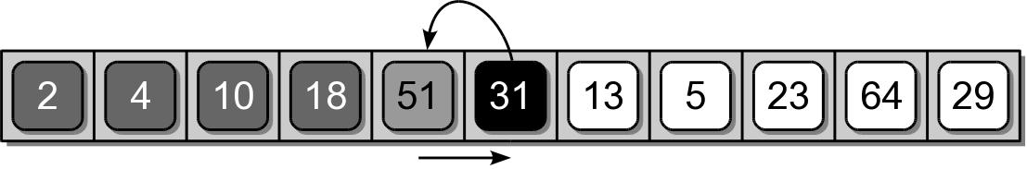
Insertion Sort Example

Slide 29
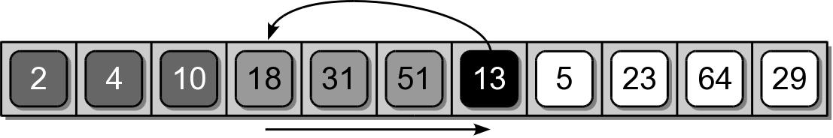
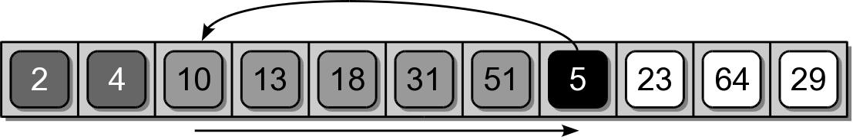
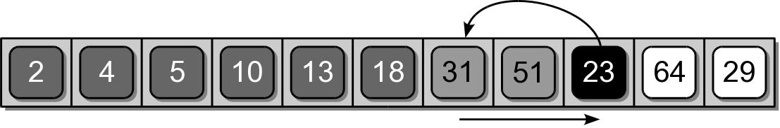
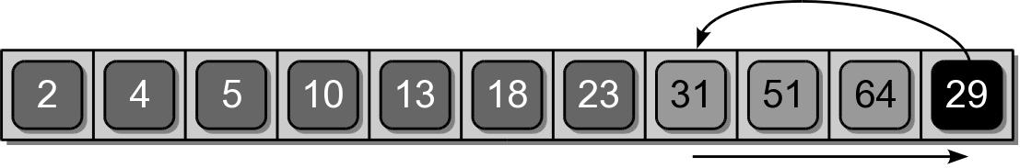
Insertion Sort Example

Slide 30
Working With Sorted Lists
The efficiency of some algorithms can be improved when working with sorted sequences.
  For non-static collections, it would be inefficient to re-sort a sequence for each add/remove.
  Better to maintain a sorted sequence.

Slide 31
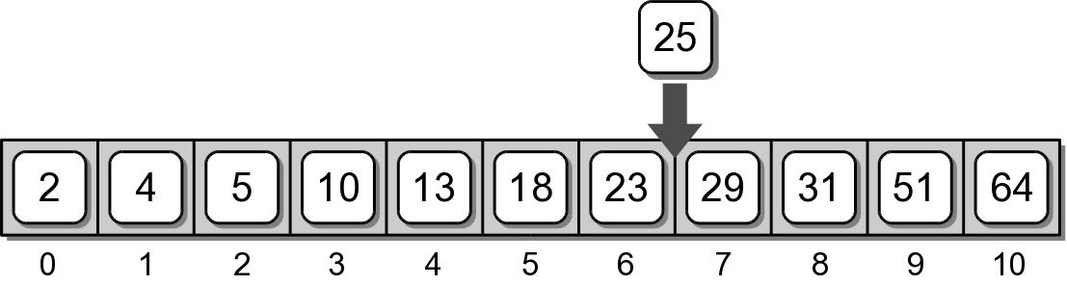
Maintaining a Sorted List
To maintain a sorted list, new items must be inserted into their proper position.
  Can not simply be appended at the end.
  Must locate the proper position and use insert().

Slide 32
Modified Binary Search
A modified version of the binary search can be used to find the proper location of an item.
def findSortedPosition( theList, target ):
low = 0
high = len(theList) - 1
while low <= high :
mid = (high + low) // 2
if theList[mid] == target :
return mid # Index of the target.
elif target < theList[mid] :
high = mid - 1
else :
low = mid + 1
# Index where the target value should be.
return low

Slide 33
Merging Sorted Lists
Sometimes it may be necessary to merge two sorted lists into a new list.
  For example
  creates a new merged list
listA = [ 2, 8, 15, 23, 37 ]
listB = [ 4, 6, 15, 20 ]
newList = mergeSortedLists( listA, listB )
print( newList )
[2, 4, 6, 8, 15, 15, 20, 23, 37]

Slide 34
Merging Algorithm
We can use an approach similar to what you might do, if merging two stacks of cards by hand.
  Examine the value of the top card.
  Select the smallest of the two.
  Flip it over and place it on top of a third stack.
  Repeat until one of the two original stacks is empty.
  Finally, flip all of the cards in the remaining stack onto the top of the new stack.

Slide 35
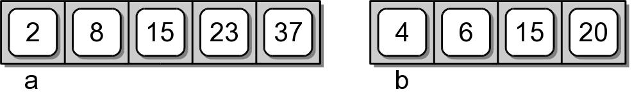
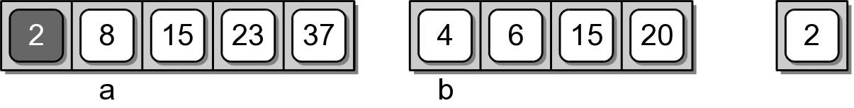
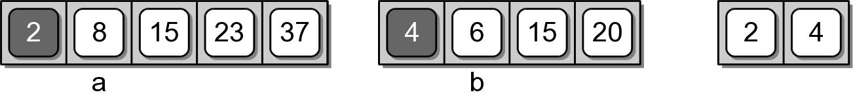
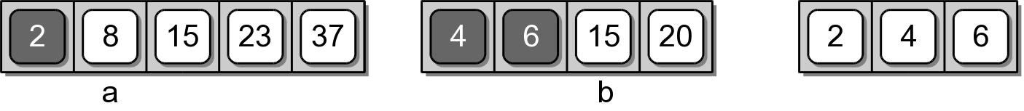
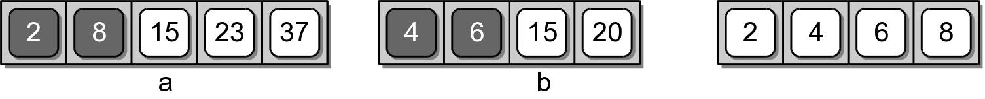
Merging Example

Slide 36
Merging Example

Slide 37
Merging Implementation
def mergeSortedLists( listA, listB ) :
newList = list()
a = 0
b = 0
while a < len( listA ) and b < len( listB ) :
if listA[a] < listB[b] :
newList.append( listA[a] )
a += 1
else :
newList.append( listB[b] )
b += 1
while a < len( listA ) :
newList.append( listA[a] )
a += 1
while b < len( listB ) :
newList.append( listB[b] )
b += 1
return newList

Slide 38
Merging Analysis
Assume listA and listB each contain n items.
The worst case depends on the number of iterations performed by all three loops combined.
  Max iterations of the 1st loop:
    occurs when the selection alternates between the two lists.
    2n -1 iterations + 1 iteration of either of the next two loops.
  Min iterations of the 1st loop:
    occurs when all values of one list are selected in order.
    n iterations + n iterations of either of the next two loops.

Slide 39
Set ADT Revisited
We examined the worst come run-times in the previous chapter.
  The contains operation required linear time due to the linear search.
  The quadratic times of some operations were due to the use of linear contains operation.

Slide 40
Set ADT: Run-Times
List Operation | Worst Case
s = Set() | O(1)
len(s) | O(1)
x in s | O(n)
s.add(x) | O(n)
s.isSubsetOf(t) | O(n²)
s == t | O(n²)
s.union(t) | O(n²)
traversal | O(n)

Slide 41
Set ADT: Sorted List
Can the efficiency of the set operations be improved if we used a sorted list?
What changes would be necessary?

Slide 42
Set Class: Sorted List
binaryset.py
class Set :
def __init__( self ):
self._theElements = list()
def __len__( self ):
return len( self._theElements )
def __contains__( self, element ):
ndx = self._findPosition( element )
return ndx < len( self ) and\
self._theElements[ndx] == element
# ...

Slide 43
Set Class: Sorted List
binaryset.py
class Set :
# ...
def add( self, element ):
if element not in self :
ndx = self._findPosition( element )
self._theElements.insert( ndx, element )
def remove( self, element ):
assert element in self,
"The element must be in the set."
ndx = self._findPosition( element )
return self._theElements.pop( ndx )

Slide 44
Set Class: Sorted List
binaryset.py
class Set :
# ...
def isSubsetOf( self, setB ):
for element in self :
if element not in setB :
return False
return True

Slide 45
Comparing Implementations
Operation | Linear Set | Binary Set
s = Set() | O(1) | O(1)
len(s) | O(1) | O(1)
x in s | O(n) | O(log n)
s.add(x) | O(n) | O(n)
s.isSubsetOf( t ) | O(n²) | O(n log n)
s == t | O(n²)
s.union(t) | O(n²)
traversal | O(n) | O(n)

Slide 46
New Set Equals
If we use the original isSubsetOf(), the result is a worst case time of O(n log n).
class Set :
# ...
def __eq__( self, setB ):
if len( self ) != len( setB ) :
return False
else :
return self.isSubsetOf( setB )

Slide 47
New Set Equals
A more efficient implementation is possible.
class Set :
# ...
def __eq__( self, setB ):
if len( self ) != len( setB ) :
return False
else :
for i in range( len(self) ) :
if self._theElements[i] != setB._theElements[i] :
return False
return True

Slide 48
New Set Union
The efficiency of the set union operation can also be improved.
Set union using two sorted lists is very similar to the problem of merging two sorted lists.
  The new list only contains unique elements.
  If both lists contains a given element, only one instance is placed in the new list.

Slide 49
Set Class: Sorted List
binaryset.py
class Set :
# ...
def union( self, setB ):
newSet = Set()
a = 0
b = 0
while a < len( self ) and b < len( setB ) :
valueA = self._theElements[a]
valueB = setB._theElements[b]
if valueA < valueB :
newSet._theElements.append( valueA )
a += 1
elif valueA > valueB :
newSet._theElements.append( valueB )
b += 1
else :
newSet._theElements.append( valueA )
a += 1
b += 1

Slide 50
Set Class: Sorted List
binaryset.py
class Set :
# ...
def union( self, setB ):
# ...
while a < len( self ) :
newSet._theElements.append(self._theElements[a])
a += 1
while b < len( setB ) :
newSet._theElements.append(setB._theElements[b])
b += 1
return newSet

Slide 51
Comparing Implementations
Operation | Linear Set | Binary Set
s = Set() | O(1) | O(1)
len(s) | O(1) | O(1)
x in s | O(n) | O(log n)
s.add(x) | O(n) | O(n)
s.isSubsetOf( t ) | O(n²) | O(n log n)
s == t | O(n²) | O(n)
s.union(t) | O(n²) | O(n)
traversal | O(n) | O(n)

