Slide 1
Linked Structures
Chapter 6

Slide 2
Review
Arrays
  Basic sequence container
  Provides easy and direct element access.
  Supported at the hardware level.
  Limited functionality.
  Fixed size.

Slide 3
Review
Python list
  Extends array functionality.
  Provides a larger set of operations.
  Can automatically adjust size as needed.
  Change in size requires allocation of new array.
  Insertions and deletions require items to be shifted.

Slide 4
Introduction
In this chapter, we introduce the linked list data structure.
  Can be used to store a collection in linear order.
  Improves on the construction and management of an array and list.
  Requires smaller memory allocations.
  No element shifts for insertions and deletions.
  Eliminates constant time direct element access.

Slide 5
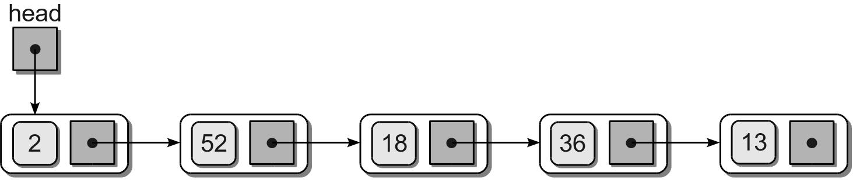
Linked Structure
Constructed using a collection of objects called nodes.
Each node contains data and at least one reference or link to another node.
Linked list – a linked structure in which the nodes are linked together in linear order.

Slide 6
Linked List
Terms:
  head – first node in the list.
  tail – last node in the list; link field has a null reference.

Slide 7
Linked List
Most nodes have no name; they are referenced via the link of the preceding node.
head reference – the first node must be named or referenced by an external variable.
  Provides an entry point into the linked list.
  An empty list is indicated by a null head reference.

Slide 8
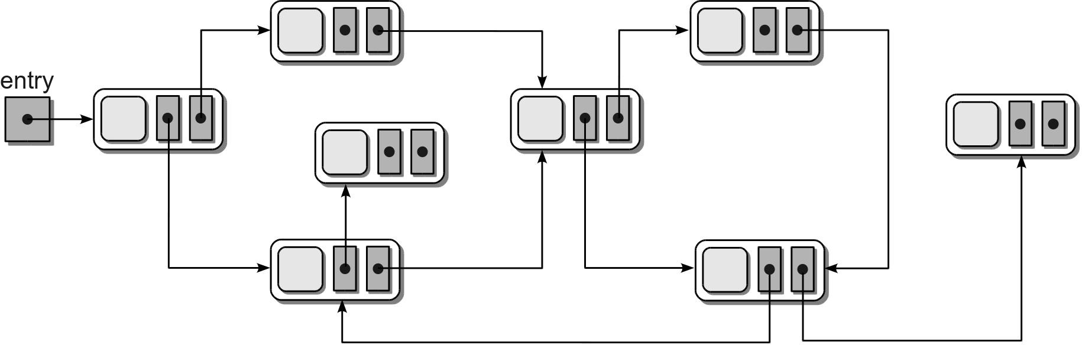
Linked List
Linked list are built using fundamental components provided by the language:
  reference variables
  objects
Many different configurations are possible:

Slide 9
Singly Linked List
A linked list in which
  each node contains a single link field and
  allows for a complete linear order traversal from front to back.
Several common operations can be performed.

Slide 10
Node Definition
The nodes are constructed from a simple storage class:
class ListNode:
def __init__( self, data ):
self.data = data
self.next = None

Slide 11
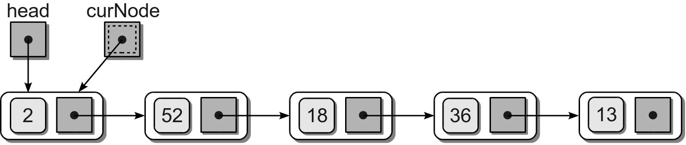
Traversing the Nodes
We can traverse the nodes using a temporary external reference variable.
  Initialize a temporary reference to the head node.
  Visit the node.

Slide 12
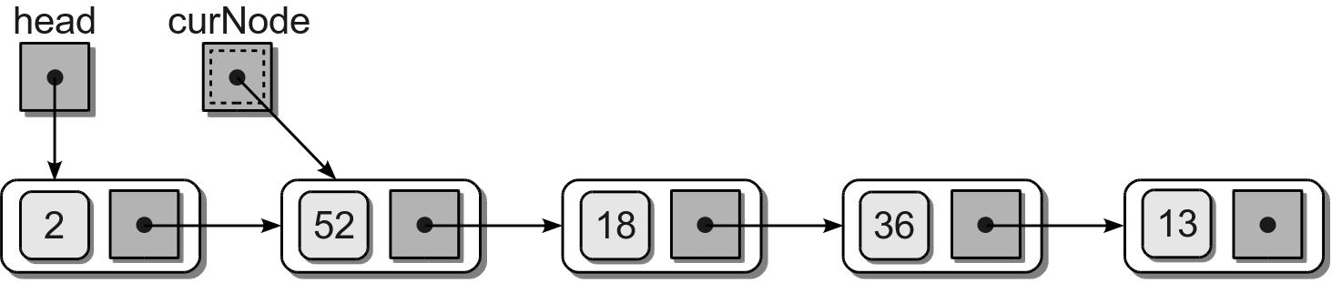
Traversing the Nodes
  Advance the temporary reference to the next node using the link field and visit that node.

Slide 13
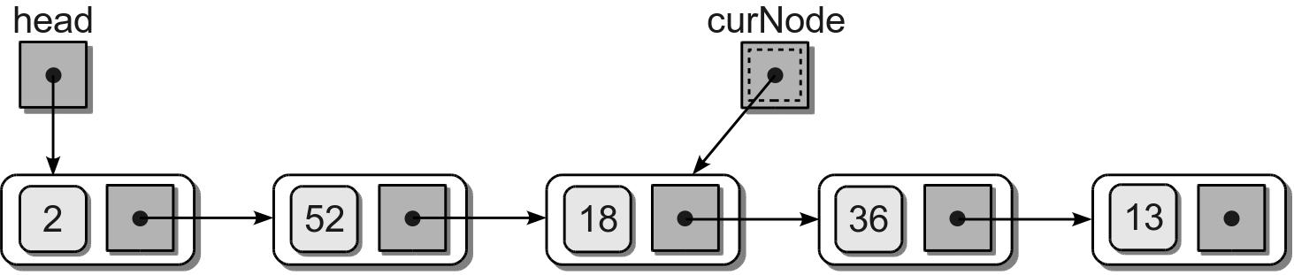
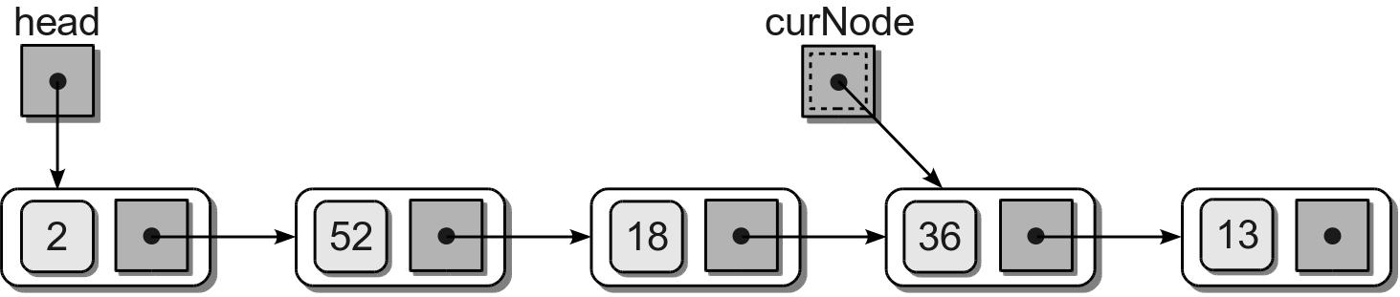
Traversing the Nodes
  Repeat the process until the reference falls off the end of the list.

Slide 14
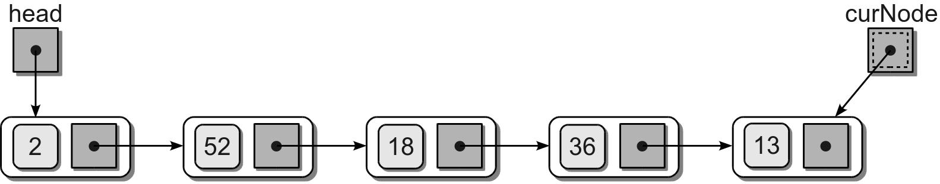
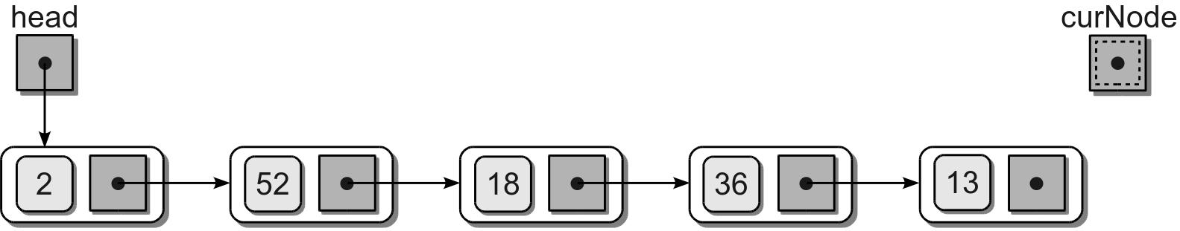
Traversing the Nodes
  Repeat the process until the reference falls off the end of the list.

Slide 15
Traversal Code
Given the head reference, we can traverse the nodes.
def traversal( head ):
curNode = head
while curNode is not None :
print( curNode.data )
curNode = curNode.next

Slide 16
Searching
We can perform a linear search to determine if the list contains a specific data item.
def unorderedSearch( head, target ):
curNode = head
while curNode is not None and
curNode.data != target :
curNode= curNode.next
return curNode is not None

Slide 17
Prepending Nodes
When working with an unsorted linked list, new values can be inserted at any point.
We can prepend new items with little effort.
Example: add value 96 to the sample list.

Slide 18
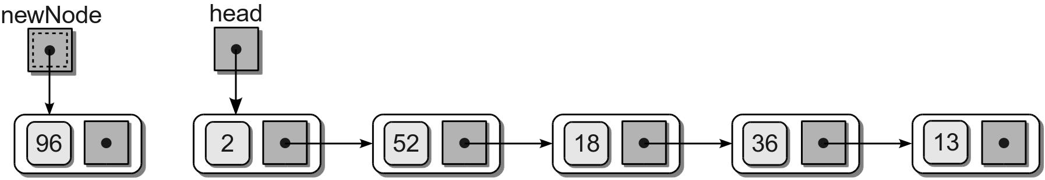
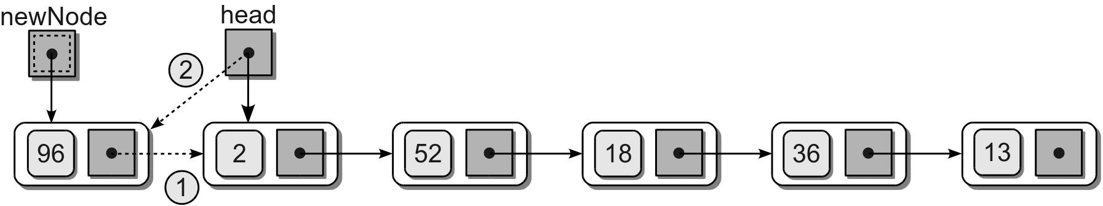
Prepending Nodes
Create a new node for the new item.
Connect the new node to the list.

Slide 19
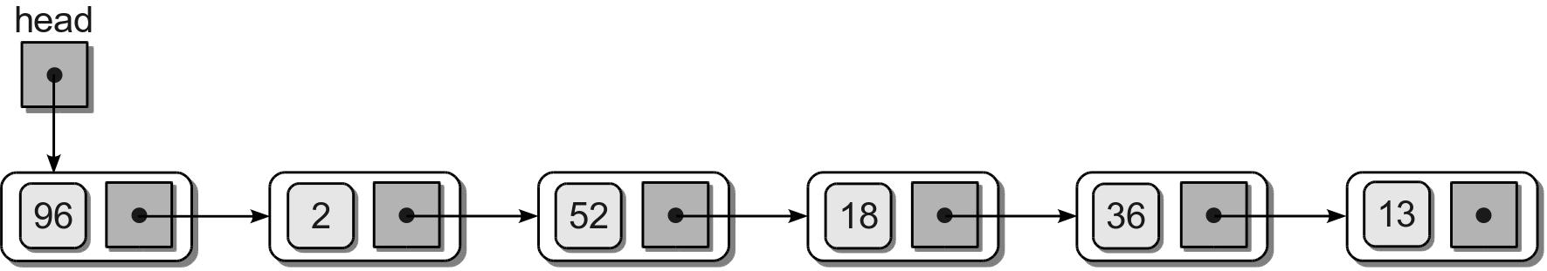
Prepending Nodes
The resulting list.
Python code
# Given the head reference and the new item.
newNode = ListNode( newItem )
newNode.next = head
head = newNode

Slide 20
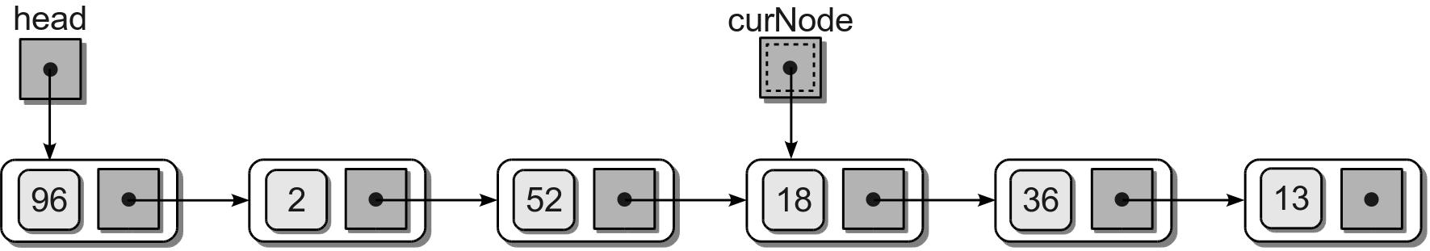
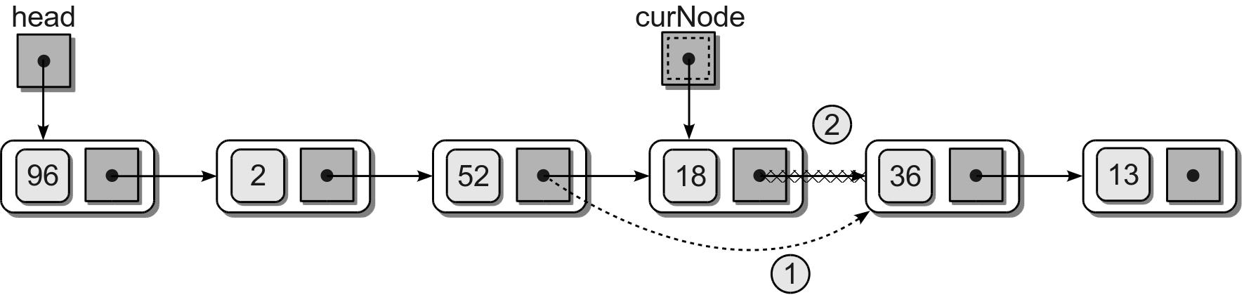
Removing Nodes
An item can be removed from a linked list by removing or unlinking the node containing the item.
  Find the node containing the item.
  Unlink it from the list.

Slide 21
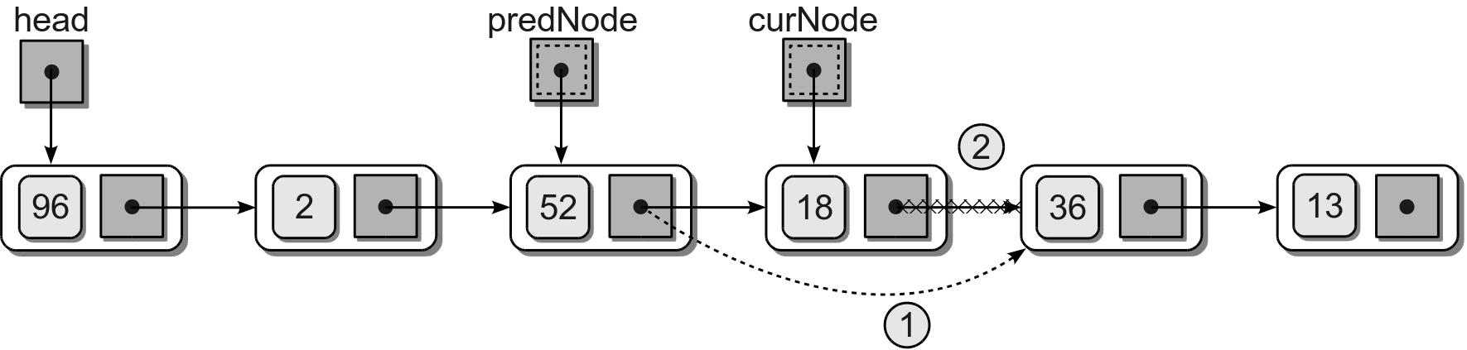

Removing Nodes
Removing a node from the middle of the list requires a second external reference.
Resulting list.

Slide 22
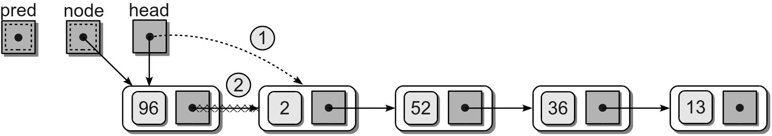
Removing Nodes
Removing the first node is a special case.
The head reference must be reposition to reference the next node in the list.

Slide 23
Removing Nodes
Given the head reference, we can remove a target from a linked list.
predNode = None
curNode = head
while curNode is not None and curNode.data != target :
predNode = curNode
curNode = curNode.next
if curNode is not None :
if curNode is head :
head = curNode.next
else :
predNode.next = curNode.next

Slide 24
The Bag ADT Revisited
We can implement the Bag ADT using a linked list.
  The items will be prepended to the list.
  Must keep track of the size of the list.

Slide 25
Bag ADT – Linked List
llistbag.py
class Bag :
def __init__( self ):
self._head = None
self._size = 0
def __len__( self ):
return self._size
def __iter__( self ):
return _BagIterator( self._head )
# ...
# Defines a private storage class for creating list nodes.
class _BagListNode( object ):
def __init__( self, item ) :
self.item = item
self.next = None

Slide 26
Bag ADT – Linked List
llistbag.py
class Bag:
# ...
def __contains__( self, target ):
curNode = self._head
while curNode is not None and curNode.item != target :
curNode = curNode.next
return curNode is not None
def add( self, item ):
newNode = _BagListNode( item )
newNode.next = self._head
self._head = newNode
self._size += 1

Slide 27
Bag ADT – Linked List
llistbag.py
class Bag:
# ...
def remove( self, item ):
predNode = None
curNode = self._head
while curNode is not None and curNode.item != item :
predNode = curNode
curNode = curNode.next
# The item has to be in the bag to remove it.
assert curNode is not None, "The item must be in the bag."
# Unlink the node and return the item.
self._size -= 1
if curNode is self._head :
self._head = curNode.next
else :
predNode.next = curNode.next
return curNode.item

Slide 28
Comparing Implementations
Operation | Python List | Linked List
b = Bag() | O(1) | O(1)
n = len(b) | O(1) | O(1)
x in b | O(n) | O(n)
b.add(x) | O(n) | O(1)
b.remove(x) | O(n) | O(n)
traversal | O(n) | O(n)

Slide 29
Building Linked Lists
There are more ways to build a linked list than simply prepending nodes to the front.
  Appending nodes
  Sorted linked lists

Slide 30
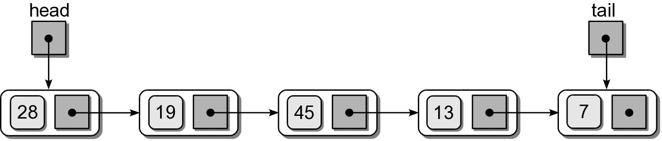
Using a Tail Reference
Some applications require items be appended to the end of the linked list.
  tail reference – a second external reference indicating the tail or last node in the list.

Slide 31
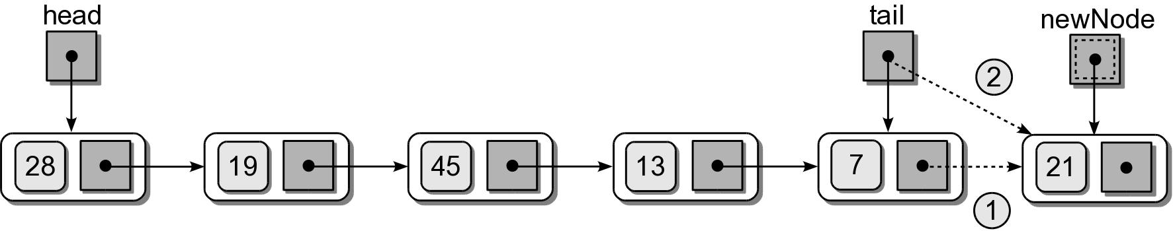
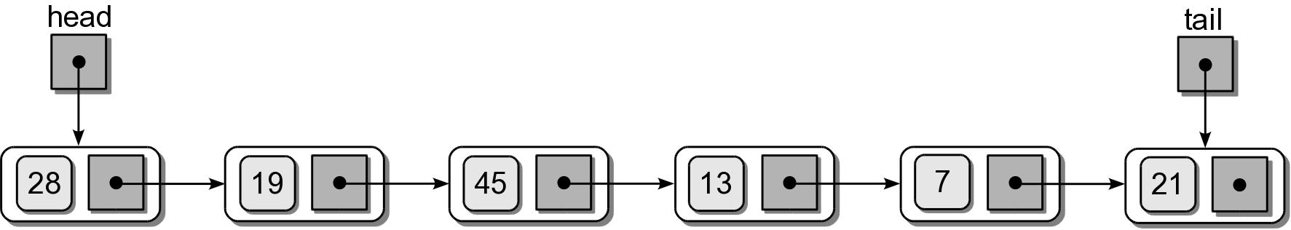
Appending Nodes
Must manage the tail reference as nodes are added/removed.
  Example: append 21 to the list.

Slide 32
Appending Nodes
Given the head and tail reference, we can add an item to a linked list.
newNode = ListNode( item )
if head is None :
head = newNode
else :
tail.next = newNode
tail = newNode
What is the time complexity to append a node to a linked list, if no tail reference is used?

Slide 33
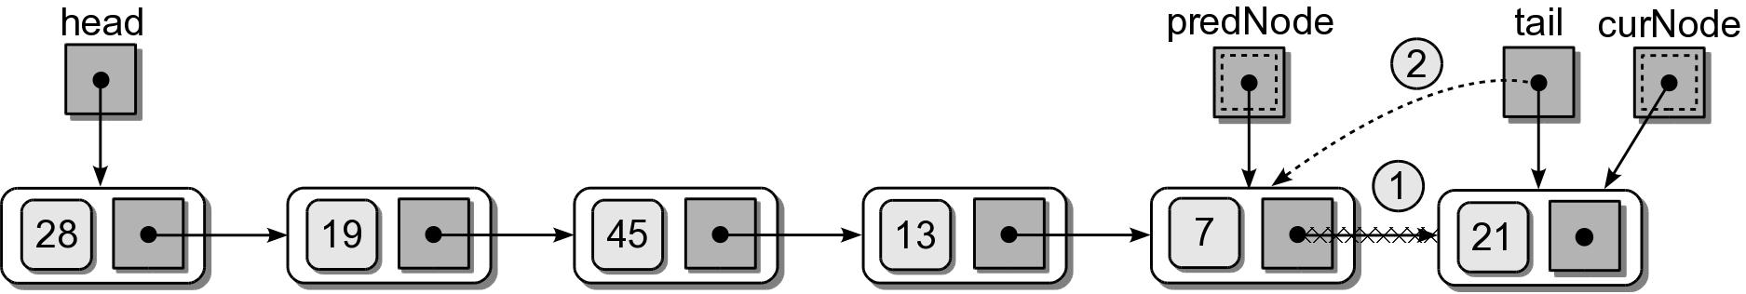
Removing Nodes
If the tail node is removed, the tail reference has to be adjusted.

Slide 34
Removing Nodes
Given the head and tail reference, we can remove a node from a linked list.
predNode = None
curNode = head
while curNode is not None and curNode.data != target :
predNode = curNode
curNode = curNode.next
if curNode is not None :
if curNode is head :
head = curNode.next
else :
predNode.next = curNode.next
if curNode is tail :
tail = predNode

Slide 35

The Sorted Linked List
The items in a linked list can be maintained in sorted order.

Slide 36
Sorted List: Searching
Searching a sorted list is similar to that of an unsorted list.
def sortedSearch( head, target ):
curNode = head
# Stop early when a larger value is encountered.
while curNode is not None and \
curNode.data < target :
if curNode.data == target :
return True
else :
curNode = node.next
return False

Slide 37
Sorted List: Insert
Adding a new node to a sorted list requires locating the correct position within the list.
  Locating the position is similar to the removal operation.
  Use a second temporary reference for the predecessor.
There are 3 possible cases.
  front
  middle
  back

Slide 38
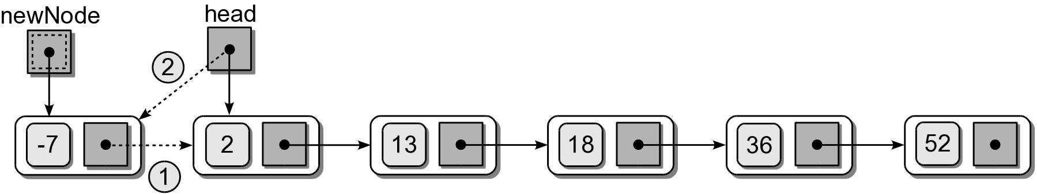
Sorted List: Insert
(1) Insert at the front.

Slide 39
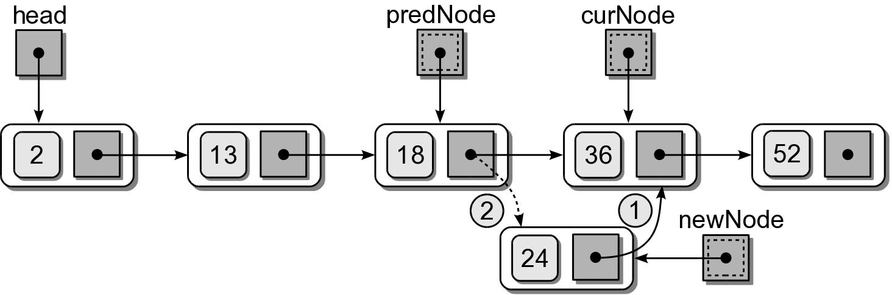
Sorted List: Insert
(2) Insert in the middle.

Slide 40
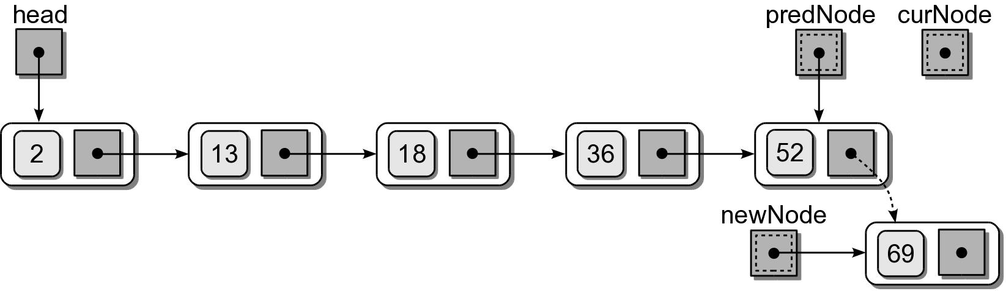
Sorted List: Insert
(3) Insert at the end.

Slide 41
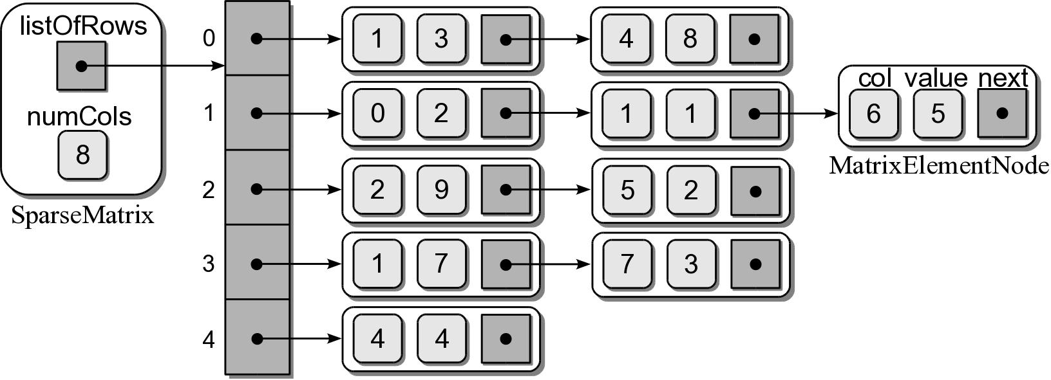
The Sparse Matrix
In the previous chapter, we used a Python list to store the non-zero elements.
We can improve the Sparse Matrix ADT with the use of an array of sorted linked lists.

Slide 42
Array of Linked Lists
The array contains one element for each row of the matrix.
Each element contains a sorted linked list.
  The nodes correspond to the non-zero elements for that row.
  The nodes are sorted by column index.

Slide 43
Sparse Matrix ADT – Linked List
llistsparse.py
from array import Array
class SparseMatrix :
def __init__( self, numRows, numCols ):
self._numCols = numCols
self._listOfRows = Array( numRows )
def numRows( self ):
return len( self._listOfRows )
def numCols( self ):
return self._numCols
# ...
class _MatrixElementNode :
def __init__( self, col, value ) :
self.col = col
self.value = value
self.next = None

Slide 44
Sparse Matrix ADT – Linked List
llistsparse.py
class SparseMatrix :
# ...
def scaleBy( self, scalar ):
for row in range( self.numRows() ) :
curNode = self._listOfRows[row]
while curNode is not None :
curNode.value *= scalar
curNode = curNode.next

Slide 45
Sparse Matrix ADT – Linked List
llistsparse.py
class SparseMatrix :
# ...
def __setitem__( self, ndxTuple, value ):
(row, col) = ndxTuple
predNode = None
curNode = self._listOfRows[row]
while curNode is not None and curNode.col != col :
predNode = curNode
curNode = curNode.next
if curNode is not None and curNode.col == col :
if value == 0.0 : # remove the node.
if curNode == self._listOfRows[row] :
self._listOfRows[row] = curNode.next
else :
predNode.next = curNode.next
else : # change the node's value.
curNode.value = value
elif value != 0.0 :
newNode = _MatrixElementNode( col, value )
newNode.next == curNode
if curNode == self._listOfRows[row] :
self._listOfRows[row] = newNode
else :
predNode.next = newnode

Slide 46
Sparse Matrix ADT – Linked List
llistsparse.py
class SparseMatrix :
# ...
def __add__( self, rhsMartrix ) :
assert rhsMatrix.numRows() == self.numRows() and \
rhsMatrix.numCols() == self.numCols(), \
"Matrix sizes not compatable for adding."
newMatrix = SparseMatrix( self.numRows(), self.numCols() )
for row in range( self.numRows() ) :
curNode = self._listOfRows[row]
while curNode is not None :
newMatrix[row, curNode.col] = curNode.value
curNode = curNode.next
for row in range( rhsMatrix.numRows() ) :
curNode = rhsMatrix._listOfRows[row]
while curNode is not None :
value = newMatrix[row, curNode.col]
value += curNode.value
newMatrix[row, curNode.col] = value
curNode = curNode.next
return newMatrix

Slide 47
Comparing Implementations
Operation | 2-D Array | Python List | Linked Lists
constructor | O(1) | O(1) | O(1)
s.numRows() | O(1) | O(1) | O(1)
s.numCols() | O(n) | O(1) | O(1)
x = s[i,j] | O(n) | O(k) | O(n)
s[i,j] = x | O(1) | O(k) | O(n)
s.scaleBy(x) | O(n²) | O(k) | O(k)
r = s + t | O(n²) | O(k²) | O(kn)

Slide 48

Polynomials
Expressions specified in terms of variables and constants
  term – a_{i}x^{i}
  coefficient – a_{i} (can be zero).
  degree – the exponent part of x^{i}
Example

Slide 49
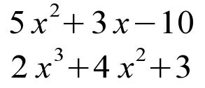
Polynomials: Addition
Two polynomials of the same variable can be summed by adding the coefficients of corresponding terms of equal degree.
  Example
  Result is a third polynomial

Slide 50

Polynomials: Multiplication
The product of two polynomials is a third polynomial.
Obtained by summing the result from multiplying each term of the first polynomial by each term of the second.

Slide 51
Polynomial: Evaluation
The easiest operation is the evaluation of a polynomial.
  Specify a value for the variable and compute the real value.
  Example: let x = 3

Slide 52
The Polynomial ADT
A polynomial is a mathematical expression of a variable constructed of one or more terms.
  Each term is of the form a_{i}x^{i}
  where a_{i} is a scalar and x^{i} is the unknown variable of degree i.
Polynomial() Polynomial( degree, coefficient ) degree() getitem( degree ) | evaluate( scalar ) add( rhsPoly ) subtract( rhsPoly ) multiply( rhsPoly )

Slide 53

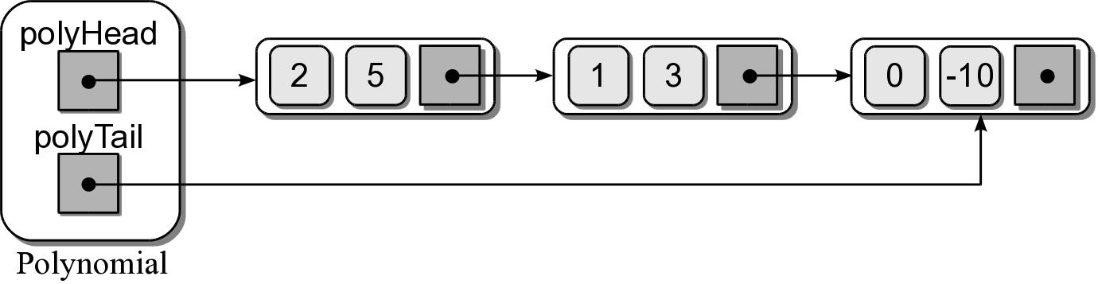
Polynomial ADT – Linked List
We can use a singly linked list to represent a one-variable polynomial.
  Use a tail reference for easy append operations.
  Store the individual non-zero terms in each node.
  Order the terms by degree in descending order.

