Slide 1
Stacks
Chapter 7

Slide 2
Stacks
A restricted access container that stores a linear collection.
  Very common for solving problems in computer science.
  Provides a last-in first-out (LIFO) protocol.

Slide 3
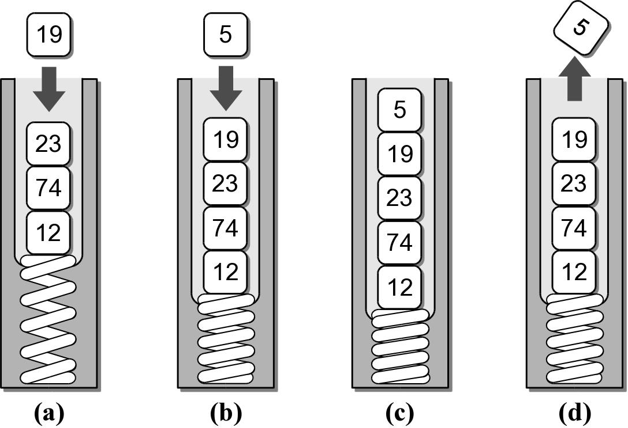
The Stack
New items are added and existing items are removed from the top of the stack.

Slide 4
The Stack ADT
A stack stores a linear collection of items with access limited to a last-in first-out order.
  Adding and removing items is restricted to the top of the stack.
Stack() isEmpty() length() pop() peek() push( item )

Slide 5
Stack Example
reverse.py
# Extracts a collection of integer values from the user
# and prints them in reverse order.
PROMPT = "Enter an int value (<0 to end):"
myStack = Stack()
# Extract the values and push them onto a stack.
value = int(input( PROMPT ))
while value >= 0 :
myStack.push( value )
value = int(input( PROMPT ))
# Pop the values from the stack and print each.
while not myStack.isEmpty() :
value = myStack.pop()
print( value )

Slide 6
Stack Implementation
Several common ways to implement a stack:
  Python list
    easiest to implement
  Linked list
    better choice when a large number of push and pop operations are performed.

Slide 7
Stack: Python List
How is the data organized within the Python list?
  Most efficient is to let the end of the list represent the top of the stack.
Why would the reverse organization not be as efficient?

Slide 8
Stack: Python List
pyliststack.py
# Implementation of the Stack ADT using a Python list.
class Stack :
def __init__( self ):
self._theItems = list()
def isEmpty( self ):
return len( self ) == 0
def __len__ ( self ):
return len( self._theItems )
def peek( self ):
assert not self.isEmpty(), "Cannot peek at an empty stack"
return self._theItems[-1]
def pop( self ):
assert not self.isEmpty(), "Cannot pop from an empty stack"
return self._theItems.pop()
def push( self, item ):
self._theItems.append( item )

Slide 9
Stack: Linked List
How should the data be organized?
  Let the head of the list represent the top of the stack.
Why is this the most efficient organization?

Slide 10
Stack: Linked List
lliststack.py
class Stack :
def __init__( self ):
self._top = None
self._size = 0
def isEmpty( self ):
return self._top is None
def __len__( self ):
return self._size
def peek( self ):
assert not self.isEmpty(), "Cannot peek at an empty stack"
return self._top.item
# ...
# The private storage class for creating stack nodes.
class _StackNode :
def __init__( self, item, link ) :
self.item = item
self.next = link

Slide 11
Stack: Linked List
lliststack.py
class Stack :
# ...
def pop( self ):
assert not self.isEmpty(), "Cannot pop from an empty stack"
node = self._top
self.top = self._top.next
self._size -= 1
return node.item
def push( self, item ) :
self._top = _StackNode( item, self._top )
self._size += 1

Slide 12
Stack Applications
Many applications encountered in computer science requires the use of a stack.
  Balanced delimiters
  Postfix expressions

Slide 13
Balanced Delimiters
Many applications use delimiters to group strings of text or simple data into subparts.
  mathematical expressions
  programming languages
  HTML markup

Slide 14
Source Code Example
Consider the following C++ source code:
int sumList( int theList[], int size )
{
int sum = 0;
int i = 0;
while( i < size ) {
sum += theList[ i ];
i += 1;
}
return sum;
}

Slide 15
Source Code Example
The delimiters must be paired and balanced.
We can design and implement an algorithm to:
  scan a C++ source file, and
  determine if the delimiters are properly paired.

Slide 16
Valid C++ Source?
from lliststack import Stack
def isValidSource( srcfile ):
s = Stack()
for line in srcfile :
for token in line :
if token in "{[(" :
s.push( token )
elif token in "}])" :
if s.isEmpty() :
return False
else :
left = s.pop()
if (token == "}" and left != "{") or \
(token == "]" and left != "[") or \
(token == ")" and left != "(") :
return False
return s.isEmpty()

Slide 17
Mathematical Expressions
We work with mathematical expressions on a regular basis.
  Easy to determine the order of evaluation.
  Easy to calculate.
But the task is more difficult in computer programs.
  A program can not visualize the expression to determine the order of evaluation.
  Must examine one token at a time.

Slide 18
Types of Expressions
Three different notations can be used:
  infix: A + B * C
  prefix: + A * B C
  postfix: A B C * +

Slide 19
Infix to Postfix
Infix expressions can be easily converted by hand to postfix notation.
  1. Fully parenthesize the expression.
  2. For each set of (), move operator to the end of the closing parenthesis.
A * B + C / D
((A * B) + (C / D))
((A B *) (C D /) +)

Slide 20
Infix to Postfix (cont)
The expression at the end of step 2:
  3. Remove all of the parentheses.
Which results in the postfix version.
((A B *) (C D /) +)
A B * C D / +

Slide 21
Evaluating Postfix Expressions
We can evaluate a valid postfix expression using a stack structure.
For each token:
  If the current token is an operand, push its value onto the stack.
  If the current token is an operator:
    pop the top two operands off the stack.
    perform the operation (top value is RHS operand).
    push the result of the operation back on the stack.
The final result will be the last value on the stack.

Slide 22
Postfix Evaluation Examples
To illustrate the use of the algorithm, assume
  the existence of an empty stack, and
  the following variable assignments
Evaluate the valid expression:
A = 8 C = 3
B = 2 D = 4
A B C + * D /

Slide 23
Postfix Example #1
Token | Alg Step | Stack | Description
ABC+*D/ | 1 | 8 | push value of A
ABC+*D/ | 1 | 8 2 | push value of B
ABC+*D/ | 1 | 8 2 3 | push value of C
ABC+*D/ | 2(a) | 8 | pop top two values: y = 3, x = 2
 | 2(b) | 8 | compute z = x + y or z = 2 + 3
 | 2(c) | 8 5 | push result (5) of the addition
ABC+*D/ | 2(a) |  | pop top two values: y = 5, x = 8
 | 2(b) |  | compute z = x * y or z = 8 * 5
 | 2(c) | 40 | push result (40) of the multiplication
ABC+*D/ | 1 | 40 4 | push value of D
ABC+*D/ | 2(a) |  | pop top two values: y = 4, x = 40
 | 2(b) |  | compute z = x / y or z = 40 / 4
 | 2(c) | 10 | push result (10) of the division

Slide 24
Postfix Example #2
What happens if the expression is invalid?
A B * C D +
Token | Alg Step | Stack | Description
AB*CD+ | 1 | 8 | push value of A
AB*CD+ | 1 | 8 2 | push value of B
AB*CD+ | 2(a) |  | pop top two values: y = 2, x = 8
 | 2(b) |  | compute z = x * y or z = 8 * 2
 | 2(c) | 16 | push result (16) of the multiplication
AB*CD+ | 1 | 16 3 | push value of C
AB*CD+ | 1 | 16 3 4 | push value of D
AB*CD+ | 2(a) | 16 | pop top two values: y = 4, x = 3
 | 2(b) | 16 | compute z = x + y or z = 3 + 4
 | 2(c) | 16 7 | push result (7) of the addition
Error | xxxxxx | xxxxxx | Too many values left on the stack.

Slide 25
Postfix Example #3
What happens if there are too many operators for the given number of operands?
A B * + C /
Token | Alg Step | Stack | Description
AB*+C/ | 1 | 8 | push value of A
AB*+C/ | 1 | 8 2 | push value of B
AB*+C/ | 2(a) |  | pop top two values: y = 2, x = 8
 | 2(b) |  | compute z = x * y or z = 8 * 2
 | 2(c) | 16 | push result (16) of the multiplication
AB*+C/ | 2(a) |  | pop top two values: y = 16, x = ?
Error | xxxxxx | xxxxxx | Only one value on stack, two needed.

Slide 26
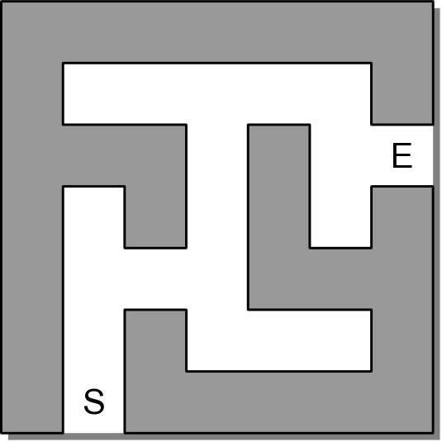
Solving a Maze
How can we find a path through a maze?

Slide 27
Brute-Force
The most basic problem-solving technique.
  Find a solution by systematically examining all possible candidates.
  Is time-consuming and generally chosen as a last resort.
When applied to solving a maze:
  Start at the beginning and follow a path.
  If we find a blocked passage, start over from the beginning and follow a different path.

Slide 28
Backtracking
The process of eliminating possible contenders from the solution and partially backing up to try others.
  backtracking algorithms – broad class of algorithms that employ this technique.
  Attempt to find a solution by extending a partial solution one step at a time.

Slide 29
Backtracking
When applied to solving a maze:
  Start from the beginning and move forward.
  If we encounter a blocked passage, backup one step and try a different path.
  Follow the new path until we find the exit or encounter another blocked passage.
  Repeat until we find the exit or return to the starting position.

Slide 30
Designing a Solution
Backtracking can be applied to the problem maze problem.
  Problem details
  Algorithm description
  Implementation details

Slide 31
Problem Description
Given a maze with starting and exit positions:
  determine if there is a path from the starting position to the exit.
  specify the path with no circles or loopbacks.

Slide 32
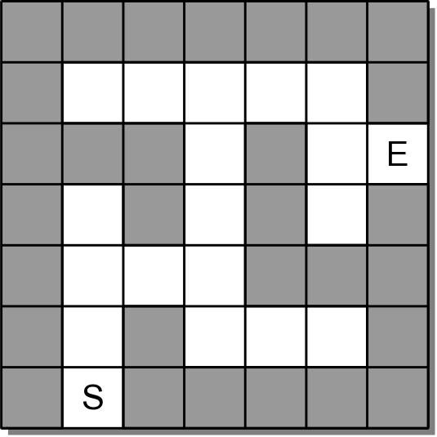
Maze Structure
The maze is a collection of equal-sized cells laid out in rows and columns. Each cell is either
  filled to represent a wall, or
  empty to represent an open space.

Slide 33
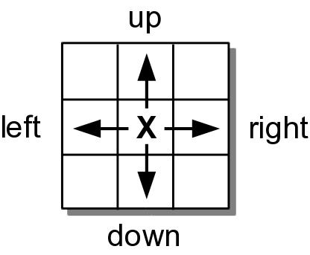
Movement
Movement within the maze is restricted:
  can only move one cell at a time and can only move to open positions:
    those not blocked by a wall, and
    those not previously used in the current search.
  can only move horizontally and vertically.

Slide 34
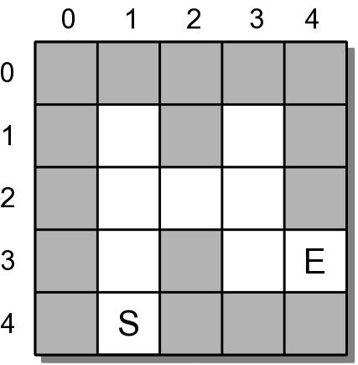
The Algorithm
Begin at the starting position.
Attempt to move from cell to cell until
  we find the exit or
  have exhausted all possible moves.

Slide 35
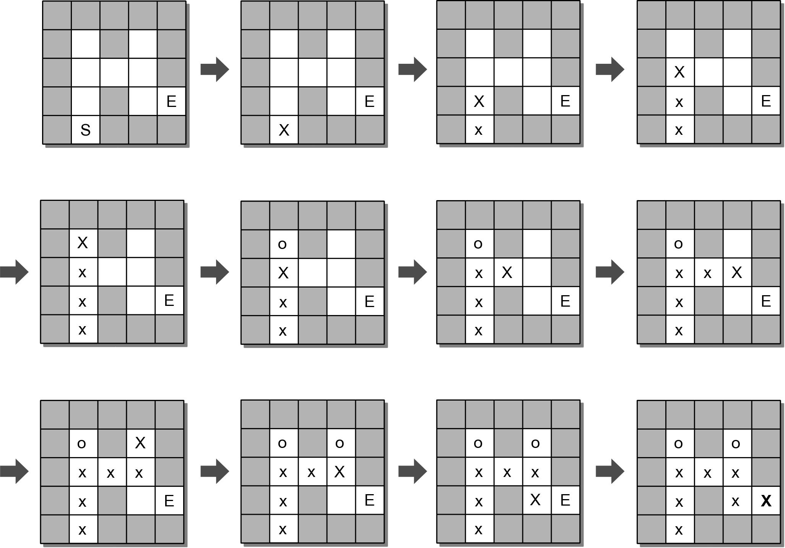
Algorithm: Finding the Exit

Slide 36
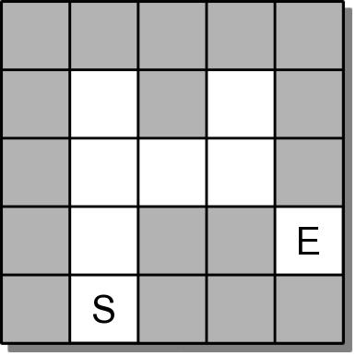
Algorithm: No Path to the Exit
What if there is no path to the exit?

Slide 37
The Maze ADT
A maze is a two-dimensional structure divided into rows and columns of equal-sized cells.
  Individual cells can be filled (wall) or empty (open)
  One cell is marked as the start and another as the exit.
Maze( nrows, ncols ) numRows() numCols() setWall( row, col ) setStart( row, col ) | setExit( row, col ) findPath() reset() draw()

Slide 38
Using the Maze ADT
solvemaze.py
# Program for building and solving a maze.
from maze import Maze
def main():
maze = buildMaze( "mazefile.txt" )
if maze.findPath() :
print( "Path found...." )
maze.draw()
else :
print( "Path not found...." )
def buildMaze( filename ):
......
def readValuePair( infile ):
line = infile.readline()
valA, valB = line.split()
return int(valA), int(valB)
# Call the main routine to execute the program.
main()

Slide 39
Maze Text File
The maze will be constructed from a maze specification stored in a text file.
  line 1: size of the maze – rows and cols
  line 2: starting position
  line 3: ending position
5 5
4 1
3 4
*****
*.*.*
*...*
*.*..
*.***

Slide 40
Building the Maze
solvemaze.py
def buildMaze( filename ):
infile = open( filename, "r" )
# Read the size of the maze.
nrows, ncols = readValuePair( infile )
maze = Maze( nrows, ncols )
# Read the starting and exit positions.
row, col = readValuePair( infile )
maze.setStart( row, col )
row, col = readValuePair( infile )
maze.setExit( row, col )
# Read the maze itself.
for row in range( nrows ) :
line = infile.readline()
for col in range( len(line) ) :
if line[col] == "*" :
maze.setWall( row, col )
# Close the maze file and return the newly constructed maze.
infile.close()
return maze

Slide 41
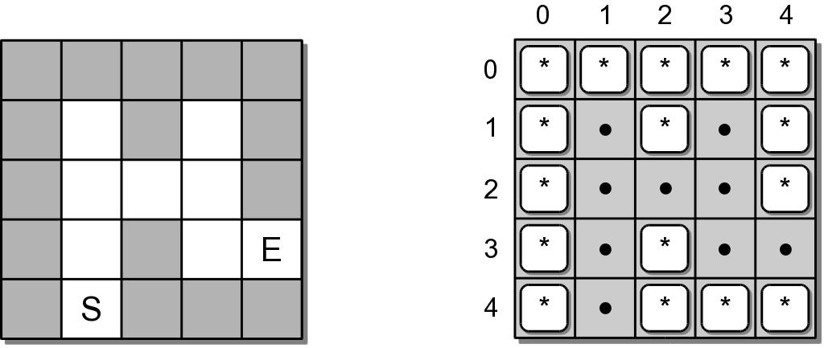
Maze Implementation
What data structure should be used?
  Obvious choice is a 2-D array
  Array elements represent the cells of the maze.
  Open cells can be represented as null references.
  Walls and tokens can be individual characters.

Slide 42
Maze Implementation
maze.py
from array import Array2D
from lliststack import Stack
class Maze :
# Define constants to represent contents of the maze cells.
MAZE_WALL = "*"
PATH_TOKEN = "x"
TRIED_TOKEN = "o"
# Creates a maze object with all cells marked as open.
def __init__( self, numRows, numCols ):
self._mazeCells = Array2D( numRows, numCols )
self._startCell = None
self._exitCell = None
# ...
# Private storage class for holding a cell position.
class _CellPosition( object ):
def __init__( self, row, col ):
self.row = row
self.col = col

Slide 43
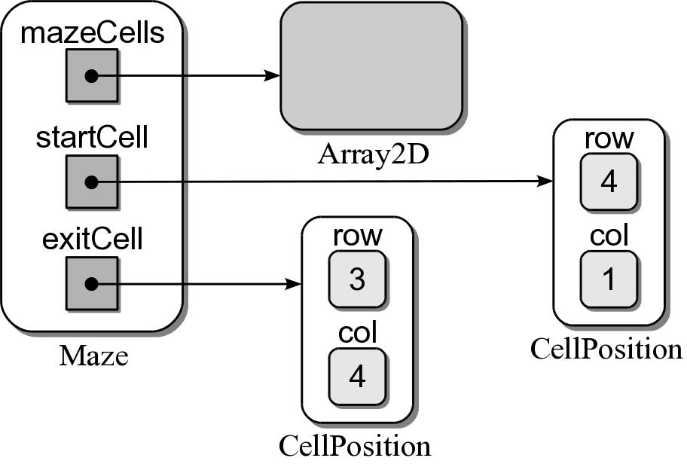
Sample Maze Object
A maze object contains three data fields.

Slide 44
Maze Implementation
maze.py
class Maze :
# ...
# Returns the number of rows in the maze.
def numRows( self ):
return self._mazeCells.numRows()
# Returns the number of columns in the maze.
def numCols( self ):
return self._mazeCells.numCols()

Slide 45
Maze Implementation
maze.py
class Maze :
# ...
# Fills the indicated cell with a "wall" marker.
def setWall( self, row, col ):
assert row >= 0 and row < self.numRows() and \
col >= 0 and col < self.numCols(),
"Cell index out of range."
self._mazeCells.set( row, col, self.MAZE_WALL )
# Sets the starting cell position.
def setStart( self, row, col ):
assert row >= 0 and row < self.numRows() and \
col >= 0 and col < self.numCols(),
"Cell index out of range."
self._startCell = _CellPosition( row, col )
# Sets the exit cell position.
def setExit( self, row, col ):
assert row >= 0 and row < self.numRows() and \
col >= 0 and col < self.numCols(), \
"Cell index out of range."
self._exitCell = _CellPosition( row, col )

Slide 46
Maze Implementation
maze.py
class Maze :
# ...
# Returns True if the given cell position is a valid move.
def _validMove( self, row, col ):
return row >= 0 and row < self.numRows() and \
col >= 0 and col < self.numCols() and \
self._mazeCells[row, col] is None
# Helper method to determine if the exit was found.
def _exitFound( self, row, col ):
return row == self._exitCell.row and \
col == self._exitCell.col
# Drops a "tried" token at the given cell.
def _markTried( self, row, col ):
self._mazeCells.set( row, col, self.TRIED_TOKEN )
# Drops a "path" token at the given cell.
def _markPath( self, row, col ):
self._mazeCells.set( row, col, self.PATH_TOKEN )

