Slide 1
Big Data, Big Commerce, Big Challenge
Reporter：Ximeng Liu
Supervisor: Rongxing Lu
School of EEE, NTU
http://www.ntu.edu.sg/home/rxlu/seminars.htm

Slide 2
Outline
GOOD:
Challenge:
BIG DATA→ COMMERCE IN DATA → BIG MONEY
BIG DATA→ BIG PROBLEM→ BIG SECURITY ISSUE

Slide 3













Big Data

Slide 4
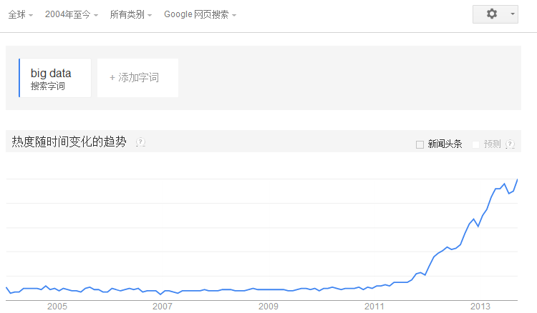
Google trends: big data

Slide 5
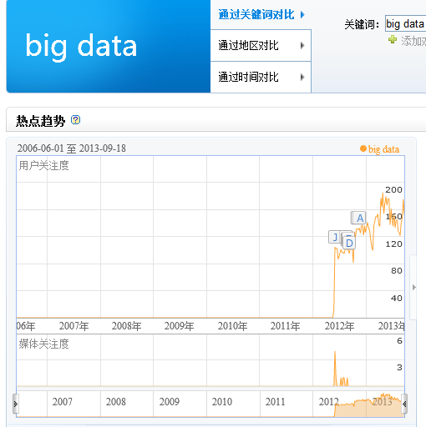
Baidu Index: big data

Slide 6
What is big data?
Doug Laney → three Vs: volume, velocity and variety ¹
Volume→ From TB to PB.
Velocity→ Deal with in a timely manner.
Varity→ All types of formats. Structured/Unstructured text documents.
¹ Source: META Group. "3D Data Management: Controlling Data Volume, Velocity, and Variety." February 2001.

Slide 7
What is big data?
SAS → add to more Vs: Variability and Complexity ¹.
Variability→ Data flows can be highly inconsistent with periodic peaks.
Complexity→ correlate relationships, hierarchies and multiple data linkages.
¹ Source: “What is Big Data?” http://www.sas.com/big-data/.

Slide 8
Big Data, Big Commerce
Acxiom has records on approximately 500 million people with 1,500 data points → one of its datacenters: 12 Pbytes.
NSA was collecting 14 Pbytes per year.
Facebook has 100 Pbytes.
Microsoft has 300 Pbytes.
Amazon has 900 Pbytes.
QUESTION: what use are these data?
Source: Fears O F. Big Data, Big Brother, Big Money[J]. IEEE Security & Privacy, 2013.

Slide 9
Big Data, Big Commerce
Swipe ¹ estimates the value of different pieces of information.
Address + Date of birth+ Phone number + Social Security number + Driver’s license →
Facebook/Google/Baidu
¹ Source: Swipe, http://turbulence.org/Works/swipe/.
$13.75.
sell targeted advertising

Slide 10
Big Data —— double-edged sword
It is win-win.
Example: It’s now easy to find automobile prices online. Fishermen use cellphones to find the ports in order to sell fish as much as possible before its rotted. Customer could buy the fish with lower price.

Slide 11
Big Data —— double-edged sword
Big Commerce & win-win → Sounds Great! BUT
It have some problems.
Privacy Problem，“filter bubble,”， Bad Data vs. Good Data， the permanence of personal data

Slide 12
Big Data —— double-edged sword
Also，Good OR Bad depends partly on how it’s used.
Example:
Kaiser Permanente found that children born to mothers who used antidepressant drugs during pregnancy have double the risk of autism-related illness.
Good → a way to prevent autism.
Bad → medical insurers will start refusing coverage which someone
uses antidepressants

Slide 13
Privacy Issues
PRISM (surveillance program) [since 2007] ¹
collects stored Internet communications based on demands made to Internet companies.
Bloomberg was looking at message content, not just addressees² .
¹ Source: PRISM (surveillance program), http://en.wikipedia.org/wiki/PRISM_(surveillance_program)
² Source: Fears O F. Big Data, Big Brother, Big Money[J]. IEEE Security & Privacy, 2013.

Slide 14
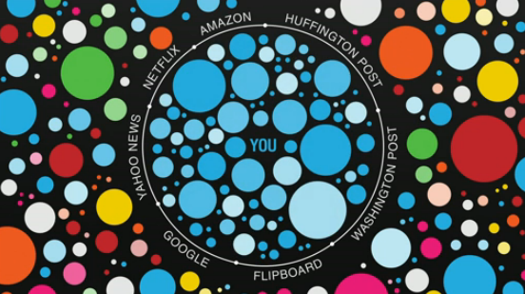
Filter Bubble
Users become separated from information that disagrees with their viewpoints, effectively isolating them in their own cultural or ideological bubbles.
Source : E. Pariser, The Filter Bubble, Penguin, 2011.

Slide 15
An example
The most famous example is exemplified by an article in The Wall Street Journal entitled
------“If TiVo Thinks You Are Gay, Here’s How to Set It Straight,”

Slide 16
Bad Data vs. Good Data
According to the Federal Trade Commission, 20 percent of credit reports contain bad information.
Other bad data problems involve identity theft use their data for fraud.
Erroneous data propagates itself into incorrect deductions. Sandy Pentland of the Massachusetts Institute of Technology
→70 to 80 percent of machine learning results are wrong.

Slide 17
Living with Our Past--- the permanence of data
We must be very careful about what they post online because the Internet never forgets.
If young people must keep thinking about anything they do that might be later captured → avoid anything risky.

Slide 18
How to solve?-----discussion
Privacy Problem-→ use some privacy preserving methods to protect the identity/data content. Without authorization, no one can access the data.
Filter Bubble → not just keyed to relevance，also other point of view.
Living with Our Past → When the data is out of date, maybe the best solution is secure delete the data.

Slide 19
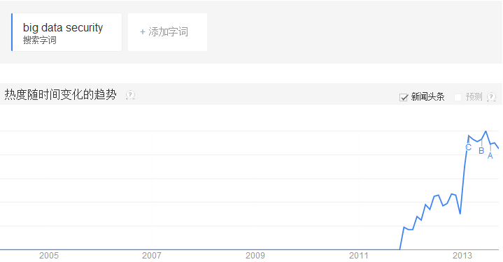
Google trends: big data v.s. big data security （ trends ）
Big Data security
Big Data

Slide 20
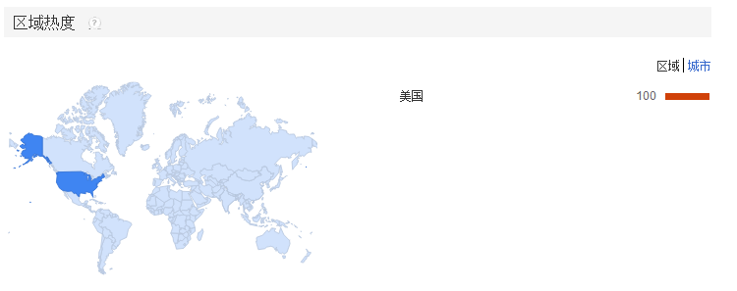
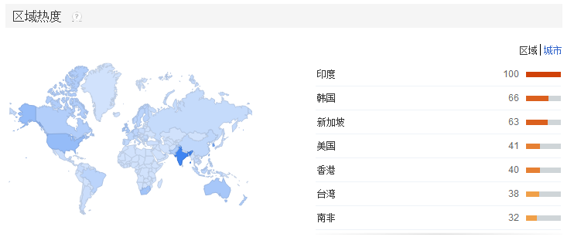
Google trends: big data v.s. big data security (location)
Big Data security
Big Data

Slide 21
Thank you
Rongxing’s Homepage: http://www.ntu.edu.sg/home/rxlu/index.htm
PPT available @: http://www.ntu.edu.sg/home/rxlu/seminars.htm
Ximeng’s Homepage:
http://www.liuximeng.cn/

