Slide 1
The big Data security Analytics Era Is Here
Reporter：Ximeng Liu
Supervisor: Rongxing Lu
School of EEE, NTU
http://www.ntu.edu.sg/home/rxlu/seminars.htm

Slide 2
References
Main Source: white paper: The big data security analytics era is here.
Source: ESG Research Report, U.S Advanced Persistent Threat Analysis, 2011
Source； ESG Research Report, Security Management an Operations: Changes on the Horizon, 2012.

Slide 3
Outline
Obstacle faced NOW.
Enter the big data security analytics Era→ What is the challenge the big data bring to us?

Slide 4
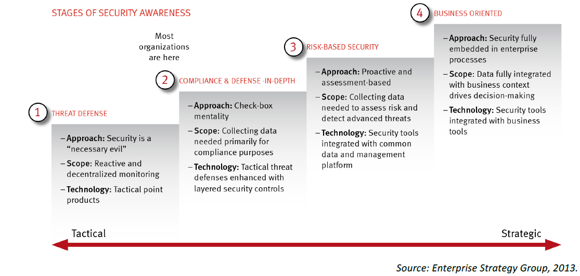
The obstacles to improving organizational security Maturity

Slide 5
The obstacles to improving organizational security maturity
The model was first published by ESG in 2011. The ESG assumed that the risk-based security would be established by most organizations by early 2013.
Many non-security executives → information security oversight and increasing information security budgets.
BUT, still failed transition from phase 2 to 3. WHY?

Slide 6
The obstacles difficult transition from phase 2 to 3
1. The volume and sophistication of new threat： The threat increase at exponential rate. According to ESG， 59% company certain or fairly certain they have been the target of an APT(Advanced Persistent Threats，example “ Stuxnet computer worm”). Detecting, analyzing and remediating add additional requirements to risk-based phase.

Slide 7
The obstacles difficult transition from phase 2 to 3
2. Rapid IT changes：New immature technology: virtualization, cloud computing, mobile device support. → immature, prone to security vulnerability.

Slide 8
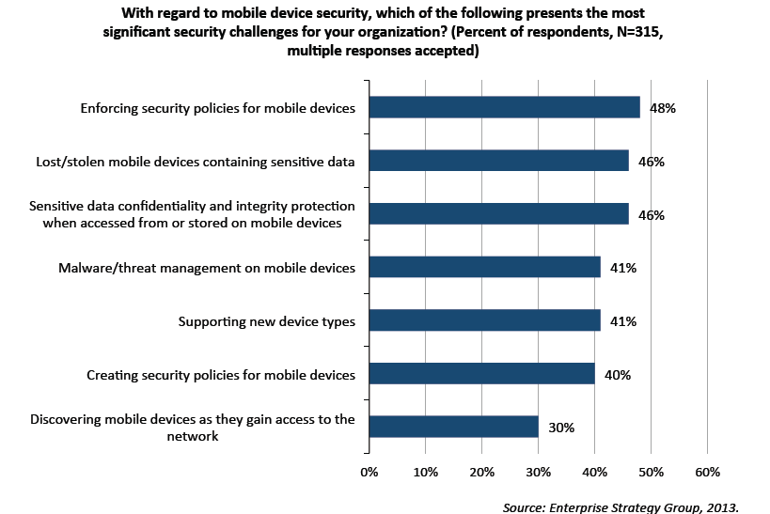
Mobile device present a number of security challenges

Slide 9
The obstacles difficult transition from phase 2 to 3
3. A growing security skill shortage: Over 50% organization add number of information security group, 23% → shortage of security skill.
But 83% of enterprise organization find it is difficult to hire security professionals.

Slide 10
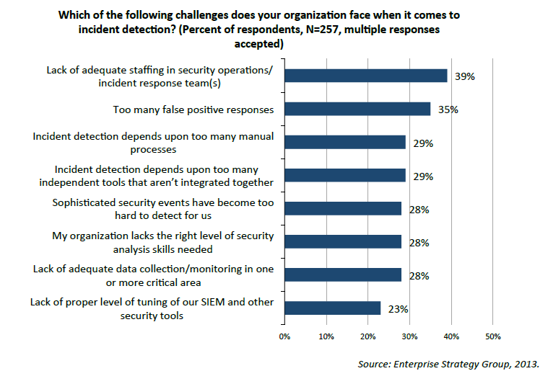
The challenges the organization faces

Slide 11
Challenges of the analytic tool
1. Security analytics tool cannot keep up with today’s data collection and processing needs. → more online security data are analysis, investigation, and modeling→ Proprietary data stores that cannot scale for such type of data volume. → slow down the detection/response→ increase the IT risk.

Slide 12
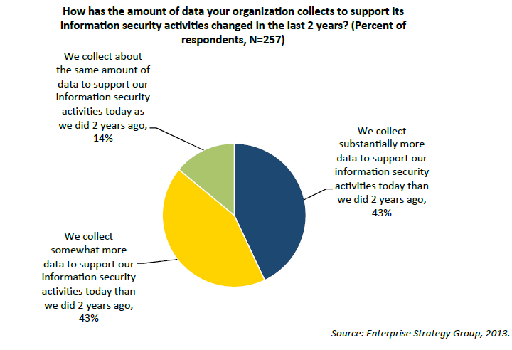
How has the amount of data you organization collects

Slide 13
Challenges of the analytic tool
2. Organization need an enterprise-wide security purview→ against explicit types of threats →aggregated tool: labor-intensive.
3. Existing security analysis tool depend excessively on customization and human intelligence → Enterprise security analysis need strong experience. → need a tool to reduce their work.

Slide 14













Big Data

Slide 15
Enter the Big data security analytics Era
Tools different, tactics is different.
Big data→ volume of data collection, processing, storage and analysis.
security analytics rapidly.

Slide 16
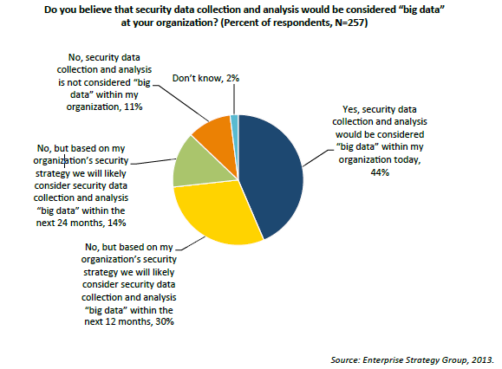
The organization is now considering the big data

Slide 17
The Challenges big data bring to us
To ESG, big data security is really about collecting and processing numerous internal and external security data sources, and analyzing this data immediately to gain real-time situational awareness across the enterprise.
Once the security data is analyzed, new intelligence as a baseline for adjusting security strategies, much faster than ever before.

Slide 18
A new security system providing
Massive scale: Efficiently collect, process, query and analytics rules to TB or PB (Hadoop, distributed processing of extremely large data across servers is fit for security analytics requirements). Also, big data security analytics deployed in a distributed architecture. Centralize analysis of massive volumes of distributed data while maintaining data integrity and providing for high-performance needs.

Slide 19
A new security system providing
Enhanced intelligence: big data security analytics offer combination of templates, heuristics, statistical and behavior models…
Tight integration. Big data security analytics should be integrated with security policy control for tactical adjustments and automation. → minimize risk. (Unusual traffic flow, Change the instructions )

Slide 20
ESG suggest CISOs
Address limitation with existing security infrastructure ： Compare security analytics output with existing capabilities, processes, and requirement.
Shift investment from prevention to detection/remediation.
Identify staffing deficiencies and knowledge gaps：Hire and train. ESG recommends that CISOs clearly identify areas of weakness at the genesis of their big data security analytics planning process.

Slide 21
Discussion
Security challenge of Big data: collecting and processing in real-time. Varity→ All types of formats. Volume is huge. Difficult to processing real-time.
In a distributed architecture. Centralize analysis of massive volumes of distributed data while maintaining data integrity and providing for high-performance needs.

Slide 22
Thank you
Rongxing’s Homepage: http://www.ntu.edu.sg/home/rxlu/index.htm
PPT available @: http://www.ntu.edu.sg/home/rxlu/seminars.htm
Ximeng’s Homepage:
http://www.liuximeng.cn/

