Slide 1
Social-Network-Sourced Analytics
& Privacy in the Age of Big Data
Reporter：Ximeng Liu
Supervisor: Rongxing Lu
School of EEE, NTU
http://www.ntu.edu.sg/home/rxlu/seminars.htm

Slide 2
References
SOURCE: Privacy in the age of big data: a time for big decisions.
SOURCE: Social-Network-Sourced Big Data Analytics

Slide 3
Outline
BIG DATA: big data→ The virtuous circle→ Big benefits.
BIG DATA: Privacy concerns.

Slide 4
Big data
Walmart’s transactional databases →more than 2.5 petabytes of data consisting of customer behaviors and preferences, network and device activity, and market trends data.
Moreover, sensor, social media, mobile, and location data are growing at an unprecedented rate. In parallel to this significant growth, data are also becoming increasingly interconnected.

Slide 5
Big data
Facebook, for instance, is nearly fully connected, with 99.91 percent of individuals on the social network belonging to a single, large connected
component.
One open challenge is determining how Internet computing technology should evolve to let us access, assemble, analyze, and act on big data.

Slide 6
Big data, big connect
Most social networks connect people or groups who expose similar interests or features. In the near future, we expect that such networks will connect other entities.
More importantly, the interactions among people and nonhuman artifacts have significantly enhanced data scientists’ productivity.
Big data analytics can accumulate the wisdom of crowds, reveal patterns, and yield best practices.

Slide 7
Big data: Big benefits
The uses of big data can be transformative, and the possible uses of the data can be difficult to anticipate at the time of initial collection.
Example in health sector: 27,000 cardiac arrest deaths occurring between 1999 and 2003 to use of Vioxx. This was made possible by the analysis of clinical and cost data collected by Kaiser Permanente.

Slide 8
Big data: Big benefits
Google Flu Trends: a service that predicts and locates outbreaks of the flu by making use of information— aggregate search queries. Of course, early detection of disease, when followed by rapid response, can reduce the impact of both seasonal and pandemic influenza.

Slide 9
Big data: Big benefits
Health sector is by no means the only arena for transformative data use.
The smart grid is designed to allow electricity service providers, users, and other third parties to monitor and control electricity use.
Benefits: who are able to reduce energy consumption by learning which devices and appliances consume the most energy, or which times of the day put the highest or lowest overall demand on the grid.

Slide 10
Big data: Big benefits
Big data is also transforming the retail market.
Wal-Mart’s inventory management system, called Retail Link, pioneered the age of big data by enabling suppliers to see the exact number of their products on every shelf of every store at each precise moment in time.
Amazon’s “Customers Who Bought This Also Bought” feature, prompting users to consider buying additional items selected by a collaborative filtering tool.

Slide 11
The virtuous circle
Connected people produce a continuous data stream that’s deposited into a repository of connected data;
Individuals or business entities might conduct big data analytics on these connected data by leveraging ad hoc clouds or connected computers; and
Analytics on the big data from these connected computers generates intelligence that subsequently proliferates back to connected people.
In fact, connected data is the confluence where social networks and clouds are presented as a solution for big data analysis.

Slide 12
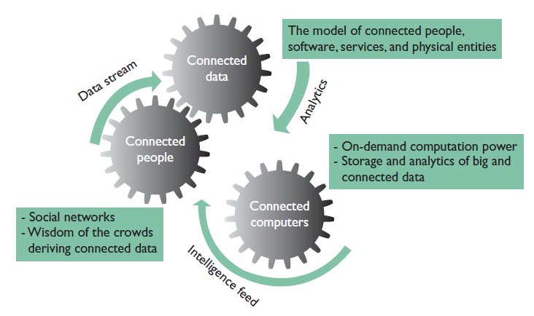
The virtuous circle

Slide 13
Connected People: Social Networks and Big Data
1. Humanistic Social Networks
Social scientists and sociologists have employed several methods to managing the networks. Modeling approaches include network-oriented data collection, block modeling, network-oriented data sampling, diffusion models, and models for longitudinal or emerging data.

Slide 14
Connected People: Social Networks and Big Data
2. Complex Network Theory
Mathematicians and physicists → more quantitative aspects.
Network structure is irregular, complex, and dynamically evolving in time.

Slide 15
Connected People: Social Networks and Big Data
Most fundamental forms as graphs or small-world networks, but more intricate topographies are represented as weighted, random, power-law, or spatial networks.
Spectral graph partitioning → determines the minimal number of edges between two sets of vertexes within a graph.

Slide 16
Connected People: Social Networks and Big Data
Hierarchical clustering→ a priori knowledge of the number of communities is lacking.
Divide nodes into clusters → the connections within the cluster more closely related than the connections to nodes assigned to a different cluster.

Slide 17
Connected People: Social Networks and Big Data
3. Information Networks and Social Networking
Combined social and complex networks→ networks representing information-systems oriented environments.
Fundamental question: “Do online social networks resemble or behave in similar ways as people in real-world situations?”

Slide 18
Connected People: Social Networks and Big Data
4. Social Networks as Big Data
Hope to predict behavior to ultimately enhance marketing, sales, and online commerce.
Characterized by the “three Vs”

Slide 19
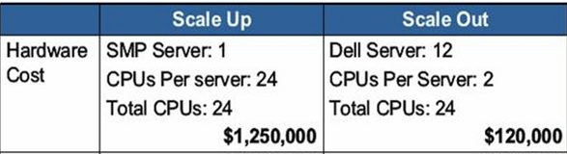
Connected Computers: Advances in Scale-Out Systems
Adopting scale-out rather than scale-up systems.

Slide 20
Connected Computers: Advances in Scale-Out Systems
Key features of the scale-out pattern → server clusters, share-nothing architecture (no shared memory, storage, and so on), a TCP/ IP network connection, and a parallel programming framework such as MapReduce.
Dropbox, Amazon’s Simple Storage Service (S3). Amazon Elastic MapReduce to power its user-behavior analytics. Microsoft Windows Azure and IBM SmartCloud Enterprise+ . On top of the Apache Hadoop ecosystem.

Slide 21
Connected Computers: Advances in Scale-Out Systems
Scale-out data stores
NoSQL systems → flexible schema and elasticity to overcome relational databases’ limitations.

Slide 22
Connected Computers: Advances in Scale-Out Systems
Relational models and SQL provide an abstraction layer between the database’s physical.
NoSQL data stores offer various forms of data structures. Users must understand data’s physical organization and employ vendor-specific APIs to manipulate these data.
Current state of the art attempts to devise a SQL layer on top of NoSQL, but without an abstract data model.

Slide 23
Connected Computers: Advances in Scale-Out Systems
Incremental Processing and Approximate Result.
A large volume of data is injected into such a system at a high speed, while analysis and interpretation must occur at the same pace.
Stream computing opens a gateway to real-time analytics.
1. Interplay between building the batch mode model and sensing the realtime streams. (the accumulated historical data an help information specialists build a statistical model to guide stream processing, the newly arrived data from the stream system should be leveraged to tune the model to reflect the recent trends.)

Slide 24
Connected Computers: Advances in Scale-Out Systems
Volume-velocity challenges, another perspective is to provide approximate, just-in-time results to queries, or prioritize different queries by allocating a varying amount of resources.

Slide 25
Connected Computers: Advances in Scale-Out Systems
NoSQL, Scalable SQL, and NewSQL
NewSQL projects seek to modernize the RDBMS architecture to provide the same scalable performance of NoSQL while preserving the ACID guarantees of a traditional, single-node database system.

Slide 26
Connected Data: New Challenges for Clouds and Social Networks
Users on these sites aren’t usually trying to connect with strangers but are primarily communicating with people who are already part of their direct or extended social network. A level of trust already exists between social network users
Establishing security policies that leverage existing trust relationships, promoting data and resource sharing within networks of people with similar interests, and optimizing data analytics by leveraging the fact that people in the same network potentially share the same interests and will thus submit similar queries.

Slide 27
Connected Data: New Challenges for Clouds and Social Networks
1. Resource Sharing
Social networking on the cloud could enable resource sharing based on the social relationship between users. → volunteer computing.
Questions: reliability and quality-ofservice (QoS) guarantees → build reputation for users and establish their corresponding resource reliability

Slide 28
Connected Data: New Challenges for Clouds and Social Networks
2. Locality of Reference in the Cloud
In computer science, locality of reference, also known as the principle of locality, is a phenomenon describing the same value, or related storagelocations, being frequently accessed. There are two basic types of reference locality. Temporal locality and Spatial locality.¹
These users are potentially interested in the same patterns, so computations would exhibit high locality of reference, which can help to optimize performance.
¹ Source: Locality of reference, http://en.wikipedia.org/wiki/Locality_of_reference

Slide 29
Connected Data: New Challenges for Clouds and Social Networks
3. Privacy-Preserving Data Analytics
Privacy-preserving statistical techniques, such as differential privacy, can be employed in conjunction with social links to maximize query result accuracy without revealing private data.
Differential privacy techniques must also be refined to deal with incremental data that has social annotations.

Slide 30
Connected Data: New Challenges for Clouds and Social Networks
4. Cross-Domain Data Analytics
To perform cross-domain data analytics, we must develop and maintain a common ontology that will capture the differences and similarities in terminologies and define relationships between terms within and across the network.

Slide 31
Connected Data: New Challenges for Clouds and Social Networks
5. Socializing Access Control Policies
Security is a major concern that we must address when coupling social networks with the cloud.
We could leverage social relationships to build an evolving access control system that self-adapts to the addition, deletion, and update in users and their relationships
Self-adapting policy rules are needed to determine users’ access rights.

Slide 32
Connected Data: New Challenges for Clouds and Social Networks
6. Service Reputation Frameworks
Automatic service discovery and composition can occur based on services’ reputation.
A service reputation can be built from users’ feedback and by auditing a service invocation and execution.
Some generic frameworks propose incorporating service reputation as a selection criterion when composing services.

Slide 33
Classification for Social Networks
Classify all social networks using two criteria: level of generality and ability to execute.

Slide 34
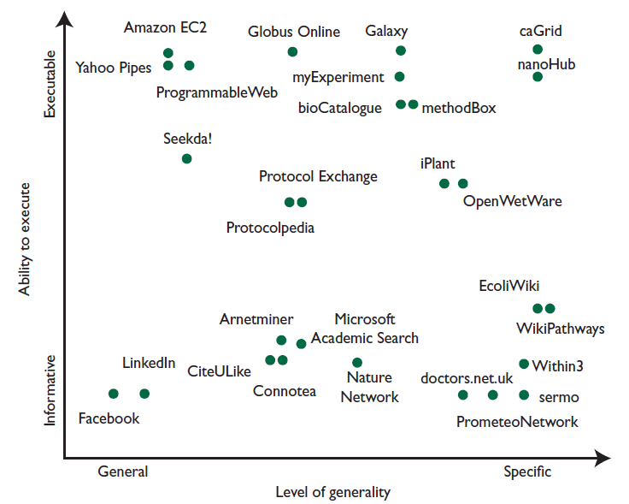
Classification for Social Networks

Slide 35
Classification for Social Networks
1. Informative vs. Executable
General-purpose social networking sites have aspects of both：
Informative. General-purpose social networks such as Facebook and LinkedIn have been harnessed to cultivate communication and collaboration.
Executable. Besides these informative social networks, many websites provide open and collaborative platforms to search for executable mashups, Web services, and so on. Example：Amazon Elastic Compute Cloud

Slide 36
Classification for Social Networks
Research-oriented social networks tend to be naturally integrated with informativeness and execution capabilities:
Informative websites are based on author-publication-citation networks and can be used to identify connections among authors, publications, and research topics., such as CiteULike and Nature Network.

Slide 37
Classification for Social Networks
Informative-executable. Many sites go beyond just bringing people together. Rather, they enable researchers to share data and protocols that describe methodologies for conducting experiments and obtaining data. OpenWetWare.
Executable. Some research-specific social networks are computation oriented. myExperiment

Slide 38
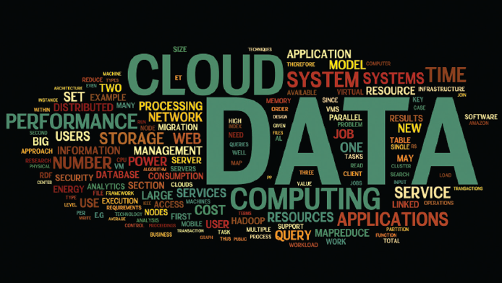
Frequency of words
Word cloud generated from more than 60 recent research papers on cloud computing and big data in the last two years.

Slide 39
Big data: big concerns
The harvesting of large data sets and the use of analytics clearly implicate
privacy concerns.
Traditionally, organizations used various methods of de-identification (anonymization, pseudonymization,encryption, key-coding, data sharding) to distance data from real identities and allow analysis to proceed while at the same time containing privacy concerns.

Slide 40
Big data: big concerns
De-identification has become a key component of numerous business models, most notably in the contexts of health data (regarding clinical trials, for example), online behavioral advertising, and cloud computing.

Slide 41
OPT-IN OR OPT-OUT?
Privacy and data protection laws are premised on individual control over information and on principles such as data minimization and purpose limitation.
Yet it is not clear that minimizing information collection is always a practical approach to privacy in the age of big data

Slide 42
OPT-IN OR OPT-OUT?
The legitimacy of processing should be assumed even if individuals decline to consent.
Example:
Web analytics rich value by ensuring that products and services can be improved to better serve consumers. Privacy risks are minimal, if properly implemented, deals with statistical data, typically in de-identified form. Yet requiring online users to opt into analytics would no doubt severely curtail its application and use.

Slide 43
OPT-IN OR OPT-OUT?
Policymakers must also address the role of consent in the privacy framework. Too many processing activities are premised on individual consent.
‘Privacy Policy,’ consumers believe that their personal information will be protected in specific ways; In fact, Privacy policies often serve more as liability disclaimers for businesses than as assurances of privacy for consumers.

Slide 44
OPT-IN OR OPT-OUT?
Collective action problems may generate a suboptimal equilibrium where individuals fail to opt into societally beneficial data processing in the hope of free riding on the goodwill of their peers.
This phenomenon is evident in other contexts where the difference between opt-in and opt-out regimes is unambiguous.
Also, A consent-based regulatory model tends to be regressive, since individuals’ expectations are based on existing perceptions.
Facebook → News Feed feature in 2006

Slide 45
Opportunities for engineers and scientists
Engineers will need to introduce new distributed data analysis frameworks in which users have access to subsets of the “big data” datasets as well as situational awareness into global processing.
New simulation techniques for predictive decision support when deciding when or if to initiate a new analysis.
New comprehensive cross-network, crosscloud data models must be developed

Slide 46
Opportunities for engineers and scientists
In a socially connected world, however, these policies must leverage interconnected, graph-based social relationships.
A need will exist for highly self-configurable security policies to protect users’ security and privacy while also preserving privacy embedded within the data.

Slide 47
Disscussion on big data privacy & security
1. De-identification.
2. highly self-configurable security policies to protect users’ security and privacy while also preserving privacy embedded within the data.

Slide 48
Thank you
Rongxing’s Homepage: http://www.ntu.edu.sg/home/rxlu/index.htm
PPT available @: http://www.ntu.edu.sg/home/rxlu/seminars.htm
Ximeng’s Homepage:
http://www.liuximeng.cn/

