Slide 1
Collaborative Filtering Recommendation
Reporter：Ximeng Liu
Supervisor: Rongxing Lu
School of EEE, NTU
http://www.ntu.edu.sg/home/rxlu/seminars.htm

Slide 2
References
1 Herlocker J L, Konstan J A, Borchers A, et al. An algorithmic framework for performing collaborative filtering[C]//Proceedings of the 22nd annual international ACM SIGIR conference on Research and development in information retrieval. ACM, 1999: 230-237.（cite：1908 ）
2. Sarwar B, Karypis G, Konstan J, et al. Item-based collaborative filtering recommendation algorithms[C]//Proceedings of the 10th international conference on World Wide Web. ACM, 2001: 285-295. （cite：3309 ）
3. Melville P, Mooney R J, Nagarajan R. Content-boosted collaborative filtering for improved recommendations[C]//AAAI/IAAI. 2002: 187-192. （cite： 850）
4. Su X, Khoshgoftaar T M. A survey of collaborative filtering techniques[J]. Advances in artificial intelligence, 2009, 2009: 4.（cite： 573）
5. Jin X, Mobasher B. Using semantic similarity to enhance item-based collaborative filtering[C]//Proceedings of The 2nd IASTED International Conference on Information and Knowledge Sharing. 2003: 1-6.

Slide 3
Outline
Collaborative Filtering based recommender → user-based and item-based

Slide 4
Collaborative filtering
Collaborative Filtering (CF) is a technology that has emerged in e-Commerce applications to produce personalized recommendations for users. It is based on the assumption that people who like the same things are likely to feel similarly towards other things.

Slide 5
Collaborative filtering
Two approaches of CF based recommender; user-based or memory-based and item-based or model based.

Slide 6
User based algorithms
User based algorithms are CF algorithms that work on the assumption that each user belongs to a group of similar behaving users. The basis for the recommendation is composed by items that are liked by users. Items are recommended based on users tastes (in term of their preference on items). The algorithm considers that users who are similar (have similar attributes) will be interested on same items.

Slide 7
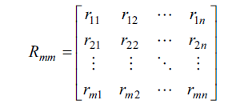
Collaborative filtering
Collaborative filtering algorithm is processed in item-user rating matrix.
User-item matrix usually is described as a m × n ratings matrix Rmn, shown as formula (1), where row represents m users and column represents n items. The element of matrix rij means the score rated to the user i on the item j, which commonly is acquired with the rate of users’ interest
Notes:
User-item matrix usually is described as a
m × n ratings matrix Rmn, shown as formula (1), where row
represents m users and column represents n items.

Slide 8
User-based collaborative filtering
One critical step in user-based collaborative filtering is to
compute the similarity between users and then to select the nearest neighbors.
There are a number of different ways to compute the similarity between users.

Slide 9

User-based Cosine-based similarity
Cosine-based similarity: In this case, two users are
thought of as two vectors in the n dimensional user-space.
The similarity between them is measure by computing the
cosine of the angle between these two vectors. Formally, in
the m × n ratings matrix, similarity between users u and v,
denoted by sim(u, v) is given by

Slide 10
User-based correlation-based similarity
Correlation-based similarity: In this case, similarity
between two users u and v is measured by computing the Pearson-r correlation corr(u,v). To make the correlation computation accurate we must first isolate the co-rated cases (i.e., cases where the items rated by u and v). Let the set of items which both rated by u and v are denoted by Iuv then the correlation similarity is given by

Slide 11
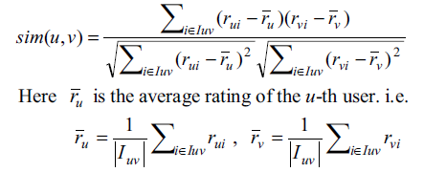
User-based correlation-based similarity

Slide 12



Predictions

Slide 13
Item-based algorithms
Item-based algorithms avoid this bottleneck by exploring the relationships between items first, rather than the relationships between users. Recommendations for users are computed by finding items that are similar to other items the user has liked. Because the relationships between items are relatively static, item-based algorithms may be able to provide the same quality as the user-based algorithms with less online computation.

Slide 14
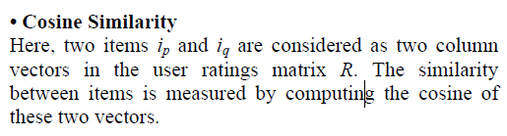
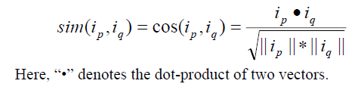
Cosine Similarity

Slide 15
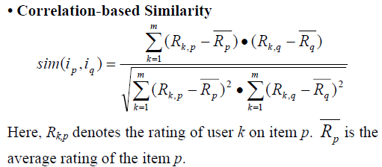
Correlation-based Similarity

Slide 16
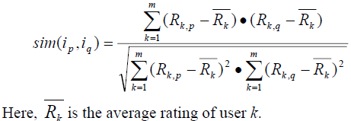
Adjusted Cosine Similarity
Since different users have different rating styles. For example, in moving rating scenario, rating scale between 1 and 5, some users may give rating 5 to a lot of movies they consider to be “not bad”; while some people are “strict” raters, for they only give rating 5 to those movies they like most. To offset the different scale problem, another similarity measure called Adjusted Cosine Similarity is presented.

Slide 17
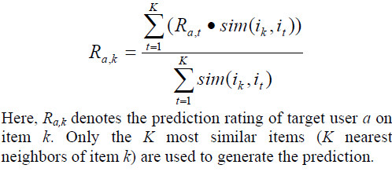
Prediction Computation
After computing the similarity between items, we select a set of most similar items to the target item and generate a predicted rating for the target item using target user’s ratings on the similar items. We use a Weighted Sum as follows.

Slide 18
Questions & Discussion

Slide 19
Thank you
Rongxing’s Homepage: http://www.ntu.edu.sg/home/rxlu/index.htm
PPT available @: http://www.ntu.edu.sg/home/rxlu/seminars.htm
Ximeng’s Homepage:
http://www.liuximeng.cn/

