Slide 1

Two Encryption Algorithms based on Layered Cellular Automata
Zhang Xing

Slide 2

Content
Cellular Automata
LRCA(Layered and Reversible Cellular Automata)
TLCA(T-shaped Layered Cellular Automata)

Slide 3
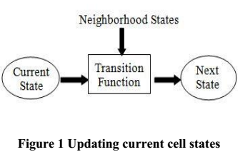
Cellular Automata(CA) is dynamic and discrete system
A Cellular Automaton (CA) is an infinite, regular lattice of simple finite state machines that change their states synchronously, according to a local update rule that specifies the new state of each cell based on the old states of its neighbors.
Cellular automata are a collection of cells that each adapts one of a finite number of states. Single cells change in states by following a local rule that depends on the environment of the cell.

Slide 4
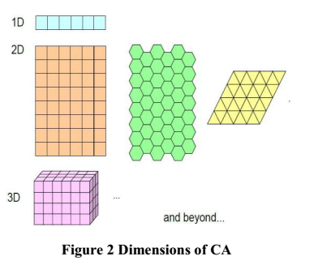
CA can be represented by {D,K,N,f,B}
D defines the dimension of CA may be 1D, 2D,… (Figure 2)
K holds set of possible states of all cells in a CA
{1,2,3,…}
{born,death}
{black, white}
…
for convenience , {0,1}

Slide 5
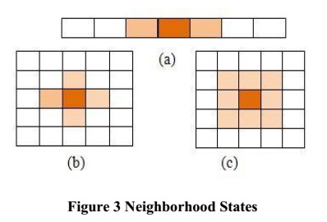
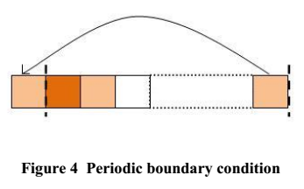
CA can be represented by {D,K,N,f,B}
N defines the set of neighborhood states(Figure 3)
3 neighbour (a)
Von-Neumann(b)
Moore neighborhood(c)
f is transition function ( Transition rule)
B defines the boundary condition
Periodic boundary (Figure 4)
Fixed boundary

Slide 6
inherent properties:
Discrteness, Parallelism, Locality, Homogeneity, Unpredictability
classification
Uniform CA: all cells obey the same rule
Hybrid CA
Reversible CA: the global transition function is one-to-one mapping
Nonreversible CA
Programmable CA: different iteration step using different rules
…

Slide 7






Configuration of a CA
the state of all cells at time t
next time
the state of i-th cell at time t
the state of i-th cell at time t+1
(1)
r is neighborhood radius
Take radius as one (Elementary CA)
(2)

Slide 8


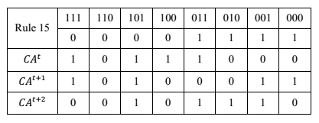
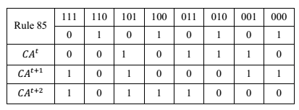
Rule
Transition rule in 1D CA two neighbors----- (256)
(Elementary CA)
rule 30
00011110=30
reversible rule couple
(15,85),(51,51),(170,240),(204,204)(Periodic boundary)

Slide 9
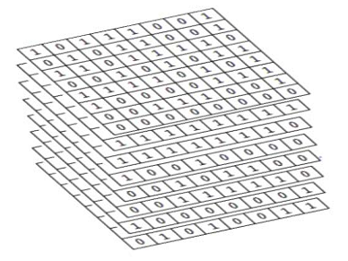

Layered Cellular Automata(LCA)
LCA can be viewed as a system,that consist of layers ,and each layer is consists of 1D CA
Transformation function--
The text is converted into binary form and arranged in layers where each row is considered as a 1D CA with periodic boundary with radius equal to unity. 1D rule are used for encryption on each layer.

Slide 10
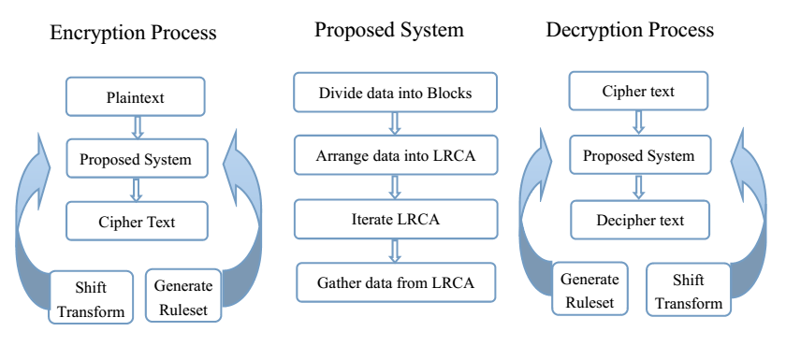
A Encryption system based on Layered and Reversible CA(LRCA)

Slide 11
A Encryption system based on Layered and Reversible CA(LRCA)
Generation Ruleset
1. Select rules which are reversible
(15,85),(51,51),(170,240),(204,204)
2. Index the rules for both encryption and decryption
Index:0 1
Map:15---00 51---01 170---10 204---11(encryption)
85---00 51---01 240---10 204---11(decryption)
3. Generate Random series of indexes
for example:1101010000010001 1010011011111001 1000110011100011
4. Identify rule set from random series for both encryption and decryption
5. Shifting the rules for each row for both encryption and decryption

Slide 12
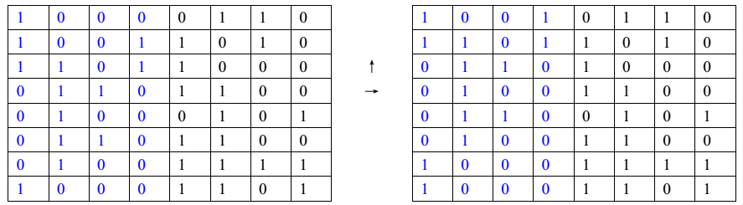
A Encryption system based on Layered and Reversible CA(LRCA)
Half Shift Transformation

Slide 13
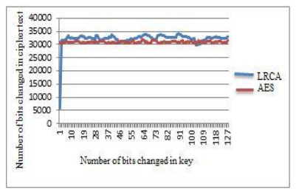
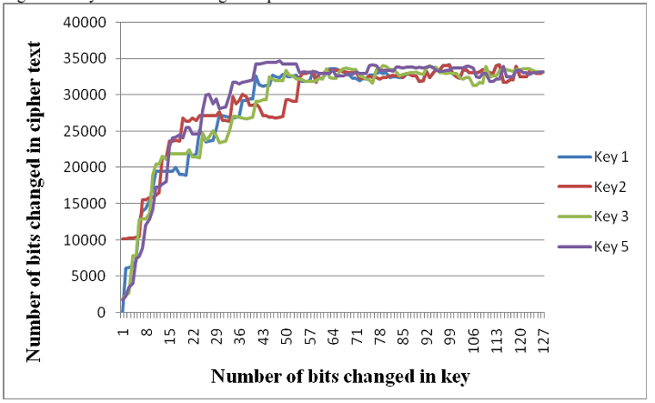
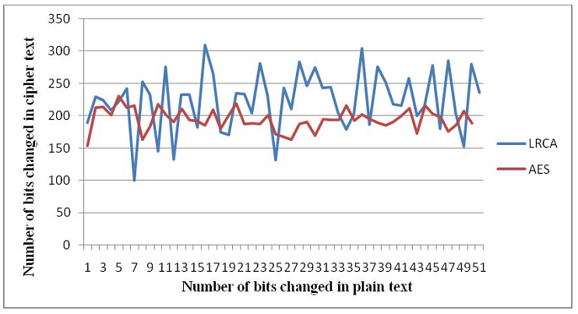
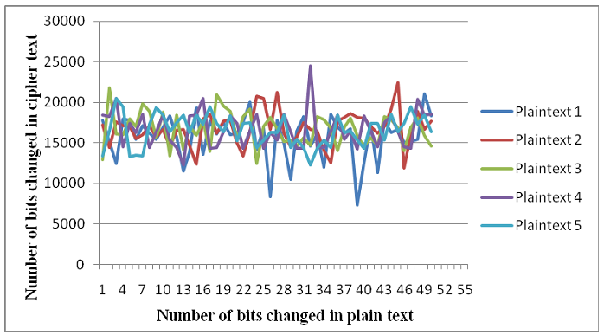
Security Analysis
Confusion
Diffusion

Slide 14
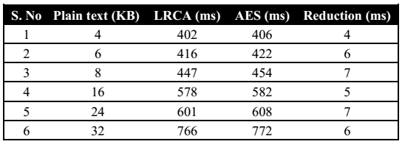
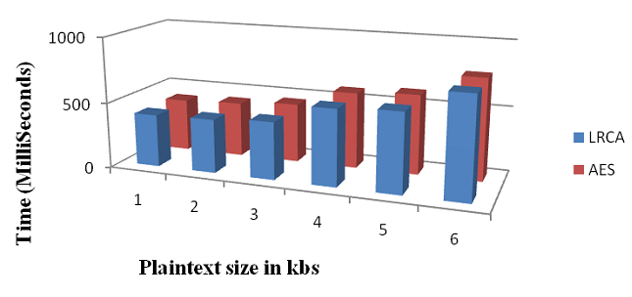
Security Analysis
Time analysis of LRCA and AES

Slide 15
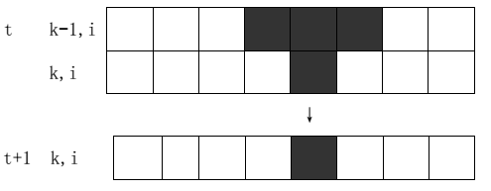



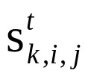
Encryption based on T-shaped Layered Cellular Automata(TLCA)
the state of i-th cell at time t:
Elementary CA
Layered CA & T-shaped neighbor structure
means the state of k-th layer i-th row j-th column at time t
T-shaped neighbor structure

Slide 16

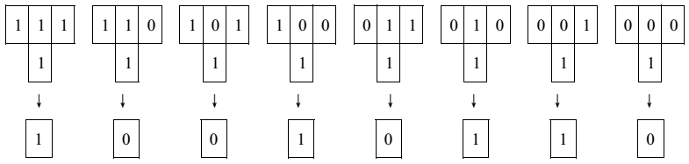
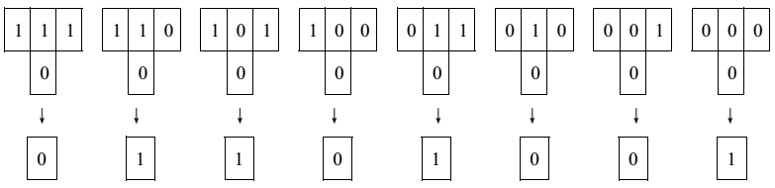

Encryption based on T-shaped Layered Cellular Automata(TLCA)
Rule T38505
rule number
called a binary number be composed of the mapping values of all neighboring state from high to low as the rule number of T-shaped cellular automata.
1001011001101001=38505

Slide 17






Encryption based on T-shaped Layered Cellular Automata(TLCA)
The prove of reversible:
For
If ,
so
If , that is
so

Slide 18


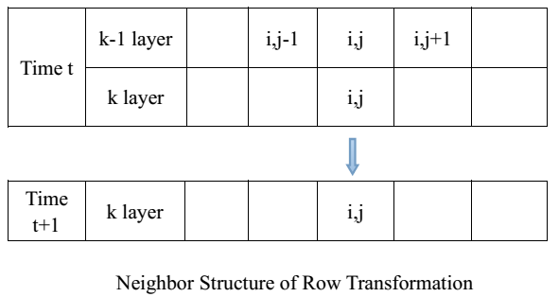
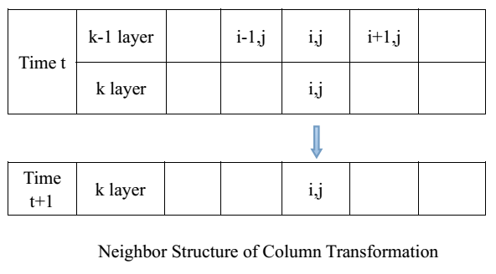
Row Transformation
Column Transformation

Slide 19
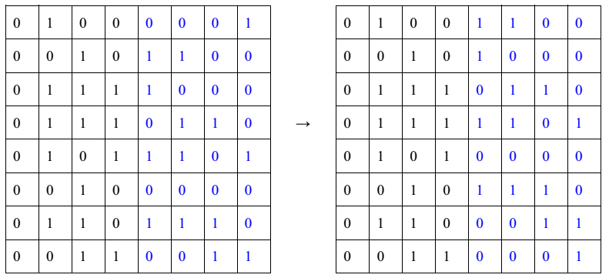
Encryption based on T-shaped Layered Cellular Automata(TLCA)
(Half) Shift Transformation

Slide 20
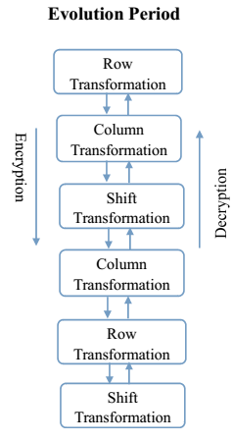
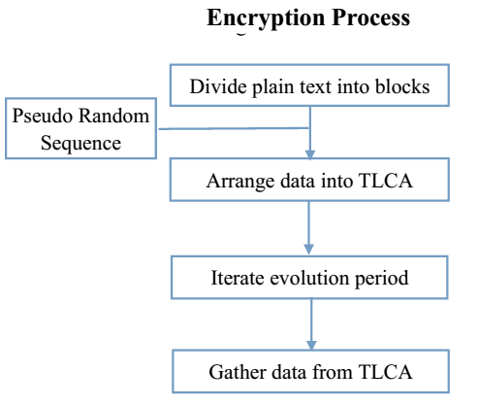
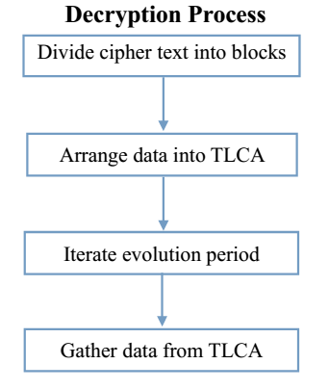
Encryption based on T-shaped Layered Cellular Automata(TLCA)

Slide 21
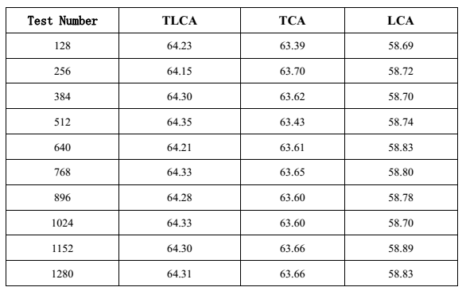
Encryption based on T-shaped Layered Cellular Automata(TLCA)
Security Analysis
Avalanche Effect

Slide 22
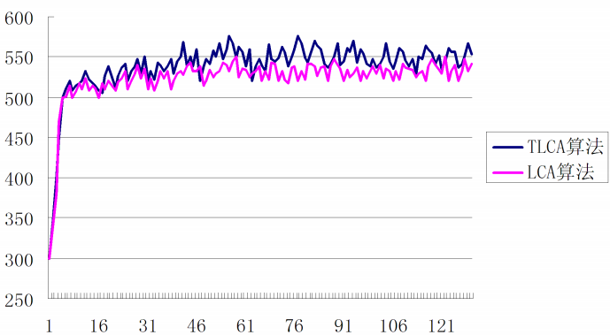
Encryption based on T-shaped Layered Cellular Automata(TLCA)
Security Analysis
Avalanche Effect
Diffusion Property
Number of bits changed in cipher text
Number of bits changed in plain text

Slide 23
Thanks!

