Slide 1
Efficient Processing of Metric Skyline Queries
Reporter：Ximeng Liu
Supervisor: Rongxing Lu
School of EEE, NTU
http://www.ntu.edu.sg/home/rxlu/seminars.htm

Slide 2
References
Chen L, Lian X. Efficient processing of metric skyline queries[J]. Knowledge and Data Engineering, IEEE Transactions on, 2009, 21(3): 351-365.

Slide 3
Skyline
Given a d-dimensional data set D, a skyline query returns all the data objects which are not dominated by other objects in D.

Slide 4
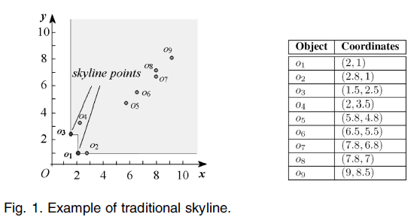
Skyline

Slide 5
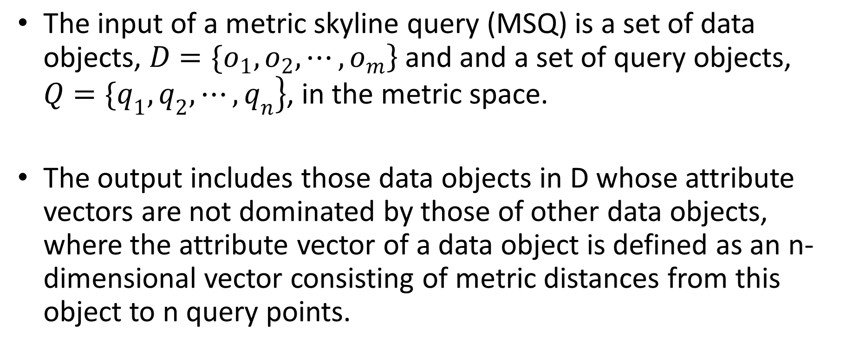
Metric Skyline

Slide 6
Applications of MSQs
MSQs have many important applications. For example, consider a business plan of opening a number of shops near some residential areas. The candidate locations for opening a shop can be viewed as data objects in the database, whereas residential areas that the shop is targeting at are query points. The manager has to decide appropriate shop locations for the convenience of customers living in the targeted areas. In particular, the candidate locations of shop must be interesting in terms of the traveling distance from a shop to all its targeted customers (areas), and any candidate location should satisfy the condition that no other location is closer to all its targeted areas than itself.

Slide 7
Applications of MSQs
Note that the computation of the traveling distance between a candidate location and a residential area should consider the underlying road network, for instance, the shortest road path between two places, which is a metric distance function.

Slide 8
Applications of MSQs
In an image database, due to the gap between semantic concepts and low-level image features [33], a single image is often not enough to express a semantic concept that users want to query. We can select a group of example query images and find those images whose distance vectors to these query images are not dominated by others.

Slide 9
Applications of MSQs
Here, the distance between any two images can be measured by the cosine similarity between two feature vectors of images, which is metric. For instance, if users want to search all the images about “sunset in mountains,” they can select a set of query images such as sun, mountains, and sky, and conduct an MSQ over the image feature vectors in the database to find candidate images. Note that, here, we want to retrieve the most probable candidate images such that there are no other images that are more similar to all the query images.

Slide 10
Applications of MSQs
One of important tasks is to find near-duplicate documents in applications such as detecting e-mail spam or plagiarism. Usually, such near duplicate documents are copied from different sources. we can specify a number of query documents and issue an MSQ to obtain candidate documents that are most likely to be near-duplicates of query documents. The similarity between two documents can be measured by a metric distance function such as Edit distance.

Slide 11
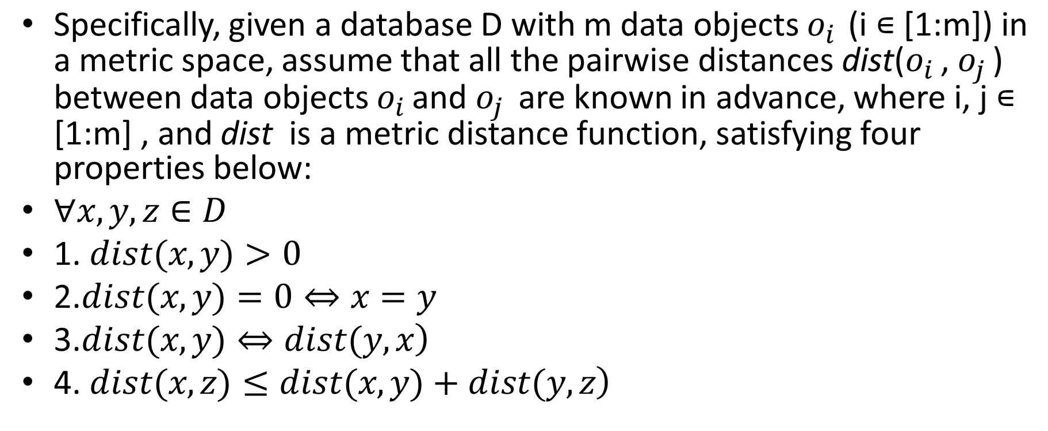
THE PRUNING FOUNDATION

Slide 12
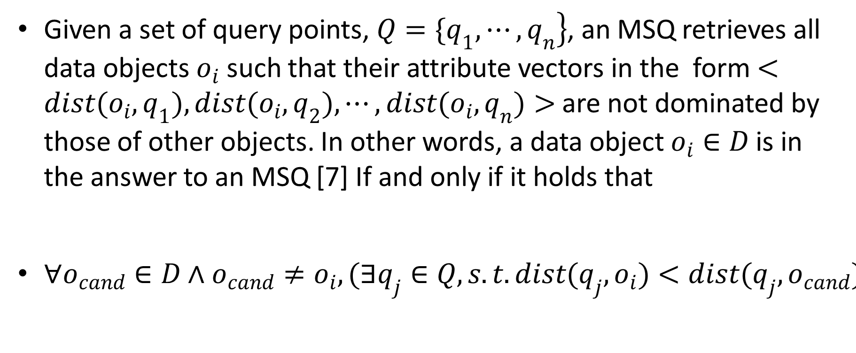
Definition

Slide 13
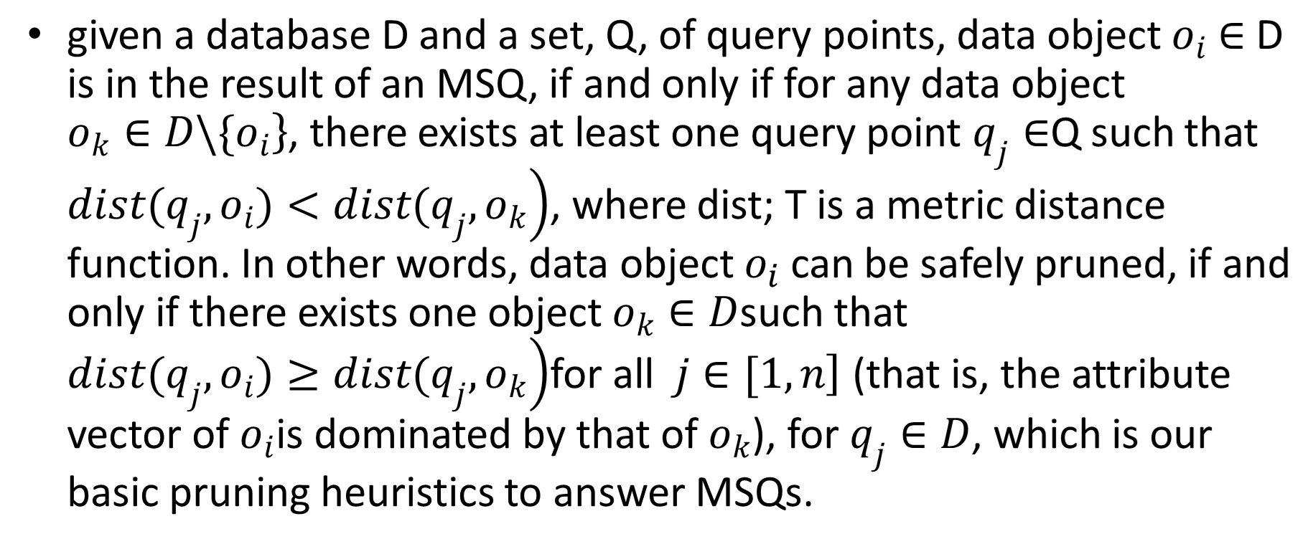
THE PRUNING FOUNDATION

Slide 14
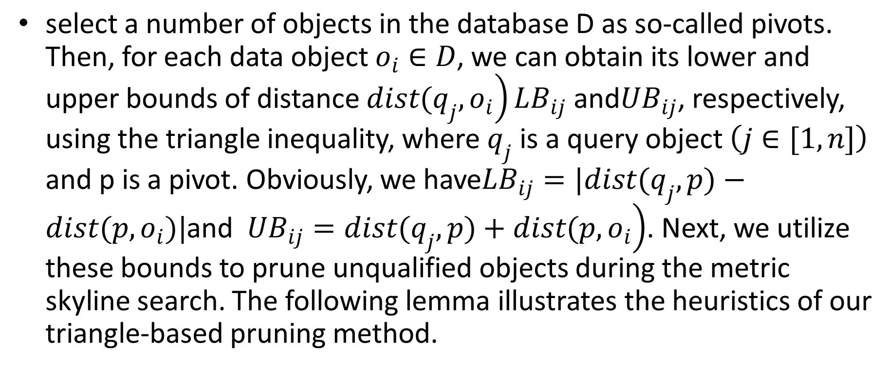
Triangle-Based Pruning

Slide 15
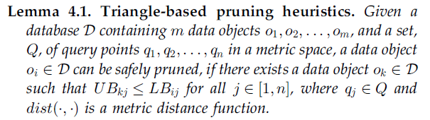
THE PRUNING FOUNDATION

Slide 16
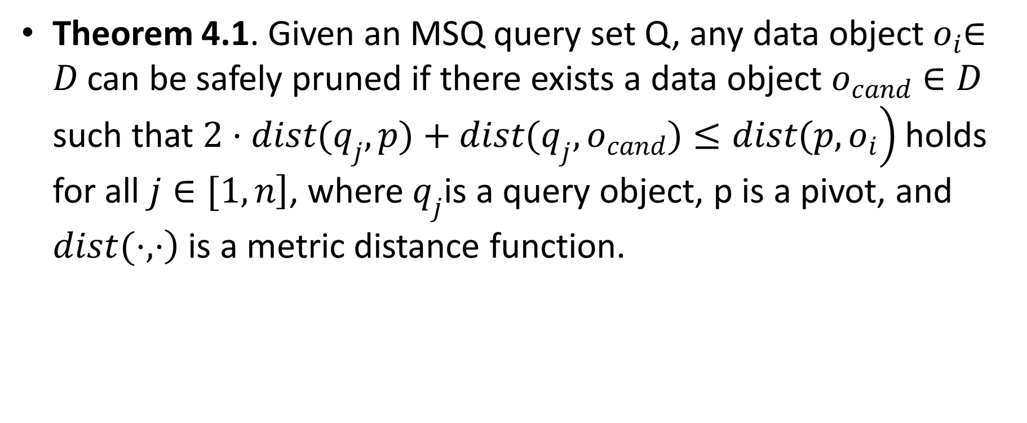
THE PRUNING FOUNDATION

Slide 17
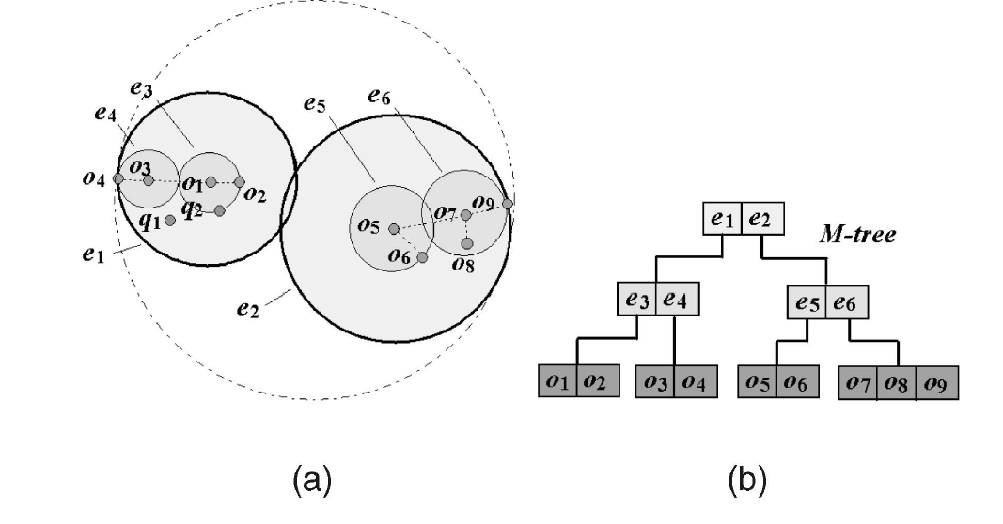
METRIC SKYLINE QUERY
We discuss query processing of metric skyline via indexes in the metric space, which can significantly reduce the search space by filtering out the unqualified data objects as early as possible.

Slide 18
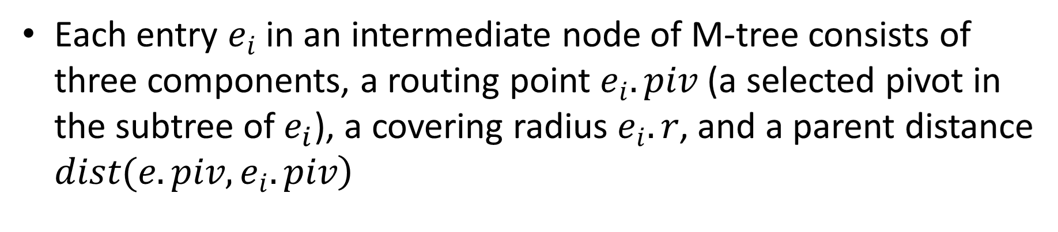
Rationale of Query Processing

Slide 19
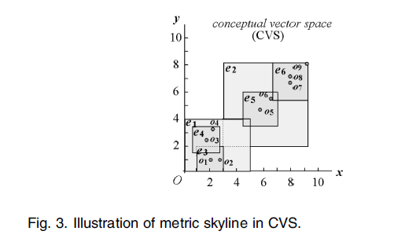
Rationale of Query Processing
In order to clarify our MSQ processing, we conceptually map each entry ei of M-tree onto a hyperrectangle in an n-dimensional vector space, namely conceptual vector space (CVS), in which each dimension is related to one dynamic attribute.

Slide 20
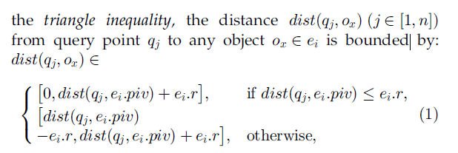
Rationale of Query Processing

Slide 21
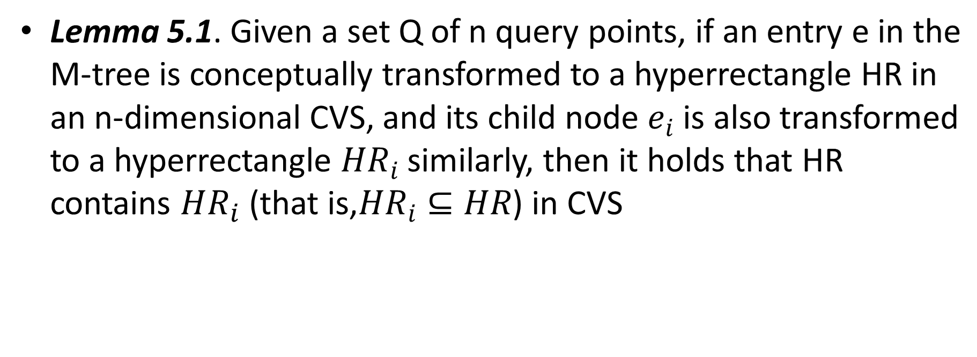
Rationale of Query Processing

Slide 22
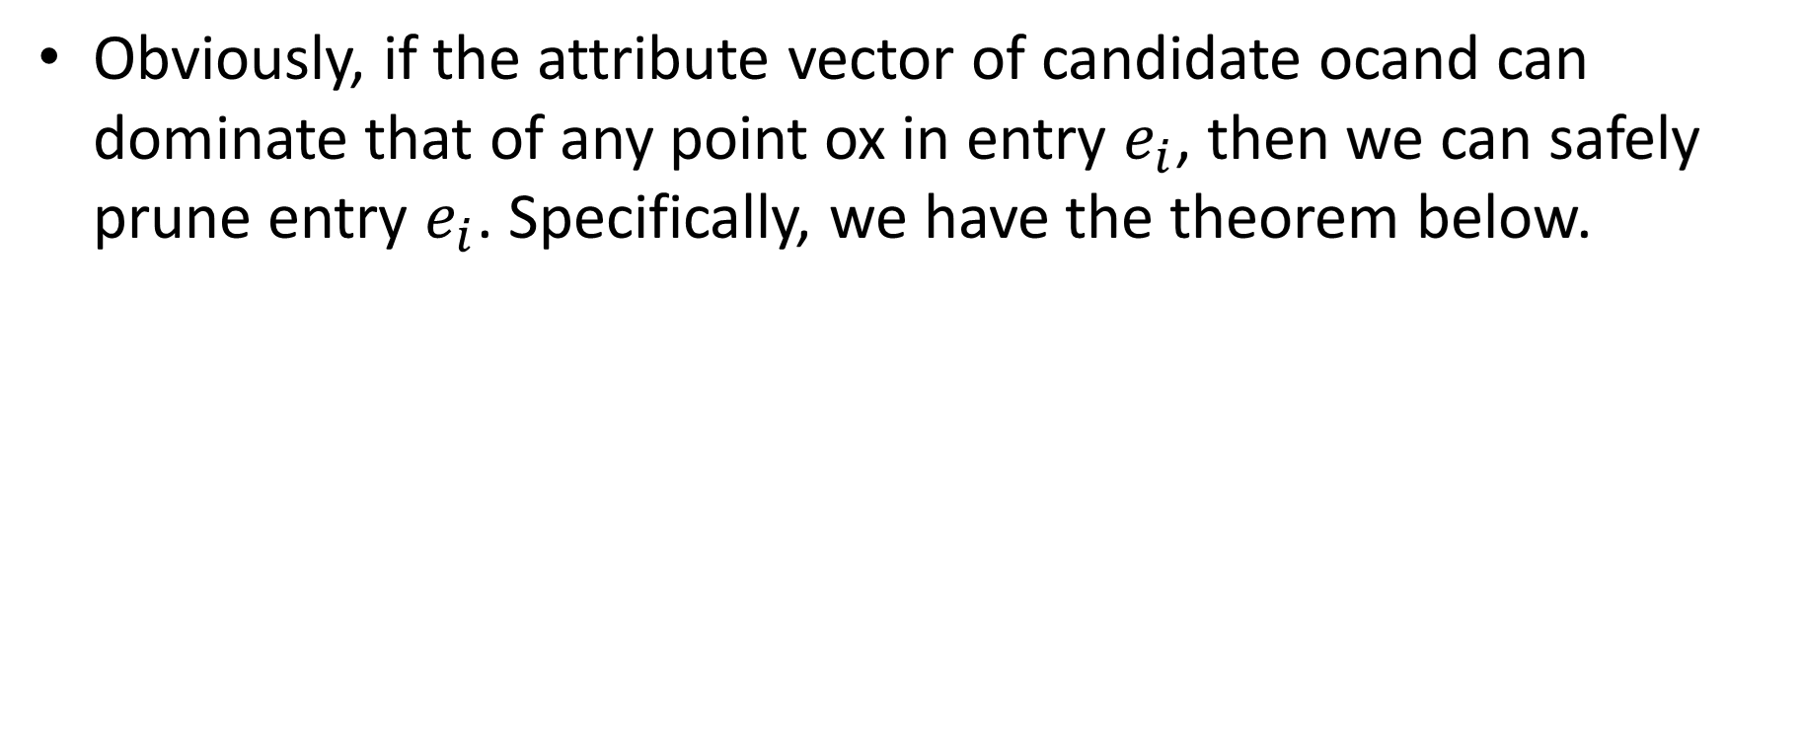
Pruning Intermediate Entries

Slide 23
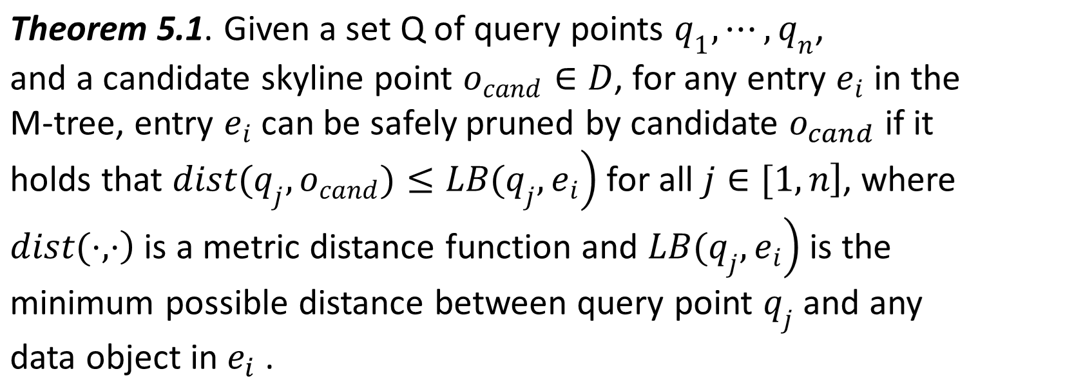
Pruning Intermediate Entries

Slide 24
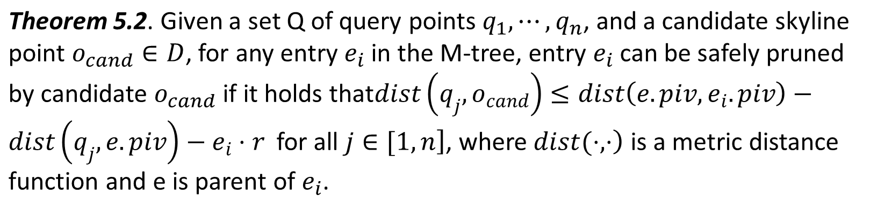
Pruning Intermediate Entries

Slide 25
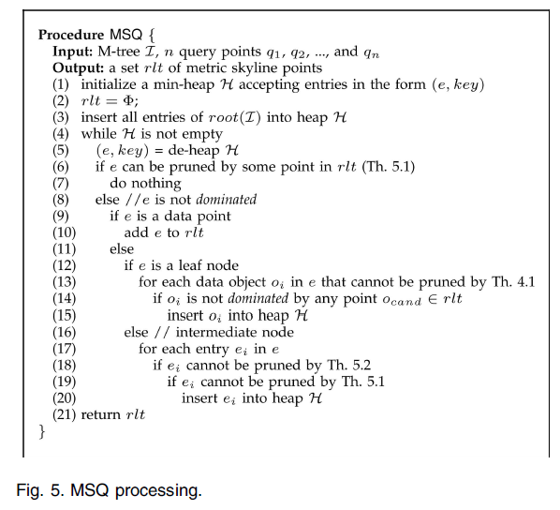
Query Processing

Slide 26
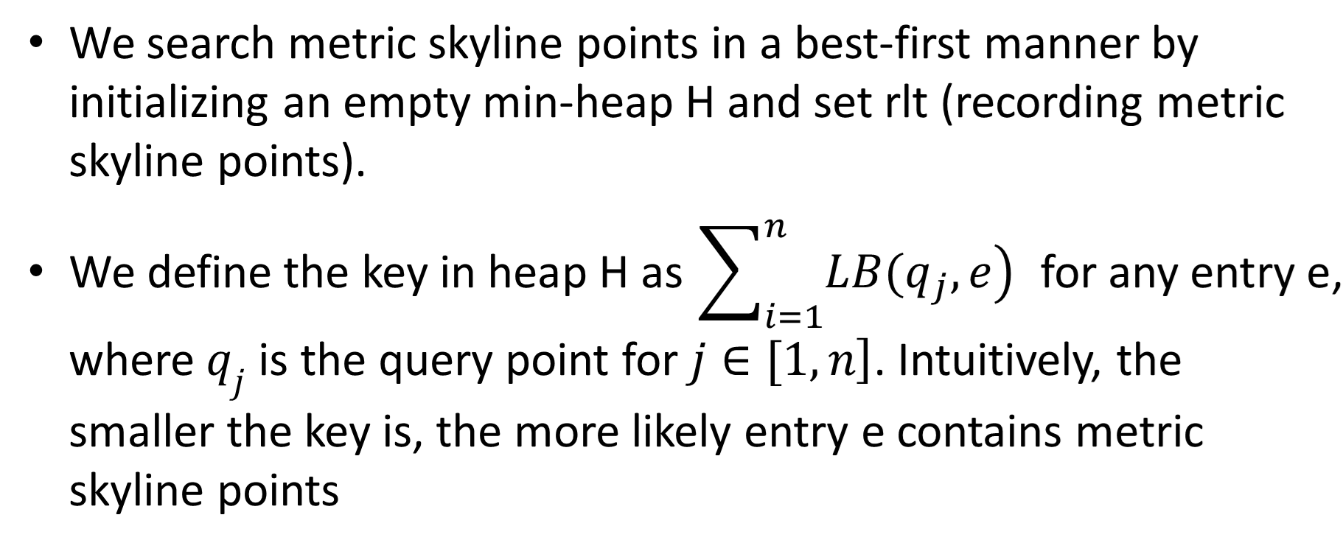
Query Processing

Slide 27
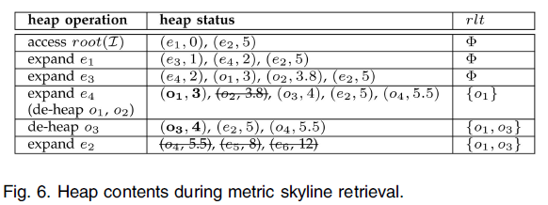
Query Processing

Slide 28
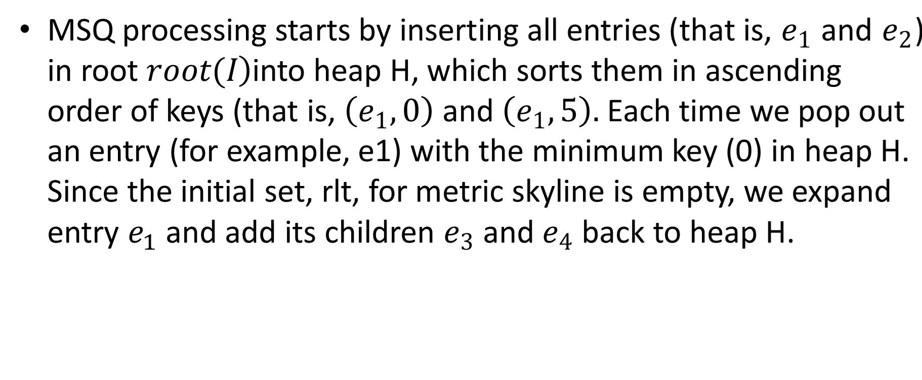
Query Processing

Slide 29
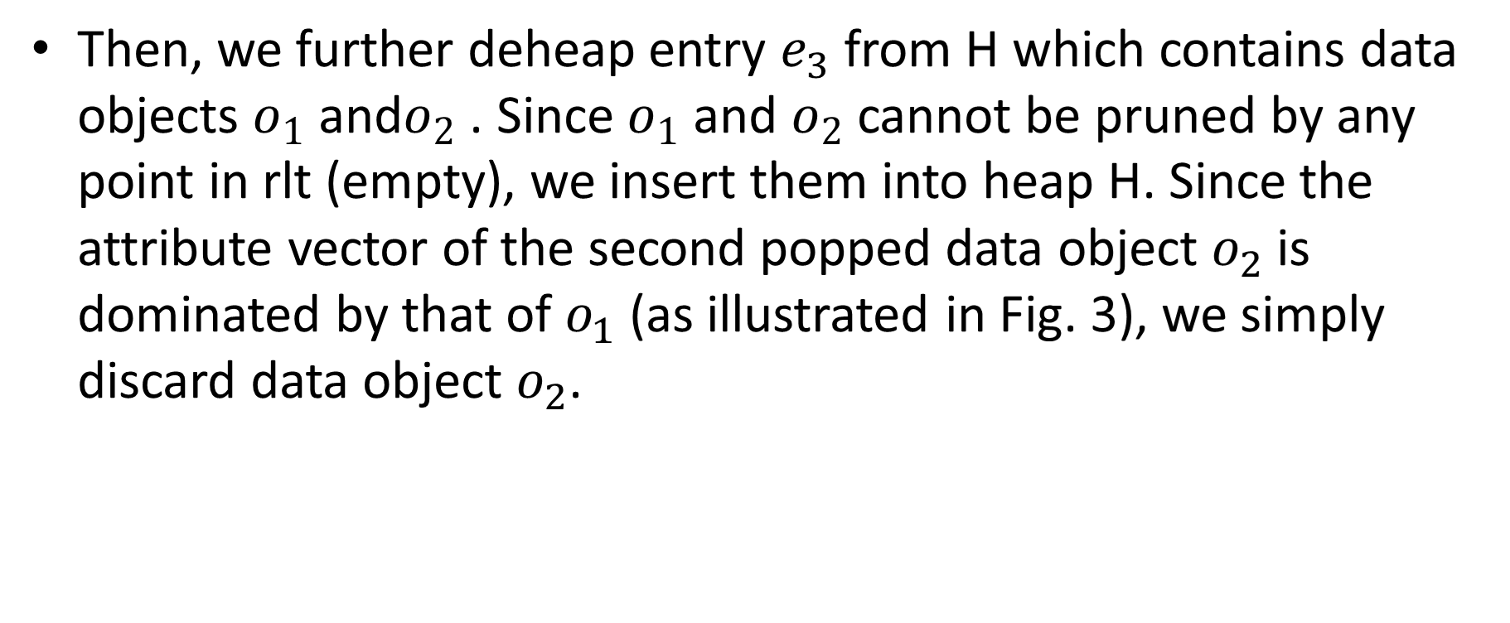
Query Processing

Slide 30
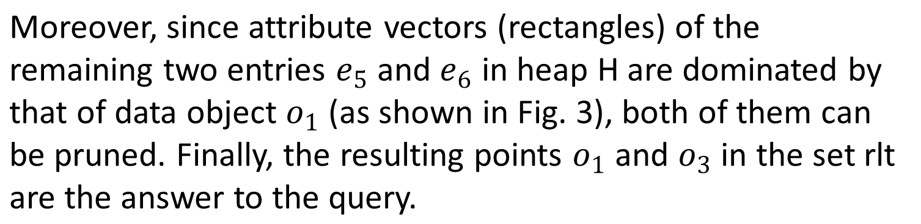
Query Processing

Slide 31
Thank you
Rongxing’s Homepage: http://www.ntu.edu.sg/home/rxlu/index.htm
PPT available @: http://www.ntu.edu.sg/home/rxlu/seminars.htm
Ximeng’s Homepage:
http://www.liuximeng.cn/

