Slide 1
M- tree: an efficient access method for similarity search in metric spaces
Reporter：Ximeng Liu
Supervisor: Rongxing Lu
School of EEE, NTU
http://www.ntu.edu.sg/home/rxlu/seminars.htm

Slide 2
References
Paolo Ciaccia and Marco Patella and Pavel Zezula. M-tree: An Efficient Access Method for Similarity Search in Metric Spaces. VLDB. 1997. 426-435.
Skopal T, Pokorný J, Snasel V. PM-tree: Pivoting Metric Tree for Similarity Search in Multimedia Databases[C]//ADBIS (Local Proceedings). 2004.

Slide 3
Introduction
Need to manage various types of data stored in large computer repositories has drastically increased and resulted in the development of multimedia database systems aiming at a uniform management of voice, video, image, text, and numerical data. It is of vital importance to effectively and efficiently support the retrieval process devised to determine which portions of the database are relevant to users’ requests.

Slide 4
Introduction
Since multimedia applications typically require complex distance functions to quantify similarities of multi-dimensional features, such as shape, texture, color [FEF+94], image patterns [VM95], sound [WBKW96], text, fuzzy values, set values [HNP95], sequence data [AFS93, FRM94], etc., multi-dimensional (spatial) access methods (SAMs), such as R-tree [Gut84] and its variants [SRF87, BKSS90], have been considered to index such data.

Slide 5
Introduction
No attempt in the design of these structures has been done to reduce the number of distance computations

Slide 6
Preliminaries
A metric space means to provide an efficient support for answering similarity queries, i.e. queries whose purpose is to retrieve DB objects which are “similar” to a reference (query) object, and where the (dis)similarity between objects is measured by a specific metric distance function d.

Slide 7
M-tree
M-tree, is proposed to organize and search large data sets
from a generic “metric space”.

Slide 8
Metric space
A metric space is a pair, M = (D, d), where D is a domain of feature values – the indexing keys – and d is a total (distance) function with the following properties:
1.d(Ox,Oy) = d(Oy,Ox) (symmetry)
2. d(Ox,Oy) > 0 (Ox = Oy) and d(Ox,Ox) = 0 (non negativity)
3. d(Ox,Oy) ≤ d(Ox,Oz) + d(Oz,Oy) (triangle inequality)

Slide 9
The Structure of M-tree Nodes
Leaf nodes of any M-tree store all indexed (database) objects, represented by their keys or features, whereas internal nodes store the so-called routing objects. A routing object is a database object to which a routing role is assigned by a specific promotion algorithm.

Slide 10
Routing object
For each routing object Or there is an associated pointer, denoted ptr(T(Or)), which references the root of a sub-tree, T(Or), called the covering tree of Or. All objects in the covering tree of Or are within the distance r(Or) from Or, r(Or) > 0, which is called the covering radius of Or and forms a part of the Or entry in a particular M-tree node. Finally, a routing object Or is associated with a distance to P(Or), its parent object, that is the routing object which references the node where the Or entry is stored.

Slide 11

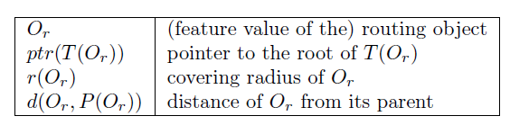
Routing object

Slide 12
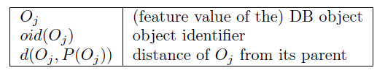
Database object
Database object Oj in a leaf is quite similar to that of a routing object, but no covering radius is needed, and the pointer field stores the actual object identifier (oid), which is used to provide access to the whole object possibly resident on a separate data file.

Slide 13
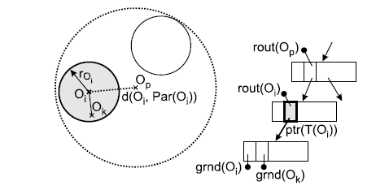


M-tree

Slide 14
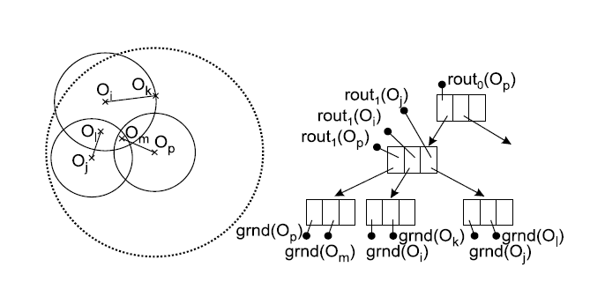
M-tree

Slide 15
Building the M-tree
The Insert algorithm recursively descends the M-tree to locate the most suitable leaf node for accommodating a new object, On, possibly triggering a split if the leaf is full. The basic rationale used to determine the “most suitable” leaf node is to descend, at each level of the tree, along a sub-tree, T(Or), for which no enlargement of the covering radius is needed, i.e. d(Or,On) ≤ r(Or).

Slide 16
Building the M-tree
If no routing object for which d(Or,On) ≤ r(Or) exists, the choice is to minimize the increase of the covering radius, d(Or,On) − r(Or).

Slide 17
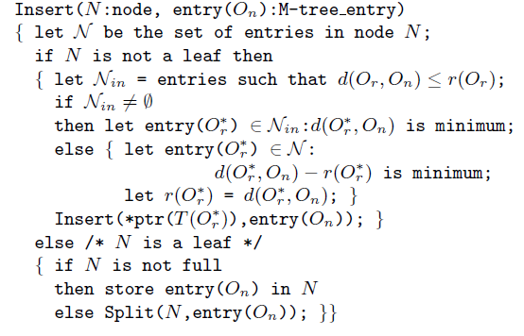
Insert algorithm

Slide 18
Split Management
As any other dynamic balanced tree, M-tree grows in a bottom-up fashion. The overflow of a node N is managed by allocating a new node, N’, at the same level of N, partitioning the entries among these two nodes, and posting (promoting) to the parent node, Np, two routing objects to reference the two nodes. When the root splits, a new root is created and the M-tree grows by one level up.

Slide 19
Split Management
A specific implementation of the Promote and Partition methods defines what we call a split policy.

Slide 20
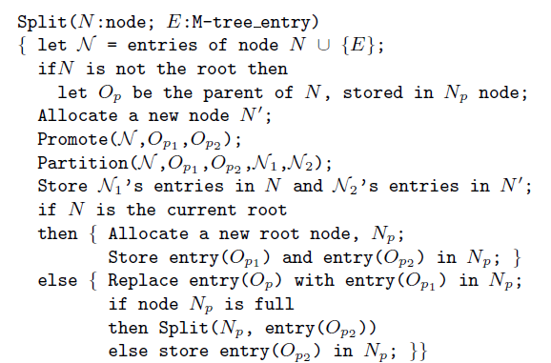
Split Management

Slide 21
Split Policies
The “ideal” split policy should promote Op1 and Op2 objects, and partition other objects so that the two soobtained regions would have minimum “volume” and minimum “overlap”.

Slide 22
Choosing the Routing Objects
M_RAD , mM_RAD, M_LB_DIST, RANDOM, SAMPLING.
M_LB_DIST: The acronym stands for “Maximum Lower Bound on DISTance”. This policy differs from previous ones in that it only uses the precomputed stored distances. In the confirmed version, where Op1≡ Op, the algorithm determines Op2 as the farthest object from Op, that is
d(Op2,Op) = max_j {d(Oj,Op)}

Slide 23
Distribution of the Entries
Given a set of entries N and two routing objects Op1 and Op2 , the problem is how to efficiently partition N into two subsets, N1 and N2.
Generalized Hyperplane: Assign each object Oj ∈ N to the nearest routing object: if d(Oj,Op1 ) ≤ d(Oj,Op2 ) then assign Oj to N1, else assign Oj to N2.
Balanced: Compute d(Oj,Op1) and d(Oj,Op2 ) for all Oj ∈ N. Repeat until N is empty: Assign to N1 the nearest neighbor of Op1 in N and remove it from N; Assign to N2 the nearest neighbor of Op2 in N and remove it from N.

Slide 24
Thank you
Rongxing’s Homepage: http://www.ntu.edu.sg/home/rxlu/index.htm
PPT available @: http://www.ntu.edu.sg/home/rxlu/seminars.htm
Ximeng’s Homepage:
http://www.liuximeng.cn/

