Slide 1
Privacy Preserving Association Rule Mining in Vertically Partitioned Data
Reporter：Ximeng Liu
Supervisor: Rongxing Lu
School of EEE, NTU
http://www.ntu.edu.sg/home/rxlu/seminars.htm

Slide 2
References
Vaidya J, Clifton C. Privacy preserving association rule mining in vertically partitioned data[C]//Proceedings of the eighth ACM SIGKDD international conference on Knowledge discovery and data mining. ACM, 2002. cite: 769
Agrawal R, Srikant R. Fast algorithms for mining association rules[C]//Proc. 20th Int. Conf. Very Large Data Bases, VLDB. 1994, 1215: 487-499. cite: 14840.
Agrawal R, Imieliński T, Swami A. Mining association rules between sets of items in large databases[C]//ACM SIGMOD Record. ACM, 1993, 22(2): 207-216. cite: 13461

Slide 3
Introduction
The author present a privacy preserving algorithm to mine association rules from vertically partitioned data. By vertically partitioned, we mean that each site contains some elements of a transaction.

Slide 4
Introduction
Using the traditional \market basket" example, one site may contain grocery purchases, while another has clothing purchases. Using a key such as credit card number and date, we can join these to identify relationships between purchases of clothing and groceries.

Slide 5
Introduction
PROBLEM: this discloses the individual purchases at each site, possibly violating consumer privacy agreements.

Slide 6
Introduction
There are more realistic examples. In the sub-assembly manufacturing process, different manufacturers provide components of the finished product. Cars incorporate several subcomponents; tires, electrical equipment, etc.; made by independent producers. Again, we have proprietary data collected by several parties, with a single key joining all the data sets, where mining would help detect/predict malfunctions.

Slide 7
Introduction
The problem is to mine association rules across two databases, where the columns in the table are at different sites, splitting each row. One database is designated the primary, and is the initiator of the protocol. The other database is the responder. There is a join key present in both databases. The remaining attributes are present in one database or the other, but not both. The goal is to find association rules involving attributes other than the join key.

Slide 8
Introduction
Issues that cause a disparity between local and global results include:
1. Values for a single entity may be split across sources. Data mining at individual sites will be unable to detect cross-site correlations.

Slide 9
Introduction
2. The same item may be duplicated at different sites, and will be over-weighted in the results.
3. Data at a single site is likely to be from a homogeneous population, hiding geographic or demographic distinctions between that population and others.

Slide 10


PROBLEM DEFINITION
A vertical partitioning of the database between two parties A and B. The association rule mining problem can be formally stated as follows[2]: be a set of literals, called items. Let D be a set of transactions, where each transaction T is a set of items such that .

Slide 11





PROBLEM DEFINITION
Associated with each transaction is a unique identifier, called its TID. We say that a transaction T contains X, a set of some items in , if . An association rule is an implication of the form, ,where and

Slide 12


PROBLEM DEFINITION
The rule X ) Y holds in the transaction set D with confidence c if c% of transactions in D that contain X also contain Y.
The rule has support s in the transaction set D if s% of transactions in D contain .

Slide 13
EXAMPLE
Customer items
1 | orange juice, coke
2 | milk, orange juice, window cleaner
3 | orange juice, detergent
4 | orange juice, detergent, coke
5 | window cleaner

Slide 14
EXAMPLE
 | Orange | Win Cl | Milk | Coke | Detergent
Orange | 4 | 1 | 1 | 2 | 2
WinCl | 1 | 2 | 1 | 0 | 0
Milk | 1 | 1 | 1 | 0 | 0
Coke | 2 | 0 | 0 | 2 | 1
Detergent | 1 | 0 | 0 | 0 | 2

Slide 15
EXAMPLE
Confidence(A==>B)=P(B|A)。
IF Orange THEN Coke, P(B|A)=0.5.
SUPPORT: 2/5=0.4.

Slide 16
EXAMPLE
Meaning of Confidence and Support.
IF a Customer buy Orange, he has 50% to buy Coke.
Buy Orange and Coke will happen with 40% probability.

Slide 17
PROBLEM DEFINITION
Given a set of transaction D, the problem of mining assocaition rules is to generate all association rules that have support and confidence greater than the user-specified minimum support (called minsup) and minimum confidence(minconf) respectively.

Slide 18
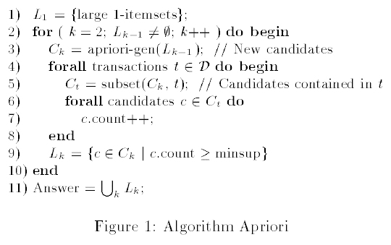
APRIORI

Slide 19

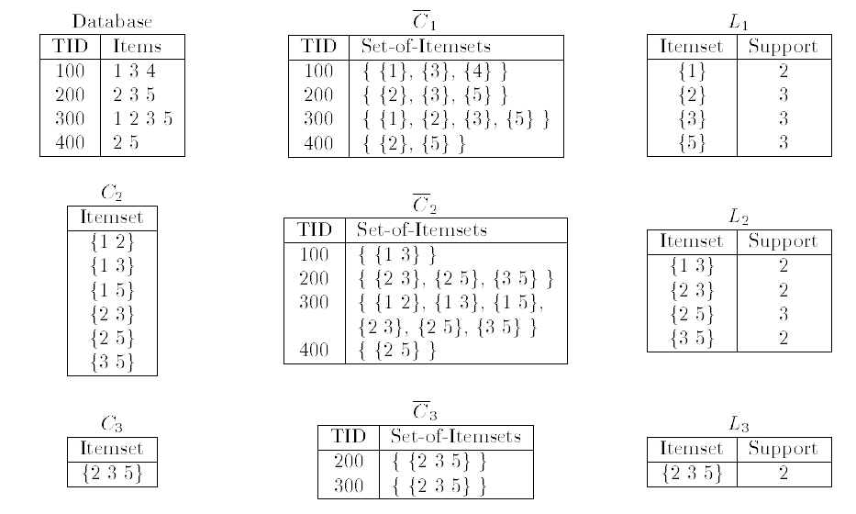
Example

Slide 20
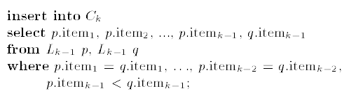
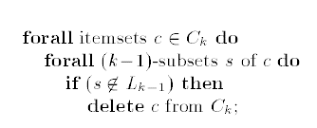
APRIORI-GEN

Slide 21
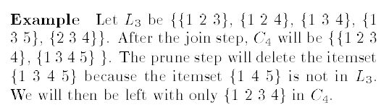

Slide 22




PROBLEM DEFINITION
Assume A has p attributes a1 : : : ap and B has q attributes and we want to compute the frequency of
the w = p + q-itemset . Each item in is composed of the product of the corresponding individual elements, i.e. . This
computes and without sharing information between A
and B. The scalar product protocol then securely computes
the frequency of the entire w-itemset.

Slide 23




PROBLEM DEFINITION
For example, suppose we want to compute if a particular 5-itemset is frequent, with A having 2 of the attributes, and B having the remaining 3 attributes. I.e., A and B want to know if the itemset is frequent. A creates a new vector of cardinality n where (component multiplication) and B creates a new vector of cardinality n where

Slide 24
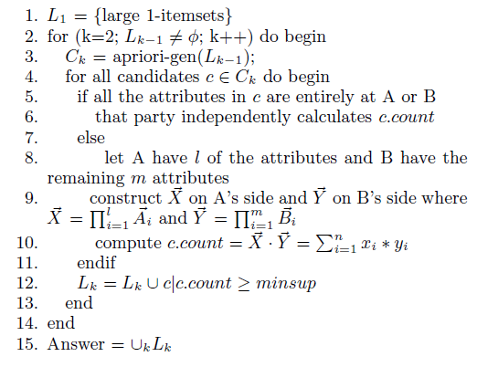

Slide 25
KEY: how to compute step 10 without revealing information.

Slide 26
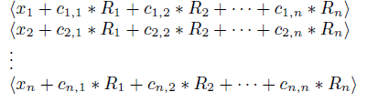
Scalar product protocols
Using Scalar product protocols：
Step1： A generates randoms . From these, , and a matrix C forming coeffcients for a set of linear independent equations, A sends the following vector to B:

Slide 27

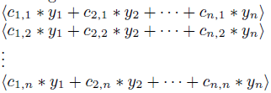
Scalar product protocols
In step 2, B computes . B also calculates the
following n values:

Slide 28
Scalar product protocols
But B can't send these values, since A would then have n
independent equations in n unknowns revealing
the y values. Instead, B generates r random values,
. The number of values A would need to know to obtain full disclosure of B's values is governed by r. B partitions the n values created earlier into r sets, and the R' values are used to hide the equations as follows:

Slide 29
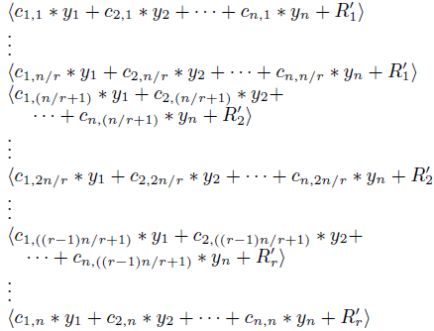
Scalar product protocols

Slide 30
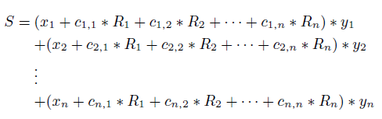
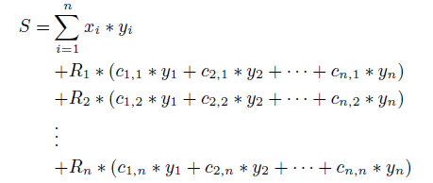
Scalar product protocols
Then B sends S and the n above values to A, who writes:

Slide 31
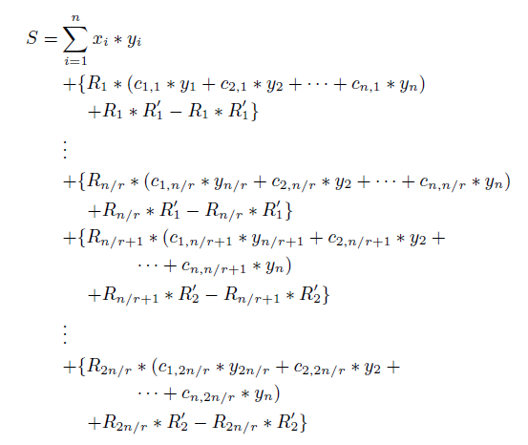
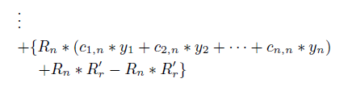
Scalar product protocols

Slide 32
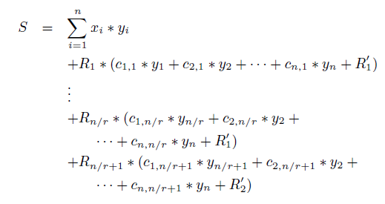
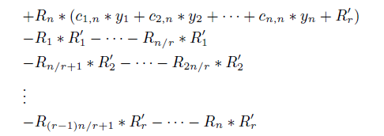
Scalar product protocols

Slide 33
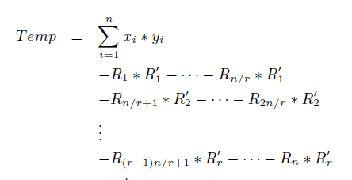
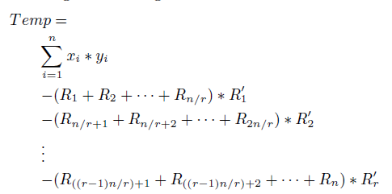
Scalar product protocols

Slide 34
Scalar product protocols
In step 3, A sends the r values to B, and B (knowing R') computes the nal result. Finally B replies with the result.

Slide 35
Thank you
Rongxing’s Homepage: http://www.ntu.edu.sg/home/rxlu/index.htm
PPT available @: http://www.ntu.edu.sg/home/rxlu/seminars.htm
Ximeng’s Homepage:
http://www.liuximeng.cn/

