Slide 1
Public key encryption system based on T-shaped neighborhood layered cellular automata
Xing Zhang

Slide 2
Theoretical basis
Reversibility of two-dimension cellular automata is undecidable even when restricted to CA using the Von Neumann neighborhood. (Kari J. Cryptosystems based on reversible cellular automata, 1992)
Reversiblr Cellular Automata (RCA)
Layered Cellular Automata(LCA)

Slide 3
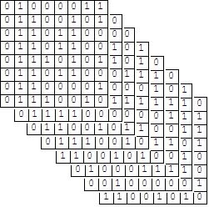
Cellular Automata(CA)
{D,S,N,f,B}:
D--dimension: 1D,2D
S--state set : {0,1,2,3}
N--neighborhood: radius(1D)--2r+1 cells
f--transition function( transition rule )
B--boundary: periodic boundary
RCA: global map (transition rule) is invertible
LCA:

Slide 4
Basic idea of the encryption system
The general objective of a public key cryptosystem based on RCA is to design an RCA that is hard to invert without some secret knowledge.
Central problem:construct a two-dimension
How to construct: four 1D 4-state 1/2-radius periodic boundary RCA→a new T-shaped neighborhood two-dimension

Slide 5
Public key encryption system
Public key: Kp = CA₁◦CA₂◦CA₃◦ CA₄
Private key: Ks = {CA₁⁻¹, CA₂⁻¹, CA₃⁻¹, CA₄⁻¹}
Encryption: C = E_{Kp}(M)
Decryption: D_{Ks}(C) = M

Slide 6
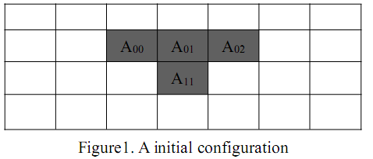
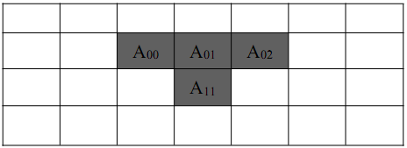
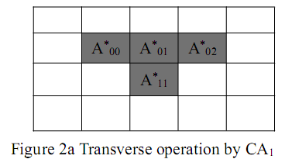
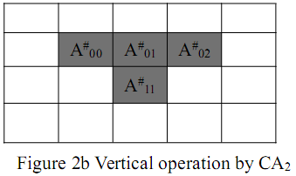
Prove the correctness of the construction algorithm
A₀₁----central cell
CA₁ and CA₂----1D 4-state 1/2-radius RCA
CA₁: transverse operation
A*₀₀=f(A₀₀,A₀₁)
A*₀₁=f(A₀₁,A₀₂)
CA₂: vertical operation
A#₀₁=f(A*₀₁,A*₁₁)
(A₀₀,A₀₁,A₀₂,A₁₁)→A#₀₁
A#₀₁ → A*₀₁→A₀₁
CA₂⁻¹
CA₁⁻¹

Slide 7

Example:
So: (2031)→3

Slide 8
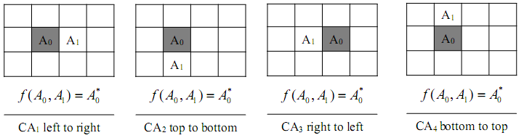
Generation new two-dimension CA transition rules
CA₁, CA₂, CA₃, CA₄:1D,4-state and 1/2-radius RCA (self-reversible)

Slide 9
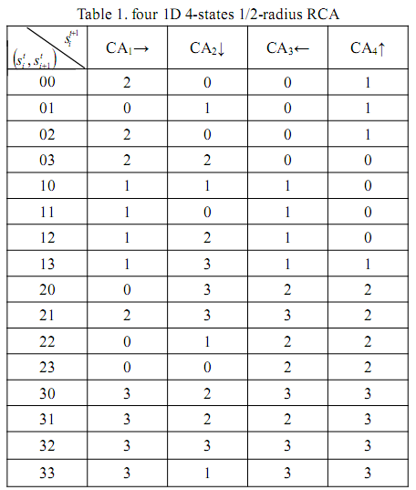
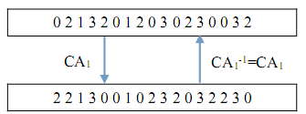

Slide 10
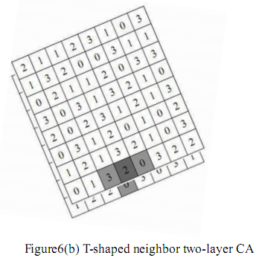
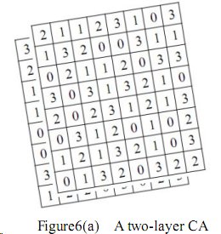
Encryption based on T-shaped neighborhood layered CA

Slide 11
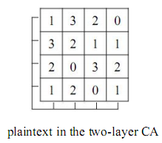
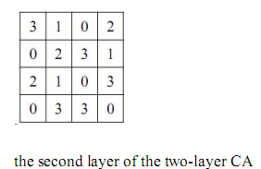
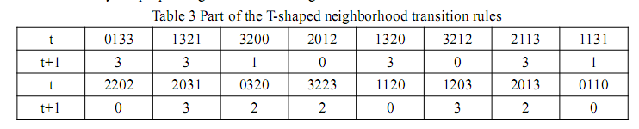
Example

Slide 12
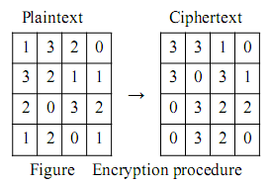
Decryption procedure:
3→0333→0333→0333→0131→0131→1
3→3312→3312→2312→2310→0310→3
1→3101→3000→3000→3000→3220→2
0→1032→1132→1122→1223→1023→0
3→1300→1300→1200→1300→1300→3
0→3030→3131→3131→3030→3230→2
3→0313→0313→0313→0111→0111→1
1→3130→3031→3031→3131→3131→1
0→2030→2131→2121→2020→0200→2
3→0321→0321→0321→0223→2003→0
2→3220→3221→3221→3322→3302→3
2→2203→2203→2203→2003→0223→2
0→0031→0130→0130→0131→0131→1
3→0320→0320→0320→0022→2202→2
2→3202→3202→3202→3101→3221→0
0→2001→2100→2100→2101→2122→1

Slide 13
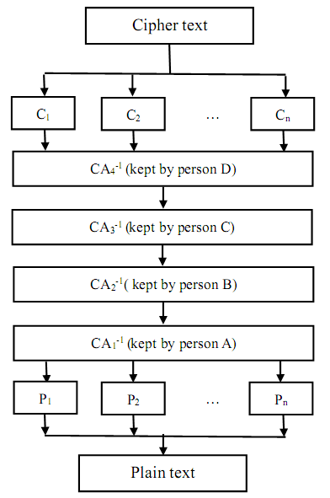
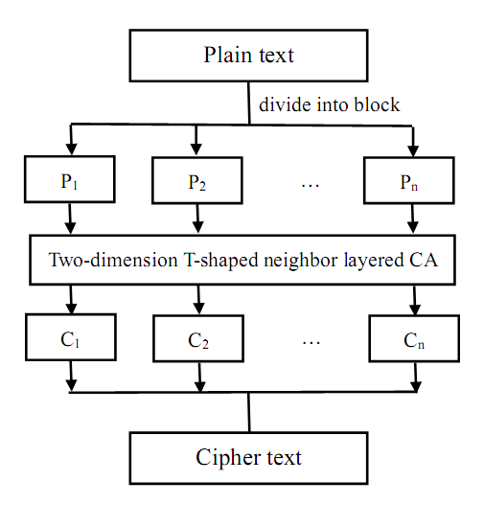
Distributed public key cryptosystem
Encryption procedure
Decryption procedure

Slide 14




Security analysis
Transition rules of 2D layered CA are composed of four 1D CA reversible rules, this makes possible pattern and possible rules in the new 2D layered CA.
The reversibility of a two-dimension CA is undecidable and it is hard to find its inverse that proved to be at least theoretically non-feasible. So someone may try to exhaust the one-dimension RCA to decryption. While, doing so is doomed to failure.
One-dimension RCA is a special class of CA . There are 4-state 1/2-radius CAs in total, and exist many reversible CAs , besides there may be 30 self-reversed CAs among them. Considering four directions in generating rules algorithm that may lead to almost possible combinations.
Moreover, it will be much more possible combinations if increase or decrease the states or adjust the radius of the 1D RCA.

