Slide 1
OSCAR: A Collaborative Bandwidth Aggregation System
Author: Karim Habak, Khaled A. Harras, Moustafa Youssef
Publication: Qatar Foundation Annual Research Forum Proceedings, Volume 2013
Presenter: Guoming Wang
Jan 17, 2014

Slide 2
Outline
  Introduction
  Motivation Scenario And Solution
  OSCAR architecture
  OSCAR communication protocols

Slide 3
Data Tsunami Problem
FCC, indicated an expected data tsunami problem predicting a 2550* increase in mobile data traffic by the year 2015
  Expected explosive data
  Expensive data roaming charges
  Users’ expections to remain connected
    In all places
    At all time
Notes:
FCC, indicated an expected data tsunami problem predicting a 2550* increase in mobile data traffic by the year 2015,

Slide 4
Relative work – Solitary Solutions
Solitary Solutions
  exploit and direct Internet connectivity on any of the available interfaces by distributing applications data across them in order to achieve higher throughput, minimize energy consumption , and minimize cost.
shortcoming
  1.require changes to legacy servers in order to support these new sockets.
  2. requires feedback from the applications about their performance, hence not backwards compatible
  3. modern OS only allow users to use one of the available intrfaces at a time
Notes:
application layer solutions either assume that applications are aware of the existing network interfaces and take the responsibility of utilizing them for their needs or rely on modifying the kernel socket handling functions to enable existing applications use multiple interfaces.

Slide 5
Relative work – Collaborative Solutions
Collaborative Solutions
  enable and incentivize mobile devices to utilize their neighbors' underutilized bandwidth in addition to their own direct Internet connections.
shortcoming
  1. require Internet infrastructure updates the existence of proxy servers, updating the available applications to interface with the new API and specify their requirements,
  2. focus only on maximizing throughput
  3. usually ignore developing incentives systems.
Fon
  a commercial system share their home bandwidth for obtaining WiFi coverage via other worldwide FON users.
Notes:
shy attempts to utilize the available interfaces in the collaborative form.
motivation: increase of the devices and are aimed at sharing neighboring devices connectivity.
difference between FON and OSCAR:
1. FON does not aggregate the available bandwidth .
2. FON uses special router(Fonera)
3. FON routers are static while OSCAR targets mobile devices.
4. The user is unable to connect to more than one Fonera.
5. OSCAR adds a tangible financial pricing system to further encourage collaboration.

Slide 6
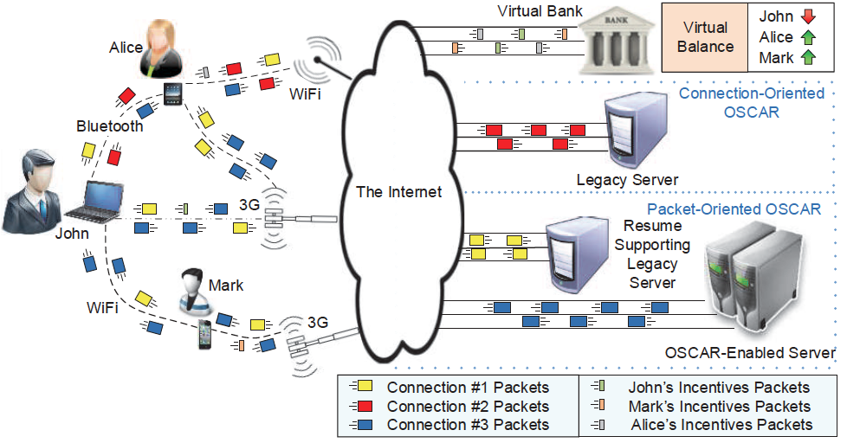
OSCAR Scenario
Notes:
based on OSCAR, John can utilize all the available connectivity options including neighboring devices' under-utilized interfaces to achieve John's requirements and enhances his experience.
the device shedules the connections to the paths in a connection-oriented mode,
however, while being connected to an OSCAR enabled server or resume-supporting legac server, it uses fine-grained packet-oriented scheduling for further performance enhancements.
incentive system: a virtual bank is used to pay for the bandwidth he shared from neighboring devices' interfaces.

Slide 7
Five Main Communicating Entities
Assumption
OSCAR works in a distributed environment,
Assumption: all OSCAR components are trusted
1
3
Client devices
Legacy servers
Equipped with multiple network interface rates and cost per unit data. Connectivity options vary in their usage cost and available bandwidth to be shared. These possible ways to connect to the Internet is called a path.
The clients use the connection-oriented mode to connect with them.
2
4
Virtual bank
Connection resume-supporting legacy servers
Handles the payment transactions between the different devices as well as the authentication related aspects.
Leveraged by OSCAR to enhance the performance by switching to a packet-oriented mode.
5
OSCAR-enabled servers
Run software modules, which OSCAR leverages for enabling highly efficiently packet-oriented scheduling.

Slide 8
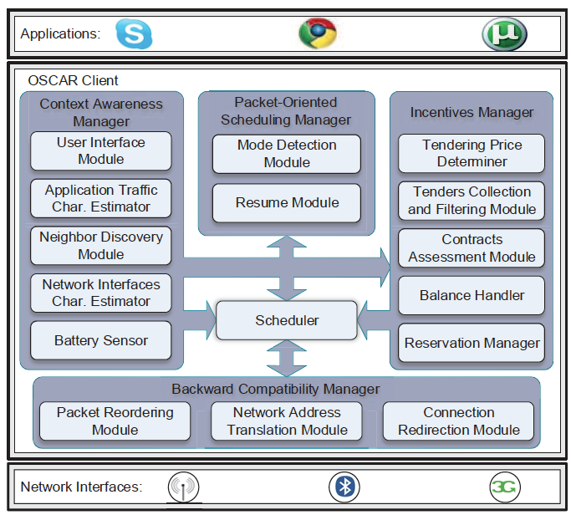
OSCAR Client Architecture
Notes:
one of the key factors is its ability to determine, store, and utilize the mobile device's context information. Context-awareness manager consists of five modules
utilizing the opportunities of packet-oriented scheduling is one of the key features this module exploits the availability of OSCAR-enabled servers or servers that support the connection resumption to enhance the performance of OSCAR. it contains to sub-modules

Slide 9
Five Main Core Functionalities
Assumption
OSCAR works in a distributed environment,
Assumption: all OSCAR components are trusted
1
3
Context awareness
Extention
Implemented through the Context Awareness Manager
Leverage connection resume-supporting legacy servers and OSCAR-enabled servers for further performance enhancements
2
4
Backward compatibility
Incentive
Enables OSCAR's clients to make use of the available connectivity opportunities without requiring any changes to legacy servers, network infrastructure, or legacy applications.
Incentive Manager, handling the user incentives and collaborating with the trusted bank module
5
Dynamic
OSCAR Scheduler, optimally scheduling the connections and packet on the different paths.
Notes:
one of the key factors is its ability to determine, store, and utilize the mobile device's context information

Slide 10
Packet-Oriented Scheduling
Packet-Oriented Scheduling Managers
  mode detection module
  resume module
Notes:
utilizing the opportunities of packet-oriented scheduling is one of the key features
this module exploits the availability of OSCAR-enabled servers or servers that support the connection resumption to enhance the performance of OSCAR. it contains to sub-modules

Slide 11
OSCAR Scheduleing
Optimal Scheduling
Formulate scheduler and its different modes of operation
1
3
Throughput Maximization Mode
Cost Minimization Mode
Implemented through the Context Awareness Manager
Leverage connection resume-supporting legacy servers and OSCAR-enabled servers for further performance enhancements
2
Energy Minimization Mode
Enables OSCAR's clients to make use of the available connectivity opportunities without requiring any changes to legacy servers, network infrastructure, or legacy applications.
Notes:
one of the key factors is its ability to determine, store, and utilize the mobile device's context information

Slide 12
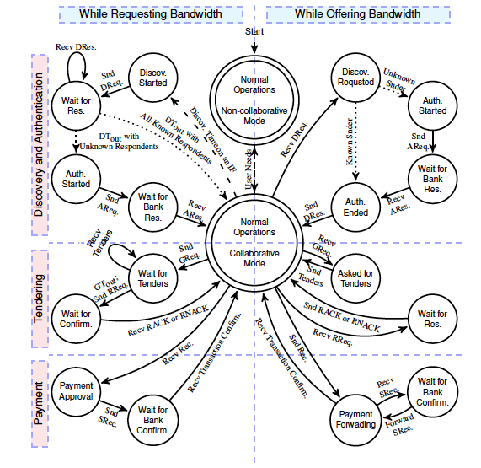
OSCAR Collaboration protocol
Notes:
the state diagram of this protocol. The communicating entities in this protocol are client devices offering or requesting bandwidth (separated by vertical line)
and the trusted bank server supporting our incentive system. The figure also shows the states generally broken down to the following three phases (separated by the horizontal lines): discovery and authentication, tendering, and payment.

Slide 13
Three phaces of protocol
maintain energy-efficient neighbor discovery, a requesting node sends neighbor discovery requests only when it has active packet-oriented connections or new connection requests
Discovery and Authentication
received and authenticated DRes replies from neighbors
calculates the required tender for each of its connectivity options and sends a tenders packet
Tendering
After each service period, the offering node prepares a receipt for what has been consumed by the requesting node and signs the hashed version of this receipt with its private
key.
Payment

Slide 14
Incentive approaches
Incentive approaches
  reputation-based
    nodes earn a reputation base on their collaboration. however, it is not suitable for depolyable collaborative bandwidth aggregation systems.
  credit-base approaches
    they rely on a trusted third party that maintains credit for the communicating nodes
Notes:
utilizing the opportunities of packet-oriented scheduling is one of the key features
this module exploits the availability of OSCAR-enabled servers or servers that support the connection resumption to enhance the performance of OSCAR. it contains to sub-modules

Slide 15
Conclusion
OSCAR architecture, aims at maximizing
throughput while maintaining the average cost and energy consumption at user defined levels
energy and cost aware
incentive-based
Deployable
bandwidth aggregation
Specific,
action-oriented

Slide 16

Thank you – Enjoy the rest of your day

