Slide 1
The user accountability/traitor tracing in attribute based encryption
Zhao Qianqian
2014-1-17

Slide 2
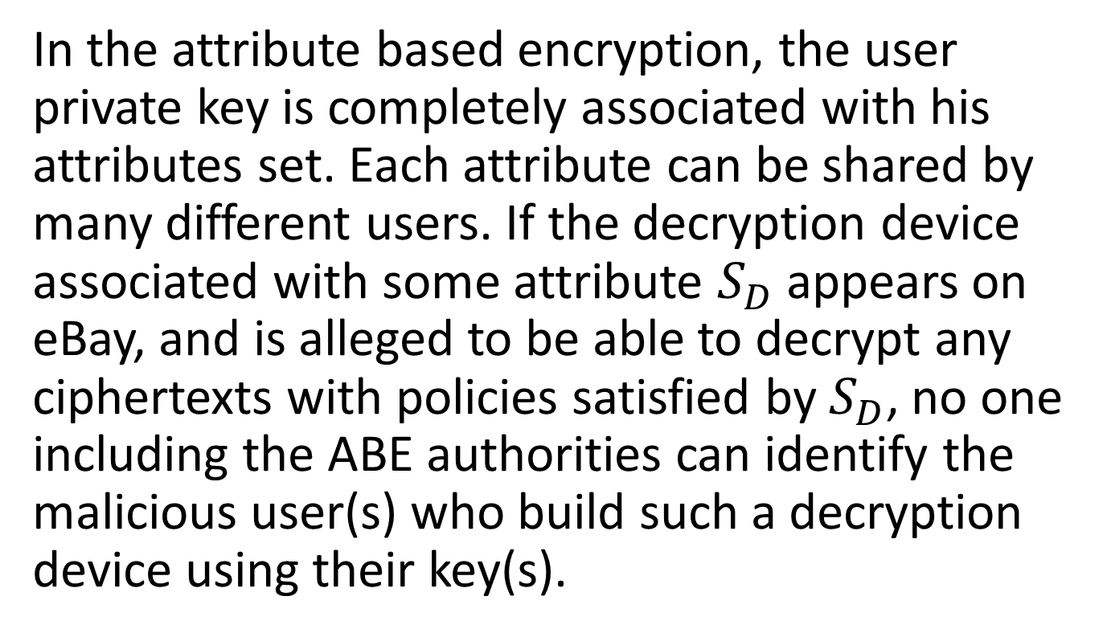
What is the user accountability?
In the attribute based encryption, the user private key is completely associated with his attributes set. Each attribute can be shared by many different users. If the decryption device associated with some attribute $S_{D}$ appears on eBay, and is alleged to be able to decrypt any ciphertexts with policies satisfied by $S_{D}$, no one including the ABE authorities can identify the malicious user(s) who build such a decryption device using their key(s).

Slide 3
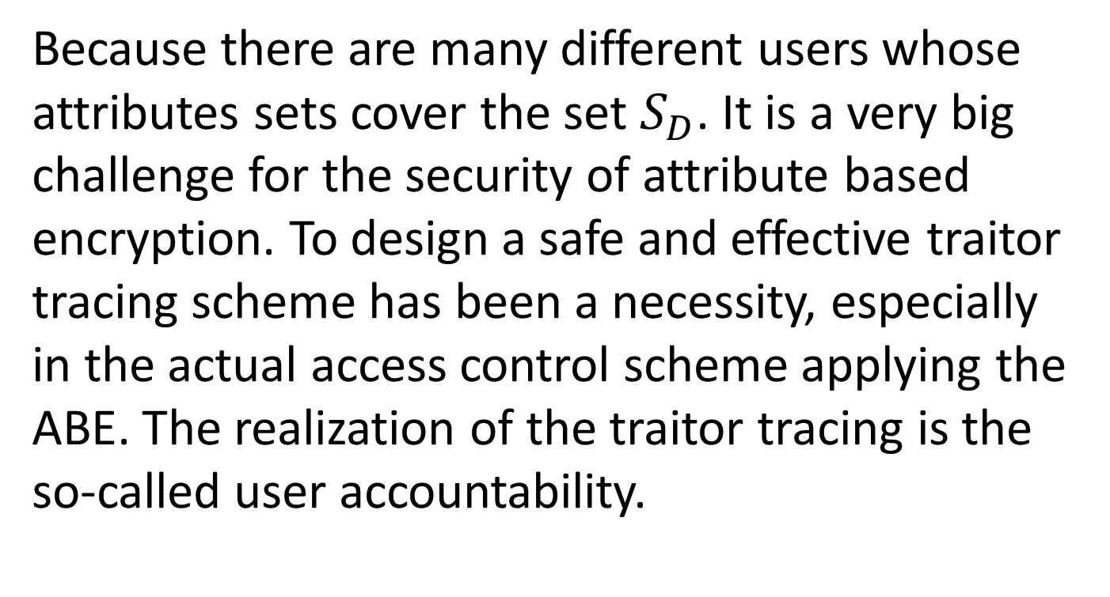
What is the user accountability?
Because there are many different users whose attributes sets cover the set $S_{D}$. It is a very big challenge for the security of attribute based encryption. To design a safe and effective traitor tracing scheme has been a necessity, especially in the actual access control scheme applying the ABE. The realization of the traitor tracing is the so-called user accountability.

Slide 4
Two different levels of traceability
White-box traceability: it means that given a well-formed decryption key as input, a tracing algorithm can find the user who owns the key.
Black-box traceability: it means that given a decryption black box/device, while the decryption key and even the decryption algorithm could be hidden, the tracing algorithm can still find out the malicious user whose key must have been used in constructing the decryption black box.

Slide 5
Multi-Authority Ciphertext-Policy Attribute-Based Encryption with Accountability
Jin Li, Qiong Huang, Xiaofeng Chen, Sherman S. M. Chow, Duncan S. Wong, Dongqing Xie；ASIACCS 2011

Slide 6
The reason of the multi-authority
The load bottleneck: all the attributes of the users need to be verified by the only authority, which is quite big burden for the system.
The escrow problem: the private key of all users is issued by the authority, which means that the authority can decrypt all the ciphertexts in the system.

Slide 7
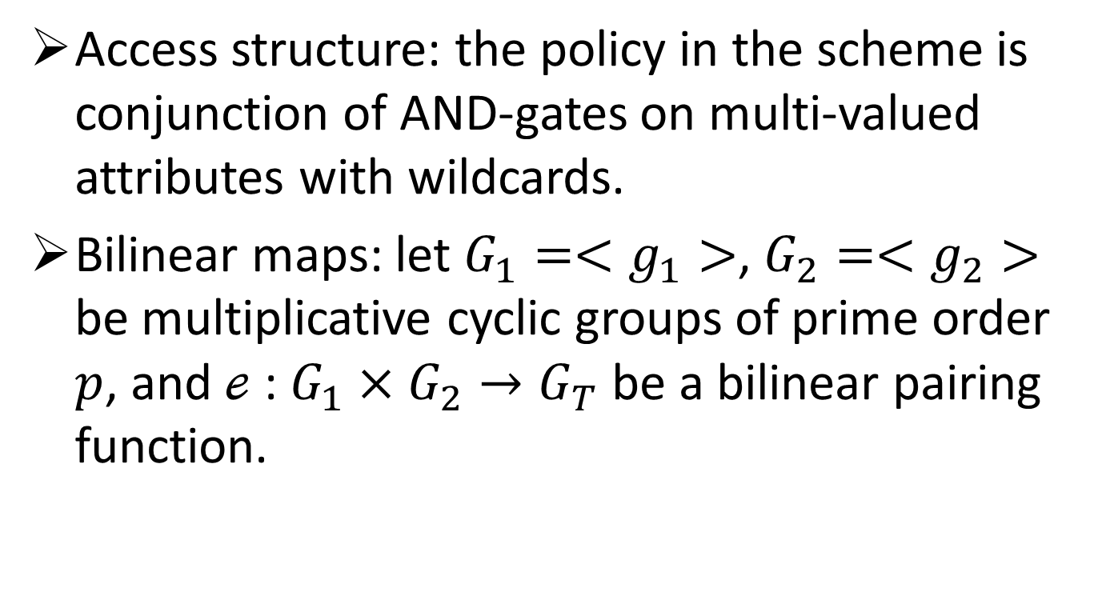
The background of the scheme
Access structure: the policy in the scheme is conjunction of AND-gates on multi-valued attributes with wildcards.
Bilinear maps: let $G_{1}=<g_{1}>$, $G_{2}=<g_{2}>$ be multiplicative cyclic groups of prime order $p$, and $ℯ$ : $G_{1}×G_{2}→G_{T}$ be a bilinear pairing function.

Slide 8
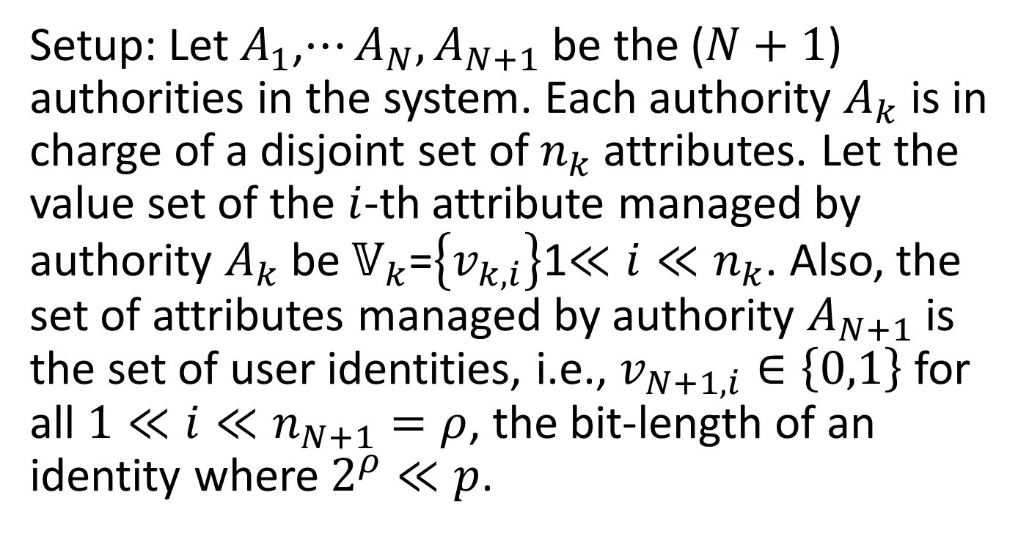
The specific scheme
Setup: Let${ A}_{1}$,$⋯A_{N},A_{N+1}$ be the ($N+1$) authorities in the system. Each authority $A_{k}$ is in charge of a disjoint set of $n_{k}$attributes. Let the value set of the $i$-th attribute managed by authority $A_{k}$be $𝕍_{k}$=$\left\{v_{k,i}\right\}$1$≪i≪n_{k}$. Also, the set of attributes managed by authority $A_{N+1}$ is the set of user identities, i.e., $v_{N+1,i}∈\left\{0,1\right\}$ for all $1≪i≪n_{N+1}=ρ$, the bit-length of an identity where $2^{ρ}≪p$.

Slide 9
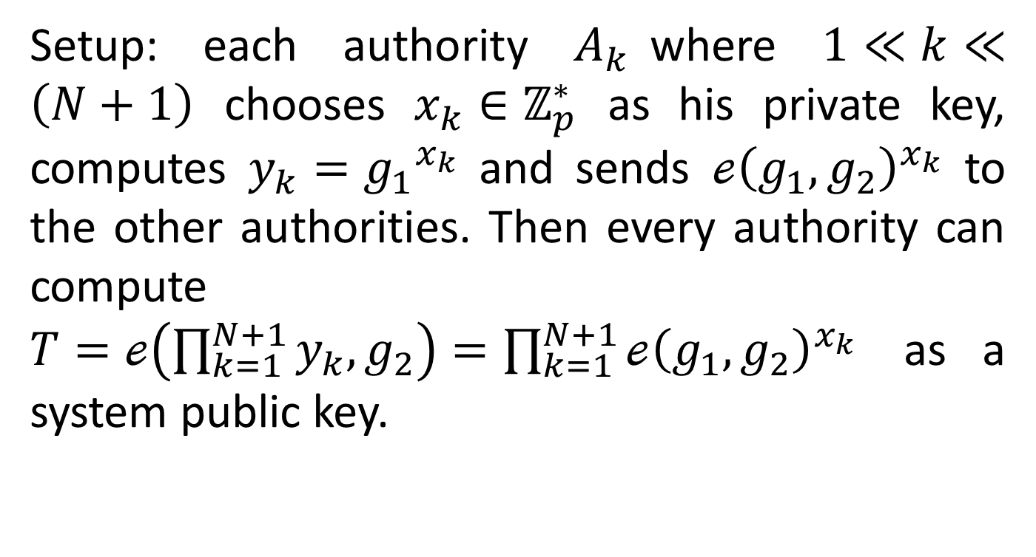
The specific scheme
Setup: each authority $A_{k}$where $1≪k≪\left(N+1\right)$ chooses $x_{k}∈ℤ_{p}^{∗}$ as his private key, computes $y_{k}={g_{1}}^{x_{k}}$ and sends ${ℯ\left(g_{1},g_{2}\right)}^{x_{k}}$ to the other authorities. Then every authority can compute $T=ℯ\left(\prod_{k=1}^{N+1}{y_{k},g_{2}}\right)=\prod_{k=1}^{N+1}{{ℯ\left(g_{1},g_{2}\right)}^{x_{k}}}$ as a system public key.
Notes:
这个system public key理论上来说全网只需要一个即可，然而这样交互的结果是所有的attribute authority都可以计算出这样的一个系统参数，但是最后我们应用的是取自于哪个authority的呢？反正最后是要作为系统参数公开的？那么这样的交互还有意义吗？

Slide 10
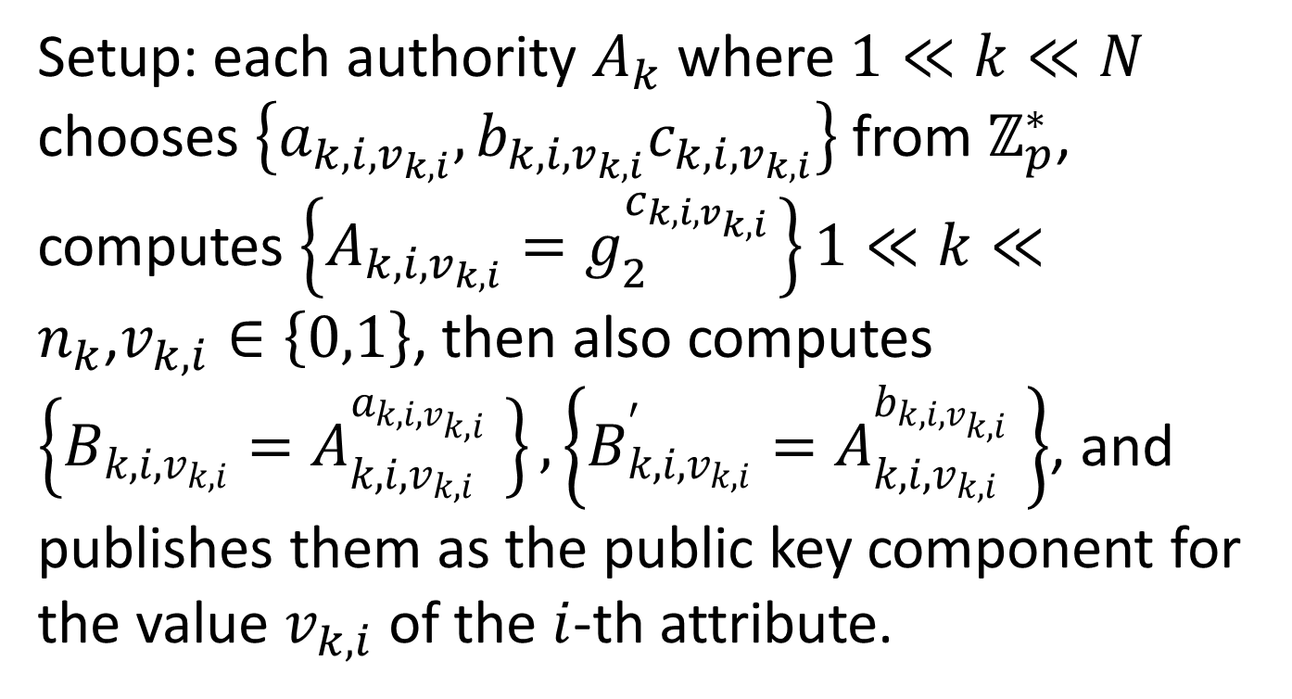
The specific scheme
Setup: each authority $A_{k}$ where $1≪k≪N$ chooses $\left\{a_{k,i,v_{k,i}},b_{k,i,v_{k,i}}c_{k,i,v_{k,i}}\right\}$ from $ℤ_{p}^{∗}$, computes $\left\{A_{k,i,v_{k,i}}=g_{2}^{c_{k,i,v_{k,i}}} \right\}1≪k≪n_{k}$,$v_{k,i}∈\left\{0,1\right\}$, then also computes $\left\{B_{k,i,v_{k,i}}=A_{k,i,v_{k,i}}^{a_{k,i,v_{k,i}}} \right\}, \left\{B_{k,i,v_{k,i}}^{′}=A_{k,i,v_{k,i}}^{b_{k,i,v_{k,i}}} \right\}$, and publishes them as the public key component for the value $v_{k,i}$ of the $i$-th attribute.

Slide 11
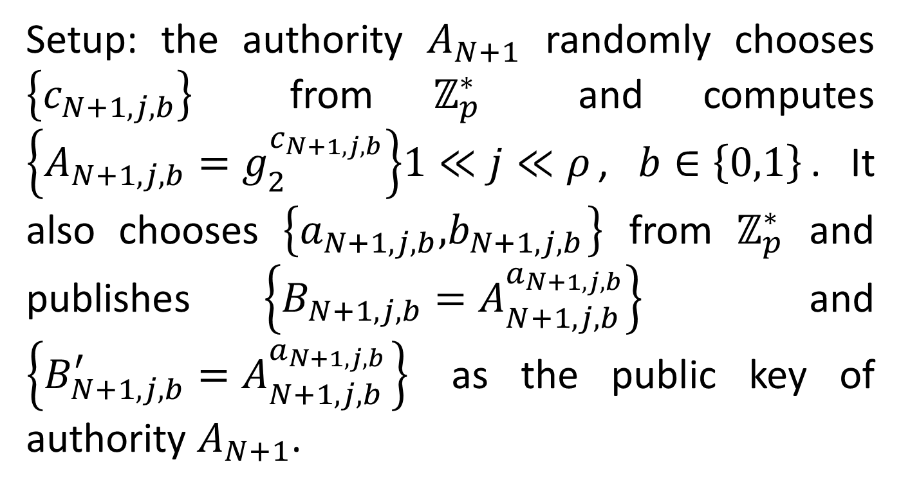
The specific scheme
Setup: the authority $A_{N+1}$ randomly chooses $\left\{c_{N+1,j,b}\right\}$ from $ℤ_{p}^{∗}$ and computes $\left\{A_{N+1,j,b}=g_{2}^{c_{N+1,j,b}}\right\}1≪j≪ρ$, $b∈\left\{0,1\right\}$. It also chooses $\left\{a_{N+1,j,b}\text{,}b_{N+1,j,b} \right\}$ from $ℤ_{p}^{∗}$ and publishes $\left\{B_{N+1,j,b}=A_{N+1,j,b}^{a_{N+1,j,b}}\right\}$ and $\left\{B_{N+1,j,b}^{′}=A_{N+1,j,b}^{a_{N+1,j,b}} \right\}$ as the public key of authority $A_{N+1}$.

Slide 12
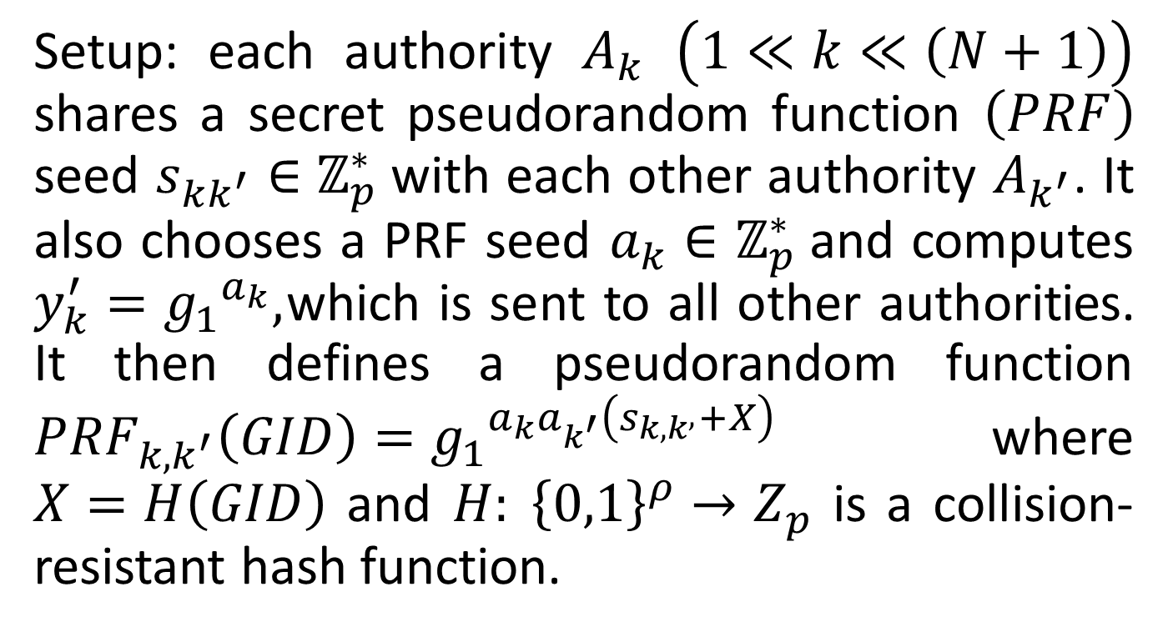
The specific scheme
Setup: each authority $A_{k}$ $\left(1≪k≪\left(N+1\right)\right)$ shares a secret pseudorandom function $\left(PRF\right)$ seed $s_{kk^{′}}∈$ $ℤ_{p}^{∗}$with each other authority $A_{k^{′}}$. It also chooses a PRF seed $a_{k}∈$ $ℤ_{p}^{∗}$and computes $y_{k}^{′}={g_{1}}^{a_{k}},$ which is sent to all other authorities. It then defines a pseudorandom function ${PRF}_{k,k^{′}}\left(GID\right)={g_{1}}^{a_{k}a_{k^{′}}\left(s_{k,k^{,}}+X\right)}$ where $X=H\left(GID\right)$ and $H: {\left\{0,1\right\}}^{ρ}→Z_{p}$ is a collision-resistant hash function.
Notes:
The GID is the specific user identity.

Slide 13

The specific scheme
The system public parameter is
$$\left(\begin{aligned}g_{1},g_{2},T,H\left(∙\right), \left\{y_{k}^{′},\left\{A_{k,i,v_{k,i}}{,B}_{k,i,v_{k,i}},B_{k,i,v_{k,i}}^{′} \right\}1≪i≪n_{k}\right\}, \\ \left(y_{N+1}^{′},A_{N+1,j,b}\text{,}B_{N+1,j,b}\text{,}B_{N+1,j,b}^{′} \right)1≪j≪ρ,b∈\left(0,1\right)\end{aligned}\right)$$

Slide 14
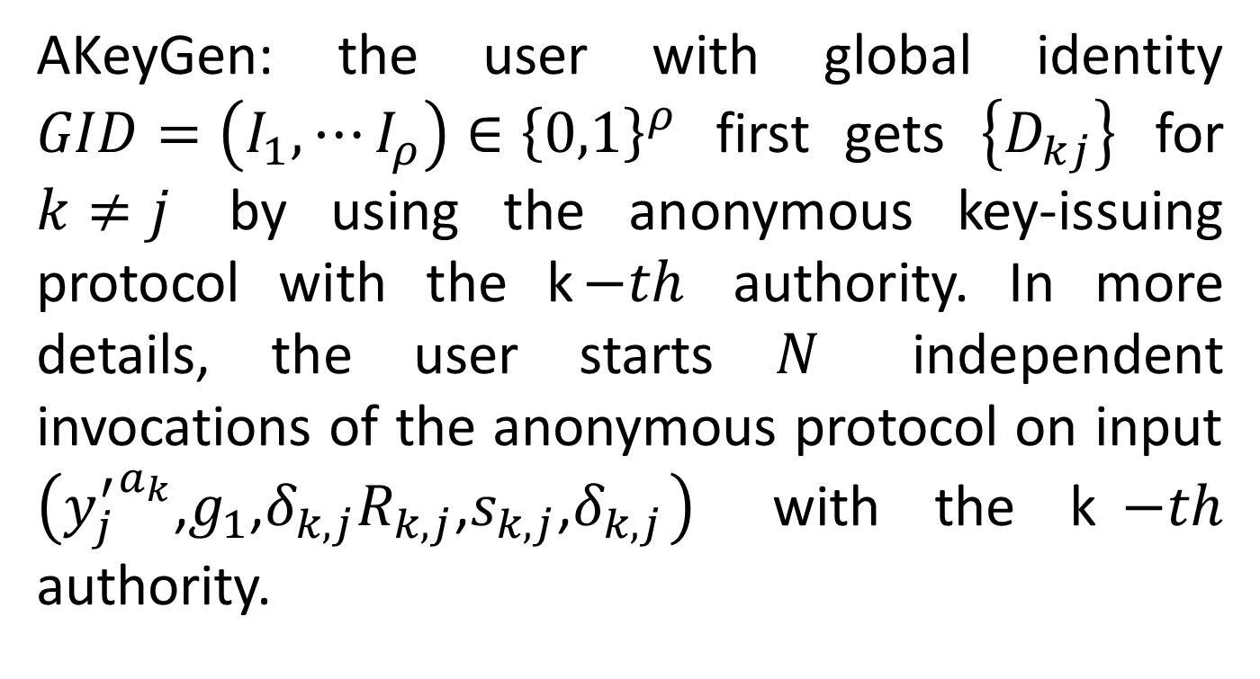
The specific scheme
AKeyGen: the user with global identity $GID=\left(I_{1},⋯I_{ρ}\right)∈{\left\{0,1\right\}}^{ρ}$ first gets $\left\{D_{kj}\right\}$ for $k≠j$ by using the anonymous key-issuing protocol with the k$−th$ authority. In more details, the user starts $N$ independent invocations of the anonymous protocol on input $\left({y_{j}^{′}}^{a_{k}}\text{,}g_{1}\text{,}δ_{k,j}R_{k,j}\text{,}s_{k,j}\text{,}δ_{k,j} \right)$ with the k$−th$ authority.

Slide 15
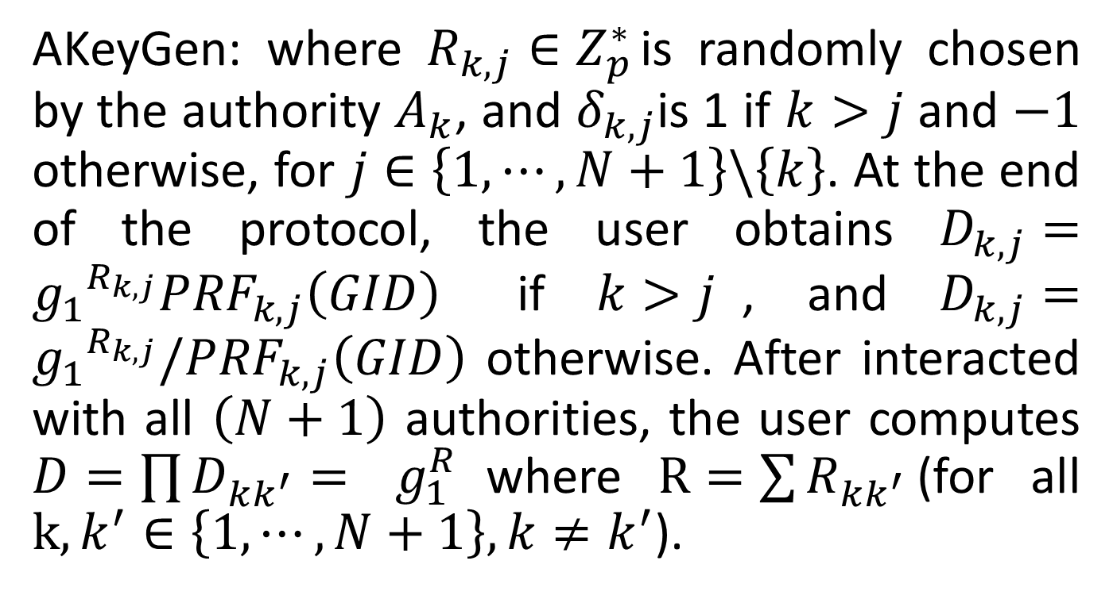
The specific scheme
AKeyGen: where $R_{k,j}∈Z_{p}^{∗}$ is randomly chosen by the authority $A_{k}$, and $δ_{k,j}$is 1 if $k>j$ and $−1$ otherwise, for $j∈\left\{1,⋯,N+1\right\}\backslash \left\{k\right\}$. At the end of the protocol, the user obtains $D_{k,j}={g_{1}}^{R_{k,j}}{PRF}_{k,j}\left(GID\right)$ if $k>j$, and $D_{k,j}={g_{1}}^{R_{k,j}}{/PRF}_{k,j}\left(GID\right)$ otherwise. After interacted with all $\left(N+1\right)$ authorities, the user computes $D=\prod{D_{kk^{′}}}=$ $g_{1}^{R}$ where $R=\sum{R_{kk^{′}}}$(for all $k,k^{′}∈\left\{1,⋯,N+1\right\},k≠k^{′}$).

Slide 16
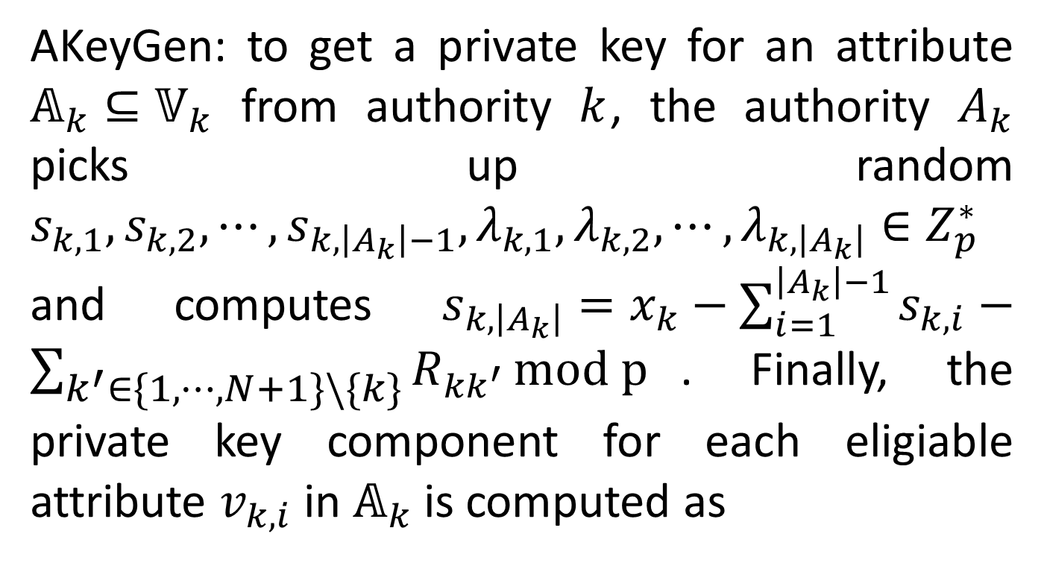
The specific scheme
AKeyGen: to get a private key for an attribute $𝔸_{k}⊆𝕍_{k}$ from authority $k$, the authority $A_{k}$ picks up random $s_{k,1},s_{k,2},⋯,s_{k,\left|A_{k}\right|−1},λ_{k,1},λ_{k,2},⋯,λ_{k,\left|A_{k}\right|}∈Z_{p}^{∗}$ and computes $s_{k,\left|A_{k}\right|}=x_{k}−\sum_{i=1}^{\left|A_{k}\right|−1}{s_{k,i}}−\sum_{k^{′}∈\left\{1,⋯,N+1\right\}\backslash \left\{k\right\}}{R_{kk^{′}}}mod p$. Finally, the private key component for each eligiable attribute $v_{k,i}$ in $𝔸_{k}$ is computed as

Slide 17
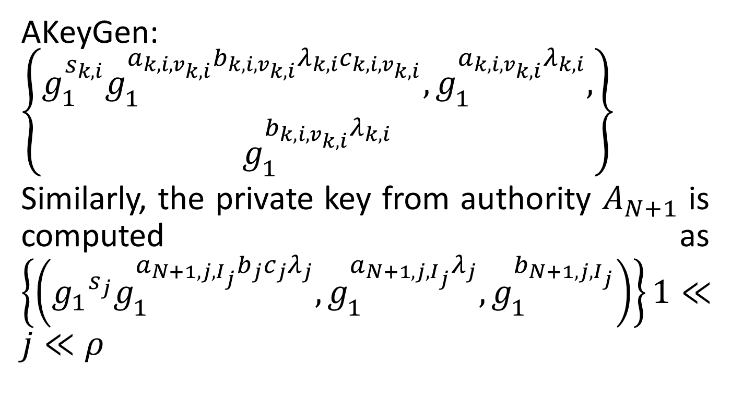
The specific scheme
AKeyGen: $\left\{\begin{aligned}g_{1}^{s_{k,i}}g_{1}^{a_{k,i,v_{k,i}}b_{k,i,v_{k,i}}λ_{k,i}c_{k,i,v_{k,i}}},g_{1}^{a_{k,i,v_{k,i}}λ_{k,i}}, \\ g_{1}^{b_{k,i,v_{k,i}}λ_{k,i}}\end{aligned}\right\}$
Similarly, the private key from authority $A_{N+1}$ is computed as $\left\{\left({g_{1}}^{s_{j}}g_{1}^{a_{N+1,j,I_{j}}b_{j}c_{j}λ_{j}},g_{1}^{a_{N+1,j,I_{j}}λ_{j}},g_{1}^{b_{N+1,j,I_{j}}}\right)\right\}1≪j≪ρ$

Slide 18
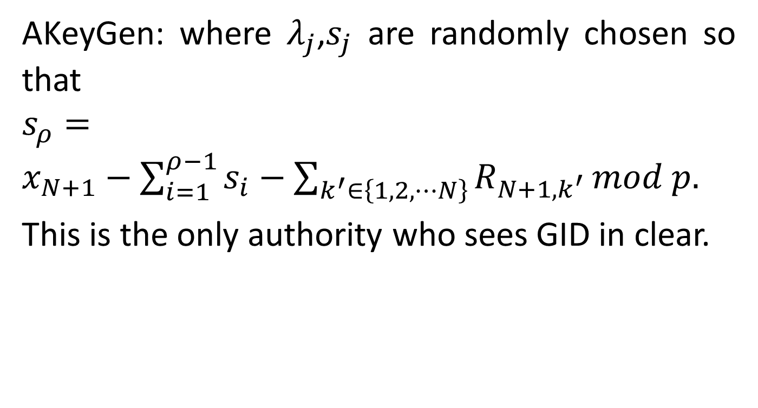
The specific scheme
AKeyGen: where $λ_{j}$,$s_{j}$ are randomly chosen so that $s_{ρ}=x_{N+1}−\sum_{i=1}^{ρ−1}{s_{i}}−\sum_{k^{′}∈\left\{1,2,⋯N\right\}}{R_{N+1,k^{′}}}mod p.$
This is the only authority who sees GID in clear.

Slide 19

The specific scheme
Enc: to encrypt a message $M∈G_{T}$ under the policy $ℙ=\left[ℙ_{1}⋀⋯⋀ℙ_{N}\right]$, the encryptor first picks random $z$ and computes $C^{′}=M∙T^{z}$, $C_{0}=g_{2}^{z}$.

Slide 20
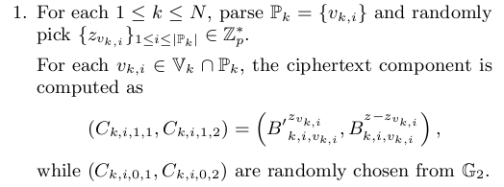
The specific scheme
Enc:

Slide 21
The specific scheme
Enc:

Slide 22
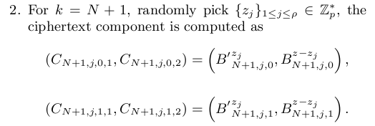
The specific scheme
Enc:

Slide 23
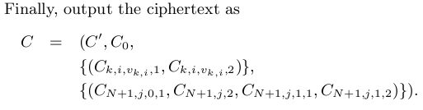
The specific scheme
Enc:

Slide 24
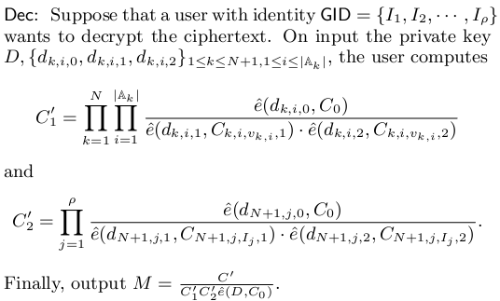
The specific scheme

Slide 25
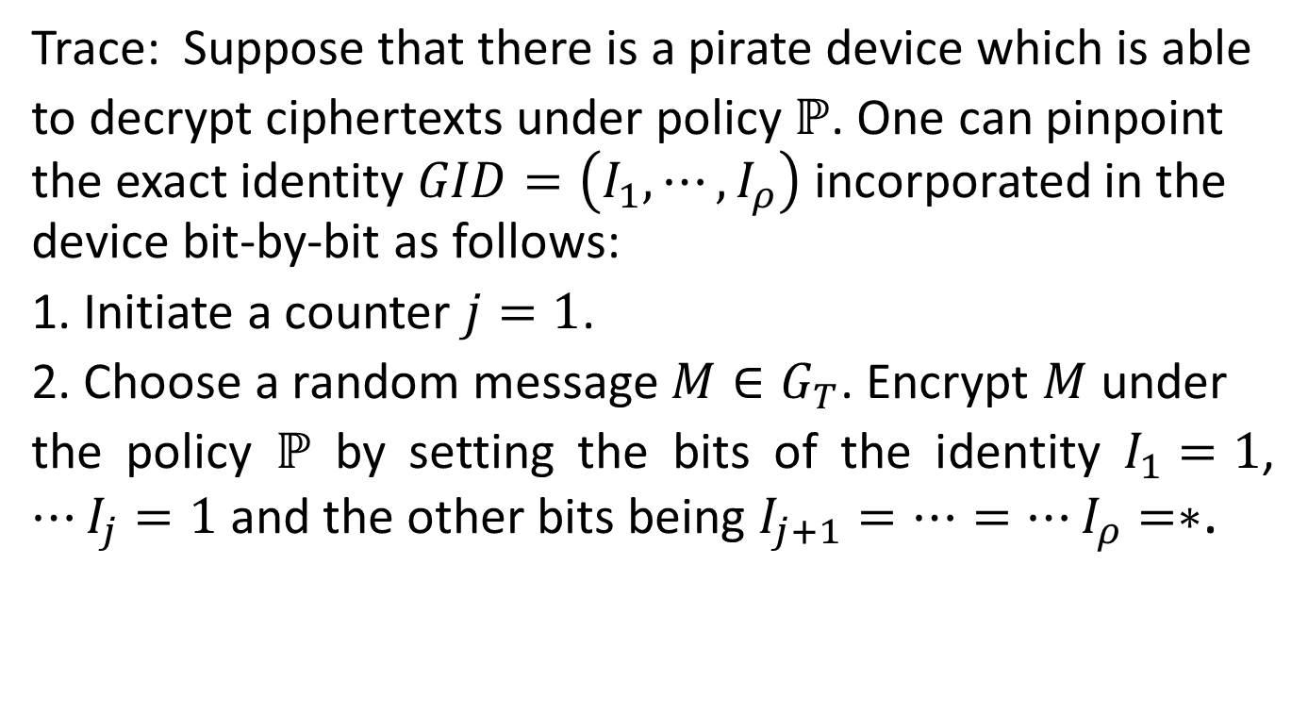
The specific scheme
Trace: Suppose that there is a pirate device which is able
to decrypt ciphertexts under policy $ℙ$. One can pinpoint the exact identity $GID=\left(I_{1},⋯,I_{ρ}\right)$ incorporated in the device bit-by-bit as follows:
1. Initiate a counter $j=1$.
2. Choose a random message $M∈G_{T}$. Encrypt $M$under
the policy $ℙ$ by setting the bits of the identity $I_{1}=1$, $⋯I_{j}=1$ and the other bits being $I_{j+1}=⋯=⋯I_{ρ}=∗$.

Slide 26
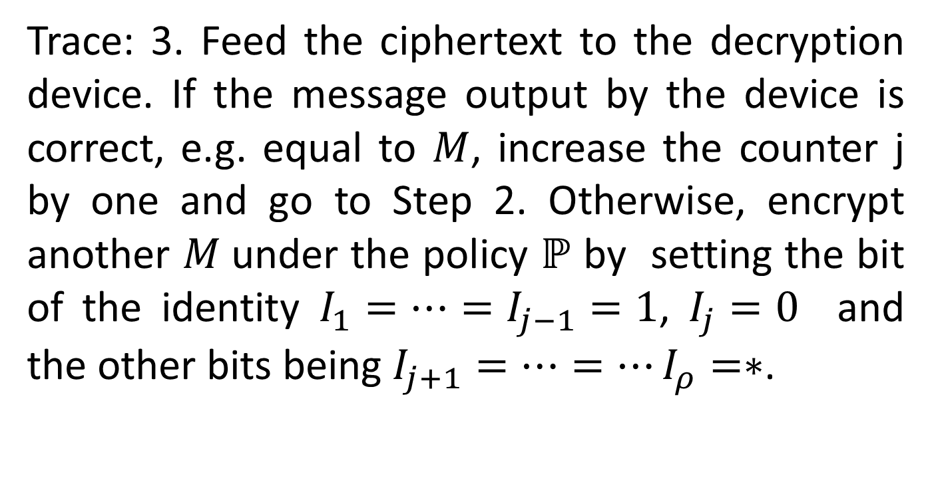
The specific scheme
Trace: 3. Feed the ciphertext to the decryption device. If the message output by the device is correct, e.g. equal to $M$, increase the counter j by one and go to Step 2. Otherwise, encrypt another $M$under the policy $ℙ$ by setting the bit of the identity $I_{1}=⋯=I_{j−1}=1$, $I_{j}=0$ and the other bits being $I_{j+1}=⋯=⋯I_{ρ}=∗$.

Slide 27

The specific scheme
Trace: The iteration stops until the whole identity is recovered, e.g. $j=ρ$. It can be readily seen that the iteration repeats for at most $ρ$ times.

Slide 28
The advantage of this scheme
Public traceability: it means any user in this system can achieve this traceability and do not need other confidential information.
Black-box

Slide 29
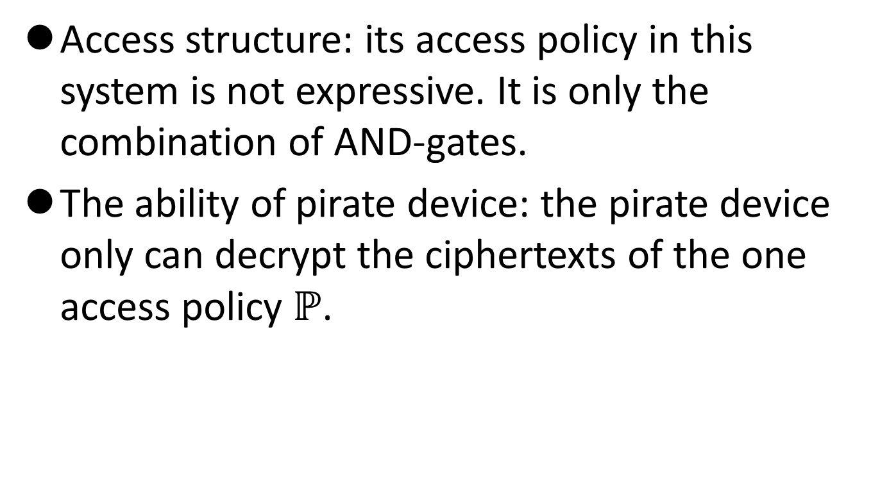
The disadvantage of this scheme
Access structure: its access policy in this system is not expressive. It is only the combination of AND-gates.
The ability of pirate device: the pirate device only can decrypt the ciphertexts of the one access policy $ℙ$.

