Slide 1
Privacy-Preserving K-means Clustering over Vertically Partitioned Data
Reporter：Ximeng Liu
Supervisor: Rongxing Lu
School of EEE, NTU
http://www.ntu.edu.sg/home/rxlu/seminars.htm

Slide 2
References
Vaidya J, Clifton C. Privacy-preserving k-means clustering over vertically partitioned data[C]//Proceedings of the ninth ACM SIGKDD international conference on Knowledge discovery and data mining. ACM, 2003: 206-215.

Slide 3
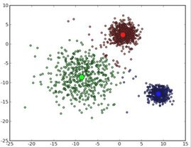
Introduction
K-means clustering is a simple technique to group items into k clusters.

Slide 4
Introduction
The k-means algorithm also requires an initial assignment (approximation) for the values/positions of the k means. This is an important issue, as the choice of initial points determines the final solution.

Slide 5
Introduction
Vertically partitioned data: The data for a single entity are split across multiple sites, and each site has information for all the entities for a specific subset of the attributes.

Slide 6
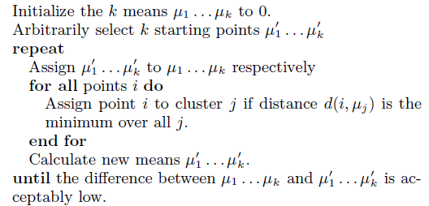
Introduction- K-means
K-means algorithm：

Slide 7
Introduction
Each item is placed in its closest cluster, and the cluster centers are then adjusted based on the data placement. This repeats until the positions stabilize.

Slide 8
Problems
So what’s the problem when we use vertically partitioned data to store data? How can we keep the data privacy?

Slide 9
Problems
At first glance, this might appear simple – each site can simply run the k-means algorithm on its own data. This would preserve complete privacy. But it will not work. How can we compute it privately?

Slide 10

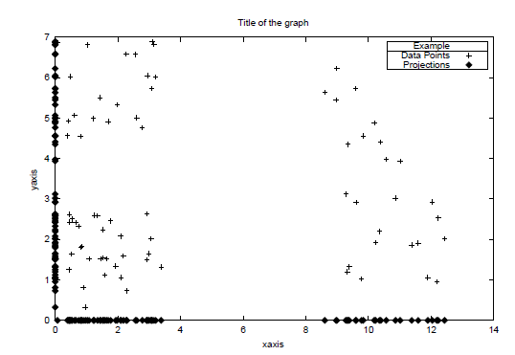
Problems

Slide 11
Problems
The second problem is knowing when to quit, i.e., when the difference between μ and μ0 is small enough;
How to privately compute this?

Slide 12
Formally define the problem
Let r be the number of parties, each having different attributes for the same set of entities. n is the number of the common entities. The parties wish to cluster their joint data using the k-means algorithm. Let k be the number of clusters required.

Slide 13
Formally define the problem
The final result of the k-means clustering algorithm is the value/position of the means of the k clusters, with each side only knowing the means corresponding to their own attributes, and the final assignment of entities to clusters

Slide 14
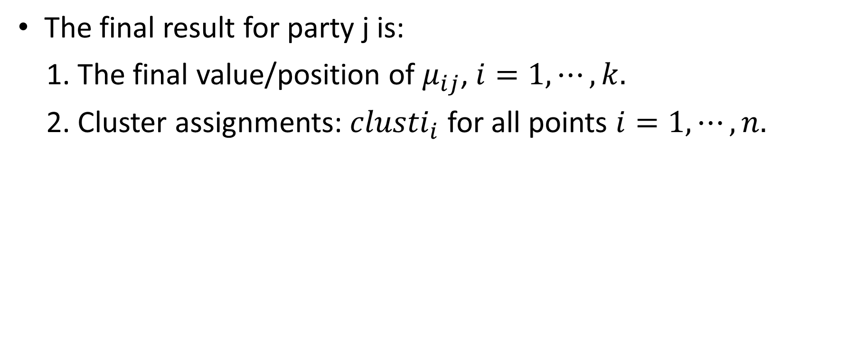
Formally define the problem

Slide 15
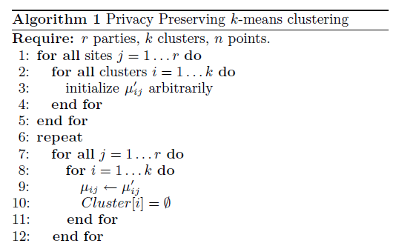
Privacy Preserving k-means clustering

Slide 16
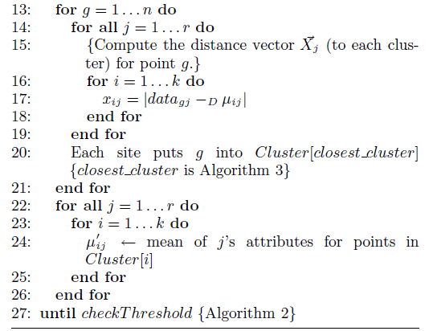
Privacy Preserving k-means clustering

Slide 17
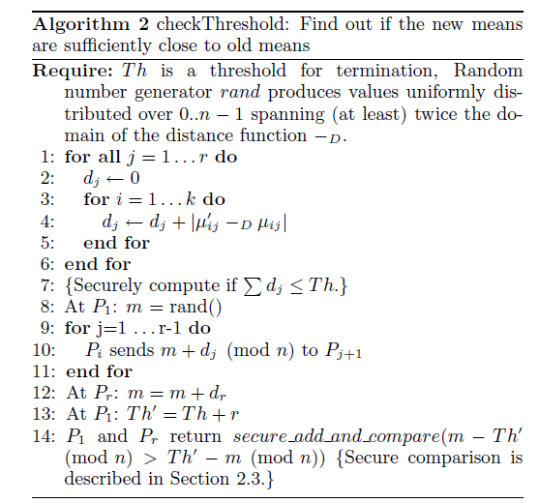
Algorithm: checkThreshold

Slide 18
Subroutine: Securely Finding the Closest Cluster
Next algorithm is used as a subroutine in the k-means clustering algorithm to privately find the cluster which is closest to the given point, i.e., which cluster should a point be assigned to.

Slide 19
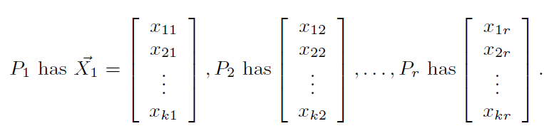
Subroutine: Securely Finding the Closest Cluster
The problem is formally defined as follows:
Consider parties , each with their own k-element vector

Slide 20
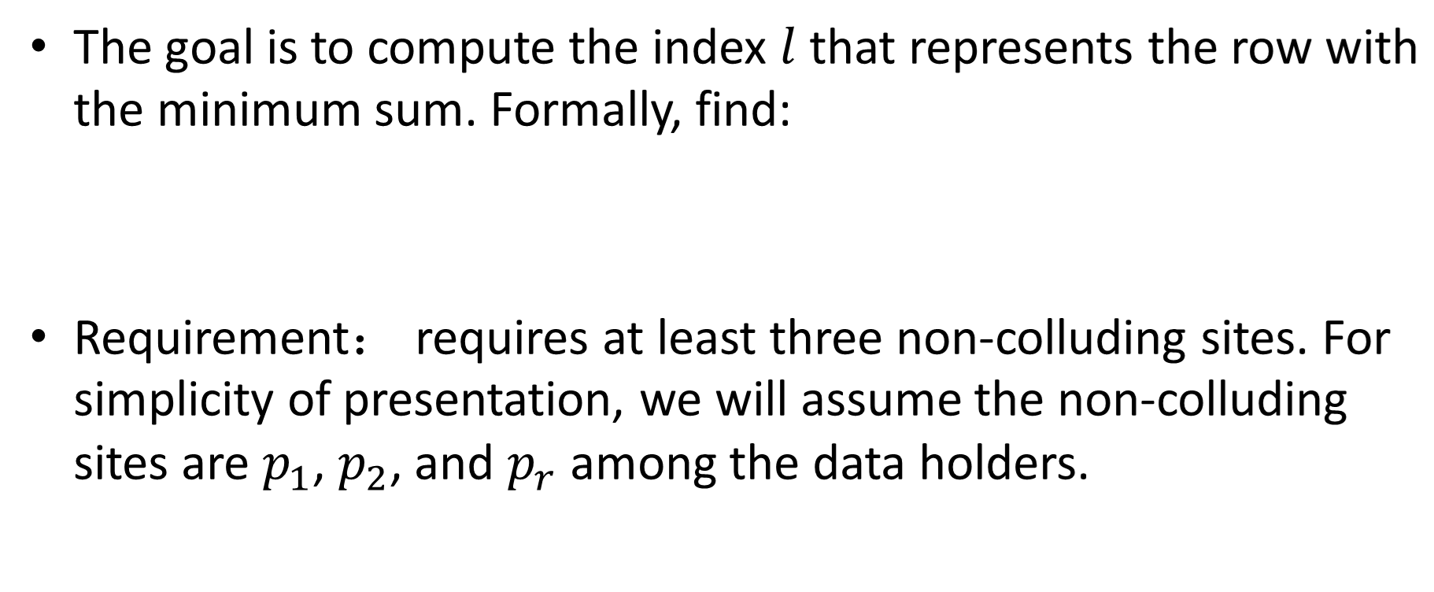

Subroutine: Securely Finding the Closest Cluster

Slide 21
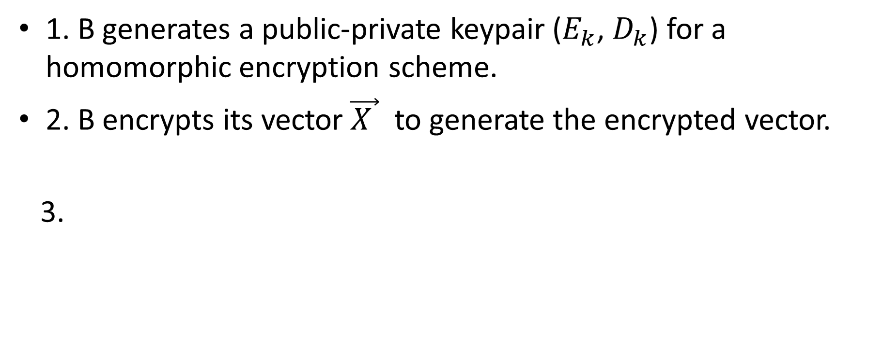
Permutation

Slide 22
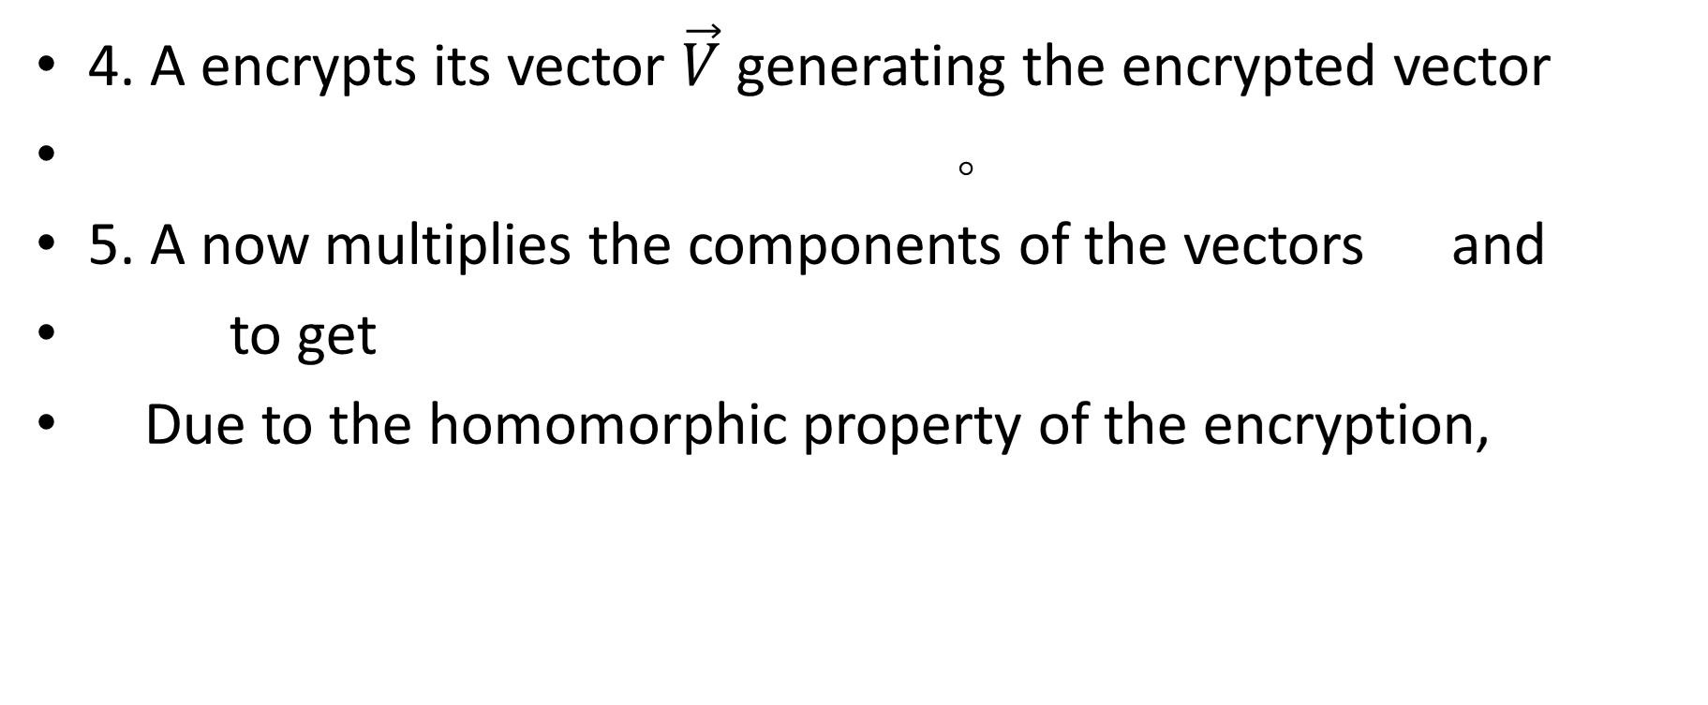


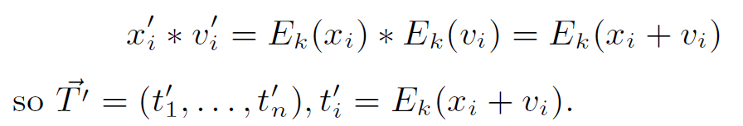
Permutation

Slide 23
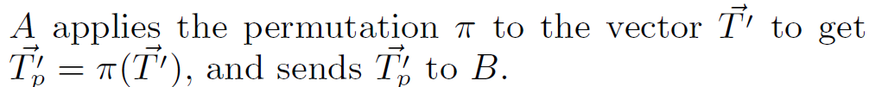
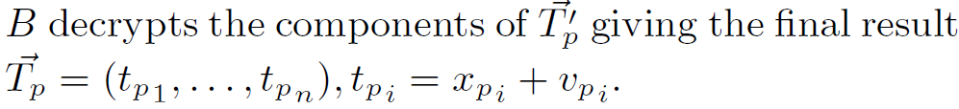
Permutation
6.
7.

Slide 24
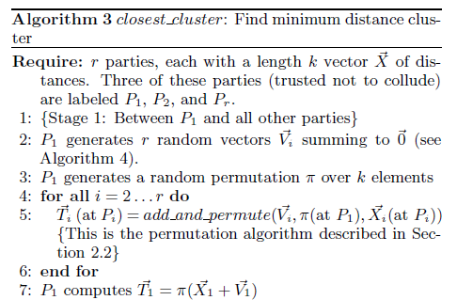
Closest cluster: Find minimum distance cluster

Slide 25
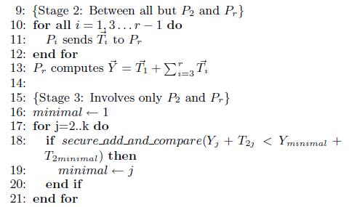

Closest cluster: Find minimum distance cluster

Slide 26
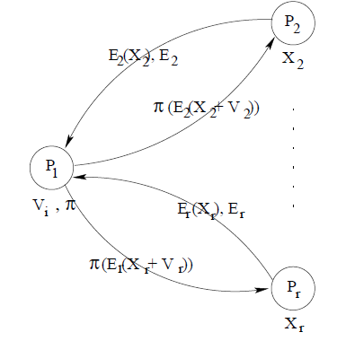
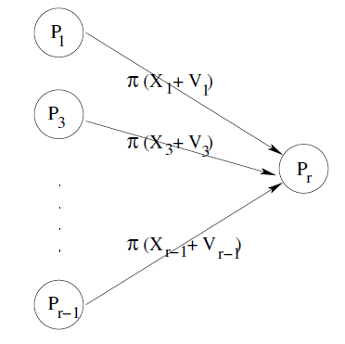
Closest cluster: Find minimum distance cluster

Slide 27
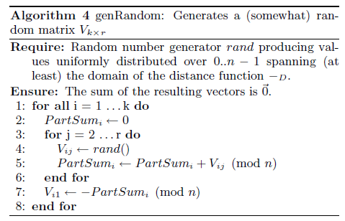
Closest cluster: Find minimum distance cluster

Slide 28
Secure Multiparty Computation
/ Secure Comparison
Secure two party computation was first investigated by Yao and was later generalized to multiparty computation.
The seminal paper by Goldreich proves that there exists a secure solution for any functionality.

Slide 29
Secure Multiparty Computation
/ Secure Comparison
Combinatorial circuit is needed in this paper. But the author does not introduce how to implement the secure add and compare function.

Slide 30
Discussion
Any Question?

Slide 31
Thank you
Rongxing’s Homepage: http://www.ntu.edu.sg/home/rxlu/index.htm
PPT available @: http://www.ntu.edu.sg/home/rxlu/seminars.htm
Ximeng’s Homepage:
http://www.liuximeng.cn/

