Slide 1
Game Theory and Cryptography
1. Introduction to game theory and its solutions.
2. Relate Cryptography with game theory problem by introducing an example.
3. Open questions and discussions.
Presented by Li Ruoyu
Supervisor: Dr. Lu Rongxing

Slide 2
What is Game Theory
Game theory can be defined as the study of mathematical models of conflict and cooperation between intelligent rational decision-makers.
Game theory provides general mathematical techniques for analyzing situations in which two or more individuals make decisions that will influence one another’s welfare. [Roger B. Myerson, 1991]

Slide 3
Player’s Welfare- Utility Theory
Utility Theory can be used to measure relative
preference of an agent.
Utility function: a mapping from a state of the world to a real number, indicating the agent’s level of “happiness” with each state of the world.
Used in computing investment preference
and Artificial Intelligence in various decisions to be made in learning, classification tasks, etc.
The Maximum Expected Utility Principle

Slide 4
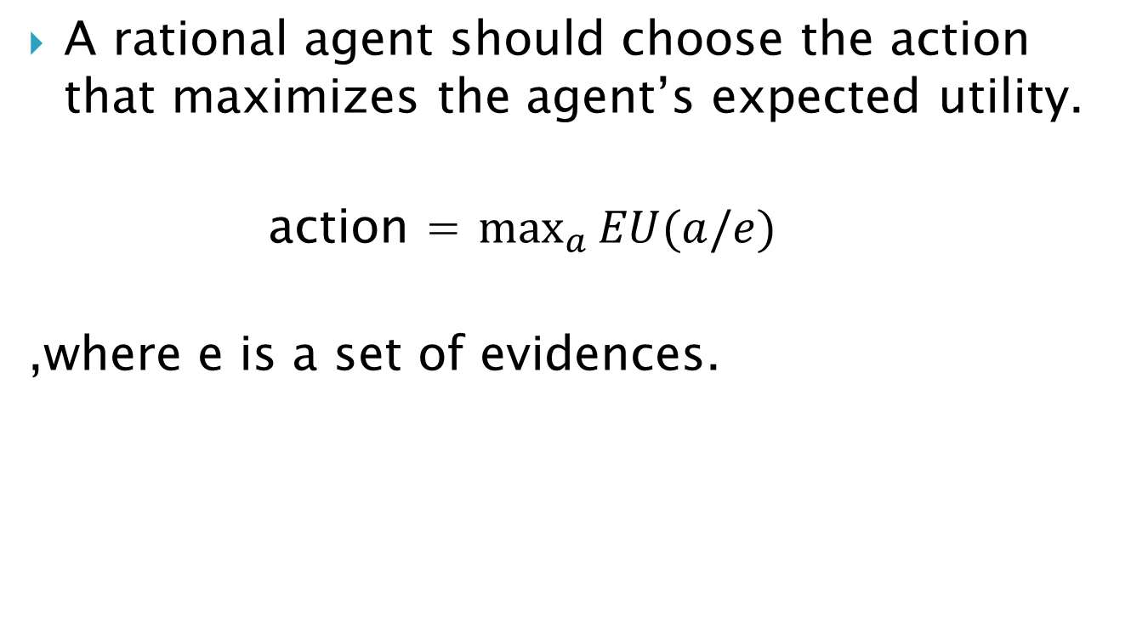
The Maximum Expected Utility Principle and Rationality
A rational agent should choose the action that maximizes the agent’s expected utility.
action = $\max_{a}{EU(a/e)}$
,where e is a set of evidences.

Slide 5

A famous example of game theory- Prisoner’s Dilemma (PD)
1. Two accomplice caught by the Police
2. Interrogated separately
3. The police suggests a deal
4. Choices of the prisoner: Cooperate or Defect [to the other prisoner]. In other words, do not confess or confess [to the police].

Slide 6
Prisoner’s Dilemma Game
PD is One shot game- only played once
Simultaneous move game- when playing, agents do not know other player’s choice. Otherwise, sequential move game
PD is a non-zero/non-constant sum game: players’ interests are not always in direct conflict, so that there are opportunities for both to gain their utilities.

Slide 7
Three elements of a game
The players
How many players are there? Anyway, N>1
A complete description of the actions available to each player- identical or may not
all players’ actions form a strategy profile
A description of consequences (payoff) for each player for every possible combination of actions (strategy profiles)- payoff matrices

Slide 8
Prisoner’s Dilemma Game- payoff matrices
Prisoner 2
 | Cooperate | Defect
Cooperate | R/R (3/3) | S/T (0/5)
Defect | T/S (5/0) | P/P (1/1)
Prisoner 1
Note: T > R > P > S and 2R > T + S.

Slide 9
Some thinking
What if we let the game repeat ?
What if the game repeats for unbounded time of round ? Will the agents try other actions instead of D (defect) ?

Slide 10
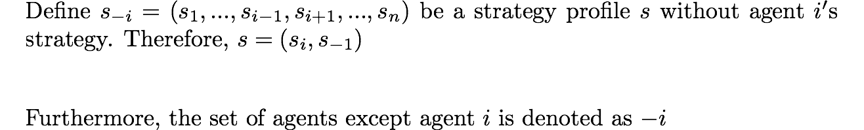
Best Response and Nash Equilibrium
Definition of Best Response:

Slide 11
Best Response and Nash Equilibrium
Definition 1.1 Nash Equilibrium
Definition 1.2 (Strict Nash equilibrium)
Definition 1.3 (Weak Nash equilibrium)
Notes:
Go back to the PD game and check

Slide 12
Different looks at NE
Play Prescription
Given NE s*, s* is a prescription to play. No one player has incentive to deviate from it’s play in s* because unilaterally doing so will lower its payoff.
Pre-play Communication
Players meet beforehand and discuss and reach to an agreement on how to play the game. It is not understandable that players would come to an agreement that is not an NE. (rational players)
Rational Introspection
Players will ask themselves what would be the outcome of the game. Assuming non of the agents will make a mistake, try to introspect rational decisions for all including itself.

Slide 13
Different looks at NE-continued
No regrets concept
Having all other agents’ choices fixed, did I do the best I can do?
Self-fulfilling belief
I believe everyone else will do what’s the best for itself, I will do my best.
Trial and Error
Players start playing a strategy profile that is not a NE. Some players discover they are not playing their best, so improve the payoff by switching from one action to another. This goes on until a strategy profile that is a NE is found. (No guarantee this will happen. But many repeated game or evolutionary game theory are interested in this)

Slide 14
Nash Equilibrium
NE is the solution to a game
Usually for a given game with NE existing, there are more than one NE, some are mixed strategy NE, some are pure. Some are strict but most are weak NE.
Does NE always exist ? Not always.

Slide 15
Finding Nash Equilibrium
1. Pure Strategy NE
Recall PD game for practice.
 | Cooperate | Defect
Cooperate | R/R (3/3) | S/T (0/5)
Defect | T/S (5/0) | P/P (1/1)

Slide 16
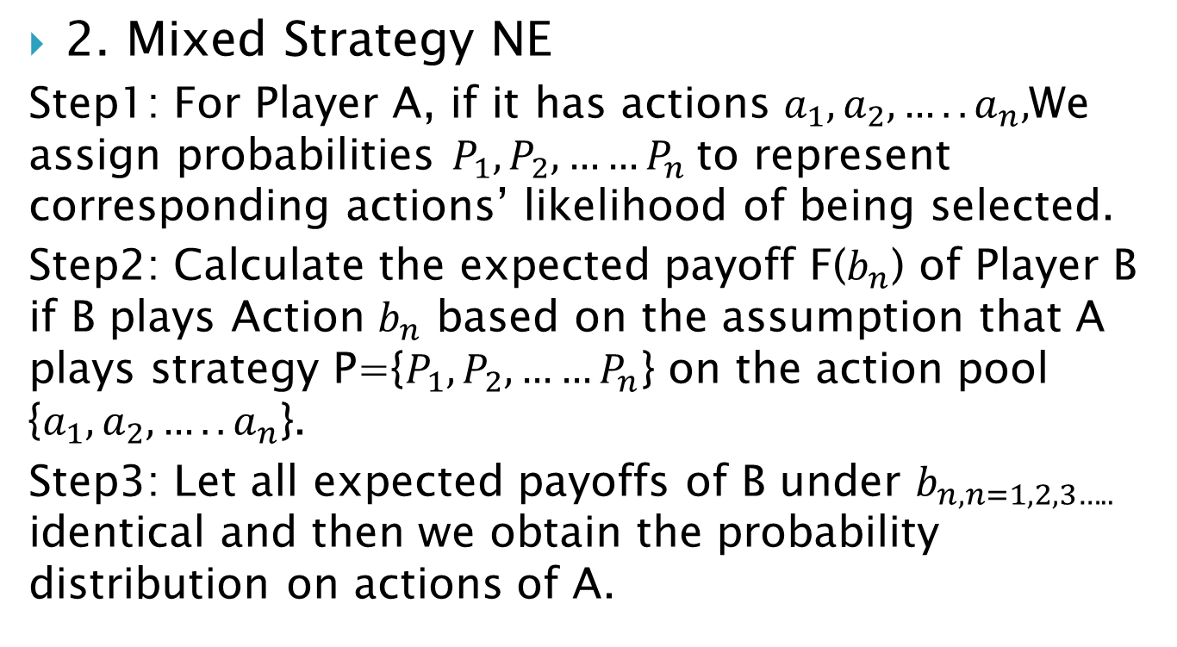
Finding Nash Equilibrium
2. Mixed Strategy NE
Step1: For Player A, if it has actions $a_{1},a_{2},…..a_{n},$We assign probabilities $P_{1},P_{2},……P_{n}$to represent corresponding actions’ likelihood of being selected.
Step2: Calculate the expected payoff F($b_{n}$) of Player B if B plays Action $b_{n}$ based on the assumption that A plays strategy P={$P_{1},P_{2},……P_{n}$} on the action pool {$a_{1},a_{2},…..a_{n}$}.
Step3: Let all expected payoffs of B under $b_{n, n=1,2,3…..}$ identical and then we obtain the probability distribution on actions of A.

Slide 17
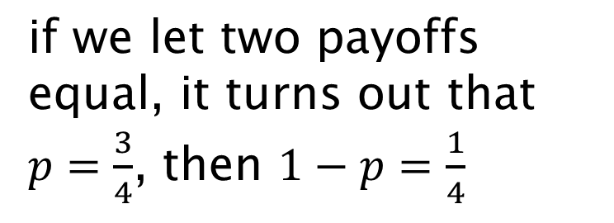
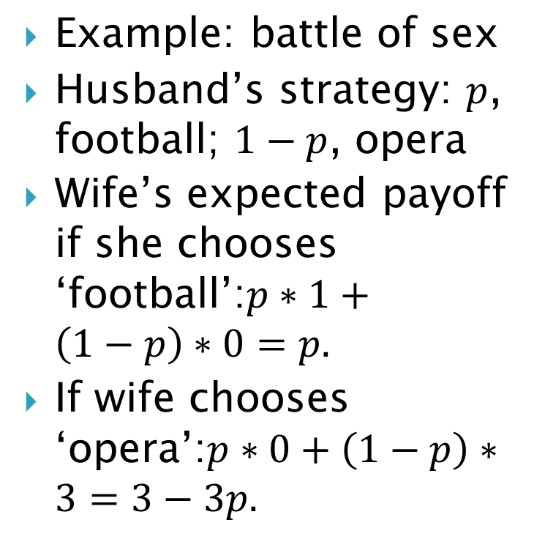
Finding Nash Equilibrium
Example: battle of sex
Husband’s strategy: $p$, football; $1−p$, opera
Wife’s expected payoff if she chooses ‘football’:$p∗1+\left(1−p\right)∗0=p.$
If wife chooses ‘opera’:$p∗0+\left(1−p\right)∗3=3−3p.$
 | Football | Opera
Football | (3/1) | (0/0)
Opera | (0/0) | (1/3)
if we let two payoffs equal, it turns out that $p=\frac{3}{4}$, then $1−p=\frac{1}{4}$

Slide 18
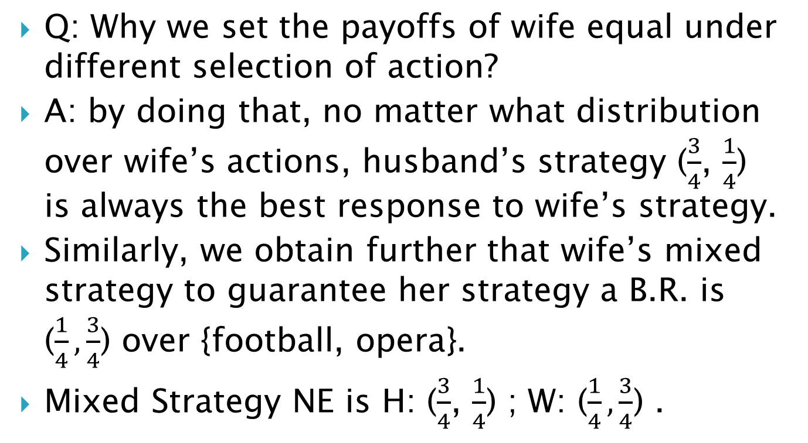
Finding Nash Equilibrium
Q: Why we set the payoffs of wife equal under different selection of action?
A: by doing that, no matter what distribution over wife’s actions, husband’s strategy ($\frac{3}{4}$, $\frac{1}{4}$) is always the best response to wife’s strategy.
Similarly, we obtain further that wife’s mixed strategy to guarantee her strategy a B.R. is ($\frac{1}{4}, \frac{3}{4}$) over {football, opera}.
Mixed Strategy NE is H: ($\frac{3}{4}$, $\frac{1}{4}$) ; W: ($\frac{1}{4}, \frac{3}{4}$) .

Slide 19
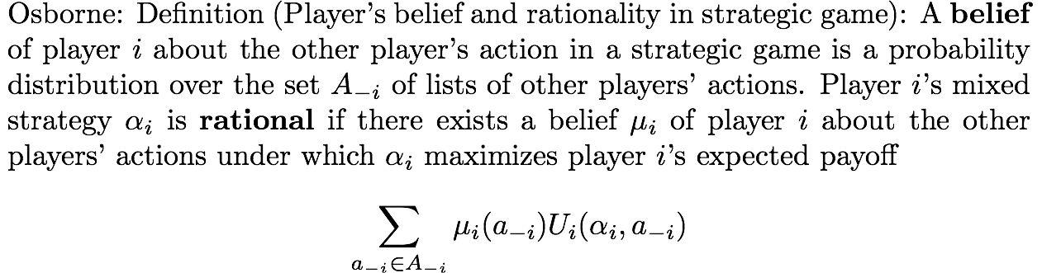
Player’s Belief and Rationalizability
Note:
In the solution concept, “elimination of dominated strategies,” we claimed that a rational player will never play a dominated strategy.
This definition allows a player to believe that the other players’ actions are “correlated.”

Slide 20


Motivating examples-Rationalizability
In some games, the assumption of rationality significantly restricts the player’s choice.
For any belief about the other player’s action (i.e., no matter what the other chooses), D yields higher payoff.
D is therefore only rational choice.
Strategy C isn’t rationalizable for row player
C isn’t a best response to any strategy that column player could play
 | C | D
C | (3/3) | (0/5)
D | (5/0) | (1/1)

Slide 21
Motivating examples-Rationalizability
In some other games, the assumption of rationality is less restrictive.
If 1 believes that 2 will choose C, then 1 will choose C as well.
If 1 believe that 2 will choose D, then 1 will choose D.
Thus, both C and D are rational choices for 1.
But for 2, only D is rational choice.
2
 | C | D
C | 3/2 | 0/3
D | 2/0 | 1/1
1

Slide 22
Example- Game of Chicken
Two pure strategy NE
(D C) and (C D)
The average payoff (7+2)/2=4.5
One mixed strategy NE
C: 2/3 D: 1/3
Expected payoff of the two agents : 14/3 = 4.66667
 | C | D
C | 6, 6 | 2, 7
D | 7, 2 | 0, 0

Slide 23
Game of Chicken- continued
From above game, we observe that if player 1 choose D, player 2 has no incentive to choose D since the corresponding payoffs (0,0) are both dominated by other options.
While, in mixed NE, it still has probability 1/3*1/3 = 1/9 to choose the action profile (D,D). It is obvious not reasonable.

Slide 24
Correlated Equilibrium
In a standard game, each player mixes his pure strategies independently
In this sense, the correlated equilibrium is a solution concept generalizing the Nash equilibrium.
In correlated equilibria, agents mix their strategy correlatively.
Instead of studying distribution over player’s actions, CE studies the distribution over action profiles.

Slide 25
Reconsider the game of chicken
Eliminating (D,D), the rest of action profiles (C,D),(D,C) and (C,C) are picked randomly.
A random device (or random variable) with known distribution determines two players’ action through a private signal to each player.
 | C | D
C | 6, 6 | 2, 7
D | 7, 2 | 0, 0

Slide 26
Reconsider the game of chicken
The random device can work according to any distribution. We assume it runs as (1/3,1/3,1/3) over the three action profiles.
Expected payoffs of the two:
1/3*7 + 2/3*1/2*6 + 2/3*1/2*2 = 5
5>4.666. CE gives higher payoff than NE
Different from NE, in CE player could inference partially about what other player is going to play.

Slide 27
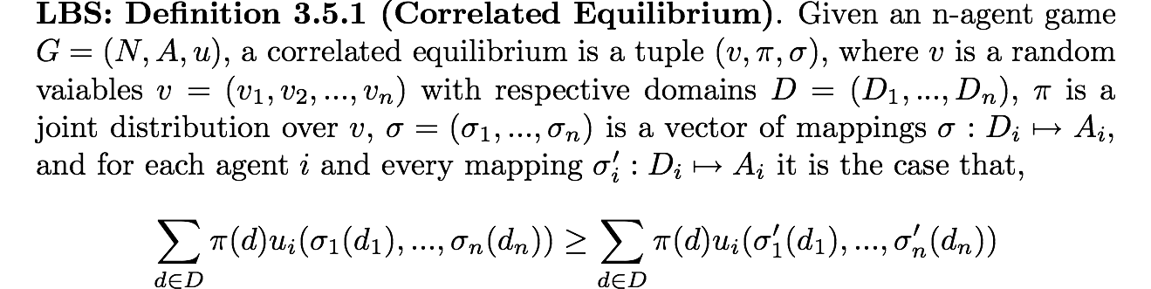
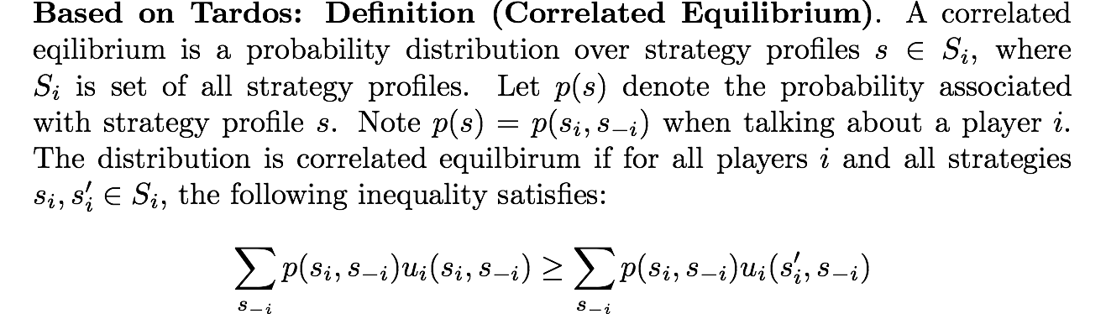
Formal definition of CE
Look for Best distribution over strategy files

Slide 28
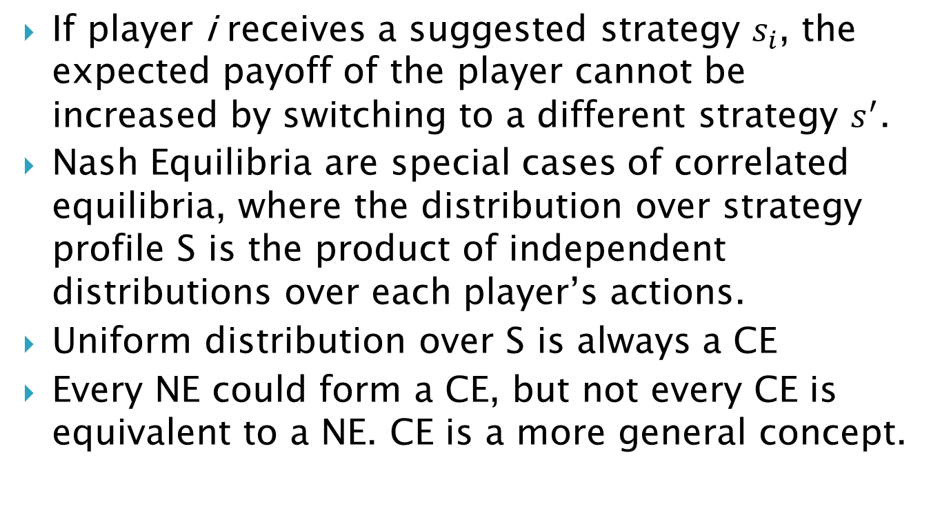
Comments on CE’s definition
If player i receives a suggested strategy $s_{i}$, the expected payoff of the player cannot be increased by switching to a different strategy $s_{}^{′}$.
Nash Equilibria are special cases of correlated equilibria, where the distribution over strategy profile S is the product of independent distributions over each player’s actions.
Uniform distribution over S is always a CE
Every NE could form a CE, but not every CE is equivalent to a NE. CE is a more general concept.

Slide 29
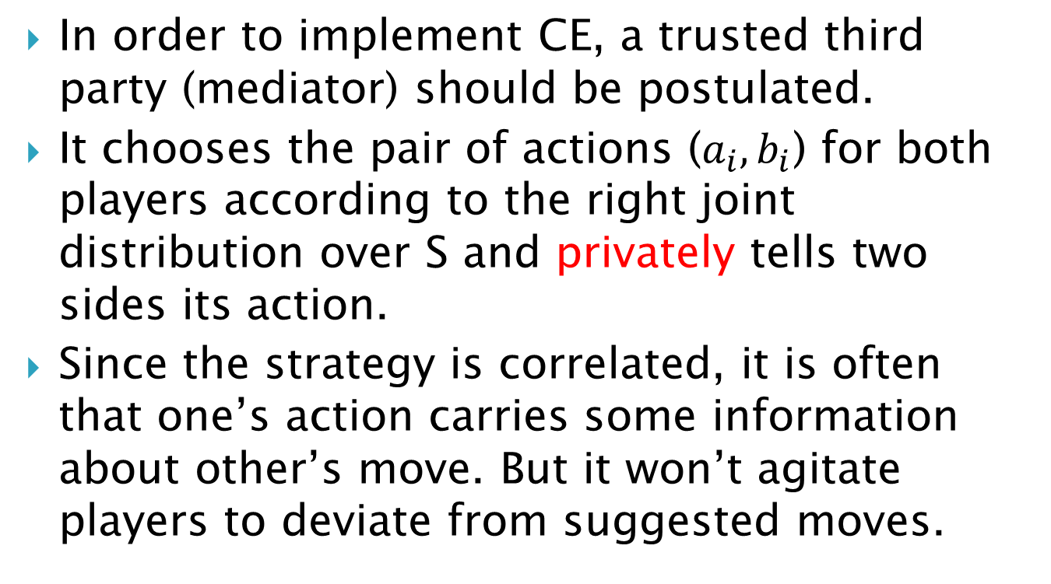
Correlated Equilibrium and Mediator
In order to implement CE, a trusted third party (mediator) should be postulated.
It chooses the pair of actions ($a_{i},b_{i}$) for both players according to the right joint distribution over S and privately tells two sides its action.
Since the strategy is correlated, it is often that one’s action carries some information about other’s move. But it won’t agitate players to deviate from suggested moves.

Slide 30
Remove the Mediator
Is it possible?
Replace the mediator with a secure two party cryptographic protocol and let it play the role of “random device” for profile selection ?
Dodis, Yevgeniy, Shai Halevi, and Tal Rabin. "A cryptographic solution to a game theoretic problem." Advances in Cryptology—CRYPTO 2000. Springer Berlin Heidelberg, 2000.
Cited over 100 times since 2000.

Slide 31
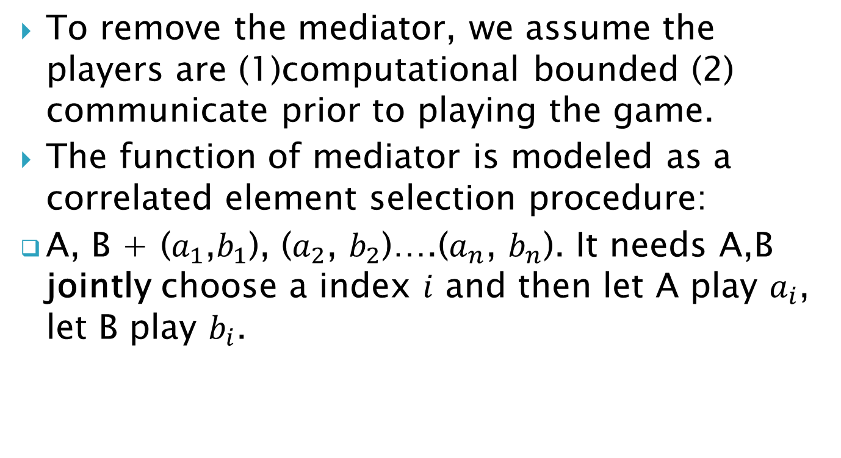
Correlated Element Selection
To remove the mediator, we assume the players are (1)computational bounded (2) communicate prior to playing the game.
The function of mediator is modeled as a correlated element selection procedure:
A, B + ($a_{1}$,$b_{1}$), ($a_{2}$, $b_{2}$)….($a_{n}$, $b_{n}$). It needs A,B jointly choose a index $i$ and then let A play $a_{i}$, let B play $b_{i}$.

Slide 32
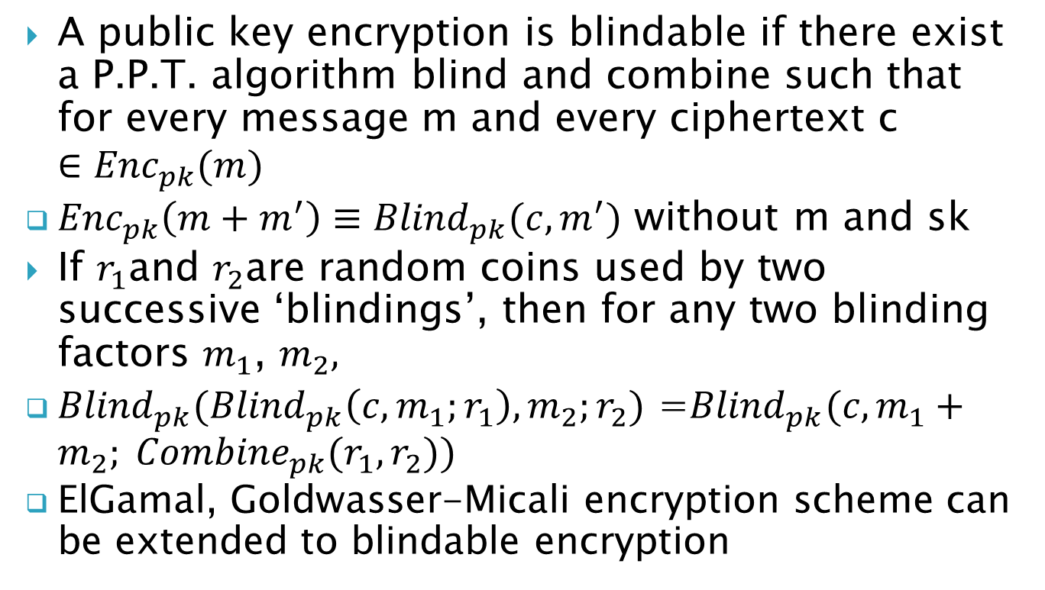
Blindable Encryption
A public key encryption is blindable if there exist a P.P.T. algorithm blind and combine such that for every message m and every ciphertext c $∈{Enc}_{pk}(m)$
${Enc}_{pk}\left(m+m^{′}\right)≡{Blind}_{pk}(c,m^{′})$ without m and sk
If $r_{1}$and $r_{2}$are random coins used by two successive ‘blindings’, then for any two blinding factors $m_{1}$, $m_{2},$
${Blind}_{pk}({Blind}_{pk}\left(c,m_{1};r_{1}\right),m_{2};r_{2})$ =${Blind}_{pk}(c,m_{1}+m_{2}; {Combine}_{pk}(r_{1},r_{2}))$
ElGamal, Goldwasser-Micali encryption scheme can be extended to blindable encryption

Slide 33
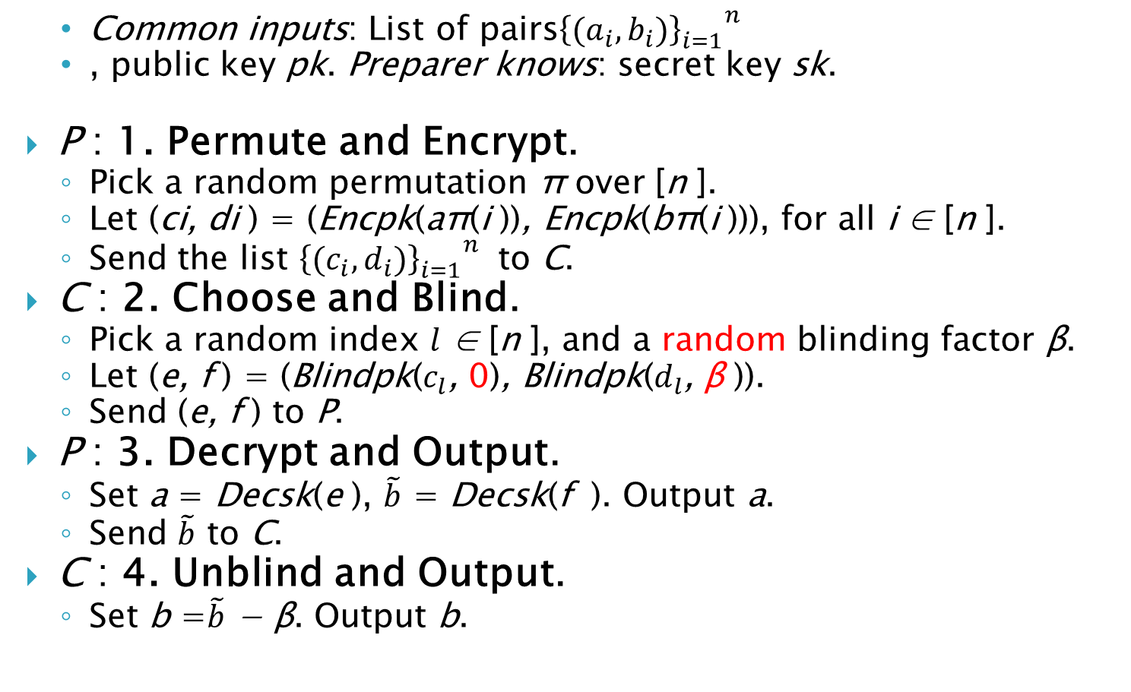
Protocol for Honest but Curious Case
Common inputs: List of pairs${{\left\{(a_{i},b_{i})\right\}}_{i=1}^{}}^{n}$
, public key pk. Preparer knows: secret key sk.
P : 1. Permute and Encrypt.
Pick a random permutation π over [n ].
Let (ci, di ) = (Encpk(aπ(i )), Encpk(bπ(i ))), for all i ∈ [n ].
Send the list ${{\left\{(c_{i},d_{i})\right\}}_{i=1}^{}}^{n}$ to C.
C : 2. Choose and Blind.
Pick a random index $l$ ∈ [n ], and a random blinding factor β.
Let (e, f ) = (Blindpk($c_{l}$, 0), Blindpk($d_{l}$, β )).
Send (e, f ) to P.
P : 3. Decrypt and Output.
Set a = Decsk(e ), $\tilde{b}$ = Decsk(f ). Output a.
Send $\tilde{b}$ to C.
C : 4. Unblind and Output.
Set b =$\tilde{b}$ − β. Output b.

Slide 34
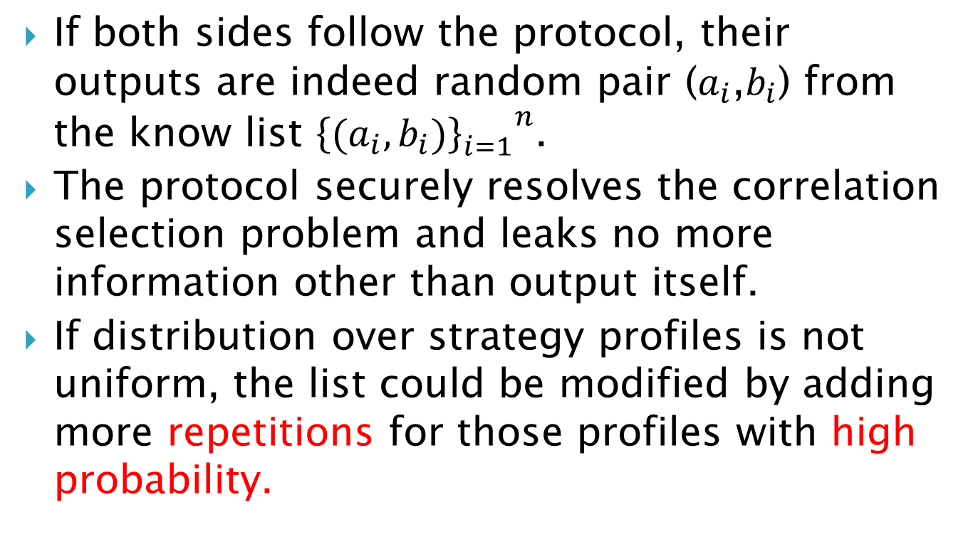
Comments
If both sides follow the protocol, their outputs are indeed random pair ($a_{i}$,$b_{i}$) from the know list ${{\left\{(a_{i},b_{i})\right\}}_{i=1}^{}}^{n}$.
The protocol securely resolves the correlation selection problem and leaks no more information other than output itself.
If distribution over strategy profiles is not uniform, the list could be modified by adding more repetitions for those profiles with high probability.

Slide 35
Dealing with dishonest player
Dishonest Players may deviate from the suggested moves/ give wrong encryption
Add a zero-knowledge proof after each flow of the protocol to let players prove that they do follow the prescribed protocol.

Slide 36
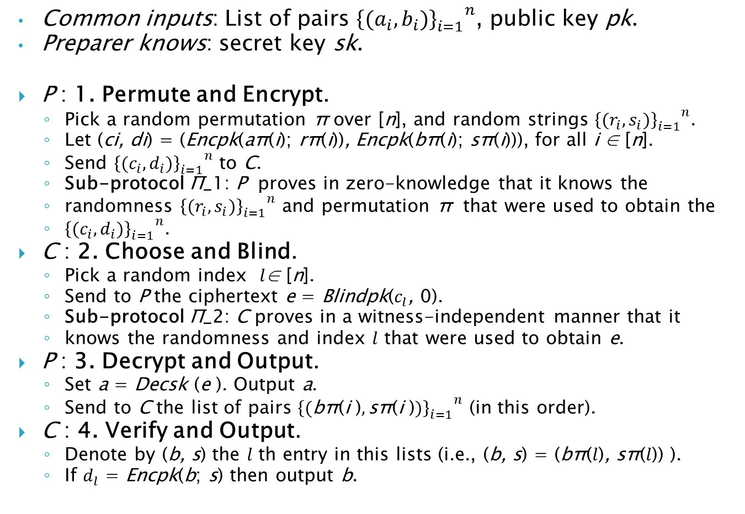
Protocol for Dishonest Player
Common inputs: List of pairs ${{\left\{(a_{i},b_{i})\right\}}_{i=1}^{}}^{n}$, public key pk.
Preparer knows: secret key sk.
P : 1. Permute and Encrypt.
Pick a random permutation π over [n], and random strings ${{\left\{(r_{i},s_{i})\right\}}_{i=1}^{}}^{n}$.
Let (ci, di) = (Encpk(aπ(i); rπ(i)), Encpk(bπ(i); sπ(i))), for all i ∈ [n].
Send ${{\left\{(c_{i},d_{i})\right\}}_{i=1}^{}}^{n}$ to C.
Sub-protocol Π_1: P proves in zero-knowledge that it knows the
randomness ${{\left\{(r_{i},s_{i})\right\}}_{i=1}^{}}^{n}$ and permutation π that were used to obtain the
${{\left\{(c_{i},d_{i})\right\}}_{i=1}^{}}^{n}$.
C : 2. Choose and Blind.
Pick a random index $l$∈ [n].
Send to P the ciphertext e = Blindpk($c_{l}$, 0).
Sub-protocol Π_2: C proves in a witness-independent manner that it
knows the randomness and index $l$ that were used to obtain e.
P : 3. Decrypt and Output.
Set a = Decsk (e ). Output a.
Send to C the list of pairs ${{\left\{(\text{bπ}\text{(}\text{i} \text{)},\text{sπ}\text{(}\text{i} \text{)})\right\}}_{i=1}^{}}^{n}$ (in this order).
C : 4. Verify and Output.
Denote by (b, s) the $l$ th entry in this lists (i.e., (b, s) = (bπ($l$), sπ($l$)) ).
If $d_{l}$ = Encpk(b; s) then output b.

Slide 37
Comments
For the second proof of knowledge, it is not necessary to be zero knowledge, a weak condition - “witness independent proof” -is good enough.
Only one decryption, bring high efficiency if decryption is more difficult.

Slide 38
Conclusion
By implementing the cryptographic solution to the game theoretic problem, we gain on the game theory front, it turns out that the mediator could be eliminated.
In cryptographic front, we also gain by excluding the problem of early stopping.
In some situation, game theoretic setting may punish the malicious behaviors and increase the security. Maybe it is no need to add zero-knowledge-proof into the protocol.

