Slide 1
Privacy-Enhanced Data Aggregation Scheme Against Internal Attackers in Smart Grid
Haiyong Bao
Nanyang Technological University
baohaiyong1@163.com
June 6, 2014

Slide 2
Overview
Introduction
Preliminaries
Scheme
Security proofs
Conclusion & Discussion

Slide 3
Reference
C.I. Fan, S.Y. Huang, and Y.L. Lai, Privacy-enhanced data aggregation scheme against internal attackers in smart grid, IEEE Transactions on Industrial Informatics, vol. 10, no. 1, pp. 666-675, 2014.
D. Boneh, B. Lynn, and H. Shacham, “Short signatures from The Weil pairing,” in Proc. Advances in Cryptol. –ASIACRYPT 2001, Berlin, Germany, 2001, pp. 514–532.
J. Camenisch, S. Hohenberger, and M. Pedersen, “Batch verification of short signatures,” in Proc. Advances in Cryptol. – EUROCRYPT 2007, Berlin, 2007, pp. 246–263.

Slide 4
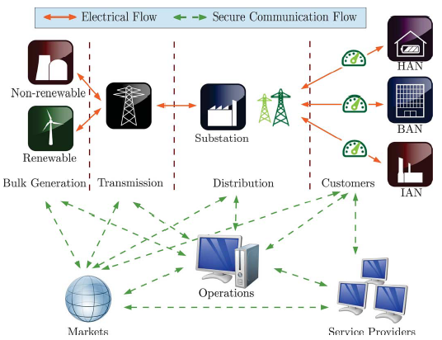
Smart grid power-system architecture

Slide 5
Aims of this scheme
Against external attackers (message authentication, communication system security, and data aggregation)
How to prevent internal attackers (e.g., electricity suppliers)
The first one against internal attackers
Besides, the first one providing a secure batch verification procedure for efficient verification
Blinding factors

Slide 6
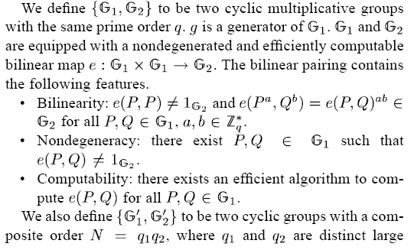

Preliminaries
Bilinear Pairing Setting

Slide 7
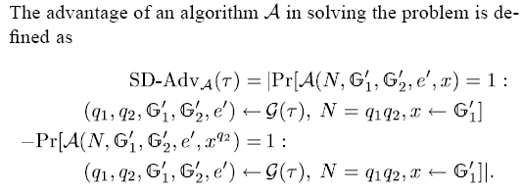
The Subgroup Decision Problem

Slide 8
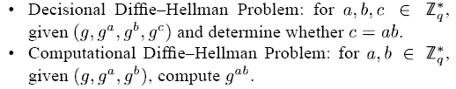
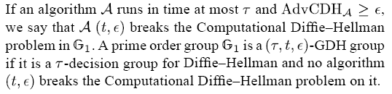
Gap Diffie–Hellman Problem

Slide 9
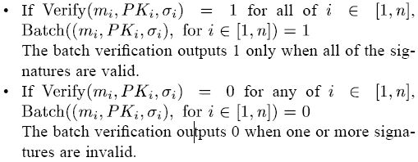
Security Definitions
Semantic Security
Unforgeability
Batch Verification Security

Slide 10
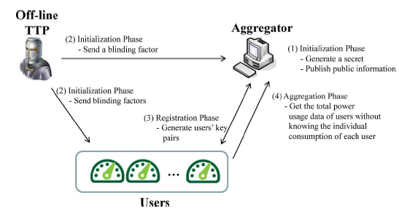
Scheme
System model

Slide 11
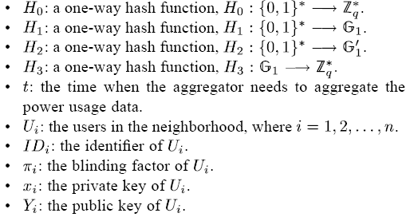
Construction

Slide 12

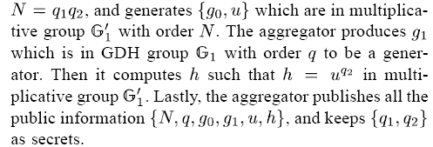
Initialization Phase

Slide 13
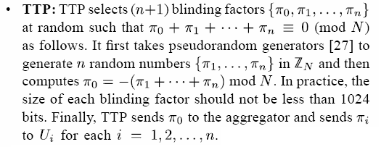
Initialization Phase

Slide 14
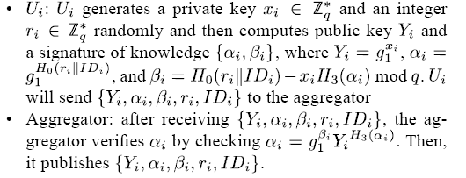
Registration Phase

Slide 15
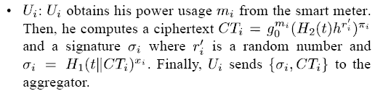
Aggregation Phase

Slide 16
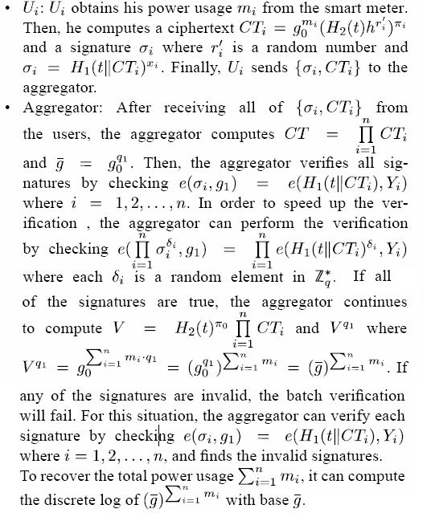

Slide 17
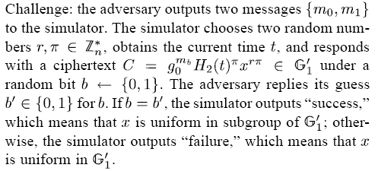
Security proofs
Against External Attackers

Slide 18

Security proofs
Against Internal Attackers

Slide 19
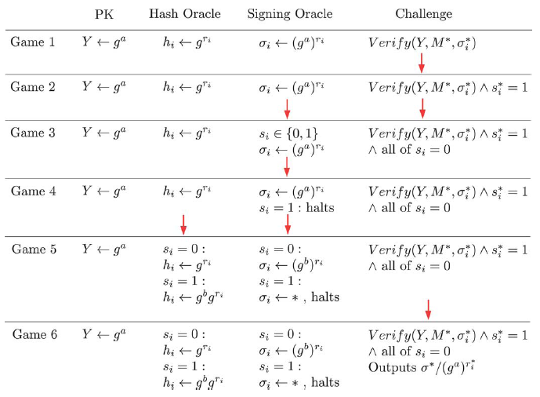
Proof of unforgeability
Sequences of games

Slide 20
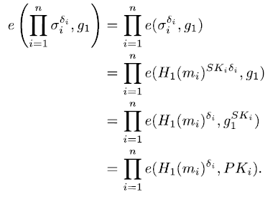
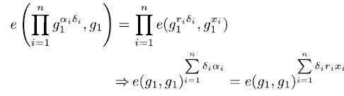
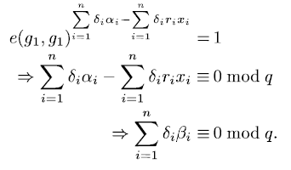
Proof of batch verification security

Slide 21
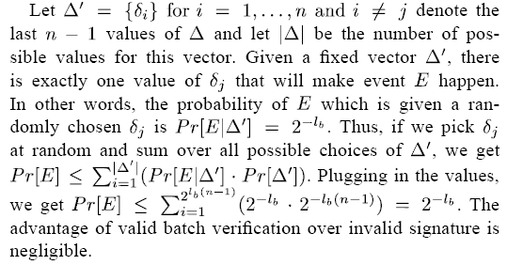

Slide 22
Conclusion & Discussion
User authentication phase of this scheme, possible attacks?
Should the validity of the partial signature be checked? (efficiency, traceable)
Security of batch verification?
How to satisfy the security property of message integrity using digital signature or other crypt methods?

