Slide 1
02/04/2006 12:05 PM (Computer Science Implementation Paper)

Slide 2
Abstract
* The science community needs to reform science education to make it effective and relevant for a larger portion of the student population.
* This need is driven by significant changes in society and the economy, including the increasing importance of technical literacy for addressing global issues and enhancing career prospects.
* The goal of science education should now be to educate all students, not just future scientists.
* Improving science education for all students is likely to result in more and better-educated scientists.

Slide 3
Introduction (Continued 1)
* The number of physical science majors in college is more influenced by students' ability to tolerate traditional instruction than their ability to do science.
* The physics community should take the lead in providing effective and relevant science education for all students, as a better-educated citizenry would appreciate the value of supporting physics research.
* Effective physics instruction changes the way students think about physics and causes them to think like experts, i.e., practicing physicists.
* Experts see physics as a coherent structure of general concepts, while "novices" see it as isolated pieces of information.

Slide 4
Introduction (Continued 2)
* Traditional science instruction, used in the majority of college physics courses, is characterized by teacher lecturing, back-of-the-chapter-style homework problems, and exams with similar problems.
* Research shows that traditional instruction is not very effective at getting the average student to think like an expert.

Slide 5
Methodology (Continued 1)
* Physics education researchers have studied the effectiveness of teaching practices for the past few decades.
* Three key aspects of learning in physics are conceptual understanding, transfer of information, and basic beliefs about physics.
* Conceptual understanding has been extensively studied and is important because a few fundamental concepts can explain a wide range of phenomena in physics.
* Most studies have focused on students' learning of basic physics concepts in traditional introductory physics courses.

Slide 6
Methodology (Continued 2)
* Research shows that students receiving traditional instruction master, on average, less than 30% of the concepts they did not already know at the start of the class.
* This result is consistent across lecturer quality, class size, and institution.
* Physics education researchers have developed carefully constructed tests, such as the Force Concepts Inventory (FCI), to explore student understanding of basic concepts like force and motion.
* Eric Mazur, a renowned physics teacher at Harvard University, has studied students' understanding of concepts in electricity, motivated by FCI results.

Slide 7
Experiments & Results (Continued 1)
* Azur's exams with paired problems reveal that students can answer traditional test questions without understanding basic physics concepts or learning problem-solving approaches.
* A study in a non-science majors' introductory physics class showed that only 10% of students could correctly answer a multiple-choice question about the physics of sound 15 minutes after the lecture, even when explained engagingly and lucidly.
* This 10% retention rate is typical for non-obvious or counterintuitive facts presented in lectures, even when the audience is primarily physics faculty and graduate students.
* Physics teachers often overestimate the number of students who answer correctly, and some refuse to believe the data.

Slide 8
Experiments & Results (Continued 2)
* A similar study by Redish had students interviewed right after a lecture, and they were unable to recall the lecture's content.

Slide 9
Conclusion & Future Work (Continued 1)
* Hrepic et al.
conducted a study where 18 students were given six elementary questions on the physics of sound, followed by a 14-minute lecture on the same topic by a renowned physics lecturer.
* Results showed that most students were unable to learn the correct answers from the lecture.
* This finding contradicts the assumption that all lectures are effective for learning.

Slide 10
Conclusion & Future Work (Continued 2)
* Lectures can be effective if designed according to cognitive principles about how people learn.
* Research has been conducted on students' general beliefs about physics and problem solving in physics.
* Surveys measuring students' thinking show that, on average, students become less expert-like in their thinking after taking an introductory physics course.
* Students view physics as less connected to the real world, less interesting, and more as something to be memorized without understanding.

Slide 11
Conclusion & Future Work (Continued 3)
* Similar results have been found in introductory chemistry courses.

Slide 12


Slide 13
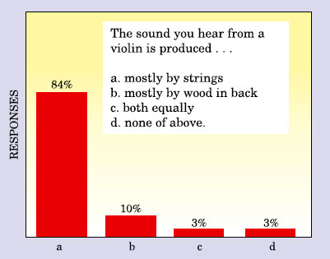

Slide 14
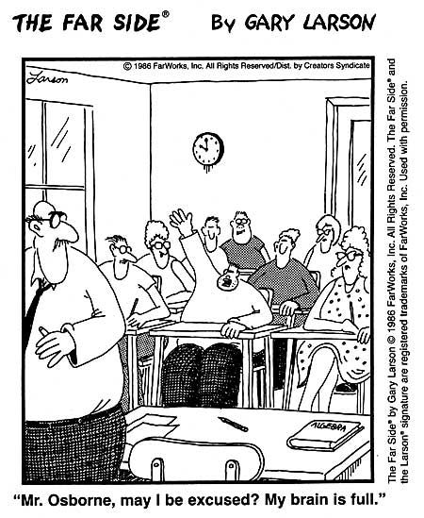

Slide 15
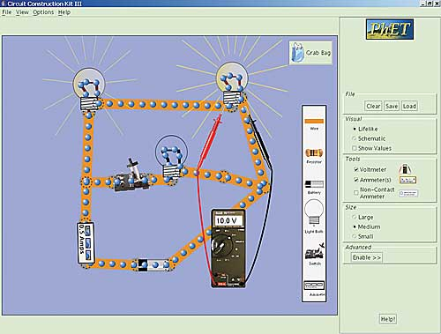

Slide 16
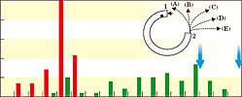

Slide 17


Slide 18
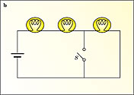

Slide 19
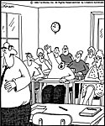

Slide 20
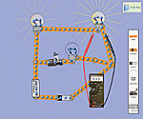

Slide 21
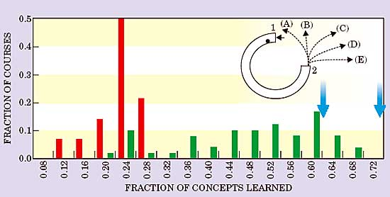

Slide 22
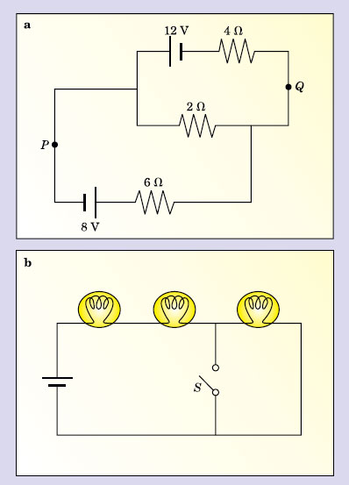

Slide 23
THANK YOU

