Slide 1
What’s Lagging in Our
Understanding of
Interruptions?
Jenny Sloane
Chris Donkin, Ben Newell, Garston Liang

Slide 2
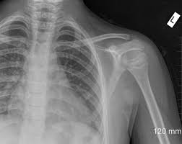
Emergency Room (Simulation)
Scenario 1: Alcoholic Patient
Primary task: keep patient alive
Interruptions: patient suddenly begins vomiting blood
Scenario 2: Car Accident
Primary task: keep patient alive
Interruptions: nurse enters with X-ray

Slide 3
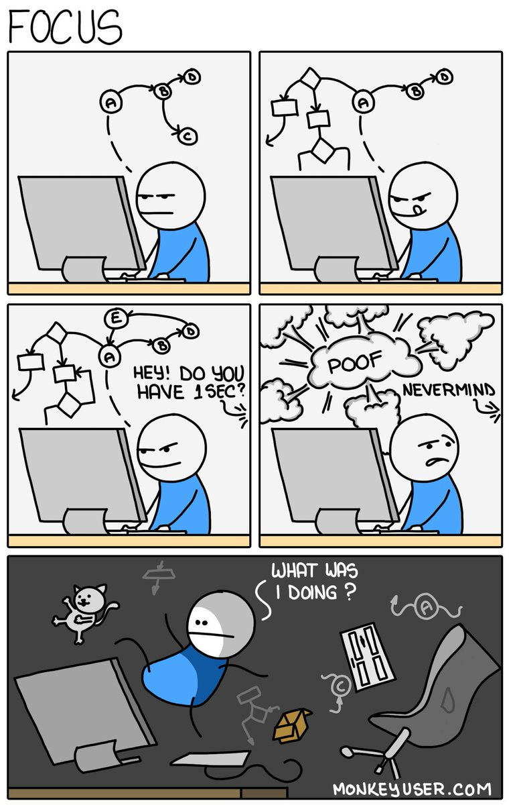
Scenario 1: Alcoholic Patient
Primary task: keep patient alive
Interruptions: patient suddenly begins vomiting blood
Scenario 1: Alcoholic Patient
Primary task: keep patient alive
Interruptions: nurse enters with X-ray
Notes:
Now, even if you may not be able to relate to these specific scenarios, we know from every day life that even the slightest interruption can completely throw us off task
so keep these 2 scenarios in mind and we’ll return to them later

Slide 4
Theoretical Framework
DV!
Interruption Lag
Resumption Lag
Primary
Task
Alert/
Cue
Interruption/
Secondary Task
Primary
Task
Time
(Modified from Trafton et al. 2003)
Hypothesis: Interruption lag gives you time to prepare to resume primary task after an interruption

Slide 5
Theoretical Framework
DV!
Interruption Lag
Resumption Lag
Primary
Task
Alert/
Cue
Interruption/
Secondary Task
Primary
Task
Time
(Modified from Trafton et al. 2003)
Hypothesis: Interruption lag gives you time to prepare to resume primary task after an interruption

Slide 6
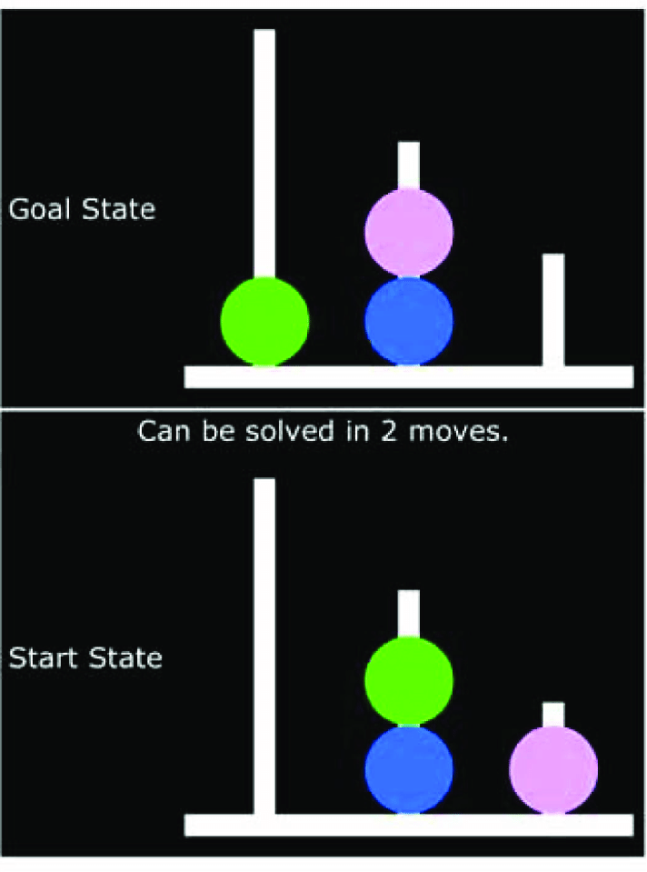
Previous Research
Shows that interruption lags are beneficial in some problem solving tasks
Tower of London (Hodgetts & Jones, 2006)
Complex resource-allocation task (Trafton et al., 2003)
But, these tasks don’t help us understand why the interruption lags are helping
Notes:
What is it about the lags that are beneficial

Slide 7



Goals for This Talk
Introduce a novel sequential decision making task demonstrating the positive effects of interruptions lags
Explain how this task may be able to facilitate why interruption lags are beneficial by looking at some of the underlying processes

Slide 8
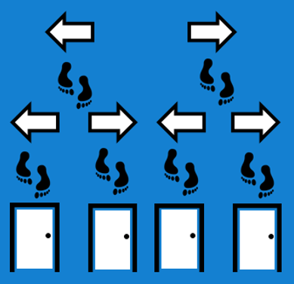
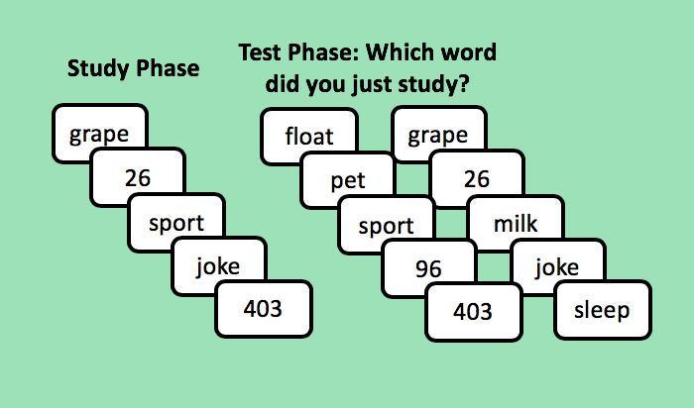
Methods
Interruption Lag
Resumption Lag
Primary
Task
Alert/
Cue
Interruption/
Secondary Task
Primary
Task
Time
Primary task: Navigate through a maze to open all of the doors
Fairly simple decision making task
The design allows us to manipulate when, where, and how often interruptions occur
Interruption: 2 alternative forced choice (2AFC) memory test
Notes:
Will go in to more details in a minute but first let’s go through one trial

Slide 9
Example of One Trial…

Slide 13



Slide 17
“Good job! You have
opened a new door!

Slide 18
“Good job! You have
opened a new door!

Slide 19
“Good job! You have
opened a new door!

Slide 20
“Sorry! You have already
opened this door!”

Slide 21
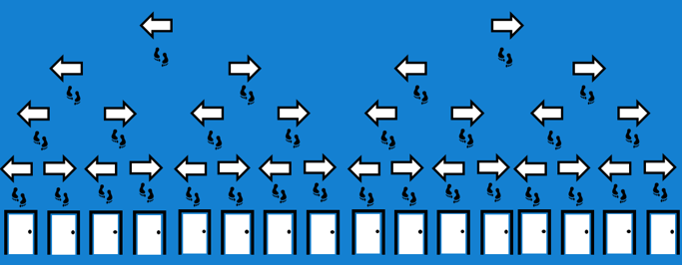
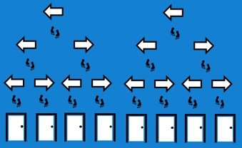

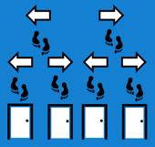
Experimental Design: Difficulty Manipulation
Hard:
16 doors
Medium:
8 doors
Easy:
4 doors
1 interruption
2 interruptions
4 interruptions
Notes:
Interruptions ¼ of the trials

Slide 22
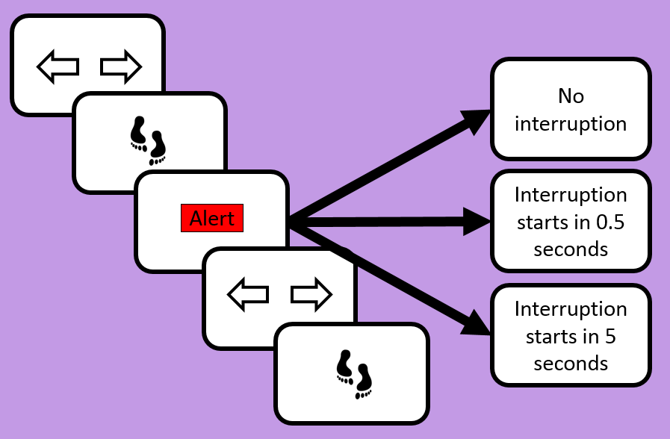


Experimental Design: Interruption Manipulation
Interruption Lag
Interruption Lag
Notes:
Maybe 2 slides here

Slide 23
Experiment 1
Primary Task:
The Mazing Race
Interruption:
Memory Test (10 items)
Level 1
Study Phase
Test Phase: Which word did you just study?
grape
17
3
Level 2
22
fun
cook
sport
grape
75
3
float
sport
fun
22
sleep
Could open doors in any order
Maximum number of trials: 6 (easy), 12 (medium), 24 (hard)
Both memory tasks, so similar cognitive processes
3 (difficulty: easy, medium, hard) x 3 (interruption: no interruption, interruption, interruption + lag) fully within subject design
Notes:
Max trials 150% of number of doors

Slide 24
Experiment 1: Takeaways
The freedom to choose any door on any given trial resulted in too much flexibility making it difficult to analyze aggregate data
Although there were individual differences, there were certain common strategies (e.g. always start from one side)
Experiment 2…

Slide 25

Experiment 2: Forced Order
Always have to start by opening left-most door and systematically work their way to the right-most door
Feedback:
Correct door
Already opened
New door, but incorrect
Only 1 correct door on every trial
Can better measure the effects of interruptions
*Interruption lag = self paced
Participants could decide when the memory test would begin (rather than 5 seconds)
1
2
3
4
5
6
7
8

Slide 26
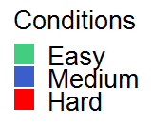
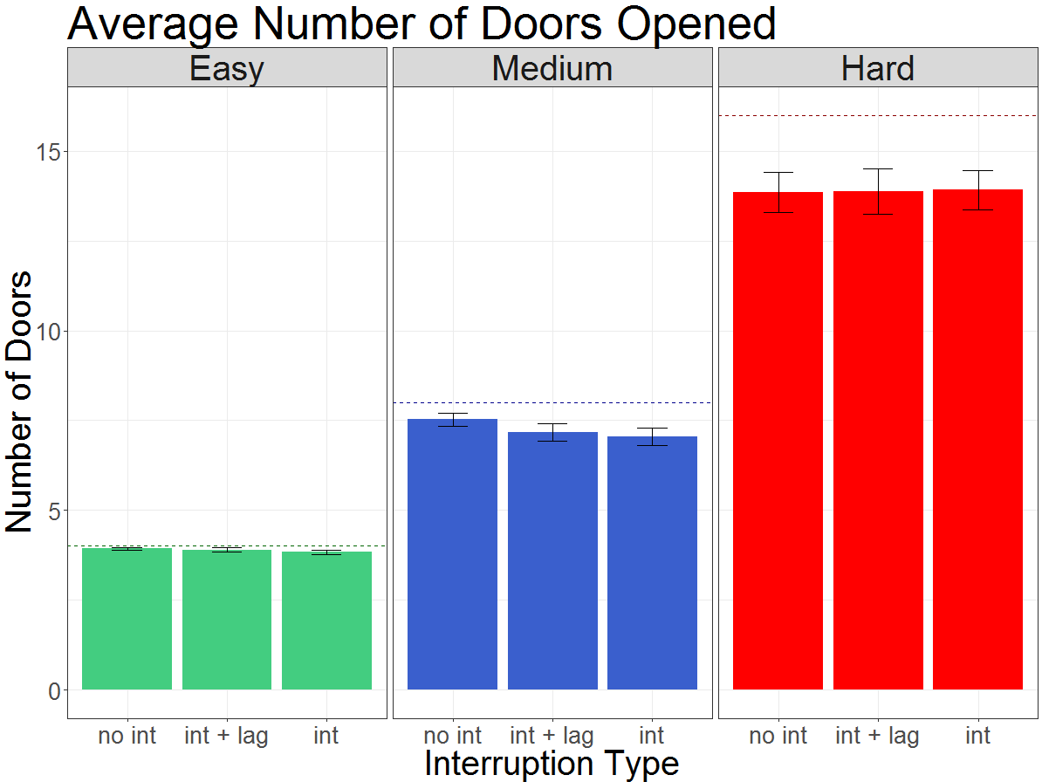
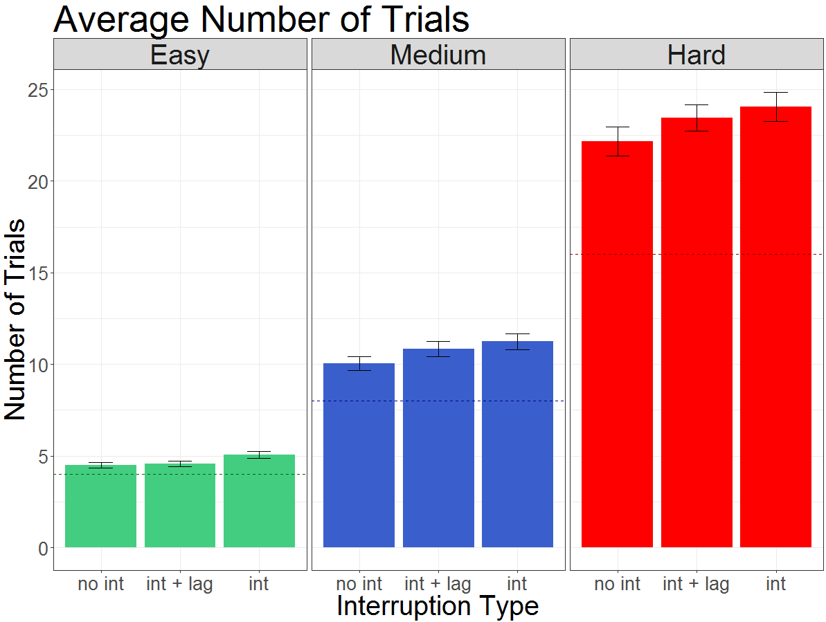
Experiment 2: Results (n=59)
No large effects of interruption type
49 participants successfully opened every door in all the easy blocks, suggesting ceiling performance
Real world implication – if task is too easy, interruption may not be disruptive
Type of interruption did effect performance on the number of trials
Pattern begins to emerge: performance with no interruption > interruption + lag > interruption
Notes:
Focus on overall trend in the data
Average number of doors
Possible ceiling effects in easy (39 participants opened all the doors in medium and hard while a handful < 50%) so big individual differences
Inconclusive for medium (p = .03 but BF 1.4)
Average number of trials
Best performance in no interruption condition
Got worse in interruption + lag
Worst in interruption
Significant results from ANOVA tests for all: type of interruption did effect the number of trials

Slide 27
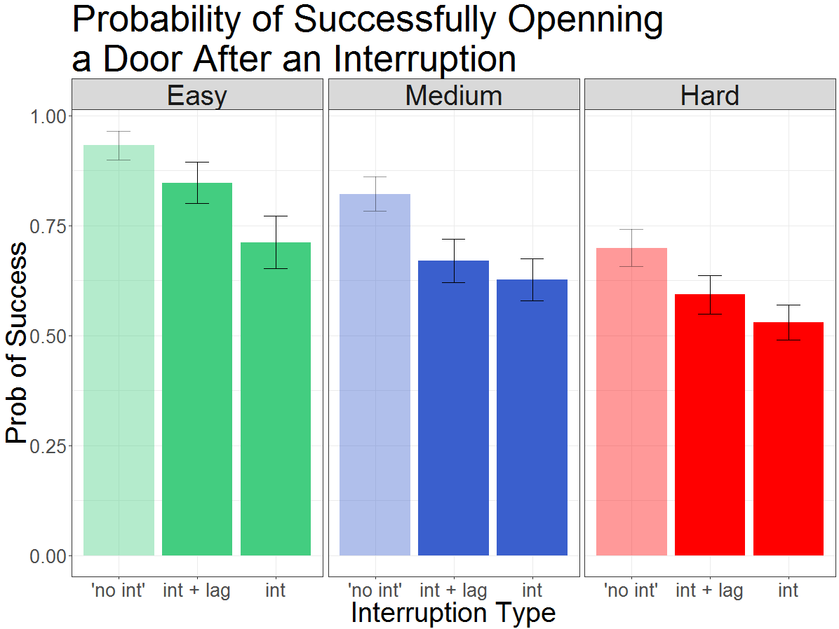
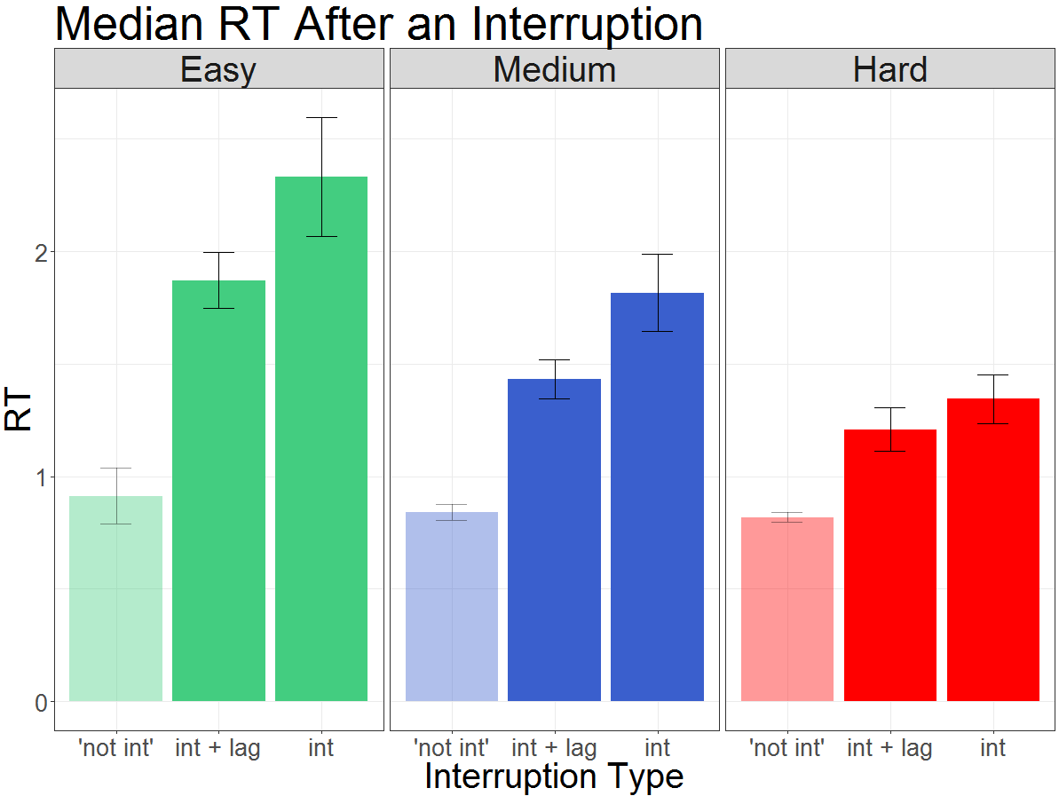
Experiment 2: Results (n=59)
Resumption Lag
Pattern continues
RTs take longer in the interruption + lag and even longer in the interruption
Practice effects
Chances of successfully opening a door after an interruption decreases across conditions

Slide 28
Conclusions
We saw the same pattern across multiple analyses, such that performance:
No interruption > interruption + lag > interruption
These results suggest there is evidence that interruption lags can reduce some interruption costs

Slide 29
Goals for This Talk
Introduce a novel sequential decision making task demonstrating the positive effects of interruptions lags
Explain how this task may be able to facilitate why interruption lags are beneficial by looking at some of the underlying processes

Slide 30
Understanding why Interruption Lags are Beneficial?
There are different ways to be effected by an interruption
1. Slightly disruptive – quick recovery
2. Very disruptive – long recovery
1
2
3
4
5
6
7
8
1
2
3
4
5
6
7
8
Interruption lag gave you some time to prepare
Remember you have opened 2 doors, but lost your place in the trial
May go right by mistake, but once you get the negative feedback you will recover by the next trial
This is the 6th block and no lag, so the interruption has completely thrown you off
You can’t even remember how many doors you have opened
This kind of error will likely take longer (more trials) to recover

Slide 31
Understanding why Interruption Lags are Beneficial?
There are different ways to be effected by an interruption
1. Slightly disruptive – quick recovery
2. Very disruptive – long recovery
Goal now: build a model that can infer different states from response patterns
Chance of Opening Right Door
Actually
Remember
Think You
Remember
Slightly Lost
or Quick Recovery
Actually
Lost
Completely Lost
Long Recovery
Trial
Slightly Lost
or Quick Recovery
Lost
Completely Lost
Long Recovery
Notes:
MPT – multinomial process tree models

Slide 32
Future Directions
Can use the model to help us better understand response patterns from both experiments
Do interruption lags prevent you from getting completely lost?
Will we see same patterns if the interruption task is different?
What would happen if the primary task is harder? (e.g. randomize order of what door to open)

Slide 33
References
Hodgetts, H. M., & Jones, D. M. (2006). Interruption of the Tower of London task: support for a goal-activation approach. Journal of Experimental Psychology: General, 135(1), 103.
Trafton, J. G., Altmann, E. M., Brock, D. P., & Mintz, F. E. (2003). Preparing to resume an interrupted task: Effects of prospective goal encoding and retrospective rehearsal. International Journal of Human-Computer Studies, 58(5), 583-603.

Slide 34
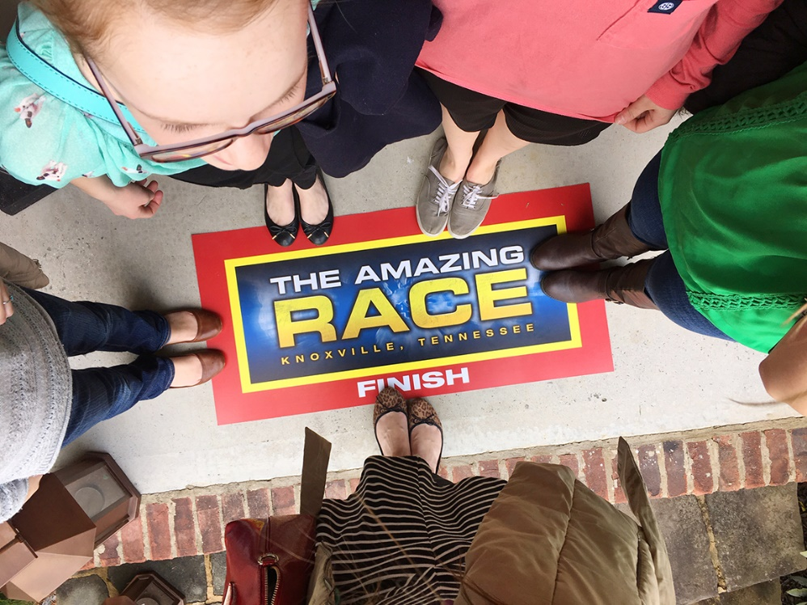
Thank you!
Questions?

Slide 35
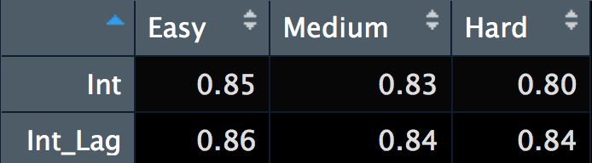
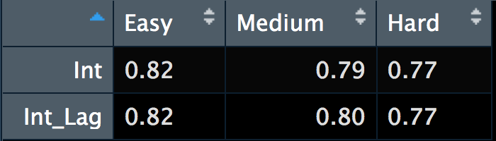
Interruption Data
Experiment 1
(min = .69)
Experiment 2
(min = .57)

Slide 37
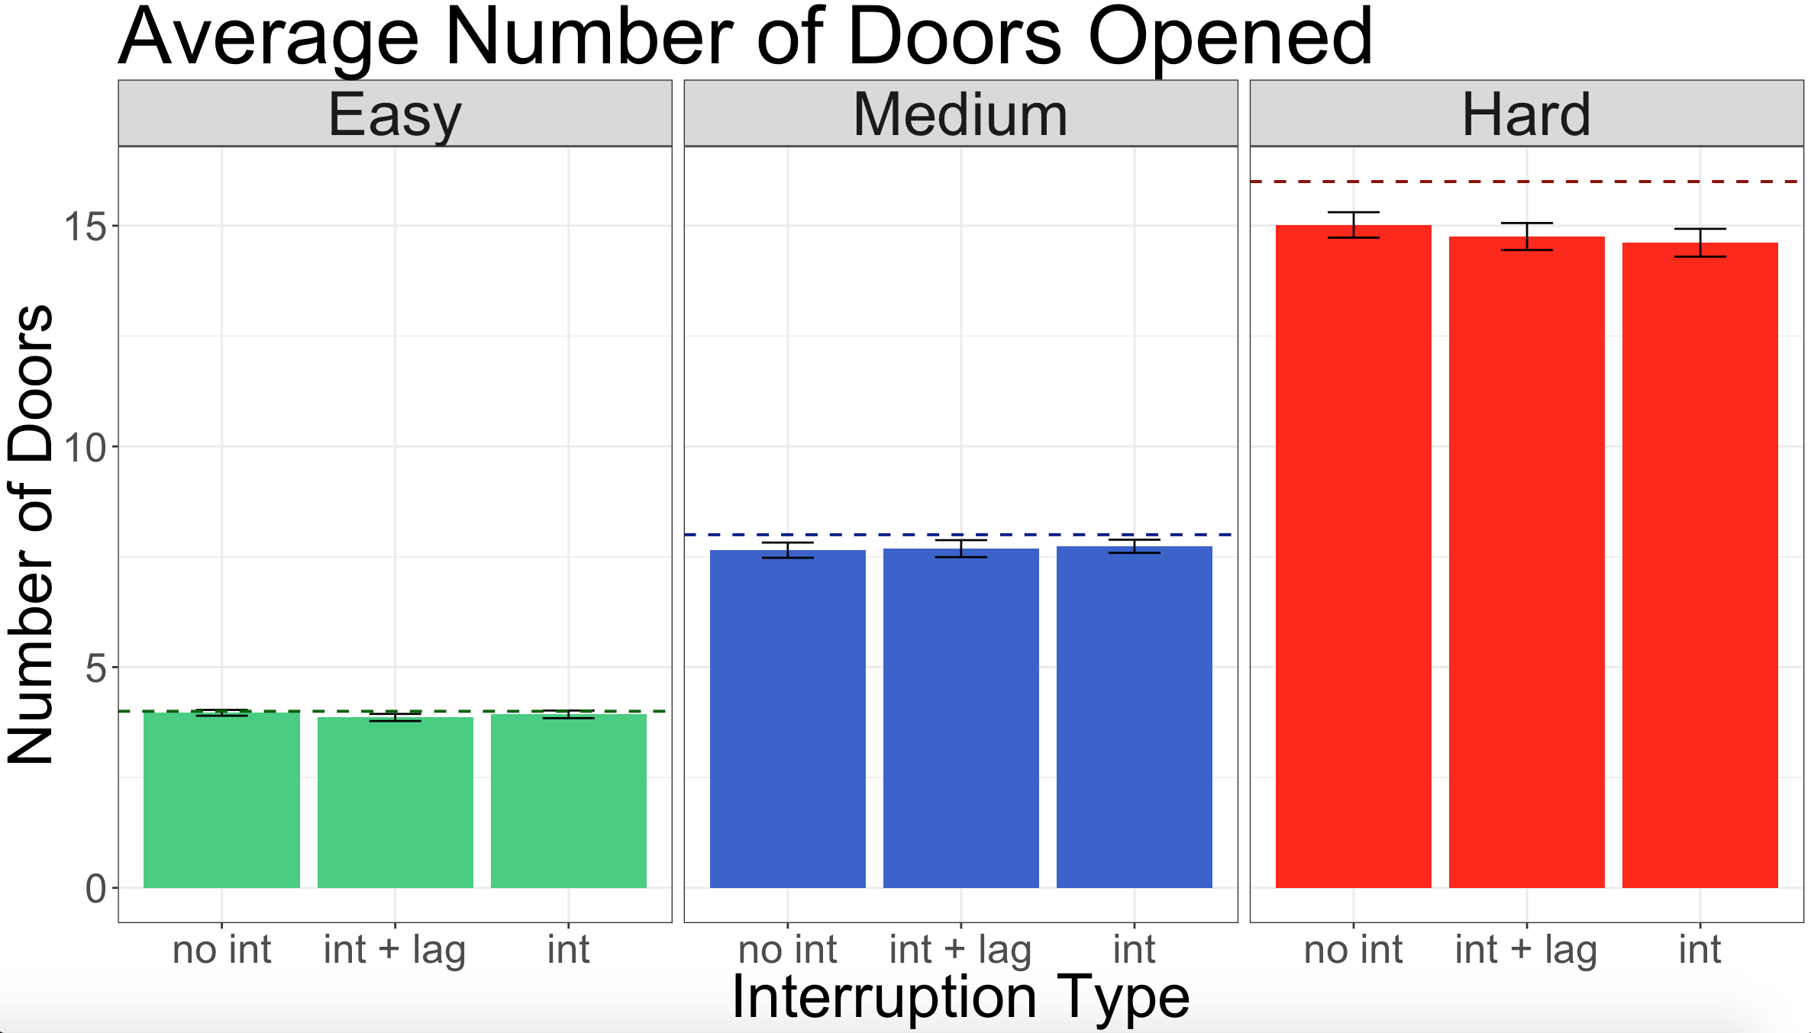
Experiment 1: Results (n=57)
Notes:
Median RT give example: you are looking at the two arrows and get interrupted, you return to those arrows and the RT here is the time it takes you to push either the left or right button
Not sure if “messy data” is what I want to say
Explain ‘no int’ serves as a baseline for comparison

Slide 38
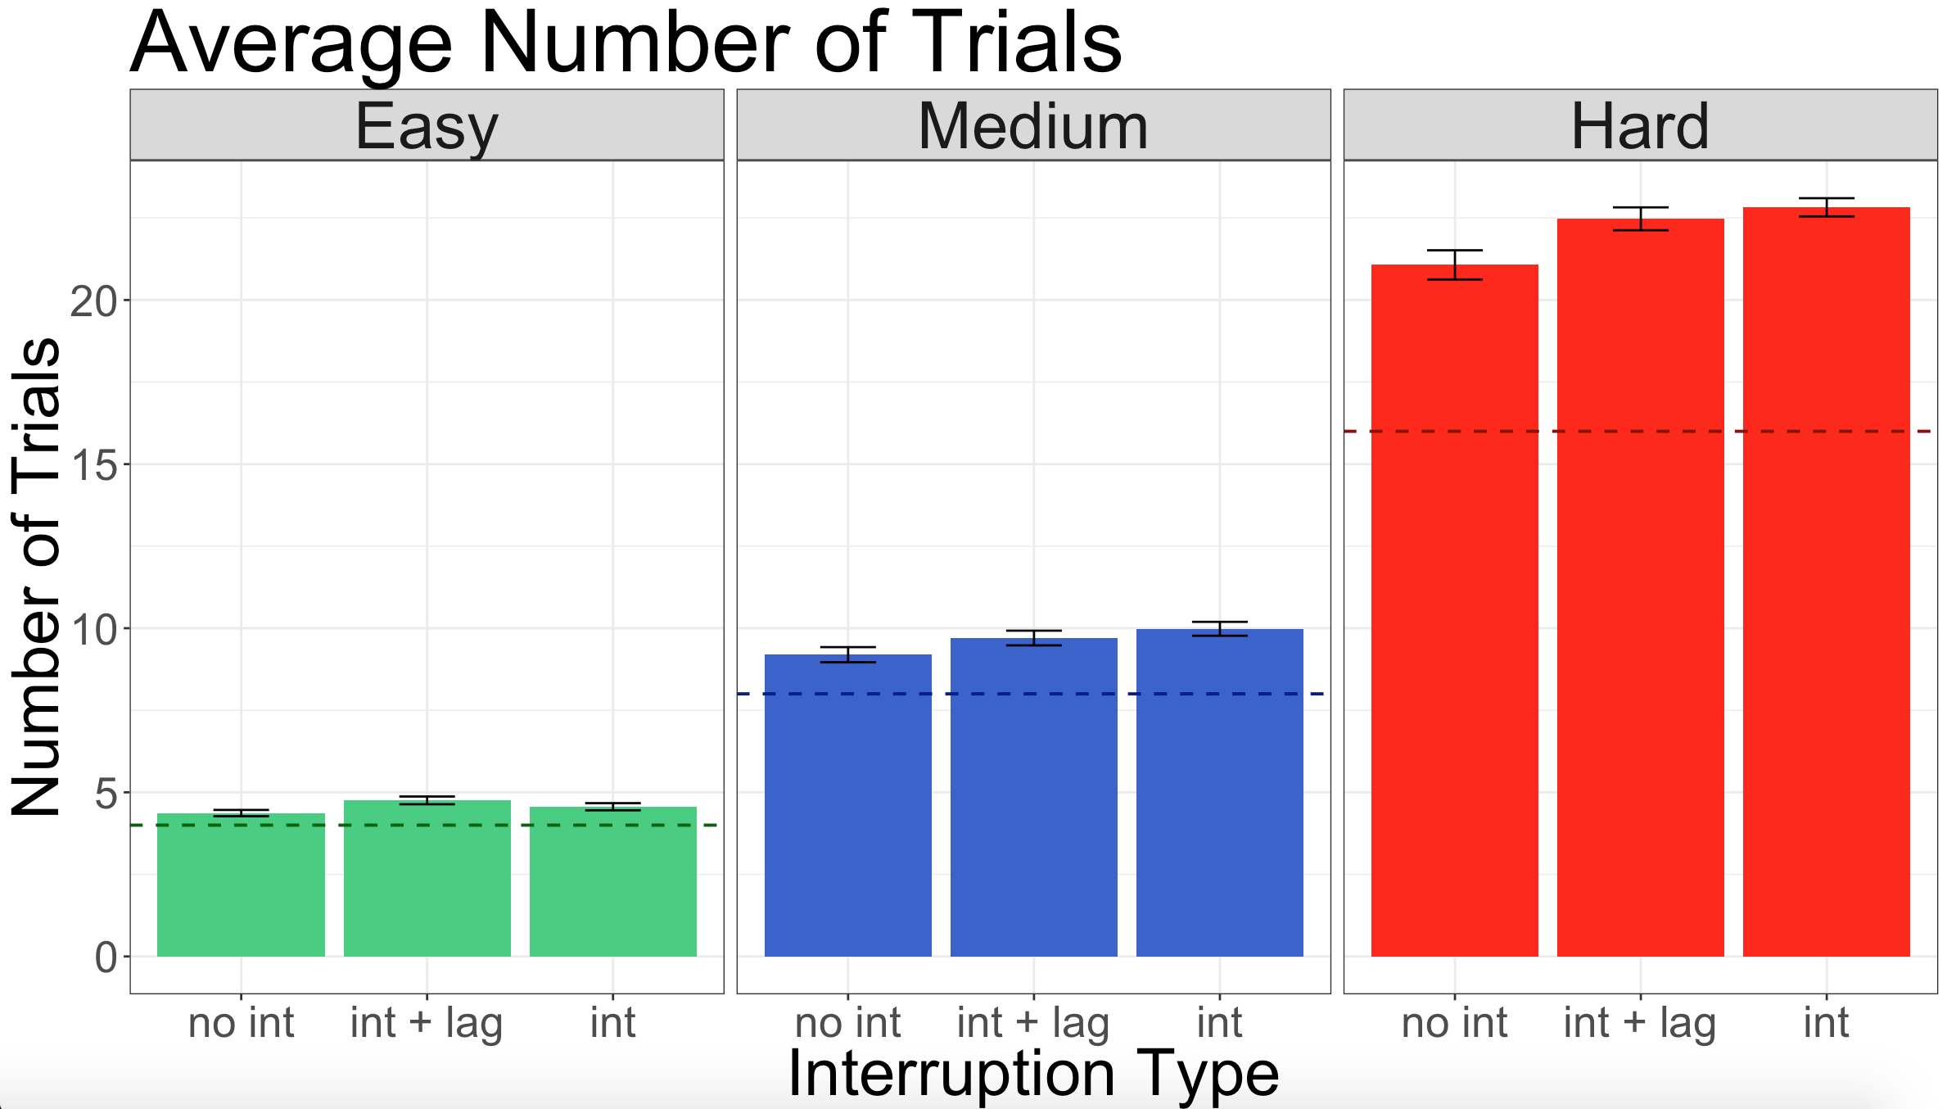
Experiment 1: Results (n=57)
Notes:
Median RT give example: you are looking at the two arrows and get interrupted, you return to those arrows and the RT here is the time it takes you to push either the left or right button
Not sure if “messy data” is what I want to say
Explain ‘no int’ serves as a baseline for comparison

Slide 39
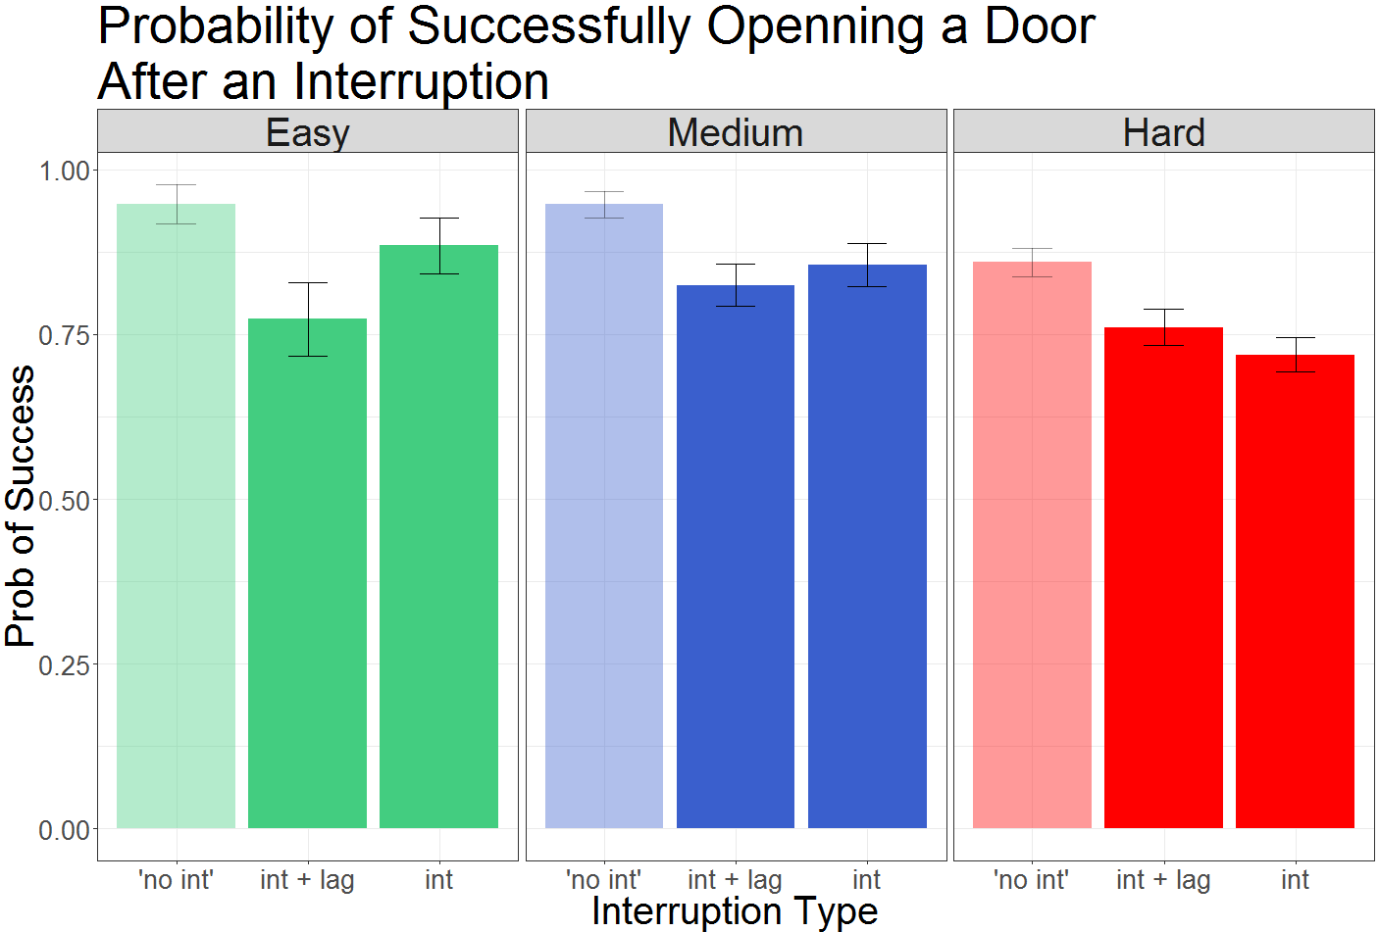
Experiment 1: Results (n=57)
Hard condition: consistent with what we would predict
Easy and medium: less clear what is going on
Possibly explained by RTs
Notes:
Median RT give example: you are looking at the two arrows and get interrupted, you return to those arrows and the RT here is the time it takes you to push either the left or right button
Not sure if “messy data” is what I want to say
Explain ‘no int’ serves as a baseline for comparison

Slide 40
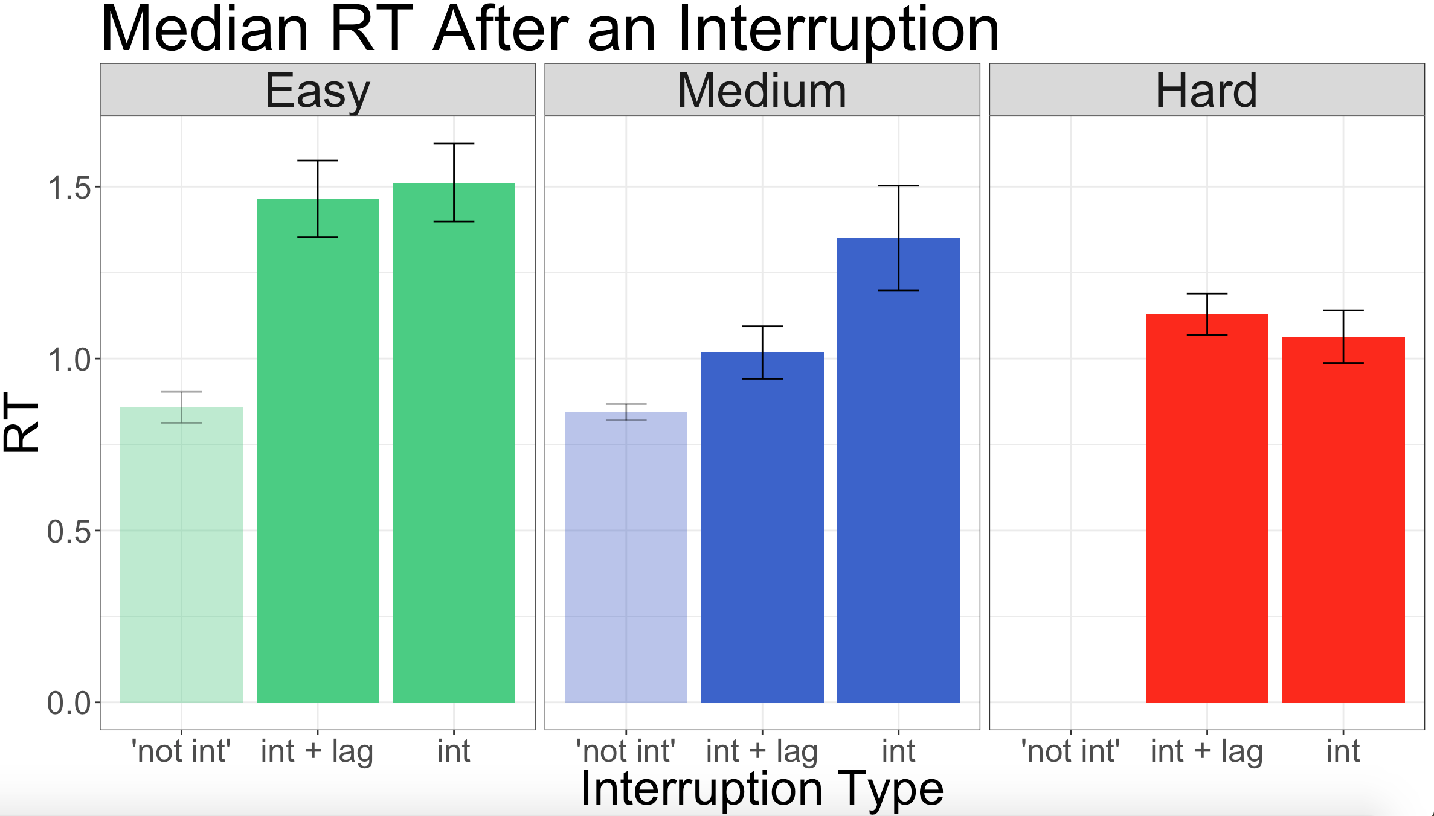
Experiment 1: Results (n=57)
Notes:
Median RT give example: you are looking at the two arrows and get interrupted, you return to those arrows and the RT here is the time it takes you to push either the left or right button
Not sure if “messy data” is what I want to say
Explain ‘no int’ serves as a baseline for comparison

Slide 41
dumb_model <- function(ndoors, max_trial, prob_remember) {
maze_complete = 0 # complete maze when open all doors successfully or reached max trial
trial = 0 # keep track of the trial, start at 0 so first iteration will be trial 1
remember = 1 # if you remember (1) you open the correct door 100% of the time, if you don't remember (0) random chance of opening any door
prob_remember = prob_remember # the probability you actually remember where you are in the maze
correct_door = 1 # correct door in the forced experiment starts off as 1 (left most door)
p_cond = rep(0,ndoors) # in the easy condition there are 4 possible outcomes/doors
p = rep(.25,ndoors) # because 4 doors, there is a 25% chance of randomly selecting each, but still works for medium and hard because R is smart and adjusts probabilities accordingly
response = vector(length = max_trial) # easy there are a max number of 8 trials so need to record 8 responses
for (i in 1:max_trial){
if (maze_complete == 0) { # starts off assuming the maze is incomplete
trial = trial + 1 # add a trial to each iteration
if (remember == 1) { # if you think remember where you are,
R = rbinom(1,1,prob_remember) # R = the probability that you actually remember depending on the variable prob_remember
} else R = 0 # if you don't remember, R = 0
if (R != 0) { # if R is 1 (not 0),
p_cond[correct_door] = 1 # put a 1 in the slot for the correct door
response[trial] = correct_door # response for the trial is the correct door because they successfully remembered
} else {
response[trial] = which(rmultinom(1,1,p) == 1) # if R = 0, response is drawn from the multinomial distribution and each of the options gets a .25 probability of being selected. whichever one is chosen the row/(door #) is recorded as the response
}
if (response[trial] == correct_door) {remember == 1 & (correct_door = correct_door + 1)} else {remember == 0} # if you do select the correct door, update remember to be true/1 because you will get the positive feedback to know you opened the correct door, but if the slot for the correct door is not 1, then the variable remember must = 0 because you are lost
if (correct_door == (ndoors+1)) {maze_complete = 1} else {maze_complete = 0} # maze will be complete if correct_door reaches number of doors + 1 (5 easy, 8 medium, 17 hard)
if (maze_complete == 1) break # if maze is complete, end the loop and the rest of the trials will be 0
}
}
return(response)
}

