Slide 1
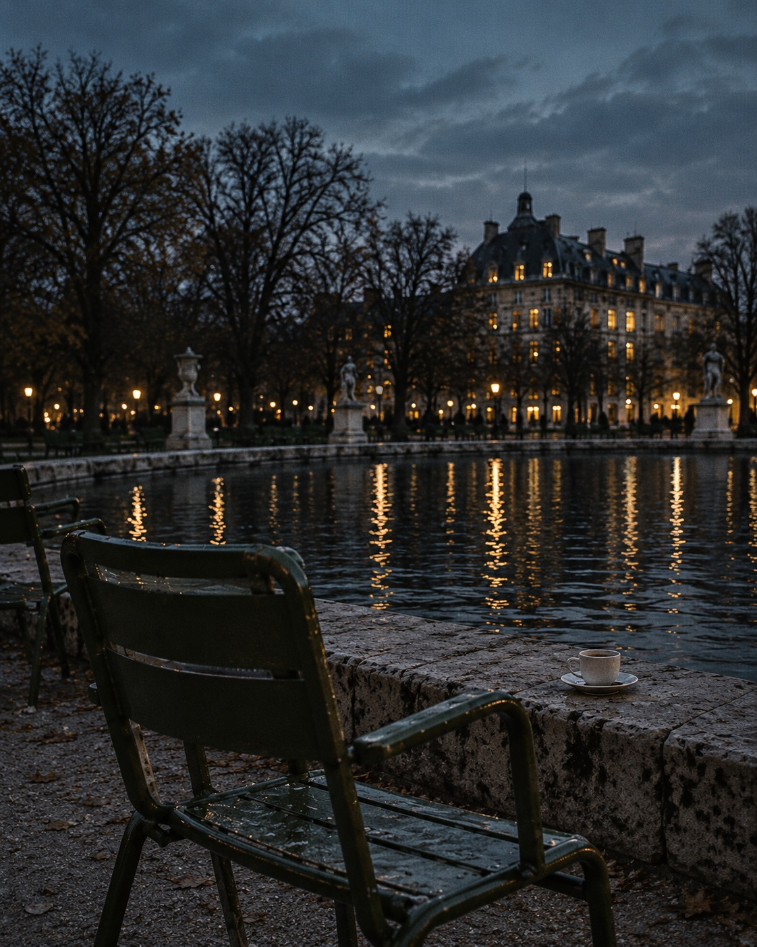
OFF HOURS
THE PARK EDIT / CONCEPT ISSUE 01
The city can wait.
A coffee. A green chair. Nowhere to rush.
AFTER THE LAST EMAIL
The park is quieter now. The messages
can wait, the to-do list can wait. A small
coffee, a cool evening and a moment to
be here: that is enough for today.
TAKE THE SLOW WAY
Same city, different pace. A green chair,
a warm cup, the sound of water instead
of notifications. Not a plan, just a pause
and a little room between one thing and
the next.
Not every minute needs
a destination.
SAMPLE PROJECT / FICTIONAL PUBLICATION
01
AI-generated image; AI-assisted copy and layout. Creative direction: Helin.

Slide 2
OFF HOURS / THE PARK EDIT
NOTES FROM THE CITY
Between one thing
and the next.
A short note on leaving a little space in the day.
01 / THE SLOWER ROUTE
You do not need a free afternoon to take a different
THREE SMALL DETOURS
route. Sometimes it is the street beside your usual
01 Order it to stay.
one, the path along the water, or the seat you
Let the coffee be a moment, rather than
normally walk past.
something carried to the next task.
Put the headphones away for a moment. Notice the
02 Take the empty seat.
windows coming on, the last movement in the trees,
No destination required. Just a different view
the city carrying on without needing anything from
of a familiar place.
you.
There is no itinerary here. Walk until somewhere
03 Leave a page blank.
feels worth stopping. Then stop.
Not every page needs a list.
COFFEE, OUTSIDE
A warm cup. An open sky.
Nothing to finish for a minute.
SAMPLE PROJECT / FICTIONAL PUBLICATION
02
AI-generated image; AI-assisted copy and layout. Creative direction: Helin.

