Slide 1
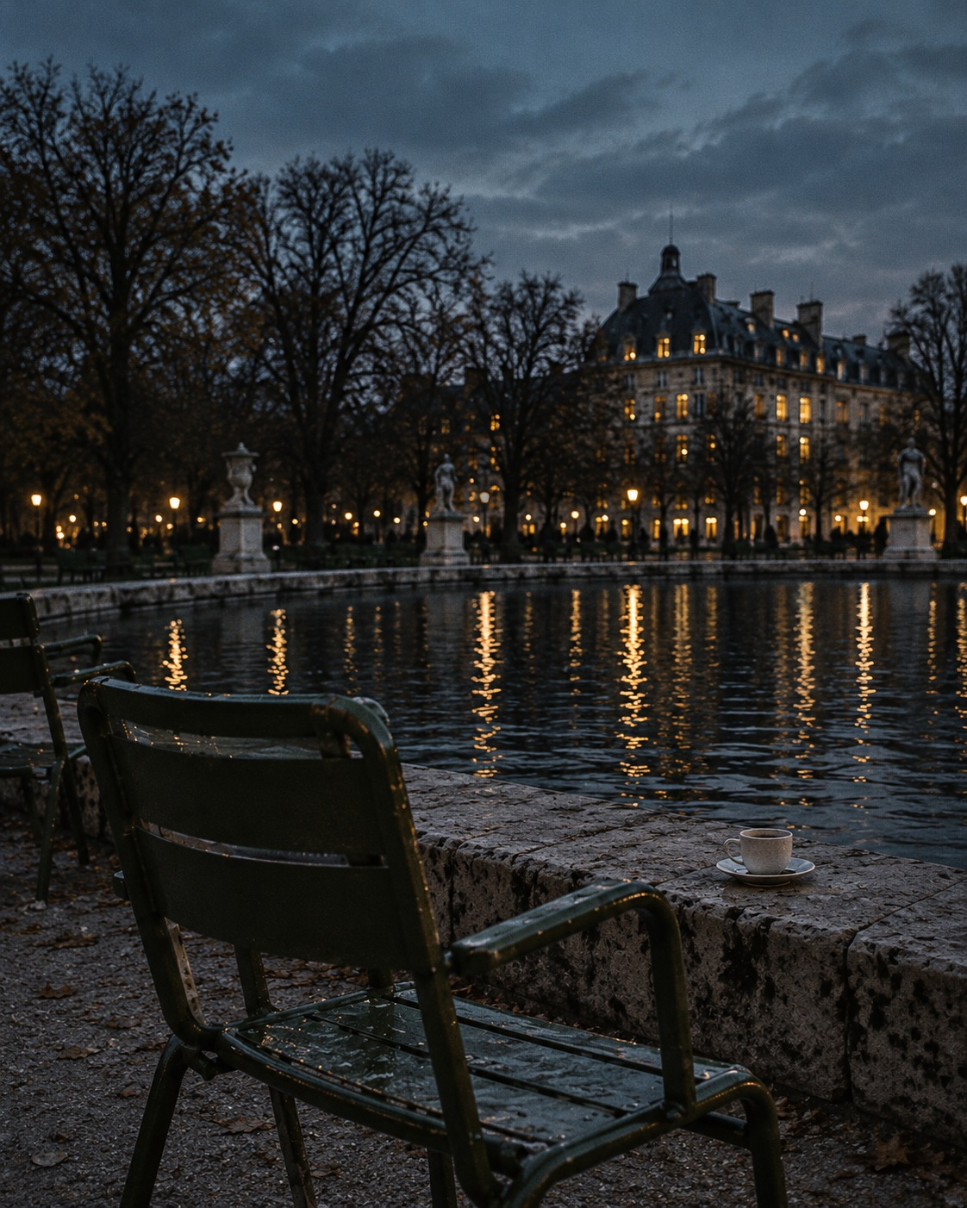
OFF HOURS
THE PARK EDIT / CONCEPT ISSUE 01
The city can wait.
AFTER THE LAST EMAIL
TAKE THE SLOW WAY
The park is quieter now. The messages can
Same city, different pace. A green chair, a warm
wait, the to-do list can wait. A small coffee, a
cup, the sound of water instead of notifications.
cool evening and a moment to be here: that is
Not a plan, just a pause and a little room
enough for today.
between one thing and the next.
Inside: a slower route, a coffee note and three small detours.
SAMPLE PROJECT / FICTIONAL PUBLICATION
01
AI-generated image; AI-assisted copy and layout. Creative direction: Helin.

Slide 2
OFF HOURS / THE PARK EDIT
NOTES FROM THE CITY
Between one thing
and the next.
A short note on leaving a little space in the day.
01 / THE SLOWER ROUTE
You do not need a free afternoon to take a
THREE SMALL DETOURS
different route. Sometimes it is the street beside
01 Order it to stay.
your usual one, the path along the water, or the
Let the coffee be a moment, rather than
seat you normally walk past.
something carried to the next task.
Put the headphones away for a moment. Notice
02 Take the empty seat.
the windows coming on, the last movement in
the trees, the city carrying on without needing
No destination required. Just a different view of
anything from you.
a familiar place.
There is no itinerary here. Walk until
03 Leave a page blank.
somewhere feels worth stopping. Then stop.
A notebook does not always need a list.
COFFEE, OUTSIDE
A warm cup. An open sky. Nothing to finish for a minute.
SAMPLE PROJECT / FICTIONAL PUBLICATION
02
AI-generated image; AI-assisted copy and layout. Creative direction: Helin.

