Slide 1
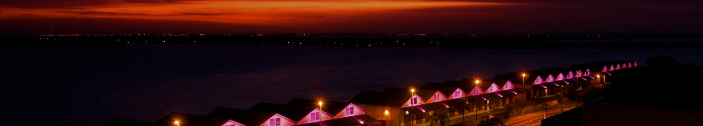
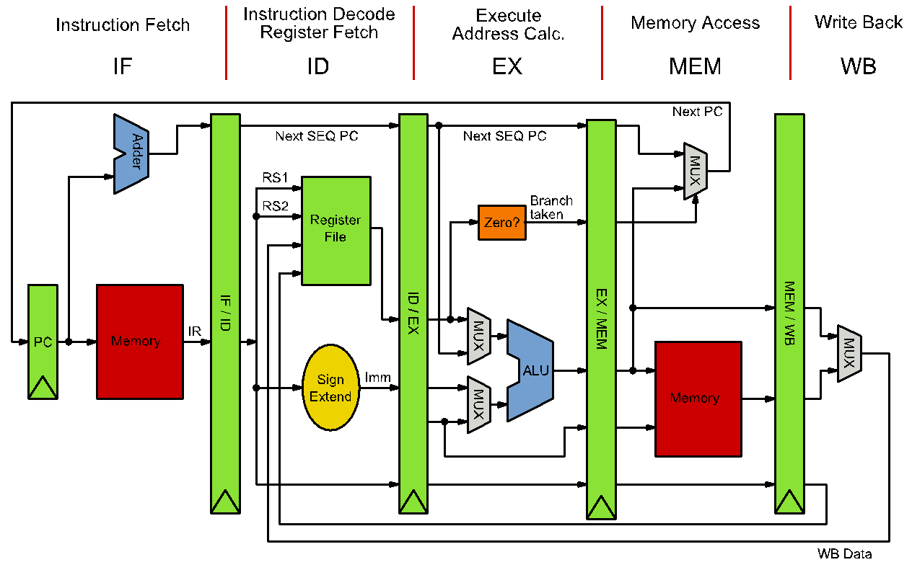
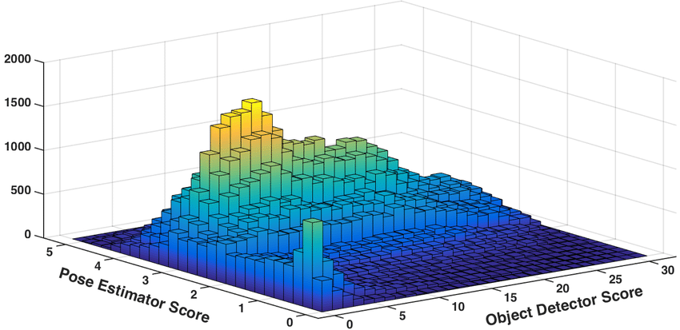




12th IEEE CASS Rio Grande do Sul Workshop 2022
An Example Poster to Present your Research in the IEEE CASSW-RS 2022
1st Author Name, 2nd Author Name, 3rd Author Name
Undergraduate or Graduate
Introduction
A4 page (21 x 29.7 cm) PDF
Stick to the template in the following areas: main title, author list, affiliation and contact sections
Inform that the first author is Undergraduate or Graduate student
Presenting author must be highlighted
The remaining can be freely modified to suit your needs
Go straight to the point, simple, clear, preferring images to text with credit to the sources
Your 5-min video will provide further explanations
Suggested Structure
Introduction
Proposal
Methods
Results
Conclusions
References
Element | A4 Font size | A1 result
Conf. Name | 21 | 84
Paper Title | 18 | 72
Author list | 15 | 60
Tex Body | 14 | 56
Affiliation | 10 | 40
References | 11 | 44
Sources | 8 | 32
Source: Google
Source: Wikipedia
References
[1] Wei-Pei Huang, et al., An Efficient Parallel Processor for Dense Tensor Computation, IEEE TVLSI, 2021
[2] Sigang Ryu et al., A Time-Based Pipelined ADC Using Integrate-and-Fire Multiplying-DAC, TCAS-I, 2020
[3] Kangjun Bai, et al. Spatial-Temporal Hybrid Neural Network With Computing-in-Memory Architecture, TCAS-I, 2021
Affiliation:
<University>
<Graduate Program>
<City>/<State>, <Country> Contact: <e-mail> | <webpage>
Sponsors:
<Example>
<Examples>
12th IEEE CASS Rio Grande do Sul Workshop – November 3 - 4, 2022 – Porto Alegre, Brazil

