Slide 1

By: Pierce Fleming
CS Student Shares Forbidden Diamond Algorithm and What Happened Next Will Shock You (it’s not what you think)

Slide 2
Introduction
Diamond dataset
Motivation
Wanted to make something that could be monetized
Classifying on price
New Topic
Tensorflow

Slide 3
Dataset
The Dataset
Dataset contains data from 53,941 diamonds
Index counter, carat, cut, color, clarity, depth (relative to width), table, price, x_length, y_width, z_depth
I decided to classify on price

Slide 4
Data Cleaning
Data Cleaning
Cut dataset down to 2k records to reduce runtime
Discretized price from 1 to 10
For kNN made categorical into continuous values

Slide 5

Data Analysis
Classification Methods
kNN (70%)
Discretizing into 10 equal length bins
TDIDT (15%)
kNN ensemble (66%)
Holdout method for ensemble
Tensorflow linear evaluator (60%)
Ensemble Method
trained on different training sets
N of 20, M or 7
Biggest correlation was between carat/price

Slide 6
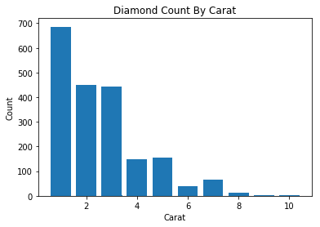
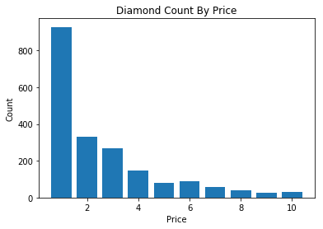
Data Analysis pt.2

Slide 7
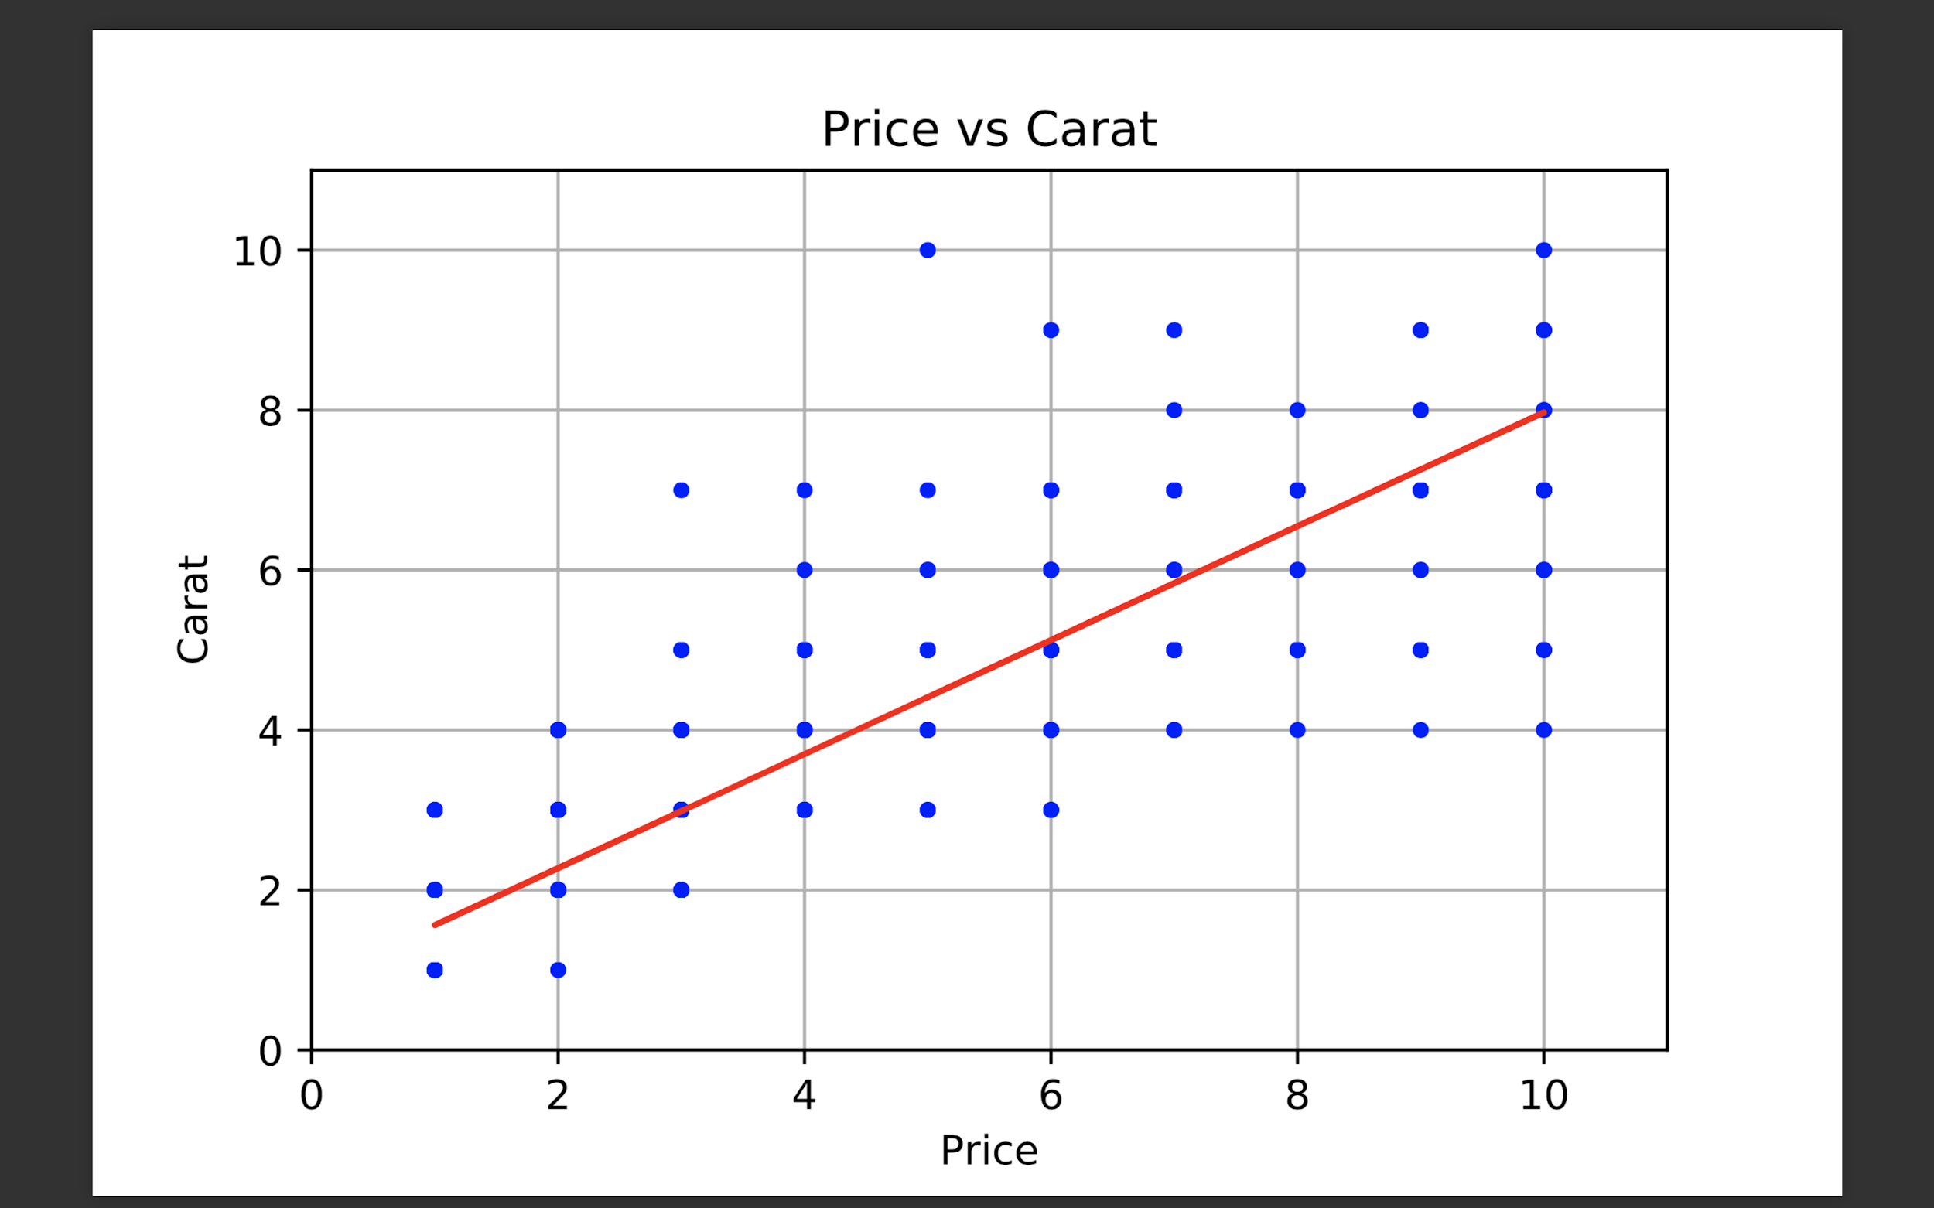
Data Analysis pt.3

Slide 8

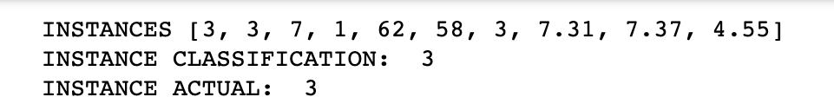
Classification Results
Most accurate classifier was kNN
Trained it on every attribute
Performance measures
Stratified k-fold using 10 folds

Slide 9
Conclusion
Improvements
Ensemble I only trained on different training sets, would have trained on different attributes or used different attribute selection technique
Challenges
Tensorflow - documentation was outdated/deprecated
Ensemble - didn’t figure out pa7

Slide 10
Conclusion
Monetization (and why the algorithm is forbidden)
Future/big picture
Can be used on any homogeneous product, or financial securities
Could be useful for auctions like ebay
Work breakdown
Pierce did everything

Slide 11
Questions?
Sources to cite: https://www.tensorflow.org/guide/datasets_for_estimators, https://nbviewer.jupyter.org/gist/yufengg/a6dff912ab48f7a273f5704ad9ab1311

