Slide 1
DATA INTEGRATION
Overview ETL - Workshop 1

Slide 2
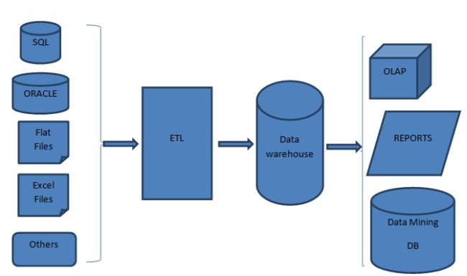
What is ETL?
Extraction
Transformation/data cleaning
Load

Slide 3
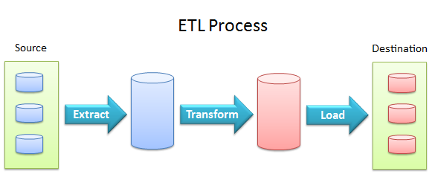
WHAT IS ETL?

Slide 4
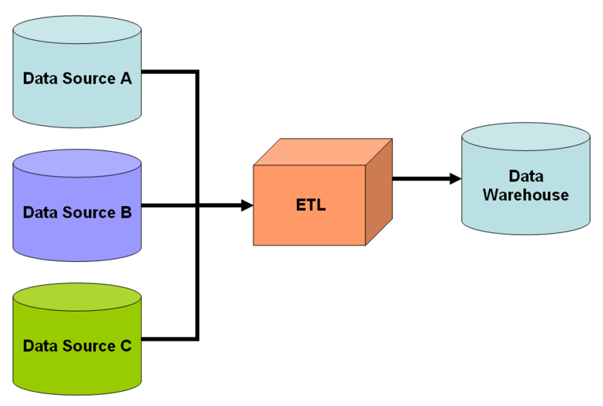
WHAT IS ETL?

Slide 5
WHat is ETL?

Slide 6
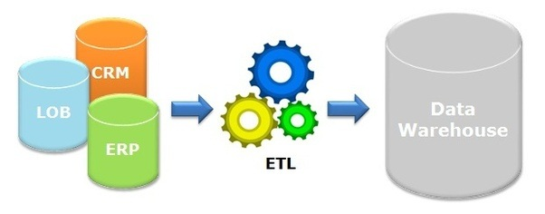
WHAT IS ETL?

Slide 7
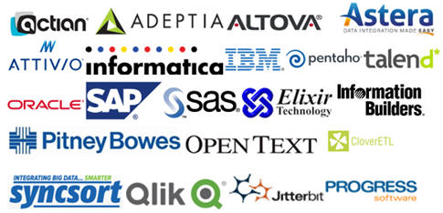
ETL TOOLS
Commercial
SAP Data Services
Oracle Data Integrator
Microsoft SSIS
IBM DataStage
Informatica
Open source
Pentaho
CloverETL
…

Slide 8
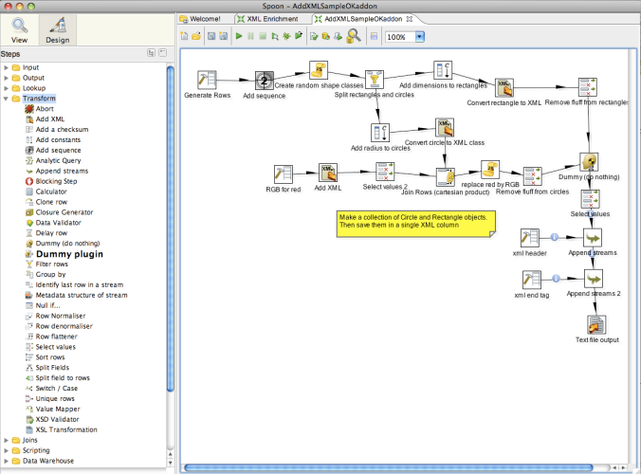
EXAMPLE Pentaho interface

Slide 9
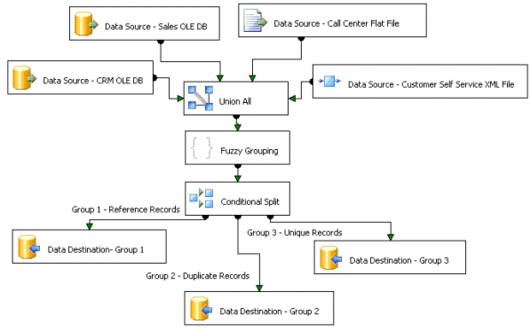
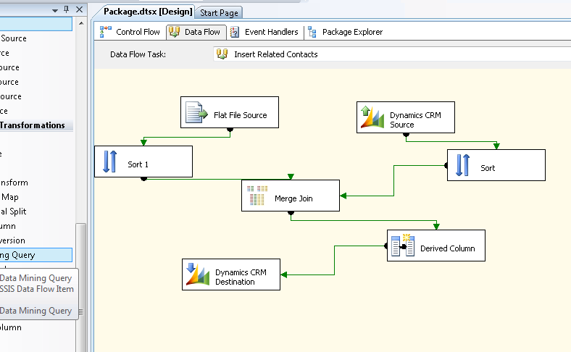
Microsoft SSIS

Slide 10
EXTRACTION
https://en.wikipedia.org/wiki/Change_data_capture

Slide 11
EXTRACTION
Datasources
RDBMS
Oracle
PostgreSQL
Microsoft SQL
MySQL / MariaDB
API
Screen scraping
Web spidering
NoSQL
MongoDB (json data store)
ElasticSearch
Hadoop / Hbase
MapR
Cassandra
…
Files
XML
JSON
CSV/TSV
…

Slide 12
EXTRACTION – CHANGE DATA CAPTURE
Challenges
Don’t read all the data again everytime
Detection of inserts / updates /deletes
Extraction of big data volumes (initial loads vs increments)
Slow or unstable network
→ CDC to the rescue

Slide 13
CHANGE DATA CAPTURE
Intrusive - CDC
SQL queries : Impact on the source system
Trigger – based
Snapshot – based
Source Data -based
Non-intrusive - CDC
Database log shipping

Slide 14
CDC - Source-Based CDC
CREATION_DATE / LAST_UPDATE_DATE timestamp
CREATION_DATE = timestamp of creation
LAST_UPDATE_DATE = timestamp of last update
Possibility to detect inserts and updates!
If only CREATION_DATE is available -> only insert detection is possible
Database auto-increment column (sequence)
Possible to check which records have been added, since the last time the source system was checked
Only insert detection is possible!

Slide 15
CDC – SOURCE-BASED REMARKS
Difference between inserts and updates
Only possible when insert / update timestamp is available
Deleted records detection
This is not possible. Only if a logical delete flag is available in the source system
Multi update detection
When a records is updated multiple time, the intermediate updates are lost.
Real-time possibilities
Timestamp or sequence-based data extraction is always a batch operation and not suited for real-time dataloads

Slide 16
CDC - Trigger based CDC
Database trigger on INSERT / UPDATE / DELETE
A copy of the change is put aside in a temporary table
Copy the changed data to the staging area of the Datawarehouse
Replication to the datawarehouse

Slide 17
CDC - SNAPSHOT based CDC
When no CREATION_DATE of LAST_UPDATE_DATE is available
A full extract of the source is needed and needs to be compared with the previous version of the extract which is saved
snapshot 1 |  |  | snapshot 2
ID | Color |  | ID | Color
1 | Black |  | 1 | Brown | Update
2 | Brown |  | 2 | Black | Update
3 | Yellow |  | 3 | Yellow
 |  |  | 4 | Greeen | Insert

Slide 18
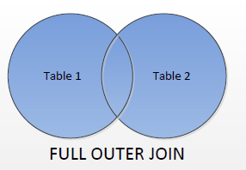
CDC - SNAPSHOT based CDC
Full outer join op Primary Key (PK)
Assign a flag for insert / update /delete
select * from
(select case
when t2.id is null then ‘D’
when t1.id is null then ‘I’
when t1.color <> t2.color then ‘U’
else ‘N’
end as flag
, case
when t2.id is null then t1.id
else t2.id
end as id
, t2.color
from snapshot_1 t1
full outer join snapshot_2 t2
on t1.id = t2.id
) a
where flag <> 'N’

Slide 19
CDC - LOG based CDC
Most advanced option for CDC
Database replication
Database logs
Binary log formats
Must be converted to human readable format

Slide 20
CDC - alternatives
Vendor specific software
Oracle GoldenGate €€€
MS SQL Redgate
PostgreSQL replication
…

Slide 21
CDC - OVERVIEW
 | DATA SOURCE BASED | SNAPSHOTBASED | TRIGGER BASED | LOG BASED
Insert / update detection | Y | Y | Y | Y
Multiple update detection | N | N | Y | Y
delete detection | N | Y | Y | Y
non – intrusive | N | N | N | Y
Real - time support | N | N | Y | Y
DBMS independent | Y | Y | N | N
DBA necessary | N | N | N | Y

Slide 22
TRANSFORM
A sequence of rules and functions which are executed on the data
Some data doesn’t need transformation
Pass-through data
Data cleaning
Only useful information is filtered
Missing / incorrect data management

Slide 23
TRANSFORM
Filtering of data
Data translation (Foreign Key lookups)
1 = M = Male
2 = F = Female
Value mapping
Male/male/ M = 1
Female / female / F = 2
Mathematical operations
Analytical operations
Sorting
Compute aggregates
Count / Sum / Min / Max / Avg / …
Surrogate key generation
Transpose / pivoting of data
Split or concatenate data fields
Data validation (go / no go)
Credit cards numbers / mail address validation / Phonenumber validation

Slide 24
LOAD
Lots of options
Depends on the project
Per hour / daily / Weekly load of data
Formats
DBMS / Datawarehouse
CSV / XML / JSON
More about this later….

