Slide 1
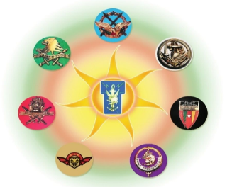
CYBERSECURITY STRATEGY deployment: A Challenge for Managers, CisoS AND USERS
By Colonel MBECK MOMENDENG Jean Levrai,
HELIOS Project Executive Manager
ICCF-eMBA @HEC Paris
CSEP-ASEP-CISM – CISSP-CISO
ISO/IEC 27005-EBIOS 27005 Certified
« I AM HELIOS ELITE SOLDIER OF THE DIGITAL »

Slide 2
AIM
Information and Communication Technology has evolved to become the backbone of modern business, critical services and infrastructure, social networks, and the global economy as a whole, catalysts for multisectoral growth and social development.
Our societies are increasingly dependent on digital infrastructure, and technology remains inherently vulnerable. Cybersecurity is becoming a complex challenge that encompasses many different aspects of governance, policy, operation, technical and legal, requiring an applicable strategy to ensure confidentiality, integrity, availability, the ICT infrastructure is facing a rapid change in risks, which requires a real Cyber Security STRATEGY. Hence, the need for an expert position in some companies and organizations CISO (Chief Information Security Officer). What should be the position of the TOP Manager in the cybersecurity strategy process, the role of the CISO in its implementation? its impact on IT and other stakeholders in the company? This work aims to give all of them guidelines and tools to deploy a cybersecurity strategy in their organizations, structures and companies, to be influential actors and know how to take the right actions that fit with its movement.
« I AM HELIOS, ELITE SOLDIER OF THE DIGITAL »

Slide 3
PLAN
1- CONCEPTS DEFINITION AND CYBERSECURITY STRATEGY LIFECYCLE;
2- CYBERSECURITY STRATEGY CHARACTERISTICS
3- CYBERSECURITY STRATEGY GOOD PRACTICES
4- OPEN EXERCISE
« I AM HELIOS, ELITE SOLDIER OF THE DIGITAL »

Slide 4
PART 1
CONCEPTS DEFINITION AND CYBERSECURITY STRATEGY LIFECYCLE
« I AM HELIOS, ELITE SOLDIER OF THE DIGITAL »

Slide 5
1.1- WHAT IS CYBERSECURITY?
“Cybersecurity” is meant to describe the collection of tools, policies, guidelines, approaches, actions, trainings, best practices, assurance, and technologies that can be used to protect the availability, integrity, and confidentiality of assets in the connected infrastructures pertaining to government, private organisations, and citizens; these assets include connected computing devices, personnel, infrastructure, applications, digital services, telecommunications systems, and data in the digital-environment..
« I AM HELIOS ELITE, SOLDIER OF THE DIGITAL »

Slide 6
1-2. WHAT IS CYBERSECURITY STRATEGY?
A Cyber Security Strategy is a structured approach that an organization, government, or individual follows to protect its information technology (IT) systems, networks, data, and assets from cyber threats.
A Cybersecurity strategy can take many forms and can go into varying levels of detail, depending on the particular country’s objectives and levels of cyber-readiness.
It is:
an expression of the vision, high-level objectives, principles and priorities that guide a corporate in addressing cybersecurity;
an overview of the stakeholders tasked with improving cybersecurity of the corporate and their respective roles and responsibilities; and;
a description of the steps, programmes and initiatives that will be undertaken to protect its cyber-infrastructure and, in the process, increase its security and resilience.
« I AM HELIOS ELITE, SOLDIER OF THE DIGITAL »

Slide 7
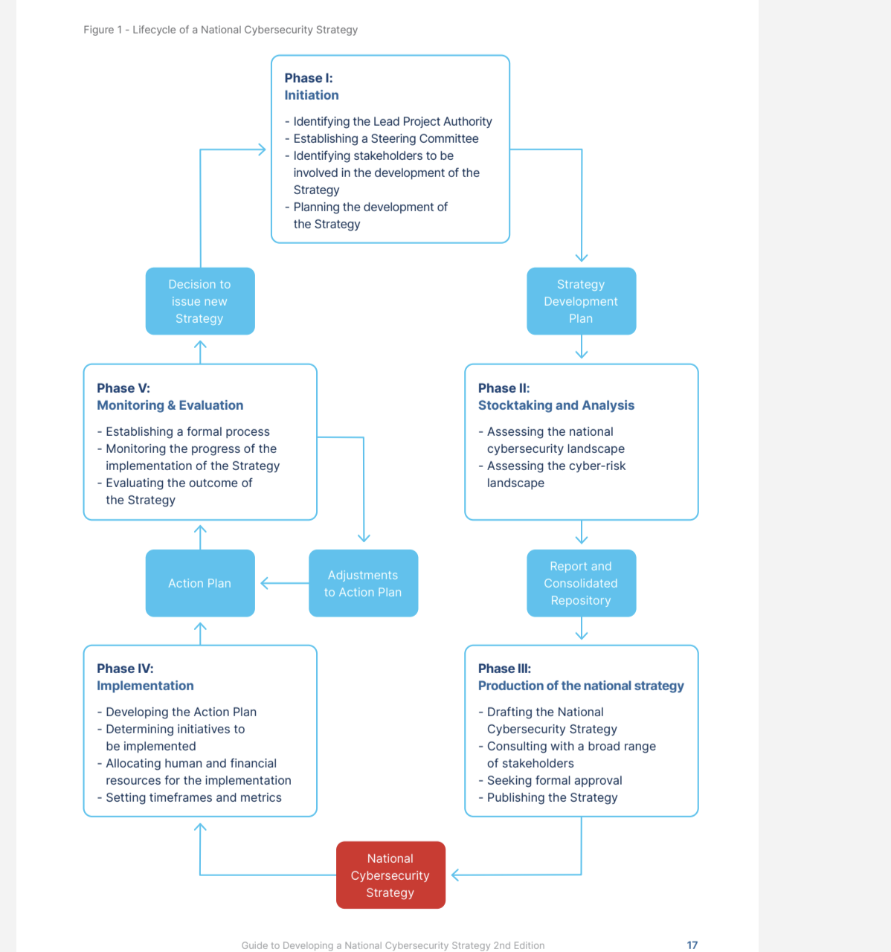
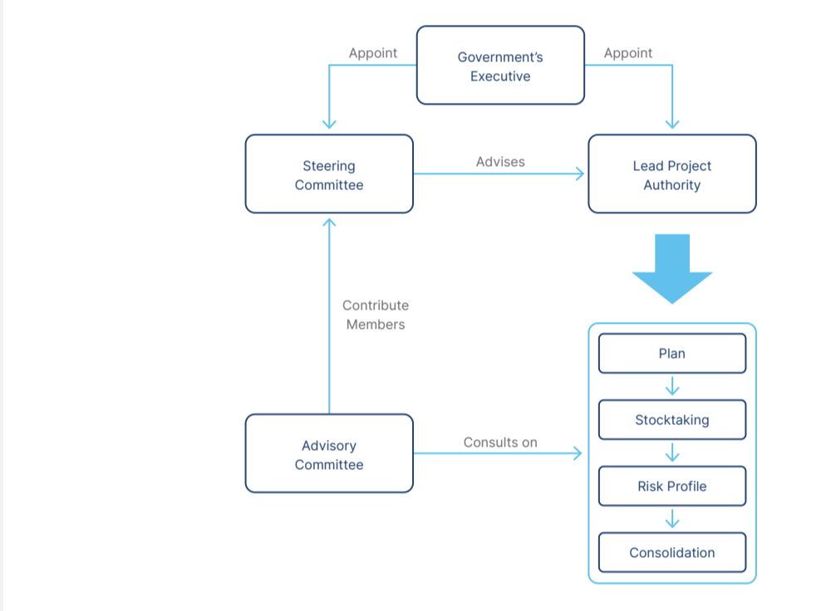
CYBERSECURITY STRATEGY LIFE CYCLE
« I AM HELIOS ELITE, SOLDIER OF THE DIGITAL »

Slide 8
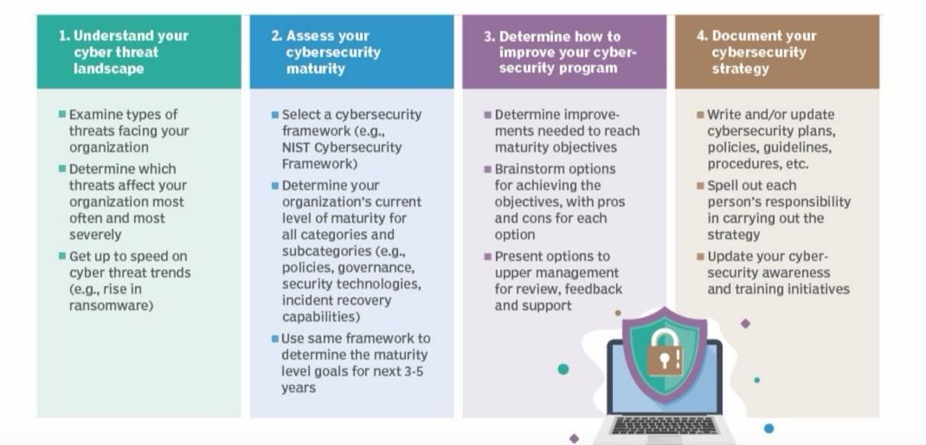
CYBERSECURITY STRATEGY Framework
« I AM HELIOS ELITE, SOLDIER OF THE DIGITAL »

Slide 9
CYBERSECURITY CHARACTERISTICS
PART 2
« I AM HELIOS, ELITE SOLDIER OF THE DIGITAL »

Slide 10
CYBERSECURITY STRATEGY CHARACTERISTICS
1- Whole structure vision of protecting from cyber threats;
2- Comprehensive approach and tailored priorities: an all-encompassing understanding and analysis of the overall digital environment, yet be tailored to the country’s circumstances and priorities;
3-Inclusiveness: with the active participation of all the relevant stakeholders, and it should address their needs and responsibilities;
4-Economic and Social Prosperity; foster economic and social prosperity and maximise the contribution of ICT to sustainable development and social inclusiveness.
« I AM HELIOS, ELITE SOLDIER OF THE DIGITAL »

Slide 11
CYBERSECURITY STRATEGY CHARACTERISTICS
5- Fundamental human rights: should respect and be consistent;
6-Risk management and resilience: enable an efficient management of cybersecurity risks and drive the resilience of the economic and social activities;
7-Appropriate set of policy instruments: utilize the most appropriate policy instruments available to realise each of its objectives, considering the country’s specific circumstances.
8-Appropriate set of policy structures: assigning relevant roles and responsibilities and allocating sufficient human and financial resources;
9-Trust environment: build a digital environment
« I AM HELIOS, ELITE SOLDIER OF THE DIGITAL »

Slide 12
CYBERSECURITY GOOD PRACTICES
PART 3
« I AM HELIOS, ELITE SOLDIER OF THE DIGITAL »

Slide 13
Area 1 - Governance
1.1 Ensure the highest level of support: sufficient resources will be allocated;
intertwined with digital economy and other social and political aspects that depend on digital systems, and must be THE priority.
1.2 Establish a competent cybersecurity authority
1.3 Ensure intra-cooperation and partnerships
1.4 Ensure inter-sectoral cooperation
1.5 Allocate dedicated budget and resources
1.6 Develop an implementation plan
« I AM HELIOS, ELITE SOLDIER OF THE DIGITAL »

Slide 14
AREA 2 - Risk management in cybersecurity ISO/IEC 27005
2.1 Conduct a cyber threat assessment and align policies with the everexpanding cyber threat landscape;
2.2 Define a risk-management approach
2.3 Identify a common methodology for managing cybersecurity risk: EBIOS- NIST 800 – MEHARI
2.4 Develop sectoral cybersecurity risk profiles
2.5 Establish cybersecurity policies
« I AM HELIOS, ELITE SOLDIER OF THE DIGITAL »

Slide 15
AREA 3 - Preparedness and resilience
3.1 Establish cyber-incident response capabilities: CERT/CIRT, CSIRT, …
3.2 Establish contingency plans for cybersecurity crisis management and disaster recovery;
3.3 Promote information-sharing
3.4 Conduct cybersecurity exercises
3.5 Establish impact or severity assessment of cybersecurity incidents
« I AM HELIOS, ELITE SOLDIER OF THE DIGITAL »

Slide 16
area 4 - Critical Infrastructure and essential services
4.1 Establish a risk-management approach to identifying and protecting critical infrastructure and essential services;
4.2 Adopt a governance model with clear responsibilities
4.3 Define minimum cybersecurity baselines
4.4 Utilise a wide range of market levers
4.5 Establish public private partnerships
« I AM HELIOS, ELITE SOLDIER OF THE DIGITAL »

Slide 17
area 5 - Capability and capacity building and awareness raising
5.1 Strategically plan capability and capacity building and awareness raising: assign clear roles and responsibilities to entities
5.2 Develop cybersecurity curricula: facilitate the development or expansion of dedicated trainings curricula aimed at accelerating cybersecurity skills development and awareness throughout the formal cybersecurity education program;
5.3 Stimulate capacity development and workforce training;
5.4 Implement a coordinated cybersecurity awareness-raising programme;
5.5 Foster cybersecurity innovation and R&D;
5.6 Tailor programmes for vulnerable sectors and groups;
« I AM HELIOS, ELITE SOLDIER OF THE DIGITAL »

Slide 18
Area 6 - Legislation and regulation
6.1 Establish a legal framework for cybersecurity;
6.2 Establish a legal framework on cybercrime and electronic evidence;
6.3 Recognise and safeguard human rights and liberties;
6.4 Create compliance mechanisms: set in place to prevent, combat, and mitigate actions directed against the confidentiality, integrity, and availability of ICT systems and infrastructures, and threatening computer data, in accordance with the aforementioned legal framework;
6.5 Promote capacity-building for law enforcement: training and education for a range of stakeholders involved in combating cybercrime (e.g., judges, prosecutors, lawyers, lawenforcement officials,
6.6 Establish inter-organisational processes: ensure compliance with cybercrime legislation
6.7 Support international cooperation to combat cyber threats and cybercrime
« I AM HELIOS, ELITE SOLDIER OF THE DIGITAL »

Slide 19
Area 7 - International cooperation
7.1 Due to its transboundary and lacunarity characteristics recognise cybersecurity as a component of foreign policy and align domestic and international efforts;
7.2 Engage in international discussions and commit to implementation;
7.3 Promote formal and informal cooperation in cyberspace;
7.4 Promote capacity building for international cooperation;
« I AM HELIOS, ELITE SOLDIER OF THE DIGITAL »

Slide 20
IV- OPEN EXERCISE
The concern here is to set up the posture, the job description and the tasks of these personal, during the Cybersecurity Strategy deployment and Life Cycle, what achievements should they perfomed while exploiting the Cybersecurity Strategy Best Practices.
Link to open Exercise: : file:///Users/jlvmbeck/Documents/HELIOS_DOCUMENTS/Cyber_Wednesdays/CyberSecurity_Strategy_Exercise.xlsx
« I AM HELIOS, ELITE SOLDIER OF THE DIGITAL »

Slide 21
REFERENCES AND DOCUMENTATION
- Modern Cybersecurity Strategies for Enterprises, by ASHISHI MISHRA, PBP Publications, 2023;
C|CISO Certified Chief Information Security Officer, Version 3, EC-Council,
CISSP Training Series, EC-Council, University of Dallas, 2016;
Guide to Developing a National Cybersecurity Strategy by Strategic Engagement in Cybersecurity, 2nd Edition 2021;
La securite informatique pour la petite entreprise, Etat de l’Art et bonnes pratiques, By Jean-Francois Charpentier, Editions Eni, 13 Janvier 2016.
National Cybersecurity Strategy Guide, Cyber Security Studies, Marshall Institute, May 2024
« I AM HELIOS, ELITE SOLDIER OF THE DIGITAL »

Slide 22
{....
.... ‘’THANK YOU FOR YOUR KIND ATTENTION’’;
}
{....
....‘’QUESTIONS’’;
....
END
}

