Slide 1

SUPPLY CHAIN MANAGEMENT: Cyber Challenges and perspectives
By Colonel MBECK MOMENDENG Jean Levrai,
HELIOS Project Executive Manager
ICCF-eMBA @HEC Paris
CSEP-ASEP-CISM – CISSP-CISO
ISO/IEC 27005-EBIOS 27005 Certified
« I AM HELIOS ELITE SOLDIER OF THE DIGITAL »

Slide 2
AIM
Since COVID-21 pandemy, the geopolitical context has , the change in consumption trends , changing habits and the digitalization of businesses, Supply Chains is becoming more complex with some constraints such as Adaptability to uncertainty, change, and resilience of Supply Chain Management in the cyber, the cloud innovation opportunities and unfortunately the IA, … and Generative IA.
What is Supply Chain Management? How does it works? Its Importance in the enterprise? IT role in SCM and the challenges for incoming years and technology and cyber innovation and threats?
« I AM HELIOS, ELITE SOLDIER OF THE DIGITAL »

Slide 3
PLAN
1- SCM DEFINITION A D FUNCTIONS
2- SCM IN THE ENTERPRISE
3- IT ROLE IN SCM
5- SCM CYBER CHALLENGES: exercice.
« I AM HELIOS, ELITE SOLDIER OF THE DIGITAL »

Slide 4
PART 1
CONCEPTS & DEFINITION IN SCM
« I AM HELIOS, ELITE SOLDIER OF THE DIGITAL »

Slide 5
1.1- WHAT IS SCM?
“
SUPPLY CHAIN MANAGEMENT” is a system MANAGES THE FLOW OF PRODUCTS, DATA, MONEY, AND INFORMATION THROUGHOUT THE SUPPLY CHAIN, STARTING FROM SUPPLIERS OF RAW MATERIALS, RUNS THROUGH THE INTERMEDIATE TIERS OF THE PROCESSING COMPANIES, AND ENDS WITH THE DISTRIBUTORS AND RETAILERS
IT IS ALSO THE MONITORING AND OPTIMIZATION OF THE PRODUCTION AND DISTRIBUTION OF A COMPANY’S PRODUCTIONS AND SERVICES.
« I AM HELIOS ELITE, SOLDIER OF THE DIGITAL »

Slide 6
. 1-1. WHAT IS SCM? (CONTINUOUS)
Supply chain management (SCM) SYSTEM is the centralized management of the flow of goods and services to and from a company and includes all of the processes involved in transforming raw materials and components into final products.
« I AM HELIOS ELITE, SOLDIER OF THE DIGITAL »

Slide 7
1.2 SCM SYSTEM FUNCTIONS
1- Customer Analysis
2- Purchasing supplier parterNing
3- Inventory management and control
4- Demand and Lead Time Management
5- Materials Management;
6- Manufacturing- ReManufacturing – Assembly
7- Storage and Transportation
8- Order fulfilment;

Slide 8
1.2 SCM SYSTEM FUNCTIONS (ALTERNATE )
Supply chain management (SCM) SYSTEM has many functions:
- Warehouse management;
- Transport management;
- Planning;
- Forecasts;
- Inventory management;
- Procurement management;
- Production management;
- Management of the data produced by all these systems.
- ...
« I AM HELIOS ELITE, SOLDIER OF THE DIGITAL »

Slide 9
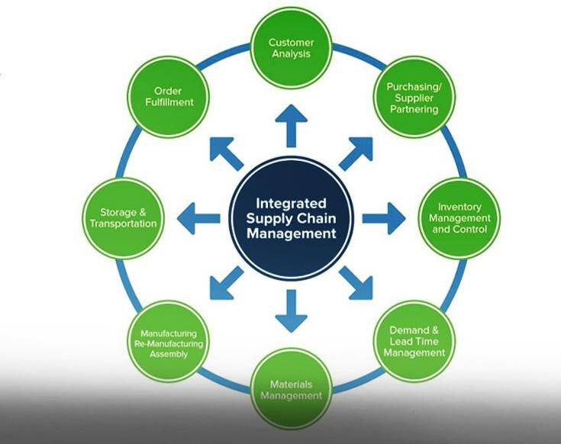
SCM FUNCTIONS

Slide 10
PART 2
SCM IN THE ENTERPRISE
« I AM HELIOS, ELITE SOLDIER OF THE DIGITAL »

Slide 11
2.1- SCM IMPORTANCE IN THE ENTERPRISE?
As defineD the SCM, IT IS OBVISOUS THAT With SCM, companies can cut excess costs and deliver products to the consumer faster and more efficiently.
Good SCM can help prevent expensive product recalls and lawsuits as well as bad publicity.
« I AM HELIOS ELITE, SOLDIER OF THE DIGITAL »

Slide 12
2.2. SCM ROLE IN THE ENTERPRISE
The role of IT in supply chain management is crucial, as it provides essential tools for collecting and analysing data. These tools support the execution of strategies, enabling companies to make data-driven decisions. Effective supply chain management requires IT to handle supply chain disruptions, ensure timely operations, and adapt to market changes, which optimizes its overall performance and increases efficiency throughout the supply chain. By integrating various functions like inventory management, procurement, and project management, IT enhances visibility, accuracy, and control, making the entire process more reliable and resilient.
« I AM HELIOS ELITE, SOLDIER OF THE DIGITAL »

Slide 13
PART 3
IT IN SCM
« I AM HELIOS, ELITE SOLDIER OF THE DIGITAL »

Slide 14
3.1. SCM INFORMATION FLOWS IN THE ENTERPRISE
Supply Chain Management enables seamless communication, data flow, and operational efficiency across all sectors of the supply chain. With the growing complexity of the digital supply chain, leveraging IT helps companies maintain a competitive edge. Supply chain managers rely on these tools to streamline their operations, monitor inventory levels, and manage the flow of goods and information more effectively. IT also assists by providing supply chain analytics and assisting with supply chain planning solutions that help ensure businesses are ready to meet changes in customer demand and maintain inventory accuracy.
« I AM HELIOS ELITE, SOLDIER OF THE DIGITAL »

Slide 15
3.2. Functional Roles of IT in Supply Chain Management
Efficient supply chain operations are achieved with IT through process automation, increased accuracy, and enhanced real-time data sharing, all of which streamline workflows and improve overall effectiveness. IT tools also improve overall effectiveness by integrating various systems, enabling better coordination and collaboration among supply chain managers, suppliers, and other stakeholders.
« I AM HELIOS ELITE, SOLDIER OF THE DIGITAL »

Slide 16
A/ Inventory Management
In a supply chain, IT enhances inventory management by providing real-time visibility, automating tracking and replenishment processes, and optimizing stock levels through advanced analytics. This application of IT reduces manual labour, increases accuracy, and leads to better inventory decision-making, improving overall management supply chain efficiency. It also aligns with supply chain planning efforts, ensuring companies have the right amount of inventory to meet customer demand without overstocking. By using supply chain technology, companies leverage the accurate data of its inventory forecasting to reduce waste, minimize stockouts, and improve profitability.
« I AM HELIOS ELITE, SOLDIER OF THE DIGITAL »

Slide 17
B/ Supply Chain Visibility
IT plays a crucial role in supply chain visibility by using technologies like Internet of Things (IoT), Radio Frequency Identification (RFID), and cloud computing. These tools provide real-time data on inventory levels, production status, and logistical movements, enabling quicker, informed decisions across the supply chain. Enhanced visibility leads to a more resilient supply chain, as it allows supply chain management professionals to respond promptly to disruptions and supply chain disruption risks. With greater visibility, companies can track their entire supply chain and ensure that issues are addressed before they become costly problems.
« I AM HELIOS ELITE, SOLDIER OF THE DIGITAL »

Slide 18
C/ Product Improvement
Product improvement in the supply chain is facilitated by IT with process automation, enhancing data flow, improving shipment tracking, and optimizing warehouse management systems. These advancements lead to improved product quality and faster, more efficient supply chain operations. Moreover, this helps supply chain analysts identify areas for cost savings and efficiency gains within the supply chain function. With data-driven insights, product improvement initiatives can focus on refining processes across all stages of the supply chain, from raw materials to final product delivery.
« I AM HELIOS ELITE, SOLDIER OF THE DIGITAL »

Slide 19
D/ Cost Reduction
IT enables cost reduction within supply chain management by streamlining operations through automation. With technology supply chain tools like advanced analytics and real-time monitoring, businesses can optimize processes, minimize inefficiencies, and reduce overall costs. This reduction is particularly evident in areas like procurement, transportation management systems, and supplier relationship management, where automation and data insights drive more efficient supply management. By integrating cost-saving technologies, businesses can maximize resource utilization, reduce lead times, and maintain optimal inventory levels, all contributing to a more cost-effective supply chain.
« I AM HELIOS ELITE, SOLDIER OF THE DIGITAL »

Slide 20
E/ Collaboration and Coordination
IT enhances collaboration and coordination within the supply chain management by connecting stakeholders via integrated platforms. This real-time data sharing improves communication, ensuring that all parties are aligned for more efficient and effective operations within the management supply chain. Supply chain leaders can oversee the entire network, ensuring that supply chain professionals work together cohesively to meet goals. Digital supply chain management is further enabled by these platforms, creating smooth coordination and improved performance across the global supply chain, from suppliers to end consumers.
« I AM HELIOS ELITE, SOLDIER OF THE DIGITAL »

Slide 21
IT SOLUTIONS FOR SCM
Solution | Objective | Overlapping | Add-Value | Complement | Famous
ERP (Enterprise Resource Management0 | Integration of differents functions | Procurement, stocks, coordinations modules, | Integration with SCM, SRM, WRM |  | SAP Oracle
SRM (Suppliers Resource Management) | Stakeholders Interaction Management | Suppliers evaluation | - | SRM functions
PRM (Purchasing Resource Management) | management of supplies, requisitions and procurement of goods and services | ERP | Automatisation | Data Analysis | Coupa, Ariba, Jagger
SCM (Supply Chain Management) | Overall Supply Chain management | ERP | Link SCM to ERP |  | Infor, Oracle SCM SAP, SCM

Slide 22
IT SOLUTIONS FOR SCM (CONTINUED)
Solution | Objective | Overlapping | Add-Value | Complement | Famous
E-Sourcing platform | Online procurement | RFP(Request for proposals) RFQ (Requests for Quotes) | Integration with SRM |  | GEP, Proactis, Ivalua
IMS(Inventory Management Systems | Optimal inventory level | ERP | Control, real-time tracking | Advanced analystics
WMS(Warehouse Management Systems) | Efficient handling | ERP, SCM, |  |  | Manhattan, Blue Yonder, Fishbowl
TMS (Transport Management Systems) | Optimization goods movement | SCM and TMS integration |  | Advanced Analystics | Descartes, MercuryGate Oracle TMS

Slide 23
IT SOLUTIONS FOR SCM (END)
Solution | Objective | Overlapping | Add-Value | Complement | Famous
Blockchain for Supply Chain | Transparency/tracability | ERP/SCM | Integration of Blockchain in ERP/SCM | Increase trust
AI/ML | Optimize sourcing/ decisions Market prediction | ERP/SCM | AI/ML integration in ERP, SCM, SRM
OMS (Operations Management Systems)
MES (Manufacturing Execution System) |  |  |  |  | SAP

Slide 24
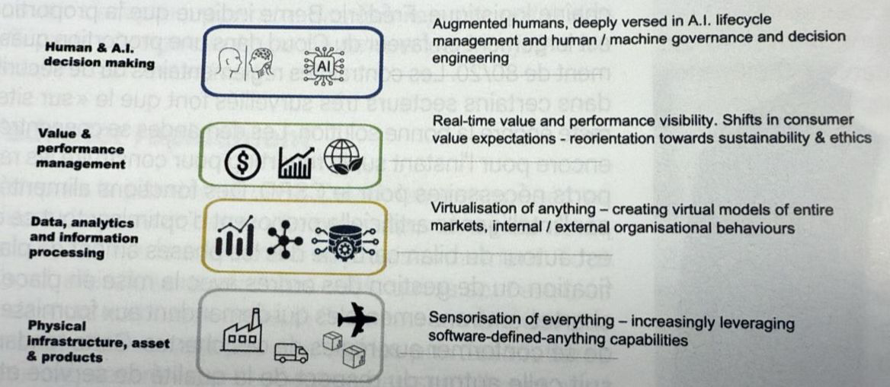
THE FUTURE OF CMS

Slide 25
CONCLUSION
WITH THE CONTINUOUS GROW OF IT SOLUTIONS AND EQUIPMENTS, SCM IS ON EXPONENTIALLY DEVELOPMENT CURVE, NO MORE GREEN SCREENS IN STOREHOUSES AND LOGISTICS CENTERS, GIVE PLACE TO TABLETS, SMARTPHONES, PDA, ... ROBOTS,...
SOME INCOMING CHALLENGES ARE ON VIEW BY RESEARCHERS AND MULTINATIONALS: VISIBILITY, MODERNIZING THROUGH TECH AND DIGITAL, LABOR AND SKILLS SHORTAGES, COST REDUCTION, AI AND GENERATIVE AI ACCROS SUPPLY CHAINS FUNCTION...
... THE IT SOLUTIONS AND DIGITAL SERVICES PROVIDER STILL HAVE TOO MUCH TO FULFILL THE NEEDS IN THAT AREA.

