Slide 1
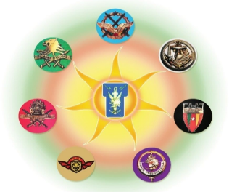
TOKENIZATION:
Concept and applications in Banking Systems.
By Colonel MBECK MOMENDENG Jean Levrai,
HELIOS Project Executive Manager
ICCF-eMBA @HEC Paris
CSEP-ASEP-CISM – CISSP-CISO
ISO/IEC 27005-EBIOS 27005 Certified
« I AM HELIOS ELITE, SOLDIER OF THE DIGITAL »

Slide 2
AIM
Cyber criminals have proven adept at thwarting existing IT defences and exploiting weak links in the payments ecosystem. Merchants, service providers, and enterprises thus face severe and ongoing challenges securing card data from capture through the transaction lifecycle. Organizations are also under pressure to achieve scope and cost reduction goals in meeting compliance mandates such as the Payment Card Industry Data Security Standard (PCI DSS). SCIENCE IN GENERAL AND CRYPTOGRAPHY SYSTEMS IN PARTICULAR SUCH AS Tokenizationn HELP IN data protection and audit scope reduction, recommended by the PCI DSS Security Standards Council. THUS can both accelerate initial compliance efforts and reduce costs for future audits. SOME CRITICAL PROBLEMS HAVE EMERGED SUCH AS COMPLEXITY AND COSTS, INTEGRITY, SECURITY AND RISK, PERFORMANCE AND SCALE, PCI USE CASE COMPLETENESS, …
THE PURPOSE OF THIS WORK is to intended for merchants, payment processors, and enterprises that understand what tokenization is, and either want to replace existing first-generation implementations or implement a solution to cut costs, reduce scope, and reduce breach risks to a minimum.
« I AM HELIOS ELITE, SOLDIER OF THE DIGITAL »

Slide 3
PLAN
I- WHAT IS TOKENIZATION?
II- HOW DOES TOKENIZATION WORK?
III- TOKENIZATION IN BANKING PAYMENT
« I AM HELIOS ELITE, SOLDIER OF THE DIGITAL »

Slide 4
PART I
WHAT IS TOKENIZATION?
« I AM HELIOS ELITE, SOLDIER OF THE DIGITAL »

Slide 5
1.1- DEFINITION
Tokenization is a process by which ”PRIMARY ACCOUNT NUMBERS” (PANs), “PERSONAL HEALTH INFORMATION” (PHI), “PERSONAL IDENTIFIED INFORMATION” (PII), and other sensitive data elements are replaced by surrogate values, or tokens.
Tokenization is really a form of encryption, but the two terms are typically used differently.
PHI encompasses any information about a patient that is linked with identifiers such as medical record numbers, subscriber IDs, and dates of birth. It's crucial for healthcare data privacy and protection.
PII STANDS FOR information like name, address, social security number, email address, and phone number, but also potentially less obvious data like IP addresses or device identifiers when linked to an individual: SENSIBLE FOR PRIVACY AND DATA PROTECTION.
« I AM HELIOS ELITE, SOLDIER OF THE DIGITAL »

Slide 6
1.2- ORIGINS OF TOKENIZATION
Digital tokenization was first CREATED BY TRUSTCOMMERCE IN 2001 to help a client protect customer credit card information. Merchants were storing cardholder data on their own servers, which meant that anyone who had access to their servers could potentially view or take advantage of those customer credit card numbers.
ITS PURPOSE WAS to reduce risk in handling high value financial instruments by replacing them with surrogate equivalents.
« I AM HELIOS ELITE, SOLDIER OF THE DIGITAL »

Slide 7
1-3. TYPES OF TOKENIZATION
There are two types of tokenization: reversible and irreversible.
Reversible tokens can be detokenized – converted back to their original values. In privacy terminology, this is called pseudonymization. Such tokens may be further subdivided into cryptographic and non-cryptographic, although this distinction is artificial, since any tokenization really is a form of encryption.
Irreversible tokenIZATION consists in creating tokens that cannot be converted back to their original data. This is often used for data anonymization, where the tokenized data can be used in less secure environments or for third-party analytics. THEY do not store the original data's decryption key, making it impossible to retrieve the original values.
« I AM HELIOS ELITE, SOLDIER OF THE DIGITAL »

Slide 8
PART II:
HOW DOES TOKENIZATION WORK?
« I AM HELIOS ELITE, SOLDIER OF THE DIGITAL »

Slide 9
2.1. STRUCTURE OF TOKENIZATION
Cryptographic tokenization generates tokens using strong cryptography; the cleartext data element(s) are not stored anywhere – just the cryptographic key. EXAMPLE NIST STANDARD FF1 mode AES
Non-cryptographic tokenization originally meant that tokens were created by randomly generating a value and storing the cleartext and corresponding token in a database, like the original TrustCommerce offering.
« I AM HELIOS ELITE, SOLDIER OF THE DIGITAL »

Slide 10
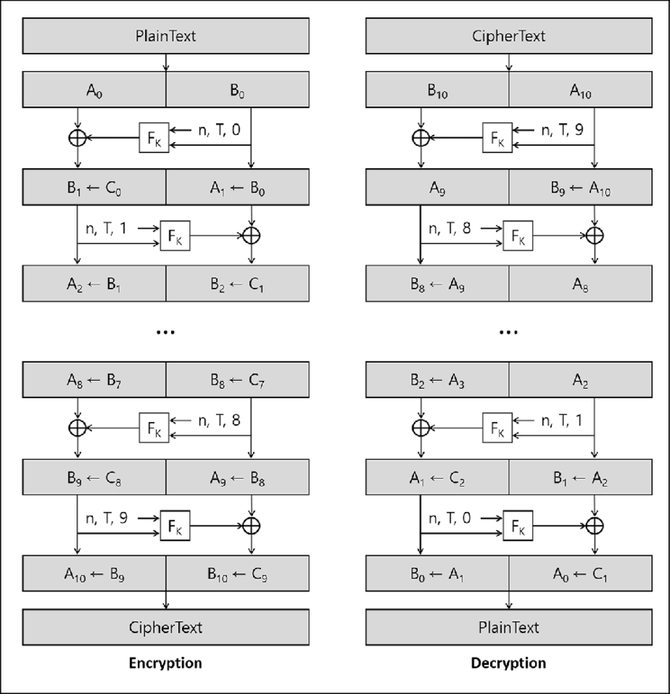
2-2. FF1 and FF3: ENCRYPTION - DECRYPTION
FF1:Is an FPE (FORMAT PRESERVED ENCRYPTION) method based on a 128-bit block encryption algorithm (like AES) and that uses 10 rounds of a feistel function
FF3:Is also an FPE method based on a 128-bit block encryption algorithm, but it uses 8 rounds of a Feistel function
« I AM HELIOS ELITE, SOLDIER OF THE DIGITAL »

Slide 11
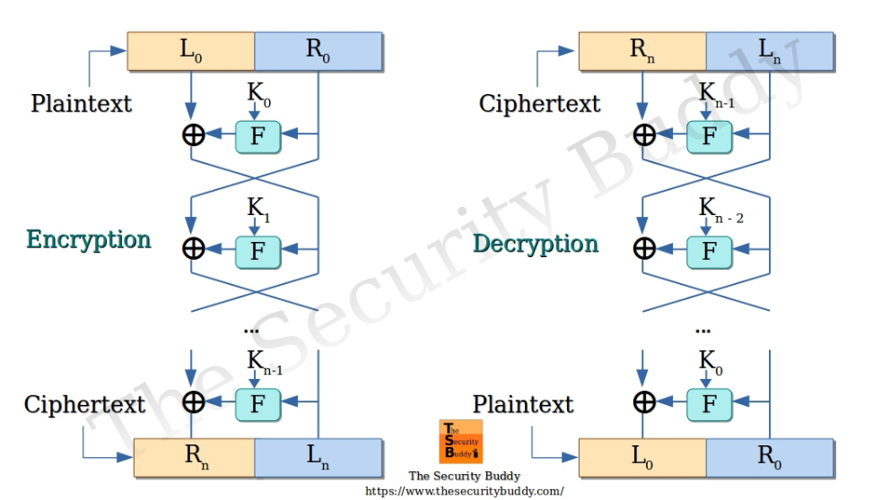
2-2 FF1 & FF3: FEISTEL FUNCTION or FEISTEL ENCRYPTION
« I AM HELIOS ELITE, SOLDIER OF THE DIGITAL »

Slide 12
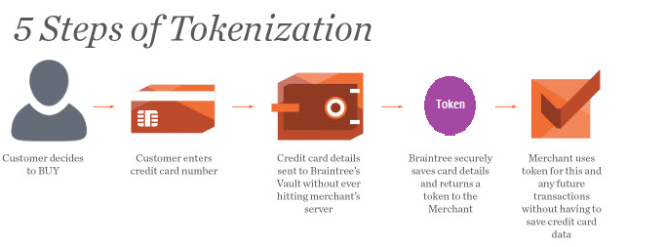
2.3 – TOKENIZATION OPERATION PROCESS
« I AM HELIOS ELITE, SOLDIER OF THE DIGITAL »

Slide 13
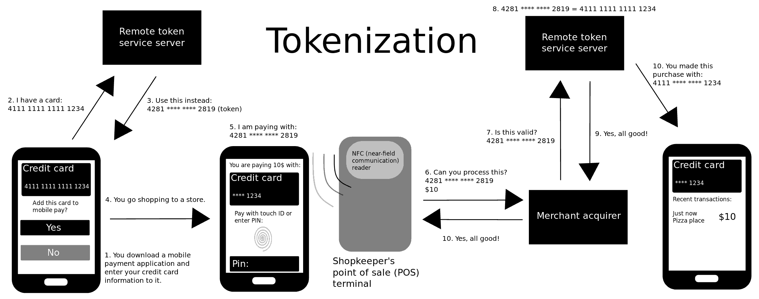
2.4 – TOKENIZATION MOBILE OPERATION PROCESS
Digital tokenization was first CREATED BY TRUSTCOMMERCE IN 2001 to help a client protect customer credit card information. Merchants were storing cardholder data on their own servers, which meant that anyone who had access to their servers could potentially view or take advantage of those customer credit card numbers.
It is an isolated actor, autonomous group, team belonging to a bigger entity who put at the disposal of anyone fraudulous access to systems.
« I AM HELIOS ELITE, SOLDIER OF THE DIGITAL »

Slide 14
2.5- BENEFITS OF TOKENIZATION
Tokenization requires minimal changes to add strong data protection to existing applications. Tokens use the same data formats, require no additional storage, and can pass validation checks.
reduces the risk of data breach and theft
KEEP CREDIT CARD DATA SAFE
better experience and greater safety and security.
can be used for any type of personally identifiable information. U.S. retailers primarily use the technology to protect financial data
the merchant. You don't have to invest as many resources making your payment infrastructure secure
fraud risk is lower, approval rates are higher, a lesser chance of your bank declining a transaction
« I AM HELIOS ELITE, SOLDIER OF THE DIGITAL »

Slide 15
PART III:
APPLICATIONS OF TOKENIZATION IN BANKING SYSTEMS
« I AM HELIOS ELITE, SOLDIER OF THE DIGITAL »

Slide 16
3.1- PCI DSS COMPLIANCE
PCI DSS STANDS FOR PAYMENT CARD INDUSCTRY DATA SECUIRTY STANDARD.
Tokenization for card data got an early boost due to requirements set by the Payment Card Industry Security Standards Council (PCI SSC). The Payment Card Industry Data Security Standard (PCI DSS) requires businesses that deal with payment card data to ensure compliance with strict CYBERSECURITY requirements. While securing payment card data with encryption is allowed per PCI DSS, merchants may also use tokenization to meet compliance standards. Since payments data flows are complex, high performance, and well defined, tokenization is much easier to add than encryption: Payment card data
« I AM HELIOS ELITE, SOLDIER OF THE DIGITAL »

Slide 17
3.2- TOKENIZATION-MFA-PCI DSS FACILITIES
Tokenization requires minimal changes to add strong data protection to existing applications. Tokens use the same data formats, require no additional storage, and can pass validation checks.
In-store using a phone or watch
Online and in-app using a phone, tablet or laptop
Online – using a card on file
Online – guest checkout
« I AM HELIOS ELITE, SOLDIER OF THE DIGITAL »

Slide 18
3.3- IN ANSI X9 (X9.17 PRG) COMPLIANCE
TOKENIZATION IS Currently USED in standards definition in ANSI X9 as X9.119 part 2 who is responsible for the industry standards for financial cryptography and data protection including payment card PIN management, credit and debit card encryption and related technologies and processes.
The PCI Council has also stated support for tokenization in reducing risk in data breaches, when combined with other technologies such as Point-to-Point Encryption (P2PE) and assessments of compliance to PCI DSS guidelines Visa Inc. released Visa Tokenization Best Practices for tokenization uses in credit and debit card handling applications and services.
DON’t FORGET THAT IT USED BLOCK CIPHER TECHNIQUES TO ENCRYPT DATA: AES and TRIPLE DES
« I AM HELIOS ELITE, SOLDIER OF THE DIGITAL »

Slide 19
3.4- APPLICATIONS OF TOKENIZATION
Tokenization is used to secure many different types of sensitive data, including:
Payment card data
U.S. Social Security numbers and other national identification numbers
Telephone numbers
Passport numbers
Driver’s license numbers
Email addresses
Bank account numbers
Names, addresses, birth dates
« I AM HELIOS ELITE, SOLDIER OF THE DIGITAL »

Slide 20
3.5 – APPLICATIONS OF TOKENIZATION (2)
In Europe, for example, many businesses rely on tokenization for:
Patient records;
Employee files;
Usernames;
Passwords;
Email addresses;
Customer accounts,
…
« I AM HELIOS ELITE, SOLDIER OF THE DIGITAL »

Slide 21
3.5- FUTURE OF TOKENIZATION
After a couple false starts, tokenized financial assets are moving from pilot to at-scale development. McKinsey analysis indicates that tokenized market capitalization could reach around $2 trillion by 2030 (excluding cryptocurrencies like Bitcoin and stablecoins like Tether). Specifically, we expect that organizations working with certain asset classes will be the quickest adopters; these include cash and deposits, bonds and exchange-traded notes, mutual funds and exchange-traded funds, as well as loans and securitization. Larry Fink, the chairman and CEO of BlackRock, said in January 2024: “We believe the next step going forward will be the tokenization of financial assets, and that means every stock, every bond … will be on one general ledger.”
« I AM HELIOS ELITE, SOLDIER OF THE DIGITAL »

Slide 22
CONCLUSION
In order for tokenization to take hold and secondary markets to thrive, industry participants may have to forgo any ambition of being the dominant platform provider. While some institutions have invested heavily in their own permissioned distributed ledger platforms, the wider industry will likely not move forward with tokenization if the benefits accrue to just a few dominant platforms. To build successful markets and gain positive network effects tends to require connecting these different platforms to facilitate better experiences for more users. Absent such cooperation, the ultimate success of tokenization networks could be in jeopardy.
« I AM HELIOS ELITE, SOLDIER OF THE DIGITAL »

Slide 23

THANK YOU FOR YOUR KIND ATTENTION, ....
{
....
QUESTIONS? }
« I AM HELIOS ELITE, SOLDIER OF THE DIGITAL »

