Slide 1
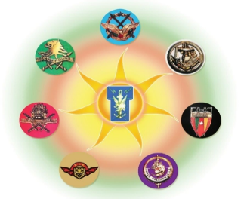
CLOUD COMPUTING SECURITY: State of the Art, perspectives and Challenges.
By Colonel MBECK MOMENDENG Jean Levrai,
HELIOS Project Executive Manager
ICCF-eMBA @HEC Paris
CSEP-ASEP-CISM – CISSP-CISO
ISO/IEC 27005-EBIOS 27005 Certified
« I AM HELIOS ELITE, SOLDIER OF THE DIGITAL »

Slide 2
AIM
The Shift of the whole world towards Cloud, by 2028 Cloud computing will be to technology disruptor to maintain business competitiveness, then upcomes a need to understand It better and stitch them into our security ecosystem in uder to deal with it.
Illustrate different cloud components at the infrastructure layer that need to be secured to maintain and uplift the security posture ot the organization, 80% of Businesses migrated to the Cloud have been submitted to Cyberattack. For Gartner, by 2025, 99% of the Incident in the Cloud will be caused by social engineering.
Public cloud technology exposed to public networks, not located into secure network perimeter is more vulnerable than on-premises infrastructure meanwhile, security in a private or hybrid cloud remains a difficulty, highly automated structure environment. And various integration points with public cloud systems raise multiple security risks.
We project to understand various parts acting as a block in Cloud and their associated security and to understand the security to adopt and key considerations for private cloud, hybrid cloud and multi-cloud setup and in-depth comprehension of how data classification plays a critical role in overall ecosystem.
« I AM HELIOS ELITE, SOLDIER OF THE DIGITAL »

Slide 3
PLAN
1- CLOUD COMPUTING ECOSYSTEM
2- CLOUD COMPUTING SECURITY PRINCIPLES
3- CLOUD COMPUTING SECURITY APPLICATIONS
4- CLOUD SECURITY CHALLENGES.
« I AM HELIOS ELITE, SOLDIER OF THE DIGITAL »

Slide 4
PART 1
CLOUD COMPUTING ECOSYSTEM
« I AM HELIOS ELITE, SOLDIER OF THE DIGITAL »

Slide 5
1.1- WHAT IS CLOUD COMPUTING?
Hosted on the internet and accessible from anywhere in the world, the hardware resources are virtualized and abstracted to enable resource scaling, sharing, and provisioning among end users in different parts of the world. IT PROVIDES REMOTE SERVICES ON THE INTERNET TO MANAGE, ACCESS, AND STORE DATA, SERVERLESS TECHNOLOGY.
ALSO ENABLE TO CREATE, CONFIGURE AND CUSTOMIZE APPLICATIONS THROUGH AN INTERNET CONNECTION, DEVELOPMENT PLATFORM, HARD DRIVE, SOFTWARE AND DATABASE.
« I AM HELIOS ELITE, SOLDIER OF THE DIGITAL »

Slide 6
1.2- NEED OF CLOUD COMPUTING?
INSTEAD OF HAVING DATABASE SERVER, MAIL SERVER, FIREWALLS, ROUTERS, MODEMS, HIGH SPEED INTERNET ACCESS AND TO HAVE COST REDUCTION AND TO FOCUS ON THE COMPANY BUSINESS.
WE HAVE THESE SERVICES:
IAAS,SAAS, PaaS, CLOUD-BASED VIRTUAL DESKTOPS, CLOUD BACKUP and cloud storage, cloud disaster recovery, …
WHY?
SCAlABILITY;
ACCESSIBILITY;
SECURITY;
COST-EFFECTIVENESS
« I AM HELIOS ELITE, SOLDIER OF THE DIGITAL »

Slide 7
1-3. Cloud infrastructure deployments models
Public cloud: Service by as-needed basis and is priced on a pay-as-you-go basis, the vendor is charged of the public cloud’s outside of its firewall, pools of virtualized resources is shared;
Private cloud: access to cloud environments through their firewall, setup as virtualized on-premise data centers.
Hybrid cloud: created by combining public, for cost-sensitive workloads, and private clouds, for security-sensitive workloads because they are transferable across the hybrid cloud.
MULTI CLOUD COMPUTING: COMBINING MULTIPLE PUBLIC CLOUD SOLUTIONS.
…
COMMUNITY CLOUD COMPUTING: Created by a community.
« I AM HELIOS ELITE, SOLDIER OF THE DIGITAL »

Slide 8
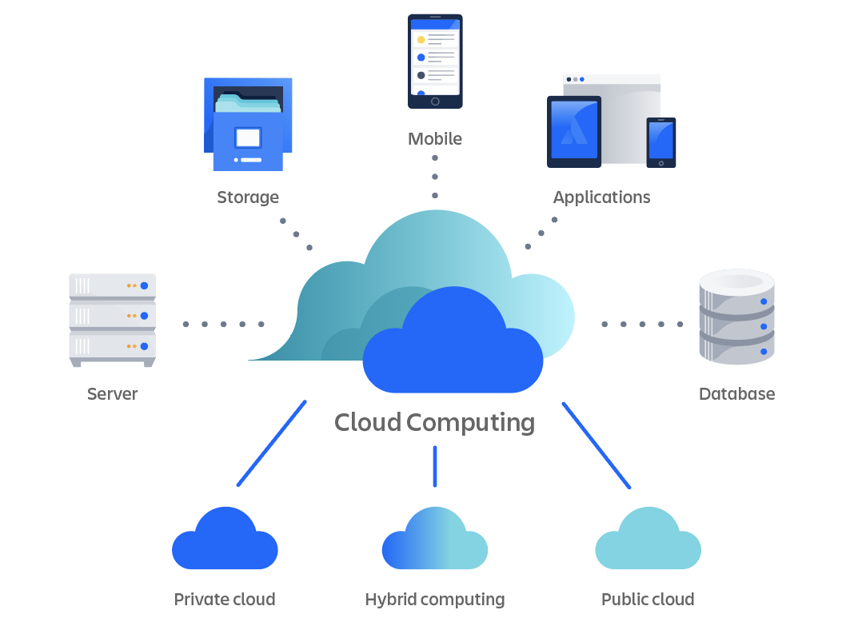
1-3. Cloud infrastructure deployments models
FRONT END (Fat client, thin client)
BACK-END PLATFORMS (SERVERS, STORAGE)
CLOUD-BASED DELIVERY AND A NETWORK (Intra, internet, intracloud)
« I AM HELIOS ELITE, SOLDIER OF THE DIGITAL »

Slide 9
PART 2
CLOUD COMPUTING SECURITY PRINCIPLES
« I AM HELIOS ELITE, SOLDIER OF THE DIGITAL »

Slide 10
2-1. SECURITY ISSUES IN CLOUD COMPUTING
DATA LOSS OR DATA BREACHES
INTERFERENCE OF HACKERS AND INSECURE API’S;
USER ACCOUNT HIJACKING
CHANGING SERVICE PROVIDER
LACK OF SKILL
DOS ATTACK
SHARED RESOURCES
COMPLIANCE AND LEGAL ISSUES
DATA LOCATION AND SOVEREIGNTY
LOSS OF CONTROL
INCIDENT RESPONSE AND FORENSICS
DATA BACKUP AND RECOVERY
VENDOR SECURITY PRACTICES
-IOT DEVICES AND EDGE COMPUTING
SOCIAL ENGINEERING AND PHISHING
INADEQUATE SECURITY MONITORING
DATA ENCRYPTION
INSIDER THREATS

Slide 11
2.2- REQUIREMENTS FOR A CLOUD SECURITY SOLUTION
Deep visibility to asset inventory
Real-time Risk Exposure alongside Cloud threat detection and prevention
Unified platform to span across development, operations and runtime
Leverage both agent-based and agentless technologies
Native high-fidelity threat intelligence
MDR (Management and Detection Response)
« I AM HELIOS ELITE, SOLDIER OF THE DIGITAL »

Slide 12
2.3- Key considerations for Cloud Security
Geo-resiliciency
Advanced networking options
Data isolation with an offline version
Data encryption in transit and at rest
Role-based access controls
Flexibility in deployment models
« I AM HELIOS ELITE, SOLDIER OF THE DIGITAL »

Slide 13
2-4. SECURITY CONTROLS IN CLOUD COMPUTING
Deterrent controls, Ex: Insider Threat ;
Preventive controls, Ex: Antivirus, IPS/IDS;
Detective controls, Ex: Antivirus, AntiSpam, EDR, ;
Corrective controls, Ex: AV, EDR, XDR, ...
« I AM HELIOS ELITE, SOLDIER OF THE DIGITAL »

Slide 14
PART 3
CLOUD COMPUTING SECURITY APPLICATIONS
« I AM HELIOS ELITE, SOLDIER OF THE DIGITAL »

Slide 15
3.1- SECURING PUBLIC CLOUD
« I AM ELITE, SOLDIER OF THE DIGITAL » HELIOS

Slide 16
3.1.1 Risks associated with pUBLIC cloud
Breach of DATA PUBLIC Clouds ARE LESS secure, LESS reliability;
DATA LOSS DUE TO SHARED INFRASTRUCTURE;
DATA LEAKAGE;
uNAUTHORIZED ACCESS;
UNSECURED INTERFACES AND APIS;
MISCONFIGURATIONS;
COMPLIANCE ISSUES.
« I AM HELIOS ELITE, SOLDIER OF THE DIGITAL »

Slide 17
3.1.2- APPROACH TO SECURE PUBLIC CLOUD
USE A STRONG PASSWORD FOR ACCOUNTS PROTECTION;
ENABLE MFA;
AVOIDANCE OF MISSION-CRITICAL DATA STORAGE;
ENCRYPT DATA BEFORE ANY UPLOAD;
SELECT A SECURE CLOUD STORAGE PROVIDER;
MANAGE SHARED FILES ACTIVELY;
MANAGE CLOUD STORAGE TO ACCESS DEVICES;
REVIEW THE POLICIES OF YOUR CLOUD STORAGE PROVIDER.
« I AM HELIOS ELITE, SOLDIER OF THE DIGITAL »

Slide 18
3.2 - SECURING PRIVATE CLOUD
« I AM ELITE, SOLDIER OF THE DIGITAL » HELIOS

Slide 19
3.2.1 Risks associated with private cloud
Breach of security VPGs (Virtual Private Clouds) more secure, more reliability
Concerns about physical safety : DVR motion cameras, MFA, Fire protection standards, geo-redundant datacenters
Capacity purchased too much or too little
Concerns about compliance : on-premise hardware well-defined, regulatory-aware IT team, ex CIJS and PCI DSS, HIPAA, PCI DDS
Issues with productivity: new software versions, frequent update,
« I AM HELIOS ELITE, SOLDIER OF THE DIGITAL »

Slide 20
3.2.2- APPROACH TO SECURE PRIVATE CLOUD
ENSURE THAT YOUR VIRTUAL SECURITY SYSTEM IS OPERATING AT PEAK EFFICIENCY
SELECT AN APPROPRIATE FIREWALL
CLOUD SECURITY CAN BE AUTOMATED
SECURE THE DYNAMIC CLOUD BY INTEGRATING SECURITY
« I AM HELIOS ELITE, SOLDIER OF THE DIGITAL »

Slide 21
3.2.3- COMPONENTS OF A PRIVATE CLOUD INFRASTRUCTURE: STORAGE
STORAGE EXPANSION & ALLOCATION: Crucial component of the cloud infrastructure stack is the platform and storage system. Cloud data centers preserve backups, expand storage allocation across users, and store data across a variety of storage types and devices. Storage formats are:
Block storage dividing data into blocks, saved in various storage systems across several server’s arrays. Data separated from the hardware it is stored on.
Object storage: Data files are split down into chunks and stored as uncompressed, unencrypted data objects, each with its own metadata identity. Possible of customization of metadata information, ideal for data assets that change often.
File storage: related to NAS (Network Access Storage) and is like the local hardware device storage on your computer, easily adjustable within a single data path.
Virtualization: or other software-defined computing architecture it is divorced from its hardware resources such as processing power and storage. Accessibility of virtual version of hardware resources like platform, processor, storage, and networking using a software system that emulates hardware functions
« I AM HELIOS ELITE, SOLDIER OF THE DIGITAL »

Slide 22
3.2.4 COMPONENTS OF A PRIVATE CLOUD INFRASTRUCTURE: CLIENT-SIDE
PCs, tablets, and other devices that communicate with backedn data center components over the internet.
Hardware: virtual hosts, preconfigured set of physical hardware components, used to access cloud computing. End users have no influence over the management and operation of hardware at the physical layer, many hardware assets are common to all data centers, whether cloud or on-premise: Servers, processor units, GPUs, Power supplies, memory, and other hardware components are common hardware components. Cloud service architecture, virtualization, and levels of abstraction are used to expand these physical resources across users and IT workloads, redundancy and flexibility built-in these systems avoid dependance of cloud service architecture, virtualization and levels of abstraction
Network: conduit through which data travels from back-end cloud servers to front-end client devices, cloud date site is off-site, connection is made through private or public networks. The network is made up of routers, cables, and switches, as well as software programs, and hardware and firmware that enable data transfer.
« I AM HELIOS ELITE, SOLDIER OF THE DIGITAL »

Slide 23
3.2.5- Securing private cloud
Access control: server-side authentication, vary levels of access and privileges; data accessibility to your cloud administrator, different identification procedures usage to secure your cloud data
Vulnerability management : regular vulnerability checks, various solutions to scan your cloud network, penetration test to determine the level of risk associated with vulnerabilities, security audits and vulnerabilities scanning regularly to ensure that your server is safe from cyberattacks
Authentication and authorization: users identification, utilize an authentication technique, user and admin credentials safely saved in your cloud, one-way data encryption,
Application security: Virtual machine Firewall policy ( no open ports on VM, … limited number of ports), Construct your private networks ( in private cloud, entirely decoupled from one another, don’t wait for an IP subnet range to be assigned to you by a network administrator), VM can be run behind a perimeter firewall
« I AM HELIOS ELITE, SOLDIER OF THE DIGITAL »

Slide 24
3.3- SECURING HYBRID CLOUD
« I AM ELITE, SOLDIER OF THE DIGITAL » HELIOS

Slide 25
3.3.1 HYBRID CLOUD SECURITY
Governance and compliance
Data leekage
Visibility and control
« I AM ELITE, SOLDIER OF THE DIGITAL » HELIOS

Slide 26
3.3.2 HYBRID CLOUD SECURITY RECOMMENDATIONS
Hybrid cloud security strategy: Processes should be standardized, EncryPt data on a regular basis, configure cloud-based security tools and processes, Setting up business continuity and disaster recovery policy
Uniform access management across the entire landscape
Identification and segregation of crown jewels
Adoption of CSPM (Cloud SECURITY POSTURE MANAGEMENT),
Adoption of CWPP (CLOUD WORLOAD PROTECTION PLATFORM), malware and attacks
N.B: CSPM is an overall security compliance while CWPP focuses on workloads and applications.
« I AM HELIOS ELITE, SOLDIER OF THE DIGITAL »

Slide 27
3.4- SECURE MULTI-CLOUD
« I AM HELIOS ELITE, SOLDIER OF THE DIGITAL »

Slide 28
3.4.1- Recommendations to improve multi-cloud security
Coordinate policies
Customize security policies for specific services
Security should be automated
Monitor in one place
Cloud compatibility
« I AM HELIOS ELITE, SOLDIER OF THE DIGITAL »

Slide 29
3.4.2- Key security considerations for multicloud strategy
Authentification and authorization
Upgrades and patching
Application and infrastructure component hardening
Monitoring and visibility
Multi-cloud storage
« I AM HELIOS ELITE, SOLDIER OF THE DIGITAL »

Slide 30
3.4.3- BENEFITS OF Multi-cloud security
Specialization
Cost and financial leverage
Disaster recovery
« I AM HELIOS ELITE, SOLDIER OF THE DIGITAL »

Slide 31
PART 4
CLOUD SECURITY CHALLENGES
« I AM HELIOS ELITE, SOLDIER OF THE DIGITAL »

Slide 32
4.1- SECURE YOUR CLOUD COMPONENTS: Security of data center and private cloud
Physical access
Secure network through zones
Servers and hosts security
Application scan vulnerabilities
Virtualization layers security
Sprayl VM
High sensitivity data in VM
Offline and dormant VMs security
Security of active VMs and pre-configured (golden image) VMs;
Virtuals networks lack of visibility
Exhaustion of resources
Hypervisor protection
Unauthorized hypervisor access
Using the self-service portal to hijack an account or a service
Workloads with varying levels of trust on the same server
APIs from CSP (Cloud Service Provider) pose a threat
Storage services on the public cloud
« I AM HELIOS ELITE, SOLDIER OF THE DIGITAL »

Slide 33
3.1- BUILDING A MODERN CLOUD SECURITY PROGRAM
Gain real-time visibility, from Code to Cloud, into Your Cloud Environment;
Build a risk prioritization strategy;
Incorporate Runtime Protection to Stop Breaches;
Harness Elite Expertise Combined with Cloud-native Detection and Response;
Centralize Security Processes into One WorkStream Between DevOps, Engineering and Security Teams

Slide 34
3.2- CLOUD COMPUTING BEST PRACTICES
ENCRYPT DATA IN TRANSIT, AT REST, AND IN USE;
USE MULTIFACTOR AUTHENTICATION (MFA);
IMPLEMENT CLOUD EDGE SECURITY MEASURES: FIREWALL, IPS, ...
ISOLATE CLOUD DATA BACKUPS, avoiding RANSOMWARE, ...
VISIBILITY ON DATA LOCATION;
LOG AND MONITOR DATA ACCESS, ADDITIONS & MODIFICATIONS;
...

Slide 35
CONCLUSION
WITH THE CONTINUOUS GROW OF IT SOLUTIONS AND EQUIPMENTS, CLOUD COMPUTING IS ON EXPONENTIALLY DEVELOPMENT CURVE, NO MORE GREEN SCREENS IN STOREHOUSES AND LOGISTICS CENTERS, GIVE PLACE SOFTWARE ON-DEMAND, STORAGE ON-DEMAND,
SOME INCOMING CHALLENGES ARE UNIVERSITY RESEARCHERS AND MULTINATIONALS R&D DEPARTEMENTS : VISIBILITY, MODERNIZING THROUGH TECH AND DIGITAL, LABOR AND SKILLS SHORTAGES, COST REDUCTION, AI AND GENERATIVE AI ACCROS SUPPLY CHAINS FUNCTION...
... THE IT SOLUTIONS AND DIGITAL SERVICES PROVIDER STILL HAVE TOO MUCH TO FULFILL THE NEEDS IN THAT AREA.
« I AM HELIOS ELITE, SOLDIER OF THE DIGITAL »

Slide 36
THANK YOU FOR YOUR KIND ATTENTION, ....
{....
QUESTIONS? }
« I AM HELIOS ELITE, SOLDIER OF THE DIGITAL »

