Slide 1

DATA STRATEGY & AI: Changes, Challenges, State of the Art
By Colonel MBECK MOMENDENG Jean Levrai,
HELIOS Project Executive Manager
ICCF-eMBA @HEC Paris
CSEP-ASEP-CISM – CISSP-CISO
ISO/IEC 27005-EBIOS 27005 Certified
« I AM HELIOS ELITE, SOLDIER OF THE DIGITAL »

Slide 2
AIM
Digital By 2025, companies are evolving in an economic and technological context where data and artificial intelligence are at the heart of their competitiveness. To succeed in this digital transition, they will have to rethink their strategy around several key areas that we describe in this work. These projects will succeed if data is qualified, centralized and accessible. In the field, this is already the case, some companies have successfully carried out deployments. This is not all because companies are also facing the rapid evolution of technologies, particularly the emergence of AI agents, already integrated with major publishers. And to move faster in their developments and with more precise results, more companies will be able to exploit synthetic data in the future. In this excitement, we must also not forget to take into account the ethical approach to AI, which is essential to respect current regulations and societal issues.
« I AM HELIOS ELITE, SOLDIER OF THE DIGITAL »

Slide 3
PLAN
1- WHAT IS DATA STRATEGY?
2- DATA STRATEGY DEPLOYMENT?
3- STATE OF ART: HOW AI REINVENT DATA STRATEGY?
3- AI CHALLENGES IN DATA STRATEGY
« I AM HELIOS ELITE, SOLDIER OF THE DIGITAL »

Slide 4
PART 1
CONCEPTS DEFINITION
« I AM HELIOS ELITE, SOLDIER OF THE DIGITAL »

Slide 5
1.1- DATA STRATEGY
For IBM, ”Data strategy stands for the detailed plan for using data to improve decision-making, optimize business processes and achieve business goals.”
For Gartner Institute, ”Data strategy is a highly dynamic process employed to support the acquisition, organization, analysis, and delivery of data in support of business objectives.”
digital identity is the unique representation of a subject engaged in an online transaction. A digital identity is always unique in the context of a digital service, but does not necessarily need to uniquely identify the subject in all contexts. In other words, accessing a digital service may not mean that the subject’s real-life identity is known.
IT IS ALSO cyber threat actors who specialize in gaining unauthorized access to computer networks and systems and then selling that access to other threat actors such as ransomware actors. IABs are parts of ransomware as a service economy, also called "cybercrime as a service economy”.
« I AM HELIOS ELITE, SOLDIER OF THE DIGITAL »

Slide 6
1.2 - DATA STRATEGY PRINCIPLES
There are different methodologies for creating and implementing an enterprise data strategy. Most include some version of these six basic components:
Understanding business objectives;
Assessing obstacles and challenges;
Creating a data strategy roadmap;
Establishing controls;
Focusing on small wins;
Scaling the strategy.
« I AM HELIOS ELITE, SOLDIER OF THE DIGITAL »

Slide 7
1.4 – AI CONCEPT AND TRENDS
WIKIPEDIA DEFINES ARTIFICIAL INTELLIGENCE AS the capability of computational systems to perform tasks typically associated with HUMAN INTELLIGENCE, SUCH AS LEARNING, REASONING, PROBLEM-SOLVING, PERCEPTION, AND DECISION-MAKING.
DATA MINING
MACHINE LEARNING;
GENERATIVE AI;
PREDICTIVE AI;
SYNTHETIC AI;
…
« I AM HELIOS ELITE, SOLDIER OF THE DIGITAL »

Slide 8
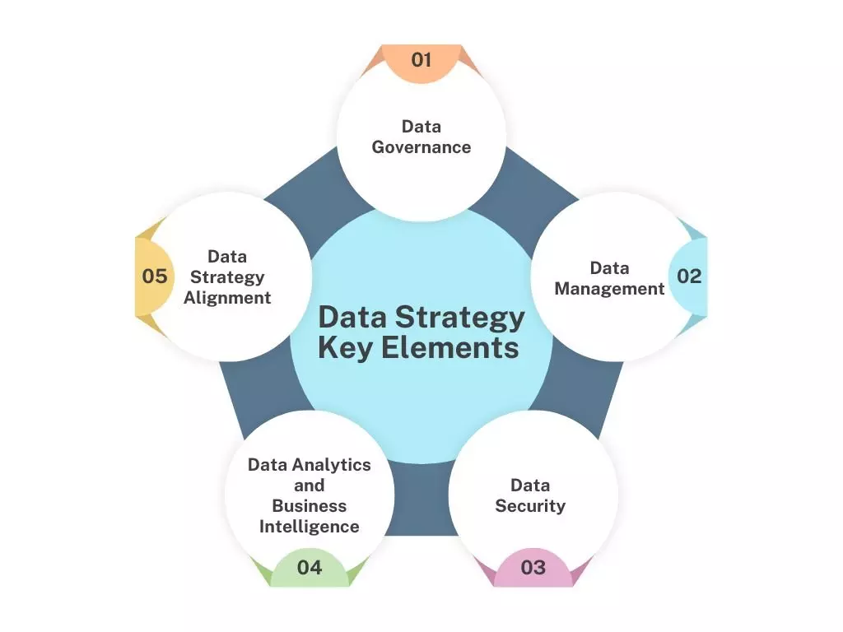
1.2 - DATA STRATEGY KEY ELEMENTS
« I AM HELIOS ELITE, SOLDIER OF THE DIGITAL »

Slide 9
PART 2
DATA STRATEGY DEPLOYMENT
« I AM HELIOS ELITE, SOLDIER OF THE DIGITAL »

Slide 10
Understanding business objectives
UNDERSTANDING BUSINESS OBJECTIVES ACROSS THE ENTIRE ORGANIZATION:
identify goals and explore how the use of data can help them achieve these goals.
the organization selects specific use cases on which the data strategy focuses.
IT professionals can then weigh in on the tools and technologies the organization might need to help achieve these outcomes.
« I AM HELIOS ELITE, SOLDIER OF THE DIGITAL »

Slide 11
Assessing obstacles and challenges;
Technical obstacles such as data silos that prevent easy data access, a lack of data governance policies or an outdated data architecture that doesn’t support modern data operations;
Human challenges. Business users might need to be educated on the pillars of a data-driven culture, and IT team members might need training to acquire specific technical skills
« I AM HELIOS ELITE, SOLDIER OF THE DIGITAL »

Slide 12
Creating a data strategy roadmap
How the data strategy is implemented. This roadmap includes:
details on the business goals, current and proposed technologies, processes and people involved.
It also establishes a timeline for completion and the metrics that measure the strategy’s success.
« I AM HELIOS ELITE, SOLDIER OF THE DIGITAL »

Slide 13
Establishing controls
Monitor data activity and maintain proper performance in data processes
Human controls, such as data advocates who meet regularly to review standards, use cases and progress across multiple lines of business.
Another important control is standardized terminology so that everyone is speaking the same language when discussing the company’s data strategy.
« I AM HELIOS ELITE, SOLDIER OF THE DIGITAL »

Slide 14
Focusing on small wins
When launching a new data strategy, organizations often aim for small wins in a short amount of time. Prioritizing data processes that show value early can help encourage adoption of the strategy across the business.
Simplifying data consumption and empowering data consumers is another tactic for gaining buy-in for the data strategy.
« I AM HELIOS ELITE, SOLDIER OF THE DIGITAL »

Slide 15
Scaling the strategy
Organizations typically provide teams with frequent updates and reports on how the strategy is meeting milestones such as driving revenue.
Organizations might also provide continuous training and support to encourage stakeholders throughout the business to adopt the data strategy.
« I AM HELIOS ELITE, SOLDIER OF THE DIGITAL »

Slide 16
PART 3
STATE OF THE ART: HOW AI REINVENT DATA STRATEGY?
« I AM HELIOS ELITE, SOLDIER OF THE DIGITAL »

Slide 17
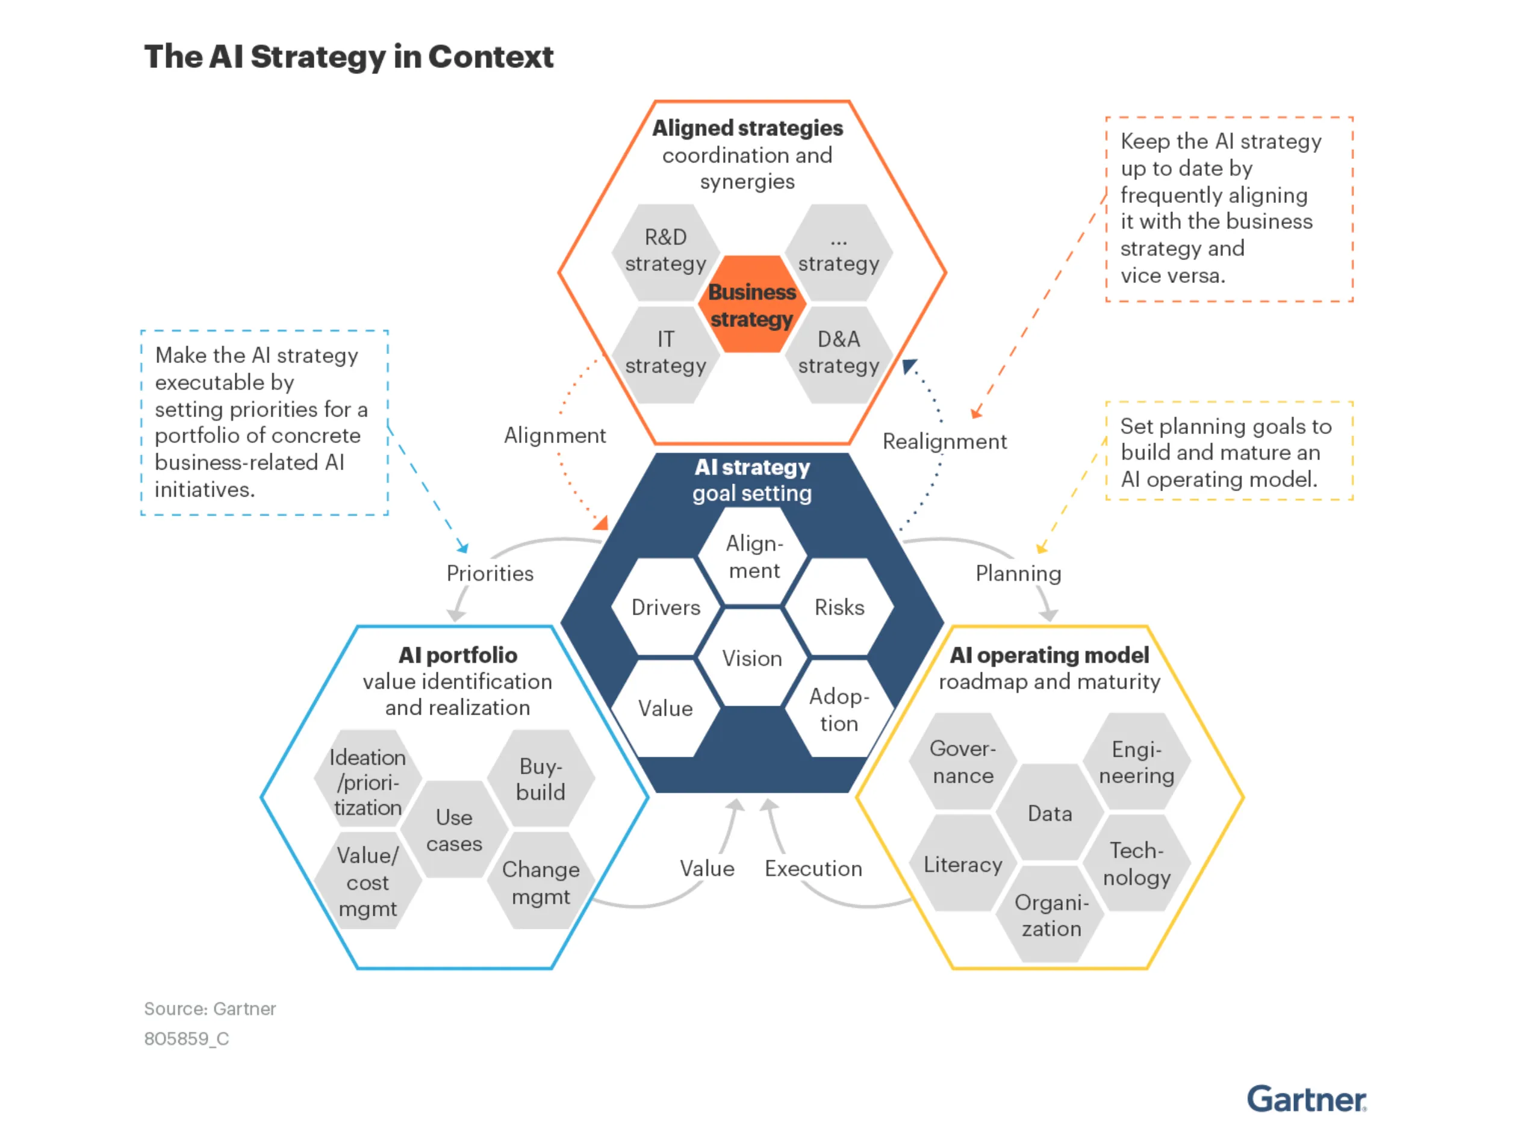
MAIN AI CONCEPTS IN DATA STRATEGY
« I AM HELIOS ELITE, SOLDIER OF THE DIGITAL »

Slide 18
STATE OF ART of AI IN DATA STRATEGY
3.1 DATA WELL MANAGED FOR BETTER RESULTS?
3.2 GENAI STRATEGIC TOOL FOR AI?
3.3 AI AGENTS FOR DATA MANAGEMENT AND BROADCASTING
3.4 SYNTHETIC DATA BOOM
« I AM HELIOS ELITE, SOLDIER OF THE DIGITAL »

Slide 19
3.1 DATA WELL MANAGED FOR BETTER RESULTS?
EXPLOIT AND VALUE DATA: GENAI BOOSTED AND MACHINE LEARNING LINKED TO UNIFIED DATA STOREHOUSE
FOR ORGANIZATIONAL AGILITY AND DATA ACCESSIBILITY BY USERS;
INTEGRATED AND PROACTIVE DATA COMPLIANCE TO REGULATION, RGPD AND EU AI ACT;
BETTER DATA MANAGEMENT AND ANALYSIS FOR SUPPORT ENHANCEMENTS;
WELL PREPARED DATA FOR AI TOOLS FOR STRATEGIC BUSINESS OBJECTIVES
GOOD GOVERNANCE AND ACCESS MANAGEMENT BY AI FACILITATE DECISIONS MAKING BY TOP MANAGEMENT;
GATHER ALL REAL-TIME DATA FROM DIFFERENT SOURCES VIA MULTIPLE CONNECTORS AND API.
« I AM HELIOS ELITE, SOLDIER OF THE DIGITAL »

Slide 20
3.1 DATA WELL MANAGED FOR BETTER RESULTS? Use cases
LEGRAND WITH Microsoft: “Scale your AI use cases with Azure AI Foundry” BOOSTS its customer support BY optimizing the management of its 300,000 references produced on a global scale by improving quality, their description, translation and updating information for its clients WITH GAIA AND ELIA tools based on AZURE OPENAI, AZURE AISEARCH, AND AZURE DATA.
CREDIT MUTUEL ARKEA and GROUPEMENT DES MOUSQUETAIRES, valorise data by exploiting like databricks, snowflake, starburst, or alteryx of ms boosted with genai and ml connected to data storehouses.
« I AM HELIOS ELITE, SOLDIER OF THE DIGITAL »

Slide 21
3.2 GENAI STRATEGIC TOOL FOR AI?
WITH AUTOMATIC ADVANCED LEARNING TECH ALLOWING TO GAIN INTELLIGENCE OUT ALL TRANSACTIONS GENERATIVE AI IS INTEGRATED INTO ALL BUSINESS PROCESSES AND OPERATIONAL IN MANY COMPANIES
ENHANCE PRODUCTIVITY WHILE RESPECTING NORMS AND COMPLIANCE
AI OFFERS PERSONNALIZABLE CLIENT EXPERIENCE AND OPTIMIZED PRODUCTIVITY: CHATBOTS, …
- AI GOVERNANCE INTEGRATING IT TO BUSINESS AND AND INSERT ORGANISATIONAL MODEL.
« I AM HELIOS ELITE, SOLDIER OF THE DIGITAL »

Slide 22
3.2 GENAI STRATEGIC TOOL FOR AI? Use cases
AXA DEPLOYS SECURE GPT OF OPENAI MORE ETHICAL AND SECURED TOOL TO GENERATE, RESUME, EDIT, TRANSLATE, CORRECT TEXTS, PICTURES, AND … CODES. IT ALLOWS EMPLOYEES TO ENHANCE THEIR PRODUCTIVITY …
MATMUT INSURANCE, AXA CONCURRENT DEVELOPS ”MATMUT PROTECTION JURIDIQUE” AN CONVERSATIONAL AI permitting 200 employees to obtain viable, rapid, sourced and actualized answers on LAWS QUESTIONS, … inducing 4.5/5 of satisfaction rate. GENERATIVE AI IS INTEGRATED INTO ALL BUSINESS PROCESSES AND OPERATIONAL IN MANY COMPANIES
ENHANCE PRODUCTIVITY WHILE RESPECTING NORMS AND COMPLIANCE
AI OFFERS PERSONNALIZABLE CLIENT EXPERIENCE AND OPTIMIZED PRODUCTIVITY: CHATBOTS, …
- AI GOVERNANCE INTEGRATING IT TO BUSINESS AND AND INSERT ORGANISATIONAL MODEL.
« I AM HELIOS ELITE, SOLDIER OF THE DIGITAL »

Slide 23
3.3 AI AGENTS FOR DATA MANAGEMENT AND BROADCASTING
AI AGENTS FURNISHING GRANULAR AND EXPLOITABLES INSIGHTS WITH ANY ANALYST INTERVENTION;
Another step in business process automatization and transformation;
Better predictive models, advanced analysis, and BUSINESS TRANSFORMATION
N.B: Agent-to-agent by google is an example of ai agent interactions protocol.
« I AM HELIOS ELITE, SOLDIER OF THE DIGITAL »

Slide 24
3.3 AI AGENTS FOR DATA MANAGEMENT AND BROADCASTING: USE CASES.
AI AGENTS in banking crime fight: In the anti-financial-crime context, it is used for automating client onboarding activities, including KYC (KNOW YOUR CUSTOMER) checks and refreshes, transaction monitoring, and sanctions or fraud investigations from alert to case closure.;
AGENT AI IN DATA MANAGEMENT: automates these processes, helping ensure data integrity and offering real-time insights, enhances operational efficiency by automating routine tasks such as data entry, cleansing and validation.;
In CRM (CUSTOMER-RELATION MANAGEMENT), agentic AI can transform customer interactions by analysing data to provide personalized recommendations, predict needs and automate follow-ups. This enhances customer satisfaction and drives sales and retention.
« I AM HELIOS ELITE, SOLDIER OF THE DIGITAL »

Slide 25
3.4 SYNTHETIC DATA BOOM
SYNTHETIC DATA mimics real data without revealing personal information, enabling AI training in privacy-sensitive fields GENERATED BY OTHER LLM .
It’s generated through statistical methods or by using AI techniques like deep learning and generative ai.
It improves compliance, reduces bias, accelerates data generation, and fosters safe cross-organization collaboration.
Challenges include quality, potential bias, legal uncertainty, and the need for responsible governance and validation.
COMPANIES CAN thus test scenarios, reinforce predictive models and secure sensible data.
« I AM HELIOS ELITE, SOLDIER OF THE DIGITAL »

Slide 26
3.4 SYNTHETIC DATA BOOM: USE CASES
IN VERSIONS 3 & R1, DEEPSEEK WILL BE TRAINED BY SYNTHETIC DATA
Gartner forecast that synthetic data would make up 60% of all data used for training LLMs by 2024 in 2023.
AI solutions company SAS ACQUIRED THE SYNTHETIC DATA STARTUP HAZY IN NOVEMBER 2024.
THE HEALTHCARE DATA IS A MINEFIELDS, AND ITS PRIVACY REGULATIONS MAKE SYNTHETIC DATA EXPONENTIAL GROWTH, SOME APPLICATIONS ARE: MRI IMAGES TO BUILD AND TEST TOOLS; LAB TESTS RESULTS, BILLING CODES, X-RAY COPIES TO RARE DISEASES
IN THE REAL-ESTATE AREA, SYNTHETIC DATA IS BEING STUDIED BY MAYEM SOLUTIONS, IT COMPANY FOR CHIC APARTS.
« I AM HELIOS ELITE, SOLDIER OF THE DIGITAL »

Slide 27
3.4 ETHICAL AND RESPONSIBLE AI
Responsible and ethical ai is a strategic priority:
Reputational impact and their revenues;
Development of transparent internal legacies for transparency;
Biais prevention and risk management of ai tools use
« I AM HELIOS ELITE, SOLDIER OF THE DIGITAL »

Slide 28
3.4 ETHICAL AND RESPONSIBLE AI: USE CASES
Orange in 2021, created a Data and AI Ethics Council OF EXTERNAL EXPERT TO ADVICE THE EXECUTIVE COMMITTEE ON AI GOVERNANCE AND ISSUED ORANGE DATA AND AI CHARTER.
FRONTIERS a WORLDWIDE research center argues that integration of Artificial Intelligence (AI) into structural engineering FOR plausible ethical dilemmas algorithmic bias in predictive models and tensions between AI-generated recommendations and human engineering judgment AND ISSUED a structured framework for responsible AI implementation, organized into three key domains:
(i) Technical Foundations (focusing on bias mitigation, robust validation, and explainability);
(ii) Operational and Governance Considerations (emphasizing industry standards and human-in-the-loop oversight);
and (iii) Professional and Societal Responsibilities (advocating for equity, accessibility, and ethical awareness among engineers).
« I AM HELIOS ELITE, SOLDIER OF THE DIGITAL »

Slide 29
PART 4
AI CHALLENGES IN DATA STRATEGY
« I AM HELIOS ELITE, SOLDIER OF THE DIGITAL »

Slide 30
4.1 - AVOIDABLE MISTAKES & potential SolUTIONS
over 80% of AI projects fail before reaching production
Mistake #1: Implementing AI Without Data Quality Foundations: establish robust data governance frameworks that include automated quality checks, consistent formatting standards, and regular validation processes.
Mistake #2: Creating Data Silos That Fragment AI Insights: approach silo elimination systematically, beginning with data discovery to understand the full scope of information fragmentation.
Mistake #3: Neglecting Data Governance and Security Protocols: establish governance frameworks before AI implementation rather than treating them as afterthoughts.
Mistake #4: Insufficient Training Data and Poor Labelling Practices: implement systematic approaches to data collection and preparation, clear labelling guidelines provided to human annotators ensuring consistency across datasets. Leveraging automation with human oversight allows AI tools to assist with labelling whilst enabling humans to correct nuanced errors. Quality assurance processes must be embedded throughout the training data lifecycle.
Mistake #5: Ignoring Real-Time Data Integration and Monitoring: comprehensive approaches that address both technical and organisational aspects of ongoing AI management. Regular reviews of AI tool performance and measurement of results enable continuous improvement, ensuring that systems adapt to changing conditions rather than becoming obsolete.
« I AM HELIOS ELITE, SOLDIER OF THE DIGITAL »

Slide 31
4.2 - Actionable recommendations
Create an AI strategy revolving around a vision that is fully aligned with business goals, market conditions and competitive pressure regarding the use of AI.
Make the AI strategy executable by setting priorities for a portfolio of concrete business-related AI initiatives, and by setting planning goals to build and mature an AI operating model.
Keep the AI strategy up-to-date by frequently aligning or realigning it with the business strategy and vice versa while continuously seeking synergies with complementary strategies such as digital/IT, and data and analytics (D&A) strategies.
« I AM HELIOS ELITE, SOLDIER OF THE DIGITAL »

Slide 32
CONCLUSION
The ultimate goal transcends technology implementation to encompass business transformation that delivers measurable competitive advantages. AI data challenges become opportunities for operational improvement when organisations approach them systematically with appropriate resources and realistic expectations. Small and Medium-size Business that master these fundamentals position themselves not just for AI success but for sustained leadership in an increasingly digital marketplace.
Success requires commitment to continuous learning and adaptation as both AI technologies and business requirements evolve. The organisations that thrive are those that view data quality and AI implementation as ongoing journeys rather than destination projects, building capabilities that compound over time to create sustainable competitive advantages in an AI-powered business environment.
« I AM HELIOS ELITE, SOLDIER OF THE DIGITAL »

Slide 33
SOURCES
IBM PUBLICATIONS,
GARTNER INSTITURE REVIEWS;
ISO 27001;
EU AI ACT;
NETWORK CENTRICS SUPPORT, LONDON WEBSITE;
MAYEM SOLUTIONS AI DATA PROTECTION STRATEGY*
ISO/IEC 27005.
« I AM HELIOS ELITE, SOLDIER OF THE DIGITAL »

Slide 34
THANK YOU FOR YOUR KIND ATTENTION, ....
{......
....QUESTIONS;
.....}
« I AM HELIOS ELITE, SOLDIER OF THE DIGITAL »

