Slide 1

INDUSTRY 4.0: State of the Art, perspectives and Challenges.
By Colonel MBECK MOMENDENG Jean Levrai,
HELIOS Project Executive Manager
ICCF & eMBA @HEC Paris
CSEP-ASEP-CISM – CISSP-CISO
ISO/IEC 27005-EBIOS 27005 Certified
« I AM HELIOS ELITE, SOLDIER OF THE DIGITAL »

Slide 2
AIM
Industry 4.0 stands for the fourth industrial revolution, which is characterized by the digital transformation and automation of production is up to increase efficiency, flexibility and networking in production. Companies benefit from higher productivity, improved processes and new business models, but are also faced with challenges such as high investment costs, complex implementations and data protection issues. The various
areas of production, logistics, IT and personnel planning, which have to adapt to the new technologies, are particularly affected.
ITS enables production processes to be monitored and optimized in real time and errors to be detected and rectified at an early stage: improvement in product quality., advanced technologies to collect and analyze real-time data strengthens the innovative power and market position of companies, resulting in an increase in competitive strength.
« I AM HELIOS ELITE, SOLDIER OF THE DIGITAL »

Slide 3
PLAN
1- industry hISTORIC REVIEW
2- INDUSTRY 4.0’s STATE OF THE ART
3- INDUSTRY 4.0 TECH CHALLENGES
4- INDUSTRY 4.0 TECHS TRENDS AND CHALLENGES.
« I AM HELIOS ELITE, SOLDIER OF THE DIGITAL »

Slide 4
PART 1
INDUSTRY HISTORIC REVIEW
« I AM HELIOS ELITE, SOLDIER OF THE DIGITAL »

Slide 5
1.1- WHAT IS INDUSTRY 1.0?
Starting in the late 18th century in Britain, the first industrial revolution helped enable mass production by using water and steam power instead of purely human and animal power: Finished goods were built with machines rather than painstakingly produced by hand.
« I AM HELIOS ELITE, SOLDIER OF THE DIGITAL »

Slide 6
1.2- INDUSTRY 2.0
A century later, the second industrial revolution introduced assembly lines and the use of oil, gas and electric power. These new power sources, along with more advanced communications via telephone and telegraph, brought mass production and some degree of automation to manufacturing processes.
« I AM HELIOS ELITE, SOLDIER OF THE DIGITAL »

Slide 7
1-3. INDUSTRY 3.0
The third industrial revolution, which began in the middle of the 20th century, added computers, advanced telecommunications and data analysis to manufacturing processes. The digitization of factories began by embedding programmable logic controllers (PLCs) into machinery to help automate some processes and collect and share data.
« I AM HELIOS ELITE, SOLDIER OF THE DIGITAL »

Slide 8
PART 2
INDUSTRY 4.0’S
STATE OF THE ART
« I AM HELIOS ELITE, SOLDIER OF THE DIGITAL »

Slide 9
2-1. INDUSTRY 4.0 CONCEPT
Industry 4.0, which is synonymous with smart manufacturing, is the realization of the digital transformation of the field, delivering real-time decision making, enhanced productivity, flexibility and agility to revolutionize the way companies manufacture, improve and distribute their products.
Flexibility is improved so that manufacturers can better meet customer demands using mass customization—ultimately seeking to achieve efficiency. By collecting more data from the factory floor and combining that with other enterprise operational data, a smart factory can achieve information transparency and better decisions.
« I AM HELIOS ELITE, SOLDIER OF THE DIGITAL »

Slide 10
2.2- UNDERSTANDING INDUSTRY 4.0
Transforming how the manufacturing sector operates, Industry 4.0 includes integrating innovative technologies like cloud computing, the Internet of Things (IoT), artificial intelligence, machine learning, and analytics to construct what is known as smart factories.
Also regarded as digital 4.0, this revolution will equip industries with advanced sensors, robotics, and software to ingest and analyze massive amounts of data to facilitate better outcomes.
The value generated would be further enhanced with the help of operational data received from enterprise resource planning (ERP), customer service, supply chain, and other systems to generate constructive insights.
« I AM HELIOS ELITE, SOLDIER OF THE DIGITAL »

Slide 11
2-3. INDUSTRY 4.0 TECH DRIVERS
IoT
CLOUD COMPUTING
AI & MACHINE LEARNING;
EDGE COMPUTING;
Cybersecurity
Digital twins
…
ADDITIVe manufacturing;
Augmented reality;
Big data;
Autonomous robots;
simulation;
System integration;
…
« I AM HELIOS ELITE, SOLDIER OF THE DIGITAL »

Slide 12
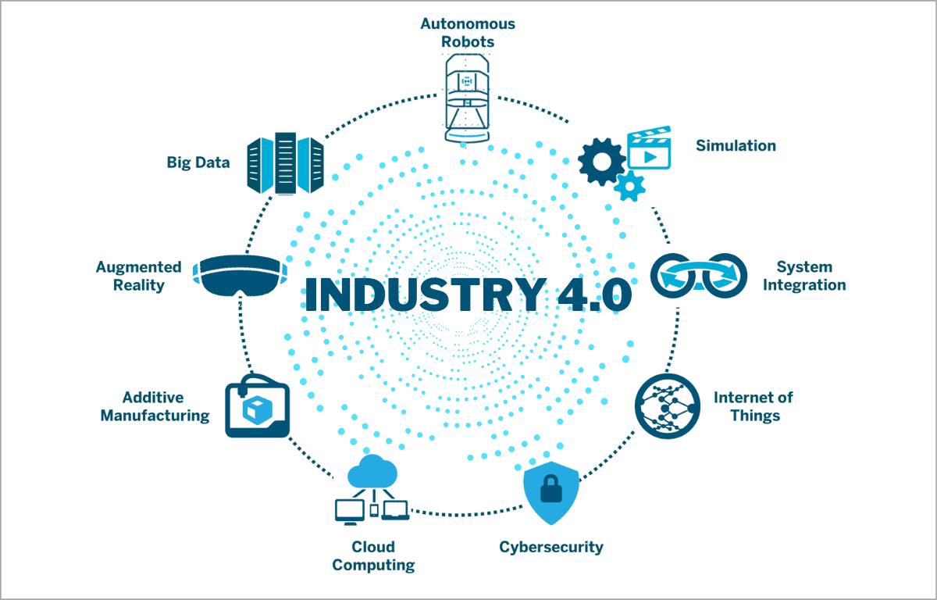
2-3. INDUSTRY 4.0 TECH DRIVERS
« I AM HELIOS ELITE, SOLDIER OF THE DIGITAL »

Slide 13
2-4. CHARACTERISTICS OF SMART FACTORY
Data analysis for optimal decision making
Embedded sensors and interconnected machinery produce a significant amount of big data for manufacturing companies. Data analytics can help manufacturers investigate historical trends, identify patterns and make better decisions. Smart factories can also use data from other parts of the organization and their extended ecosystem of suppliers and distributors to create deeper insights. By looking at data from human resources, sales or warehousing, manufacturers can make production decisions based on sales margins and personnel. A complete digital representation of operations can be created as a "digital twin".
IT-OT integration
The smart factory’s network architecture depends on interconnectivity. Real-time data collected from sensors, devices and machines on the factory floor can be consumed and used immediately by other factory assets, as well as shared across other components in the enterprise software stack, including enterprise resource planning (ERP) and other business management software.

Slide 14
2-4. CHARACTERISTICS OF SMART FACTORY
Data analysis for optimal decision making
Embedded sensors and interconnected machinery produce a significant amount of big data for manufacturing companies analyzed help manufacturers investigate historical trends, identify patterns and make better decisions. also use data from other parts of the organization and their extended ecosystem of suppliers and distributors to create deeper insights. By looking at data from human resources, sales or warehousing, manufacturers can make production decisions based on sales margins and personnel. A complete digital representation of operations can be created as a "digital twin".
IT-OT integration
The smart factory’s network architecture depends on interconnectivity. Real-time data collected from sensors, devices and machines on the factory floor can be consumed and used immediately by other factory assets, as well as shared across other components in the enterprise software stack, including enterprise resource planning (ERP) and other business management software.

Slide 15
2-4. CHARACTERISTICS OF SMART FACTORY
Custom manufacturing
Smart factories can produce customized goods that meet individual customers’ needs more cost-effectively. using advanced simulation software applications, new materials and technologies such as 3-D printing, manufacturers can easily create small batches of specialized items for particular customers. Whereas the first industrial revolution was about mass production, Industry 4.0 is about mass customization.
Industry 4.0 and hybrid multicloud IT architecturE
Building a hybrid multicloud (TWO OR MORE) IT infrastructure is a key component in digital transformation for manufacturers seeking to take advantage of Industry 4.0. to manage workloads FOR OPTIMIZATION.
Supply chain
Industrial operations in 4.0, are dependent on a transparent, efficient supply chain, which must be integrated with production operations as part of a robust Industry 4.0 strategy.
By sharing some production data with suppliers, manufacturers better schedule deliveries. deliveries can be rerouted or delayed in order to reduce wasted time or cost. Also, by studying weather, transportation partner and retailer data, companies can use predictive shipping to send finished goods at just the right time to meet consumer demand. Blockchain is emerging as a key technology to enable transparency in supply chains.

Slide 16
PART 3
INDUSTRY 4.0’S TECH CHALLENGES
« I AM HELIOS ELITE, SOLDIER OF THE DIGITAL »

Slide 17
3.1- INDUSTRY 4.0 OFFERS & BENEFITS
« I AM ELITE, SOLDIER OF THE DIGITAL » HELIOS

Slide 18
3.1.1 INDUSTRY 4.0 OFFERS
1. Automatic adaptation to different product requirements: Sensors and actuators automatically adjust to different packaging sizes and shapes, NO need for manual intervention.
2. Real-time data analysis: continuous monitoring and analysis of production data ENHANCE quick REACTION to changes in production conditions or to specific customer reqUIREMENTS, production planning and control flexible.
3. Modular DESIGN OF production systems: quickly replacEMENT or reconfigurATION
4. Customized production: digitally control production data and processes, customized products in small batch sizes without compromising efficiency.
5. Integration of customer requirements: By BROAD connectiON production orders can be taken directly from LOW LEVEL systems and integrated into the production process in real time.
« I AM HELIOS ELITE, SOLDIER OF THE DIGITAL »

Slide 19
3.1.2- INDUSTRY 4.0 BENEFITS
1. Increase in productivity: According to the study "Industry 4.0 technologies: Implementation patterns in manufacturing companies." by Frank et al (2019) the use of Industry 4.0 technologies such as digital twins, intelligent sensors and automated systems leads to a significant increase in productivity.
2. Increasing flexibility: Production systems can be adapted quickly and cost-effectively to changing market and customer requirements, including the ability to manufacture personalized products.
3. Improving product quality: According to the study by Frank et al (2019), the use of real-time monitoring and control, data-driven analyses and intelligent manufacturing systems also significantly improves product quality by detecting and correcting errors at an early stage.
4. Reduction of downtimes: Predictive maintenance allows failures to be detected and prevented at an early stage. This increases the effectiveness of the system.
5. Optimization of resource consumption: Intelligent systems help to optimize the use of energy and materials. This saves costs and reduces the impact on the environment.
6. Increasing competitiveness: By implementing advanced technologies, companies can increase their innovative strength and position themselves better on the market.
7. Better decision-making: Collecting and analyzing real-time data enables more comprehensive insights into production processes, which supports informed decisions and improved overall control.
8. Improvement of working conditions: Automated systems and advanced technologies help to improve safety and ergonomics in the workplace. This promotes the health and satisfaction of employees.
9. Promotion of sustainability: Industry 4.0 technologies contribute to the achievement of sustainability goals through more efficient use of resources and reduced environmental impact.
« I AM HELIOS ELITE, SOLDIER OF THE DIGITAL »

Slide 20
3.2 – INDUSTRY 4.0 TECH TRENDS & INNOVATION
« I AM HELIOS, ELITE SOLDIER OF THE DIGITAL »

Slide 21
3.2 – INDUSTRY 4.0 TECH TRENDS & INNOVATION
FUNCTIONALITIES | TECHNOLOGIES | TRENDS & INNOVATION | CYBERSECURITY TECHS
AUTONOMUOUS ROBOTICS | AI/ML, MiLARS, Lidar, Domotics | DIGITAL TWINS
SIMULATION | AI/ML, Protheus, GNS3, FlexSIM | HPC (High Performance Computing)
SYSTEM INTEGRATION | ESB, API-FI, LOW/NO-CODE, | IoT Driven Technology
INTERNET OF THINGS | IIoT, IPv6 , 6LowPan, 5G, | AIoT (Healthcare, Agriculture, ...) , LowerOne, Opentrend,
CYBERSECURITY | HRM, Resilience, SOC, ZTNA, | Quantum Security, Agent IA,
CLOUD COMPUTING | Hybrid and multi-Cloud Computing | SEVERLESS COMPUTING (FaaS)
ADDITIVE MANUFACTURING | 3D-PRINTING, Advanced Automation, | Multi-Material Printing,
AUGMENTED REALITY | WebAR, Spatial Computing & Mapping | MetaVers,
BIG DATA | HPC, DISTRIBUTED DATA, No-SQL DB, | Edge Computing, DaaS,.HDFS,HIVE,
EDGE COMPUTING | CONTENEURIZATION, VIRTUALIZATION, ... | EDGE AI, ETL, ELTN,
« I AM ELITE, SOLDIER OF THE DIGITAL » HELIOS

Slide 22
3.2.1 KEY TAKE AWAYS
increased automation, improved data analytics, and enhanced production efficiency.
high implementation costs,
potential job displacement.
benefits and drawbacks UNDERSTANDING is essential for successful adoption and integration of Industry 4.0 technologies.
rapid adaptATION OF operations to market changes.
cybersecurity : remains a major concern and is one of the largest challenges.
« I AM HELIOS ELITE, SOLDIER OF THE DIGITAL »

Slide 23
CONCLUSION
With the of ai, we definitely move from industry 4.0 to the 5.0 version comprising the venue of the human control under techs and opening a bright future to the mixure between it and industry landscape. This will indue some new concepts of manufacturizing and job descriptions reshaping our lifes. ThosE great potentials will generate the needs in computational power, storage constraints and network resources sollicitation. Those so bright incoming days will need too many expertise of genius able to design and build those so complex systems of systems: architects systems engineers and high level technology professionals.
« I AM HELIOS ELITE, SOLDIER OF THE DIGITAL »

Slide 24
THANK YOU FOR YOUR KIND ATTENTION, ....
{....
QUESTIONS? }
« I AM HELIOS ELITE, SOLDIER OF THE DIGITAL »

