Slide 1
FAIf: FABulous Analogue Interface
Aim:
To provide useful general purpose analogue peripherals
To stress-test/smoke-test the EDA & build tool capabilities
What we did:
Ported analogue blocks to IHP-SG13CMOS5L PDK,
Implemented an ADC and DAC,
Lots of simulations and verification,
Using a mix of VHDL and SystemVerilog…
By the Analogue Mixed Signal Team:
Pascal Gesell, Torsten Maehne, Graeme Bragg & Benedikt Lukat

Slide 2
The Idea
Not a lot of blocks, but we are using most bits of the process.

Slide 3
Achievements
Various analogue blocks ported to the PDK
OpAmp is being used by another team
DACs offered as audio output
Component-level simulation (A & D) of everything that is complete.
VHDL system-level simulation.
FPGA Verification of digital modules
We kept Simon and Leo up late with upstream bugs and issues…

Slide 4
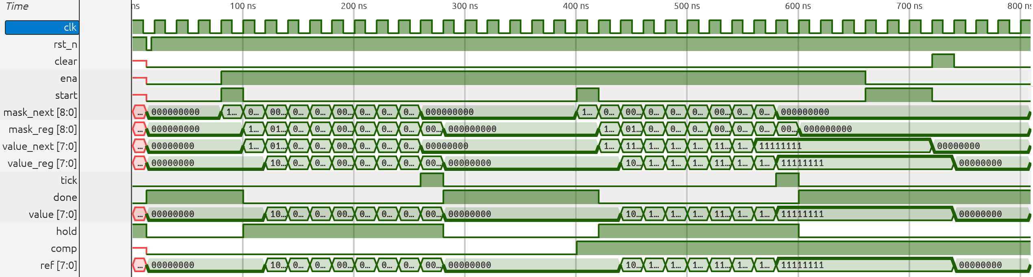
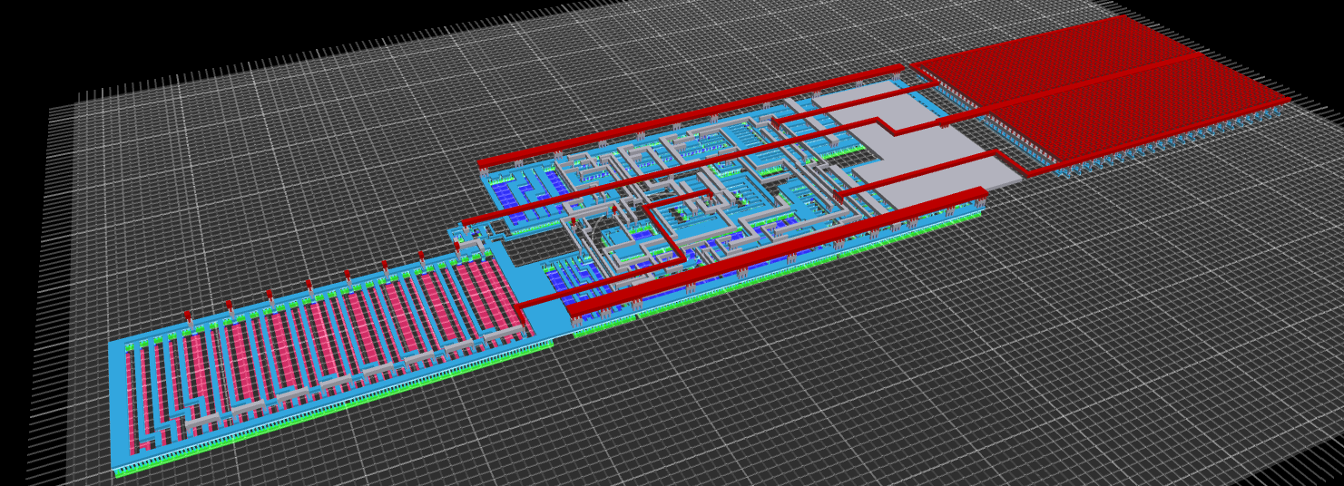
Pretty Pictures

