Slide 1
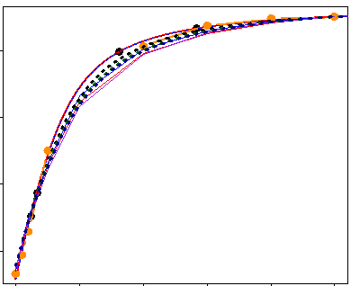
NLS estimation of photosynthetic response and evaluate models
Extract parameters from linear model
Model the evolution of functional traits
P_{max}
I₈₅
φ
I_{comp}
R_{D}
Impute functional traits in new species with ancestral state reconstruction
Model the evolution of imputed traits
P_{max}, PARi₈₅, φ, I_{comp}, R_{D}
Predict response of a new species using imputed parameters

