Slide 1
AoI-based Scheduling for Networked Control Systems over Gilbert-Elliot Channels Bachelor Thesis Final Presentation
Henry He
henry.he@tum.de
M.Sc. Onur Ayan
onur.ayan@tum.de
Notes:
Welcome to the final presentation of my bachelor‘s thesis. The title is AoI-based Scheduling for Networked Control Systems over Gilbert-Elliot Channels.

Slide 2
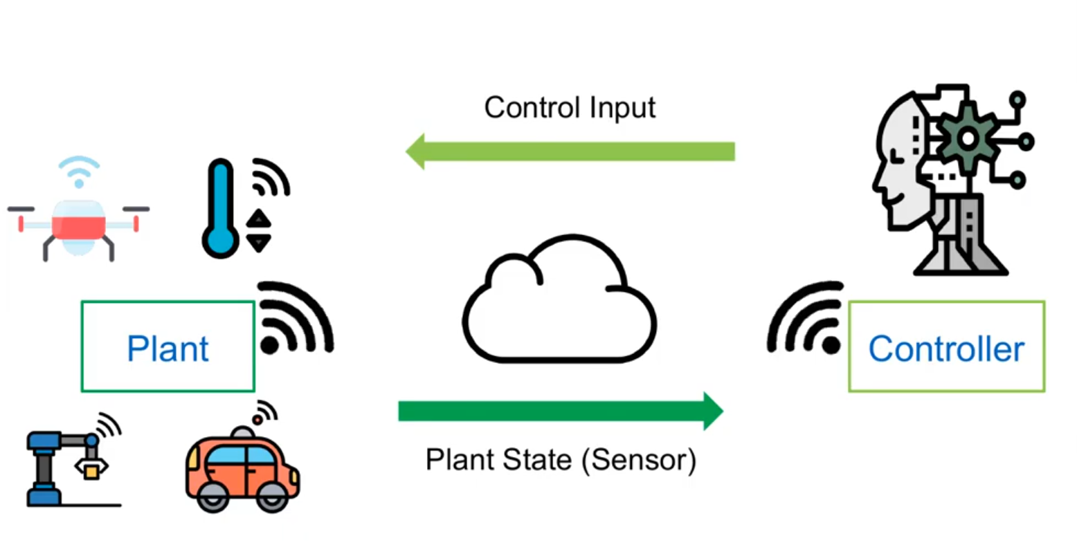
Networked Control Systems:
Feedback control loops closed over a communication network
How to schedule NCS efficiently?
Solution: Application-aware scheduler for MAC
Notes:
Now before we start, I’ll briefly describe the motivation behind the thesis. Many emerging applications for the upcoming 5G network such as industrial automation fall into the category of Networked Control Systems. These are feedback control loops which are closed over a communication network, as you can see here in this figure. However, the network introduces delays, limited bandwidth and time-varying channel conditions which makes control over networks difficult. A common problem for the network is how it should manage medium access efficiently so that different requirements are met e.g. in case of time-critical applications. A solution to this problem are application-aware schedulers

Slide 3
Agenda
Preliminaries
Problem Statement
Gilbert-Elliot Channel Model
State of the Art
Methodology
Simulation Setting
Evaluation
Performance Metric
Results
Conclusion
Notes:
This is the agenda for the presentation. We will first define our problem and then go through some Background. Afterwards I will describe the Methodology of the investigations conducted in this thesis and finally present the results of the investigations as well as give a conclusion.

Slide 4
Preliminaries
Notes:
We will first define our problem and then go through some Background

Slide 5
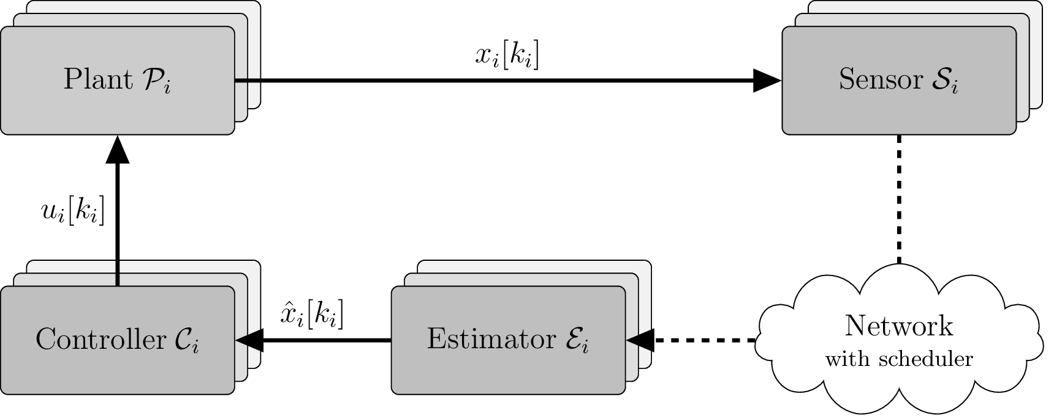
Problem Statement
Centralized resource scheduling problem for a single wireless link shared by multiple heterogeneous NCS with time-varying channel conditions
Remote estimation process between each sensor-controller pair
Goal: Optimal control-aware scheduler which takes the Gilbert-Elliot Channel Model fully into account
Notes:
We have studied a centralized resource scheduling problem for a single wireless link shared by multiple heterogeneous NCS where the channel is prone to time-varying channel conditions. The figure illustrates the considered scenario, where we have multiple sub-systems. Each of them consists of a plant, a sensor measuring the plant’s output. The measurement is then sent over the network to a remote located controller which employs a Kalman-like estimator to mitigate network-induced shortcomings. The estimated state is then used by the controller to calculate the control input according to its control law. The goal here is to derive an optimal control-aware scheduler which takes the Gilbert-Elliot Channel Model fully into account, which is the channel model we are assuming for the sensor-estimator link.

Slide 6
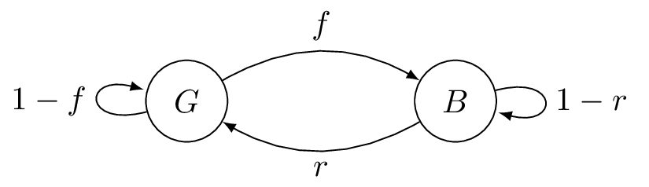
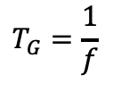

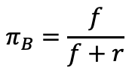

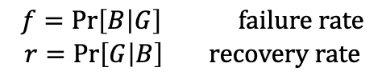

Gilbert-Elliot (GE) Channel Model
Simple model for burst errors typical in wireless networks
Two state Markov Chain
Good & Bad states
State transition probabilities
$$f=\text{Pr}\left[B | G\right] \text{failure} \text{rate}$$
$$r=\operatorname{Pr}\left[G | B\right] \text{recovery} \text{rate}$$
Statistical properties
Stationary state probabilities
Average error probability
Mean sojourn time
$$π_{G}=\frac{r}{f+r}$$
$$π_{B}=\frac{f}{f+r}$$
$$p_{E}=π_{G}p_{G}+π_{B}p_{B}$$
$$T_{G}=\frac{1}{f}$$
$$T_{B}=\frac{1}{r}$$
Notes:
So what does the Gilbert-Elliot Channel Model encompass. It is a simple model for burst errors which are typically found in wireless networks. Mathematically it is a homogenous Markov Chain with two states and its corresponding loss and state transition probabilities as seen in this figure. These values parametrize the channel and one can interpret them quite intuitively in term of these 3 properties. First of, the stationary state probabilities are the average percentage of time in which the channel is in G or B. With these ,the average error probability can be obtained. Another characteristic defined by the GE model is the mean sojourn time, which is the average duration that the channel stays in a state.

Slide 7
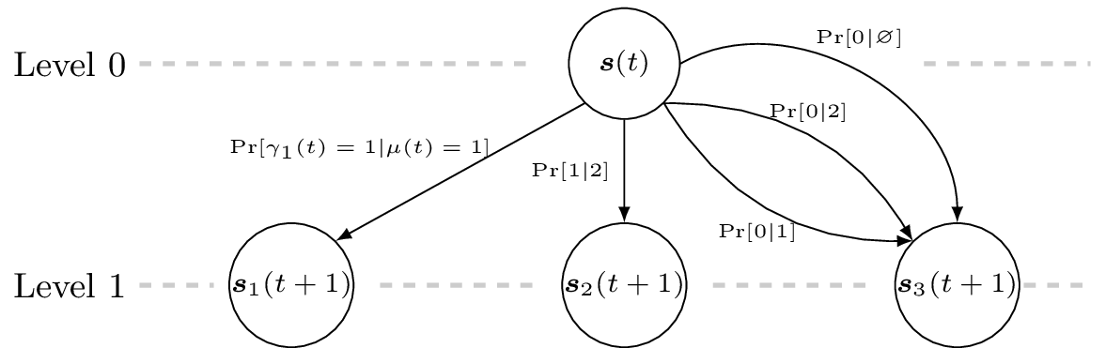
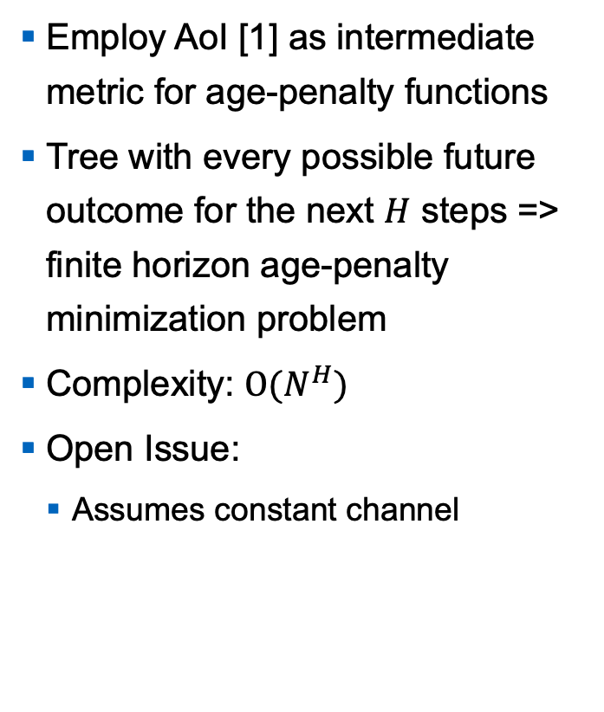
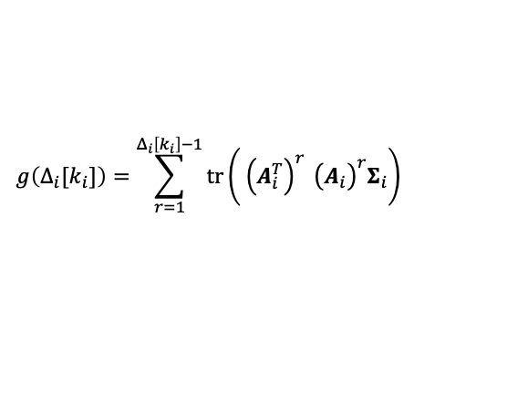
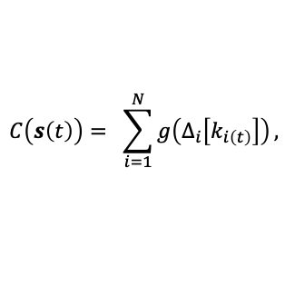

State of the Art: Finite Horizon Scheduler (FHS) [2]
Employ AoI [1] as intermediate metric for age-penalty functions
Tree with every possible future outcome for the next $H$ steps => finite horizon age-penalty minimization problem
Complexity: $Ο(N^{H})$
Open Issue:
Assumes constant channel
System dynamics
$$g\left(Δ_{i}[k_{i}]\right)=\sum_{r=1}^{Δ_{i}\left[k_{i}\right]−1}{tr\left.\left( {\left.\left(A_{i}^{T}\right.\right)}^{r} {\left.\left(A_{i}\right.\right)}^{r}Σ_{i}\right.\right)}$$
$$C\left(s\left(t\right)\right)= \sum_{i=1}^{N}{g\left(Δ_{i}\left[k_{i\left(t\right)}\right]\right)},$$
Example tree structure of FHS for $N=2$ sub-systems and finite horizon $H=1$
Notes:
For a similar scenario my supervisor already proposed a scheduling policy based on Age-of-Information called Finite Horizon Scheduler. Age-of-Information itself is a recently introduced network metric quantifying information staleness at a receiver. FHS employs AoI as an intermediate metric to calculate age-penalty functions which makes the scheduler control-aware. This you can see in the way how it is calculated. As it incorporates the system dynamics. A are the system matrices of the underlying sub-systems. What the FHS does is it builds up a tree of every possible outcome for the next H time steps. It assigns a age penalty for every outcome and performs a stochastic minimization to obtain the least expensive scheduling decision. Here you can see an example tree for H=1, which means the scheduler looks one step into the future and 2 sub-systems. Building such a tree is computational expensive as seen in its complexity which is exponential. An issue with FHS is that for the H time steps it looks into the future it assumes the channel to stay constant. So it is not directly applicable to a GE channel. So what I did was to extend the finite horizon scheduler to account for possible channel state transitions according to the GE channel model.

Slide 8
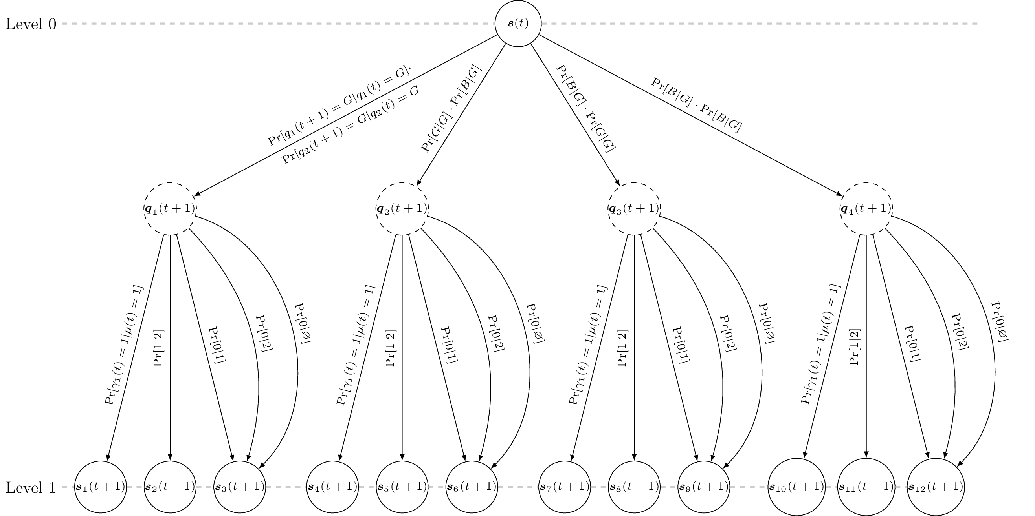

GE Channel-aware Finite Horizon Scheduler (GES)
$2^{N}$ times more possible network states for one level due to GE channel transitions => Complexity: $Ο(2^{NH})$
Notes:
So, this is how my extension looks like. For a single time step there are 2^N times more possible network states to consider due to the GE channel transitions. These can be seen in the intermediate nodes in the example tree. Each of these intermediate nodes form the root for the tree seen before. Being fully GE aware incurs a significant amount of computational burden as the tree is bigger for the same setting which is also reflected in the worse complexity.

Slide 9
Methodology
Notes:
I will describe the Methodology of the investigations conducted in this thesis

Slide 10
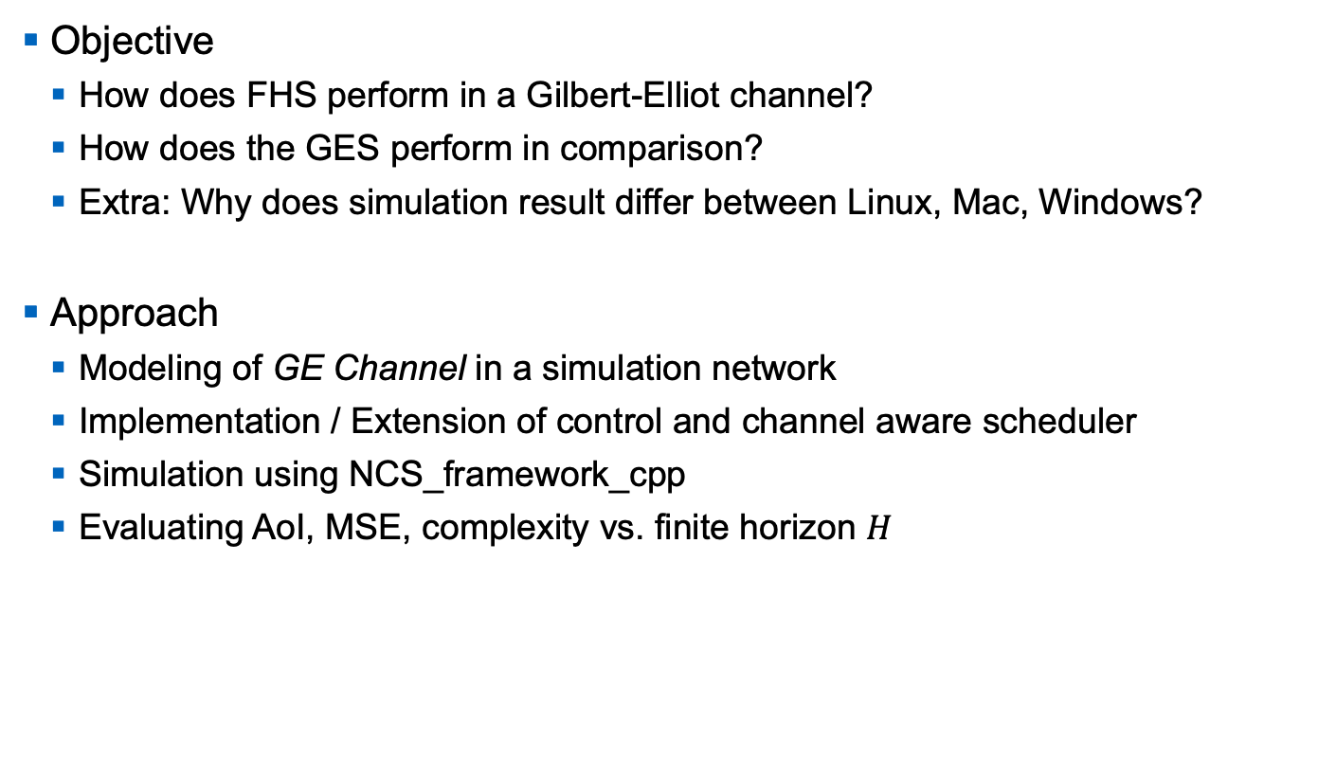
Objective and Approach
Objective
How does FHS perform in a Gilbert-Elliot channel?
How does the GES perform in comparison?
Extra: Why does simulation result differ between Linux, Mac, Windows?
Approach
Modeling of GE Channel in a simulation network
Implementation / Extension of control and channel aware scheduler
Simulation using NCS_framework_cpp
Evaluating AoI, MSE, complexity vs. finite horizon $H$

Slide 11
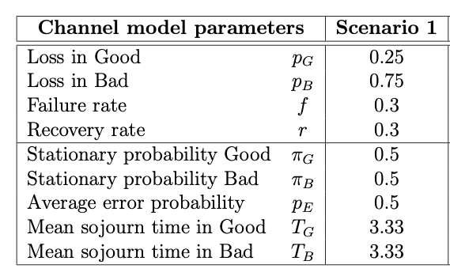
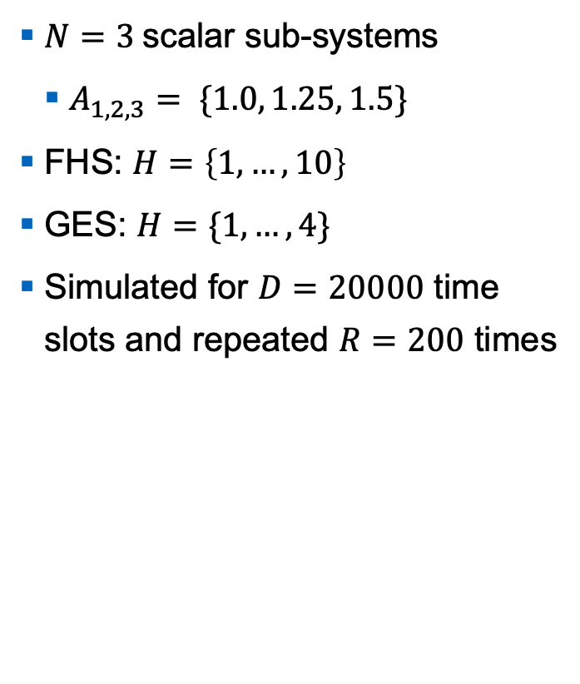
Simulation Setting
$N=3$scalar sub-systems
$A_{1,2,3}= \left.\{1.0, 1.25, 1.5\right.\}$
FHS: $H=\left\{1,…,10\right\}$
GES: $H=\{1,…,4\}$
Simulated for $D=20000$ time slots and repeated $R=200$ times
Notes:
In order to evaluate the scheduler performance, I have chosen three different scenarios. Because of time constraints I am merely presenting the first scenario consisting of 3 scalar sub-systems. These are chosen to have different system dynamics with increasing unstable system matrices. Note that A_3 is the most critical sub-system as in one time slot its state can deviate the most. We varied the finite horizon parameter or farsightedness to investigate its effect on the scheduler performance. For each horizon size we simulated 20000 time steps which was repeated 200 times. For scenario 1 these are the channel parameters. It is a quite challenging channel where the channel is in good and bad states 50% of the simulation time on average. Further on average half of the packets are lost. And the mean sojourn times are 3.33 slots for Good and Bad each.

Slide 12
Evaluation
Notes:
Finally, here are the results of the investigations

Slide 13

Performance Metric
Mean Squared Error (MSE)
$$MSE_{i}= \frac{1}{D}\sum_{t=1}^{D}{{e_{i}(t)}^{T}e_{i}(t)}, \overline{MSE}=\frac{1}{N}\sum_{i=1}^{N}{MSE_{i}}$$
Reflects estimation accuracy
Notes:
Since the network users are remote estimation processes, our main performance metric is the Mean Squared error of how much the state estimation differs from the real state at each time slot. This we have done for both for a single sub-system as well as the average in the whole network.

Slide 14
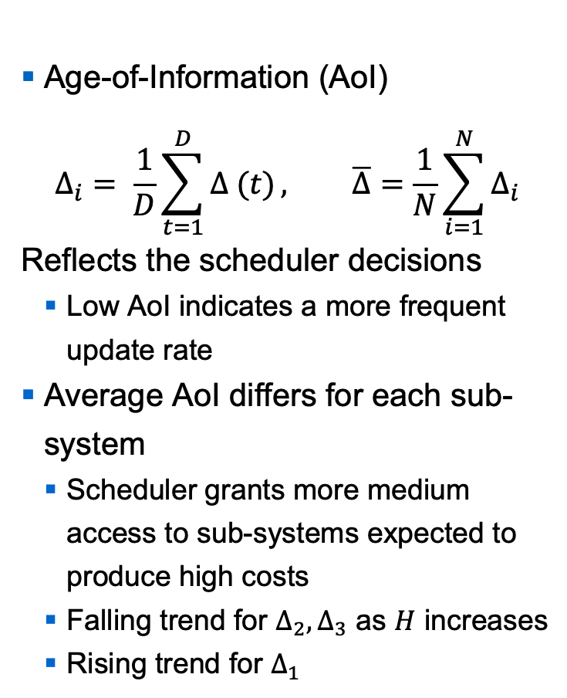
AoI Performance
FHS
Age-of-Information (AoI)
$$Δ_{i}= \frac{1}{D}\sum_{t=1}^{D}{Δ (t)}, \overline{Δ}=\frac{1}{N}\sum_{i=1}^{N}{Δ_{i}}$$
Reflects the scheduler decisions
Low AoI indicates a more frequent update rate
Average AoI differs for each sub-system
Scheduler grants more medium access to sub-systems expected to produce high costs
Falling trend for $Δ_{2}{,Δ}_{3}$ as $H$ increases
Rising trend for $Δ_{1}$
GES

Slide 15
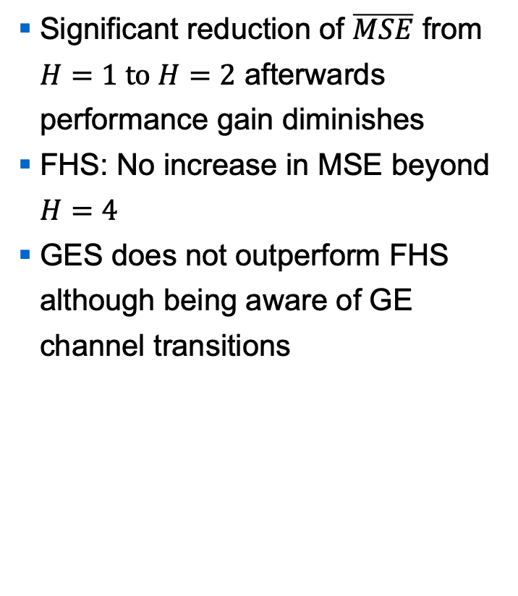
MSE Performance
FHS
Significant reduction of $\overline{MSE}$ from $H=1 to H=2$ afterwards performance gain diminishes
FHS: No increase in MSE beyond $H=4$
GES does not outperform FHS although being aware of GE channel transitions
GES
Notes:
This is the result. The top plot is the FHS and the bottom one is the GES performance. Both show this decreasing trend where we observe a significant decrease of MSE from H=1 to H=2. For higher H values the trajectory converges which means that the performance gain diminishes. What was quite surprising is that for FHS the MSE did not increase beyond H=4. We initially expected that because the mean sojourn time is 3.33t for H beyond 4 FHS would potentially wrong nodes in its tree which in turn would lead to bad decisions. Further comparing GES with FHS, although being aware of GE channel transitions GES does not outperform the FHS. This can be seen for instance at H=2 where the GES values are higher compared to FHS.

Slide 16

AoI Distribution
Most up-to-date plant measurements are available to task-critical sub-systems
$A_{3}=1.5$ has highest 1 AoI count
Shift for higher AoI values
Similar geometrical AoI distribution to the derived AoI pmf from [3]
Notes:
In addition to get a further insight of the age performance of the single sub-systems, I have measured the AoI distribution. This plot shows a histogram of the individual AoI states. We can observe that the most up-to date plant measurements were available to the most critical sub-systems which means they were scheduled more often. For instance here the green column is the highest, which is the count for A_3, followed by A_2 and A_1. For higher H values this order shifts, meaning A_1 was scheduled the least. With our measurement we could also verify the closed form geoemetrical AoI distribution from this paper. In this figure I simulated the identical scenario as in the paper. As you can see the measurement follows the paper's analytical pmf.

Slide 17
Effect of OS on Simulation Results
For the same setting MSE differ among OSs
MSE: Almost 50% deviation between Linux and Windows
Deviating scheduler decisions can be caused by
Inconsistent Random Number Generators
Inconsistent Cost Maps from where the total cost is taken from
Inconsistent floating point operations
Notes:
While we were evaluating the scheduler, we noticed that the simulation results for the same setting were different when simulating on Linux, mac and Windows. Here you can see this effect on MSE performance. For instance at H=1 the Windows and Linux trajectory deviate almost 50% which is not negliigable. Deviating MSE for the same simulation setting can only be caused by different scheduler decisions taken by the scheduler. These can be caused by the following 3 reasons. Say first two causes are from the algorithm and the last from the runtime / lower level.

Slide 18
Numerical effects on Scheduler
Realizations of normal and uniform distributions show consistent Random number generators
Cost are obtained from the same cost maps
Notes:
I investigated the first two reasons. For that I generated a million realizations of a normal and uniform distribution for all 3 OSs. As you can see the random number generators are consistent. The same goes for the cost maps of the scheduler. So in the end I could not find the root cause for the deviating OS behavior.

Slide 19
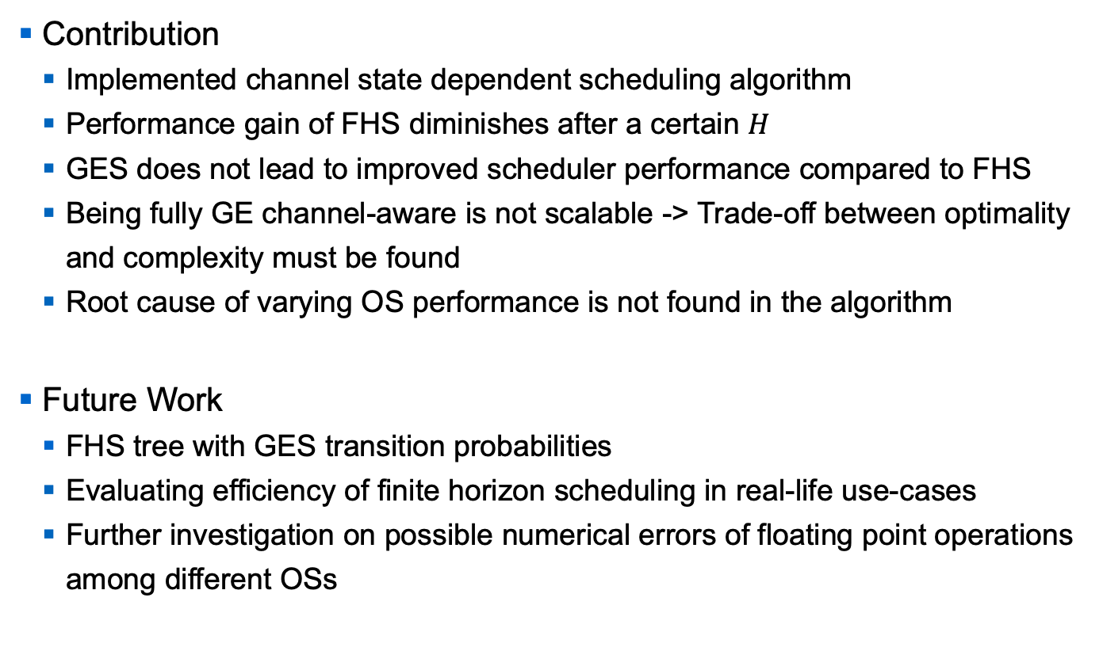
Summary of Thesis Results
Contribution
Implemented channel state dependent scheduling algorithm
Performance gain of FHS diminishes after a certain $H$
GES does not lead to improved scheduler performance compared to FHS
Being fully GE channel-aware is not scalable -> Trade-off between optimality and complexity must be found
Root cause of varying OS performance is not found in the algorithm
Future Work
FHS tree with GES transition probabilities
Evaluating efficiency of finite horizon scheduling in real-life use-cases
Further investigation on possible numerical errors of floating point operations among different OSs
Notes:
So concluding everything, my contribution is that I have impleneted a channel state dependent scheduling algorithm. Our evalutation showed that perfromacne gain for FHS diminishes after a certain horizon. Further, GES altoguh being fully channel-aware does not outperform FHS. We have also observed that being fully GE-aware is not scalable. We failed already at H=3 and that is the reason why we did not simulate further than H=4 for GES, because runtime were not feasible. That‘s why a trade-off between optimality and complexity must be found. Last but not least altough we could not find the root cause of deviating OS behavior, we ruled out our scheduling algorithm to be the origin. Future works can tackle the trade-off and an idea here would be to reuse the FHS tree structure but incroporate GE model by using the GES transition probabilities. For simplicity, we assumed scalar sub-systems in our simulation setup. Further research can be put into evaluating the efficiency of finite horizon scheduling in real-life use-cases. An example would be a vehicular scenario case-study where the users are applications from the vehicular domain, e.g. cruise control, motor speed etc. Refering to the deviating OS behavior, a further investigation is needed to check if there are inconsistencies in the floating point operations among different OSs.

Slide 20
References
[1] Kaul, Sanjit, Roy Yates, and Marco Gruteser. "Real-time status: How often should one update?." 2012 Proceedings IEEE INFOCOM. IEEE, 2012.
[2] Ayan, Onur, et al. "AoI-based Finite Horizon Scheduling for Heterogeneous Networked Control Systems." arXiv preprint arXiv:2005.02037 (2020).
[3] Ayan, Onur, et al. "Probability Analysis of Age of Information in Multi-hop Networks." IEEE Networking Letters 2.2 (2020): 76-80.

Slide 21

Questions?
Notes:
This would be the end of my presentation. Thank you for your attention and now I would be happy to take some questions.

Slide 22
Appendix

Slide 23
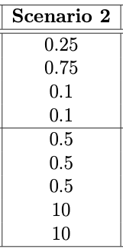
Scenario 2
FHS
Longer burst errors
GES
Notes:
MSE

Slide 24
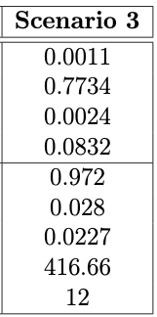
Scenario 3
FHS
Real-life channel
GES
Notes:
MSE

