Slide 1
AoI-based Finite Horizon Scheduling with Gilbert-Elliot Channel Model (Bachelor Thesis) Kick-Off Presentation
Henry He
henry.he@tum.de
M.Sc. Onur Ayan
onur.ayan@tum.de

Slide 2
Motivation and State of the Art
Motivation
Vehicular networks, industrial automation, Cyber-Physical systems etc. are emerging applications modeled as Networked Control Systems (NCS): feedback loops closed over a communication network.
Control over wireless networks inevitably introduces random delays, packet losses, time varying channel conditions
Centralized resource scheduling problem for a single wireless link shared by multiple heterogeneous NCS
State of the Art
Adaptation of cross-layer metrics for communication protocol design i.e. Age of information (AoI)
[1] Proposes a cost optimal scheduler using Dynamic Programming over age penalties derived from AoI and system parameters
Most papers assume non time varying channel properties

Slide 3
Objective and Approach
Objective
Investigate how an optimal scheduler performs in a channel model with realistic channel quality variation => Gilbert-Elliot Channel Model [2]
Approach
Modeling of Gilbert-Elliot Model in a simulation network
Implementation of control and channel aware scheduler
Simulation of a case scenario using C++
Comparison of case study with existing one in [1] or real case scenarios e.g. inverted pendulum, vehicular networks
Evaluating AoI, MSE, complexity over finite Horizon H

Slide 4

Questions?

Slide 5
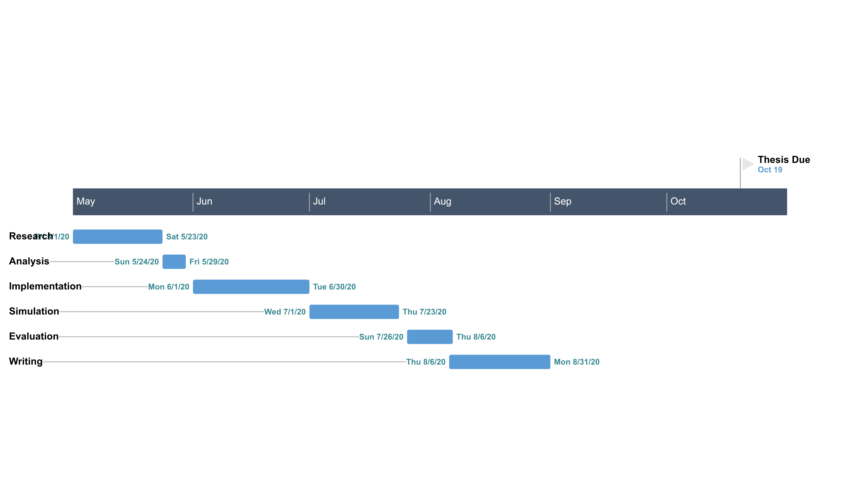
Timeplan

Slide 6
References
[1] O. Ayan et al, “AoI-based Finite Horizon Scheduling for Heterogenous Networked Control Systems”, Preprint at https://arxiv.org/pdf/2005.02037.pdf (2020)
[2] G. Hasslinger and O. Hohlfeld, “The Gilbert-Elliott Model for Packet Loss in Real Time Services on the Internet“, 14th GI/ITG Conference - Measurement, Modelling and Evalutation of Computer and Communication Systems, Dortmund, Germany, 2008, pp. 1-15.

