Slide 1

Development of a Language Model for the German Medical Domain
Master Thesis
Final Presentation
Henry He
Supervisors:
M.Sc. Raphael Scheible
M.Sc. Manuel Milling
Notes:
Welcome to the final presentation of my master‘s thesis. The title is Development of a Language Model for the German Medical Domain.

Slide 2
Why German Medical NLP Needs a New Approach
Challenge Clinical texts valuable but unstructured – hard for AI in healthcare
Solution Modern NLP with pre-trained RoBERTa Transformer and domain adaptation
Limitation Few large corpora due to privacy laws
Research Gap Existing specialized models either use outdated architecture or adapted with insufficient data
Objective
Create medical corpus including translated texts
Pre-train and evaluate German medical LMs:
Clinical- and Healthcare-Related Issues and Subjects Tuned BERT
Explore effect of different domain adaptation strategies
Notes:
Healthcare generates vast amounts of valuable textual data, like clinical notes and reports. But this data is unstructured, making it hard to use effectively with AI for improving patient care. Modern Natural Language Processing, especially with pre-trained Transformer models like RoBERTa, offers a powerful solution. By further adapting these models to the specific language of medicine – a process called domain adaptation or Transfer Learning – we can enhance their ability to understand clinical texts. However, for the German language, there's a significant hurdle: strict privacy laws limit the availability of large medical text corpora needed for this adaptation. In this context we have identified the research gap, where existing German medical language models either use outdated architectures or were trained on insufficient data, potentially limiting their performance. This is what my thesis wants to address. The main focus was to create a large medical corpus, including translated texts to overcome data scarcity. With the created dataset we set out to develop and evaluate new German medical language models, which we call \ChristBERT{} and Our second objective is to explore the effects of different domain adaptation strategies to determine the most effective approaches for the German biomedical domain.
Pre-train domain adaptation especially because of scarcity of clinical texts
Corpora limits both evaluation and domain adaptation => data augmentation

Slide 3
Agenda
Preliminaries
Transformers
GeistBERT
Methods
Corpus Creation
Pre-Training
Experimental Setup
Results
Language Modeling Performance
Downstream Task Performance
Limitations
Conclusion

Slide 4
Background
Notes:
To bring everyone on the same page. I'll briefly introduce the used architecture used.

Slide 5
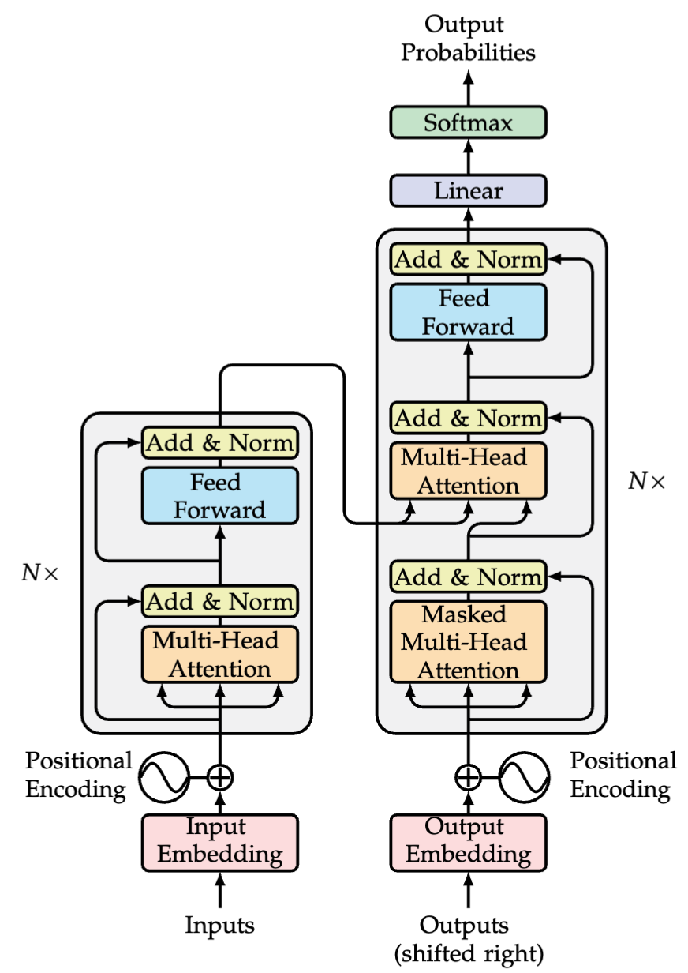
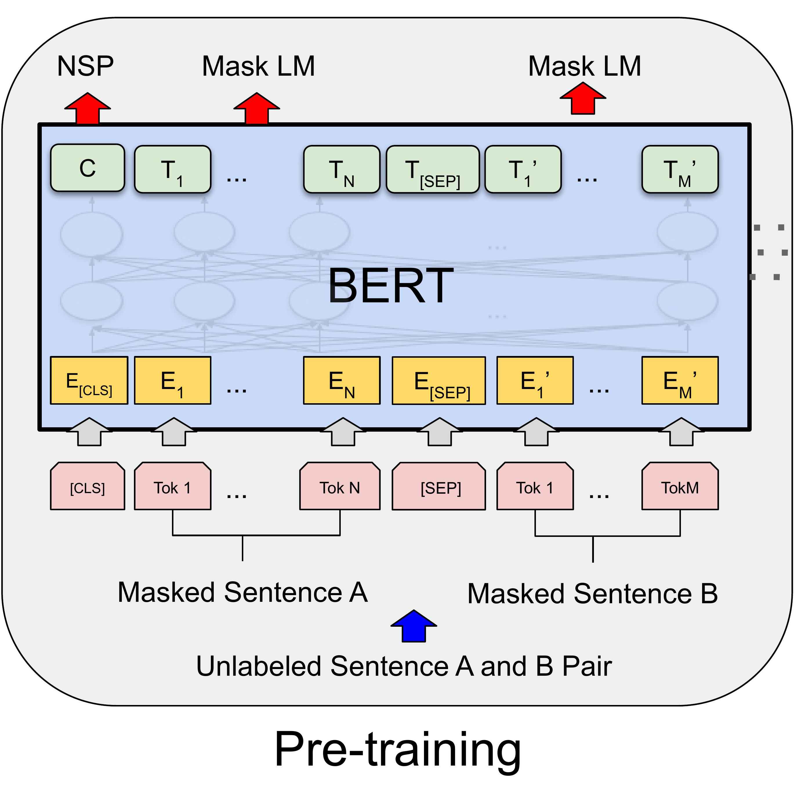
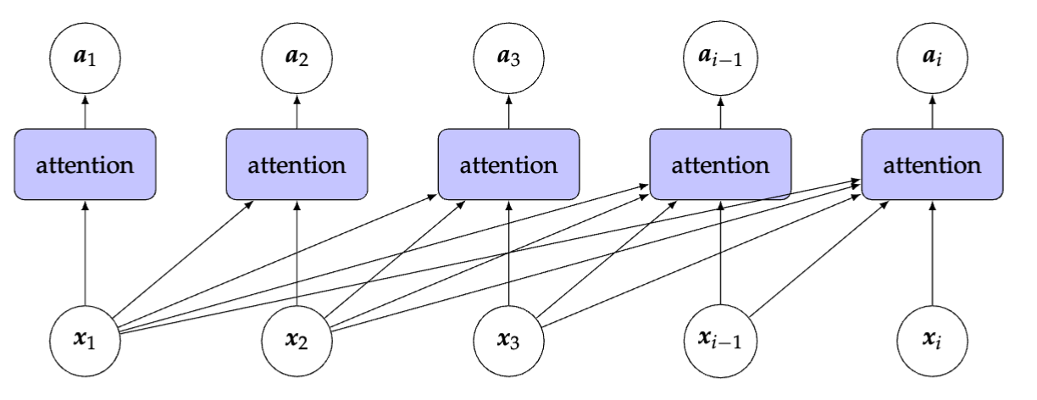
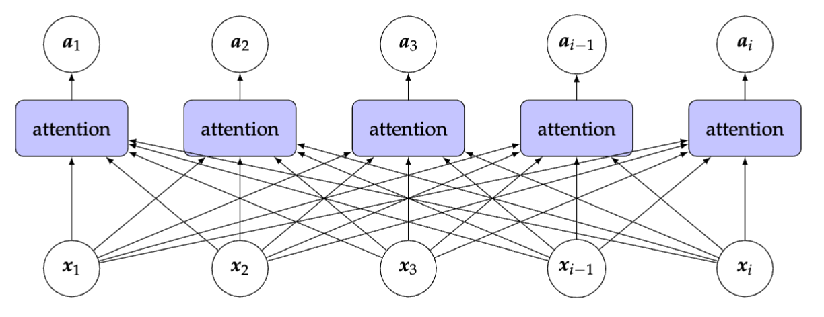
Transformers
Notes:
First I'll recap the mentioned Transformer architecture. The attention mechanism revolutionized how models weigh the importance of different input parts of a text sequence. This led directly to the Transformer architecture, which has an encoder on the left and a decoder on the right. Now, if we take the encoder part and allow its attention to be fully bidirectional, meaning it everything is interconnected as you can see now on the left side, we get the foundation for the BERT.
BERT then leverages this encoder architecture for its pre-training. As a neural network its learning signal uses Masked Language Modeling. The model learns to predict randomly masked words in a sentence. This, along with Next Sentence Prediction, allows BERT to build a deep understanding of language from unlabeled text. To use BERT on applications they need to be fine-tuned with labeled data.

Slide 6
GeistBERT: State-of-the-Art German language model
Architectural basis for developed medical language models
Successor of GottBERT – First pure German RoBERTa model
Byte-Pair Encoding Vocabulary of size 52k
Whole Word Masking (WWM) amended Masked LM
Continued pre-training on 1.3 TB contemporary German corpora for 195k (95k + 100k) steps
Pre-training settings adapted from original RoBERTa
Notes:
The foundation for our work is GeistBERT, which currently stands as a state-of-the-art general-purpose German language model. It serves as the architectural basis for the ChristBERT models we developed in this thesis. GeistBERT itself is a RoBERTa-based model, building upon its predecessor, GottBERT. It was enhanced through continued pre-training using the Whole Word Masking objective, which is an optimized version of the previously mentioned MLM. This additional training was performed for another 100,000 steps on a very large and contemporary German corpus, amounting to 1.3 terabytes of data. In addition to that the pre-training settings were adapted from the original RoBERTa

Slide 7
Methodology
Notes:
I'll come to the methods on how we achieved our objectives.

Slide 8
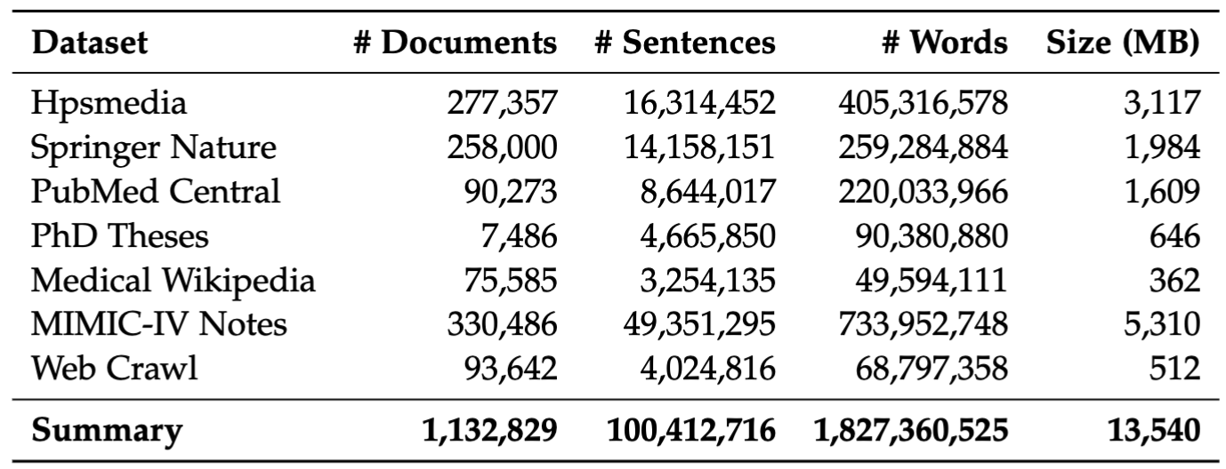
Corpus Creation
Mainly public data sources
Prioritizing data quantity and variety
Textbooks for healthcare professionals
Scientific literature (original + translated)
Clinical data (translated)
German health web
sGHW & tala-med search as seed for web crawl
Removed unsuitable content using fine-tuned GeistBERT classifier
Notes:
The first objective was to create a large medical corpus. When we curated the corpus, we focused on mainly including public data sources, while prioritizing data quantity and variety. This table give you an overview how the resulting pre-training corpus looks like. In total we acquired 13.5 GB of data. I mentioned the focus on variety.
Textbooks: Hpsmedia
Scientific literature in German: Springer Nature, PhD Theses, translated PubMed Central
To counter mainly scientific texts, we also included medical web content e.g. Medical Wikipedia and performed a web crawl on the german health web.
sGHW is a medical corpus, not publicly available due to privacy laws / copyright. But complete list of URLs are public, used as seed in combination with tala-med search. A web search engine for health-related topics sourced from mainly evidence-based web pages.

Slide 9
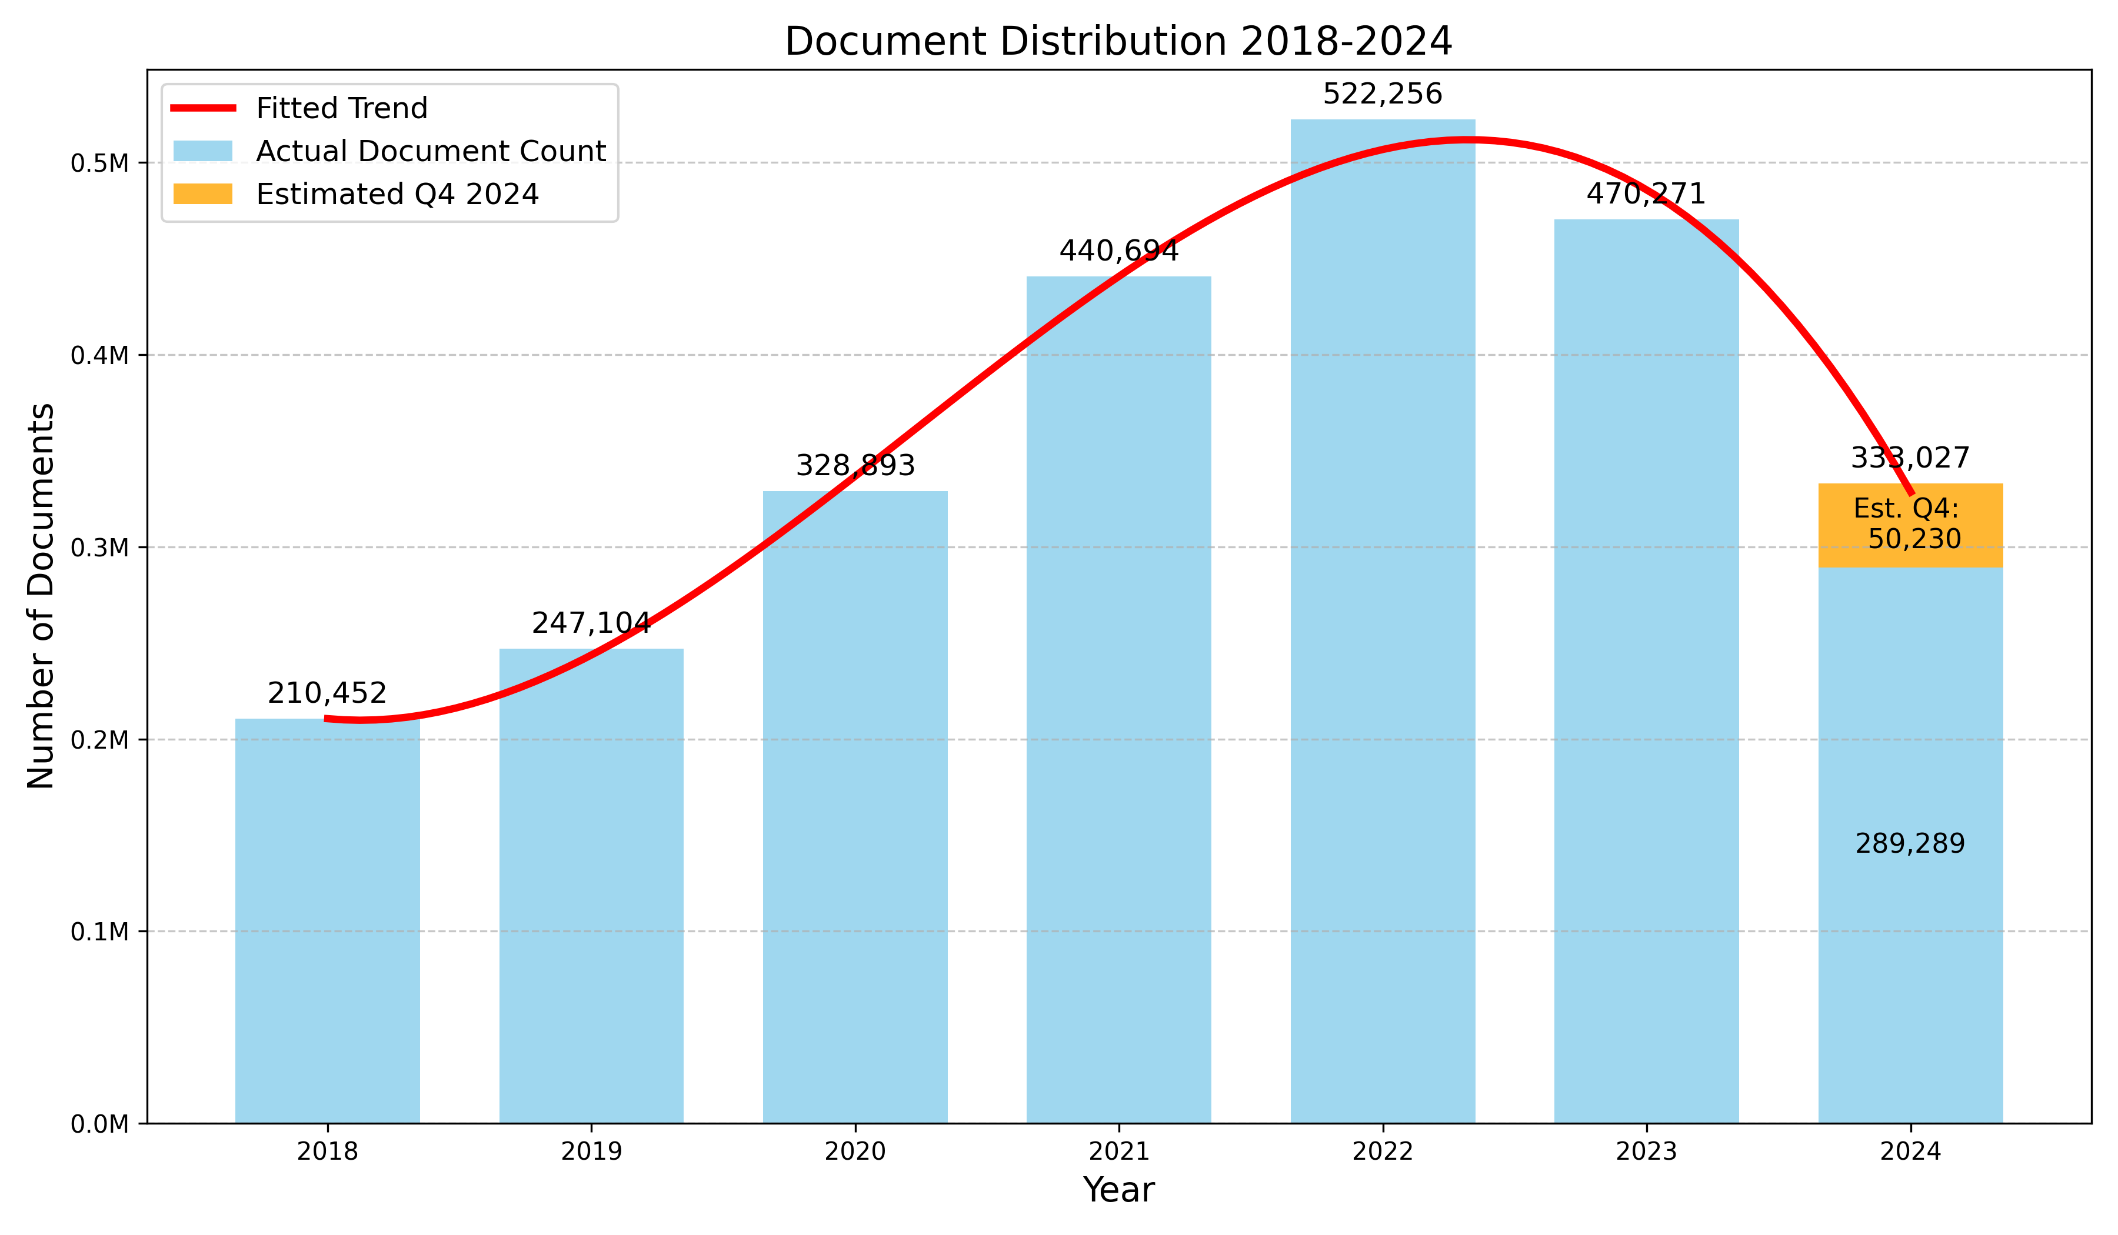
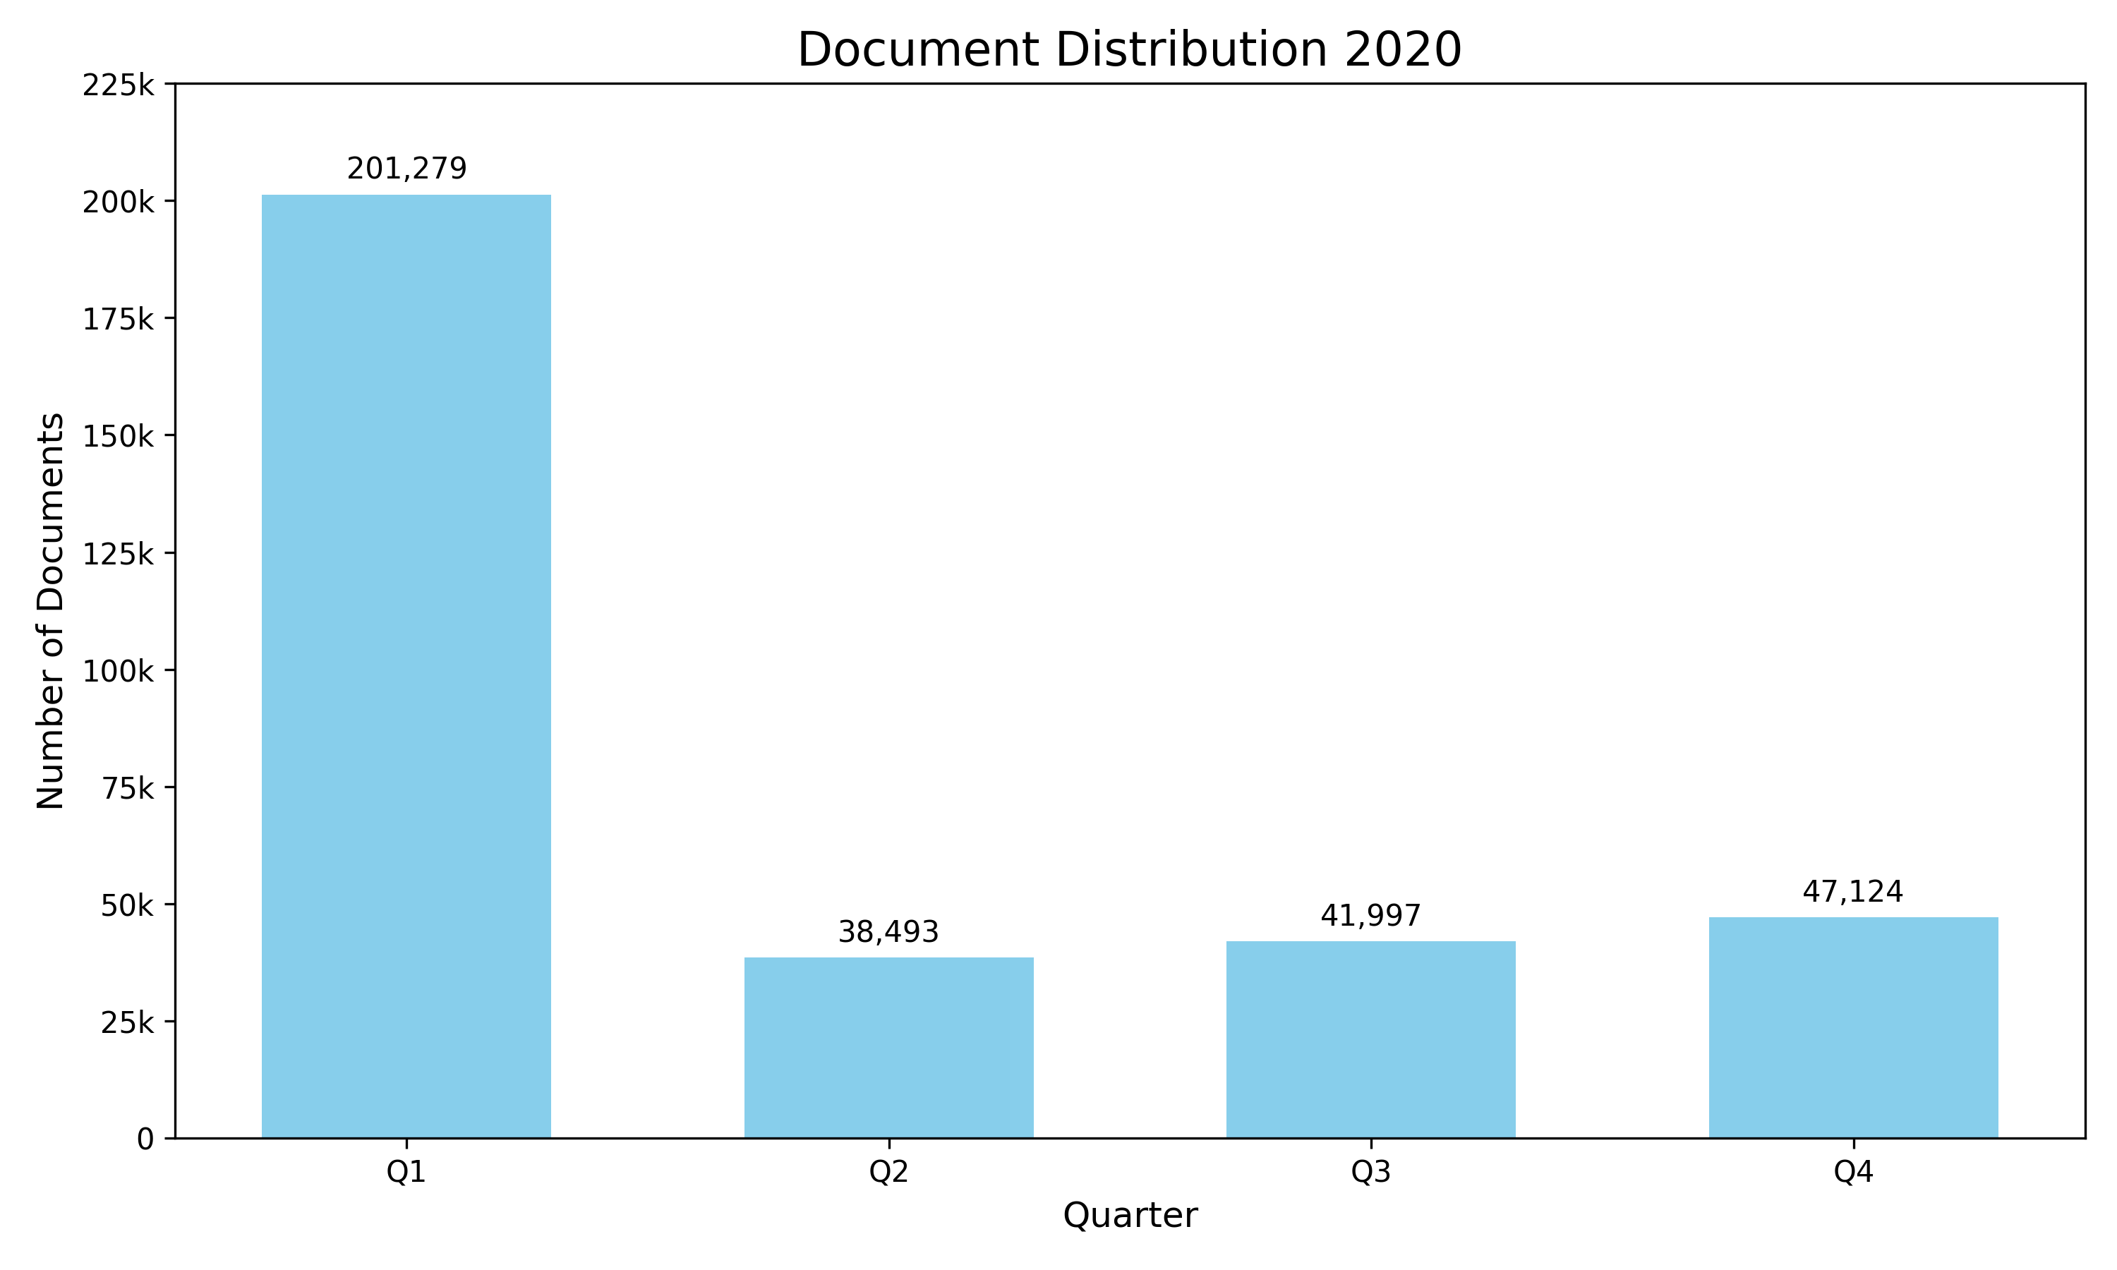
Corpus Creation: Translation
PubMed Central (PMC) Open Access Subset
Largest repository of free full-text scientific literature in biomedicine and life science
Used the export from Dec. 2024
Translated using NLLB 200 neural machine translation model
Selected articles from Q3 and Q4 2020 ∑ 87,641 documents
Notes:
As data augmentation with translation is the core of this corpus. I’m spending some time on the translation.
Pre-RAG models: due to variance of texts

Slide 10
Translation Challenges
Collagen solution (buffer) were drop casted and dried overnight. The detection range of the spectrometer was 399–4000 cm−1, and the data were measured with an interval of 0.96 cm–1 at room temperature.
Kollagenlösung (Puffer) wurden abgeworfen und getrocknet. Die Erkennung der Knochenwerte betrug 39−91.000 g. Die Daten wurden über Nacht nachgeprüft und mit einem Temperaturintervall von 37 × 200 cm × 200 g ECM-Scan-Scan-Scan-Scan-Scan-Scan-Scan-Scan-
Notes:
While translating PMC, we observed varying quality of translations. Here is an example of a bad

Slide 11
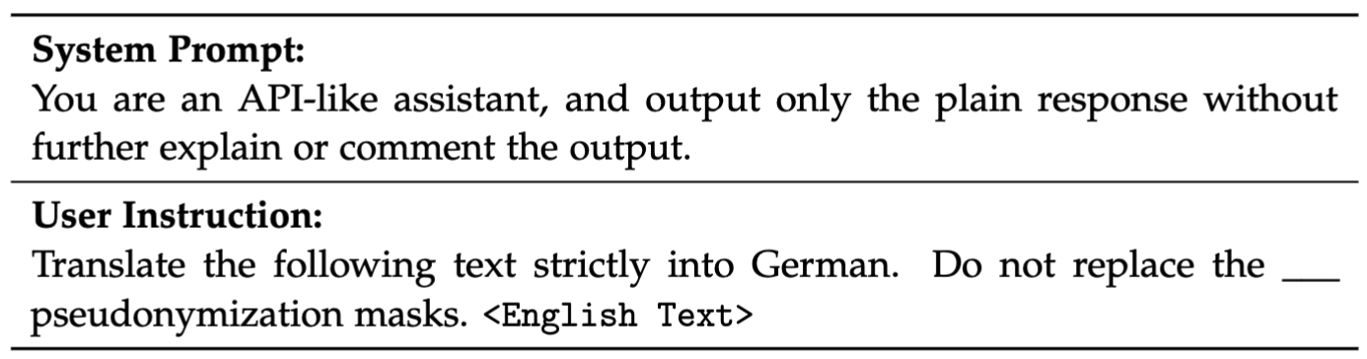
Corpus Creation: Translation
MIMIC-IV Notes
Largest anonymized clinical texts from EHR
Translated using LLaMa 3.1 8B via ollama
Medical History: 1. She had calcification in her breast, which was removed previously and per patient note, it was benign. 2. For HIV disease, she is being followed by Dr. ___ Dr. ___.
Vergangene medizinische Vorgeschichte: 1. Sie hatte eine Kalkablagerung in ihrer Brust, die entfernt wurde vorher und nach Patientenbericht, es war benign. 2. Für HIV-Erkrankung wird sie von Dr. ___ Dr. ___ verfolgt.
Notes:
Moving on to the second translated dataset, namely MIMIC

Slide 12
Model Pre-Training
Domain adaptation strategies:
Continued pre-training ChristBERT
Initial GeistBERT checkpoint
Pre-training from scratch ChristBERT_{scratch}
GeistBERT’s general BPE vocabulary
Vocabulary adaptation ChristBERT_{BPE}
Domain specific BPE vocabulary of size 52k
Pre-training settings taken from GeistBERT
WWM ammended MLM learning objective for 100k iterations
Linear warmup of 10k steps until 7e-4
Polynomial decay to zero afterwards
Notes:
Coming to our second objective, which was to investigate different domain adaptation strategies. We considered three, they are:
Continued Pre-Training: Similar to Transfer Learning, weights are intitiali

Slide 13
Experimental Setup

Slide 14
Downstream Tasks
Named Entity Recognition (NER)
BRONCO150
150 oncology discharge letters
3 entity types ∑ 13077 tags
CARDIO:DE
500 cardiovascular discharge letters
6 entity types ∑ 26860 tags
GGPONC
10k medical guidelines for oncology
8 entity types ∑ 442047 tags
Multi-Label Classification
CLEF eHealth 2019
5688 non-technical summaries of animal experiments
Labeled ICD-10 GM codes (reduced to 230)
∑ 14632 labels
JSynCC
534 case reports from medical textbooks
Labeled with medical subarea (reduced to 6)
∑ 745 labels
Notes:
To assess the usefulness of the developed models in the medicine domain, we evaluate them on two common biomedical downstream tasks: NER and CLS
NER: GGPONC most challenging because most entity types
CLS: both datasets were preprocessed only including documents where class occurred more than 25 times, CLEF more difficult
Each model either had train, validation and test splits or we generated them in a stratified manner

Slide 15
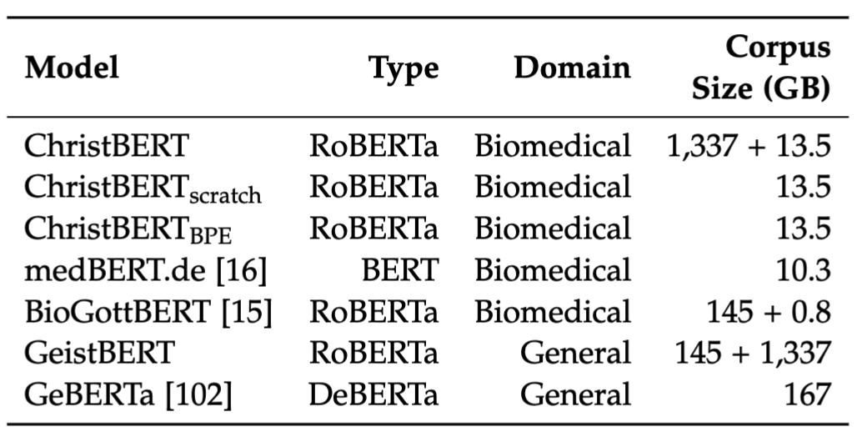
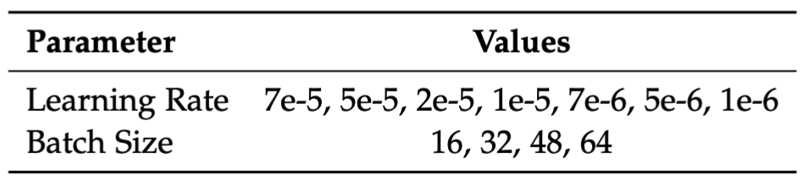
Fine-Tuning
Performance metric for NER and classification
Micro-averaged F1 score (Recall, Precision)
Hyperparameters:
Grid search over learning rate and batch size for 30 epochs
Best model selection based on validation set
Compare performance with other biomedical and general language models
Notes:
medBERT.de: A BERT-based model trained from scratch specifically for the German medical domain using a custom vocabulary and a large, diverse 10.3 GB corpus including real-world clinical data like EHRs and radiology reports.
BioGottBERT: A RoBERTa-based model adapted for the German biomedical domain by continuously pre-training the general German model GottBERT on a modest 809 MB corpus of Wikipedia articles, scientific abstracts, and drug leaflets.
GeBERTa: A general-domain German model utilizing the DeBERTa architecture with disentangled attention, trained on 167 GB of diverse cross-domain texts including medical data. Included to evaluate the impact of a different model architecture and broad cross-domain pre-training on both general and domain-specific downstream task performance.
For better comparability, the baseline models go through the same evaluation setup as described on the left side

Slide 16
Evaluation
Notes:
Let's finally come to the empirical results of our experiments

Slide 17
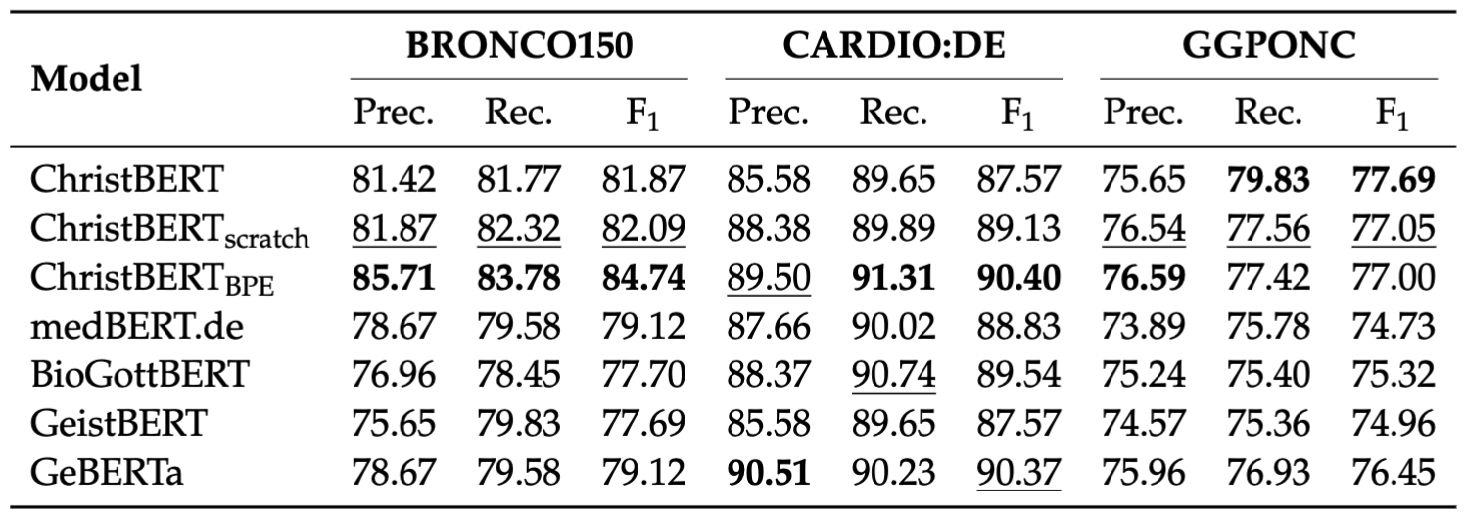
Performance on NER
Best
Second best
Notes:
Bronco: ChristBERT models outperform the baselines model, with BPE
Cardiode: Not so dominating, still BPE is the strongest, with GeBERTa second
GGPONC: ChristBERT models again outperform the baselines model, with ChristBERT
Overall no clear winning strategy, strong performance of BPE suggests that a domain adapted vocabulary is well suited for NER, domain adaptation is crucial in downstream and

Slide 18
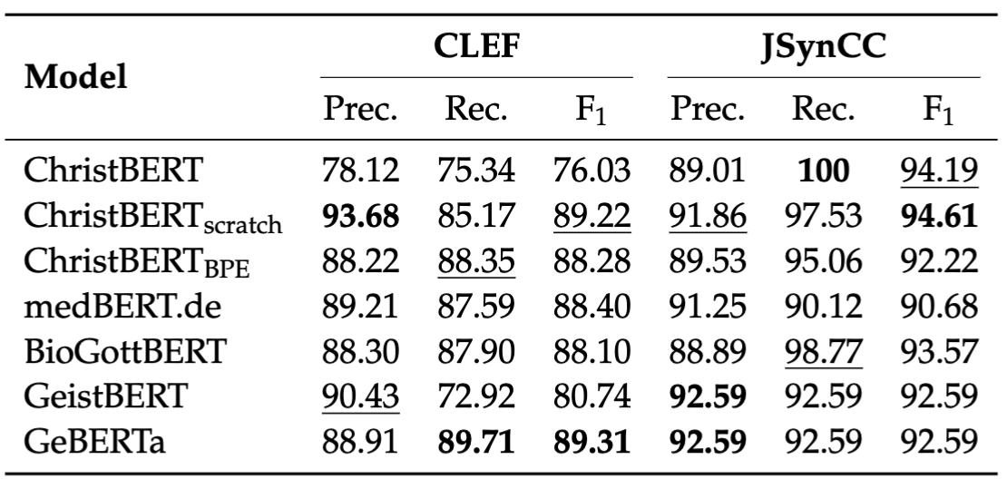
Performance on Text Classification
Best
Second best
Notes:
CLEF: GeBERTa first, Scratch second. Striking domain-adapted ChristBERT is worse than general counter part
JsynCC: Performance are similar, with ChristBERT and scratch leading, striking 100 recall
Across NER and CLS, we lead on all tasks except CLEF, achieving SOTA in our experirmental setup

Slide 19
Discussion
Continued pre-training did not perform as expected
Pre-training from scratch with general BPE robust performance on classification - second best on CLEF
Additional vocabulary adaptation performs best on NER tasks – best on BRONCO
Performance dependent on task
General-domain knowledge useful for texts written in more common language e.g. GGPONC
Pre-training only on medical corpus useful for highly specialized clinical texts
Mixed domain corpus could be a trade off
Domain adaptation is crucial, all ChristBERT variants outperform general models in specialized tasks
Large pre-training corpus for domain-adaptation matters when comparing with BioGottBERT
Notes:
So what have we seen?
Start discussion with analyzing the effects of the different domain adaptation strategies
Comparing the strategies we see that each strategy performs differently well on the downstream tasks. We can derive some patterns.

Slide 20
Limitations and Future Work
Limited maximum input length of RoBERTa (512 tokens)
Investigate effects of other architectures e.g. ModernBERT, DeBERTa, Longformer, Nyströmformer
Investigate effects of mixed pre-training corpus design
Limited range of benchmarks
Translation quality and effect on downstream task performance
Utilize created bilingual corpus to develop specialized medical translation models
Notes:
There are some limitations our work that I want to address
ModernBERT new features: alternating attention and larger context length 8,192

Slide 21
Conclusion
No clear best domain adaptation strategy
Optimal approach is task dependent
Recommendations based on our experiments:
Pre-training from scratch performs best for specialized domain texts i.e. clinical texts
Continued pre-training suited for more commonly written texts e.g. medical guidelines
Domain adaption is crucial, consistently outperformed general LMs in our experiments
Produced state-of-the-art German medical BERT

Slide 22

Questions?
Notes:
This would be the end of my presentation. Thank you for your attention and now I would be happy to take some questions.

Slide 23
Appendix

Slide 24
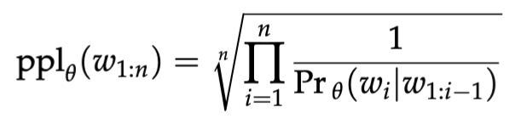
Pre-Training Performance
Assess via perplexity on hold-out validation set

Slide 25
Translation Example
Overall, recurrence of symptoms and high reintervention rates post‐LAMS removal reinforce the difficulty in managing benign gastrointestinal strictures but also argue for LAMS as a definitive therapy in select cases.
Insgesamt verstärken die Symptome nach der Entfernung von LAMS durch ein Wiederauftreten und hohe Wiederinterventionsraten die Schwierigkeit bei der Behandlung von gutartigen Magen-Darm-Strichturen, aber sie sprechen auch für eine endgültige Therapie von LAMS in ausgewählten Fällen.

Slide 26
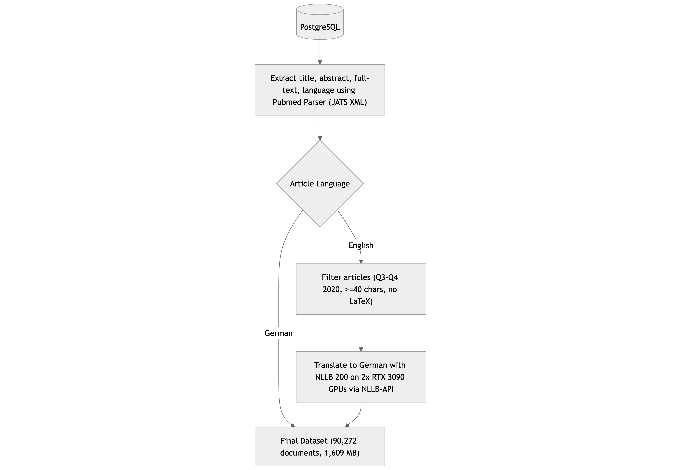
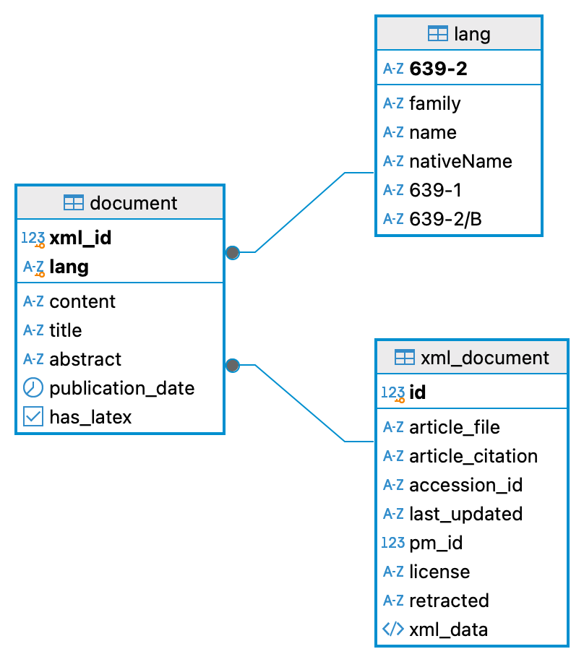
PubMed Central Translation
PostgreSQL Entity Relationship diagram
Flowchart

