Slide 1




by

Slide 2
320k
45%
Homeless people in the UK
Unemployed
*As recorded by Shelter (2018)

Slide 3

Main reasons for homelessness in the UK
Care System
Prison
Financial Instability
Health Reasons
Relationship Breakdown
1

Slide 4
So... how are we ending it?
Fundraisingfunds
Providing donations
Connectingpeople
The Pathway app will help end homelessness through connecting the homeless (also called members) with sponsors that would provide different services in three different dimensions:
Rent, services, etc.
Second-hand clothing, food, etc.
Mentoring,coaching & training
2

Slide 5
SWOT
S
W
O
T
Weaknesses
Information overload
Cyclical demand (e.g. winter, high demand for winter gear)
Maintenance requires to employ a tech admin
Strength
Personal approach
Variety of sponsor options
Lower running costs
Direct involvement with members
Opportunities
Scalability
Threats
Law and policy data protection
9

Slide 6





Competitors
Direct – online platforms
Indirect – brick and mortar shops
10

Slide 7




Who are our customers?
Homeless people
Looking for jobs.
Looking for meaningful social interactions.
Sponsors
Want to make a more meaningful impact.
Have skills/time they would like to share.
Want to build a personal connection with the people they help.
Want transparency regarding their donations.
3

Slide 8
User Story: Sarah Wilson
Situation
Aim:
Solution:
Leaving care system.
Doesn't have a phone but has tech skills.
Wants to go to College to become a hairdresser (develop skills).
Wants a phone.
Fundraising towards hair iron.
Fund iron.
Fund 1st month of rent.
Use Crisis lab.
4

Slide 9
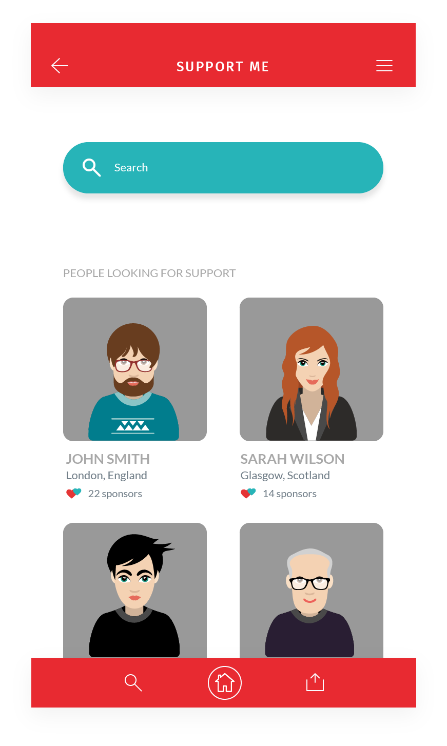
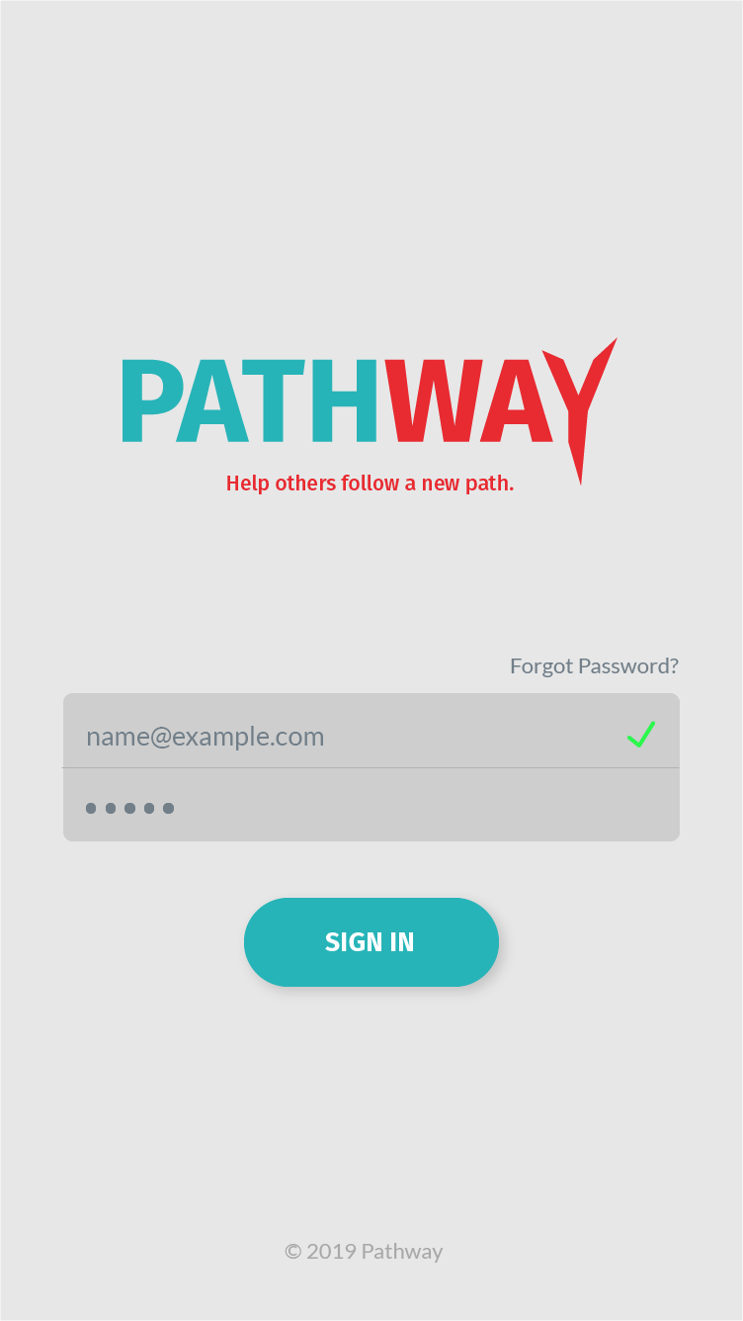

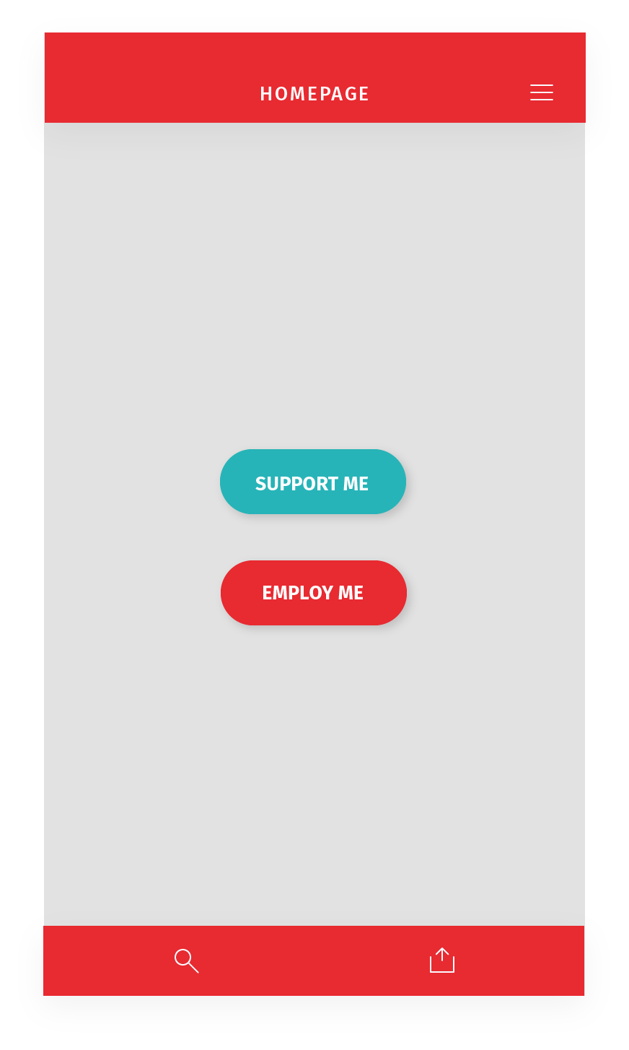
5

Slide 10
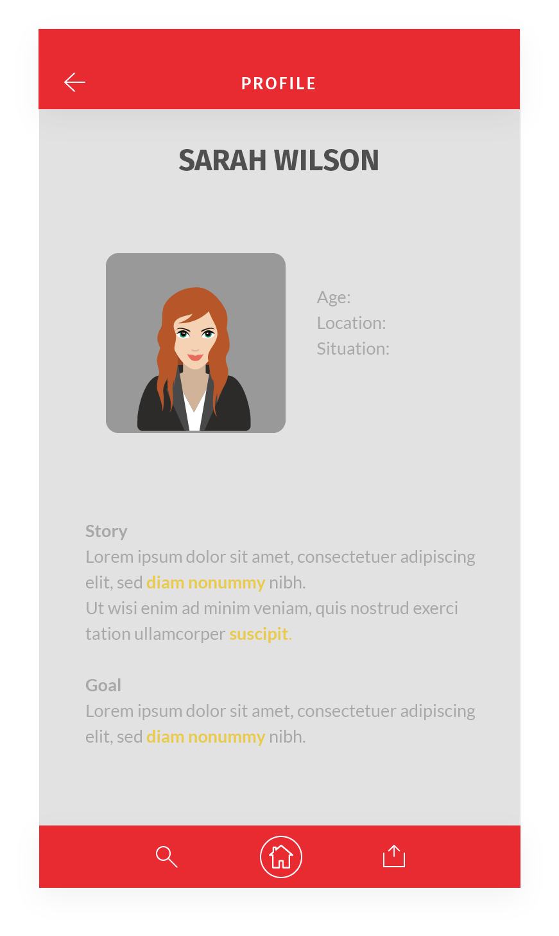
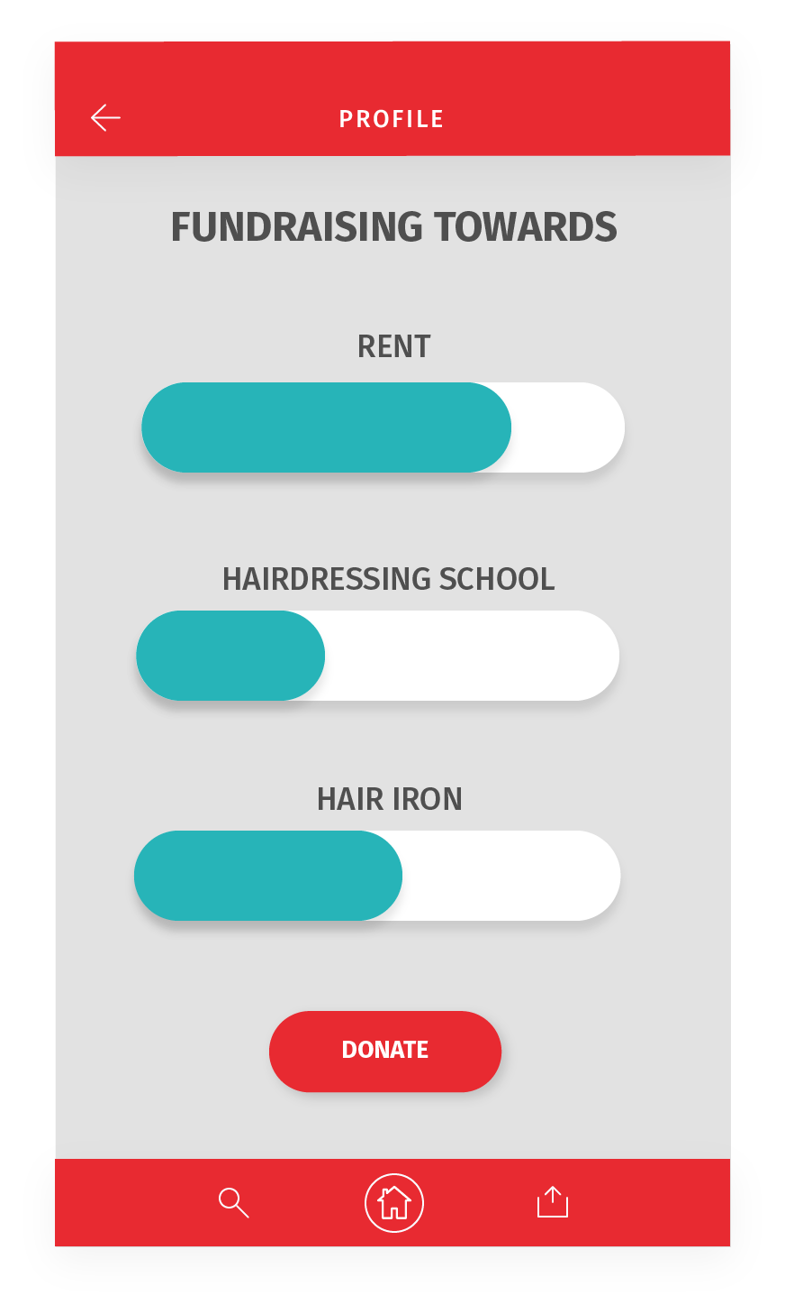
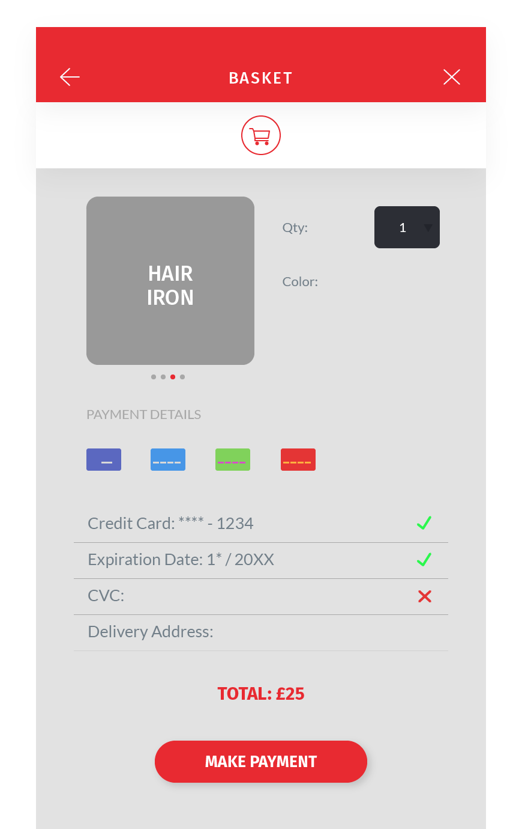
6

Slide 11
Technical Implementation
Technology
Dynamo DB
AWS Lambda
Flask
WebEx API
7

Slide 12
How are we different?
Location
Technology
Connection
Personal
Tangible
Connect from different locations
Wider range of people and skills
WebEx/ Telepresence
Connecting people from different locations
Connect both ends of the chain (sponsor → charity ← receiver)
Transparency
Builds personal connection
Direct contact = Higher motivation to help
Sponsors able to see the result of their participation
8

Slide 13
Long-term goals
Employment & Training Integration
Ongoing Support & Monitoring of Members’ Wellbeing
Sponsor-Member
Matching Optimization
Outreach to Variety of Homeless People
Working with local governments and councils
11

Slide 14
Thank you
Any questions?

