Slide 1
Web App Development 2 Design Specification
Aliou Amar, Wojciech Jazienicki, Francesco Cesana, Josep Perna Montané

Slide 2
Overview
Our application is centred around the University of Glasgow's student societies and offers users services such as viewing, creation and the managing of society webpages and events. Society owners will be able to create a webpage for their society, including pictures and descriptions. They can also create and manage events organized by their society and sell tickets to other students. They will be a able to manage members list. Students will be able to view the societies pages and register at new societies (e.g. purchase memberships). They will also be able to search for new societies, sign up for events, keep a timetable of upcoming events and purchase tickets online. There will be a section where people can share their feedback on past events.

Slide 3

Persona 1
This is Mark,
He is a computing science student at the University of Glasgow. He is so keen on what he studies that he is the founder of the computing science student society.
He needs a website where people can find out about the society and events organized by it. He needs to keep track of the students registered at the society, the events and be able to read their feedback on past events so that he can make improvements.

Slide 4

Persona 2
This is Olivia,
She is a philosophy student at the University of Glasgow. She has several interests and is registered in many university societies. She needs a website where she can easily explore new societies and their events, to meet new people with common interests. She is very busy, so she needs a clear timetable showing the events she is interested in, to help her organize her week.

Slide 5
Specification
User must be able to create, edit, delete, sign in and log out of an account.
User must be able to view society pages and become a member of them.
User must be able to sign up and buy tickets for events of the societies they are part of.
User must be able to keep a timetable of upcoming events.
User must be able to give feedback on past events he/she has assisted.
Societies must be able to create a page including pictures and descriptions.
Societies must be able to create, manage events and distribute tickets for them.
Societies must be able to view and manage their members.
Guests must be able to view societies and their events.
Guests must be able to create a user account.

Slide 6

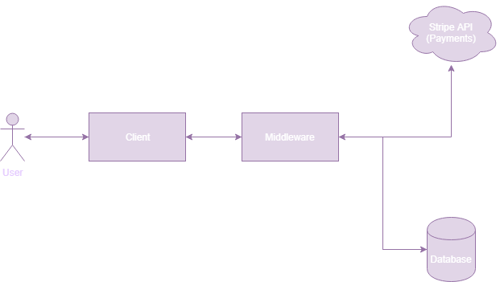
System architecture diagram

Slide 7
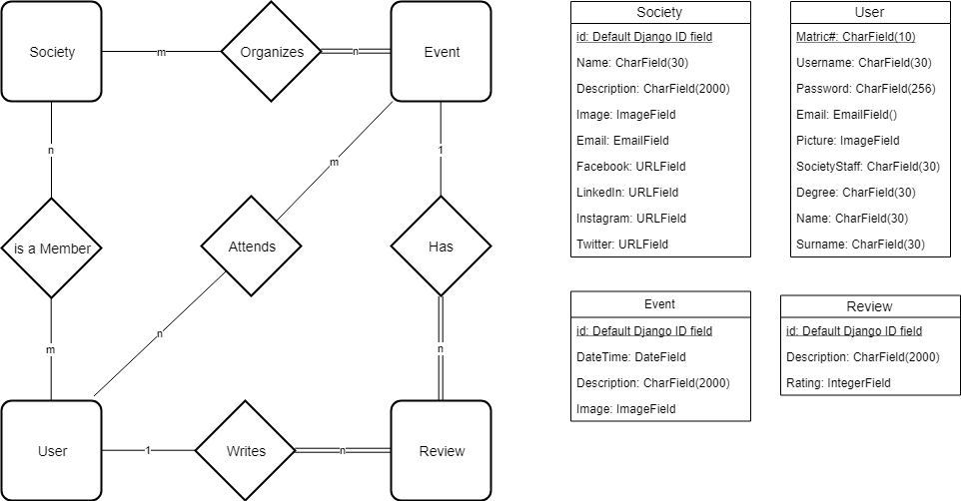
ER Diagram

Slide 8
Wireframes

Slide 9
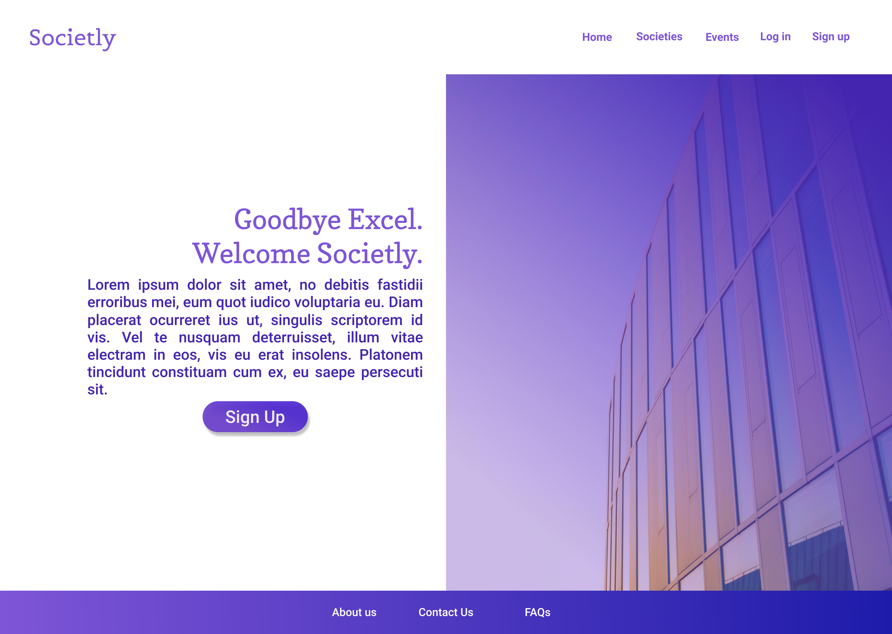
Home Page
Guests will be able to see the societies and their events but they won’t be able to register for them.

Slide 10
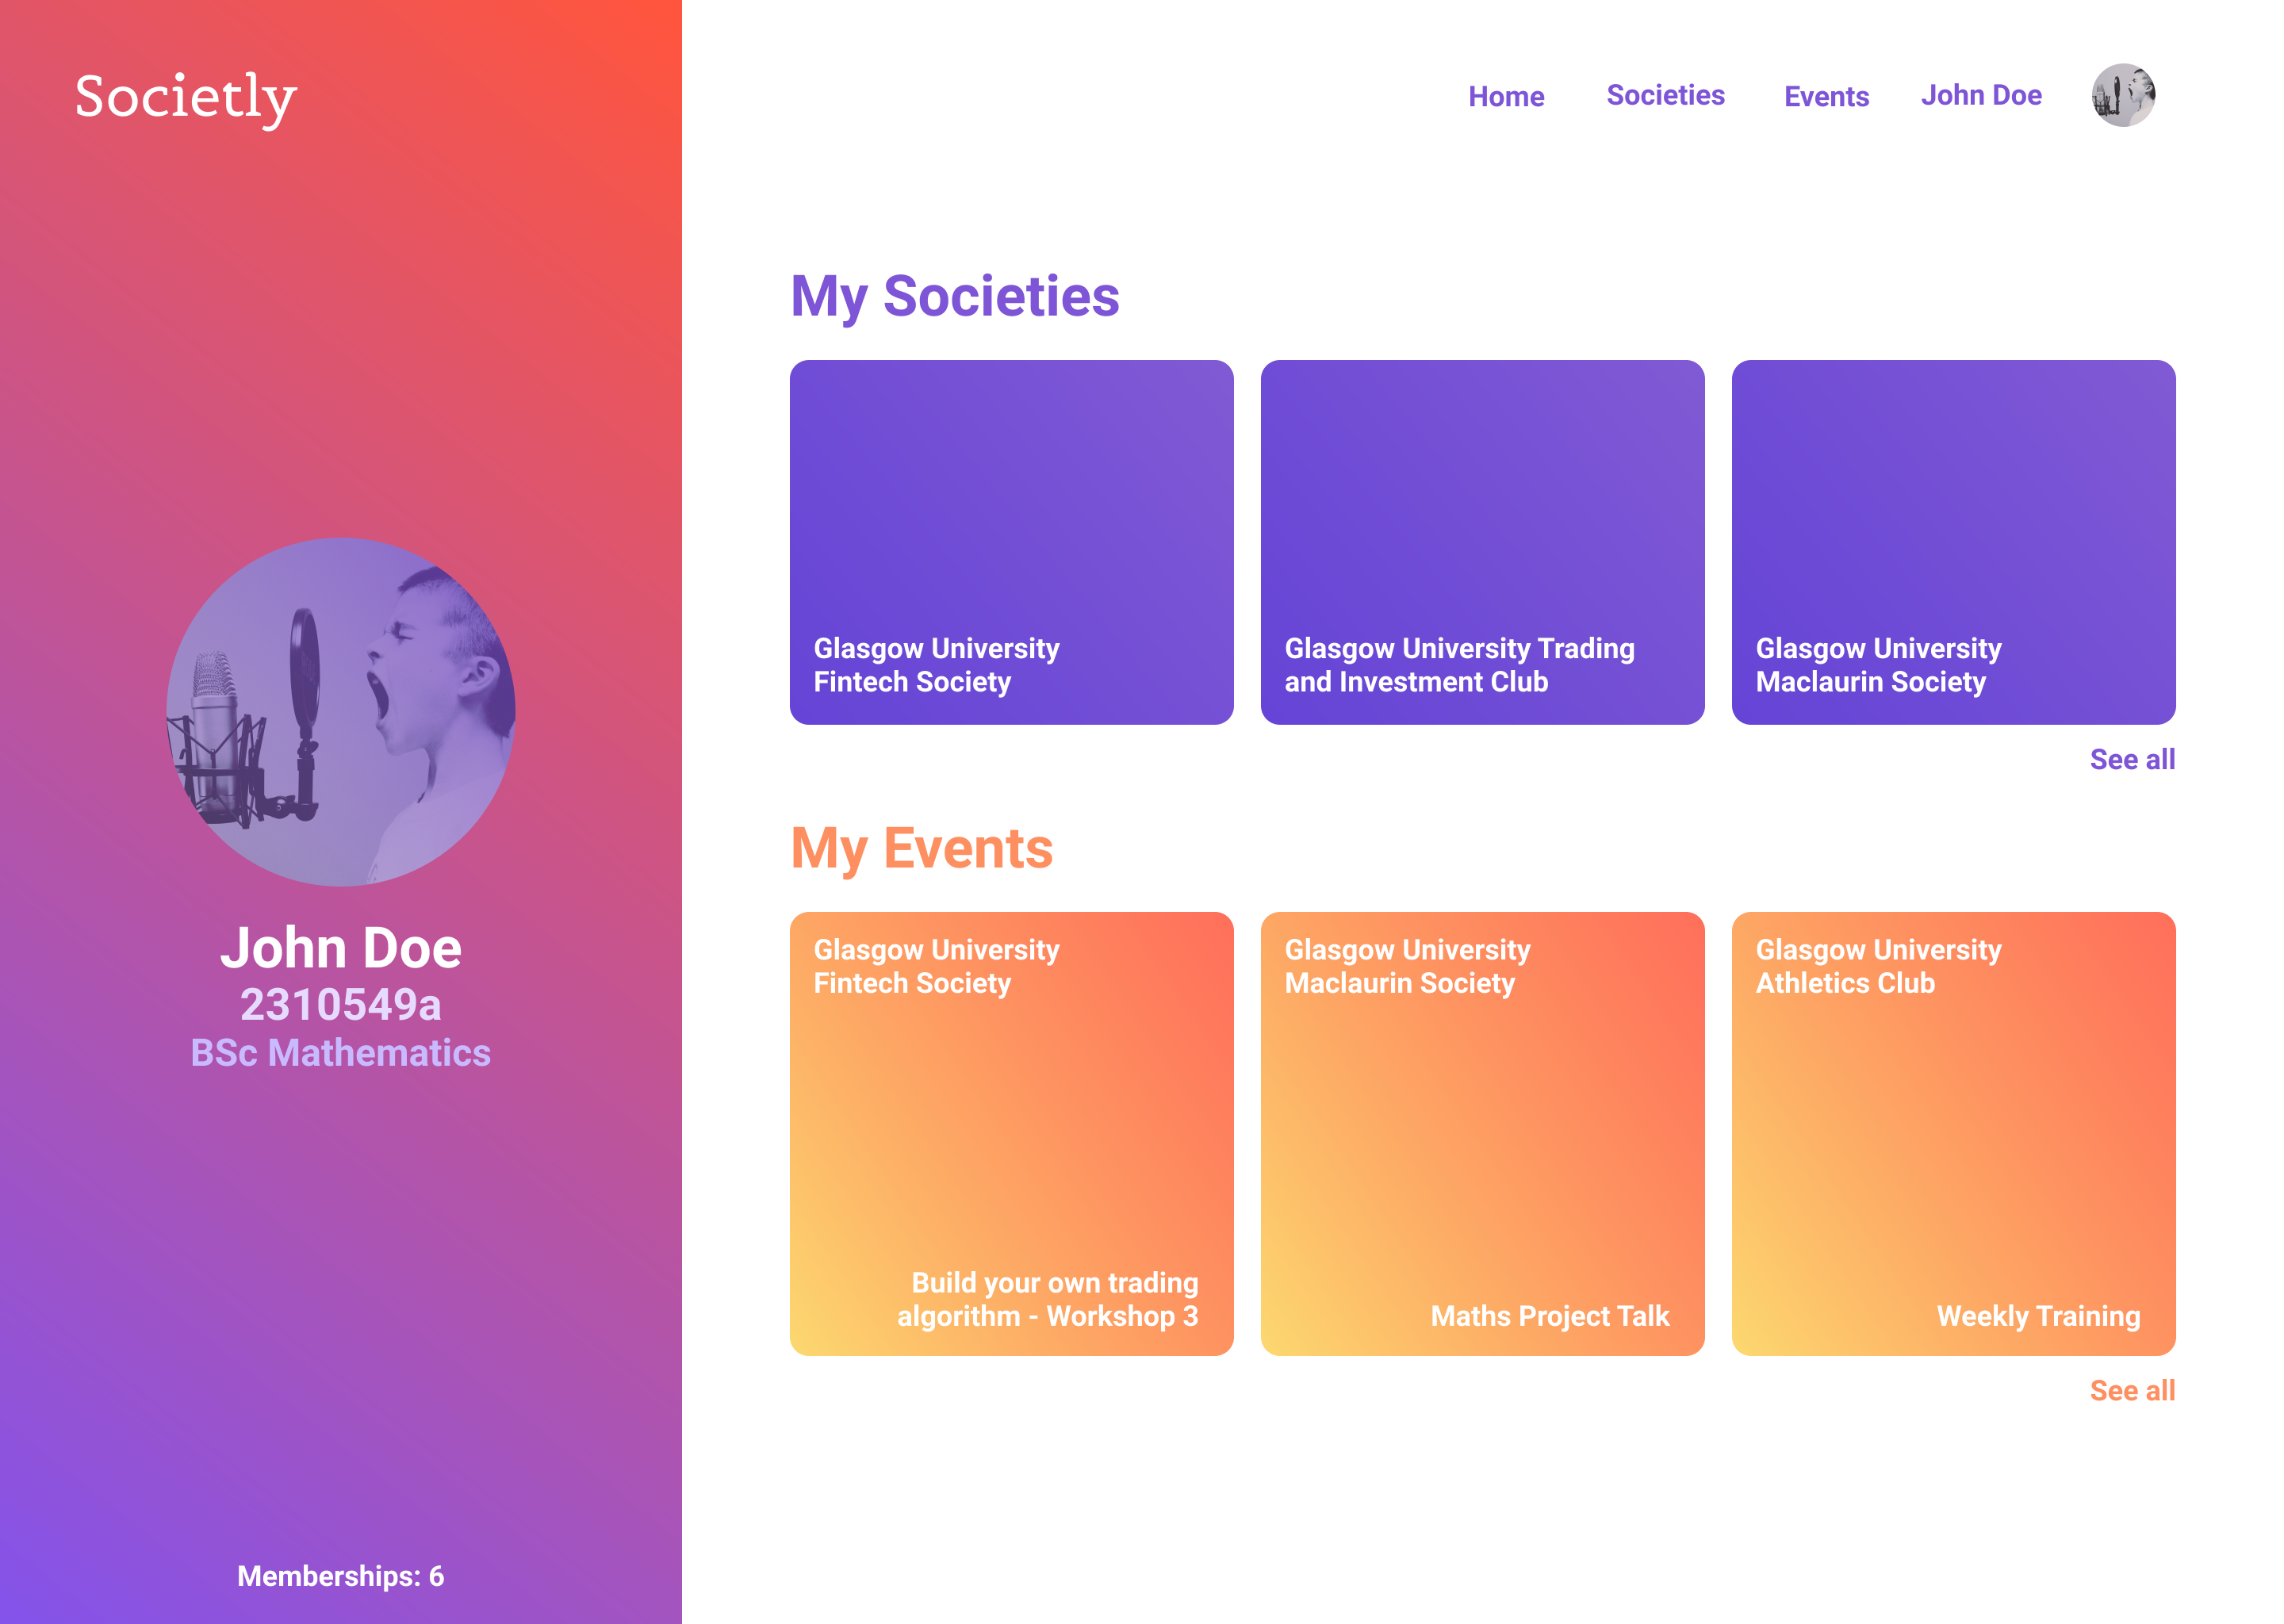
Profile Page

Slide 11
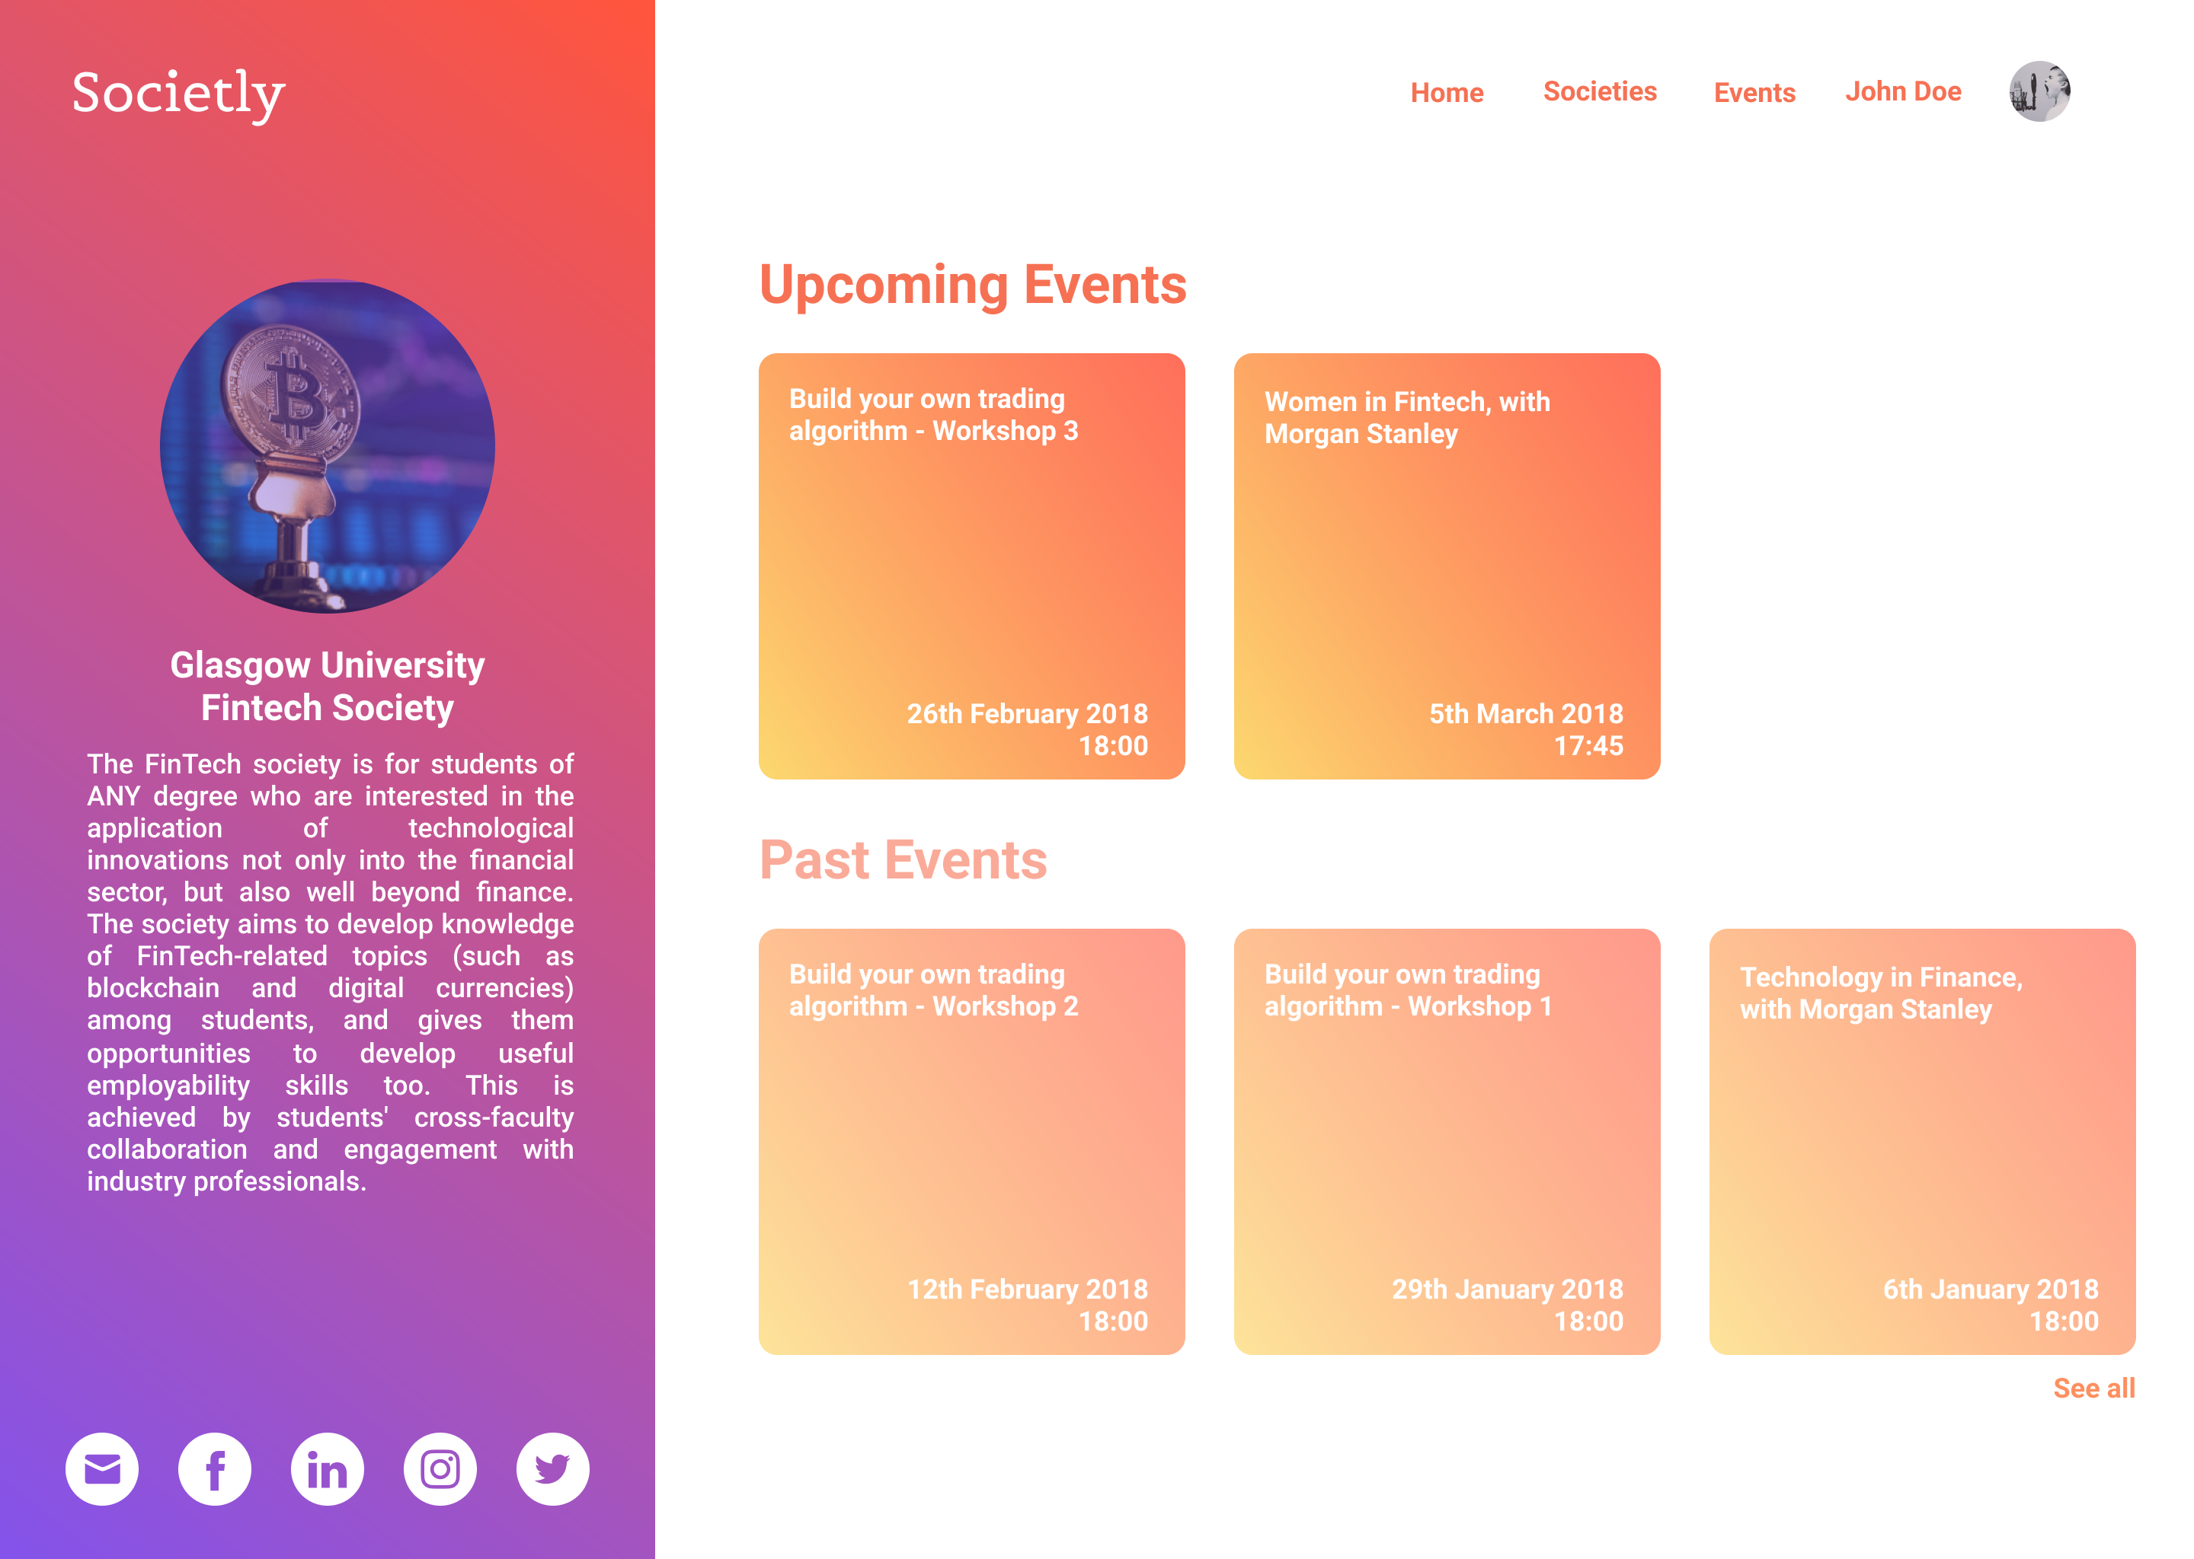
Society Page

Slide 12
Walkthrough

Slide 13
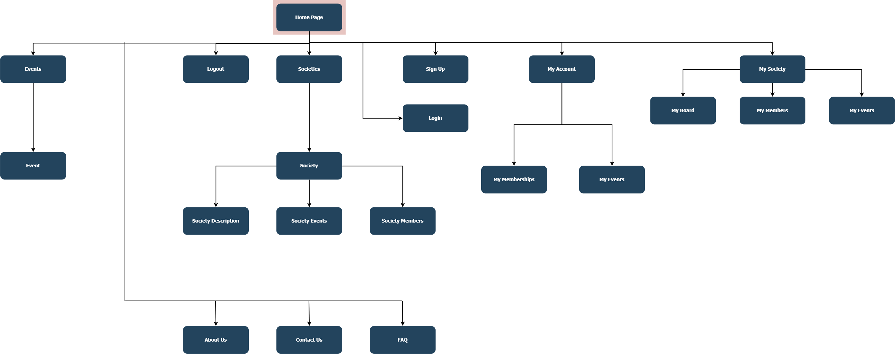
Site map

Slide 14
Site URL’s
/home
/about-us
/contact-us
/faq
/signup
/logout
/login
/myaccount
/myaccount/mymemberships
/myaccount/myevents
/mysociety
/mysociety/myboard (or myinfo)
/mysociety/mymembers
/mysociety/myevents
/societies
/societies/trending (?)
/societies/society
/societies/society/info
/societies/society/events
/societies/society/members
/events
/events/trending (?)
/events/event

