Slide 1
H
HEMOTWIN
DIGITAL TWIN · 2026
SBP · MMHG
INTRADIALYTIC HYPOTENSION · LIVE FORECAST
See the drop
before it lands.
A chair-side digital twin that forecasts intradialytic hypotension 15–60 minutes ahead — and shows the fluid trade-off before the crash.
90
RESEARCH PROTOTYPE
NOT A MEDICAL DEVICE
CALIBRATED +60 MIN
HemoTwin · V2 evidence package · November 2026
205,482 SESSIONS · 1,070 PATIENTS

Slide 2

HEMOTWIN
HEMODIALYSIS · THE BASICS
A kidney,
outside the body.
• When kidneys fail — waste and fluid build up in the blood.
• A machine steps in — a dialyzer takes over the filtering.
• Clean blood returns — waste and fluid are left behind.
3 × / WEEK
≈ 4 H / SESSION
Notes:
Hemodialysis, the short version: when the kidneys can no longer clear waste and fluid, blood is pumped from the patient's vascular access through a dialyzer and returned. A typical in-centre schedule is three sessions a week of about four hours, with roughly 70 litres of blood passing through the filter per session. This slide is illustrative; HemoTwin is a research prototype, not a medical device.

Slide 3
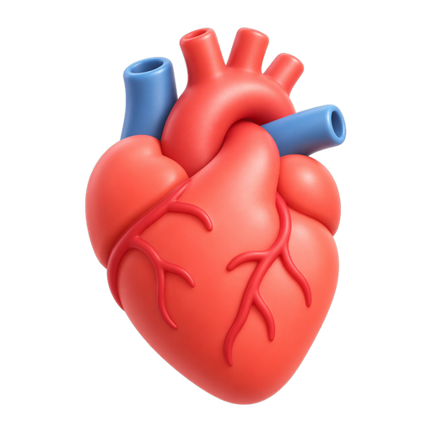
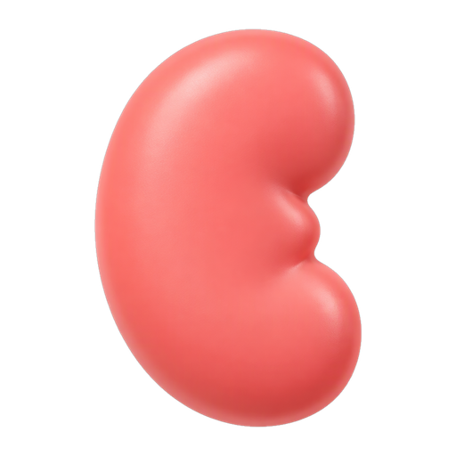

HEMOTWIN
02 / 06
01 · THE PROBLEM
The crash the session can hide.
Cardiovascular risk
Higher mortality and cardiovascular event risk.
Kidney damage
IDH is a sudden drop in systolic blood pressure during dialysis. Fluid is removed faster than the body refills, so pressure can fall before anyone notices.
Reduced renal perfusion during the pressure drop.
Cardiac complications
UF RATE
Arrhythmia and longer-term cardiac strain.
The speed at which excess fluid — usually water — is removed from the body.
The dangerous part is not the number. It is how late the number is noticed.
Outcomes: clinical literature summarized in the HemoTwin evidence package.
RESEARCH PROTOTYPE

Slide 4
HEMOTWIN
03 / 06
02 · THE GAP
The math of supervision.
INDIA · ANNUAL FIGURES
34M
≈3,300
dialysis sessions per year
nephrologists in India (2025)
≈10,000 sessions per nephrologist per year.
ILLUSTRATIVE ARITHMETIC · NOT A WORKLOAD STUDY
1.9 nephrologists per million (2020) · a chronic shortage of dialysis nurses and technicians.
A doctor cannot watch every chair, every minute.
Sources: JAPI 2025 (34M sessions; 3,340 nephrologists); Bharati et al. 2020 (1.9 per million).
RESEARCH PROTOTYPE

Slide 5

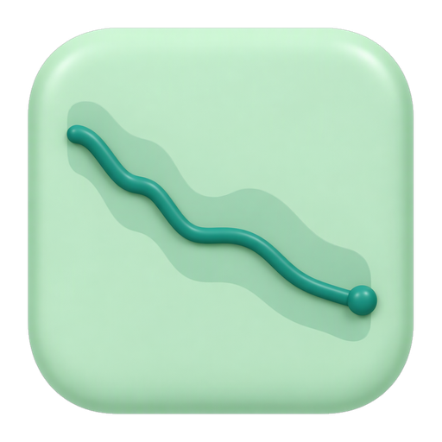

HEMOTWIN
04 / 06
03 · THE TWIN
Read. Forecast. Review.
The twin turns a raw session into a shared picture — then a structured next step.
01
02
03
Mirror
Forecast
Review
Patient-specific state: cuffs, UF, symptoms, stale-data flags.
The next 60-minute nadir, with a 90% band, refreshed at every cuff.
A versioned pathway and exact fluid arithmetic. The nurse decides.
DECISION SUPPORT, NOT AUTOMATION
15–60 MIN HORIZON · 90% BAND
The forecast never gates the review state; measured rules do.

Slide 6
HEMOTWIN
05 / 06
04 · THE MODELS
Two models, two questions.
One is computed before the first cuff. One watches the next hour.
PRE-SESSION RISK · A2
60-MINUTE EVENT MODEL
0.83
0.88
AUROC · FOLD 2
AUROC · TASK 02
0.5
1.0
0.5
1.0
Pick one crashing and one non-crashing session: the crashing one ranks higher 83% of the time.
Same test: the crashing session ranks higher 88% of the time.
History + planned UF goal · no BP, no current UF.
15–60 min horizon · shadow display, not an alarm.
HEMOBP · TAIWAN · 1,070 PATIENTS · 205,482 SESSIONS · 4,190,926 TELEMETRY ROWS
CC BY 4.0 · fold 2 held out · scores from the frozen evidence package
AUROC is a ranking metric, not an alert rate. The event model is a shadow display.
RESEARCH PROTOTYPE

