Slide 1
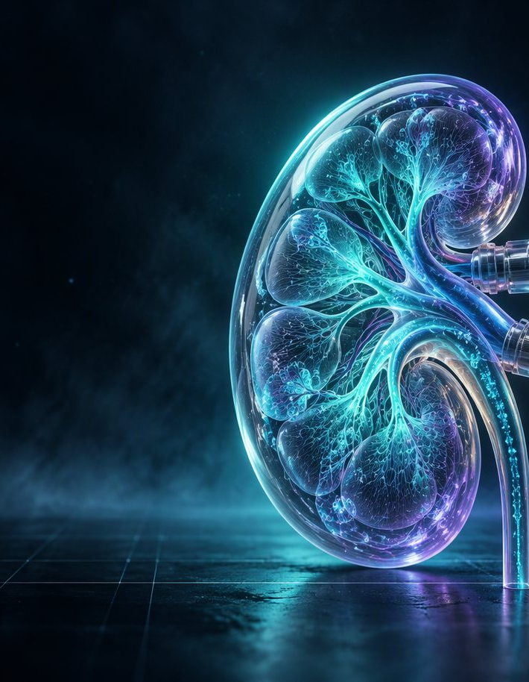
HEMOTWIN CHAIR-SIDE SESSION TWIN
INTRADIALYTIC HYPOTENSION · 60-MINUTE FORECAST
See the drop
before it lands.
A calibrated forecast, exact fluid arithmetic, and a review pathway — not a treatment engine.
RESEARCH PROTOTYPE
NOT A MEDICAL DEVICE
DISPLAY ONLY
205,482 sessions · 1,070 patients · fold 2 never touched

Slide 2
HEMOTWIN CHAIR-SIDE SESSION TWIN
02 / 10
01 · THE PROBLEM
The crash is silent.
Four hours of fluid removal. Pressure can fall between two cuffs — and the dangerous part is not the number. It is how late it is noticed.
SBP
anchor
90 mmHg floor
−60 min
+60 min
One session. Two cuffs. The gap in between.
10.4%
25.5%
≈3.5M
of HEMOBP sessions hit a hypotensive nadir
symptomatic hypotension in a Spanish cohort
estimated hypotensive episodes a year in India
Sources: HEMOBP Taiwan (1,070 patients) · Steffansson et al. · arithmetic estimate for India.
RESEARCH PROTOTYPE

Slide 3
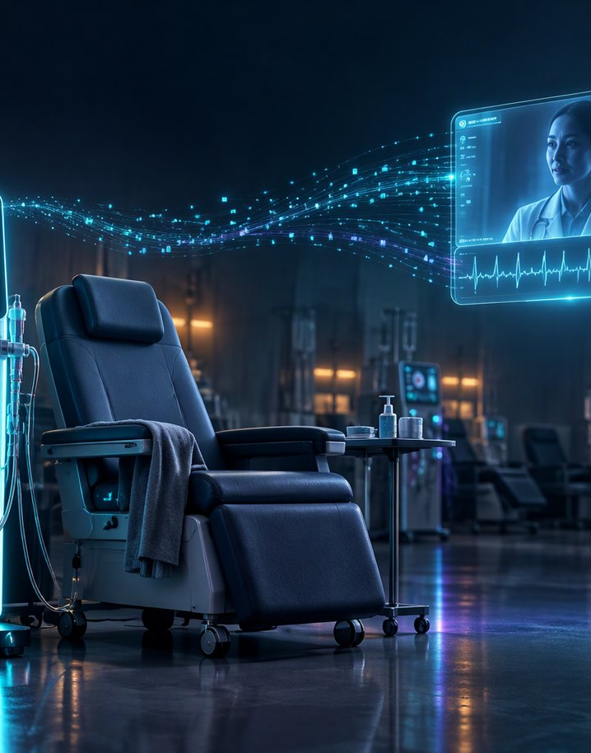
HEMOTWIN CHAIR-SIDE SESSION TWIN
03 / 10
02 · THE GAP
One nurse. Eight chairs.
In district hospitals, the chair is run by nurses and technicians. The nephrologist is remote — and covering a population.
1.0–1.5
nephrologists per million in India · 11.75 global median
145
nephrologists for ~240 million people in Uttar Pradesh
The person at the chair often has the least support — and the most immediate decisions.
Sources: ISN-GKHA 2023 · Lancet Global Health 2024 · Indian J Nephrol 2025.
RESEARCH PROTOTYPE

Slide 4
HEMOTWIN CHAIR-SIDE SESSION TWIN
04 / 10
03 · THE ANSWER
Mirror. Forecast. Review.
The twin turns a raw session into a shared picture — then a structured next step.
01
02
03
Mirror
Forecast
Review
Cuffs, UF, symptoms and history. One patient-specific state.
The next 60-minute nadir, with a 90% band. Refreshed at every cuff.
A versioned pathway and exact fluid arithmetic. The nurse decides.
The forecast never gates the review. Measured rules do.
HemoTwin v2 · chair-side session twin
RESEARCH PROTOTYPE

Slide 5
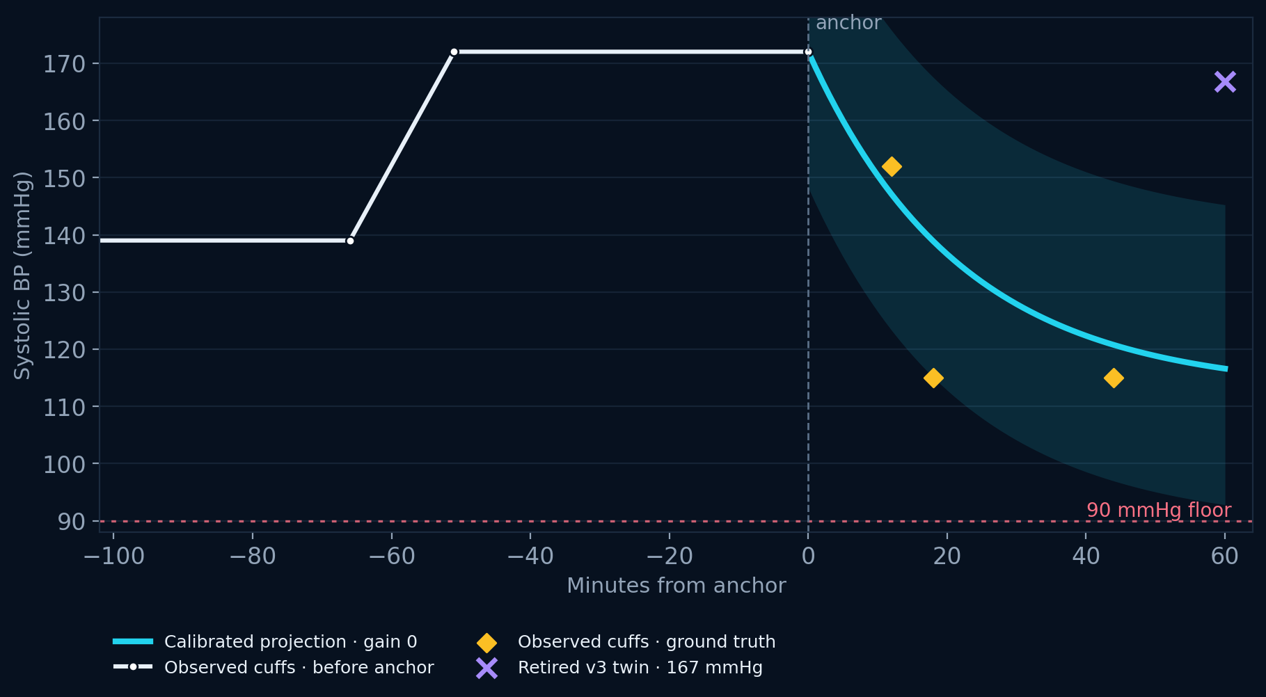
HEMOTWIN CHAIR-SIDE SESSION TWIN
05 / 10
04 · THE FORECAST
One hour ahead.
10.99 mmHg
typical miss — mean absolute error on held-out sessions
89.2 / 90.1% band coverage
59 anchor-time features · no future UF
1,070 patients · fold 2 untouched
A direction and a range — not a promise about symptoms.
Plain reading: next hour near 86 — band 67 to 105.
Model: LightGBM, 59 anchor-time features · holdout fold 2 read once.
RESEARCH PROTOTYPE

Slide 6
HEMOTWIN CHAIR-SIDE SESSION TWIN
06 / 10
05 · BEFORE THE FIRST CUFF
Before the first cuff.
0.831 AUROC
RISK BAND · SHARE OF SESSIONS · CRASH RATE
HIGH · ≥ 0.35
57.0% crash · 27.8% of sessions
MODERATE · 0.20–0.35
27.1% crash · 12.7% of sessions
pre-session risk on fold 2 · no BP, no current UF
Top 25% catches 60% of crashes. 59% of those flagged actually crash.
LOW · < 0.20
8.9% crash · 59.5% of sessions
A low band is not safe. A high band is not a diagnosis.
At eight chairs: ~1.2 true crashes for every two chairs reviewed. Fixed order, display only.
Source: chair-risk variant A2 · fold 2 · 12,651 sessions.
RESEARCH PROTOTYPE

Slide 7
HEMOTWIN CHAIR-SIDE SESSION TWIN
07 / 10
06 · THE TEST WE FAILED
The what-if didn't hold.
+0.13 mmHg
the measured effect of 0.25 L/h less ultrafiltration
95% CONFIDENCE INTERVAL
+0.13
A quarter-litre less UF per hour. The pressure change is smaller than a cuff's own noise.
−2.63
0
+3.06
The interval crosses zero — no detectable effect.
Five of six engineering checks pass. The clinical test failed — and it stays on the page.
G7 pre-registration · 581 matched events · 158 patients · minimum detectable effect 2.33 mmHg.
RESEARCH PROTOTYPE

Slide 8
HEMOTWIN CHAIR-SIDE SESSION TWIN
08 / 10
07 · THE ARITHMETIC
Where the fluid goes.
An unfinished session doesn't disappear. It moves to the next one.
NEXT PRESCRIPTION
remaining = 3.00 − 1.20 = 1.80 L
carry = 0.50 × 1.80 + 0.25 = 1.15 L
next start = 3.00 + 1.15 = 4.15 L
intensity = 4150 mL ÷ (70 × 4) = 14.8 mL/kg/h
3.00 L
4.15 L
actual start of the next session
The prescription is unchanged. The starting volume is not.
13 mL/kg/h is a reference flag, not an order.
Worked example: UF goal 3.00 L · removed 1.20 L · q_left 0.50 · bolus 0.25 L · 70 kg · 4 h.
RESEARCH PROTOTYPE

Slide 9
HEMOTWIN CHAIR-SIDE SESSION TWIN
09 / 10
08 · IN THE ROOM
Five moments. No new workflow.
01
02
03
04
05
Look
Enter
Read
Review
Hand off
Fixed board. Ranked chairs. No BP needed.
Start BP, UF goal, dry weight, symptoms.
Nadir forecast, band, protocol state.
Pathway steps, repeat BP, fluid check.
FHIR bundle, bilingual card, replay.
Same moments. Shared numbers. The decision stays with the team.
Display only — the forecast never sets the review state.
The console adds structure to moments that already exist.
RESEARCH PROTOTYPE

Slide 10

HEMOTWIN CHAIR-SIDE SESSION TWIN
10 / 10
09 · WHAT'S NEXT
Earn the right to predict.
Then the right to advise.
NOW
Local cohort and honest labels. Every UF change logged.
NEXT
A pre-registered pilot with denser BP measurement.
LATER
Wearables and machine integration — only with evidence.
The gap is time and a shared trade-off. Prediction is one feature — not the product.
HemoTwin · v2 · November 2026 · research prototype · not a medical device
RESEARCH PROTOTYPE

