Slide 1


HEMOTWIN
DIGITAL TWIN CHALLENGE 2026 · RESEARCH PROTOTYPE
Buy time
before the crash.
A chair-side session twin for dialysis: calibrated forecast, exact fluid arithmetic, and a review pathway.
RESEARCH PROTOTYPE · NOT A PRESCRIPTION
HEMOBP (Taiwan) · 205,482 sessions · 1,070 patients · CC BY 4.0
Fold 2 untouched · no treatment-effect claim · no machine control
HEMOTWIN · RESEARCH PROTOTYPE · NOT A MEDICAL DEVICE
01 / 16
Notes:
Open with the real unit: the doctor is remote, the technician is at the chair, and IDH does not wait. The product's job is time, not another prediction score.

Slide 2


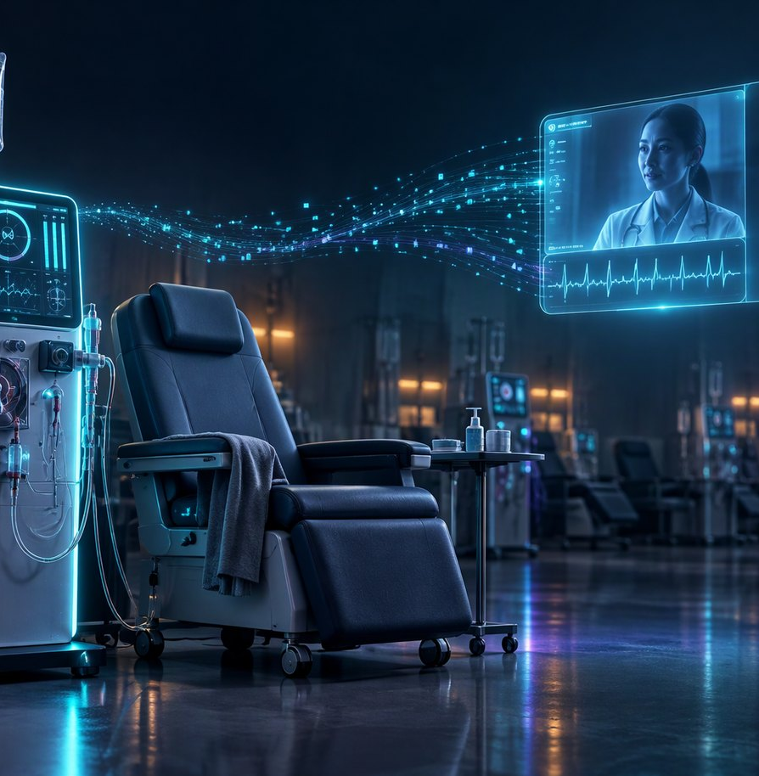
THE FIELD REALITY
The doctor is remote.
The technician is at the chair.
We build a remotely operable, IoT-enabled hemodialysis machine. In the units it serves, the person at the chair often has to act before a doctor can be reached.
IDH is one of the most common and risky events of a session. The gap is not another score. It is time and a shared trade-off.
“The technician needs to know what to ask, not just that the pressure is falling.”
Labelled hypotension: 10.4% of HEMOBP sessions (nadir <90 mmHg). Spanish cohort: 25.5% clinician-defined symptomatic. Two labels — never combined. 3D concept illustration.
HEMOTWIN · RESEARCH PROTOTYPE · NOT A MEDICAL DEVICE
02 / 16
Notes:
This is the user's field reality: a remote machine, an untrained or lightly trained technician, and a doctor who is not in the room. The two prevalence numbers use different labels; never add them.

Slide 3
THE GAP
A monitor is not a plan.
CLIMB · 2005
OUR EVENT MODEL · 2026
THE FIELD
WORSE
8.2%
AUROC
Blood-volume monitors plus an algorithm. Outcomes got worse, not better. More data did not equal better care.
Detection at the pre-registered 0.26 false-alert budget — below the current-SBP rule. Ranking is not timing.
Papers report ranking. The chair needs mmHg and a false-alert budget. Prediction without a response workflow fails.
The one deployed system that paired prediction with a nursing response reported IDH 26.1% → 12.9% over four years. The workflow is the product.
Sources: Leung, JAMA 2005; BestShape, Clin Kidney J 2025. Our own event model remains shadow-only.
HEMOTWIN · RESEARCH PROTOTYPE · NOT A MEDICAL DEVICE
03 / 16
Notes:
Three failures: monitoring alone, our own ranking model, and the field's AUROC habit. The lesson is that the response workflow is the product. We do not claim ours is validated.

Slide 4
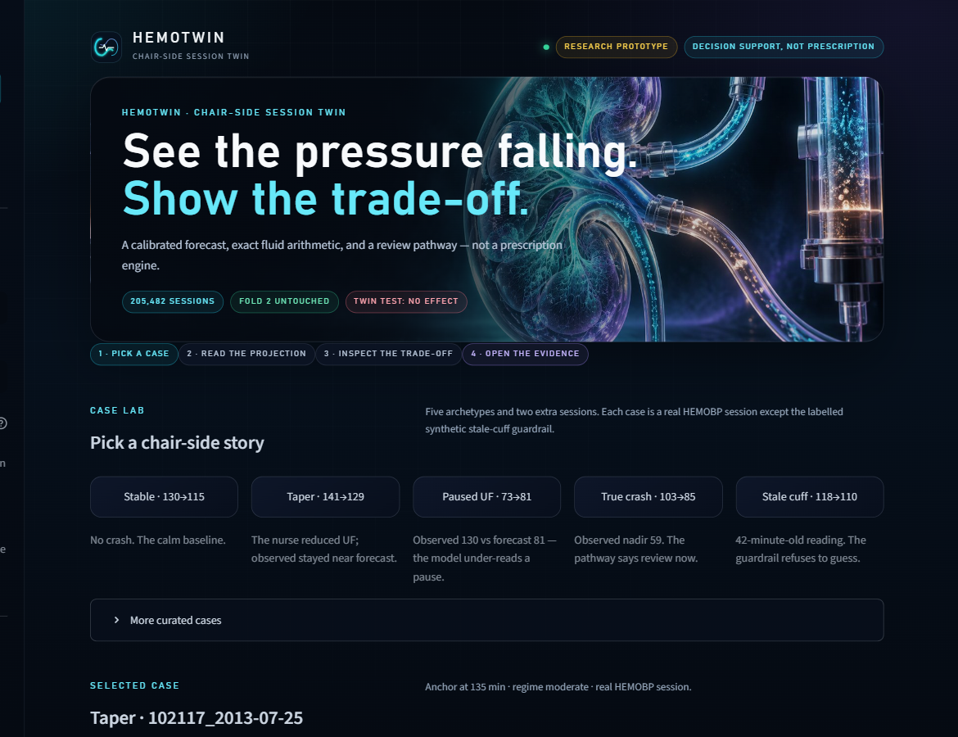
THE PRODUCT
One console.
Three views.
One honest boundary.
CASE LAB
Seven chair-side stories, one calibrated chart.
The showpiece.
LIVE SESSION
Enter a real session. Get a protocol state and the fluid arithmetic.
The working console.
EVIDENCE & HANDOFF
Gates, G7, FHIR, audit, pod triage.
The proof.
MIRROR · SHOW · BUY TIME
The Case lab, running locally with the bundled evidence. No raw data, no network.
HEMOTWIN · RESEARCH PROTOTYPE · NOT A MEDICAL DEVICE
04 / 16
Notes:
This is the product surface. The screenshot is the real app, not a mockup. One console, three views, and the boundary is visible from the first screen.

Slide 5
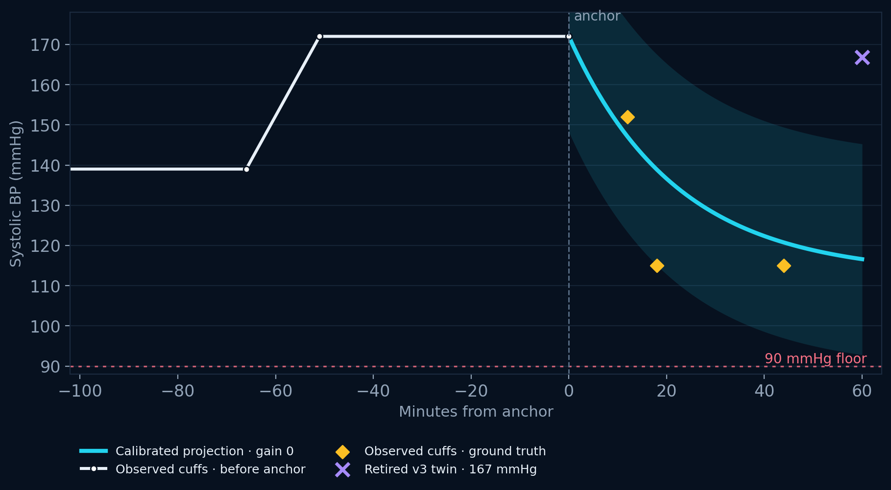
CASE LAB
Seven stories. One honest chart.
OBSERVED
115
ground truth · amber diamonds
CALIBRATED
116.6
fair pre-anchor · cyan line
RETIRED V3
167
not used · violet X
Shaded band = 90% nadir interval, widened along the path. The dashed sketch is off by default: the twin experiment failed.
g1_taper_showcase · anchor 172 · calibrated 116.6 · observed 115
HEMOTWIN · RESEARCH PROTOTYPE · NOT A MEDICAL DEVICE
05 / 16
Notes:
The chart is the product. The amber diamonds are ground truth; the cyan line is the only validated projection; the violet X is the retired v3 twin. The illustration stays hidden by default.

Slide 6
FORECAST LINEAGE
Two forecasts. Do not mix them.
FAIR PRE-ANCHOR TWIN
FORECAST-V2 ORACLE DISPLAY
10.99
9.60
fold-2 MAE (mmHg)
fold-2 MAE (mmHg)
• 59 features · no future-UF oracle block.
• RMSE 14.65 · fold 2 untouched.
• This is the calibrated floor used in the console.
• 72 features · 13 observed future-UF features.
• Display-only; not a treatment model.
• Not the G2 baseline.
USED IN THE CONSOLE
DISPLAY ONLY · NOT THE BASELINE
The smaller oracle number is not a better twin. The baseline check (G2) compares the twin to its own fair baseline; the oracle comparison is a reported failure.
Fold 2 untouched by tuning. G2 plan-written baseline: FAIL.
HEMOTWIN · RESEARCH PROTOTYPE · NOT A MEDICAL DEVICE
06 / 16
Notes:
This is the first judge question. The app's twin uses the fair 10.99 model. The 9.60 is an oracle-assisted display forecast with future UF; it is not the G2 baseline. Never compare them as if they were the same model.

Slide 7
FLUID ARITHMETIC
The trade-off, in litres.
UF POLICY
FLUID LEFT
NEXT-SESSION UF
CALIBRATED +60
“This is the number a technician can take to a doctor. It is not a prescription.”
Hold current UF
0.50 L
16.5 mL/kg/h
116.6
Taper to 75%
0.68 L
17.4 mL/kg/h
116.6
Taper to 50%
0.88 L
18.4 mL/kg/h
116.6
Keep-open 0.10 L/h
1.18 L
19.9 mL/kg/h
116.6
The trade-off is the conversation.
30-min pause, then resume
0.88 L
18.4 mL/kg/h
116.6
Case g1_taper_showcase: calibrated 116.6 vs observed 115. The fair forecast is close; the arithmetic is the honest decision surface.
At calibrated gain 0 the +60 min value is identical across policies. The fluid arithmetic is what changes.
Next-session UF reference flag: 13 mL/kg/h. Arithmetic only; not a feasibility, safety, or prescription determination.
HEMOTWIN · RESEARCH PROTOTYPE · NOT A MEDICAL DEVICE
07 / 16
Notes:
Use the g1_taper_showcase because the fair forecast is close (116.6 vs 115). The table shows that the calibrated nadir is identical across policies at gain 0; only the fluid arithmetic changes. That is the trade-off the technician can discuss.

Slide 8
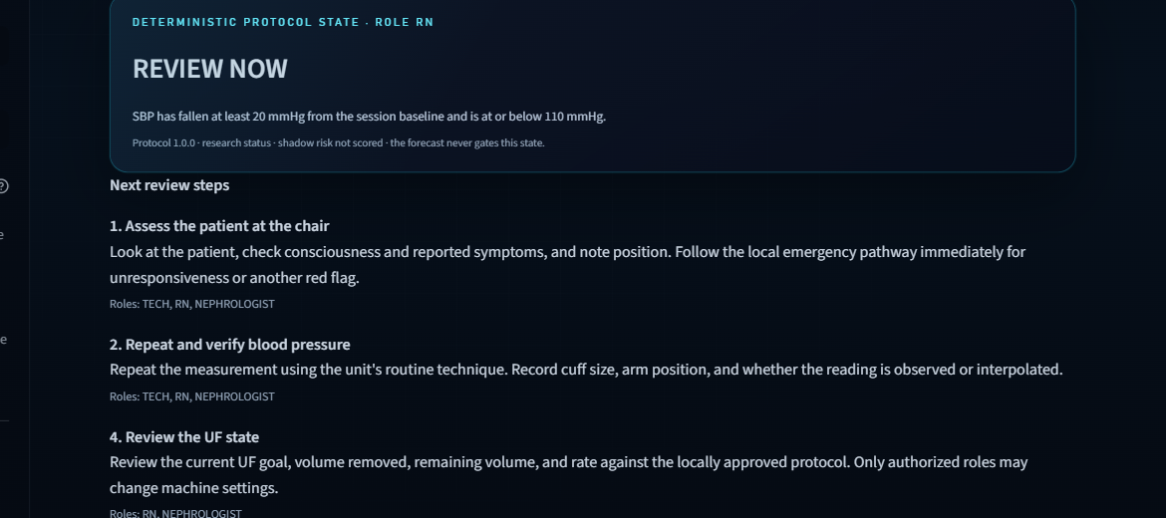
DECISION SUPPORT
The next step is a pathway, not a score.
01
ASSESS THE PATIENT AT THE CHAIR
Look, check consciousness and reported symptoms, note position. Follow the local emergency pathway for red flags.
02
REPEAT AND VERIFY BP
Repeat the measurement with the unit's routine technique. Record cuff size, arm position, observed vs interpolated.
03
REVIEW THE UF STATE
True crash case · observed nadir 59 · protocol state REVIEW NOW
Goal, volume removed, remaining volume, rate. Only authorized roles change machine settings.
The protocol state is deterministic. The forecast never gates it, and the shadow score has no alert authority. The pathway is the product.
Measured criteria activate URGENT / REVIEW_NOW / NO_ALERT / INSUFFICIENT. The forecast never gates the state. The shadow score has no alert authority.
HEMOTWIN · RESEARCH PROTOTYPE · NOT A MEDICAL DEVICE
08 / 16
Notes:
The true crash case: observed 59, state REVIEW_NOW. The pathway tells the team what to check and who to call. This is how the product buys time. The protocol is a configured research artifact, not a validated workflow.

Slide 9
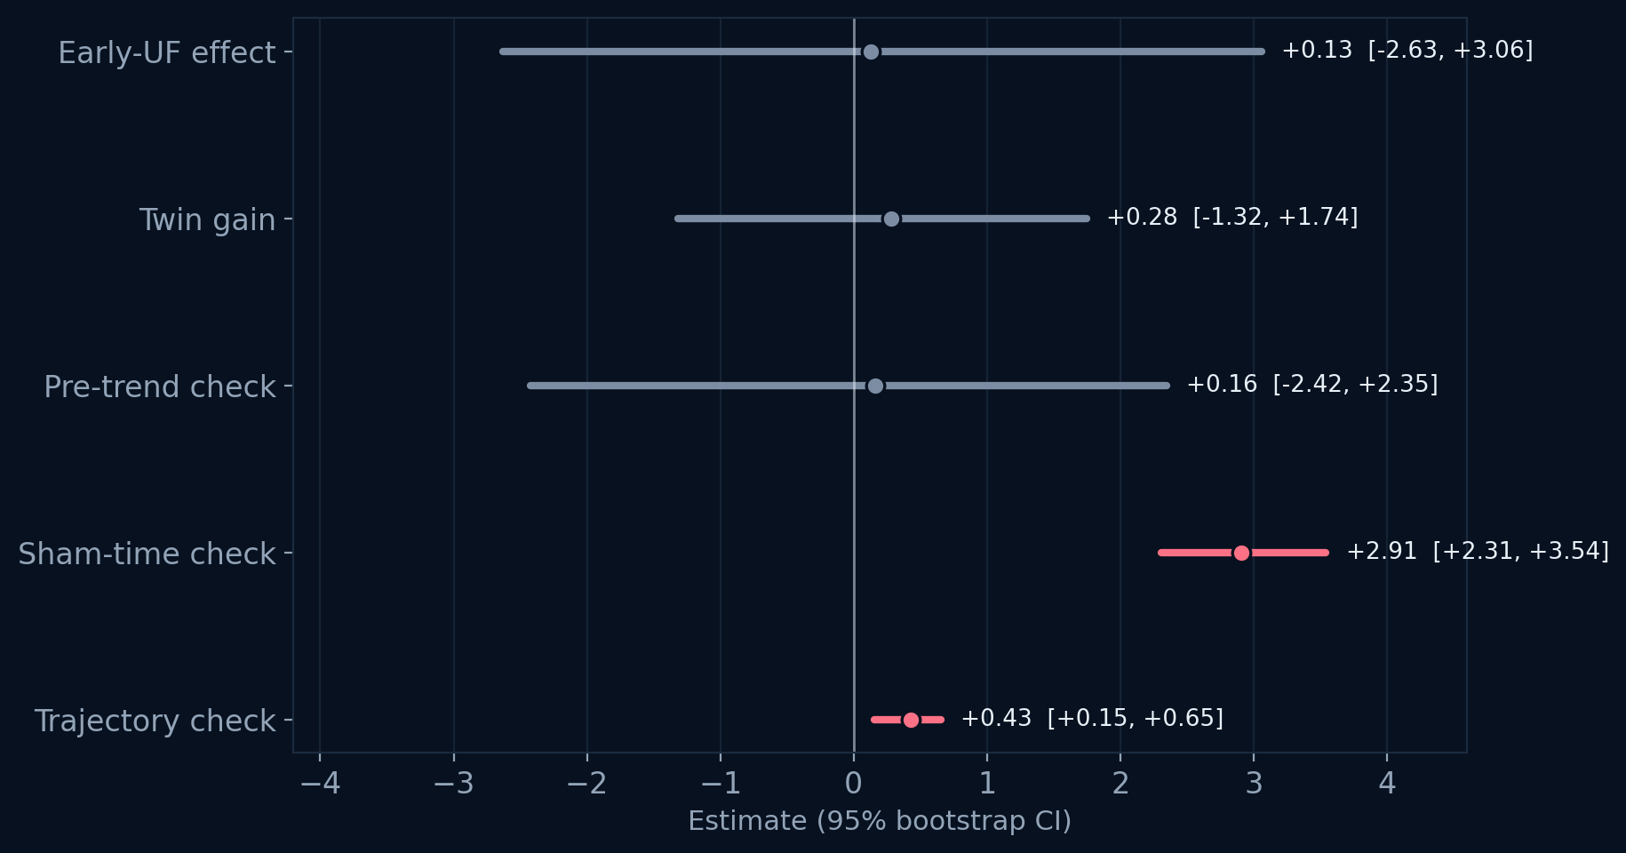
THE TWIN EXPERIMENT
We tested it. It failed.
MATCHED EVENTS
581 / 158
events / patients · within-patient
EARLY-UF EFFECT
+0.13
mmHg per 0.25 L/h · CI [−2.63, +3.06]
SHAM-TIME CHECK
+2.91
mmHg · CI [2.31, 3.54] · fails
TRAJECTORY CHECK
+0.43
mmHg worse · CI [0.15, 0.65]
VERDICT: FAIL — early UF reduction did not raise SBP more than matched controls. The effect is indistinguishable from zero; the operational gain stays 0.
Protocol SHA-256 frozen before estimation. 95% bootstrap CIs, patient-clustered.
HEMOTWIN · RESEARCH PROTOTYPE · NOT A MEDICAL DEVICE
09 / 16
Notes:
This is the trust slide. 581 matched events across 158 patients; the effect is +0.13 mmHg with a CI that includes zero; the sham control fails; P6a gets worse out of sample. Say FAIL clearly.

Slide 10
CLAIM BOUNDARY
What we refuse to claim.
WE CAN CLAIM
WE REFUSE TO CLAIM
• A calibrated pre-anchor nadir forecast: fold-2 MAE 10.99, RMSE 14.65.
• Exact arithmetic for fluid left, carry-forward and next-session intensity.
• A deterministic, versioned review pathway with role-scoped steps.
• Honest negative results: G3, G7 and the oracle G2 comparison.
• A local FHIR export and a hash-chained demo audit trail.
• A validated what-if/treatment effect from the twin.
• That any UF policy will raise SBP, prevent IDH, or is minimum effective.
• Alert utility, clinical benefit, or a safety layer.
• Prospective, external, symptomatic-IDH, or Indian-unit validation.
• A prescription, a default dose, or autonomous machine action.
The boundary is part of the product. It is why the rest is trustworthy.
HEMOTWIN · RESEARCH PROTOTYPE · NOT A MEDICAL DEVICE
10 / 16
Notes:
Judges trust the refusal more than the claim. The boundary is written into the app, the README, the evidence and this deck.

Slide 11
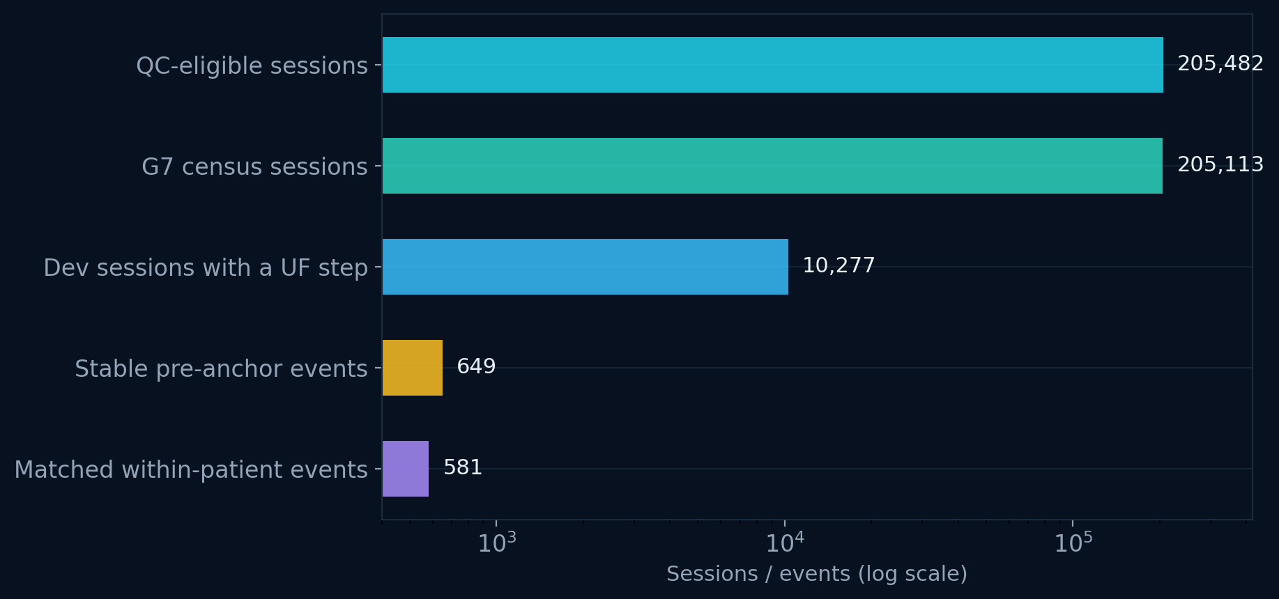
THE EVIDENCE
205,482 sessions. 581 matched events.
SESSIONS
PATIENTS
205,482
1,070
QC-eligible
de-identified
TELEMETRY
LABELLED IDH
4.19M
10.4%
rows
nadir <90 mmHg
FOLD 2 UNTOUCHED
205,482 QC-eligible → 205,113 G7 census → 581 matched events. 369 sessions lack the required pre-anchor record.
G7 census 205,113 — 369 sessions lack the required pre-anchor record. 25.5% Spanish clinician-defined symptomatic hypotension: a different label, never combined. External transport AUROC 0.474 failed. HEMOBP CC BY 4.0.
HEMOTWIN · RESEARCH PROTOTYPE · NOT A MEDICAL DEVICE
11 / 16
Notes:
Do not mix the two prevalence labels. The 369-session difference between 205,482 and 205,113 is the pre-anchor record requirement. The external transport failure is part of the honesty story.

Slide 12
ENGINEERING
Built to be inspected.
217
14/14
FHIR R4
SHA-256
package tests · 0 failures
claim-boundary checks
local export
audit chain
28 heavy-artifact tests explicitly skip-gated. Full lab suite: 241.
Frozen G1–G7, banned claims, cohort/demo integrity, deck/README links.
Bilingual handoff card. No network call at runtime.
Demo-only local chain. Not immutable, not authenticated, not clinical.
DATA → FEATURES → FORECAST → PROTOCOL → HANDOFF
One app, one README, one deck. The retired v3 console is not shipped; the current console runs from a clean V2 folder with the bundled models and evidence.
HEMOTWIN · RESEARCH PROTOTYPE · NOT A MEDICAL DEVICE
12 / 16
Notes:
The package suite is 217 tests with 28 skip-gated heavy-artifact tests; the full lab suite is 241. The claim verifier is 14/14. The audit chain is demo-only and says so.

Slide 13

THE ASK
Give us a chair, not a stage.
We are not asking for a trial on day one. Run the console beside the team, log what it would have shown, and measure whether it buys time to react.
01
02
03
SILENT MODE
LOCAL RECALIBRATION
PROSPECTIVE EVALUATION
2–4 weeks beside the team. No machine control, no alert authority. Log every display.
Your machine, your population, your protocol. Re-fit the forecast before any claim.
Time-to-review, documentation, and workflow. Pre-register the endpoint before the pilot.
Built by an engineer working on a remotely operable, IoT-enabled hemodialysis machine.
THE NEXT EXPERIMENT IS A WORKFLOW
HEMOTWIN · RESEARCH PROTOTYPE · NOT A MEDICAL DEVICE
13 / 16
Notes:
The ask is a silent-mode pilot in a real unit, not a stage demo. The next experiment is a workflow: does the console buy time to react and seek advice? Recalibrate on the partner's machine first.

Slide 14
HEMOTWIN · DIGITAL TWIN CHALLENGE 2026
The twin knows
what it cannot do.
A chair-side decision-support layer for dialysis. Calibrated forecast, exact fluid arithmetic, and a review pathway.
Research prototype. Not a medical device. No treatment recommendation.
HemoTwin · one console · three views · one honest boundary
HEMOTWIN · RESEARCH PROTOTYPE · NOT A MEDICAL DEVICE
14 / 16
Notes:
Close on the boundary. The twin knows what it cannot do; that is what makes it usable as a decision-support layer.

Slide 15
APPENDIX A
Gate definitions and results.
G1
MAE_v4 ≤ 0.80×MAE_v3 and |bias| ≤ 3
PASS
11.59 vs 15.55 · n=374
G2
vs fair base / vs oracle
PASS vs base · FAIL vs oracle
10.99 vs 9.60
G3
actual < hold · CI upper < 0
FAIL
397 rows · Δ 0 [0, 0]
G4
monotone + continuous at unit gain
PASS
0 violations / 3.09M checks
G5
90% band coverage 88–92%
PASS
89.2% HOLD · 90.1% TAPER
G6
cold start + future invariance
PASS
284 · 200/200
G7
does early UF reduction raise SBP?
FAIL
τ +0.13 [−2.63, +3.06]
A pass is an engineering check against a pre-registered criterion — not clinical validation. G2 is a tie at gain 0, not evidence of a treatment effect. G7 asks whether early UF reduction raised SBP; it did not.
HEMOTWIN · RESEARCH PROTOTYPE · NOT A MEDICAL DEVICE
15 / 16
Notes:
Use this in Q&A. G2 is a tie at gain 0 against its own base, but fails against the oracle-assisted display forecast. G3 and G7 are the what-if failures.

Slide 16
APPENDIX B
Q&A ammunition.
IF THEY ASK ABOUT THE MODEL
IF THEY ASK ABOUT THE TWIN
3 patient folds; fold 2 untouched; 59 pre-anchor features; fold-2 MAE 10.99; 90% band coverage 89–90%; manual sessions are OOD-labelled.
The twin test (G7) found no effect: the CI includes zero; sham +2.91; P6a +0.43; operational gain 0.
IF THEY ASK ABOUT THE ALERT
IF THEY ASK ABOUT DEPLOYMENT
AUROC 0.880 ranking; 8.2% detection at 0.26 false alerts/session; below the current-SBP rule; shadow only, no alert authority.
No auth, no machine integration, no prospective or external validation; the local JSONL audit is demo-only, not clinical.
Every number in this deck is traceable to evidence/ and docs/EVIDENCE_STATUS.md.
HEMOTWIN · RESEARCH PROTOTYPE · NOT A MEDICAL DEVICE
16 / 16
Notes:
Use this for Q&A. The most important answers: the two forecast numbers are different models; the twin effect is null; the alert model is shadow-only; nothing is validated prospectively.

