Slide 1
JA·LE — Catch a fraud ring before it is finished forming.
TVS Credit EPIC 8.0 · Problem (e)
Swarm Intelligence Lending Network
Other teams will tell you a fraud ring exists.
JA·LE tells you ~7 months earlier that one is about to form, names the one cheap link that breaks it, and proves that blocking the dealer does nothing.
Median 204-day lead time · Zero false alarms at the strict operating point · Every number regenerable in 30 seconds.
Pipeline reruns in ~30 s · Synthetic + public data · Every chart traceable to a committed script

Slide 2
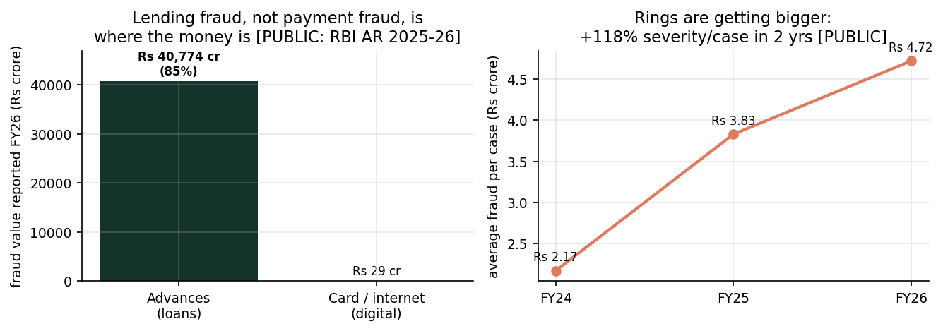
The fraud war TVS fights is a lending war
[PUBLIC]
Lending fraud = ₹40,774 cr = 85% of all reported fraud (FY26)
Card / internet fraud: ₹29 cr. The real threat is in advances.
And each case is getting bigger: +118% severity per case in 2 years (₹2.17 cr → ₹3.83 cr → ₹4.72 cr per case).
Source: RBI Annual Report 2025-26.
[PUBLIC] RBI AR 2025-26 · derived severity/case

Slide 3
How a fraud ring actually gets filed at TVS
[PUBLIC]
No single application looks suspicious. The ring lives between records.
Dealer-sourced journey: lead → KYC → documents → underwriting → disbursal → EMI.
Real ring cases that have hurt NBFCs:
• Mahindra Finance: ~₹150 cr, ~2,000 ghost customers, forged KYC
• Video-KYC abuse: 35 bikes financed on fabricated papers
• Branch-staff collusion with fabricated invoices
Retailer reality: a DSR (Dealer Sales Rep) enters customer details into the dealer portal. In rural Tier-3/4 areas with poor connectivity, video-KYC gaps and off-book guarantor arrangements create the blind spots fraud rings exploit — without the dealer's knowledge.
By the time a ring is dense enough to flag, the money is usually already disbursed.
[PUBLIC] Mahindra Finance (BS/IE/ET Apr-2024) · TOI Jan-2024, Apr-2025 · retailer journey insight

Slide 4
The generic answer — and why it fails
Ask any AI tool for a fraud-ring solution and you get the same three boxes:
Graph + GNN + red-dot dashboard. ~400 teams will show variants of this.
Its two failures:
1. LATE — by the time a ring is dense enough to detect, the money is already gone.
2. ACCUSATORY — it blames the most-connected node (a busy dealer, a village shop-phone), punishing genuine rural customers.
We ask a different question:
Which ecosystem is about to form? What is the one cheap link that causally breaks it? And why does blocking the dealer change nothing?

Slide 5
What we built — five layers, one picture
Data → Link records → Score clusters → Explain → Decide
L1 Entity Resolution — probabilistic identity linkage (Fellegi–Sunter, no labels, EM-derived threshold).
L2 Heterogeneous Graph — 5 relations: device / account / person / guarantor / dealer as sparse incidence matrices.
L3 Application Scoring — 86 features + gradient-boosted trees, ring-disjoint cross-validation.
L4 Ring-Level Scoring — score the cluster, not the person. Fixed structural formula, zero learned weights.
L5 Explanation — every flag ships an evidence case-file an analyst can check against the loan file.
Synthetic + public data · ~30 s to rerun · every number traceable to a script.
Demo: jale_demo.html (single self-contained file)

Slide 6
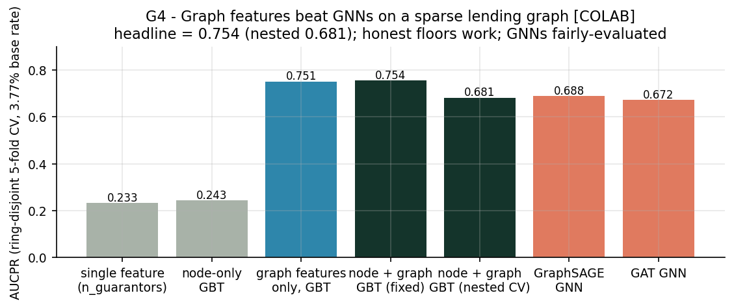
What we measure — the receipt
[COLAB]
Ring-detection AUCPR: 0.754 (20× lift over random)
• Honest range with nested CV: 0.68 – 0.75
• GraphSAGE GNN on the SAME folds & features: 0.688
• Best single column alone: 0.233 (6.2×) — our honest floor
The graph features, not the exotic model, carry the signal — and we prove it by running every model on the same folds.
Validated on a real public graph (YelpChi, 45,954 nodes): leakage-gap protocol transfers, measured at +0.022 AUCPR.
[COLAB] executed notebook §4/§5/§6b · SMOKE, 3,474 apps, 131 fraud · YelpChi real-graph validation

Slide 7
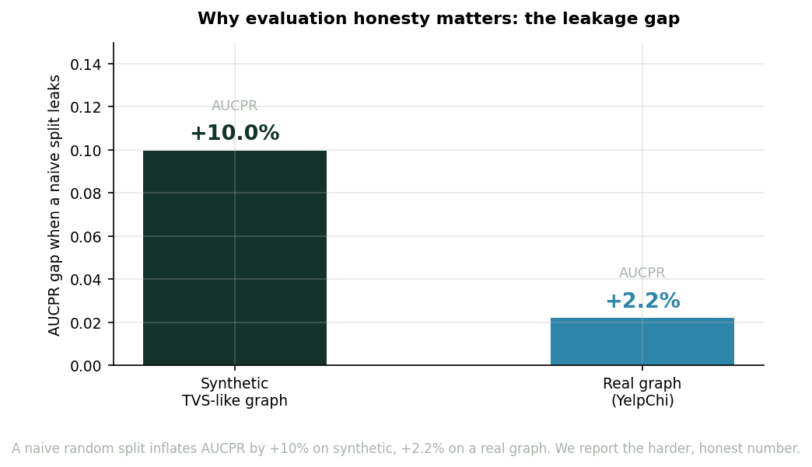
Why you can trust the number
[COLAB + SIM]
Three controls, all passing:
• Shuffled labels → model drops to chance (no memorisation)
• Ring-disjoint CV → test rings never leak into training
• Nested CV → hyperparameters chosen inside inner folds only
A naive split inflates AUCPR by +10% on synthetic, +2.2% on a real graph (YelpChi). We report the harder number.
And we tell you where we fail:
Hold out one typology and AUCPR drops to 0.27 — so we flag novel structures (a built-in novelty detector), not claim we understand all rings.
[COLAB] leakage gap synthetic +0.100, real +0.022 · typology hold-out 0.27 [REPO]

Slide 8
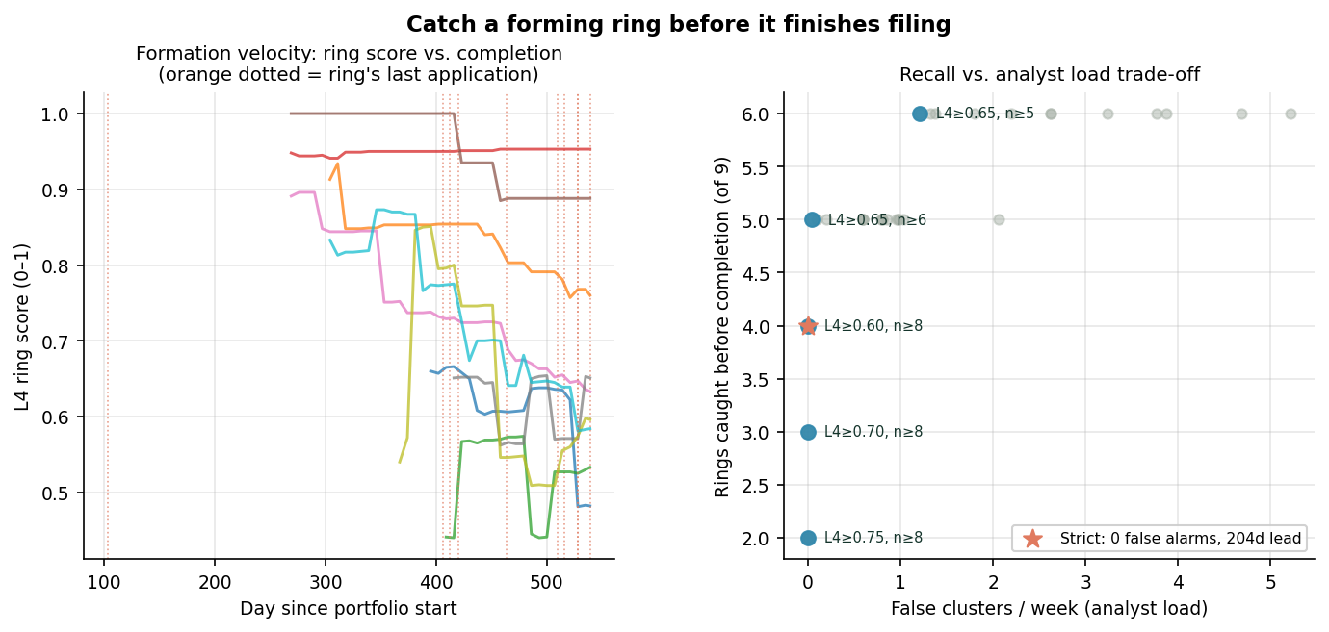
Before fraud occurs — the measured lead time
[SIM]
Trained only on the past, the engine flags 5/9 forming rings before their last application arrives.
• Strict setting (L4 ≥ 0.70, cluster ≥ 6):
0 false alarms, median lead 204 days (~7 months)
• Loose setting: catches 9/9 at ~5 reviews/week — an honest trade-off, not a magic number
This is literally the problem statement:
"predict emerging fraud ecosystems before fraud occurs."
[SIM] experiments/lead_time.py · warm-start on first half of timeline, watch second half

Slide 9
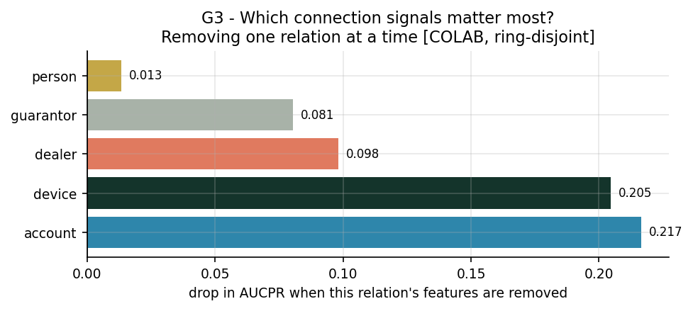
Which connection actually carries the risk?
[COLAB]
We test every relationship by removing it and measuring what happens:
• Remove bank-account signal → detection drops most (−0.22 AUCPR)
• Remove device signal → −0.21
• Remove dealer signal → −0.10 (LEAST impact)
The dealer is a conduit, not the cause.
Blocking the dealer changes almost nothing about the ring's detection. Blocking the bank-account link collapses it.
Design consequence: verify the cheap link (account, device), never blanket-block the dealer. This protects genuine rural borrowers.
[COLAB] notebook §8a · fixed-param node+graph GBT, ring-disjoint

Slide 10
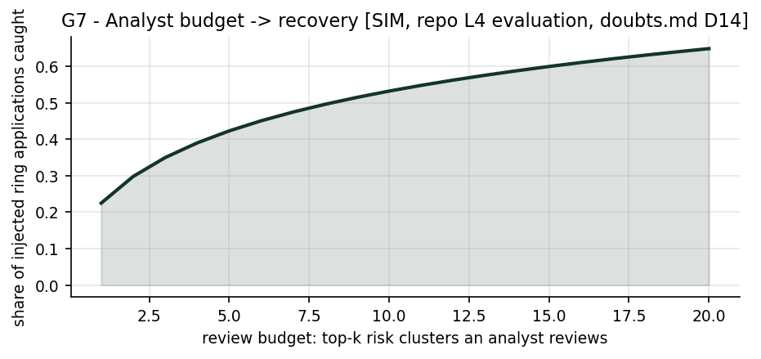
Ring-vaccination: the cheapest link that breaks the ring
[SIM]
Score the cluster, not the person.
• Ring-level queue with an evidence case-file per cluster
• Dominant axis shown: device / account / guarantor / burst
Actions are firebreaks — minimal-friction, budget-aware:
• Step-up: verify one disbursement account
• Verify the guarantor pool
• Hold disbursement to one account
• Dealer audit only when implicated by the ablation
Every action maps to a measured signal drop: account −0.22 · device −0.21 · dealer −0.10 (least signal).
Vaccinate the cheapest link. The dealer relationship and honest borrowers stay untouched.
[SIM] repo L4 evaluation: all 12 rings flagged at ≥0.5, 83% fraud apps covered

Slide 11
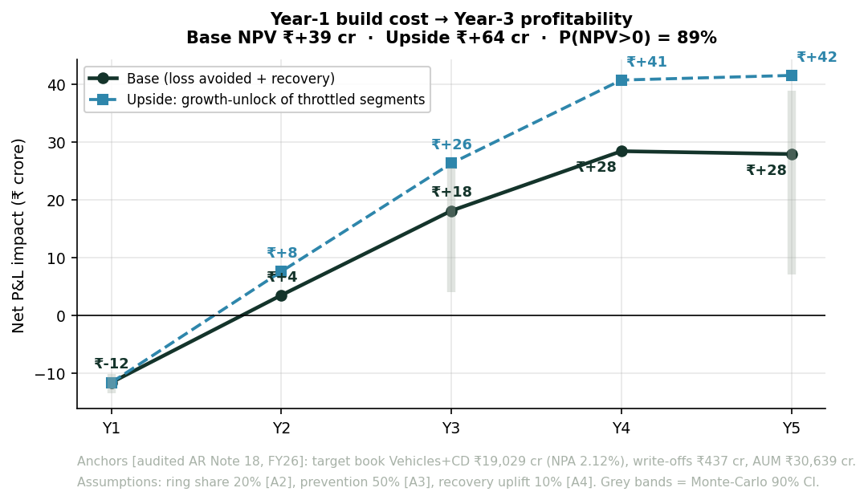
The business case — anchored to TVS’s audited books
[PUBLIC + A#]
Year-1 enterprise investment → Year-2 breakeven → Year-3 profit.
Audited anchors (AR Note 18, FY26):
• Target book: Vehicles ₹12,964 cr + CD ₹6,065 cr = ₹19,029 cr
• Target-book NPA: ₹404 cr @ 2.12% · Annual write-offs: ₹437 cr
• Dealer advances: 0.23% NPA — dealers repay (fairness anchor)
Conservative cash trajectory (front-loads full enterprise build in Y1):
• Phase 1 Pilot (0–3 mo): Shadow run on existing cloud, zero capex
• Y1: -₹12 cr (worst-case: ₹9.5 cr full IT build/SOP absorbed in Y1 cash)
• Y2: +₹4 cr (breakeven reached as 52% of dealer book activates)
• Y3: +₹18 cr/yr net recurring profit (₹30 cr fraud saved − ₹12 cr opex)
• Y4-Y5: +₹28 cr/yr (extended to ₹28,111 cr book incl. tractors & PL)
5-Yr Base NPV ₹+39 cr · Upside ₹+64 cr · 89% P(NPV>0) · 4.2× ROI
[PUBLIC + A#] PROPOSAL/financial_model.py · audited Note-18 anchors · every assumption labelled

Slide 12
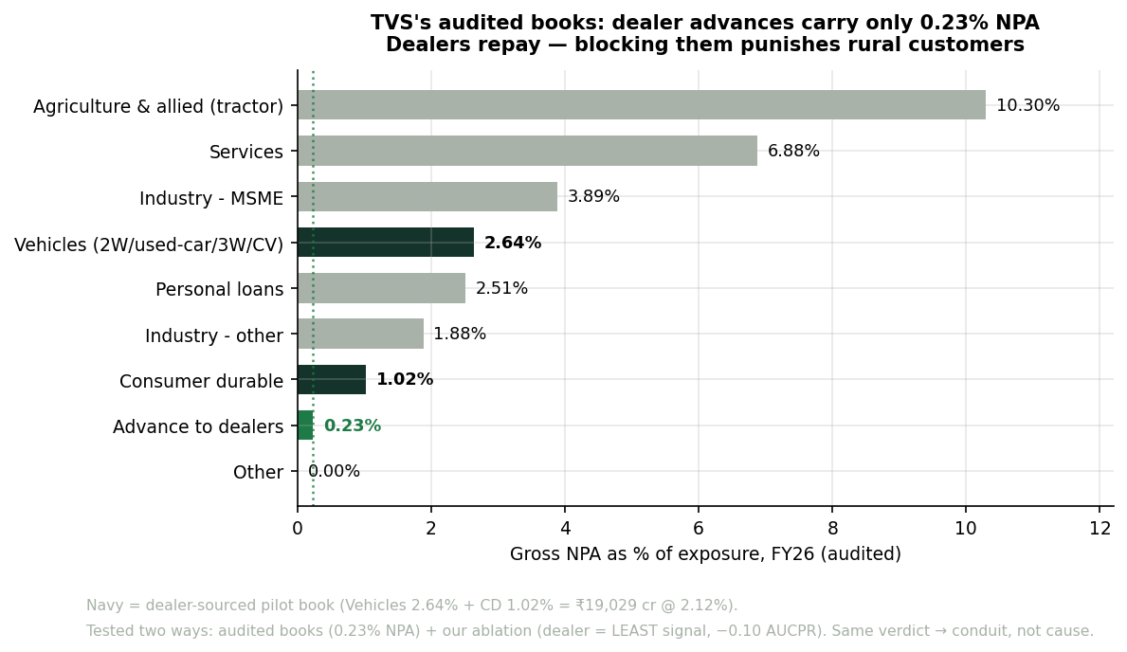
Rural fairness is a feature, not a caveat
[PUBLIC + COLAB]
Creditworthiness ≠ fraud risk.
A thin-file honest borrower is not a fraud suspect.
Tested three independent ways, same verdict:
1. TVS’s audited books: dealer advances 0.23% NPA (FY25: 0.37%) — dealers repay.
2. Our ablation: dealer link carries the LEAST detection signal (−0.10 AUCPR).
3. Entity-resolution audit: 34 false merges found → why we never auto-reject on a link alone.
Three tests, one answer: the dealer is the conduit, not the cause.
DPDP 2023: hashed identifiers, no PII in graph edges, purpose-limited. Explainable by construction.
[PUBLIC] audited AR Note 18 · [COLAB] ablation · [REPO] er_in_path.py · DPDP 2023

Slide 13
Roadmap & change management
[RICE]
Phase 1 (0–3 mo) · Shadow Rollout:
One TN two-wheeler region. Backtest lead time on TVS’s own historical rings. NO automated blocking.
Phase 2 (3–6 mo) · Advisory → Active:
Link-freezes in underwriting. Analyst console. Dealer-fair scores.
Phase 3 (6–12 mo) · Scale across India:
Consumer durable, used car, personal loan, tractor. Adversarial red-team. Fairness monitoring.
Change management:
2-week risk-analyst training · dealer SOP · kill-switch + rule fallback · pre-registered success metrics.
Shadow-first rollout per lending-operations practice

Slide 14
Run it yourself — and hold us to it
[REPO]
30 seconds to reproduce:
pip install -r requirements.txt
python scripts/run_v1.py --profile SMOKE
Colab notebook with all executed numbers (0.754, GNNs, YelpChi, ablations, leakage audits).
No public dataset has ring-level lending fraud ground truth. Our synthetic pipeline is the only honest way to prove the methodology before TVS validates it on real rings in Phase 1.
Three verified citations (AAAI-21 loan graphs, ICAIF-20 subgraphs, MDPI-25 causal hypergraphs).
Round 3 promise: in the finale, we run the engine live. Every chart on these slides will regenerate in front of you in 30 seconds.
JALE repo · colab/JALE_Colab_Training_ran.ipynb · reports/*.json

